Slide 1
Dga roundtable
February 1, 2024

Slide 2
Osp announcements
New OSP Employees: Emily Mateer, Grants & Contracts Administrator II, Post Award Unit, 1/22/24 Adam Hadley, Accountant II, Cost Accounting Unit, 2/5/24
New Grants and Contract Administrator Lead, Post Award Unit: Samiksha Gupta, 2/5/24
U of I is on track to join R1 classification of research universities in 2025.
FY25 proposed consolidated fringe rates have been submitted. They should be included in proposals as ‘estimated fringe rates’ for 7/1/24 and later. Faculty – 31.7% Staff – 40.1% Students – 2.0% Temporary (includes PERSI and non-PERSI eligible) – 10.1%
Post Award Issues for the Departmental Administrators webinar

Slide 3
Questions?

Slide 4
Proposal Submissions 101
Step 1 – review rfp/rfa/sponsor request
Identify the following:
Proposal deadline date/time
How to submit the proposal to the sponsor
Eligibility requirements for entities, and PIs
Budget parameters including cost share requirements and F&A limitations
Proposal preparation instructions
Sponsor contact information
Any unique program requirements
Tip: use key words when searching the document (Ctrl+F)
View NSF 23-511

Slide 5
Step 2 – create a veras proposal
All grant proposals must be routed through VERAS for approvals.
Sign into VERAS to create a new proposal.
If you don’t have a VERAS account, login to VERAS and fill out form.
Tip: utilize the VERAS Help button, located throughout VERAS, for additional information/instructions.
Proposals must be ready for final review at least four business days prior to the agency (required) deadline.
Subaward materials need to be final at least six business days prior to the agency (required) deadline
Tip: May use VERAS proposal V210559 as a proposal for training purposes.

Slide 6
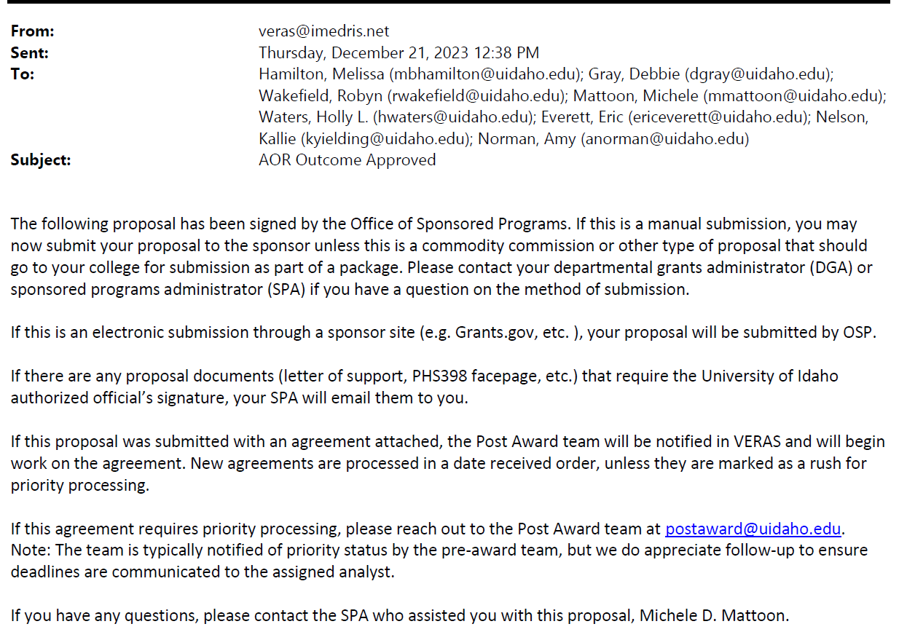
Step 3 – Veras proposal review and approvals
Notify the assigned SPA when the proposal is ready for review via the VERAS proposal correspondence.
Tip: request OSP review of budget and budget justification once ready.
The assigned SPA will review the proposal using a SPA checklist.
PIs and DGAs should respond to SPA questions/concerns promptly.
The assigned SPA will route the proposal for signatures once they have completed their review and once any required changes have been completed.
An automated AOR Outcome Approved email will be sent once the proposal is fully approved.

Slide 7
Step 4 – proposal submission
Once the AOR Outcome Approved email is received the proposal may be submitted to the sponsor.
The PI is responsible for manual submissions, unless the proposal is a commodity commission or other type of proposal that should go to your college for submission as part of a package.
The proposal will be submitted by the assigned SPA if the proposal is an electronic submission through a sponsor site (e.g. Grants.gov, Research.gov etc. ).
If the proposal was submitted with an award agreement attached, the Post Award team will be notified in VERAS and will begin work on the agreement.
Submit an OSP Pre-Award TDX ticket if the sponsor requests additional proposal information (Just-In-Time, revised budget, etc.).

Slide 8
More to come regarding proposals
F&A
Cost Share
Subawards/Service Contracts/Collaborators
Program Income
Budget and Budget Justifications

Slide 9
resources
Description | Where to Find
Components of a Proposal | https://www.uidaho.edu/research/faculty/manage-award/guide/obtaining-sponsored-funding/sponsored-proposals/components
Electronic Systems Information – VERAS Instructional Videos | https://www.uidaho.edu/research/faculty/resources/instructional-resources
Faculty and Staff Proposal Submission FAQs | https://www.uidaho.edu/research/faculty/submit-proposal/internal-proposal-routing/faqs
Four-Business Day Rule | https://www.uidaho.edu/-/media/UIdaho-Responsive/Files/research/Faculty/OSP/four-business-day-policy-and-faqs.pdf?la=en&hash=9DE9D662DA1493EBE31E4BC74037A7FCDBBC5D44
Rates, Forms, and Other U of I Information | https://www.uidaho.edu/research/faculty/resources
Submit a Proposal | https://www.uidaho.edu/research/faculty/submit-proposal
TDX Pre-Award Ticket Submissions - Submission of Just-in-Time information, requesting a letter of institutional commitment for a proposal, submitting a revised proposal budget, and waiver requests for Cost Share, F&A, and APM 45.22 (PI/Co-PI status/eligibility). | https://support.uidaho.edu/TDClient/40/Portal/Requests/ServiceCatalog?CategoryID=155

Slide 10
Acronyms
Acronym | Description
AOR | Authorized Organizational Representative. The Office of Sponsored Programs Director is the AOR.
DGA | Departmental Grant Administrator
F&A | Facilities and Administration costs. Also known as Indirect Costs or Overhead.
OSP | Office of Sponsored Programs
PI and Co-PI | Principal Investigator and Co-Principal Investigator
RFP/RFA | Sponsor “Request for Proposals” or “Request for Applications”. Another term may be Funding Opportunity Announcements (FOA). There are many terms used by different sponsors.
SPA | Sponsored Programs Administrator
VERAS | Vandal Electronic Research Administration System

Slide 11
Questions?

