Slide 1
Welcome!
2016-2017 Work-Study
Fall Orientation
Please silence your technology!!!
2016-2017
Work-Study Orientation

Slide 2
2016-2017 Work-Study Fall Orientation
Financial Aid Office – Leslie Hammes, Heather Reyes, or DeeDee Bohman
885-6312 or finaid-workstudy@uidaho.edu
How to find the FA office
Human Resources – 885-3638 or hr@uidaho.edu
How to find HR
Today’s Agenda
Getting Started + Résumé Building
What Your Work-Study Award Means to You
Pay Rates + Job Referral
Work Schedule + Job Changes
Work-Study and Your Taxes
Human Resources + Payroll
2016-2017
Work-Study Orientation

Slide 3
2016-2017 Work-Study Fall Orientation
Getting Started
Everyone should have Accepted their Work-Study award
Everyone should have selected a position from the Job Directory
After you select a position, Financial Aid will:
Produce a Referral Form which is available today!
Ensure all processing is completed upon receipt of signed referral letter
Résumé Building– You are establishing a work history
Treat your Work-Study job like any other employment
Be responsible and communicate with your supervisor
A good reference will be a great addition to your résumé
2016-2017
Work-Study Orientation

Slide 4
What Your Work–Study Award Means to You
Work-Study is a set award amount
Paid directly to you through Payroll, not credited to your account with UI
You cannot earn over the total amount awarded
You may earn more in one semester than the other
Plan ahead for the entire school year
You only receive the amount you earn by working
You are not paid for holidays or sick days
Pay Rates – Submitted by your Supervisor
Federal minimum wage is the required minimum pay rate
Rates are based on skills and experience
Rates are subject to approval
To calculate the number of hours per week you can work
Award ÷ Pay Rate ÷ 32 weeks
$2,000 ÷ $7.25 ÷ 32 weeks = 8.62 Hours per week
You would earn approximately $125 / Pay Period
2016-2017
Work-Study Orientation

Slide 5
Work – Study Referral Sheet
Take This Form To:
Contact + Department Info + Address
Bottom Section:
Anticipated Start Date
Supervisor Authorization
Position Information
2016-2017
Work-Study Orientation

Slide 6
What do you need to do?
Find the contact listed in “Take this Form To” section
They will refer you to the supervisor for your position
Meet with your supervisor quickly (and take your class schedule!)
If you can’t find the supervisor, keep trying to make contact
Discuss the job – Is this the job you were expecting?
Set a work schedule with the supervisor
Determine Anticipated Start Date
Complete I9 with Human Resources
Return to supervisor with Work Authorization Card
Show up when scheduled ready to work!
Inform the supervisor if you are unable to work as scheduled
No vacation, holiday, or sick pay with work-study
2016-2017
Work-Study Orientation

Slide 7
Job Changes
You may change jobs
Ask your supervisor for other options or review our online job directory for open positions
When choosing a job, consider your expectations and available hours
Fill out a Job Change Form – online @ www.uidaho.edu/financial-aid/forms
Form # 3
Pick up a new Referral Sheet @ Student Financial Aid
Next Working Day after 2pm
2016-2017
Work-Study Orientation

Slide 8
Work – Study and your Taxes + HR Info
Work – Study is Taxable Income
A W-2 will be available by January 31. It is mailed to all students – W2 Address (from I-9)
Option for Electronic W-2 (Highly Recommended)
Consult a Tax Consultant or the IRS for details about your taxable income
Also include earnings on FAFSA form. They will be deducted via the “Additional Financial Information” section
Save your receipts – fees, books and supplies
You may be able to deduct these
All Grant / Scholarship aid in excess of expenses paid is taxable income – Form 1098T (available by February 28)
Consult a Tax Consultant or the IRS for details about the Hope Scholarship Tax Credit and other possible education-related provisions – www.irs.gov and search for “Student”
HR Info – what you need to complete
E-Verify Contact Info, Work Authorization Card, I-9
Child Labor Form (if under 18) – Is anyone under 18?
2016-2017
Work-Study Orientation

Slide 9
Human Resources and Payroll
Visit HR → 415 W. 6th Street, next to Taco Time, across from Patty’s Kitchen
Fill out I-9 Packet:
Contact Info + Marital Status
Work Authorization Card
I-9 Page 1
Disclosure of Conflicts
Voluntary: Disability + Demographic
Intellectual Property Agreement
Work Authorization Card → Department or College Personnel
Take the Required New Employee Trainings
Sign up for Direct Deposit + Set up Tax Deductions
2016-2017
Work-Study Orientation

Slide 10
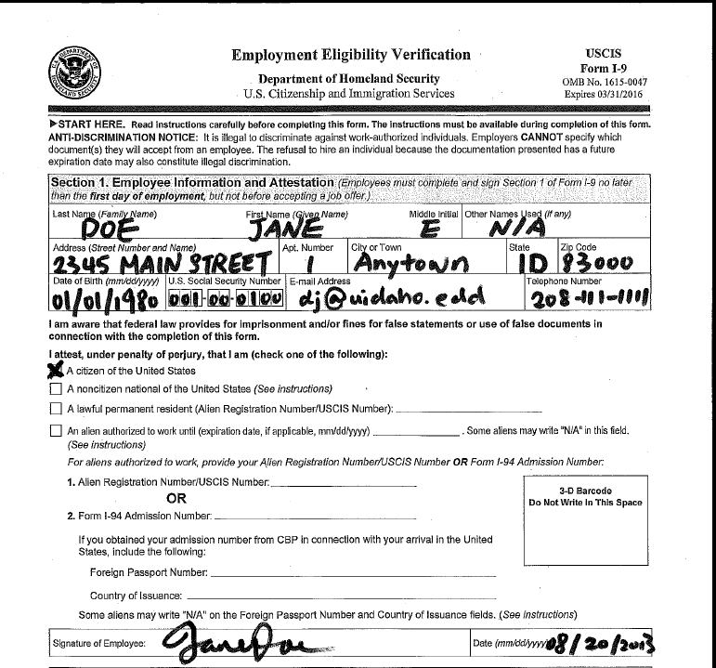
I-9 Form
Page 1
ONLY
SAMPLE!
2016-2017
Work-Study Orientation

Slide 11
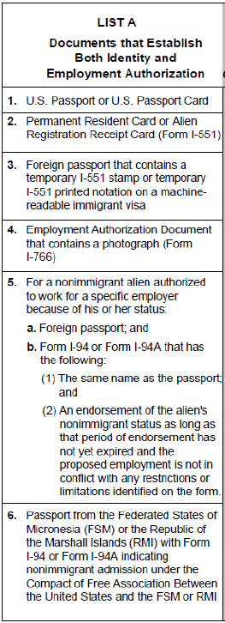
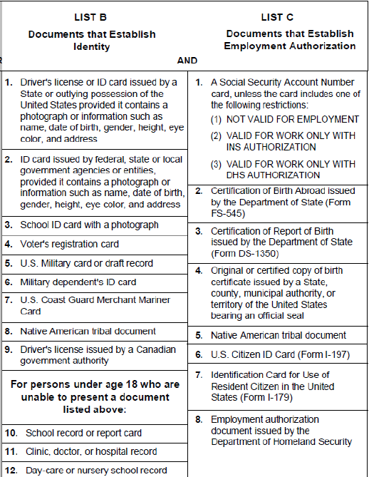
I9 Verification – ORIGINAL Documents ONLY
OR
Photocopies will
be made of provided documents

Slide 12
Human Resources and Payroll
Your Department may also need:
An Application? -An Interview? -Reference Check?
Additional Forms or Signatures
Satisfactory Results from: Criminal Background Check or Driving Background Investigation
Your Supervisor will:
Sign your Referral Sheet (After Work Authorization Card) and Return to Financial Aid
Get your info in our Payroll System, Verify Start Date
Communicate Timesheet Deadlines
Review and approve electronic timesheet
You will need to:
Give your supervisor your referral sheet – Set an Anticipated Start Date
Go to Human Resources → Complete and fill out I-9 and Work Authorization Card
Show Work Authorization Card to Supervisor
Record your hours using Web-Time Entry + Submit your timesheet ON TIME
Take the required trainings
2016-2017
Work-Study Orientation

Slide 13
Frequently Asked Paycheck Questions
When will I get my first Paycheck? $$$
2-Week Pay Lag – 1st check two or more weeks after you submit your 1st timesheet
Submit Timesheet by Required Deadline
Many students do not get their 1st paycheck until Late September – depends on I-9 and start of work
What is my timesheet?
You will use your timesheet to keep an accurate record of hours worked
University of Idaho uses an online timesheet (Web Time-Entry)
Vandal Web under “Employee Tab” then “Payroll” – Note: After EPAF is posted
How often do I submit my timesheet?
You should log your time in and out each day you work
Submit your timesheet every two weeks by the specified deadline
How do I know when to submit my timesheet?
If your supervisor does not communicate a timesheet deadline – Be Sure to ASK them!
2016-2017
Work-Study Orientation

Slide 14
Frequently Asked Paycheck Questions
What if the timesheet deadline is during a non-workday?
You are still responsible to submit your timesheet – even if you are not at work or school
Typically submit last day of work for that Pay Period for breaks – Thanksgiving, Winter, Spring
What happens if I forget to submit my timesheet?
Your paycheck will be delayed
Timesheet must be manually created (Excel)
Your pay will be added to your next check
How will I get paid?
Employees are paid via Direct Deposit
How do I update my contact information?
vandalweb.uidaho.edu
Personal Information / Address Menu → Then Update your Address(es) and Phone(s)
Update W2 Address if needed – fill out form @ www.uidaho.edu/payroll → select W2 Address Changes
2016-2017
Work-Study Orientation

Slide 15
Financial Aid Office
See the Work–Study Coordinator for:
Issues with your job that you have been unable to resolve with your supervisor
Changing jobs if you are unable to earn all of your award in your present position
Be Sure to re–apply for Financial Aid annually!
FAFSA Available Date = October 1st
FAFSA Priority Date = December 1st
If you Miss the Deadline
Not eligible for Work-Study or SEOG
2016-2017
Work-Study Orientation

Slide 16
Steps to Earning Work Study Award
Pick up your Referral Sheet – available today
See your Supervisor to determine your Anticipated Start Date
Visit HR to complete your I-9 packet and work eligibility document(s)
Return to your Supervisor with the Work Authorization Card – do not give it to them
Supervisor will sign and return your Referral Sheet to Financial Aid
Supervisor / Department will submit EPAF
Once Financial Aid has the signed Referral Sheet we will approve the EPAF
You will be added into the payroll system
An Employee tab will appear in Vandal Web – W4, web time entry, W2, and employment history information
2016-2017
Work-Study Orientation

Slide 17
THANK YOU! – Have a Great Year!
Proceed outside to pick up your Referral Sheet
Please make sure to pick up HR Info Sheet
2016-2017
Work-Study Orientation

