Slide 1
Module 2
Introduction to Cayuse424

Slide 2
Objectives
In this module you will learn:
The features and benefits of Cayuse424
How to:
Log-on
Navigate Cayuse424
Understand the Cayuse424 icons
Personalize your password
Set User preferences
User Tips

Slide 3
C424 Features/Benefits
Downloads funding opportunities directly from Grants.gov
Provides autofill and data reuse capability
Automatically tracks errors and warnings
Easy navigation between forms
Stores proposal documents and attachments
Tracks proposal submission status

Slide 4
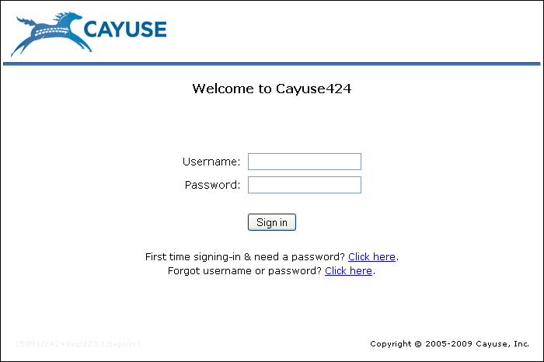
Logging into Cayuse424
To log-in to Cayuse424:
Type in your Cayuse424 URL
Click the “Need a password” link the first time you login
Enter your user name and password
Your username is the same as the username you use for EIPRS or VandalWeb
Click Sign in

Slide 5
Tabbed Navigation
Opportunities tab
Browse downloaded opportunities
Download new opportunities
Create new proposals from downloaded opportunities
Proposals tab
Create/edit a grant proposal
Create/edit a subaward proposal
Import a subaward proposal
Routing tab
Proposal routing will continue through EIPRS – this tab will not be used

Slide 6
Tabbed Navigation
People tab
Create/edit a professional profile
View a professional profile
Institutions tab
View the primary institutional profile
Create profiles for subcontracting institutions
Reports tab
Submission report
Unlinked Profiles Report

Slide 7
Tabbed Navigation
Preference/Admin tab
Change your password and email address
Edit your user preferences
Support link (on the Overview tab)
Latest documentation
Cayuse listserv
Data Integration Tools
Training modules

Slide 8
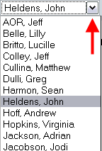
Navigation Features
Breadcrumb trails provides a quick way to navigate between screens within a tab
Drop down menus allow quick access to additional information stored in the database

Slide 9
Icons
Icons perform key tasks
Hover your cursor over an icon to determine its function
Click the icon and Cayuse424 will respond with prompts, forms changes, etc. to support performance of the activity

Slide 10
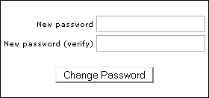
Changing Your Password
Click the Preferences tab
Click Change Password
Enter new password
Re-enter new password to verify
Click Change Password

Slide 11
User Preferences
Control how often you are prompted to save your changes as you navigate between tabs
All three boxes are checked by default, which ensures that your work is optimally auto-saved

Slide 12
Setting User Preferences
Click the Preferences tab
Click the User Preferences link
Check or uncheck the boxes

Slide 13
Cayuse424 Tips
When exiting pop-up windows always click the Close button; don't use your browser’s "back" function
Be careful when copying and pasting to your proposal -- special characters (e.g., umlauts) will cause funding agencies to reject your proposal
Don’t leave Cayuse424 running overnight

Slide 14
Conclusion
In this module you learned:
The features and benefits of Cayuse424
How to:
Log-on
Navigate Cayuse424
Understand the Cayuse424 icons
Personalize your password
Set User preferences
User Tips

