Slide 1
Idaho County Forest Condition
Kelsey Vershum
Undergraduate Research Analyst
Daria Paxton
Masters Research Analyst (advised by Dr. Mark Kimsey)
Notes:
daria

Slide 2

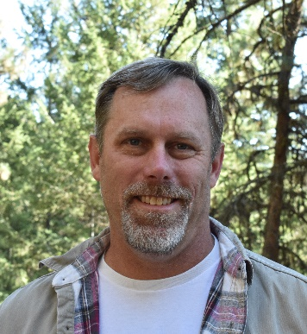
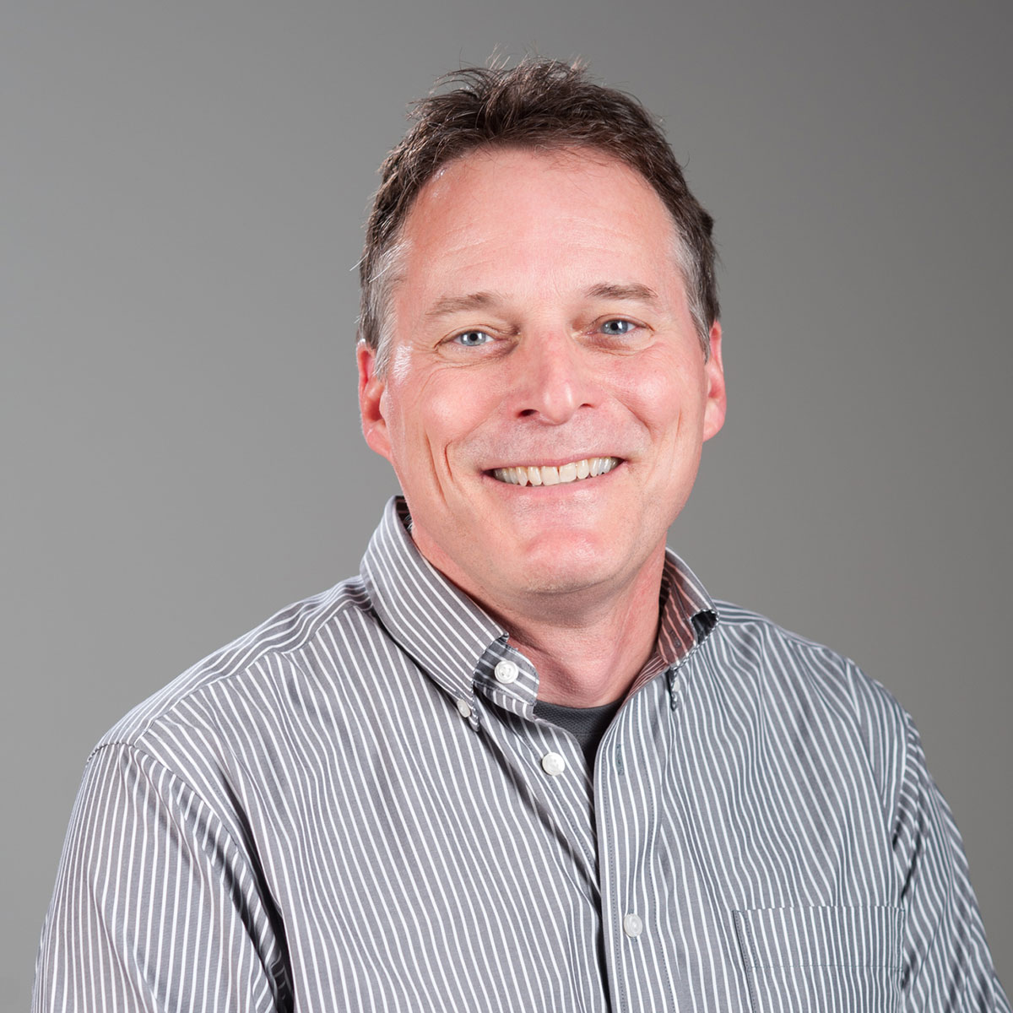
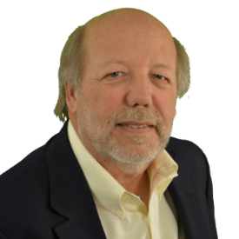
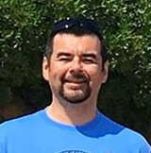
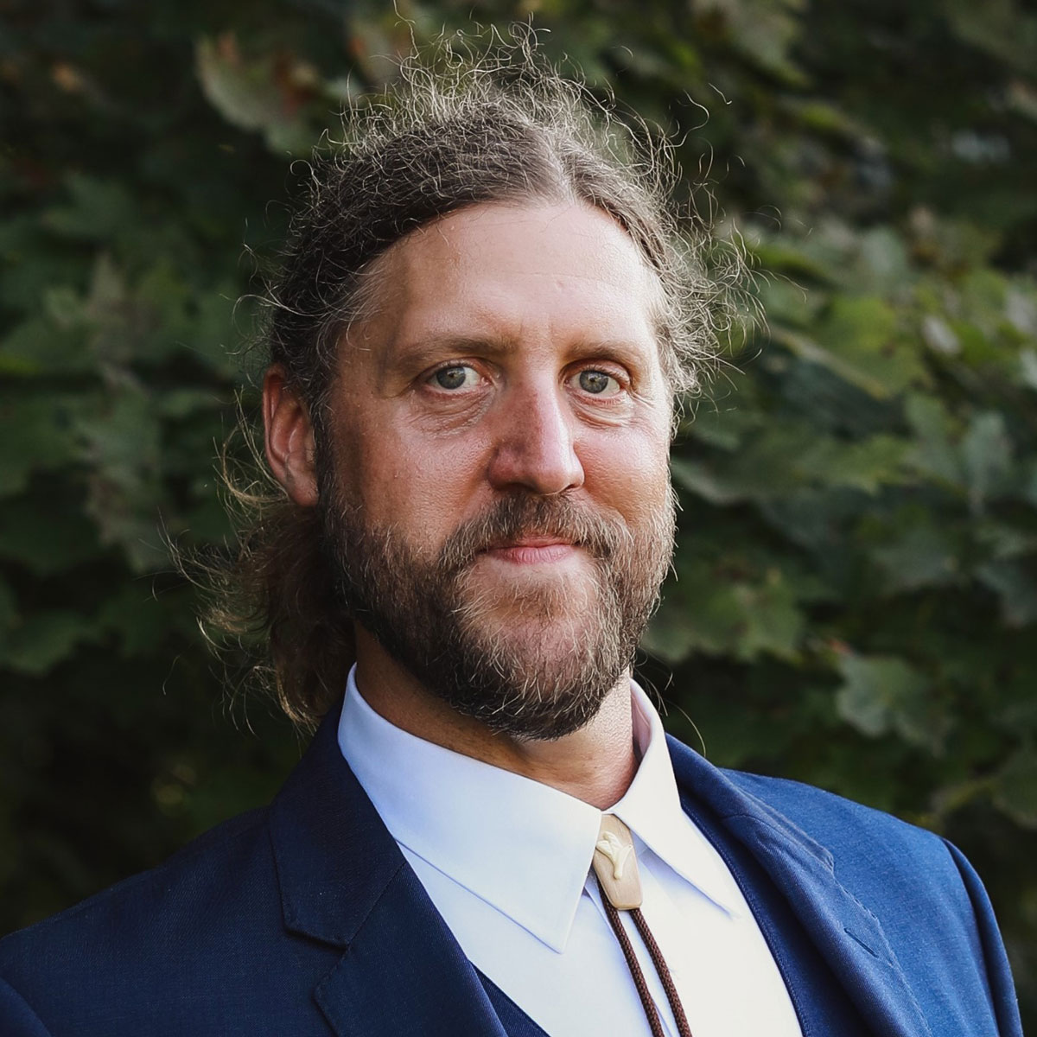
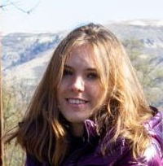
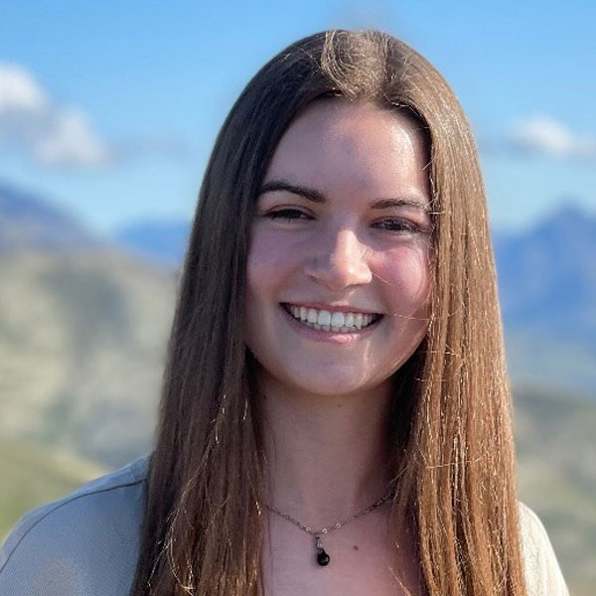
CNR Policy Analysis Group
Dennis Becker
Dean
Greg Latta
Director
Patrick Wilson
Professor
Greg Alward
Senior Scientist
Jeffrey Ross
Doctoral
Jimy Cargill
Masters
Daria Paxton
Masters
Kelsey Vershum
Undergraduate

Slide 3
Current Projects
County-Level Forest Inventory Reports
  Looking at the current state and trends of Idaho’s forests
Spatial Maximum and Relative Density Mapping
  Evaluating where those forests are overstocked
Economic Contribution of Idaho’s Natural Resources
  Exploring the state of Idaho’s rural economies
Forest Carbon Offset Market Participation
  Looking for opportunities to contribute to mitigation efforts

Slide 4
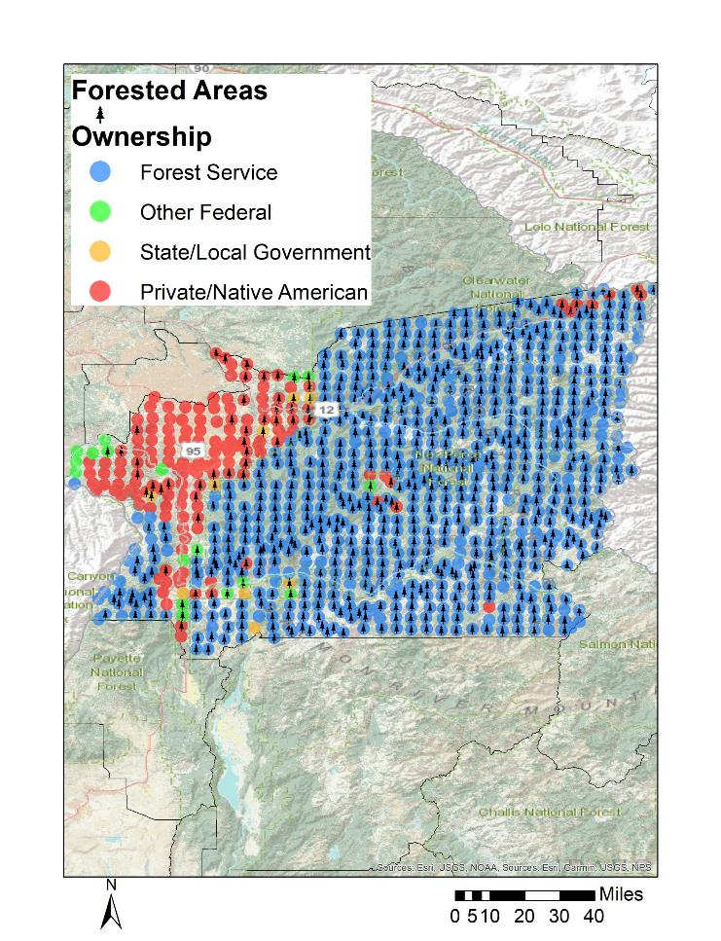
What is out there
County-Level Forest Inventory
    Highly forested
    Mostly Forest Service owned
    Lots of wilderness and roadless land

Slide 5
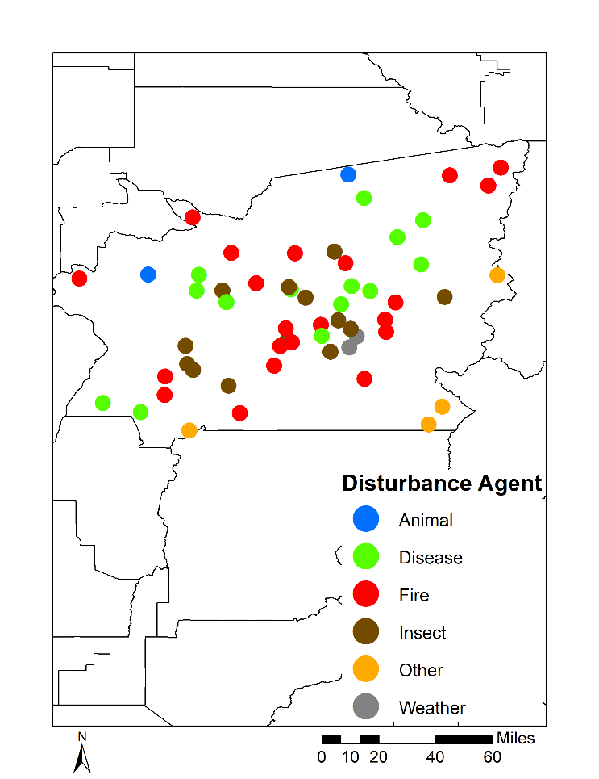

disturbance
Natural Disturbance
 |  | Forest Service | Other Federal | State/ Local | Private/ Native American
 | ------------------------------------------------- acres -------------------------------------------
Disturbance |  |  |  |  |  | Total
 | Disease | 79,306 | 1,223 | 0 | 6,197 | 86,726
 | Fire | 213,555 | 5,112 | 0 | 4,803 | 223,470
 | Insect | 84,742 | 0 | 1,859 | 1,859 | 88,460
 | Other Disturbance | 37,234 | 0 | 0 | 0 | 37,234
 | Total | 414,837 | 6,335 | 1,859 | 12,858 | 435,890
Management
 | Artificial | 0 | 0 | 620 | 0 | 620
 | Cutting | 1,549 | 0 | 620 | 2,014 | 4,183
 | Other Treatment | 0 | 0 | 620 | 0 | 620
 | Preparation | 0 | 0 | 0 | 2,052 | 2,052
 | Total | 1,549 | 0 | 1,859 | 4,066 | 7,474
 | Grand Total | 416,386 | 6,335 | 3,718 | 16,924 | 443,364

Slide 6
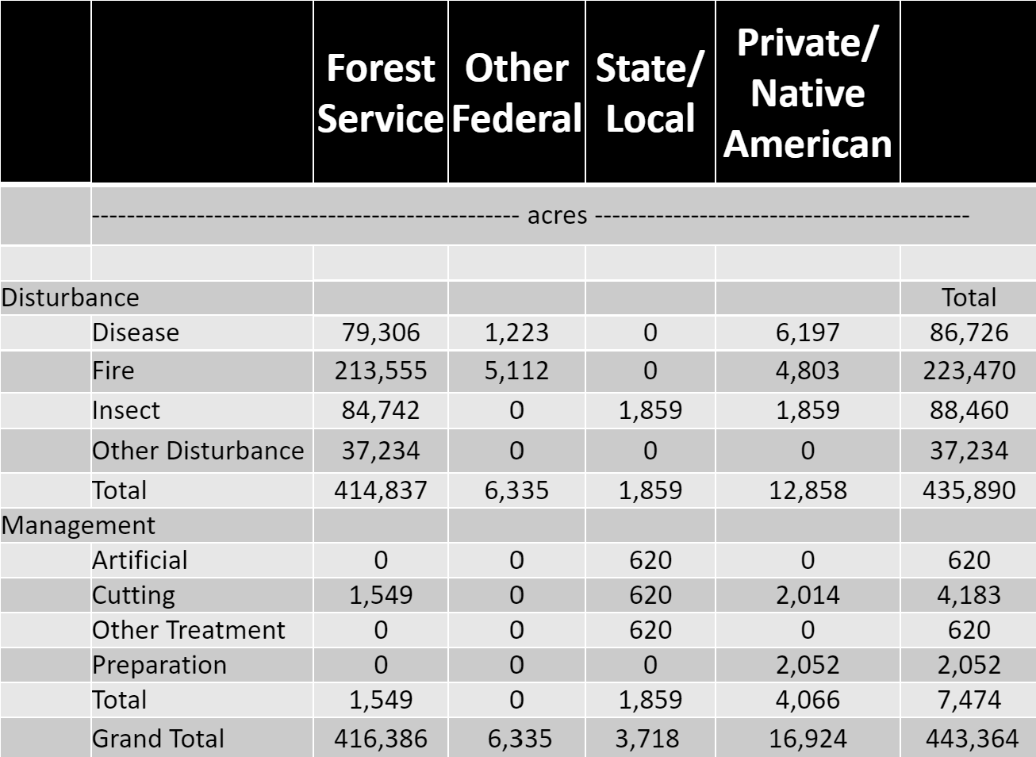
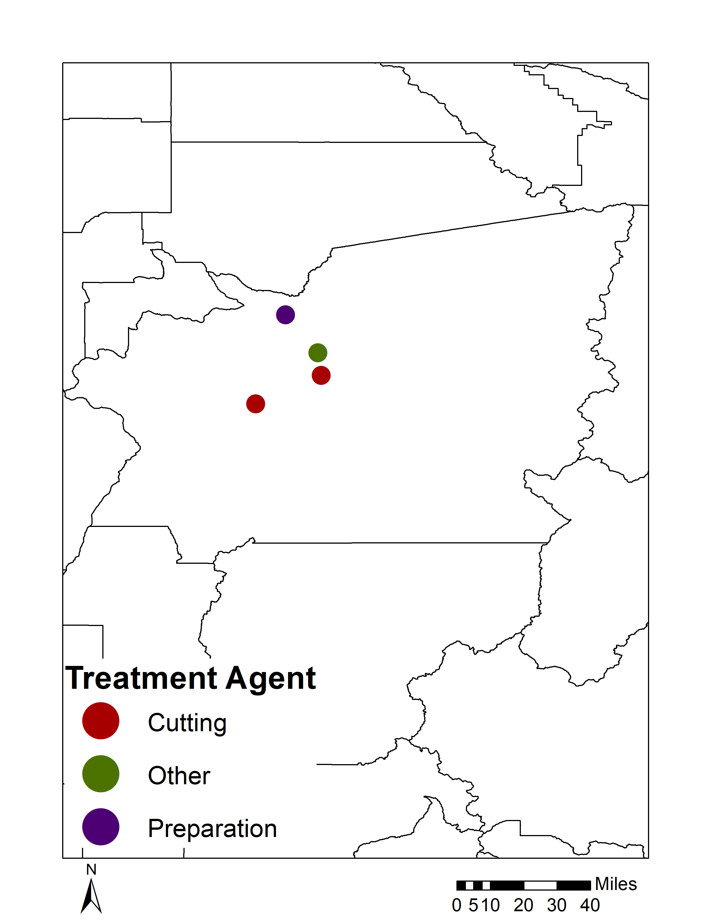
disturbance
Human Disturbance

Slide 7
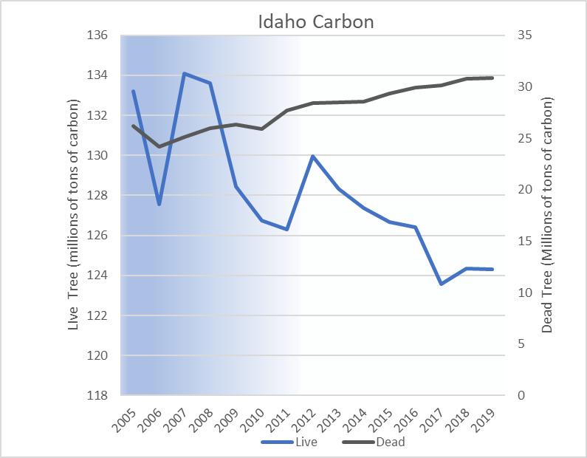
Carbon
    Live Carbon decreasing
    Dead Carbon increasing

Slide 8
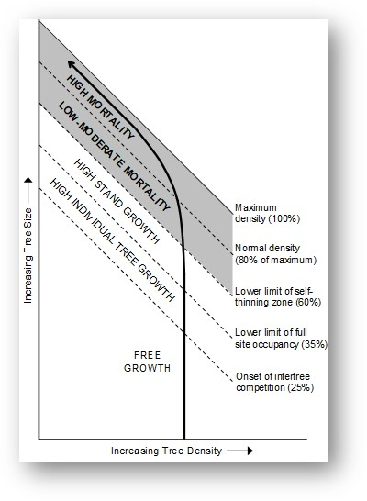
Evaluating Idaho stand density
Silviculture 101 – density matters
  Density level drives stand dynamics
        0 – 25% Free Growth
        25 – 35% High Tree Growth
        35 – 60 % High Stand Growth
        60 – 80% Low/Moderate Mortality
        Over 80% High Mortality
Reineke, L.H. 1933. Perfecting a stand density index for even-aged forests. Jour. Agric. Res. 46: 627 – 638.
Drew, T.J and J.W. Flewelling. 1979. Stand density management: An alternative approach and its application to Douglas-fir plantations. Forest Science. 25(3):518-532
Kimsey, M.J., T.M. Shaw, and M.D. Coleman. 2019. Site sensitive maximum stand density index models for mixed conifer stands across the Inland Northwest, USA. Forest Ecology and Management. 433(2019):396-404.
Notes:
“Normal” varies across time and space
Relative compared to a “normal” stand

Slide 9
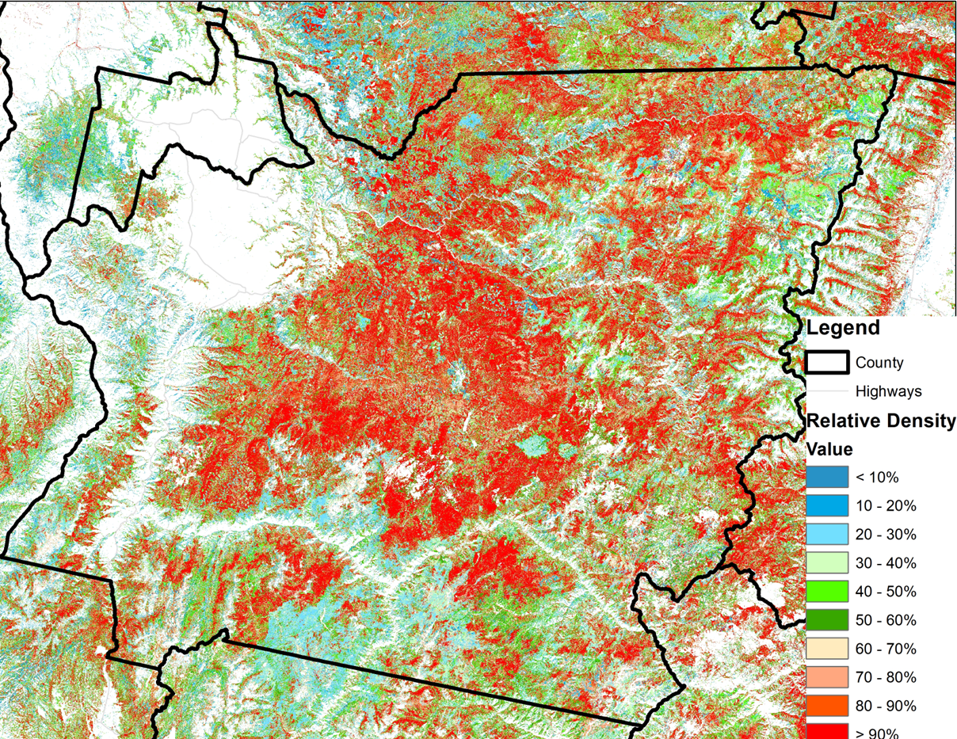
Relative density
Idaho County
Riley, K.L., I.C. Grenfell, M.A. Finney, J.M. Wiener, and R.M. Houtman. 2019. Fire Lab tree list: A tree-level model of the conterminous United States landscape circa 2014. Fort Collins, CO: Forest Service Research Data Archive. https://doi.org/10.2737/RDS-2019-0026
Notes:
Half is in the low moderate and high mortality zone.
The data used are the FireLab tree lists to give stocking level, and the kimsey max sdi value. The maps are 30-m pixels with full coverage of the state

Slide 10

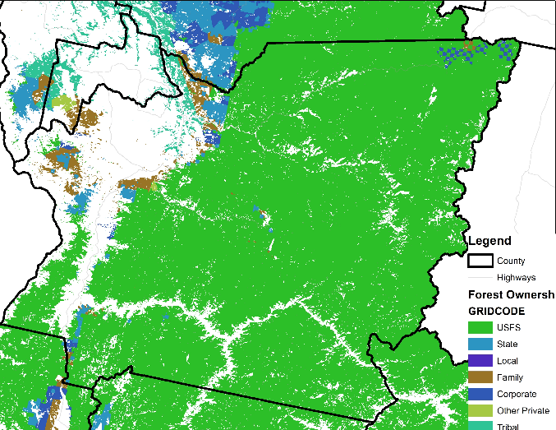
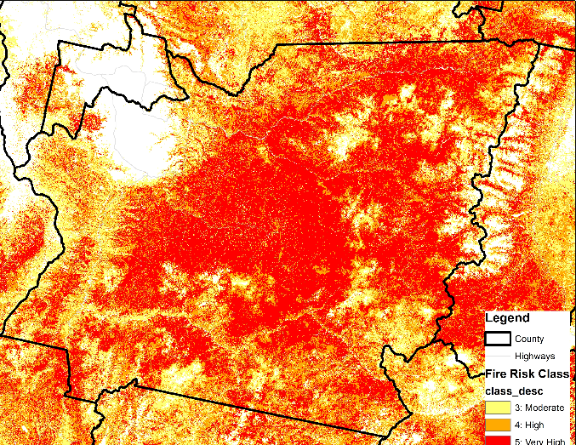
Density – What, Where, Who, and Why
Relative Density
Ownership
Fire Risk
Hewes, Jaketon H.; Butler, Brett J.; Liknes, Greg C. 2017. Forest ownership in the conterminous United States circa 2014: distribution of seven ownership types - geospatial dataset. Fort Collins, CO: Forest Service Research Data Archive. https://doi.org/10.2737/RDS-2017-0007
Dillon, Gregory K; Gilbertson-Day, Julie W. 2020. Wildfire Hazard Potential for the United States (270-m), version 2020. 3rd Edition. Fort Collins, CO: Forest Service Research Data Archive. https://doi.org/10.2737/RDS-2015-0047-3
Notes:
Here just point out that once we knw where these high density stands are we can look at other characteristics – like ownership and fire risk

Slide 11
Focus on high relative density
These would be acres with > 80% relative density (high mortality) stands in Idaho County
Relative Density Higher than 80%
Available with Relative Density Higher than 80%
56%
4.5% 15.5% 80%
Notes:
We also need to be aware about restrictions on operations – so where we have roads vs wilderness.
Most (887k acres) overstocked acres are not wilderness/roadless
Most of those 887k acres have very high fire risk

Slide 12
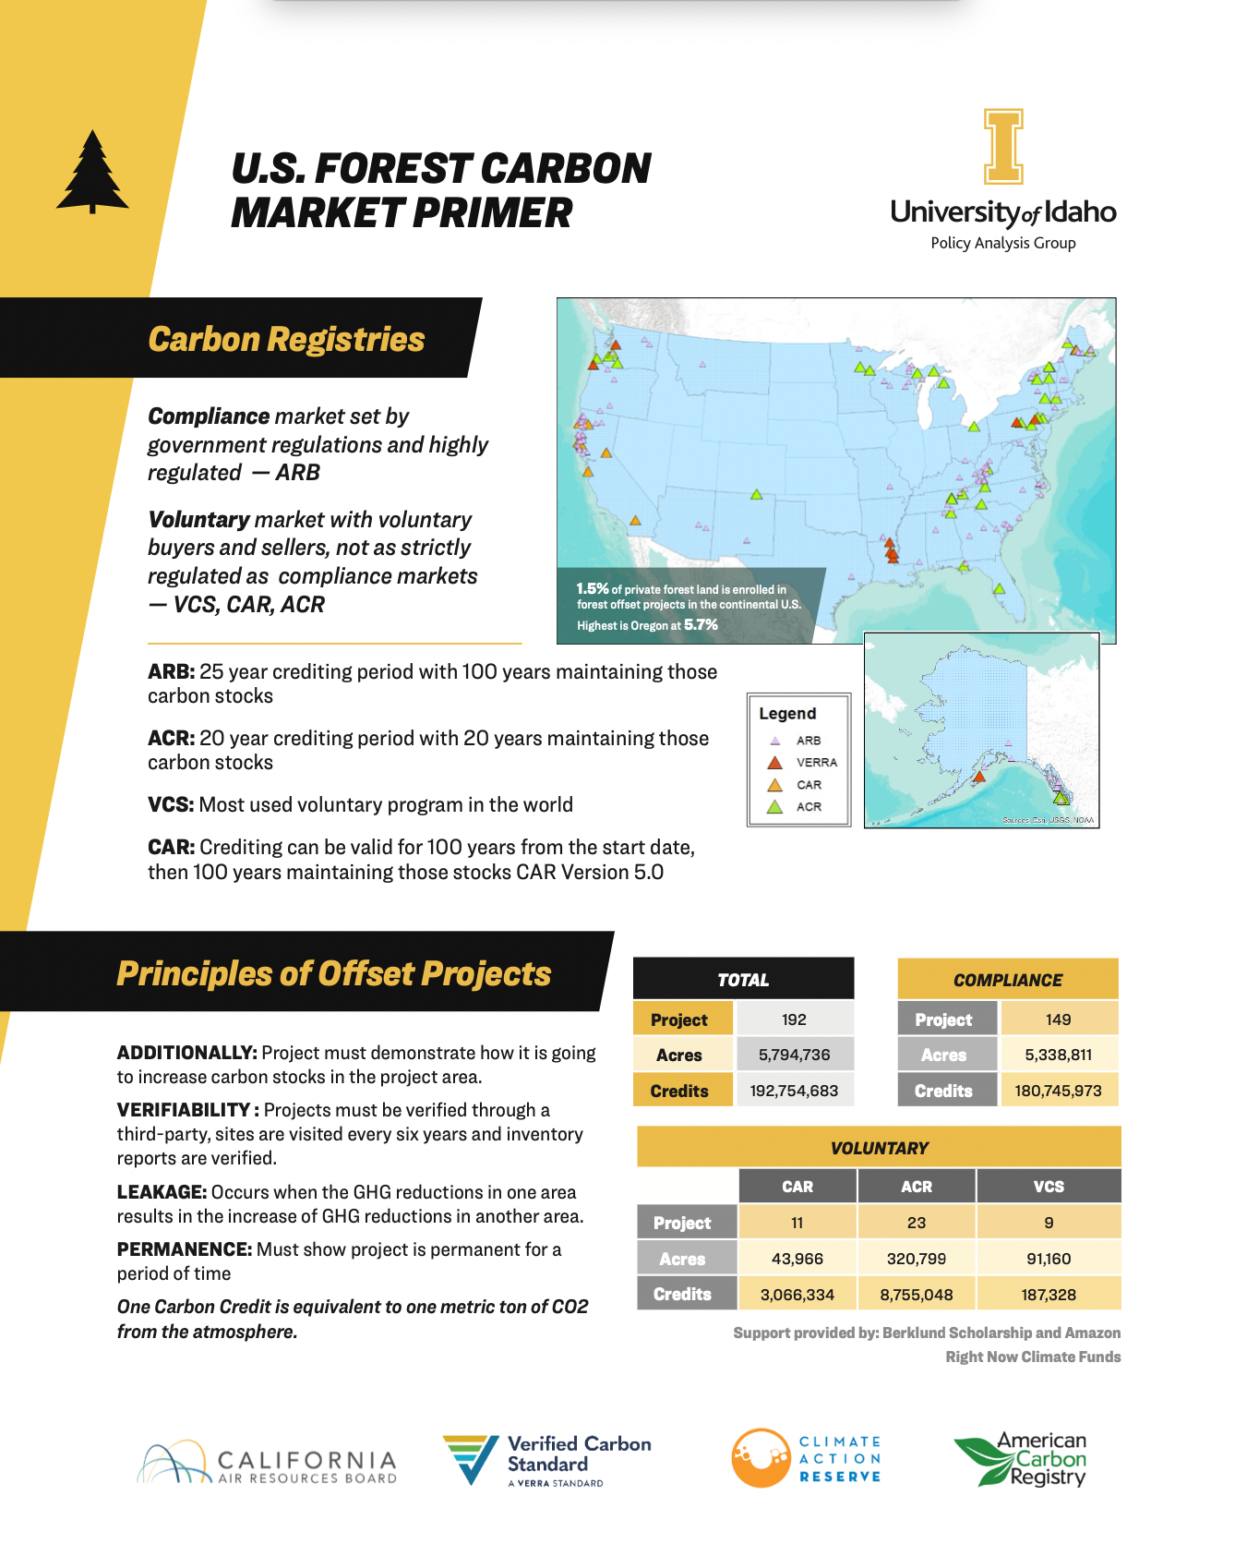
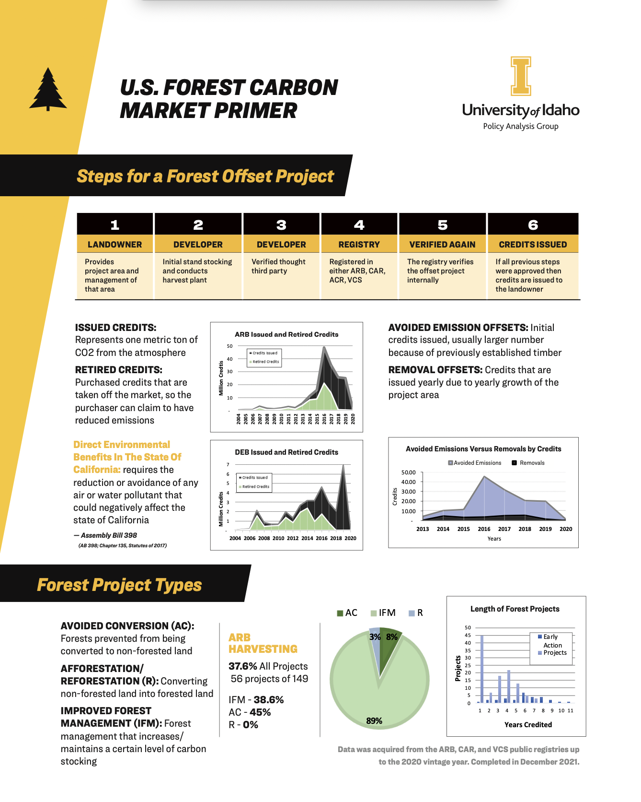
End Goal
Two-Page Fact Sheets
    Advisory Committee
    Post on Policy Analysis
    Group website

Slide 13

Daria Paxton
Graduate Research Assistant – Policy Analysis Group
University of Idaho
dpaxton@uidaho.edu
Kelsey Vershum
Undergraduate Research Assistant – Policy Analysis Group
University of Idaho
kvershum@uidaho.edu
Greg Latta
Director – Policy Analysis Group
University of Idaho
glatta@uidaho.edu; 541.619.9212
e-newsletter and reports
http://www.uidaho.edu/cnr/pag

