Slide 1
Impact of Wildfire on Forestry and Carbon
– More like Forest Carbon markets 101 and a peak at Wildfire
Greg Latta and Daria Paxton
Associate Research Professor, Department of Natural Resources and Society, University of Idaho
Presented at: 21st Annual Foresters Forum
February 10, 2023 Coeur d’Alene, ID

Slide 2

Forest Carbon markets 101 and a peak at Wildfire
What are carbon offsets?
  Why offsets – Regulatory vs Voluntary
How are they calculated?
  Programs, Registries, and Methodologies
Who would do such a thing?
  A walk through the numbers
What about fire?
  No solutions here, but maybe a couple thoughts and some maps

Slide 3
What are offsets
maybe we should take a step back first and look at why offsets instead?
  Regulatory needs
  Voluntary needs

Slide 4
What are offsets
maybe we should take a step back first and look at why offsets instead?
  Regulatory needs
    We have policy goals

Slide 5
Nationally – Paris Agreement US Nationally Determined Contribution
This is what we sent in back in April 2021:
https://www4.unfccc.int/sites/ndcstaging/PublishedDocuments/United States of America First/United States NDC April 21 2021 Final.pdf

Slide 6
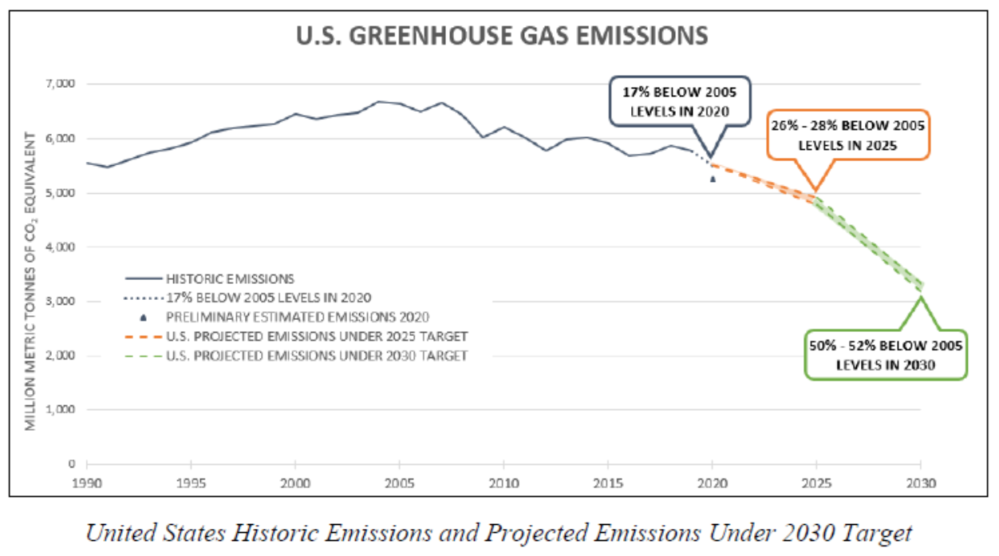
Forests can help
From last slide
Breaking down the emissions:
https://www.whitehouse.gov/wp-content/uploads/2021/10/ClimateNationalCommunication.pdf
This forest sink will either Decline or Increase
Forests Reduce Gross Emissions 12%
This does not account for the impact of policy plans from the Biden administration

Slide 7


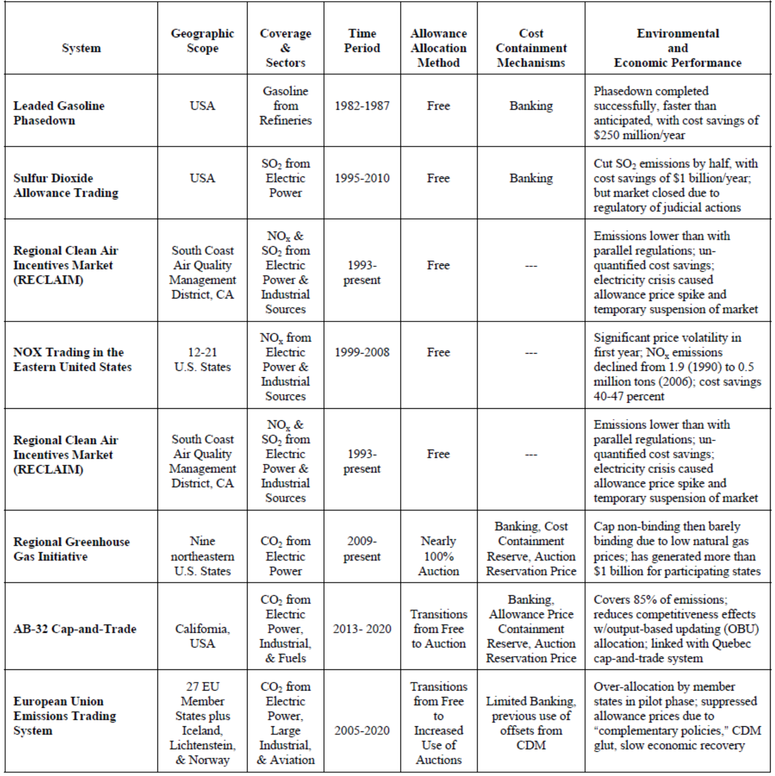

Cap and trade

Slide 8
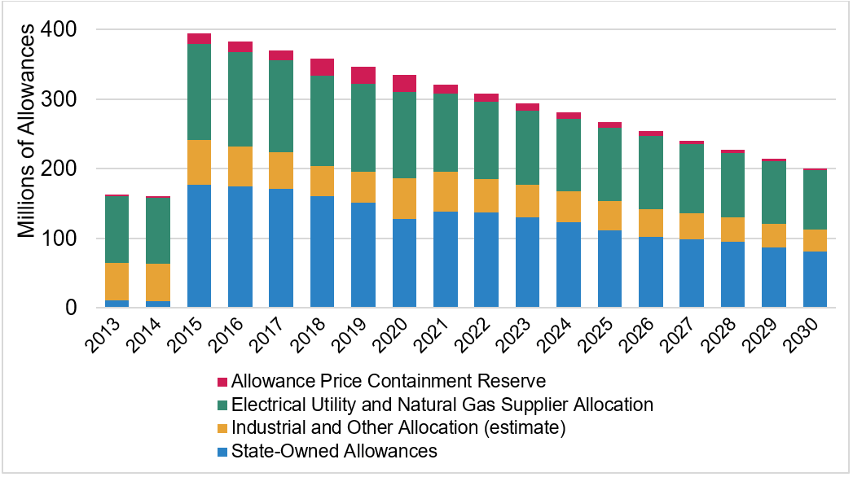
Cap and trade – California example
Give some to utilities and industry
Auction some to highest bidder
Hold a little bit in case prices go nuts

Slide 9
Cost containment - expanded
Cost Containment and Market Flexibility Mechanisms
Trading of allowances is allowed to minimize cost of pollution controls
Banking of allowances is allowed to guard against shortages and price swings
4 percent of allowances are held in a strategic reserve to contain costs
Multi-year compliance periods to buffer annual variations in product output
And the “nuts” part is where offsets come in
OFFSETS
Allowed for up to 8 percent of a facility’s compliance obligation
Limited to emissions-reduction projects in U.S.
Restricted to projects in five areas: forestry, urban forestry, dairy digesters, destruction of ozone-depleting substances, and mine methane capture
Offsets must be independently verified
Currently analyzing rice cultivation protocol

Slide 10
What are offsets
maybe we should take a step back first and look at why offsets instead?
  Regulatory needs
    We have policy goals
  Voluntary needs
    Companies have goals as well

Slide 11
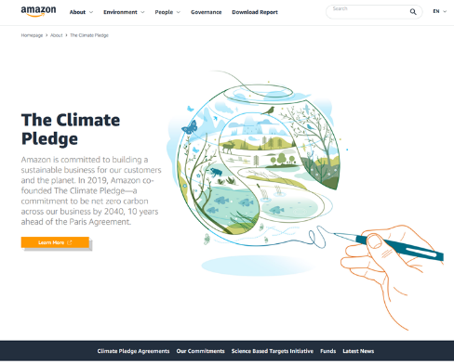
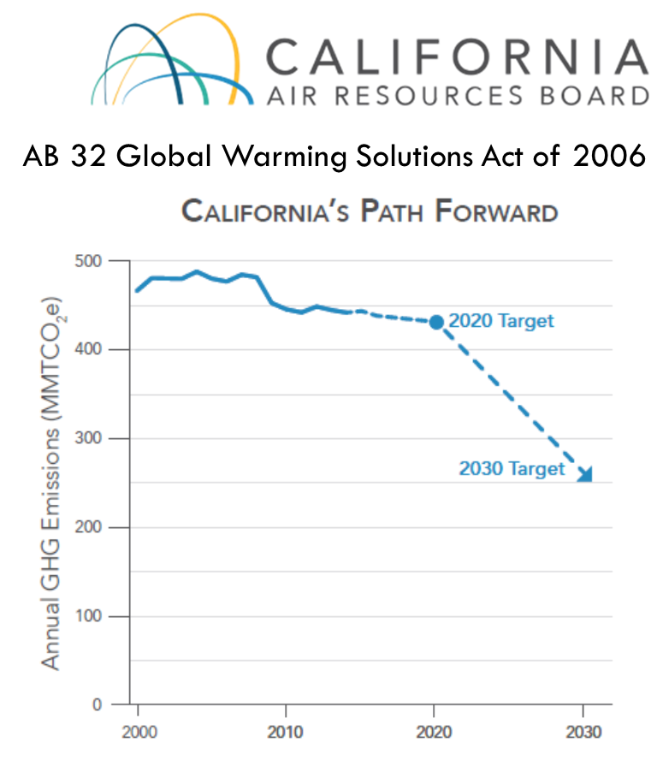
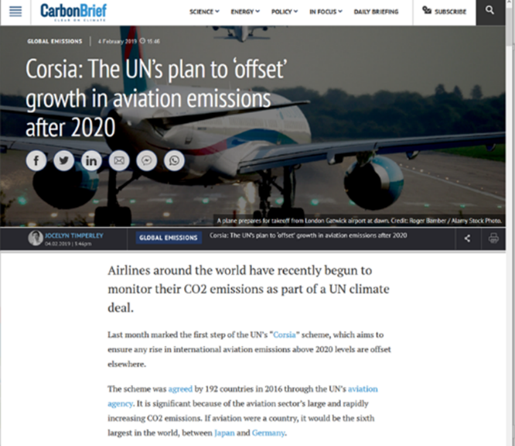
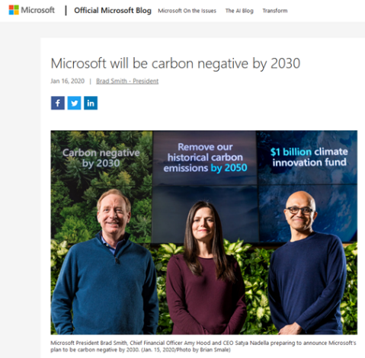
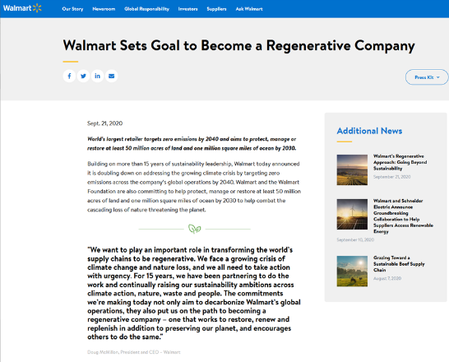
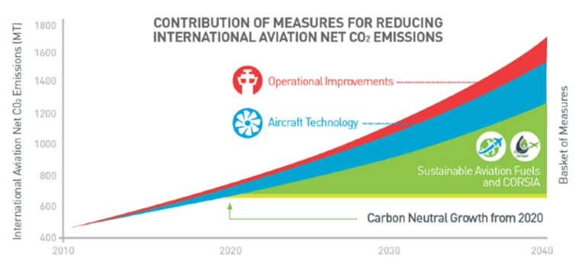
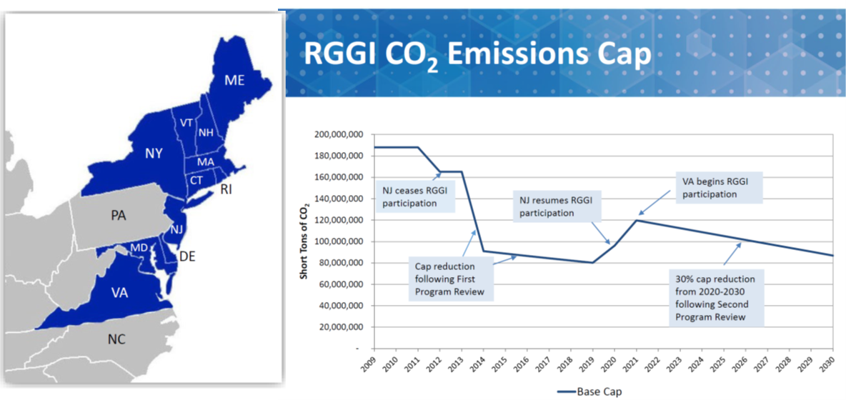
What is driving offset generation (demand)
Corporations
Airlines
State/Regional

Slide 12
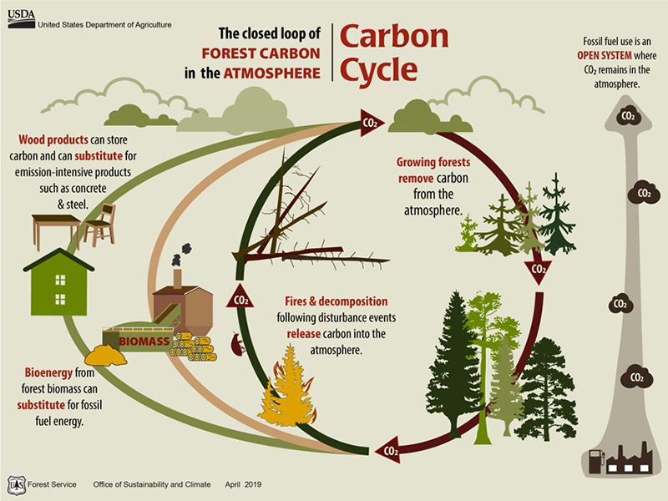
What is important in this figure?

Slide 13

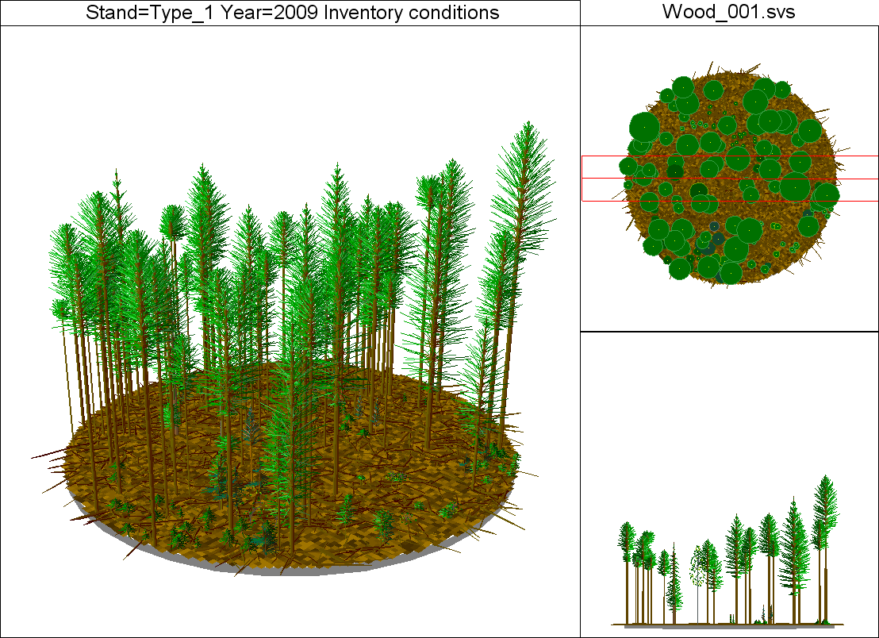
Stand Type 1
Carbon Stock based on this number
5194 Total Cubic ft / acre
Accumulating 7.3 tons / acre of CO₂ per year
Carbon Flux is what we care about

Slide 14
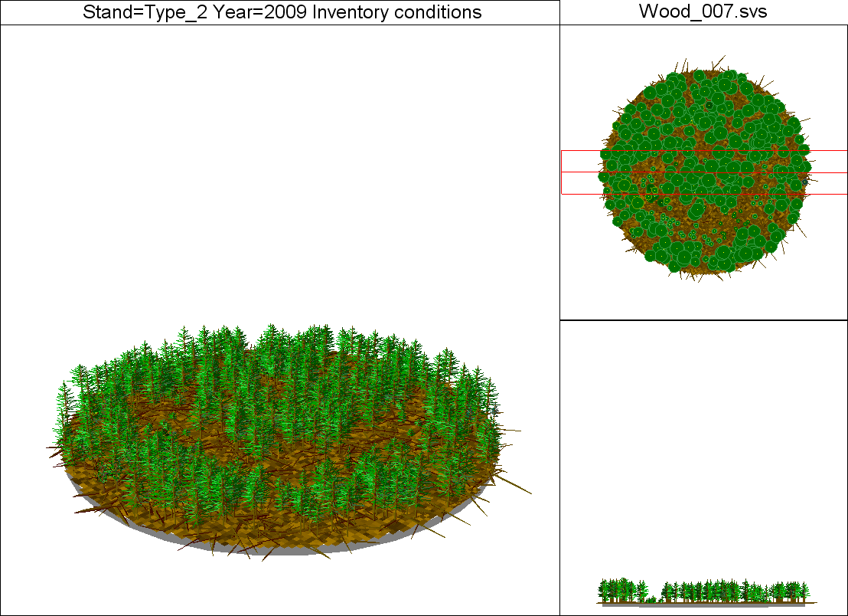
Stand Type 2
Lower Stock
740 Total Cubic ft / acre
Accumulating 19.21 tons / acre of CO₂ per year
Higher Flux

Slide 15
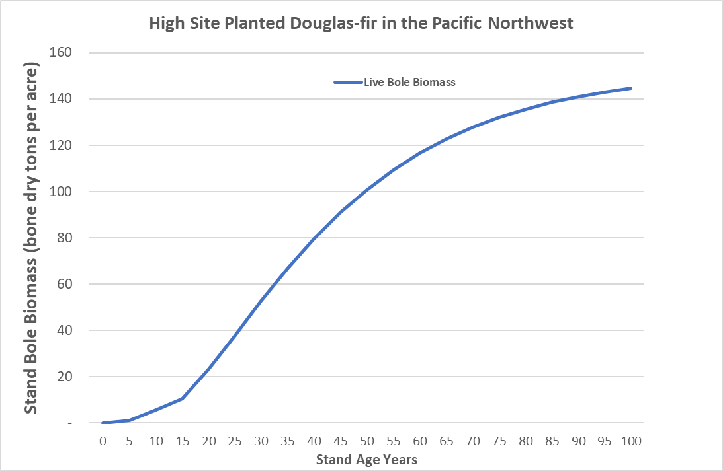
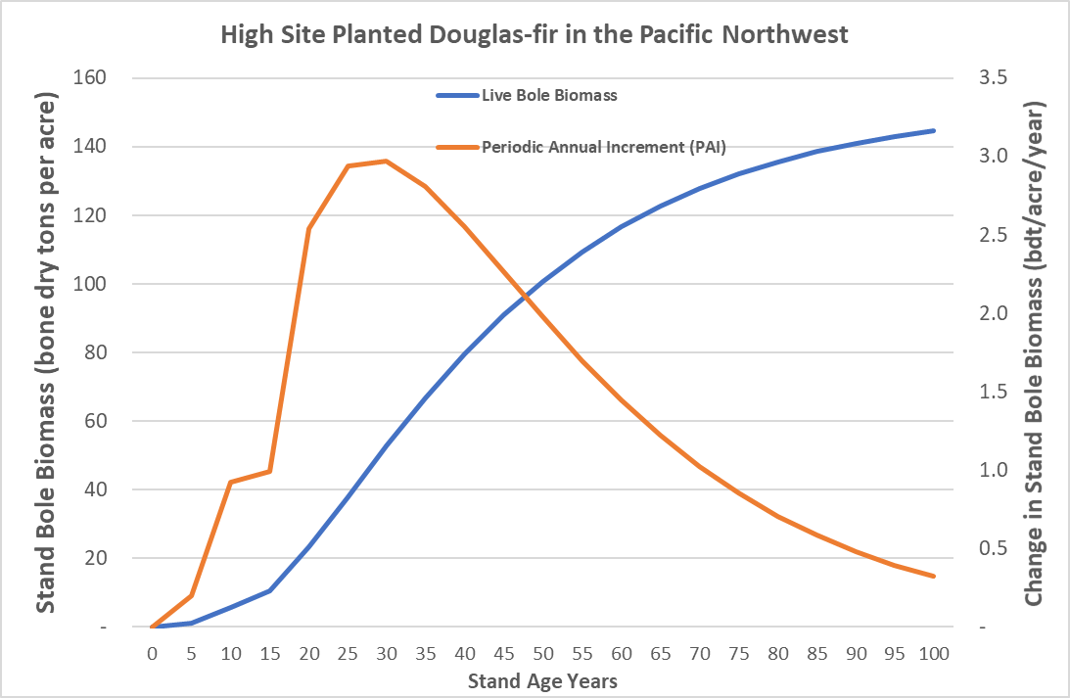
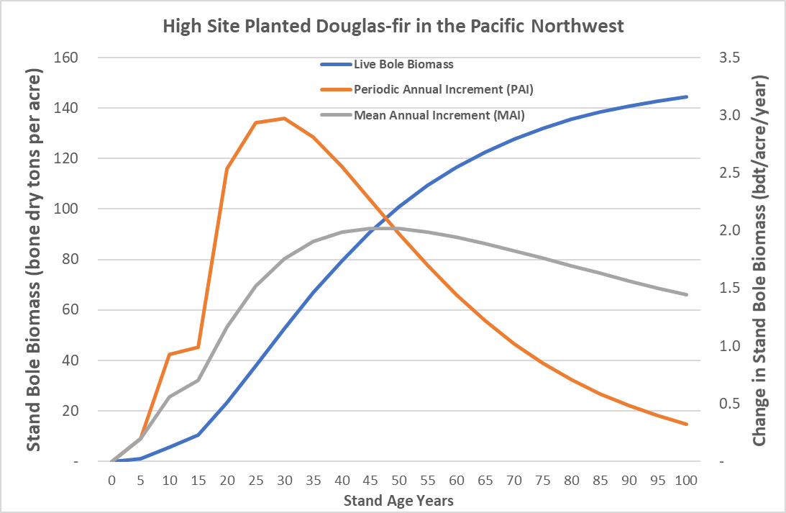
Basic Stand growth and yield
Live Bole Biomass – this is what we think of as yield in logs. It does not include small tree, tops, branches, or stump biomass
Sigmoidal – so increasing growth rate when young and then decreasing growth when older
Periodic Annual Increment (PAI) – this is what we think of annual growth rate
Peaks when the stand growth rate changes from increasing to decreasing (yield curve inflection point)
Mean Annual Increment (MAI) – this is what we think of average growth rate
The peaks is often defined as the biological rotation age (where PAI crosses MAI)

Slide 16
Basic Stand growth and yield
Carbon Stocks (CO₂) – this is what we think of as carbon stored in tree biomass. It does include small tree, tops, branches, or stump biomass
Sigmoidal – so increasing growth rate when young and then decreasing growth when older
Carbon Flux (CO₂/year) – this is what we think of annual sequestration rate
Peaks when the stand growth rate changes from increasing to decreasing (yield curve inflection point)
Average Carbon Flux (CO₂/year) – this is what we think of average sequestration rate
The peaks is often defined as the biological rotation age (where PAI crosses MAI)

Slide 17
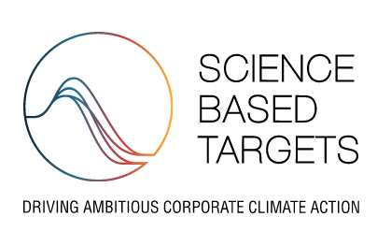
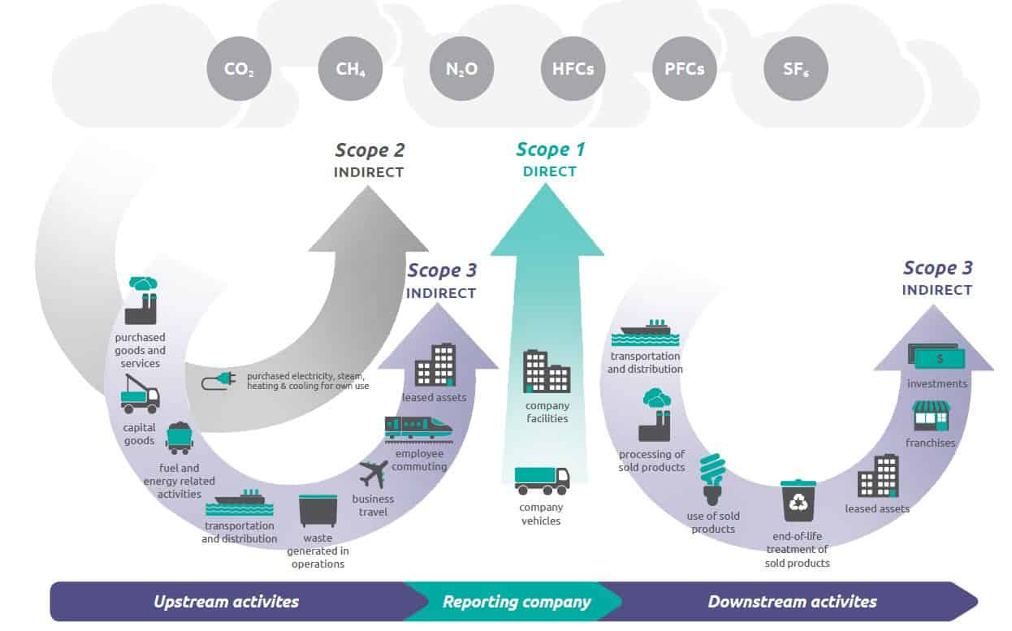
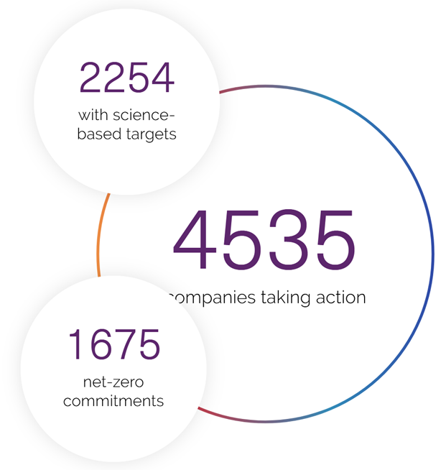
More Confusion – Carbon footprint and Insetting

Slide 18
More Confusion – Carbon footprint and Insetting

Slide 19
More Confusion – Carbon footprint and Insetting
This is going to be a big mess to correctly address offset market participants within carbon footprints
  If you have sold your sequestration then you should count it as an emission so that the purchaser gets the benefit they purchased.
      And the carbon gods are appeased
  That doesn’t mean the accounting needs to be the same though
    Things like harvested wood products could be handled differently
    Timeframes could be different as well
    But all of this will need to be disclosed
  These are issues that need to be addressed eventually

Slide 20
Major US programs
California Air Resources Board (CARB or ARB)
  Program: Regulatory program in the state of California
Climate Action Reserve (CAR)
  Registry with Programs: Biggest movement lately is Mexico
American Carbon Registry (ACR)
  Registry with Programs: Biggest US non-ARB improved forest management (IFM) program
Verified Carbon Standard (VCS or Verra)
  Registry with Programs: Biggest international registry – not much in terms of US IFM

Slide 21

Following CARBON and MONEY through an Offset Market
Discounts
For cruise error, leakage, risk of reversal, etc.
Reserve Pool
Provides insurance against reversal
Offset Buyers
Corporation
Individual
Forest
Land Owner
Provides land base and additional carbon storage
Registry
Provides protocol, tracking and accounting of account
Project Developer
Provides interaction with registry
Verifiers
Provide independent confirmation of account
Brokers
Facilitate deals between buyers and Registry accounts

Slide 22
Verifiers

Slide 23


How ARB IFM (Improved Forest Management) Works
Landowner gets a one-time allocation for carbon above Common Practice
6. Now annual carbon payments same as base year
This Average Line
Conduct forest inventory
Determine CAR Common Practice for your region / forest type
Conduct a 100 year harvest schedule
(legal and economically viable of course)
4. Average the 100 year live carbon stock value
Must be above this Common Practice Line

Slide 24
How ARB IFM (Improved Forest Management) Works
When you conduct this 100-year harvest schedule
You also average the removals for use in the Harvested Wood Products determination
  Average of storage in wood products over a 100 year timeframe
If you harvest less than this amount in a reporting period, you will be assessed a penalty (reduction in offsets) due to leakage

Slide 25
What is going on in US forest carbon offsets
Program | Projects | Acres | In the Pipeline
ARB IFM | 150 | 5,812,506 | 27
ACR IFM | 45 | 1,071,254 | 24
Things to watch:
Carbon Projects for small woodland owners
  Aggregated projects at ACR (Core Carbon from Finite)
  at VCS (Family Forest Carbon Program from American Forest Foundation)
  Natural Capital Exchange
Climate Forward at the Climate Action Reserve
  Mostly afforestation, but has one Mature Forest Management project
  There is a fuel/fire reduction methodology in review
Non-US extensions of these registries
  Mexican Forest Projects at CAR
  Canadian IFM at ACR
  Afforestation across the board

Slide 26
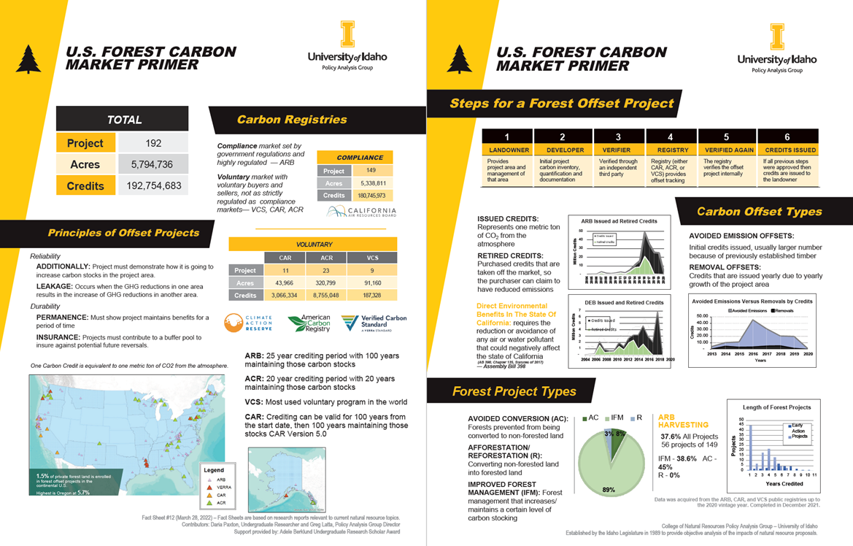

Slide 27
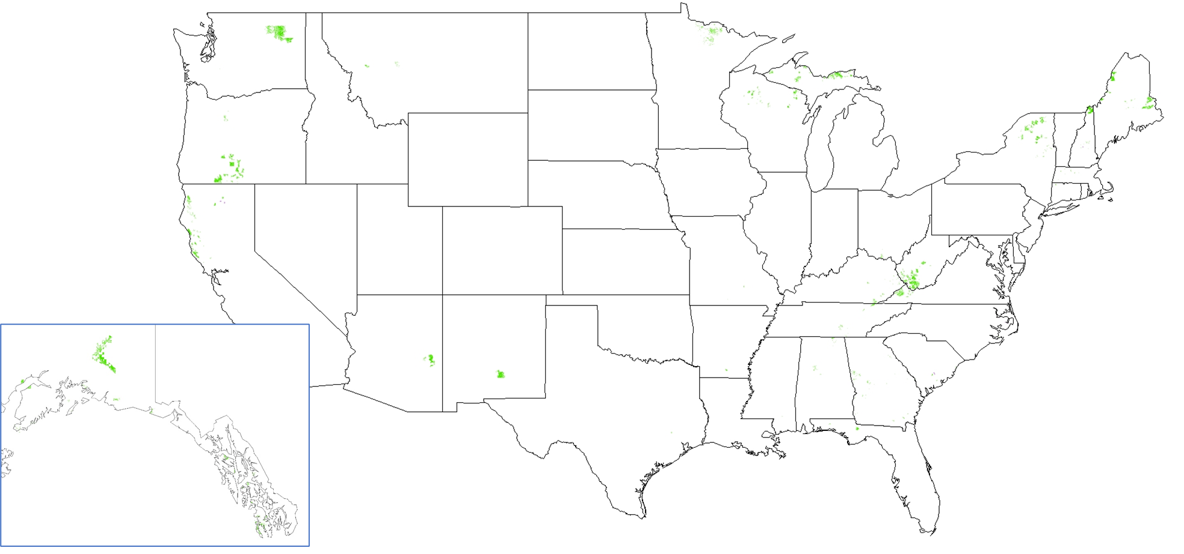
Where are these projects - ARB
Notes:
Spike in 2016 from new projects
Not lot of retired credits since 2018
We’ll have to note that this is ARB alone
We’ve talked a lot about participation and credits awarded, but here we also look at how many ARB credits have been retired
Retired is when either a capped entity in California or a corporation voluntarily uses them

Slide 28
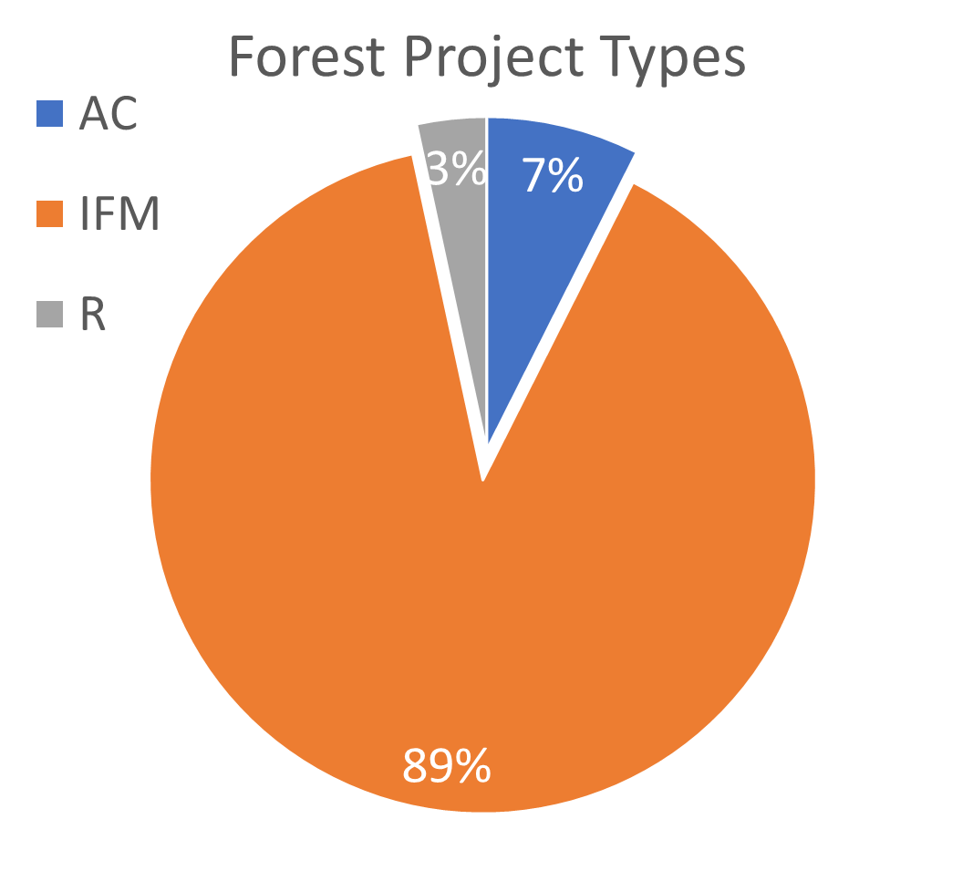
Types of Projects
Avoided Conversion (AC)
  Forests prevented from being converted to non-forested land
Improved Forest Management (IFM)
  Forest management that increases and maintains a certain level of carbon stocking
Reforestation R
  Converting non-forested land into forested land
Notes:
Spike in 2016 from new projects
Not lot of retired credits since 2018
We’ll have to note that this is ARB alone
We’ve talked a lot about participation and credits awarded, but here we also look at how many ARB credits have been retired
Retired is when either a capped entity in California or a corporation voluntarily uses them

Slide 29
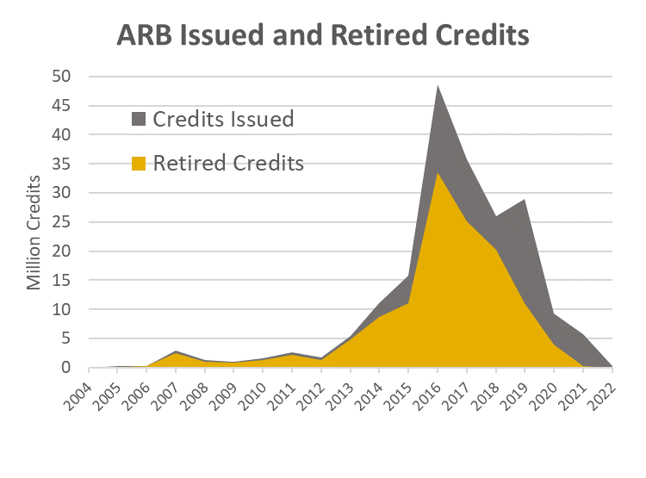
US Forest Carbon Offset crediting
Issued credits: represents one metric ton of CO₂ from the atmosphere
Retired credits: purchased credits that are taken off the market, so the purchaser can claim to have reduced emissions
ARB is California Air Resources Board
Notes:
Spike in 2016 from new projects
Not lot of retired credits since 2018
We’ll have to note that this is ARB alone
We’ve talked a lot about participation and credits awarded, but here we also look at how many ARB credits have been retired
Retired is when either a capped entity in California or a corporation voluntarily uses them

Slide 30
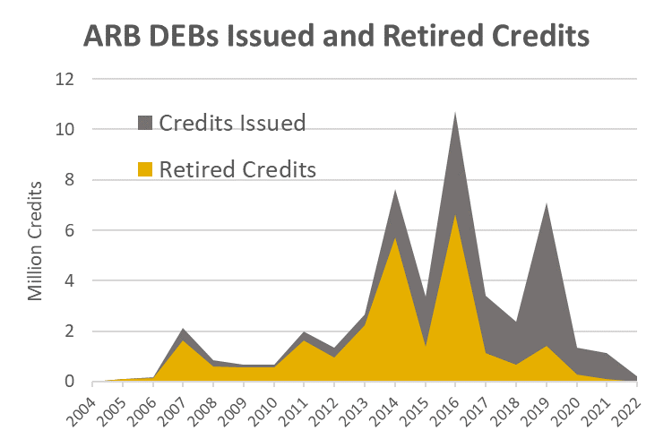
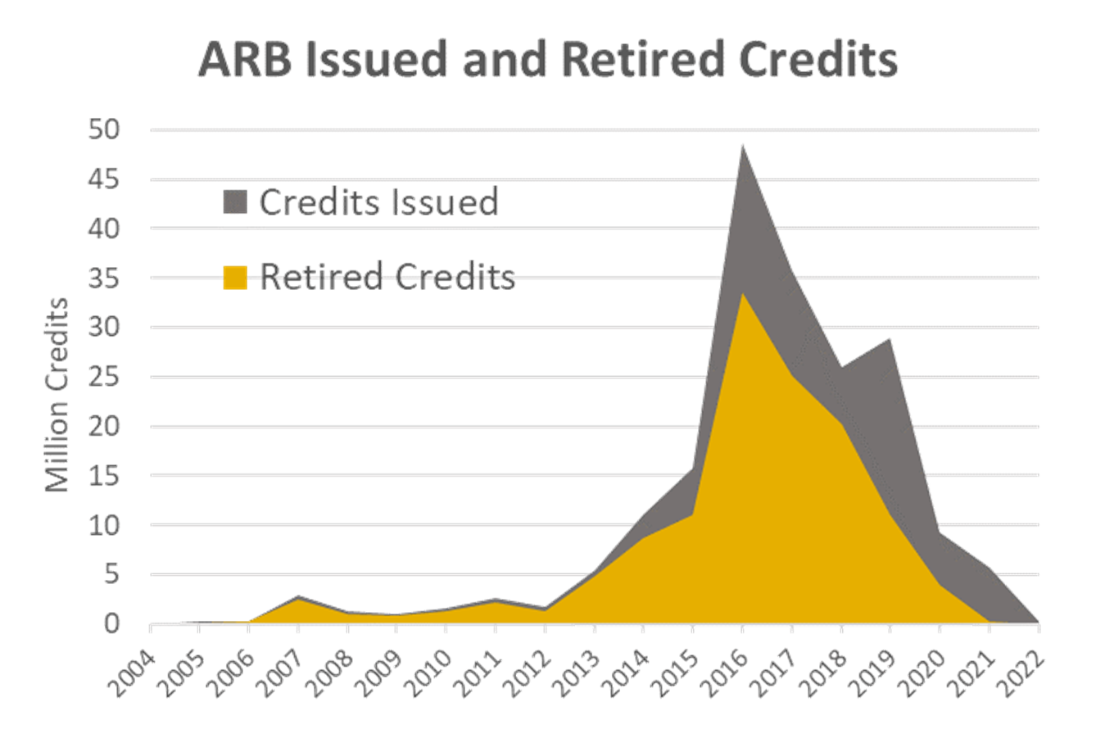
Direct environmemntal benefits (Debs)
To the State Of California requires the reduction or avoidance of any air or water pollutant that could negatively affect the state of California ( Assembly Bill 398 (AB 398; Chapter 135, Statutes of 2017) )
Prior slide (all ARB credits)
for reference
Notes:
Spike in 2016 from new projects
Not lot of retired credits since 2018
We’ll have to note that this is ARB alone
We’ve talked a lot about participation and credits awarded, but here we also look at how many ARB credits have been retired
Retired is when either a capped entity in California or a corporation voluntarily uses them

Slide 31
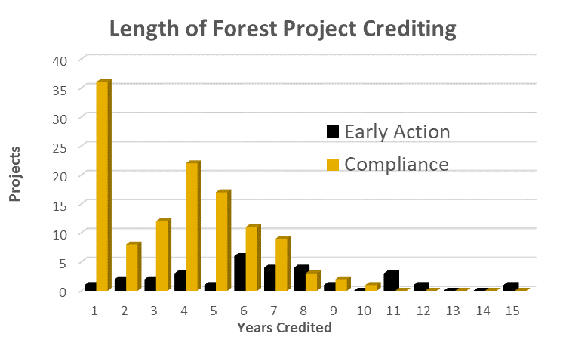
Number of crediting periods (arb only again)
Could be projects that just began (or are in the verification process)
Or
Could be projects that monetized avoided emissions credits only

Slide 32
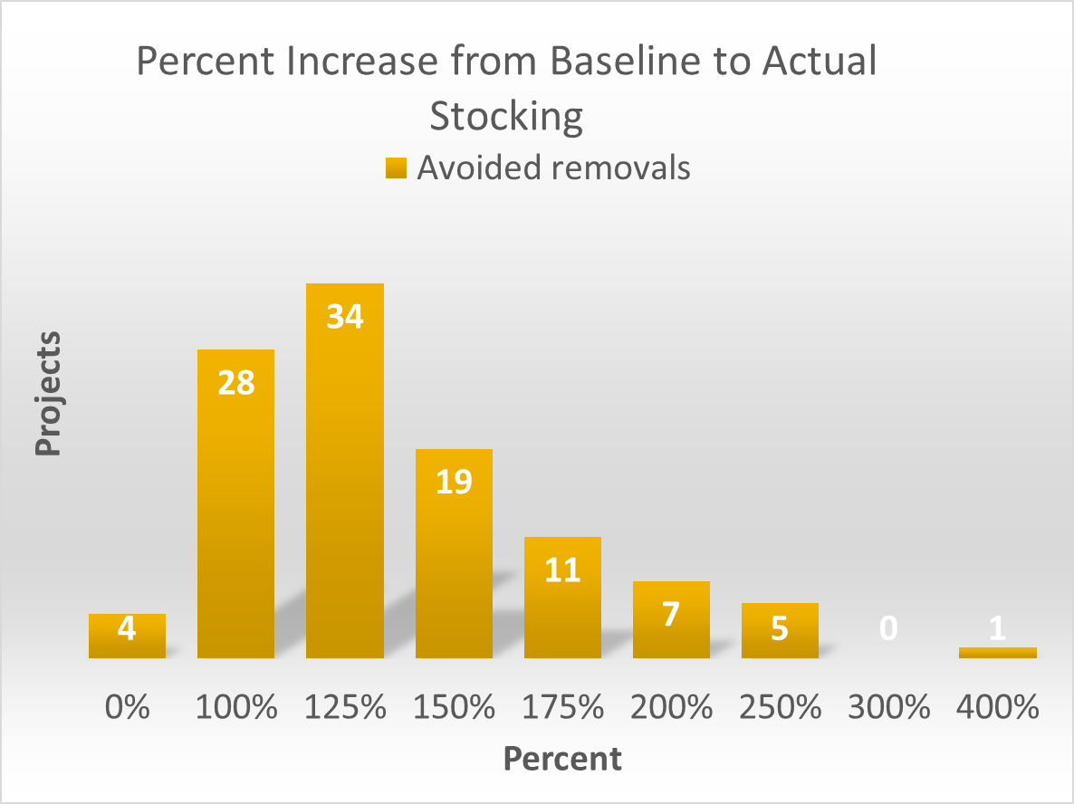
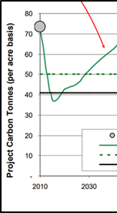
US Forest Carbon Offset stocking
ARB only here (yet again)
This graph shows the percent increase from the projected stocking to the actual stocking recorded.
(not including early action)

Slide 33
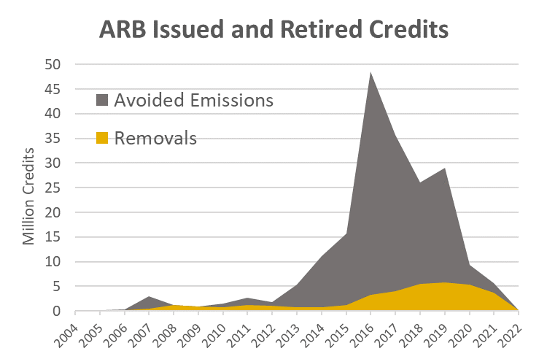
Avoided Emissions Versus Removals by Credits
Avoided Emission Offsets: Initial credits issued, usually larger number because of previously established timber
Removal Offsets: Credits that are issued yearly due to yearly growth of the project area
Removals

Slide 34
Active management – who is harvesting?
Looking just at ARB
  37% of all projects
    That is 56 projects harvesting
  38.6% of IFM (Improved Forest Management)
  45% of AC (Avoided Conversion)
  0% of R (Reforestation)
Leakage
  20% in ARB – not assessed on avoided emissions at time of crediting
  40% on most ACR – assessed against all crediting
  Most leakage values based in some way on: Murray, B. et al. 2005. Greenhouse Gas Potential in U.S. Agriculture and Forestry. United States Environmental Protection Agency Report EPA 430-R-05-006. 154p.

Slide 35
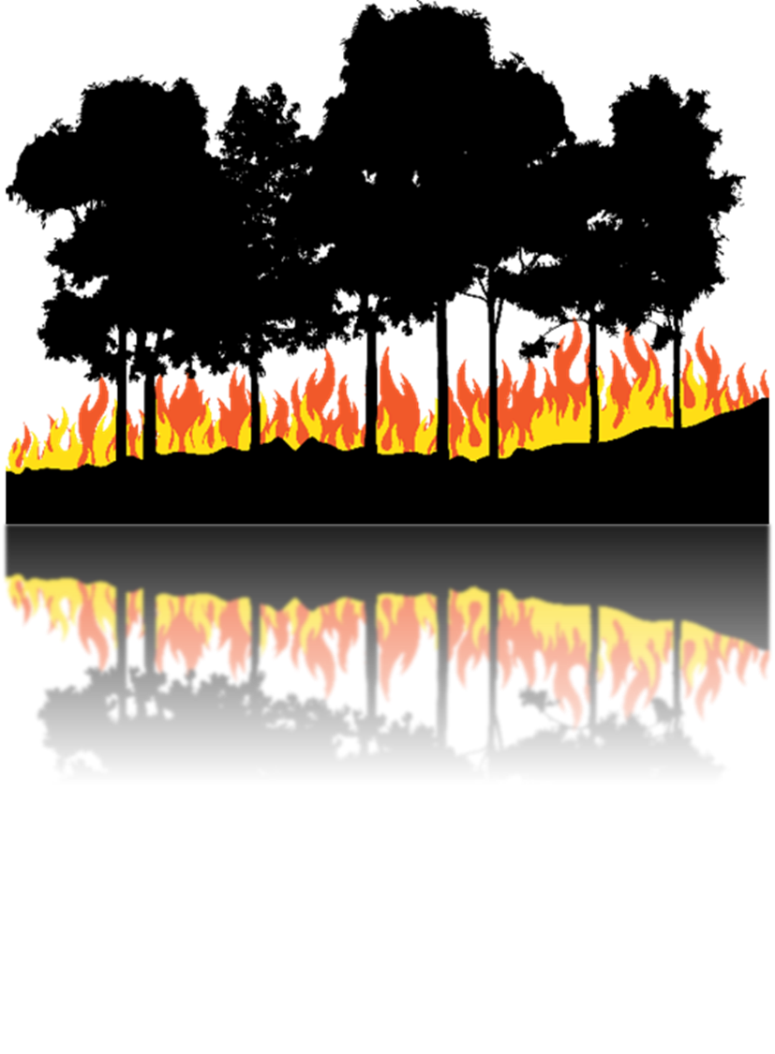
Buffer pool contribution - risk
The risk rating represents…
  Financial risks
  Natural disaster risks
  Social risks
  Management risks.
Average Risk Rating is 17.5%

Slide 36
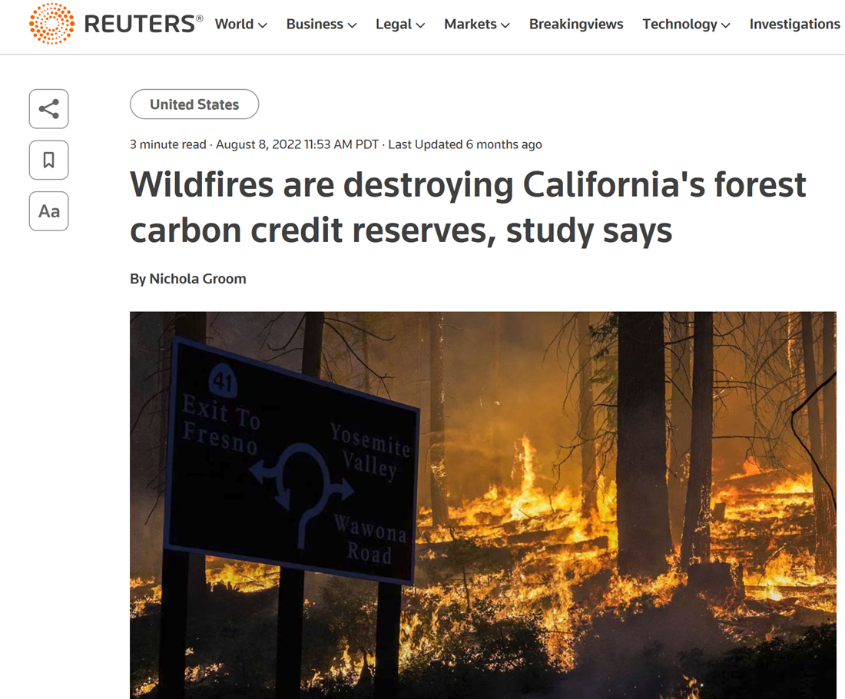
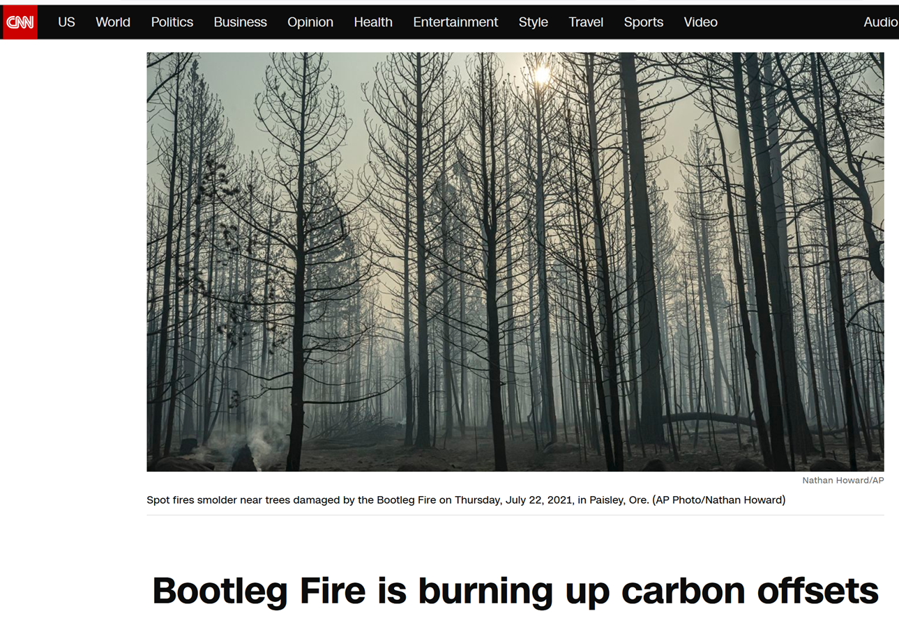
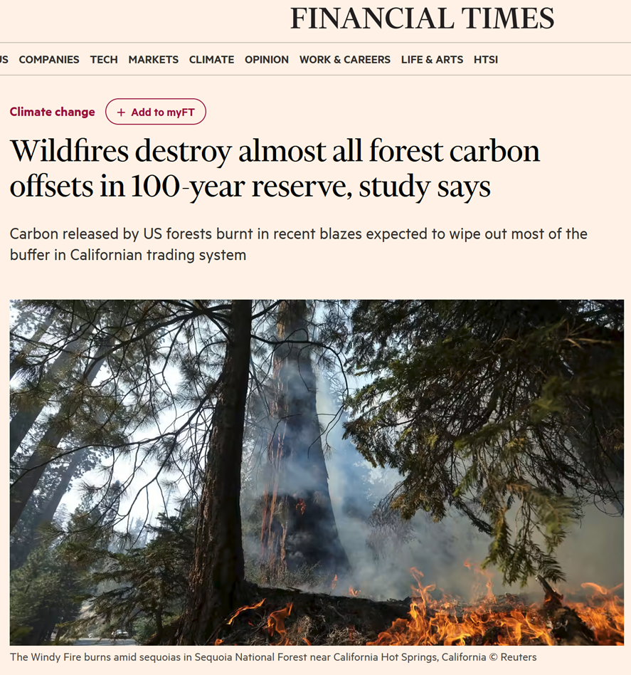
Looking at the Reserve pool (this is the wildfire part)

Slide 37
Looking at the Reserve pool (this is the wildfire part)

Slide 38
Looking at the Reserve pool (this is the wildfire part)
Our Plan
  Get ARB spatial data (where the projects are)
  Get MTBS Fire Intensity Data (how much damage they might have inflicted)
  Do a simple overlay
Monitoring Trends in Burn Severity (MTBS) is an interagency program whose goal is to consistently map the burn severity and extent of large fires across all lands of the United States from 1984 to present.

Slide 39
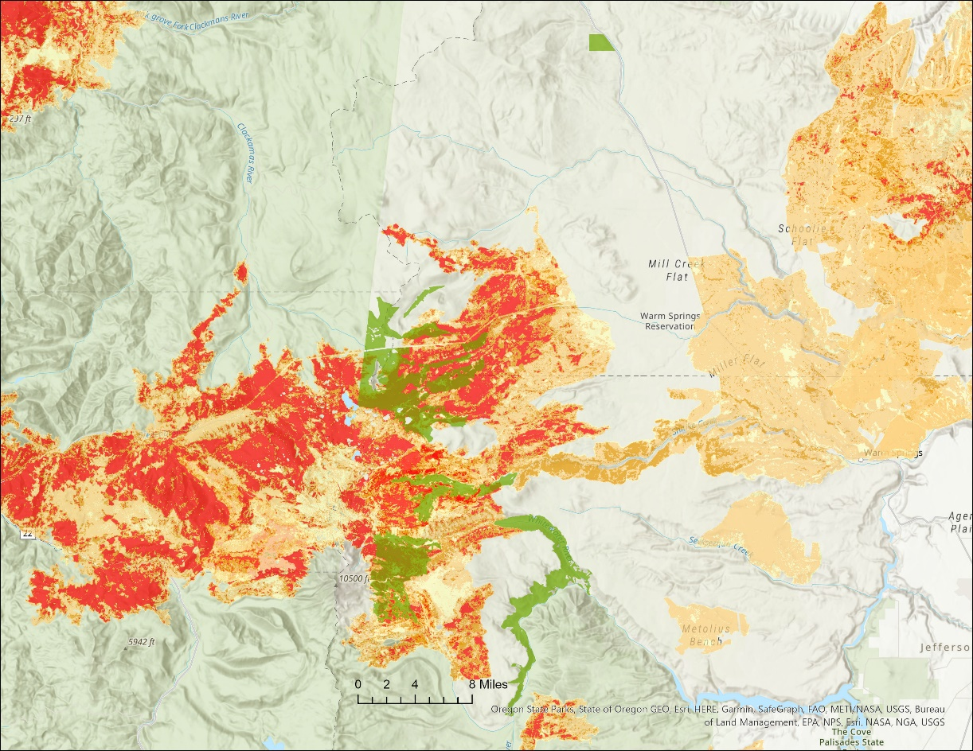
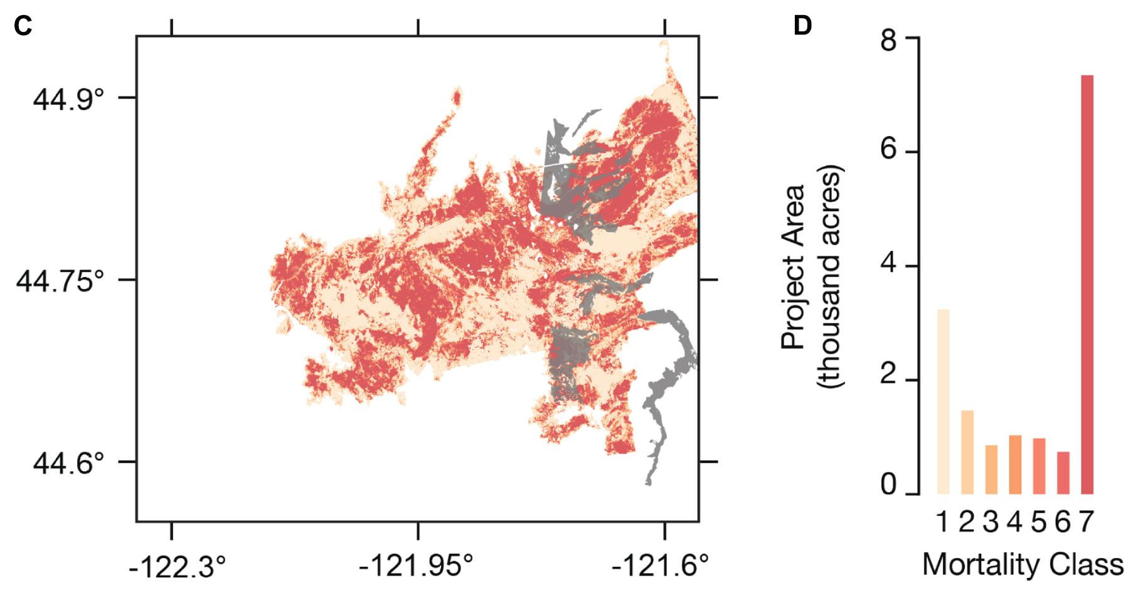
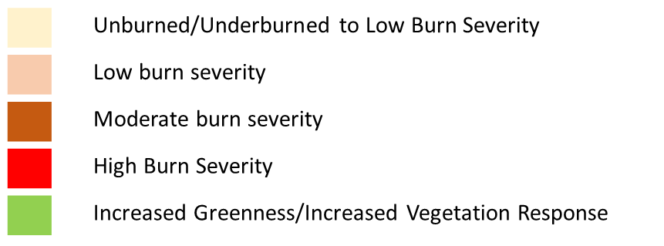
Looking at the Reserve pool (this is the wildfire part)
Our map
Lionshead fire and CAFR5214
Badgley etal. (2022) map

Slide 40
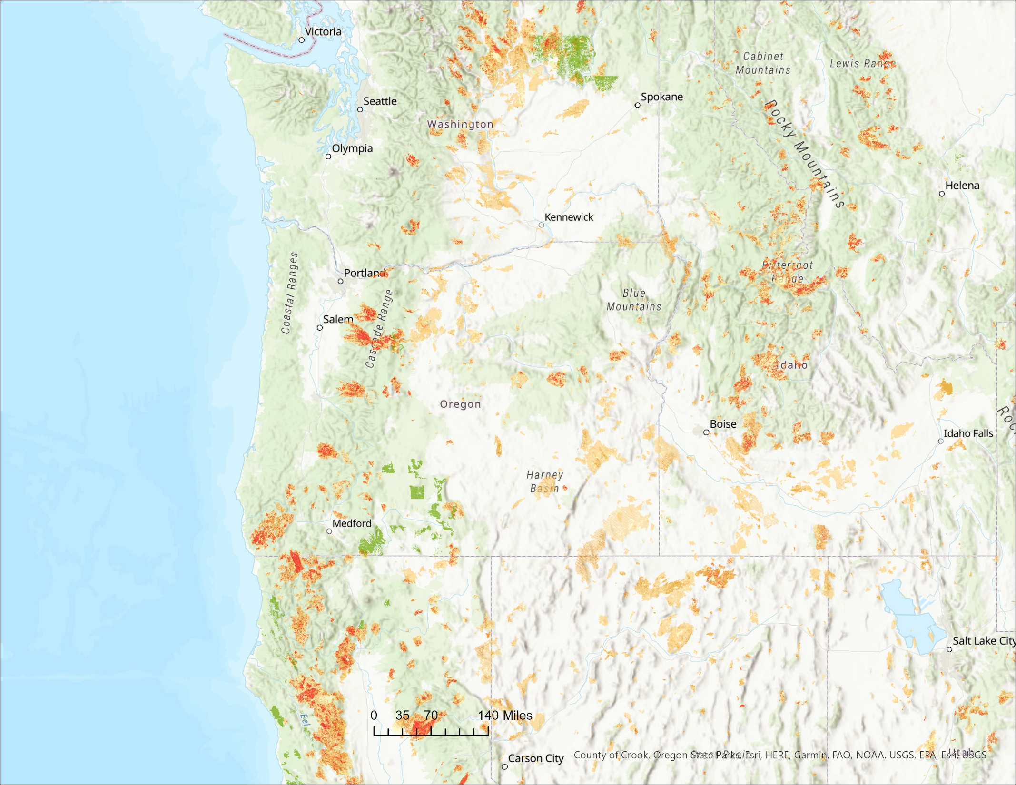
Expanding the extent to cover 10 years (2012-2021) and the West
Note: Oregon’s 2021 (eg Bootleg) data is not yet included

Slide 41
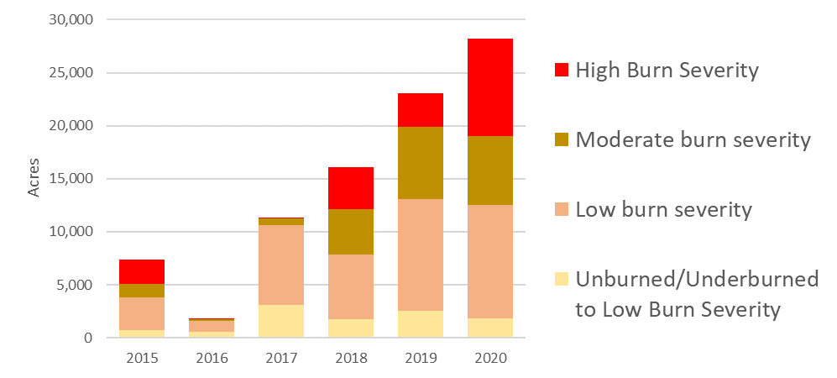

Acres burned by intensity on ARB Projects

Slide 42

Acres burned by intensity on ARB Projects
Project | 2015 | 2016 | 2017 | 2018 | 2019 | 2020
CAFR5038 |  |  |  | 757
CAFR5072 |  |  | 2384 |  |  | 1558
CAFR5076 | 7212 |  |  | 2
CAFR5096 |  |  |  |  |  | 351
CAFR5148 |  |  |  |  |  | 2173
CAFR5150 | 114
CAFR5214 | 23 |  |  |  |  | 15401
CAFR5224 |  |  |  | 1614
CAFR5225 |  | 337 | 2219 | 44 | 20962 | 7321
CAFR5233 |  |  | 563 | 12422 |  | 579
CAFR5234 |  |  |  |  | 252
CAFR5253 |  | 1447 | 6548 | 461 | 1869 | 910
CAFR5283 |  |  |  | 812
Number of projects that have seen a fire

Slide 43
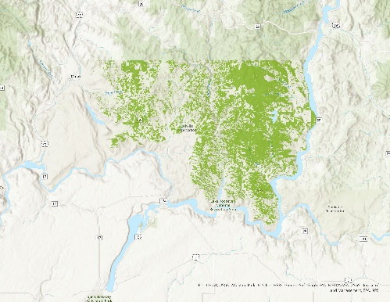
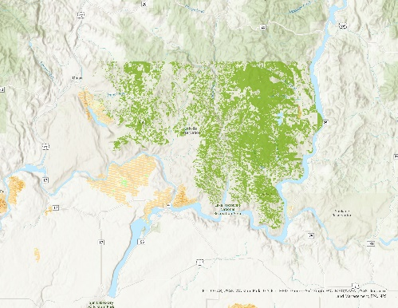

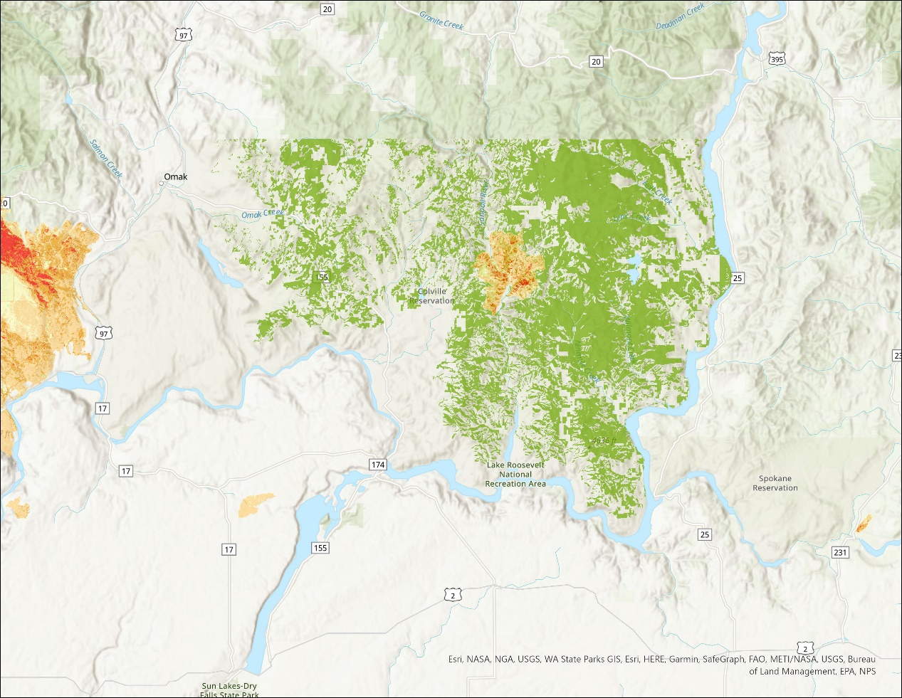

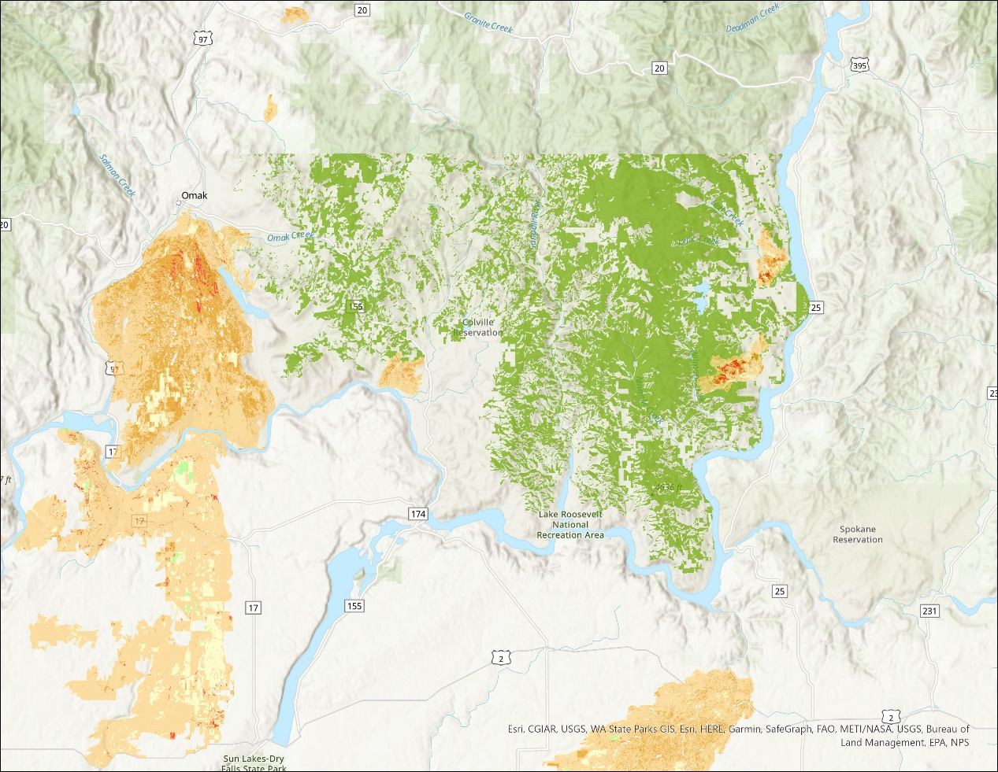
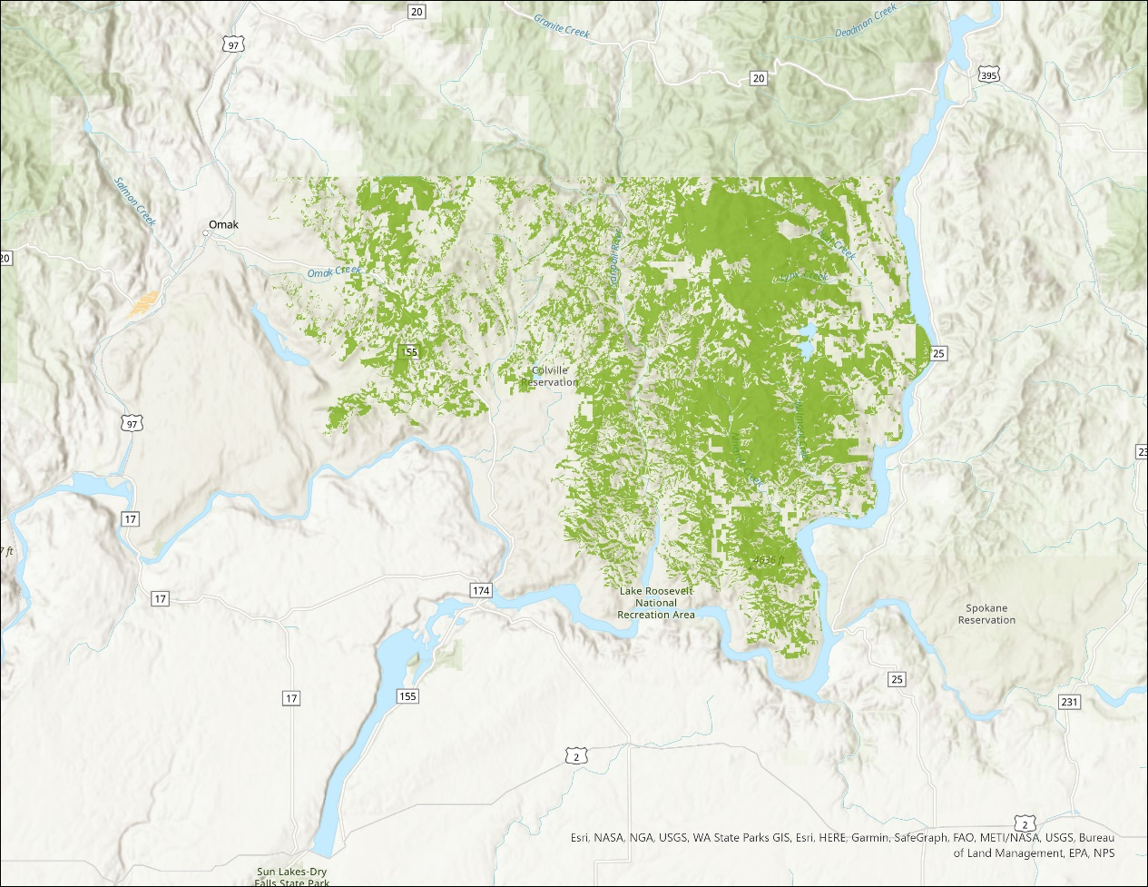

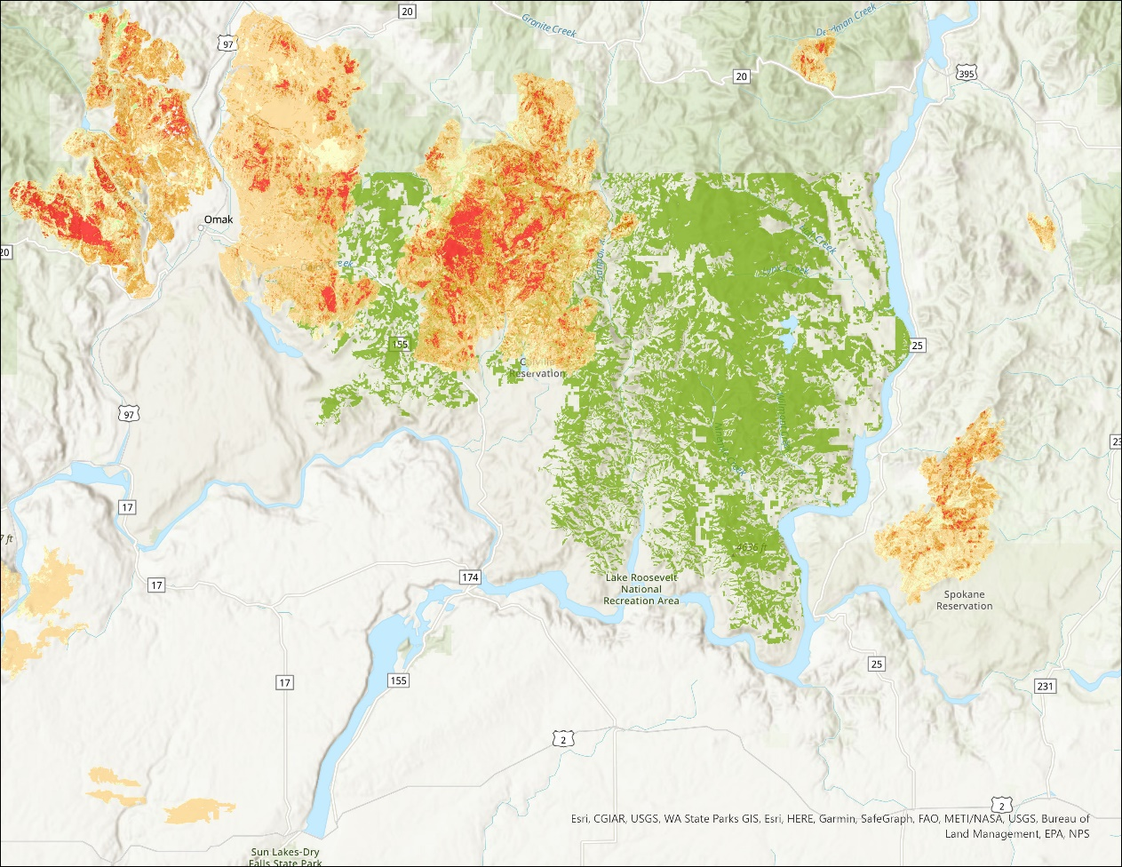


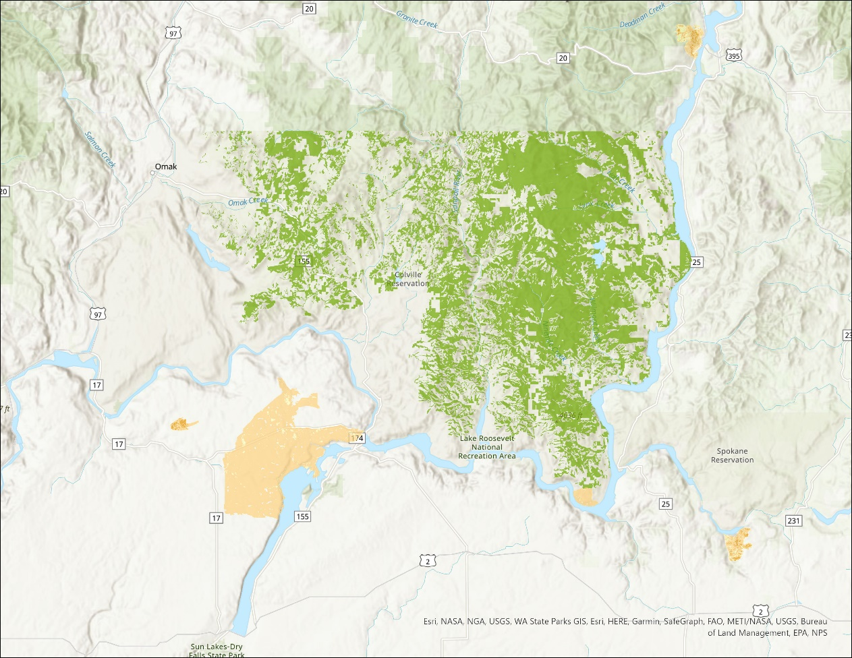
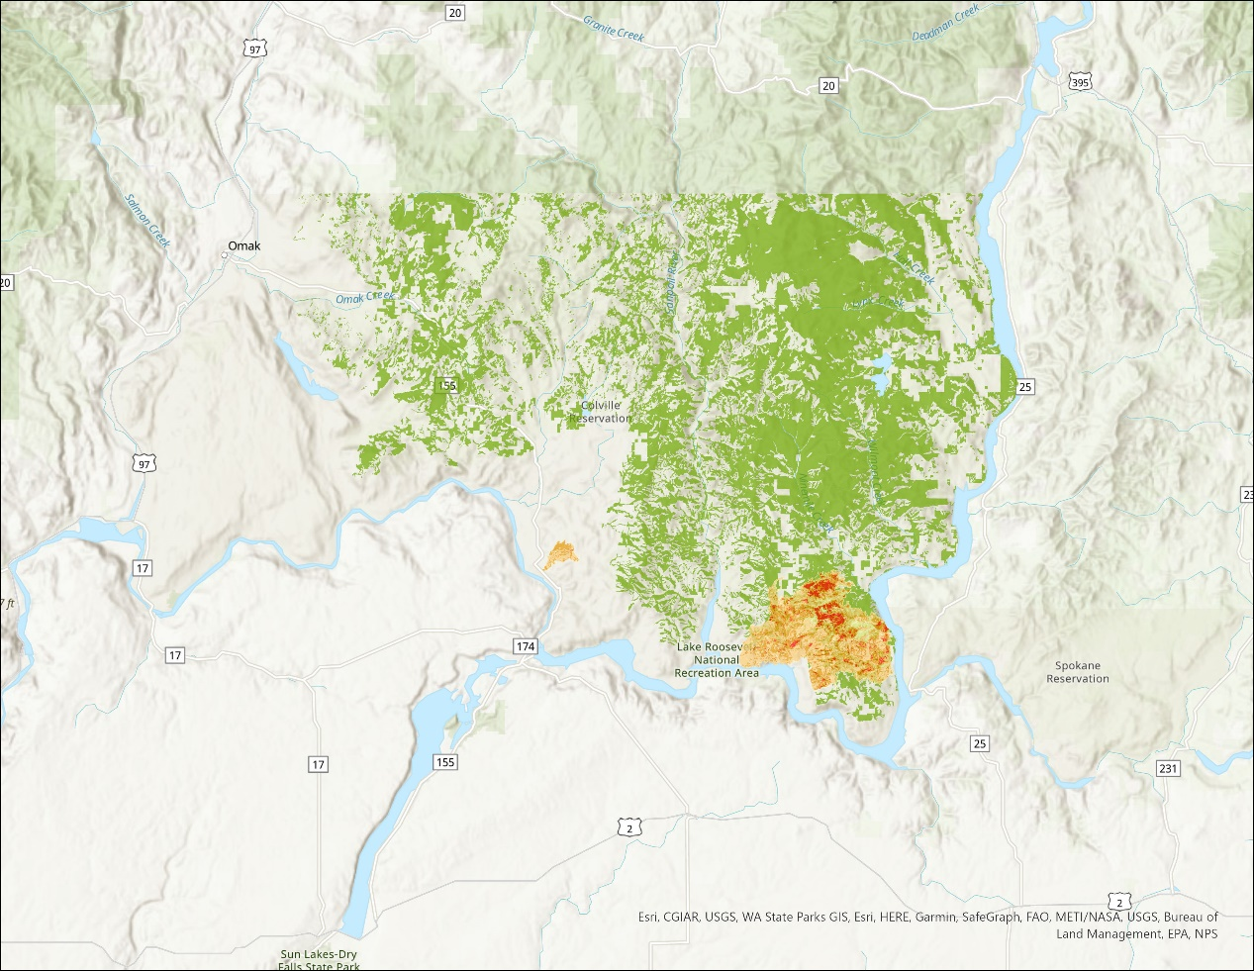
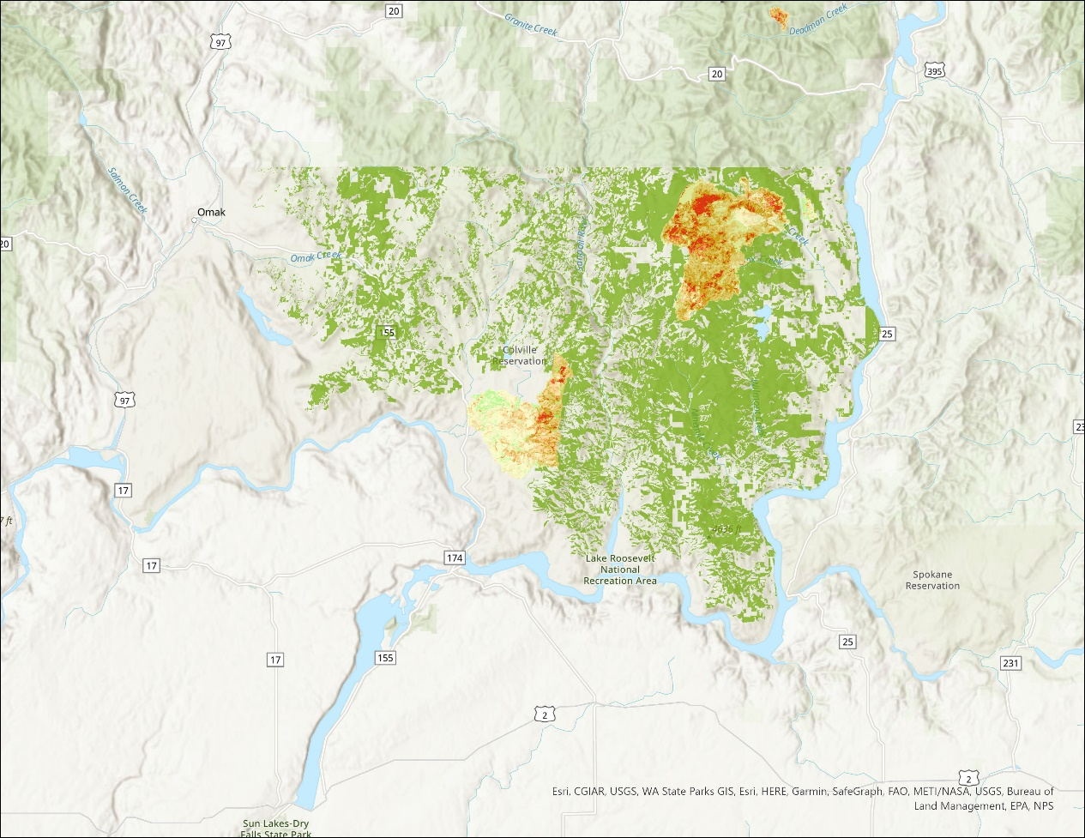
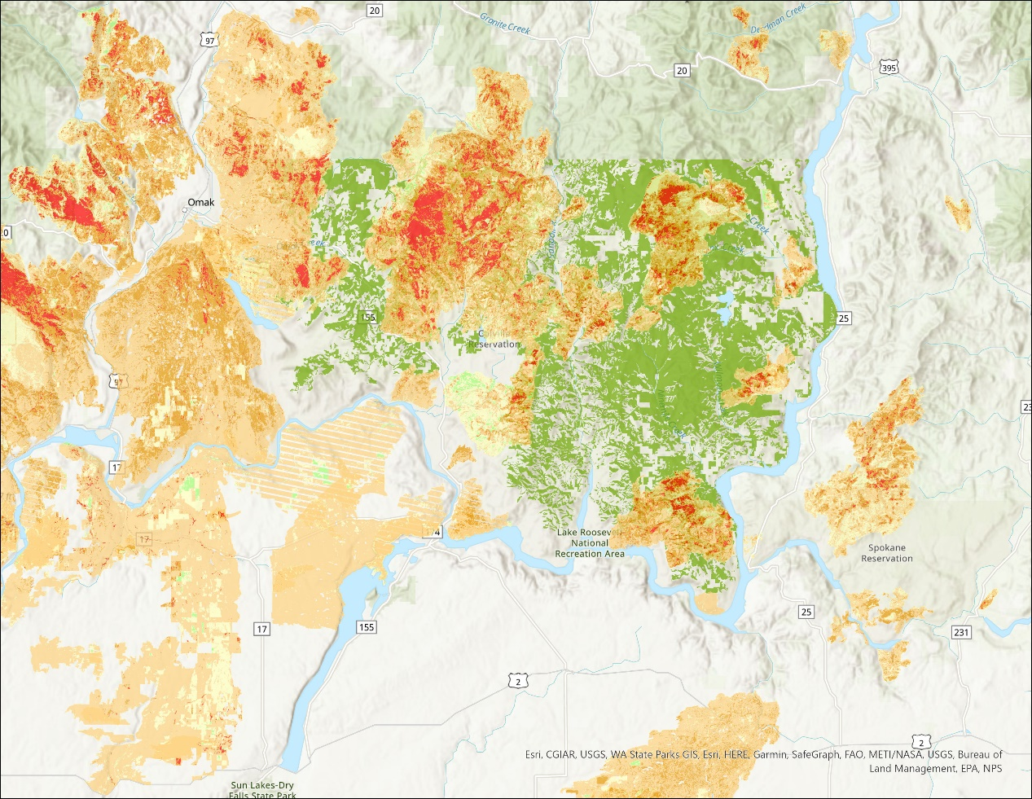




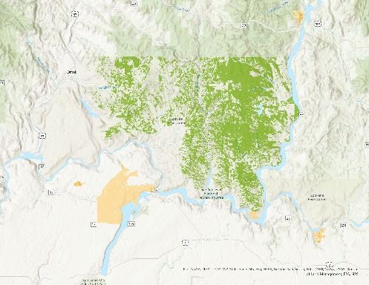
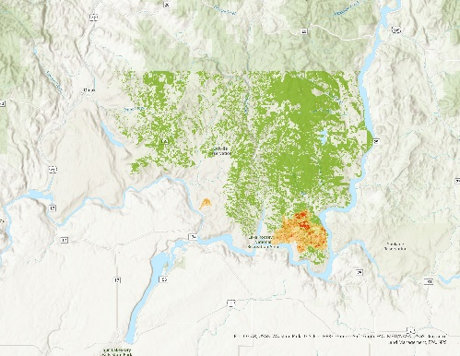



CAFR5225 – 453,027 acres with 2016 start
CAFR5225
2012
2013
2014
2015
2016
 |  | Unburned/Underburned to Low Burn Severity
 |  | Low burn severity
 |  | Moderate burn severity
 |  | High Burn Severity
 |  | Increased Greenness/Increased Vegetation Response
2017
2018
2019
2020
2021
10-Years

Slide 44







CAFR5076 – 11,902 acres with 2014 start 2016 end
CAFR5225
2012
2013
2014
2015
2016
 |  | Unburned/Underburned to Low Burn Severity
 |  | Low burn severity
 |  | Moderate burn severity
 |  | High Burn Severity
 |  | Increased Greenness/Increased Vegetation Response
2017
2018
2019
2020
2021
10-Years

Slide 45

CAFR5224 – 4,044 acres with 2017 start
 |  | Unburned/Underburned to Low Burn Severity
 |  | Low burn severity
 |  | Moderate burn severity
 |  | High Burn Severity
 |  | Increased Greenness/Increased Vegetation Response

Slide 46
Buffer pool
To date: 13 of 150 ARB projects have experienced some sort of fire activity
  1 has been terminated and 1 has withdrawn credits from the buffer pool
  1.4 million retired for unintentional
  0.6 million for intentional
  Most likely these last two years will add to that list
    Colville 0.6 million in 2019 and 3.2 million through July 2021
    Warm Springs ?
    Green Diamond Klamath East ?

Slide 47
CARBON Market research needs
There appears to be a lack of coordination/collaboration between the carbon researchers and carbon practitioners.
  There is even a communication gap (Example BC Forest Carbon SSP, vs IPCC SSP)
What can the research community do to help?
Leakage
  The Brian Murray 20% in entrenched, but not necessarily appropriate
  We can do better (hint: the leakage is not constant, it depends on carbon market participation)
Permanence
  Do we need permanence? (is forestry the problem we are trying to solve?)
  Why 100 years anyway? (would you get better participation and thus emissions reductions with shorter contracts?)

Slide 48

Fast Forward to Now
Same old story:
But worse----
Now we have NCX, FFCP, ACR Canada, CAR Mexico…
  Landowners are confused
  Academia is confused
  Project developers are confused
  Worse yet – offset buyers are confused
Market “watchdogs” are popping up all over
    And they are confused too
Can we simplify

Slide 49
Forest Carbon Markets
Simplify
Don’t focus on stocks – they don’t matter
  Only the interaction with the atmosphere matter
Only 2 Concepts
    Reliability – the emissions reduction (or sequestration) must be additional and that includes onsite and offsite effects (so leakage)
    Durability – they also need to stick around (or we need to account for the project timeframe) through reserve pools or discounting

Slide 50
FCQC Research Priorities (short-term after we finish the leakage work of course)
Harvest Probability Equations
utilizing some localized regression techniques
  so either GWR (betas vary across map) or SAR (error varies across map) –or hopefully not both
Problem is we would need FIA cooperation (location and private owner type)
These could be applied both within an NCX-type program as well as within a ARB-CAR-ACR-VCS-type program (don’t need it for VCS_FFCP)
Risk in Buffer (Reserve) Pool
  First focus on fire
    What have the actual, project emissions
  Maybe next hurricanes

Slide 52

Greg Latta
Director, Policy Analysis Group
glatta@uidaho.edu
e-newsletter and reports
http://www.uidaho.edu/cnr/pag

