Slide 1
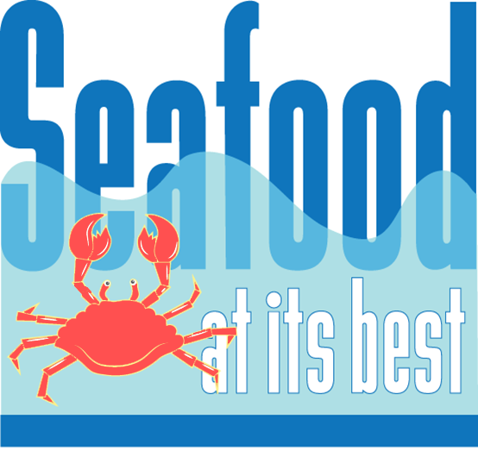


Slide 2
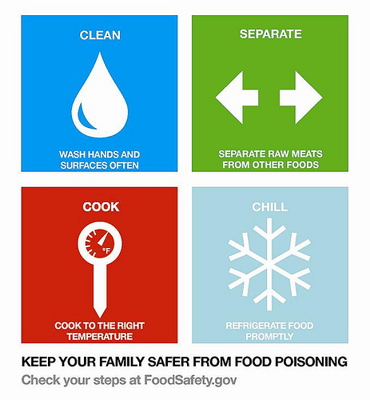
Seafood at Its Best
Lesson 3
Seafood-Borne Illnesses and
Risks From Eating Seafood

Slide 3
Lesson 3
Goals
To gain a better understanding of the potential health risks of eating seafood by covering the following topics:
Microorganisms
Raw seafood
Marine toxins
Allergens
Mercury contamination
Man-made pollutants
“Color added”
Seafood inspection
COOL
Summary
Notes:
Lesson 3 Goals (slide 3)
The goal of lesson 3 is to gain a better understanding of the potential health risks of eating seafood. Lesson 3 covers a broad range of topics. Health risks associated specifically with seafood consumption include bacterial illness associated with eating raw seafood, particularly raw molluscan shellfish, natural marine toxins, and mercury contamination. Risks associated with seafood as well as other foods include microorganisms, allergens, and environmental contaminants (e.g., PCBs).
A section on carotenoid pigments (“color added”) explains the use of these essential nutrients in fish feed for particular species. Dyes are not used by the seafood industry and color is not added to fish—a common misperception among the public. The lesson concludes with a discussion on seafood safety inspection, country of origin labeling (COOL) requirements, and a summary.

Slide 4
Lesson 3
Objectives
Increase knowledge of the potential health risks of eating seafood
Provide context on the potential health risks of eating seafood
Inform participants about seafood safety inspection and country of origin labeling
Notes:
Lesson 3 Objectives (slide 4)
The objectives of lesson 3 are to increase your knowledge of the potential health risks of seafood consumption, to provide context about the potential risks, and to inform you about seafood safety inspection programs and country of origin labeling for seafood required by U.S. law.
Before we begin, I would like you to take a few minutes to complete the pretest.
Instructor: Pass out lesson 3 pretest.

Slide 5
Foodborne Illnesses
Approximately 48 million people suffer foodborne illnesses per year, resulting in 128,000 hospitalizations and 3,000 deaths
Improper holding temperature, inadequate cooking time, and poor sanitation & hygiene are the primary food preparation practices contributing to foodborne illness
Norovirus causes most illnesses, Salmonella causes most hospitalizations and deaths of known pathogens resulting in illness
Notes:
Foodborne Illnesses (slide 5)
Although many people are complacent about foodborne illnesses (old risk, known to science, natural, usually not fatal, and perceived as controllable), the risk is serious. The Centers for Disease Control and Prevention (CDC) estimates 48 million people suffer from foodborne illnesses annually, resulting in about 128,000 hospitalizations and 3,000 deaths. Data from the CDC are limited by underreporting, lack of data, unknown causes, and lack of diagnostic tools. A large majority of foodborne illnesses have unidentified causes or a nonspecific food source (80%).
A foodborne disease outbreak is defined as the occurrence of two or more cases of a similar illness resulting from the ingestion of a common food. Foodborne illness can be caused by any food. The CDC states that raw foods of animal origin (raw meat and poultry, raw eggs, unpasteurized milk, and raw shellfish) are the mostly likely to be contaminated.
The most commonly reported food preparation practice that contributed to foodborne disease was improper holding temperature, known as temperature abuse. The second most commonly reported practice was inadequate cooking time. Poor sanitation and hygiene also contribute to foodborne illnesses. Food obtained from an unsafe source was the least reported factor.
In recent years the percentage of outbreaks and cases attributed to viruses, predominantly norovirus, has increased. This is due to enhanced surveillance of outbreaks and improved viral diagnostic tests. Whereas bacteria were previously responsible for the majority of foodborne illnesses with known causes, norovirus currently causes 58% of foodborne illnesses of known causes.
The association between seafood exposure and illness is considered higher than for other foods because specific symptoms are linked to certain types of seafood and because of the early onset of symptoms. This reinforces reporting of seafood-borne illnesses. Between 1998 and 2002 seafood was attributed to 7.3% and 2.7% of reported foodborne outbreaks and cases, respectively. The three leading causes of foodborne illness from seafood are consumption of contaminated raw molluscan shellfish, scombrotoxin and ciguatera toxin (two naturally occurring marine toxins).

Slide 6
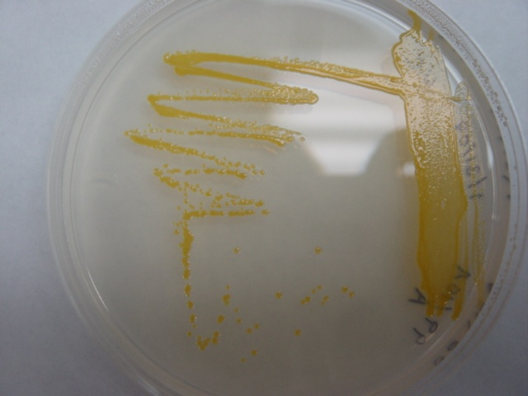
Microorganisms
Norovirus – any seafood product
Salmonella – any seafood product
Listeriosis – ready-to-eat products, smoked fish, seafood salads, pre-cooked products
Botulism – smoked, salted, canned, fermented, vacuum-packed products
Bacteria Culture in a Petri Dish
Notes:
Microorganisms (slide 6)
Microorganisms live everywhere: air, dirt, water, skin, hair, animal fur and plants. Most food safety experts believe improper handling is the leading cause of foodborne illness. Seafood is one of the most perishable foods. Spoilage begins once the animal dies, normal defense mechanisms stop working, and a series of changes caused by bacteria, enzymes, and chemical actions start to cause spoilage.
Norovirus is highly contagious. Norovirus causes acute gastroenteritis; the most common symptoms are diarrhea, vomiting and stomach pain. Anyone can get norovirus. People can become infected by eating food or drinking liquids that are contaminated with norovirus; touching surfaces or objects that are contaminated, and placing their hand in their mouth; and having direct contact with an infected person. To prevent the spread of norovirus practice proper hand hygiene, cook oysters and other shellfish thoroughly before eating them, do not prepare food while infected, clean and disinfect contaminated surfaces. There are no specific treatments, but rehydration is important to replenish fluids lost through vomiting and diarrhea.
Salmonella is an infection caused by Salmonella species bacteria. Symptoms are most severe in the elderly, infants, and people with impaired immune systems. Children are most likely to get salmonellosis. Salmonella can be found in foods such as raw poultry, eggs, and meat. Cross-contamination—preparing food on surfaces or with utensils that previously contained raw meat or meat products contaminated with the bacteria—is a typical means of transmission. Cook poultry, ground beef and eggs thoroughly. Do not eat or drink foods containing raw eggs or unpasteurized milk. Any seafood product is susceptible to Salmonella contamination; however, reported cases of seafood-borne salmonellosis are rare. Proper sanitation, through cooking of seafood , and keeping raw and cooked seafood separate to avoid cross-contamination can prevent contamination by Salmonella bacteria.
Listeriosis caused by the bacteria Listeria monocytogenes is typically in raw or processed foods that have extended shelf lives at chill temperatures (ready-to-eat products), such as smoked fish and cooked crab, shrimp, or lobster. This bacterium is ubiquitous in the general environment, but not typical of aquatic environments. Proper sanitary practices and cooking temperature (an internal temperature of 145° F) are the primary methods of control. However, for ready-to-eat products the key to handling them is to keep them cold, below 40° F, keep them clean (no raw food drips, splashes or contact), and use as soon as possible. For persons at higher risk, such as pregnant women, persons with weaken immune systems and older adults – do not eat refrigerated smoked seafood, unless it is contained in a cooked dish or unless it is a canned or shelf-stable product. Refrigerated smoked seafood is often labeled as “nova-style,” “lox,” “kippered,” “smoked,” or “jerky.” These products are usually found in the refrigerator section or sold at seafood and deli counters.
Botulism is an extremely rare but serious illness caused by the botulinum toxin. There are about 22 cases of foodborne botulism per year, mostly caused by home-canned foods. The botulinum toxin is destroyed by heat processing (boiling for 10 minutes). Botulism usually is the result of previously cooked and ready-to-eat foods that have not been properly heat processed, especially home-canned foods with low acid contents. Seafood products that may be susceptible to foodborne botulism include semi-preserved products such as smoked, salted, canned, and fermented seafood.

Slide 7

Raw Seafood
Risk of Illness
Risk of illness excluding raw seafood is 1 per million servings
Risk of illness including raw
seafood is 1 per 250,000
servings
Purchase from reputable
dealers
Notes:
Raw Seafood: Risk of Illness (slide 7)
Some seafood is traditionally eaten raw (oysters and clams on the half shell). In recent years other raw products from different cultures, such as ceviche (citrus-marinated seafood), sashimi (thinly sliced seafood), and sushi (sashimi served with vinegared rice), have become more popular in the U.S.
Eating raw foods is significantly riskier than eating properly cooked foods. The risk of illness from eating seafood, excluding raw seafood, is 1 per 1,000,000 servings. When raw seafood is included the risk increases to 1 per 250,000 servings. Raw or partially cooked seafood may contain pathogens that would normally be killed by fully cooking before eating.
Pregnant women, young children, older adults, immuno-compromised individuals, and individuals with decreased stomach acidity should not eat raw or partially cooked seafood.
Disease-causing bacteria and viruses do not normally occur in the muscle of fish, the part usually eaten; however, fillets, steaks, and portions can become contaminated by improper handling. Use only high-quality or sushi grade products and purchase from reputable dealers who have high standards for quality and sanitation. If you harvest shellfish yourself, obey all posted warnings and verify with local authorities that the waters are certified for shellfish harvesting.

Slide 8
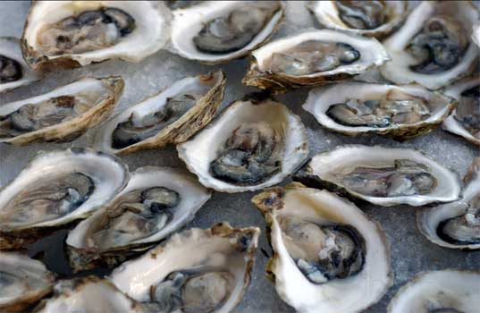
Raw Molluscan Shellfish
Commonly refers to oysters, clams, and mussels
Shellfish harvest waters are regulated under the National Shellfish Sanitation Program
Any protein food eaten raw carries greater risk of illness than cooked food
Notes:
Raw Molluscan Shellfish (slide 8)
Raw molluscan shellfish (oysters, clams, and mussels) can contain disease-causing bacteria and viruses. These animals are filter-feeders, obtaining their food from pumping water through their digestive system and filtering out small organisms. As they filter-feed, they may collect bacteria and viruses from the waters in which they live. Thus, potential health risks associated with eating raw molluscan shellfish usually are directly related to the quality of the water in which they live.
Always buy clams, oysters, and mussels from a reputable dealer. Use caution when harvesting shellfish yourself. Obey posted warnings and check with local authorities, such as your state environmental quality agency, to verify the waters are certified for shellfish harvesting. Don’t eat dead shellfish whose shells don’t close tightly when tapped or agitated. Handle and store shellfish properly (see lesson 4).

Slide 9
National Shellfish Sanitation Program (NSSP)
Federal, state, industry cooperative program to ensure safe molluscan shellfish
Sanitary control; classification of growing areas; harvesting restrictions; tags with the proper certificate number on each package; records that show origin and disposition of shellfish
FDA conducts an annual review of each state shellfish control program to ensure conformity with the NSSP
Notes:
National Shellfish Sanitation Program (slide 9)
The Food and Drug Administration and shellfish-producing states regulate shellfish harvest waters under the National Shellfish Sanitation Program (NSSP). This program sets water quality standards under which shellfish may be grown and requires regular testing. The program is designed to ensure shellfish are harvested from certified waters and meet safety standards.
As part of sanitary control, growing waters are classified according to their suitability for safe shellfish harvesting. This includes harvest restrictions if water quality is not within sanitary compliance criteria. Harvested shellfish must be properly tagged to document the shellfish were harvested from approved waters. Records are also kept to document the origin and disposition of shellfish.
FDA conducts an annual review of each state’s shellfish control program to ensure conformity with the NSSP. This program has helped protect consumers for many years, and large amounts of raw clams, mussels, and oysters are consumed without incident.

Slide 10
Vibrio vulnificus in Raw Molluscan Shellfish
Bacteria that can sicken or kill at-risk people who eat raw
oysters or clams
V. vulnificus does not change appearance, taste, or
odor of shellfish
Naturally found in coastal waters
Cooking to 145° F kills the bacteria
Notes:
Vibrio vulnificus in Raw Molluscan Shellfish (slide 10)
Vibrio vulnificus is a bacteria that can cause severe illness or death in at-risk individuals who eat raw molluscan shellfish. Because of this restaurants post warnings, especially for customers with certain health conditions. Cooking molluscan shellfish thoroughly will kill the bacteria.
V. vulnificus occurs naturally in warm coastal waters such as the Gulf of Mexico where levels of the bacteria are elevated during the summer months. It is not a result of pollution and does not alter the appearance, taste, or odor of shellfish. Infection can also occur when open wounds come in contact with the bacteria in seawater.
The Vibrio family of bacteria is indigenous to most coastal environments. The two species of concern are Vibrio vulnificus and V. parahaemolyticus. Illness results from eating raw molluscan shellfish contaminated with the bacteria. Unlike V. vulnificus, V. parahaemolyticus can infect healthy people. However, severe disease is rare. Infections of V. parahaemolyticus result mostly from eating raw oysters. Crabs, shrimp, and crayfish cross-contaminated with raw and previously cooked products also have contributed to infections.
Thorough cooking to 145° F will kill the bacteria. For shellfish in the shell, either boil until the shells open and continue boiling for 5 more minutes, or steam the shells open and then continue cooking for 9 more minutes. Do not eat shellfish that do not open during cooking. Boil shucked oysters at least 3 minutes, or fry them in oil at least 10 minutes at 375° F.

Slide 11
Who Should Never Eat
Raw Shellfish?
People who suffer from:
Liver disease
Alcoholism
Cancer
AIDS or HIV infection
Inflammatory bowel disease
Steroid dependency
Chronic kidney disease
Diabetes
Gastric disorders
Weakened immune system
Abnormal iron metabolism (hemochromatosis)
Notes:
Who Should Never Eat Raw Shellfish? (slide 11)
Vibrio vulnificus rarely affects healthy people. However, those at risk should simply never eat raw molluscan shellfish. People at risk of serious illness or death if they eat raw molluscan shellfish include those having any of the following conditions:
Liver disease (from hepatitis, cirrhosis, alcoholism, or cancer)
Iron overload disease (hemochromatosis)
Diabetes
Cancer (including lymphoma, leukemia, Hodgkin’s disease)
Stomach disorders
Any illness or medical treatment that weakens the body’s immune system

Slide 12
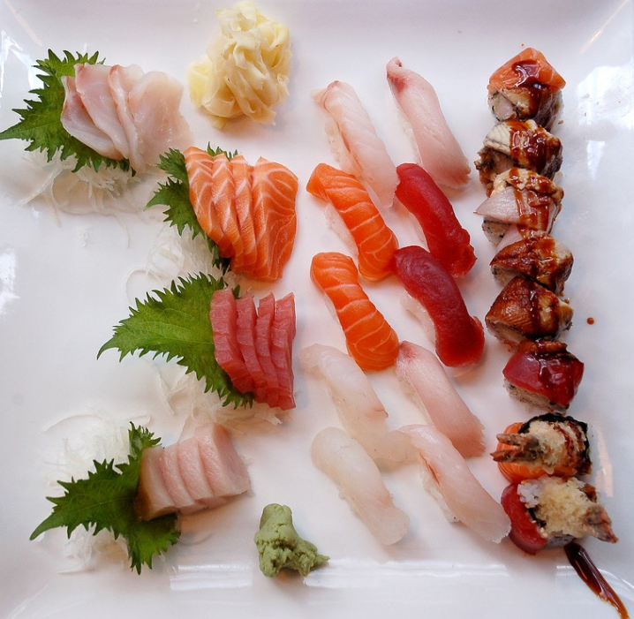
Raw Finfish
Risk of parasitic infection is rare
Adequate freezing eliminates
infection by parasites
Use commercially frozen fish to
prepare raw fish dishes such as
sashimi, sushi, ceviche, and gravlax
Alternatively, freeze fish to
internal temperature of -4° F for at least 7 days
Home freezers may not be cold enough
“Sushi in NYC” by Vladislav Bezrukov
Notes:
Raw Finfish (slide 12)
Parasites can occur in all living organisms, including fish. It is a natural occurrence; a part of nature. They are as common in fish as insects are in fruits and produce. Parasites are not a health concern in thoroughly cooked fish.
The risk of parasitic infection from raw fish is rare, but is a potential safety concern whenever raw fish such as sashimi, sushi, ceviche, and gravlax are consumed. The seafood industry uses a technique called candling to detect and remove parasites. Even with due diligence not all parasites may be found.
Although preparing raw fish dishes at home is not encouraged, it is best to use commercially frozen fish to minimize the risk of parasitic infection. Adequate freezing can eliminate potential infection from parasites. Commercial freezers are colder than home freezers. During commercial freezing fish are frozen solid at a temperature of -35° F or below for at least 15 hours to kill any parasites present. Alternatively, freeze and store at home at a temperature of -4°F or below for a minimum of 7 days. Home freezers are usually between 0° F and 10° F and may not be cold enough to kill any parasites present. Check your home freezer with a thermometer.
The health risk from parasites is far less than the risk from “unseen” illness causing bacteria which are present in almost all foods.
Gravlax is a Swedish specialty of raw salmon (usually - other fatty fish can be used) cured in a salt-sugar-dill mixture.

Slide 13
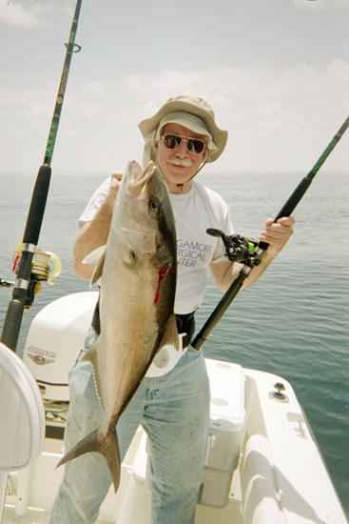
Marine Toxins
Naturally occurring chemicals contaminate certain seafoods
Contaminated seafood frequently smells, looks, and tastes normal
Ciguatera fish poisoning is usually the result of eating contaminated sport-caught marine fish
Notes:
Marine Toxins (slide 13)
Marine toxins are naturally occurring chemicals that can contaminate certain seafoods. It can be virtually impossible to identify seafood contaminated with marine toxins because contaminated seafood frequently looks, smells, and tastes normal.
Some species of naturally occurring microscopic marine algae (phytoplankton) can produce toxins that can cause illness in people. These toxins can accumulate in fish and shellfish that feed on the marine algae. As larger fish eat smaller fish these toxins bioaccumulate up the food chain resulting in higher levels in fish at the top of the food chain.
People can become ill by eating naturally contaminated fish and shellfish, such as clams, oysters, mussels, the internal organs of crabs and lobsters, or certain species of fish harvested in waters where toxin producing marine algae have bloomed. Another toxin, scombrotoxin, is the result of temperature abuse of certain fish species after they are caught.
The most common diseases caused by marine toxins in the U.S., in order of incidence, are scombroid fish poisoning, ciguatera poisoning, paralytic shellfish poisoning, neurotoxic shellfish poisoning, amnesic shellfish poisoning, and diarrhetic shellfish poisoning. Ciguatera fish poisoning usually results from eating contaminated sport-caught marine fish rather than commercially caught fish.
About 30 cases per year of marine toxin poisoning are reported in the U.S. Because healthcare providers are not required to report these illnesses and because many milder cases are not diagnosed or reported, the actual number of poisonings may be much higher.

Slide 14
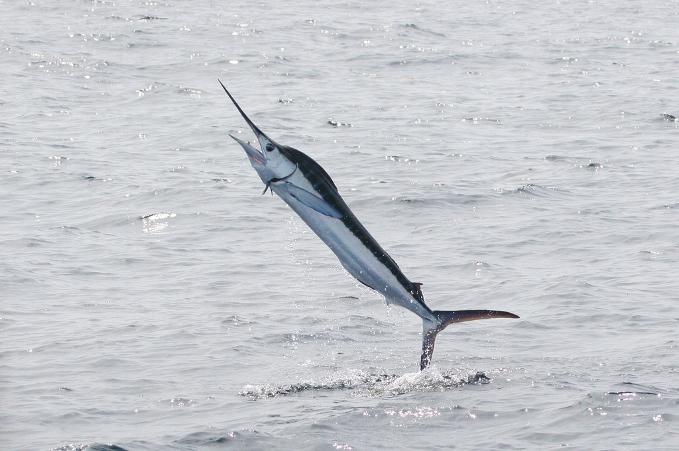
Scombroid Toxin
Scombroid toxin – most common in tuna, mahi-mahi, marlin, and bluefish
Bacterial spoilage allows histamine
to form, which may cause allergic
reaction
Toxin not destroyed by cooking
From 1998-2002, 35% of
foodborne outbreaks due to fish caused by scombroid toxin
“White Marlin in North Carolina” by Dominic Sherony
Notes:
Scombroid Toxin (slide 14)
Scombroid fish poisoning is caused by bacterial spoilage due to temperature abuse of certain fish, such as tuna, mahi-mahi, marlin, and bluefish. Bacterial spoilage of these species results in the production of byproducts such as histamine and other substances that block histamine breakdown. Spoilage bacteria grow rapidly when these fish are exposed to high temperatures for an extended period of time. This food safety hazard can be prevented by keeping these fish cold (below 40° F) on ice or under refrigeration from the time they are caught until they are eaten.
Eating spoiled fish having high levels of histamines can cause allergic-type reactions. Symptoms can include rash, diarrhea, flushing, sweating, headache, and vomiting. Symptoms begin from within minutes of eating the fish to a couple of hours later. Burning or swelling of the mouth, abdominal pain, or a metallic taste may also occur. The majority of patients have mild symptoms that resolve within a few hours.
Treatment is generally unnecessary, but antihistamines or epinephrine may be needed in certain instances. The toxin is not destroyed by cooking. From 1998 to 2002, 35% of foodborne disease outbreaks due to fish were caused by scombroid poisoning.

Slide 15
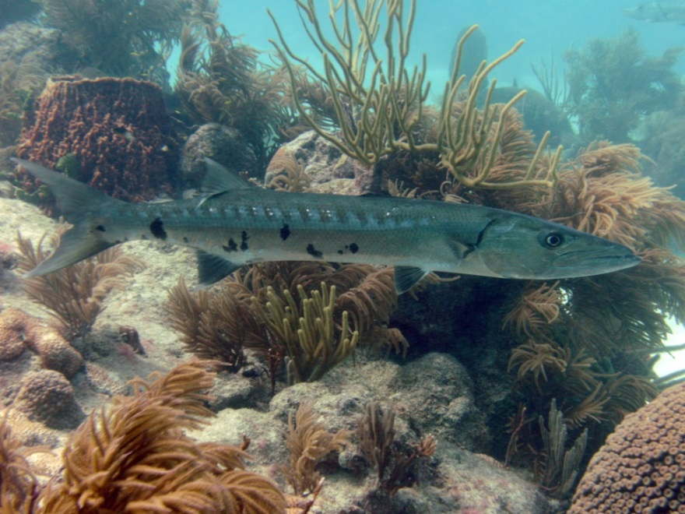
Ciguatera Toxin
Ciguatera toxin – tropical reef fish such as barracuda, amberjack, snapper, and grouper
Caused by marine algae
that fish eat
Toxin not destroyed by
cooking
From 1998-2002, 25% of foodborne outbreaks due to fish caused by ciguatera
“Side View Barracuda” by Amanderson2
Notes:
Ciguatera Toxin (slide 15)
Ciguatera poisoning is caused by eating contaminated tropical reef fish. Barracuda are commonly associated with ciguatera poisoning, but other reef species such as amberjack, snapper, and grouper have caused the disease.
The ciguatera toxin is produced by microscopic marine plants called dinoflagellates. The toxin is concentrated as it moves up the food chain from small fish to large predatory tropical reef fish. Species that inhabit the oceans between latitudes 35° north and 35° south have caused the disease.
Common symptoms include nausea, vomiting, diarrhea, cramps, excessive sweating, headache, and muscle aches. Symptoms usually occur from within minutes to 30 hours after eating contaminated fish. The sensation of burning or "pins-and-needles," weakness, itching, and dizziness can occur. Patients may experience reversal of temperature sensation in their mouth (hot surfaces feeling cold and cold, hot), unusual taste sensations, nightmares, or hallucinations. Ciguatera poisoning is rarely fatal. Symptoms usually clear in 1 to 4 weeks.
The toxin is not destroyed by cooking. From 1998 to 2002, 25% of foodborne disease outbreaks due to fish were caused by ciguatera poisoning.

Slide 16
Marine Toxins
Diagnosis and Treatments
Diagnosis based on symptoms and recent history of eating specific kind of seafood
Few treatments; antihistamines and epinephrine sometimes used for scombroid poisoning
Rare long-term consequences; amnesic shellfish poisoning can lead to long-term problems with short-term memory
Every year ~ 30 cases reported in U.S.
Notes:
Marine Toxins: Diagnosis and Treatments (slide 16)
Diagnosis of marine toxin poisoning usually is based on symptoms and a recent history of eating a specific kind of seafood. Few specific treatments are available for marine toxin poisoning. Two are antihistamines and epinephrine, which can be used for scombroid poisoning. Intravenous mannitol has been suggested for the treatment of severe ciguatera poisoning.
Marine toxin poisoning rarely has long-term consequences. Amnesic shellfish poisoning has resulted in long-term loss of short-term memory.
About 30 cases of marine toxin poisoning are reported in the U.S. each year, mainly during the summer months. The actual number of poisonings may be higher.

Slide 17
Avoiding Marine Toxins
Keep mahi-mahi, tunas, bluefish, mackerel, amberjack, and sardines refrigerated to prevent the development of histamine
Do not eat barracuda, especially from the Caribbean
Check for local advisories before collecting shellfish or catching reef fish
Do not eat seafood sold specifically as bait
Always buy from a reputable dealer
Notes:
Avoiding Marine Toxins (slide 17)
To avoid marine toxin poisoning:
Keep tuna, mackerel, grouper, bluefish, and mahi-mahi refrigerated or iced to prevent spoilage and development of histamine (<40° F).
Do not eat barracuda, especially from the Caribbean.
Check with local health officials before collecting shellfish or catching reef fish, and look out for health department advisories for algal blooms such as “red tides.”
Do not eat seafood that is sold specifically as bait.
Always buy all seafood, especially shellfish, from a reputable dealer.

Slide 18
Allergens
Fish and crustaceans can cause allergic reactions in some people
Any food containing any of the major food allergens must be properly labeled
If you are allergic to a food, avoid that food and read food labels
An allergy to one type of seafood does not mean the individual is allergic to all seafood
Notes:
Allergens (slide 18)
Food allergies can range from merely irritating to life-threatening. Food allergies affect about two per­cent of adults and four to eight per­cent of children in the United States. Children with food allergies are more likely to have asthma, eczema, and other types of allergies.
There is no cure for food allergies. The best way for consumers to protect themselves is by avoiding food items that will cause a reaction. A food allergy is a specific type of adverse food reaction involving the immune system. The body produces what is called an allergic, or immunoglobulin antibody to a food. Once a specific food is ingested and binds with the antibody, an allergic response ensues.
A food allergy should not be confused with a food intolerance or other non-allergic food reactions. Various epidemiological surveys have indicated that almost 80 percent of people who are asked if they have a food allergy respond that they do when, in fact, they do not have a true immunoglobulin-mediated food allergy. Food intolerance refers to an abnor­mal response to a food or additive, but it differs from an allergy in that it does not involve the immune sys­tem. For example, people who have recurring gastrointestinal problems when they drink milk may say they have a milk allergy. But they really may be lactose intolerant.
A major food allergen is defined as one of the following foods or food groups, or is an ingredient that con­tains protein derived from one of the following foods or food groups: milk, eggs, peanuts, tree nuts (almonds, wal­nuts, and pecans), soybeans, wheat, fish, and crustaceans (crab, lobster, and shrimp). These foods or food groups account for 90 percent of all food allergies in the United States.

Slide 19
Mercury
Occurs naturally and is also released into the atmosphere from industrial pollution
Bacteria in water transform mercury into methylmercury, which fish absorb as they feed
Methylmercury levels are higher in larger, longer-lived predatory fish, such as Shark, Swordfish, King Mackerel and Tilefish from the Gulf of Mexico
Notes:
Mercury (slide 19)
Mercury is an environmental contaminant that occurs naturally. It also is released into the environment from industrial pollution. Mercury exists in three basic forms, each of which differs in bioavailability and toxicity: the metallic element, inorganic salts, and organic compounds (methylmercury). Methylmercury is the most toxic form of mercury for humans. It is not the same type of mercury found in some thermometers or dental amalgam.
Microorganisms transform mercury deposited in the sediments of rivers, lakes, and the ocean into the organic compound methylmercury through a natural process called methylation. Methylmercury is absorbed by fish as they feed and bioaccumulates up the food chain as larger fish eat smaller fish. Larger, longer-lived predatory fish have higher levels of methylmercury than smaller and younger fish. Most of the popular species of fish and shellfish consumed in the U.S. have been shown to have very low levels of mercury. Seafood choices that are very low in mercury include: salmon, rainbow trout, catfish, sardines, pollock, flounders, cod, tilapia, shrimp, oysters, clams, scallops and crab. There is good evidence that the benefits associated with eating these species and most types of seafood outweigh the small risk associated with mercury for most people.

Slide 20
Health Risks from Mercury
Effects depend on dose, age of person, duration of exposure, route of exposure, and health of person exposed
At high levels can harm brain, heart, kidneys, lungs, and immune system
Nervous system damage (crosses blood-brain barrier and placenta)
  Learning impairment, developmental delays
Notes:
Health Risks from Mercury (slide 20)
Adverse health effects of any toxin, including mercury, depend on the dose, the age of the person exposed, the duration and route of exposure, and the health of the person exposed. Exposure to high levels of mercury can harm the brain, heart, kidneys, lungs, and immune system. The toxic effects of mercury poisoning were documented in two key incidents. One, more than 50 years ago when mercury from factories discharging into Minimata Bay, Japan contaminated the environment. And two, in Iraq where farmers mistakenly used mercury treated seed grain to make bread. In Japan the mercury poisoning resulted in severe illness, called Minimata disease, in the local population. As a result of these incidents, FDA and other world health organizations have established limits for the allowable amount of methylmercury in foods between 0.5 to 1.0 parts per million (ppm).
As a result of the pollution in Minimata Bay levels of mercury in local fish were as high as 50 ppm, some 100 times higher than is present in most oceanic fish commercially available today. Since the Japan incident, no mercury poisoning from fish consumption has been reported in the scientific literature. The general population is not exposed to those high levels observed in Japan.
The greatest concern is whether chronic methylmercury exposure in a developing fetus is associated with subtle adverse health outcomes such as learning impairments and developmental delays. The developing central nervous system of the fetus is very sensitive to methylmercury exposure.
Other symptoms of high levels of mercury poisoning include numbness or tingling in the hands or feet or around the mouth. There may also be problems affecting vision and hearing.

Slide 21
2004 FDA and EPA
Joint Mercury Advisory
FDA/EPA advisory for women who may become pregnant, are pregnant, nursing mothers, and parents of young children
Seafood is an important part of a healthy diet:
  High-quality protein
  Omega-3 fatty acids, low in saturated fat
  Contributes to a healthy heart
  Proper growth & development of children
Notes:
FDA and EPA Joint Mercury Advisory (slide 21)
Nearly all seafood contains minute traces of mercury. For most people, the risk from mercury through seafood consumption is not a health concern. Some seafoods do contain higher levels of mercury that may harm a fetus or young child’s developing nervous system. The risks from mercury depend on the amount of seafood eaten, the levels of mercury in the seafood, and population group.
Therefore, the U.S. Food and Drug Administration and the U.S. Environmental Protection Agency jointly issued in March 2004 a mercury advisory specifically for women who might become pregnant, women who are pregnant, nursing mothers, and young children to avoid certain types of fish and to eat fish and shellfish that are lower in mercury. In addition to the warning about mercury, FDA and EPA stated for the first time in a mercury advisory that seafood is an important part of a healthy diet. Specifically, seafood is a high-quality protein, contains omega-3 fatty acids, is low in saturated fat, contributes to a healthy heart, and contributes to the proper growth and development of children.
A Joint Food and Agriculture Organization and World Health Organization Expert Consultation on the Risks and Benefits of Fish Consumption report published in 2010 stated in their recommendations to Member States to, “emphasize the net benefits to offspring of women of childbearing age who consume fish, particularly pregnant and nursing mothers, and the neurodevelopmental risks to offspring of women of childbearing age who do not consume fish.”

Slide 22
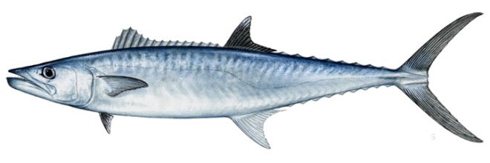
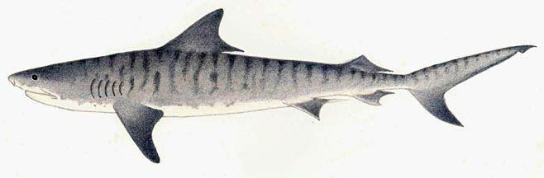
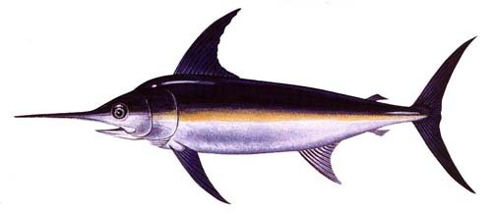
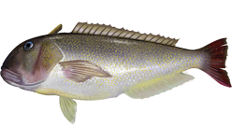
Mercury Advisory for
High-Risk Group
Do not eat Shark, Swordfish, King Mackerel, or Tilefish from the Gulf of Mexico
Eat up to 12 ounces/week of a variety of seafood low in mercury
  Shrimp, canned light tuna, salmon, pollock and catfish
  Eat up to 6 ounces/week albacore (white) tuna
Check advisories for local waters for sport-caught fish
Notes:
Mercury Advisory for High-Risk Group (slide 22)
The advisory provides three recommendations for selecting and eating seafood that enable these groups to receive the net health benefits of eating seafood yet have confidence they have reduced their exposure to mercury below harmful levels.
Do not eat shark, swordfish, king mackerel, or tilefish from the Gulf of Mexico because they contain high levels of mercury.
Eat up to 12 ounces (about 2-3 meals) a week of a variety of fish and shellfish lower in mercury. Five of the most commonly eaten seafoods low in mercury are shrimp, canned light tuna, salmon, pollock, and catfish (other choices not listed by the FDA/EPA include farmed rainbow trout, tilapia, clams, scallops, oysters). Albacore (white) tuna has more mercury than canned light tuna, so when choosing two meals of seafood per week, only one should be albacore tuna.
Check local advisories about the safety of fish caught in local water bodies (EPA http://water.epa.gov/scitech/swguidance/fishshellfish/fishadvisories/index.cfm/ or state environmental quality agency). If no advice is available, eat up to 6 ounces per week of fish caught in local waters, but do not consume any other fish that week.
Tilefish

Slide 23
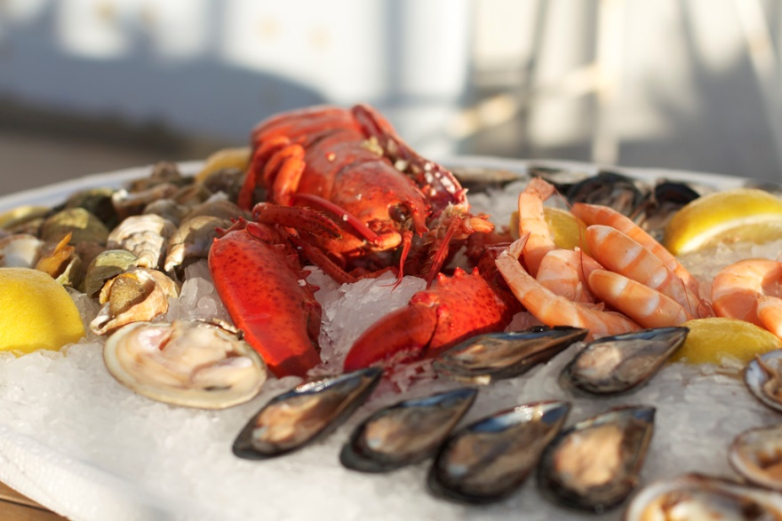
Recommendation
Majority of population does not eat enough seafood, especially fatty fish, to obtain health benefits
2010 Dietary Guidelines
encourages all to eat more
seafood
Eat a variety of seafood
If you are in the high-risk
population follow the
FDA/EPA advisory for mercury
“Champagne Seafood Delight” by Rob Taylor
Notes:
Recommendation (slide 23)
The Dietary Guidelines for Americans, 2010 states, “mean intake of seafood in the U.S. is approximately 3 ½ ounces per week, and increased intake is recommended. Seafood contributes a range of nutrients, notably the omega-3 fatty acids, eicosapentaenoic acid (EPA) and docosahexaenoic acid (DHA). Moderate evidence shows that consumption of about 8 ounces per week of a variety of seafood, which provide an average consumption of 250 mg per day of EPA and DHA, is associated with reduced cardiac deaths among individuals with and without pre-existing cardiovascular disease. Thus, this recommendation contributes to the prevention of heart disease. The recommendation is to consume seafood for the total package of benefits that seafood provides, including its EPA and DHA.”
For the general population the guidelines recommend an intake of 8 or more ounces per week (less for young children), about 20% of total recommended intake of protein foods of a variety of seafood.
Further, the nutritional value of seafood is of particular importance during fetal growth and development, as well as in early infancy and childhood. There is moderate evidence that eating at least 8 ounces of seafood per week for women who are pregnant or breastfeeding is associated with improved infant health outcomes, such as visual and cognitive development. Thus the guidelines recommend that women who are pregnant or breastfeeding eat at least 8 and up to 12 ounces of a variety of seafood per week, from choices that are lower in methylmercury. They should also avoid the 4 types of fish high in methylmercury (shark, swordfish, king mackerel, and tilefish from the Gulf of Mexico and limit white (albacore) tuna to 6 ounces per week. Peak benefits occur between 8 – 12 ounces per week, it is not a limit which differentiates safe versus unsafe.
Seafood varieties commonly consumed in the U.S. that are higher in EPA and DHA and lower in mercury include salmon, trout, anchovies, herring, sardines, Pacific oysters, and Atlantic & Pacific mackerel (not king mackerel)

Slide 24
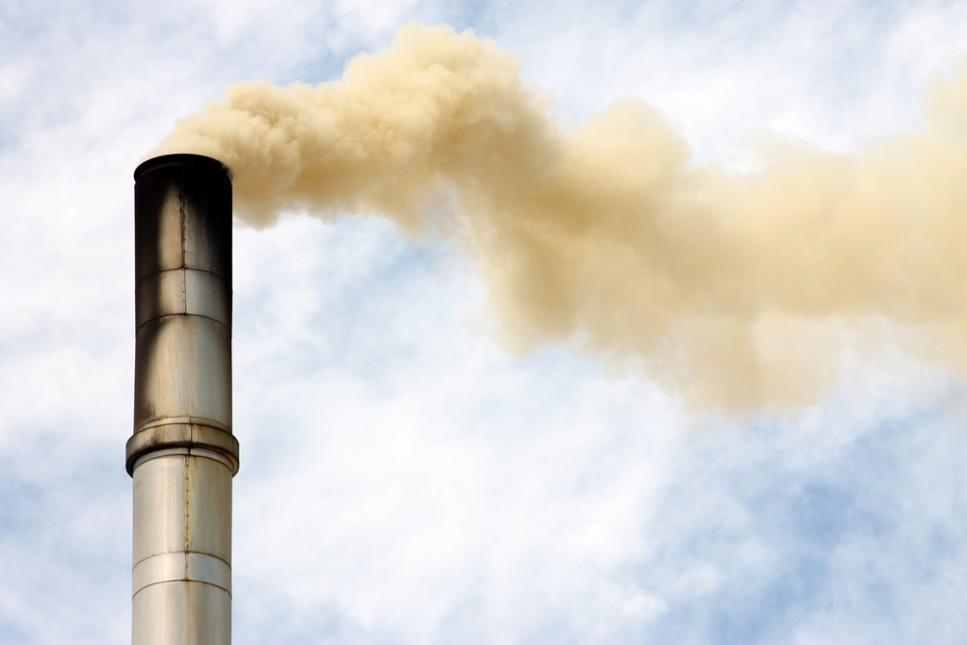
Man-made Pollutants
Dioxins and Polychlorinated Biphenyls (PCBs) are ubiquitous, very
persistent chemicals
Generally present in low
concentrations in foods,
especially fat-containing
foods such as milk,
butter, meat, and fish
“Pollution” by Ian Barbour
Notes:
Man-made Pollutants (slide 24)
Dioxins and polychlorinated biphenyls (PCBs) are very persistent chemicals, ubiquitous in the environment. These organic pollutants can accumulate in the food chain, mainly in the fatty tissue of animals. Food safety issues associated with fish and seafood are primarily due to recreational and subsistence anglers, pregnant women and young children who eat large amounts of sport fish and shellfish caught from contaminated waters.
Dioxins are byproducts of chlorine-containing manufacturing processes or incineration. Major sources are combustion and incineration processes, along with smelting operations and the pulp industry. Diffuse sources of dioxins include home heating, diesel engines, forest and grass fires, and agricultural and backyard burning. Emissions of dioxins are now heavily regulated.
Unlike dioxins, PCBs were intentionally produced as industrial fluids and plasticizers. Production of PCBs in the U.S. was banned in 1977. Due to the ban on PCB production in the U.S. and other countries, as well as stricter controls on dioxin emissions from industrial processes, a significant reduction of dioxins released into the environment has occurred since the early 1980s.
Dioxins and PCBs generally are present in extremely low concentrations in foods, especially fat-containing foods such as dairy products, meats, and fish. Concerns about these contaminants in seafood must be considered in the context of total dietary exposure. Dietary exposure to dioxins and PCBs accounts for greater than 90% of exposure in the U.S. with meats, dairy products and vegetables being the major food sources of exposure.

Slide 25
Potential Health Effects from Dioxin and PCB Exposure
Some studies suggest that dioxins and PCBs are carcinogenic and may have immune system or neurological effects
Reported health effects involve workers in chemical plants or those exposed due to accidental contamination of the environment or eating contaminated edible oils
Notes:
Potential Health Effects from Dioxin and PCB Exposure (slide 25)
Reported health effects due to exposure to dioxins and PCBs include cancer, endocrine disruption, developmental and reproductive problems, neurological alterations, and chloracne, a skin condition. There is still some debate whether these chemicals cause cancer in humans. In 1997, the International Agency for Research on Cancer (IARC) concluded they should be considered as definite human carcinogens, whereas the United Kingdom Committee on Carcinogenicity (COC) reconfirmed they should be considered probable human carcinogens. Reported health effects have been attributed to chemical plant workers, those exposed to accidental contamination of the environment, or those eating contaminated edible oils. The general public is not exposed to these high levels.

Slide 26
Percent Intake of Dioxins and PCBs in Adults by food type
Notes:
Percent Intake of Dioxins and PCBs in Adults by Food Type (slide 26)
In adult diets, meat contributes the largest share of dioxins and PCBs, followed by dairy foods, then vegetables. Fish contributes relatively little to total dietary intake of these contaminants.
For young people ages 1 to 19 years, however, most dioxins and PCBs come from dairy foods followed by meat, then vegetables.

Slide 27
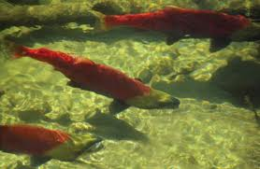
Wild and Farmed Seafood
No consistent differences between wild and farmed seafood
Contaminants in wild seafood can only be reduced by long-term reductions of pollutants
Farmed seafood offers
possibility of managing
contaminants to minimize
risk while maintaining
benefits
Notes:
Wild and Farmed Seafood (slide 27)
In a report released in 2005 the European Food Safety Authority states the available data do not allow a robust comparison of nutrient and contaminant levels of wild and farmed fish. The limited data available indicate no consistent differences between wild and farmed fish. Long-term control of pollutant emissions to the environment is the only way to reduce contaminant levels in wild fish. Fish farming offers the possibility of managing contaminant levels through quality control of feed ingredients and water quality.
Most commercial species of seafood are well below federally established limits of PCBs and dioxins. Ocean species that spend their entire life out in the ocean far from the shore are much less likely to accumulate organic pollutants than those that stay in near-shore areas.

Slide 28

Guidelines
Individuals concerned about man-made pollutants, especially those who eat large amounts of sport fish and shellfish caught from potentially contaminated waters
  eat a variety of seafood
  avoid eating excessive amounts of any
  single type of seafood
  check local advisories for local waters
  avoid eating internal organs of fish, tomalley of lobsters, mustard of crabs
  if eating sport caught fish that may contain elevated levels of contaminants trim away fat and use cooking methods that allow fats and juices to drain away
Notes:
Guidelines (slide 28)
Who should be concerned? Concerns about environmental pollutants in seafood are primarily for freshwaters, estuaries (river mouths), and near-shore areas where recreational and subsistence anglers catch sport fish and shellfish for consumption. Anglers, pregnant women and children who eat large amounts of sport fish and shellfish caught from contaminated waters are at greatest risk. Exposure from fish can be lowered by up to 40% by removing the skin and trimming away the fat, and then by either baking or broiling the fish to allow the fats and juices to drain away.
State and tribal agencies test local waters and issue fish and shellfish consumption advisories. Check advisories for local waters before eating recreationally-caught seafood.
In addition:
eat a variety of seafood
avoid eating excessive amounts of any single type of seafood
avoid eating internal organs of fish, tomalley of lobsters, mustard of crabs

Slide 29

Color Me Red
Carotenoid Pigments
“Color added” labeling required by FDA
Color is not added – carotenoid pigments are added to fish feeds for species such as salmon and trout
Carotenoid pigments give color to a wide variety of insects, birds, and fish
Notes:
Color Me Red Carotenoid Pigments (slide 29)
The U.S. Food and Drug Administration regulates food labels and requires certain food products with color additives be labeled “color added.” This includes ingredients of animal feeds whose nutritional function supports cellular function and which also impart color to the meat, milk, or eggs of the animal. Exceptions to the labeling requirement include the use of the carotenoid canthaxanthin in poultry.
People misunderstand the term “color added.” Common misperceptions about “color added” labeling include the belief color is added to the fish or the fish are injected with a dye. Color is not added to the fish. The carotenoid pigments added to the feed are not dyes.
Carotenoid pigments give color to a wide range of insects, birds, and fish. Approximately 600 pigments have been identified in nature. Carotenoid pigments are chemically related to vitamin A and have antioxidant properties. Algae, fungi, yeast, and plants produce carotenoid pigments. Animals obtain the pigments directly by eating algae or plants, or from eating other organisms that eat algae or plants. Salmon eat krill, krill eat zooplankton, and zooplankton eat algae. Salmon, krill, and zooplankton cannot synthesize carotenoid pigments. They obtain the pigments from the food they eat.

Slide 30
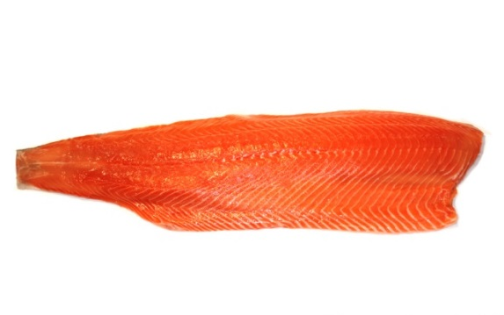
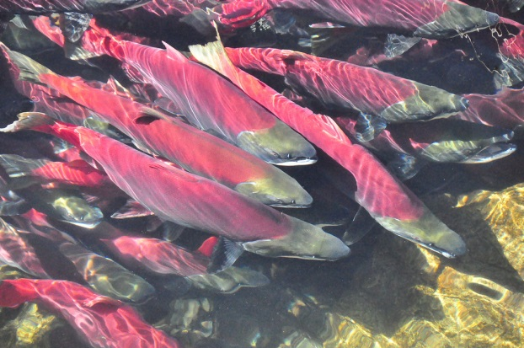
Carotenoid Pigments
Essential Nutrients for Salmonids
Wild fish obtain carotenoid pigments from eating krill or insects
Farmed fish from feeds that contain the pigments
Carotenoid pigments are essential nutrients for salmon and trout
“Salmon Chileno” by Fishercott
“Adams River Sockeye” by Peter Gordon
Notes:
Carotenoid Pigments Essential Nutrients for Salmonids (slide 30)
Wild salmon obtain carotenoid pigments from the krill and insects they eat, while farmed salmon obtain them from feeds that contain the pigments. Carotenoid pigments are an essential nutrient for salmon and trout. As female salmon mature, carotenoid pigments are transferred from muscle tissue to the developing eggs. Without this essential nutrient, the offspring would suffer high mortality. As male salmon mature, the pigments are transferred to the skin, giving them a red color.
Photographs above from top to bottom: salmon fillet and spawning Sockeye Salmon.

Slide 31
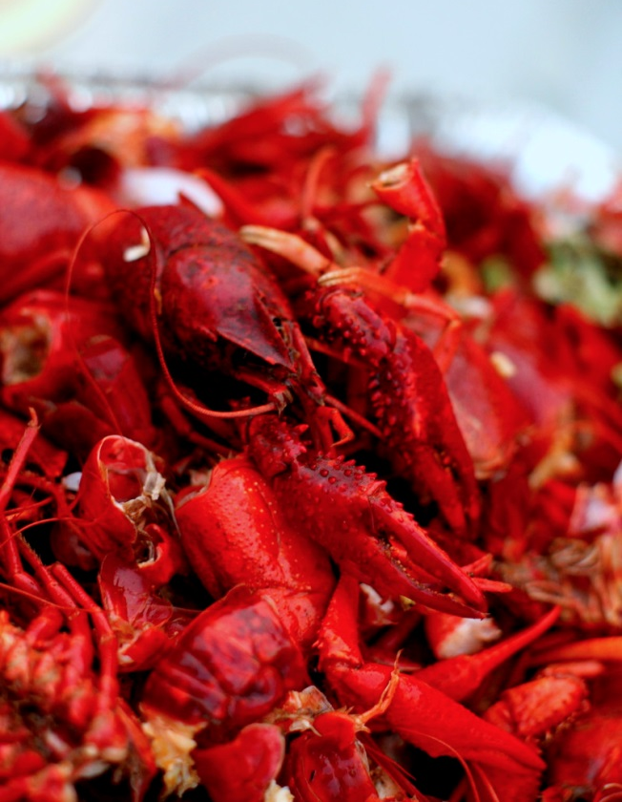
Sources of Pigments
Added to Fish Feed
Pigments can be extracted from algae, yeast, plants, or crustaceans
Or pigments can be produced by chemical synthesis
Most feeds contain astaxanthin, some canthaxanthin, or both
“Pile of Crawfish” by Isaac Wedin
Notes:
What Are the Sources of Pigments Added to Fish Feed? (slide 31)
The carotenoid pigments used for fish feeds can be extracted from algae, yeast, plants, or crustaceans. They also can be produced by chemical synthesis from beta carotene-like precursors. Most fish feeds contain the carotenoid pigment astaxanthin, some contain canthaxanthin, and others have both.

Slide 32
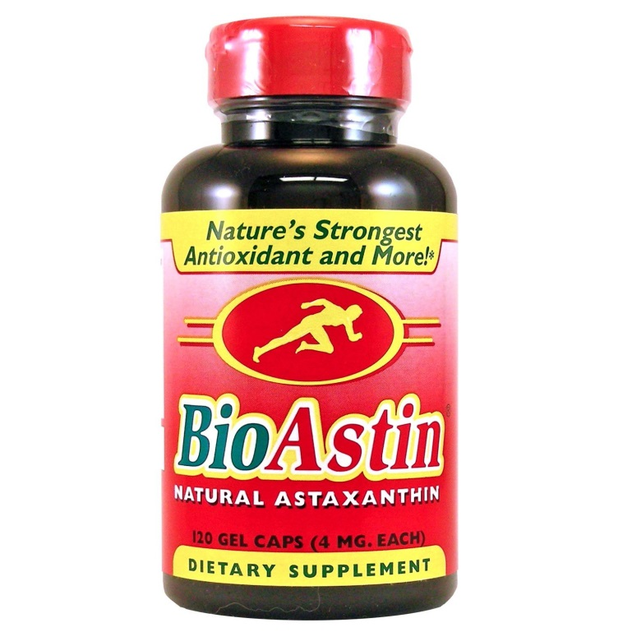
Natural vs. Synthetic Astaxanthin
No difference in function, molecular weight,
or chemical formula
Analogous to taking a vitamin C tablet
or eating an orange for vitamin C
Astaxanthin sold for human health
benefits as a natural antioxidant in
health stores and on the Internet
Notes:
Natural vs. Synthetic Astaxanthin (slide 32)
There is no difference in function, molecular weight, or chemical formula between natural and synthetic astaxanthin pigments. The use of synthetic or natural astaxanthin in fish feeds is analogous to taking a vitamin C tablet or eating an orange for vitamin C.
Look up astaxanthin on the Internet, and you may well receive more than a few hundred thousand hits, most of them advertising astaxanthin as a human health product.

Slide 33
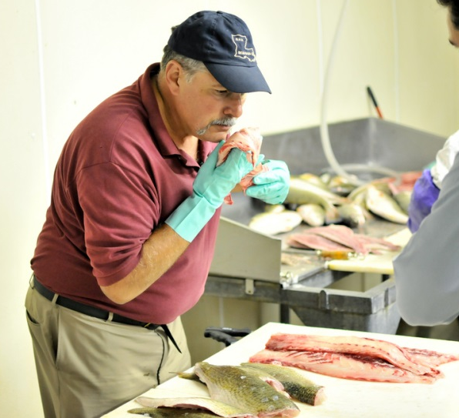
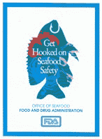
Seafood Inspection
H – hazard
A – analysis and
C – critical
C – control
P – point
“DHH Gary Lopinto Sensory Testing Fish Filets” by Louisiana GOHSEP
Notes:
Seafood Inspection (slide 33)
Seafood is subject to federal, state, and local government regulations and inspections related to food safety. At the federal level the Food and Drug Administration is primarily responsible for the regulation of seafood. Federal and state agencies work together to provide consistent standards and regulations for seafood products and the various seafood industry sectors that harvest and deliver them to consumers.
In 1997, a new seafood inspection program went into effect to further ensure consumer safety. The program requires seafood processors, repackers, and warehouses (both domestic and foreign exporters) to implement a food safety management system known as Hazard Analysis and Critical Control Point, or HACCP (pronounced hassup). Implementation has changed the manner in which seafood inspections take place, enabling inspectors to examine how the seafood is processed over time.

Slide 34
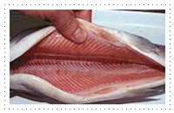
HACCP
Seafood is the first commodity to implement HACCP on an industry-wide basis
Focuses on identifying and preventing hazards that could cause foodborne illnesses
Notes:
HACCP (slide 34)
HACCP is a preventative system of food safety controls that focuses on identifying and preventing hazards that could cause foodborne illnesses. Previous food safety programs relied on spot-checks of the manufacturing process and random sampling of finished products. Seafood is the first commodity to implement the science-based HACCP system on an industry-wide basis. Other commodities that now require similar HACCP controls include meat, poultry and juice products. HACCP was developed by the Pillsbury Company and NASA during the late 1950s and early 1960s as a method to ensure the safety of food produced for the space program.
There are seven steps within the HACCP system:
Analyze hazards. Every processor must determine the potential food safety hazards associated with each of its seafood products and the measures needed to control, prevent, or eliminate those hazards. Hazards may include disease-causing organisms, natural toxins, environmental contaminants (pesticides), chemicals (cleaners, sanitizers, lubricants), and physical hazards such as ground glass.
Identify critical control points. For example, cooking or cooling may control or eliminate the potential hazard.
Establish preventive measures with critical limits for each control point. For example, store finished product at 38°F or colder.
Establish procedures to monitor critical control points. This may include how temperatures will be monitored, how often, and by whom.
Establish corrective actions when critical limits are not met. This may include safely reprocessing the seafood or disposing of it altogether.
Establish procedures to verify the system is working properly.
Establish effective recordkeeping. Records are kept at each critical control point to ascertain that the HACCP system is operating to provide a safe food product.

Slide 35
Ensuring Safety
HACCP also requires basic sanitation standards
Molluscan shellfish are also under the National Shellfish Sanitation Program
Seafood importers must verify suppliers are providing seafood processed under HACCP
Notes:
Ensuring Safety (slide 35)
In addition to the seven steps of HACCP, the HACCP regulation requires seafood companies to follow basic sanitation standards, such as the use of safe water in food preparation; cleanliness of food contact surfaces, employee clothes, and gloves; prevention of cross-contamination; and proper maintenance of hand-washing, hand-sanitizing, and toilet facilities.
Molluscan shellfish handlers can obtain shellfish only from approved waters and only if they are properly tagged to document the shellfish have come from an approved source. These requirements are part of the National Shellfish Sanitation Program. This program, administered by FDA and carried out at the state level, implements control measures over all sanitation related to the growing, harvesting, shucking, packing, and interstate transportation of molluscan shellfish.
Since the majority of seafood consumed in the U.S. is imported, the FDA requires seafood importers to verify their overseas suppliers are providing seafood processed under a HACCP program that is equivalent to that required of domestic processors.

Slide 36
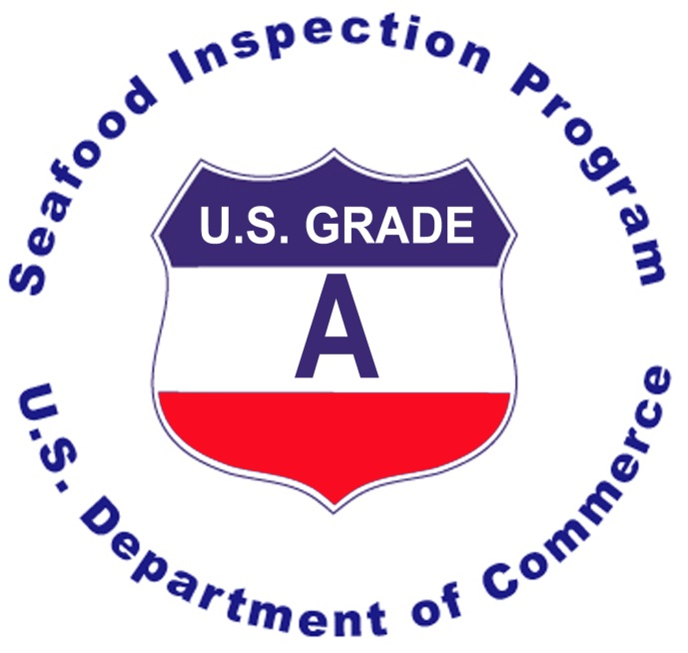
National Seafood
Inspection Program
Department of Commerce’s NOAA incorporates FDA’s HACCP regulations into their program
Certifies processors that meet federal standards and rates products with grades based on quality
®
Notes:
National Seafood Inspection Program (slide 36)
The Department of Commerce’s National Oceanic and Atmospheric Administration (NOAA) incorporates the safety features of FDA’s HACCP regulation into their National Seafood Inspection Program. For a fee, NOAA will inspect seafood processors and others, checking vessels and plants for sanitation, checking food products for quality and safety, and grading food products based on quality. Seafood plants that meet federal standards are certified. Seafood processors in good standing are free to use official marks on products indicating the seafood has been federally inspected.

Slide 37


Country of Origin Labeling
(COOL)
Applies to retail sales for wild and farm-raised fish and shellfish
Became effective April 5, 2005
Country of origin
Wild or farm raised
Label or notice must:
  Be legible
  Not obscure or interfere with other required information
Americans for
Labeling
http://www.ams.usda.gov/cool
Notes:
Country of Origin Labeling (slide 37)
Country of origin labeling for retail sales of wild and farm-raised seafood went into effect in April 2005. COOL requires retail establishments to label seafood with the country of origin and whether it is wild or farm raised. The label or notice must be legible and not interfere with other required information. The COOL regulations allow consumers greater choice when purchasing seafood at grocery stores. For additional information about COOL see: http://www.ams.usda.gov/cool/

Slide 38
Summary
Certain hazards associated with specific species (scombroid poisoning) and higher-risk behavior (at-risk people eating raw shellfish) persist
Microorganisms associated with handling and temperature abuse are controllable but persistent risks
Overall, acute seafood safety hazards are not increasing, likely due HACCP and other seafood safety programs
Notes:
Summary (slide 38)
Certain hazards associated with specific species (scombroid poisoning) and higher-risk behaviors (at-risk people eating raw shellfish) persist. Outbreaks of scombroid and ciguatera poisoning and consumption of raw molluscan shellfish are responsible for the majority of seafood-borne illnesses. The hazards of consuming raw seafood can be eliminated by choosing not to consume raw seafood. High-risk individuals whose immune systems are compromised from disease or medical conditions should never eat raw molluscan shellfish.
From a public health perspective, the health risk associated with microorganisms is controllable but persistent. Microorganisms cause the majority of foodborne illnesses of known cause, with norovirus responsible for most illnesses and Salmonella for most hospitalizations and deaths. Improper handling (temperature abuse), inadequate cooking, and poor hygiene are the common food preparation practices associated with foodborne illnesses.
Overall, acute seafood safety hazards are not increasing. This is likely due in part to the safe processing of seafood under HACCP, mandated in 1997, and to basic sanitation standards.

Slide 39

Summary
Benefits > Risks
Methylmercury is a concern for women of reproductive age and young children
Risk associated with dioxins and
PCBs are from consumption of
sport-caught seafood from
contaminated waters
To maximize net benefits and limit potential risks eat a variety of seafood twice/week
Notes:
Summary (slide 39)
Seafood is a healthy food choice for everyone. With so many varieties of seafood available, it can be overwhelming for the consumer to have all the information available on the benefits and risks associated with different types of seafood.
Many studies have found that the benefits of eating seafood greatly outweigh the risks and that not eating seafood can have negative effects on human health. The most common species of fish and shellfish eaten by Americans present very little risk while providing many health and nutritional benefits.
The primary health risk from eating seafood is exposure to harmful microorganisms and natural marine toxins. Consumers should focus on preventing exposure to harmful microorganisms with safe food handling practices.
Everyone is encouraged to eat seafood twice a week. The Dietary Guidelines for Americans, 2010 encourage greater seafood consumption. To maximize the health benefits from eating seafood twice per week, Americans will need to more than double their current consumption levels.
There are specific guidelines for special groups that can help sensitive individuals minimize their exposure to potentially harmful microorganisms or environmental contaminants.
Women who are or may become pregnant or who are breastfeeding, and young children (≤ 12 years) should avoid shark, swordfish, king mackerel and tilefish from the Gulf of Mexico due to mercury and limit albacore (white) tuna to 6 ounces per week. They also should not eat raw or partially cooked seafood, including smoked fish, unless the smoked fish is cooked in a dish such as a casserole.
The main concern with exposure to man-made pollutants is from eating large amounts of sport caught fish and shellfish from contaminated waters. Commercial seafood contributes little to dietary exposure of these pollutants.
By following the Dietary Guidelines for Americans, 2010 consumers can maximize the healthy nutritional benefits associated with eating seafood and minimize any potential food safety risk.
Now, let’s take a few minutes to complete the posttest.
Instructor: Hand out the posttest.

Slide 40
Photo credits | licensed under Creative Commons
“Sushi in NYC" by Vladislav Bezrukov – CC BY 2.0 /cropped from original
“White Marlin in North Carolina” – CC BY-SA 2.0 / cropped and rotated from original
“Side View Barracuda” by Amanderson2 – CC BY 2.0
“Champagne Seafood Delight” by Rob Taylor – CC BY 2.0
“Pollution” by Ian Barbour – CC BY-SA 2.0
“Salmon Chileno” by Fishercott – CC BY-SA 2.0
“Adams River Sockeye” by Peter Gordon – CC BY 2.0
“Pile of Crawfish” by Isaac Wedin – CC BY 2.0
“DHH Gary Lopinto Sensory Testing Fish Filets” by Louisiana GOHSEP – CC BY-SA 2.0
Notes:
Photo credits | The following are licensed under Creative Commons:
Slide 12:
“Sushi in NYC" by Vladislav Bezrukov – CC BY 2.0 /cropped from original
Slide 14:
“White Marlin in North Carolina” – CC BY-SA 2.0 / cropped and rotated from original
Slide 15:
“Side View Barracuda” by Amanderson2 – CC BY 2.0
Slide 23:
“Champagne Seafood Delight” by Rob Taylor – CC BY 2.0
Slide 24:
“Pollution” by Ian Barbour – CC BY-SA 2.0
Slide 30:
“Salmon Chileno” by Fishercott – CC BY-SA 2.0
“Adams River Sockeye” by Peter Gordon – CC BY 2.0
Slide 31:
“Pile of Crawfish” by Isaac Wedin – CC BY 2.0
Slide 33:
“DHH Gary Lopinto Sensory Testing Fish Filets” by Louisiana GOHSEP – CC BY-SA 2.0

