Slide 1
Landscape Maintenance

Slide 2
TREES
The cultivation of tress is the cultivation of the good, the beautiful, and the ennobling in man.
--J. Sterling Morton

Slide 3
Where roots really grow
arborday.org
Grow outward to a diameter 1 to 2 times the height of the tree
Roots lie less than 8 to 12 inches below the surface
Don’t grow in compacted soil under paved streets
Notes:
arborday.org

Slide 4
Girdling
arborday.org
Injures the bark of a tree trunk and extends around much of the trunk’s circumference
Caused by lawnmowers and weed trimmers
Destroy vital membranes that conduct water and minerals from the roots to the leaves and return the food produced by the leaves to the rest of the tree
Notes:
arborday.org

Slide 5
Pruning
Notes:
http://www.webweaver.nu/clipart/flower-borders3.shtml

Slide 6
Pruning
arborday.org
Don’t top trees
Never cut main branches back to stubs
Weakly attached limbs grow back higher than the original branches
New grow is ugly & bushy
Starves tree by drastically reducing food making ability
Makes tree more susceptible to insects and disease
Notes:
arborday.org

Slide 7
1/3 and ¼ rules of pruning
Never remove more than ¼ of a trees’ crown in a season
Try to encourage side branches that form angles that are 1/3 off vertical ( 10:00 or 2:00 positions)
Most species—tree should have a single trunk
Main side branches should be at least 1/3 smaller than the diameter of the trunk
Don’t prune up from the bottom any more than 1/3 of the tree’s total height
Notes:
arborday.org

Slide 8
How to make a pruning cut
arborday.org
Large limbs
Make a partial cut from beneath
Make a second cut from above several inches out and allow the limb to fall
Complete the job with a final cut just outside the branch collar
Small branches
Make a sharp clean cut, just beyond a lateral bud or other branch
Notes:
arborday.org

Slide 9
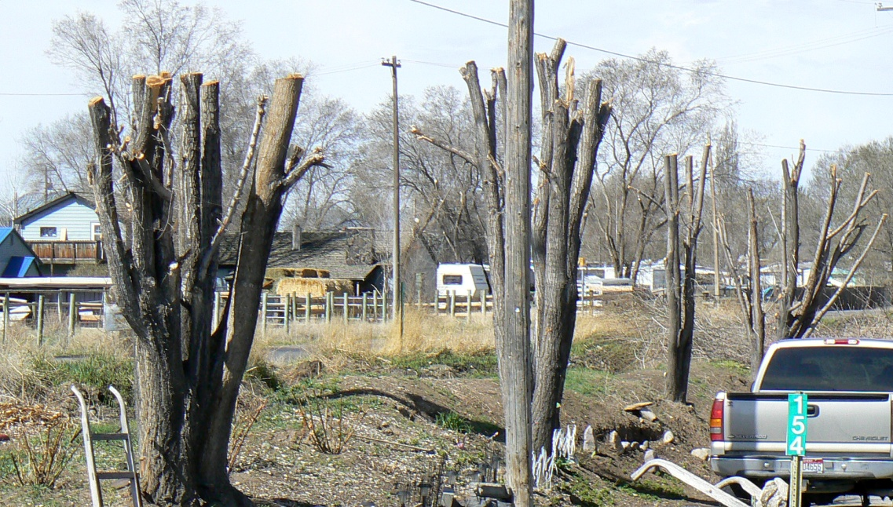
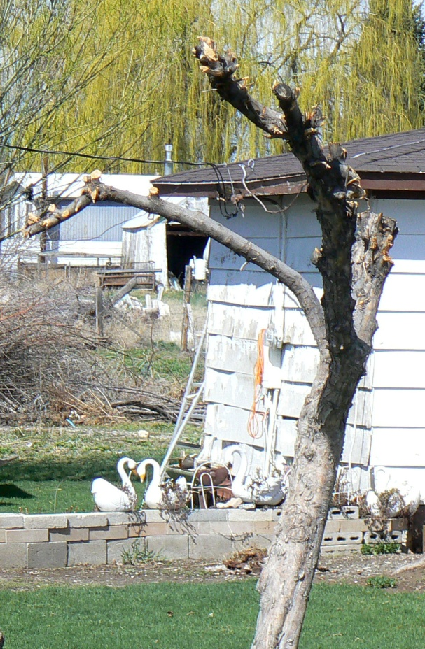
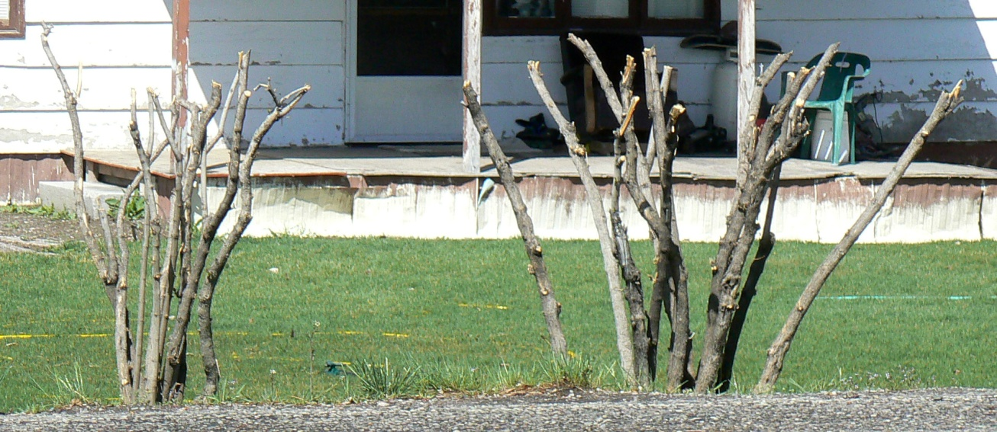
Improper topping cuts

Slide 10
Mulching

Slide 11
The value of mulch
arborday.org
Mulch
Insulates soil
Retains moisture
Keeps out weeds
Prevents soil compaction
Reduces lawnmower damage
Add aesthetic touch to yard or street
How to mulch
Pour wood chips or bark pieces 2 to 4 inches within the circle, but not touching the trunk (will rot)
Notes:
arborday.org

Slide 12
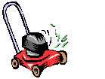
mowing
Notes:
http://www.webweaver.nu/clipart/flower-borders3.shtml

Slide 13
Mowing
dummies.com
Mowing height and mowing frequency determine how nice a lawn looks
never cut away more than one-third of the grass blade in any one mowing
Ideal Mowing Heights:
Grass type: Height:
Bahia grass; fescue, tall;
blue grama; buffalo grass 2 to 3 inches
Bent grass 1/4 to 1 inch
Bermuda grass, common 3/4 to 1-1/2 inches
Bermuda grass, hybrid 1/2 to 1 inch
Centipede grass; zoysia grass* 1 to 2 inches
Fescue, fine; St. Augustine grass 1-1/2 to 2-1/2 inches
Kentucky bluegrass 1-3/4 to 2-1/2 inches
Ryegrass, 1-1/2 to 2 inches
Edging and trimming are the finishing touches of mowing
leave clippings on the lawn
pieces break down quickly
reduce the amount of fertilizer by as much as 25%
research has proven that the clippings don't cause thatch to build up
Notes:
http://www.dummies.com/how-to/content/mowing-your-lawn-the-right-way.html

Slide 14
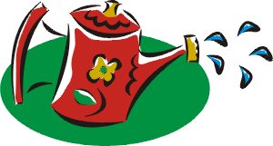
watering
Notes:
http://www.webweaver.nu/clipart/flower-borders3.shtml

Slide 15
Watering
wateruseitwisely.com
give your plants enough water without giving them too much water
Watering too little can lead to wilt from which the plant may not recover
watering too much starves the roots of oxygen
Different size and types of plants require different depths and widths.
completely wet the root zone each time you water
root zone—the area in which the plant’s feeder roots are concentrated.
The 1-2-3 Rule is an easy way to remember how deep to water:
Grass should be watered to a depth of 10 inches
Water small plants such as groundcovers, cacti, and annuals to a depth of 1 foot.
Water medium plants such as shrubs to a depth of 2 feet.
Water large plants such as trees to a depth of 3 feet.
test watering depth with a soil probe (or a very long screwdriver)
Wait one hour after watering
push the probe into the soil
it will slide easily through wet soil but will be difficult or impossible to push through dry soil
Water your plants and lawn until you can easily slide the probe to the recommended depth.
After plants are established, most water absorbing roots are located near the dripline
beneath the outer edge of the plant’s canopy—not close to the trunk or stem
Concentrate your emitters along the dripline of each plant.
The water will spread down and horizontally as it soaks into the soil, reaching the entire root zone.
When plants get more water than they need, they grow more than they should, and will need to have more pruning and mowing.
While fertilizers promote plant growth, they also increase water consumption. Apply the minimum amount of fertilizer needed.
Notes:
http://www.wateruseitwisely.com/region/arizona/100-ways-to-conserve/outdoor-tips/water-guides/Landscape-Watering-Guide.pdf

Slide 16
Watering tips:
wsnla.org
Thatch in the lawn restricts penetration of water, air and nutrients, and should be removed as soon as possible.
If soil is compacted, aerate (core) to increase water and air penetration
done only during spring
Properly fertilize
Don’t change turf mowing height
Eliminate weeds that compete for moisture
Mulch helps planting beds retain moisture
Use an oscillating sprinkler, or impact-drive revolving sprinkler
Don’t use a hand-held hose
Make sure sprinkler system is in good repair
no leaks
heads are properly adjusted to eliminate any overspray
When installing new landscapes, a properly designed and installed irrigation system should be included as a water conservation tool.
Consider water consumption when selecting and placing plants (zoning) .
Water early in the day to avoid loss due to evaporation.
Water slowly for longer periods of time to avoid loss due to run-off.
Notes:
http://www.wsnla.org/WaterForLife/wfl2.html

Slide 17
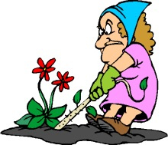
Weeding
Notes:
http://www.webweaver.nu/clipart/flower-borders3.shtml

Slide 18
Weeds:
Wikipedia.org
A weed is any plant that grows where it is not wanted
compete with crops for nutrients and water
Weeds and crops can coexist for about 3 weeks before too much competition
convert productive land into unusable scrub
poisonous, distasteful, produce burrs, thorns or other damaging body parts
contaminate harvests
host pests and diseases that can spread to cultivated crops
seeds can lay dormant in the soil for as long as 80-100 years
will germinate if soil is disturbed
can produce as many as 30,000 seeds per plant
Remove weeds before they seed out

Slide 19
Herbicides:
Wikipedia.org
Contact herbicides destroy only that plant tissue in contact with the chemical spray.
fastest acting herbicides
ineffective on perennial plants that are able to re-grow from roots or tubers.
Systemic herbicides are foliar-applied and are translocated through the plant and destroy a greater amount of the plant tissue.
designed to leave no harmful residue in the soil.
Soil-borne herbicides are applied to the soil and are taken up by the roots of the target plant.
Pre-emergent herbicides are applied to the soil and prevent germination or early growth of weed seeds.
Notes:
Wikipedia.org

Slide 20
Organic Weeding Methods*:
Wikipedia.org
Drip irrigation: Rubber hoses bring water to the roots of the desired plants. This limits weed access to water.
Manually: pulling weeds by hand
Mechanical tilling: carefully till weeds around plants
Weed mat: A weed mat is an artificial mulch, fibrous cloth material, bark or newspaper laid on top of the soil preventing weeds from growing to the surface.
(*a combination of methods are used)
Notes:
Wikipedia.org

Slide 21
Fertilizing

Slide 22
Fertilizing
uri.edu
Rates of Application:
Woody plants--N-P-K ratio between 3-1-1 and 4-1-2 (such as 12-4-4)
Landscape plants--N-P-K ratio of 3-1-2
Timing Fertilizer Treatments:
once a year is preferable to less frequent applications
twice a year in light sandy soils or in seasons of excess rainfall
best time to fertilize in the northern United States is autumn
after the first hard freeze in October and before the soil freezes in December
next best time prior to growth in early spring
between February and early April
applications may be made up to July 1
after this midsummer date is not recommended--it could delay acclimation to winter weather conditions
Methods of Application:
soil should be moist at the time of fertilizing to prevent fertilizer injury
Liquid Injection into Soil—injection sites for fertilizer
Drill Hole or Punch Bar--opens of heavy, compacted soils which allow air and fertilizer to penetrate the soil
Surface Application--surface of the ground
Fertilizer Stakes or Spikes--driven into the soil
Foliar Spraying--spraying liquid or water soluble fertilizer on the foliage
Tree Trunk Injection or Implants—holes place in the trunk root flair and infusing with liquid or implants of fertilizer
Notes:
http://www.uri.edu/ce/factsheets/sheets/fertilizelandscape.html

Slide 23
Low-Maintenance Landscape Planning
Repeated from Landscape Design Process ppt.

Slide 24
Design
Keep outlines of grass, decks, sidewalks simple
Keep lawn out of small wedges and acute angles
If it can be mowed with a riding lawnmower without a lot of trimming, it is a low maintenance design

Slide 25
Trees and Shrubs
Own planting bed
Less edging and trimming if not planted in grass
Next to building Placement
Genetically small w/ slow rate of growth
Selection
Little pruning
pest resistance
Avoid messy fruit droppage

Slide 26
Lawn
Keep plant materials separate from grass
Learn to use weed barrier fabrics, mulches, groundcovers and chemicals to reduce weeds
Only plant grass where it is actually needed
Use edging materials that are impregnable
Bender board, metal or concrete edging
Distinct mowing edge, clean lawn boundary

Slide 27
Flowers
Use annuals sparingly
Plant every year
Labor and money intensive
Rely more heavily on perennial flowers, ground covers, flowering shrubs & vines

