Slide 1
thelandscapedesigncenter.com
Just as you would not build a house without blueprints, you should not put together a landscape without a design, no matter how small.
Notes:
http://www.google.com/imgres?imgurl=http://www.thelandscapedesigncenter.com/images/pictures/patios/BlueandLilacPAflagstone.jpg&imgrefurl=http://www.thelandscapedesigncenter.com/design.html&usg=__6KaeNC64Xy6VUSSAbrCZaqYnL_Q=&h=413&w=550&sz=288&hl=en&start=39&sig2=n23kmnEqaiGSCAa9Cty-nw&itbs=1&tbnid=myxRXpeuECBM_M:&tbnh=100&tbnw=133&prev=/images%3Fq%3Dlandscape%2Bdesign%26start%3D36%26hl%3Den%26sa%3DN%26gbv%3D2%26ndsp%3D18%26tbs%3Disch:1&ei=gPkFTKClKo6sMdn0rIUJ

Slide 2
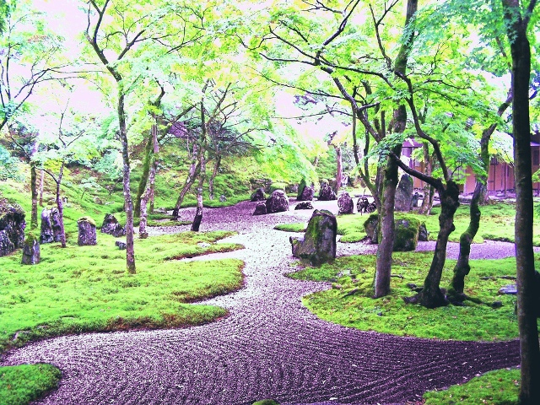
gaialandscapedesignbackgrounds.net
Notes:
http://www.gaialandscapedesignbackgrounds.net/landscape-design-background-zen-garden-Koumyouzenji-e-chan-architecture.jpg

Slide 3
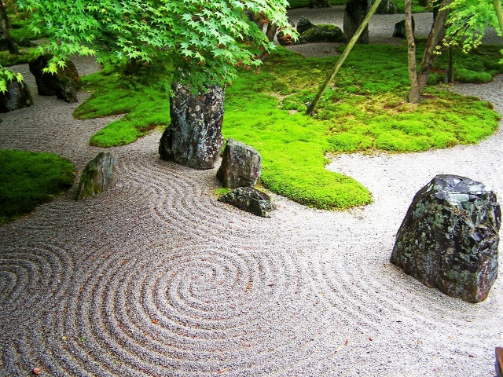
gaialandscapedesignbackgrounds.net
Notes:
http://www.google.com/imgres?imgurl=http://www.gaialandscapedesignbackgrounds.net/landscape-design-background-zen-garden-Koumyouzenji-e-chan-architecture.jpg&imgrefurl=http://www.gaialandscapedesignbackgrounds.net/&usg=__LMIkdTnszyXplKT1soqUpujdvUc=&h=480&w=640&sz=287&hl=en&start=2&sig2=I310C1j3D37JNzr6YFgpxA&itbs=1&tbnid=iWnMxP3WOeqAkM:&tbnh=103&tbnw=137&prev=/images%3Fq%3Dlandscape%2Bdesign%26hl%3Den%26gbv%3D2%26tbs%3Disch:1&ei=zvUFTNqNDpe0MeexvI8J

Slide 4
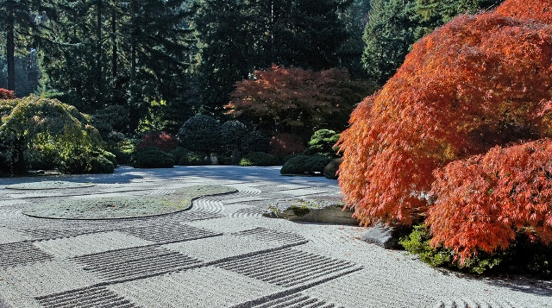
gaialandscapedesignbackgrounds.net
Notes:
http://www.google.com/imgres?imgurl=http://www.gaialandscapedesignbackgrounds.net/landscape-design-background-zen-garden-Koumyouzenji-e-chan-architecture.jpg&imgrefurl=http://www.gaialandscapedesignbackgrounds.net/&usg=__LMIkdTnszyXplKT1soqUpujdvUc=&h=480&w=640&sz=287&hl=en&start=2&sig2=I310C1j3D37JNzr6YFgpxA&itbs=1&tbnid=iWnMxP3WOeqAkM:&tbnh=103&tbnw=137&prev=/images%3Fq%3Dlandscape%2Bdesign%26hl%3Den%26gbv%3D2%26tbs%3Disch:1&ei=zvUFTNqNDpe0MeexvI8J

Slide 5
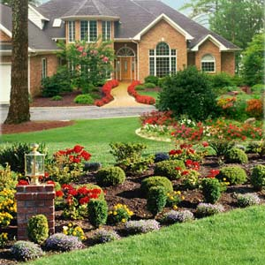
local.yodle.com
Notes:
http://local.yodle.com/articles/wp-content/uploads/2009/07/landscape-design.jpg

Slide 6
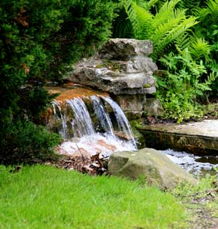
fairwaylawnskc.com
Notes:
http://www.fairwaylawnskc.com/art/landscape_stonepath.jpg

Slide 7
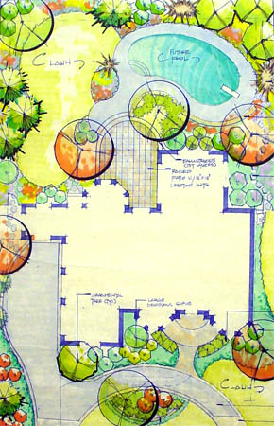
Notes:
http://www.google.com/imgres?imgurl=http://www.milieu-design.com/images/landarch_design.jpg&imgrefurl=http://www.milieu-design.com/services/landscape_architecture.htm&usg=__RQnH0zvC7ggNrfMjd_4uwhKSMZ4=&h=450&w=290&sz=86&hl=en&start=5&um=1&itbs=1&tbnid=OBeh-_g0pB3ExM:&tbnh=127&tbnw=82&prev=/images%3Fq%3Dlandscape%2Barchitecture%26um%3D1%26hl%3Den%26sa%3DN%26tbs%3Disch:1

Slide 8
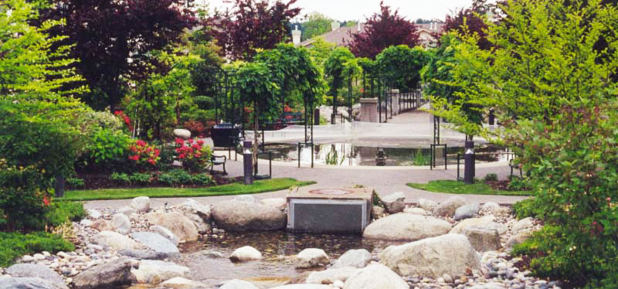
dmglandscape.com
Notes:
http://www.dmglandscape.com/images/fpslides/chelseagarden2.jpg

Slide 9
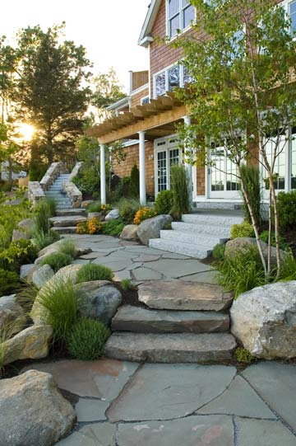
princetonscapes.com
Notes:
http://www.princetonscapes.com/images/landscape-design.jpg

Slide 10
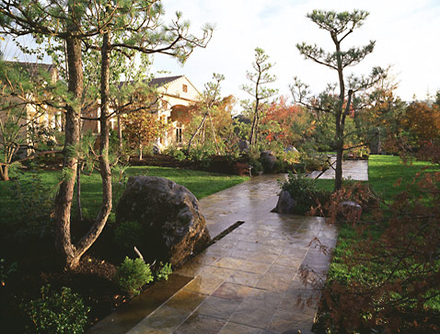
kurisu.com
Notes:
http://www.google.com/imgres?imgurl=http://www.kurisu.com/portfolio/images/kurisu-japanese-landscape-design-new-york-3-16.jpg&imgrefurl=http://www.kurisu.com/portfolio/kurisu-japanese-landscape-design-new-york-3-16.shtml&usg=__r_NCpkrchZRNZ3fdR7MWq4L9cgU=&h=363&w=478&sz=76&hl=en&start=27&sig2=_x-D_mhYiVXBj6fr6nZduA&itbs=1&tbnid=Ao35FDLi7dAlqM:&tbnh=98&tbnw=129&prev=/images%3Fq%3Dlandscape%2Bdesign%26start%3D18%26hl%3Den%26sa%3DN%26gbv%3D2%26ndsp%3D18%26tbs%3Disch:1&ei=svcFTPuUL4quNYa7jIwJ

Slide 11
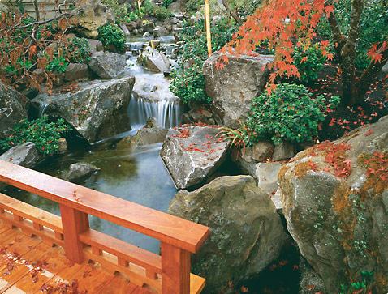
kurisu.com
Notes:
http://www.google.com/imgres?imgurl=http://www.kurisu.com/portfolio/images/kurisu-japanese-landscape-design-new-york-3-16.jpg&imgrefurl=http://www.kurisu.com/portfolio/kurisu-japanese-landscape-design-new-york-3-16.shtml&usg=__r_NCpkrchZRNZ3fdR7MWq4L9cgU=&h=363&w=478&sz=76&hl=en&start=27&sig2=_x-D_mhYiVXBj6fr6nZduA&itbs=1&tbnid=Ao35FDLi7dAlqM:&tbnh=98&tbnw=129&prev=/images%3Fq%3Dlandscape%2Bdesign%26start%3D18%26hl%3Den%26sa%3DN%26gbv%3D2%26ndsp%3D18%26tbs%3Disch:1&ei=svcFTPuUL4quNYa7jIwJ

Slide 12
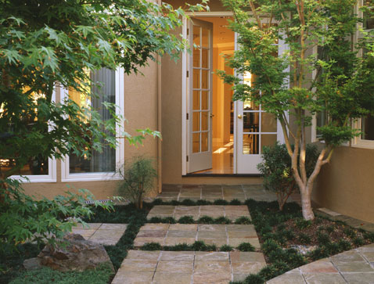
kurisu.com
Notes:
http://www.google.com/imgres?imgurl=http://www.kurisu.com/portfolio/images/kurisu-japanese-landscape-design-new-york-3-16.jpg&imgrefurl=http://www.kurisu.com/portfolio/kurisu-japanese-landscape-design-new-york-3-16.shtml&usg=__r_NCpkrchZRNZ3fdR7MWq4L9cgU=&h=363&w=478&sz=76&hl=en&start=27&sig2=_x-D_mhYiVXBj6fr6nZduA&itbs=1&tbnid=Ao35FDLi7dAlqM:&tbnh=98&tbnw=129&prev=/images%3Fq%3Dlandscape%2Bdesign%26start%3D18%26hl%3Den%26sa%3DN%26gbv%3D2%26ndsp%3D18%26tbs%3Disch:1&ei=svcFTPuUL4quNYa7jIwJ

Slide 13
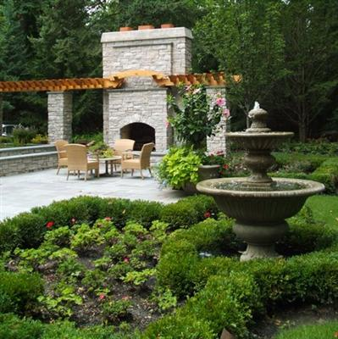
milieudesignllc.com
Notes:
http://www.milieudesignllc.com/Images/landscape-designs.jpg

Slide 14
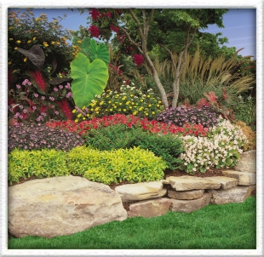
romalandscaping.com
Notes:
http://www.romalandscaping.com/images/landscaping.jpg

Slide 15
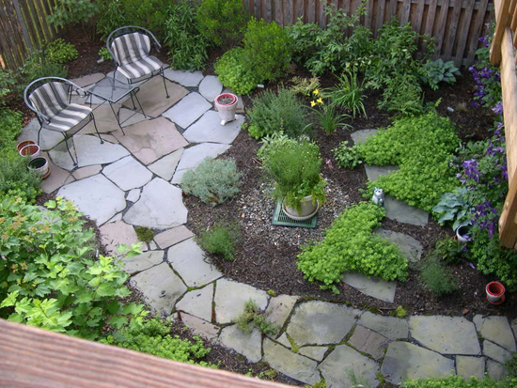
thelandscapedesigncenter.com
Notes:
http://www.thelandscapedesigncenter.com/images/pictures/patios/BlueandLilacPAflagstone.jpg

Slide 16
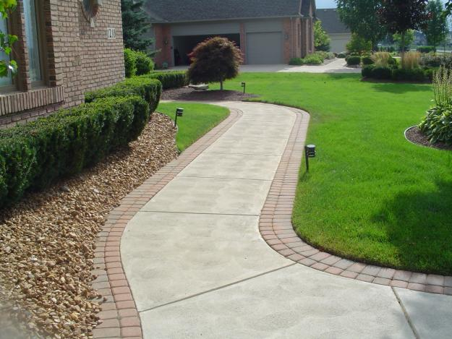
images02.olx.com
Notes:
http://images02.olx.com/ui/2/39/01/21643801_1.jpg

Slide 17
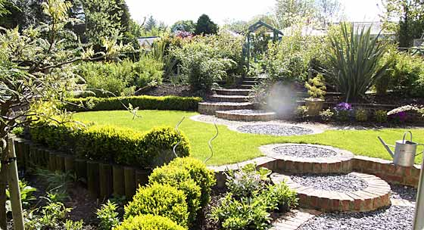
summersgardens.co.uk
Notes:
http://www.summersgardens.co.uk/images/garden-landscape-design.jpg

Slide 18
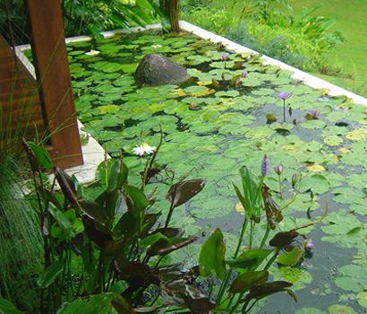
hortulus.com.au
Notes:
http://www.hortulus.com.au/assets/Uploads/_resampled/CroppedImage410350-design.jpg

Slide 19
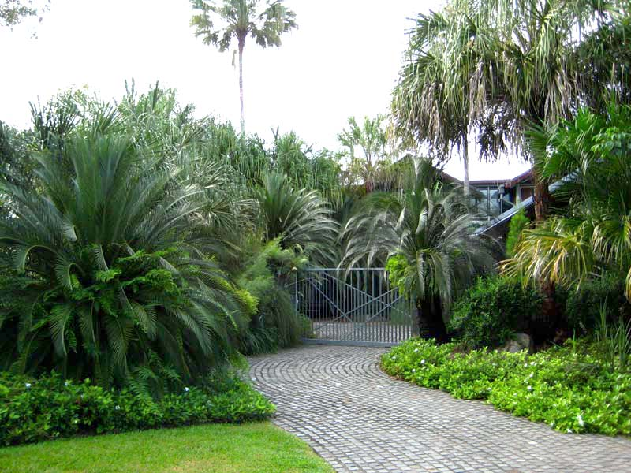
hortulus.com.au
Notes:
http://www.google.com/imgres?imgurl=http://www.hortulus.com.au/assets/Uploads/_resampled/CroppedImage410350-design.jpg&imgrefurl=http://www.hortulus.com.au/design/&usg=__IcE4fVlNVoal1rmHLue2cgceack=&h=350&w=410&sz=39&hl=en&start=70&sig2=yxpa5bO9FMr-d_WLgYdZuw&itbs=1&tbnid=BlaRd72WiC2jmM:&tbnh=107&tbnw=125&prev=/images%3Fq%3Dlandscape%2Bdesign%26start%3D54%26hl%3Den%26sa%3DN%26gbv%3D2%26ndsp%3D18%26tbs%3Disch:1&ei=pvoFTMP7I4quNYa7jIwJ

Slide 20
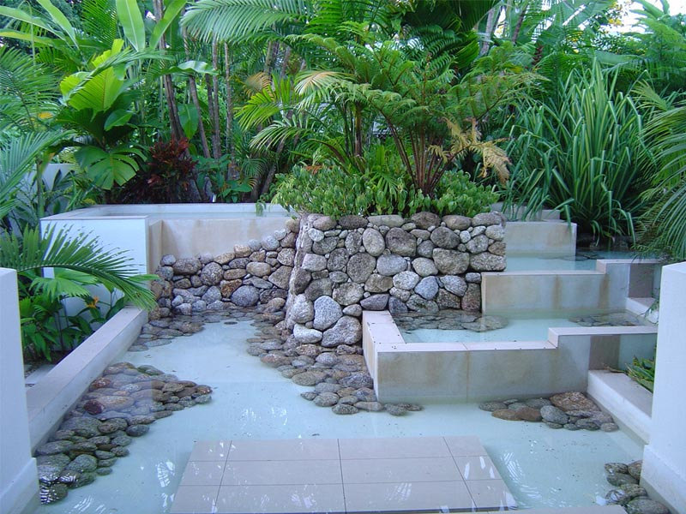
hortulus.com.au
Notes:
http://www.google.com/imgres?imgurl=http://www.hortulus.com.au/assets/Uploads/_resampled/CroppedImage410350-design.jpg&imgrefurl=http://www.hortulus.com.au/design/&usg=__IcE4fVlNVoal1rmHLue2cgceack=&h=350&w=410&sz=39&hl=en&start=70&sig2=yxpa5bO9FMr-d_WLgYdZuw&itbs=1&tbnid=BlaRd72WiC2jmM:&tbnh=107&tbnw=125&prev=/images%3Fq%3Dlandscape%2Bdesign%26start%3D54%26hl%3Den%26sa%3DN%26gbv%3D2%26ndsp%3D18%26tbs%3Disch:1&ei=pvoFTMP7I4quNYa7jIwJ

Slide 21
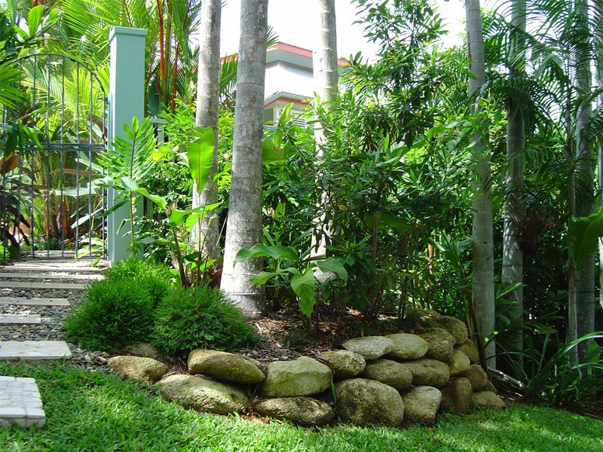
hortulus.com.au
Notes:
http://www.google.com/imgres?imgurl=http://www.hortulus.com.au/assets/Uploads/_resampled/CroppedImage410350-design.jpg&imgrefurl=http://www.hortulus.com.au/design/&usg=__IcE4fVlNVoal1rmHLue2cgceack=&h=350&w=410&sz=39&hl=en&start=70&sig2=yxpa5bO9FMr-d_WLgYdZuw&itbs=1&tbnid=BlaRd72WiC2jmM:&tbnh=107&tbnw=125&prev=/images%3Fq%3Dlandscape%2Bdesign%26start%3D54%26hl%3Den%26sa%3DN%26gbv%3D2%26ndsp%3D18%26tbs%3Disch:1&ei=pvoFTMP7I4quNYa7jIwJ

Slide 22
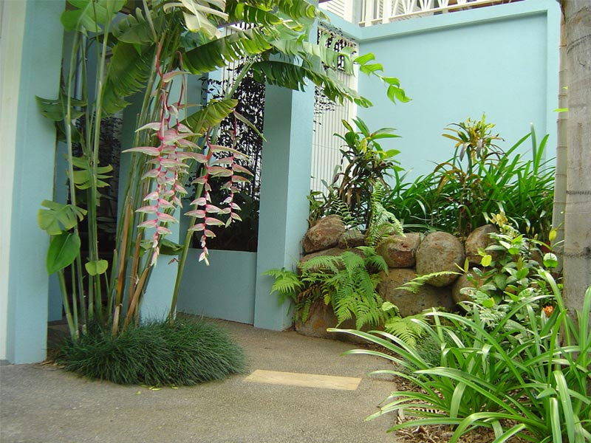
hortulus.com.au
Notes:
http://www.google.com/imgres?imgurl=http://www.hortulus.com.au/assets/Uploads/_resampled/CroppedImage410350-design.jpg&imgrefurl=http://www.hortulus.com.au/design/&usg=__IcE4fVlNVoal1rmHLue2cgceack=&h=350&w=410&sz=39&hl=en&start=70&sig2=yxpa5bO9FMr-d_WLgYdZuw&itbs=1&tbnid=BlaRd72WiC2jmM:&tbnh=107&tbnw=125&prev=/images%3Fq%3Dlandscape%2Bdesign%26start%3D54%26hl%3Den%26sa%3DN%26gbv%3D2%26ndsp%3D18%26tbs%3Disch:1&ei=pvoFTMP7I4quNYa7jIwJ

Slide 23
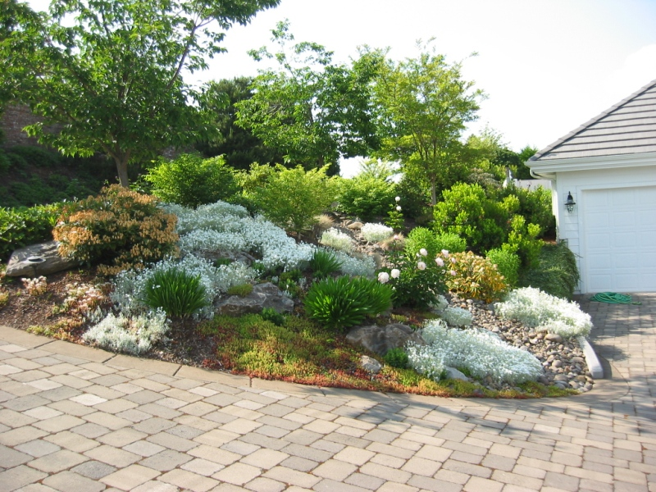
landscapedesignplans.net
Notes:
http://www.landscapedesignplans.net/landscape-design-plans-rock-garden-gardengirly-designs.jpg

Slide 24
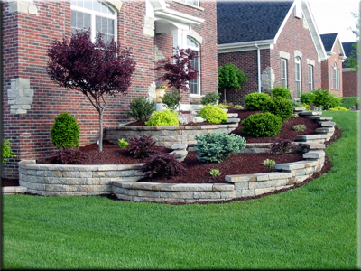
goodfellasgroup.com
Notes:
http://www.google.com/imgres?imgurl=http://goodfellasgroup.com/images/landscape_wall_jqvh.jpg&imgrefurl=http://goodfellasgroup.com/Landscape_Design_Install.html&usg=___BTYJmDEGbe6o_TCLuZOglDXYFo=&h=300&w=400&sz=121&hl=en&start=78&sig2=985gTzh-n5rjM0fnIqnAqQ&itbs=1&tbnid=kDAlRqNaQfpW1M:&tbnh=93&tbnw=124&prev=/images%3Fq%3Dlandscape%2Bdesign%26start%3D72%26hl%3Den%26sa%3DN%26gbv%3D2%26ndsp%3D18%26tbs%3Disch:1&ei=3PsFTJTLDoGkNcvflYMJ

Slide 25
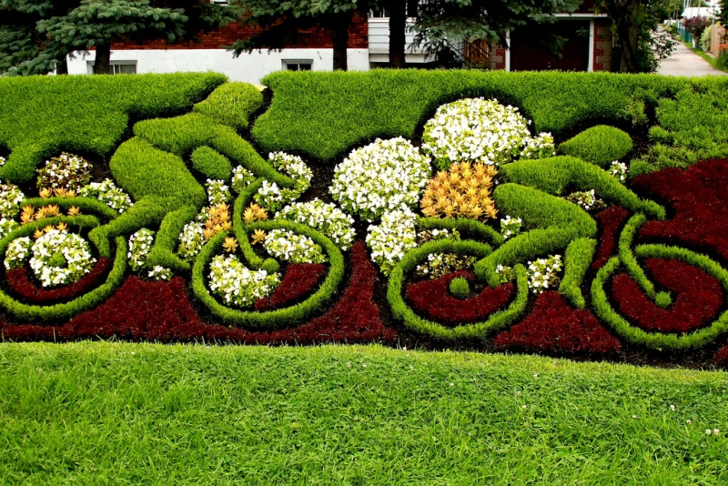
landscapedesignplans.net/
Notes:
http://www.landscapedesignplans.net/landscape-design-plans-bush-hedge-cyclists-Uncle-Paul-T-designs.jpg

Slide 26
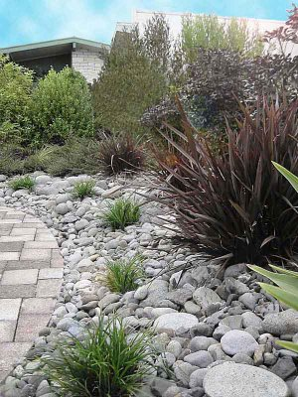
2.bp.blogspot.com/
Notes:
http://2.bp.blogspot.com/_VZ4JrUl0w_4/SYJz5sOXYwI/AAAAAAAAAOk/6NjjgCSuoXY/s400/Nz+landscape+design+designer+plans.jpg

