Slide 1




The Boise WaterShed Project: A Community Collaboration
Jan Smith, Boise State University
Cindy Busche, The Boise WaterShed
Eian Harm, West Ada School District

Slide 2
The Collaborators
The Boise WaterShed
  City of Boise Environmental Education Center with a mission to teach people of all ages about water protection and conservation
  Third year partner with West Ada School District and Micron Foundation for 2nd grade field trips
IDoTeach
  Secondary education teacher preparation program for STEM majors at Boise State University
  Replicated from innovative Uteach program
West Ada School District
  Interested in increasing engagement through real-world and hands-on experiences for students
  Promoting an integrated and inter-disciplinary approach to STEM teaching

Slide 3
Background of the Partnership
Approximately 3000 second graders from the West Ada School District visited the Boise WaterShed this year.
IDoTeach pre-service teachers worked as interns
  Modified existing program to explicitly infuse STEM careers into the experience
  Designed interactive, hands on stations for students
Funded through the generous contribution of the Micron Foundation

Slide 4
Purpose of the Study
The purpose of this study was to investigate the benefits of community partnerships between school districts, universities, and organizations.
Specifically, we used the following questions to guide the study:
How does participation in the Boise WaterShed field trip impact knowledge of STEM careers for second graders?
How does participation in the Boise WaterShed field trip impact interest in STEM careers for second graders?

Slide 5
Review of Literature
Early Introduction to STEM through Community Partnerships
  Features of successful partnerships (Watters & Diezmann, 2013)
Children’s Vocational Development
  Current disconnect between work and school (Porfeli, Hartung, & Vondracek, 2008
  Doing Science vs. Being a Scientist (Archer, et. al. 2010)
  More resources are needed to bridge this connection
Increasing the STEM Pipeline
  Bringing engineering to P-12 Classrooms (Brophy, Klein, Portsmore, & Rogers, 2008)

Slide 6
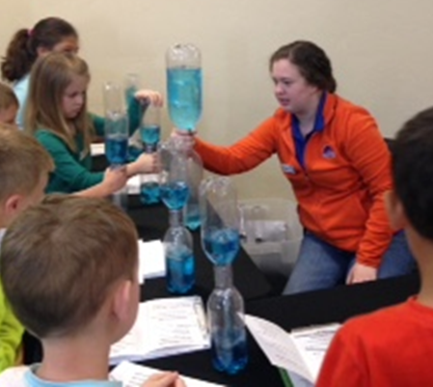

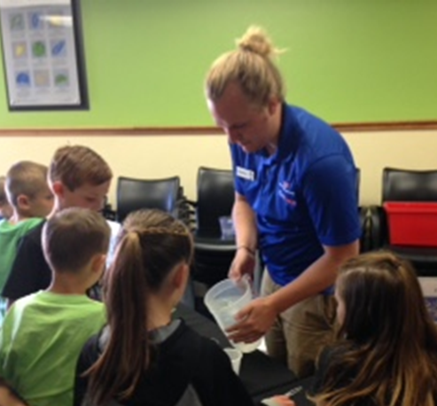
Teaching Strategies
Explicitly teach about engineering
and meteorology during the weather
lesson
Include hands on centers for
students to rotate through
Meteorology Notebook

Slide 7
Methods
Survey was administered before and after the field trip
  5 point scale using smiley faces
Initial survey was piloted with one group of students
  Changes were made to the survey
Every third survey was entered for data collection (both pre and post)

Slide 8
Questions and Reliability
Knowledge of STEM Careers:
  Questions 1, 5, and 6
    reliability: Pretest, α=.609, post test α = .751
Interest in STEM Careers:
  Questions 2, 3, and 4
    reliability: Pretest, α = .556, posttest α = .695

Slide 9
Student Survey Results by Category
d=.57
d=.43
* All means are significantly different at the p<.05 level

Slide 10
Student Survey Results
Student Responses on five point scale
d=.80
d=.21
d=.44
d=.35
d=..48
d=.55
Individual Question Analysis
* All means are significantly different at the p<.05 level

Slide 11
Discussion and Implications
Informal educational experiences for young children can help develop vocational awareness and interest.
Does increased engagement lead to increased outcomes (aka. increased learning?)
Specific focus on STEM may help increase the STEM pipeline
How do we create collaborative projects such as this to ensure sustained “real world” experiences in STEM through student academic career?

Slide 12
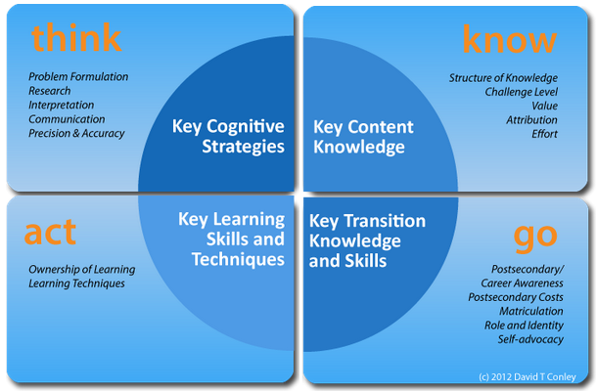
College and Career Readiness

Slide 13
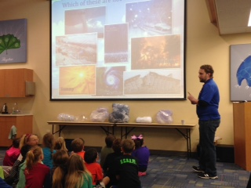
Future Research
Continue to measure the impact of this experience for students over time
  Interest and test-based measurements of outcomes directly due to engagement
  Do we see increase in STEM major or career entry?
Study the impact this
partnership has had on
IDoTeach interns
(Interviews with IDoTeach students are in progress)
Notes:
The experience, “strengthened my confidence and abilities to take charge of a big group.” -Kevin Shrumm
“I enjoyed it immensely and the fact that I enjoyed it so much makes me excited to be a real teacher someday.” -Mason Kreamer
The experience, “strengthened my confidence and abilities to take charge of a big group.” -Kevin Shrumm
“I enjoyed it immensely and the fact that I enjoyed it so much makes me excited to be a real teacher someday.” -Mason Kreamer

