Slide 1
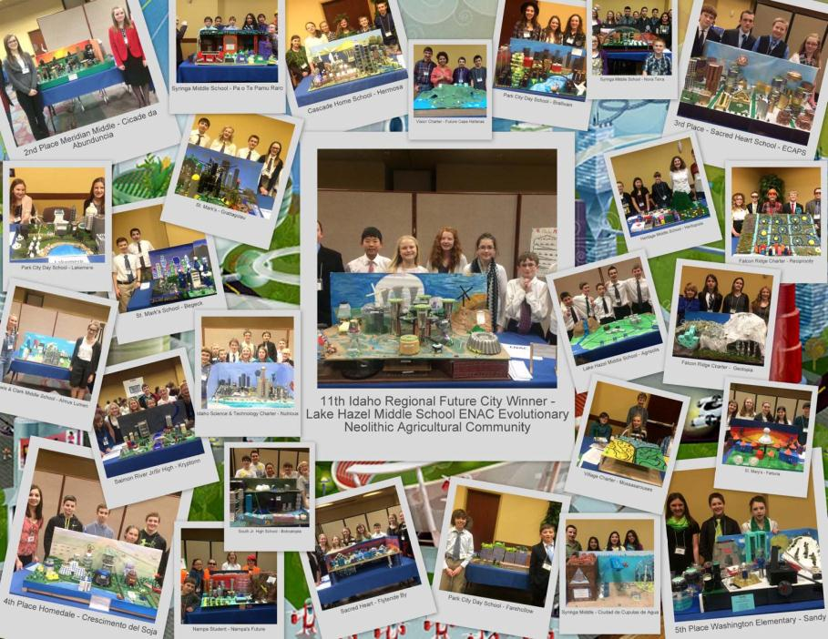

Future City

Slide 2
Presenters
Lynn Olson
  Idaho Regional Future City Coordinator
Melyssa Ferro
  Earth, Life & Advanced Science Teacher, Syringa Middle School, Caldwell, ID
Karissa Hardy
  ID Steering Committee member & Mentor
Students Lake Hazel Middle

Slide 3
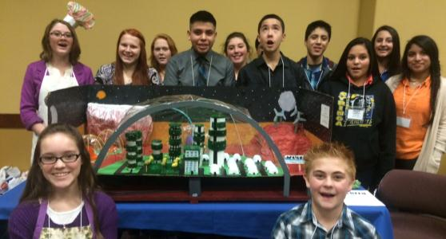
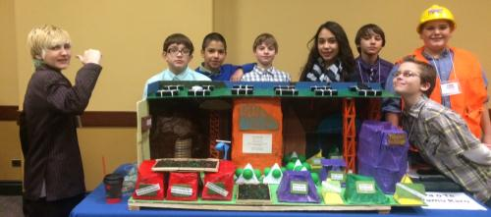
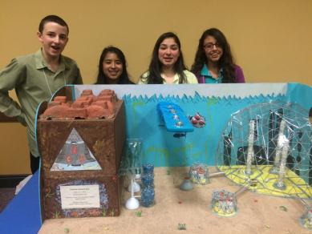
Future City - Who
Future City Participants
6th-8th grade
public, private, home schools
recognized youth-focused
organization such as Boy/Girl Scouts, Clubs, 4H, Y
minimum of 3 students up to entire classroom
3 teams per school

Slide 4
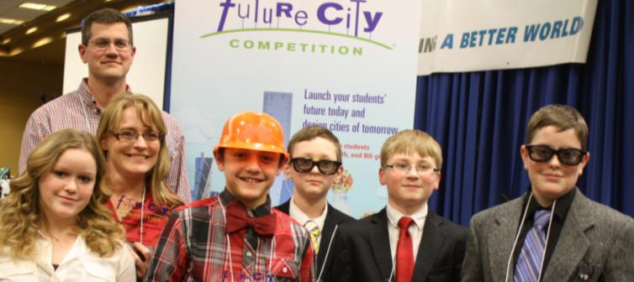
Future City - Who (cont.)
Support Team
Educator
Mentor (Engineer)
ID Steering Committee – ideas/contacts
Website (new and improved, launching July 2015)
  About program, leading team, resources
Revised Handbook – framework for engineering design process, project management, activities
Online webinars
Online Project Management Center

Slide 5
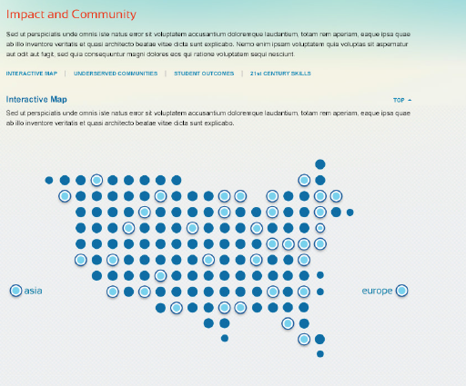
Future City - Who (cont.)
2015-16 Idaho Schools
Battle Mountain Middle School (new)
Falcon Ridge Charter School
Idaho Science & Tech Charter School
Homedale Middle School
Kootenai Elementary (new)
Lake Hazel Middle School
Meadows Valley Jr/Sr. High School (new)
Meridian Middle School
Sacred Heart School
Saint Mary’s School
Salmon River Jr./Sr. High
South Junior High
Syringa Middle School
Timberline Schools (new)
Vision Charter School
Washington Elementary

Slide 6
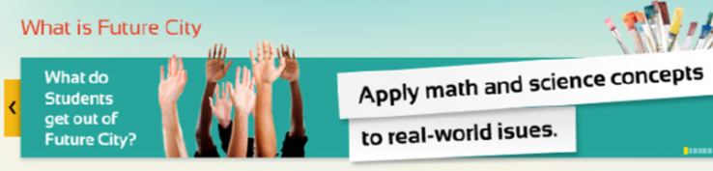
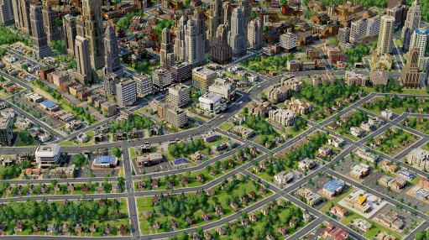
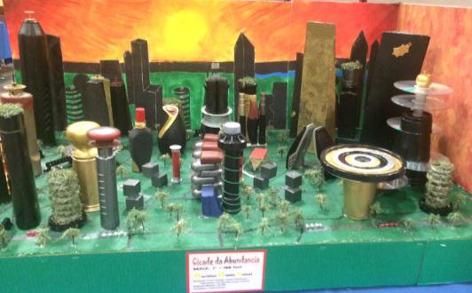
Future City – What
A national, project-based learning experience where students imagine, design, and build cities of the future.
  plan cities using SimCity™ software;
  research & write solutions to an engineering problem;
  build tabletop scale models with recycled materials
  present their ideas before judges @ 12th Idaho Regional Competition, January 23, 2015 Boise State.

Slide 7
Future City – What (cont.)
Students identify problems; brainstorm ideas; design solutions; test, retest and build; and share their results, aka, the engineering design process
Apply math and science concepts to real-world issues
Develop writing, public speaking, problem solving, and time management skills
Research & propose solutions to engineering challenges
Discover types of engineering & explore careers options
Learn how communities work to become better citizens
Develop strong teamwork skills

Slide 8
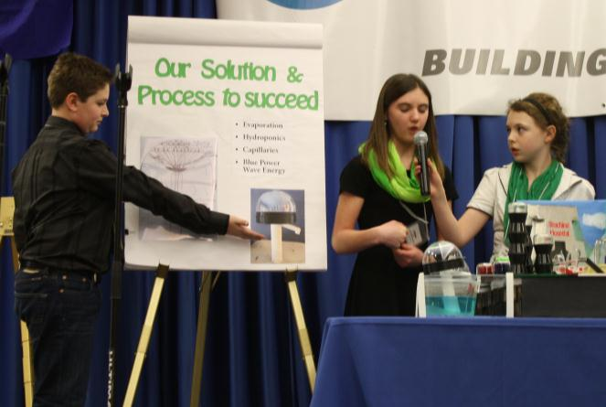
Future City – What (cont.)
Deliverables
SimCity (early Dec)
City Description (mid Dec)
  1500 words
City Model (at Competition)
  recycled materials, <$100
City Presentation (at Competition)
  7 minute presentation
Project Plan (1 week before Competition)
  4 worksheets
  plan, organize, stay on task, roles

Slide 9

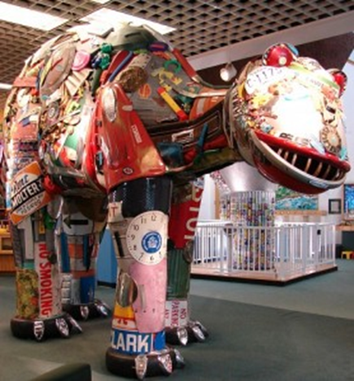


Future City – What (cont.)
Theme for 2015-16
Waste Not, Want Not Challenge:
Design an innovative city-wide solid waste disposal system for your future city that is safe, environmentally sound, and energy efficient.
Ideas for Field Trips
  Trash museums
  Local recycling centers
  Department of Public Works
  Keep America Beautiful
  Landfill tours

Slide 10
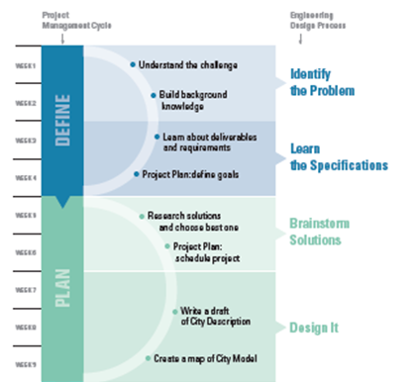
Future City - When

Slide 11
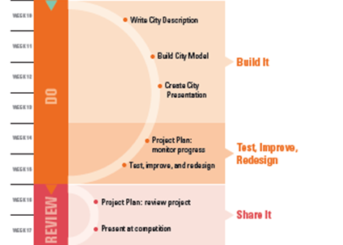
Future City - When

Slide 12
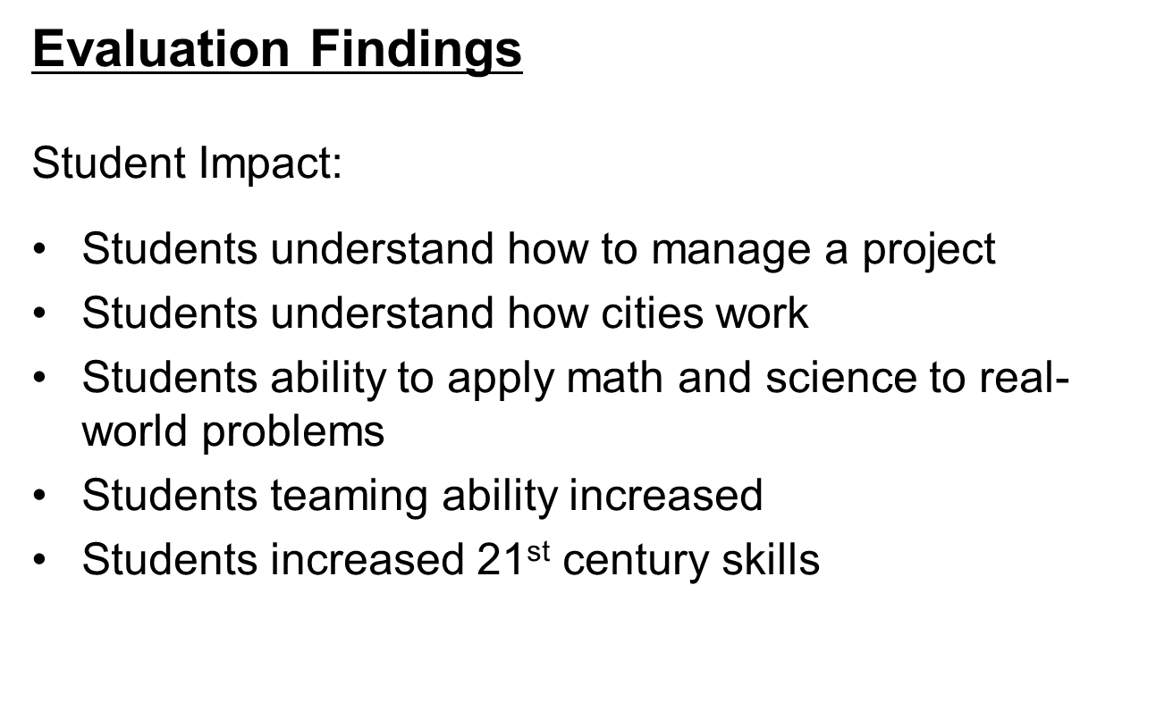
Future City - Why

Slide 13
Future City – Why (cont.)
Students Discover Engineering
84% report that Future City helped them see math and science are important to their future
65% can see themselves as engineers someday
61% want to keep doing other engineering clubs or activities.
The evaluation found a statistically significant improvement in students’ ability to apply engineering design process skills to real-world problems.

Slide 14
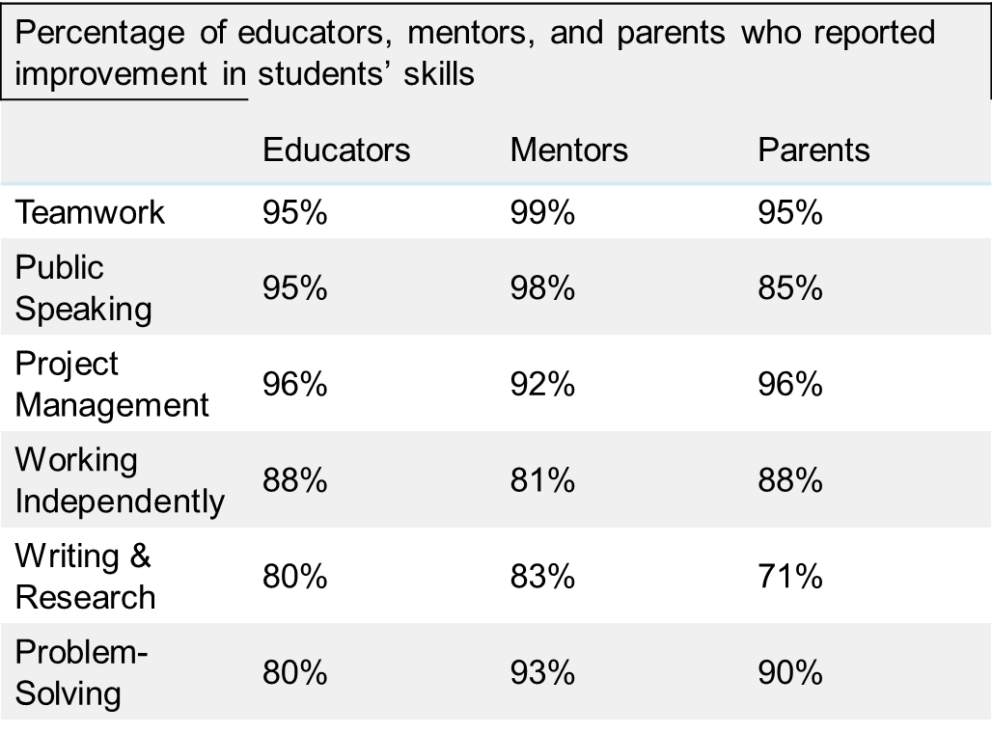
Future City – Why (cont.)

Slide 15
Future City – Why (cont.)
Future City Reaches Girls
43% of participants are girls
Students Drive Future City
75% of student reported making the design decisions
85% said Future City taught them that they could create something on their own – without direction of an adult.
Student Learn How Their Communities Work and Become More Informed Citizens
90% of students reported that Future City helped them to appreciate all of the engineering that goes into a city.
63% reported that Future City made them more aware of civic issues like politics and taxes.

Slide 16
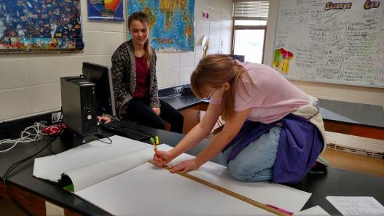

Future City – How from Teacher
Syringa Middle School
Compete as a class, 24-26
students on a team
Students choose one of 4 teams (SIM, essay, model, oral presentation) to work on based on interests and abilities
Each team selects 1-2 leaders who must communicate with other teams
Try to connect each class team with a mentor who is connected to students

Slide 17
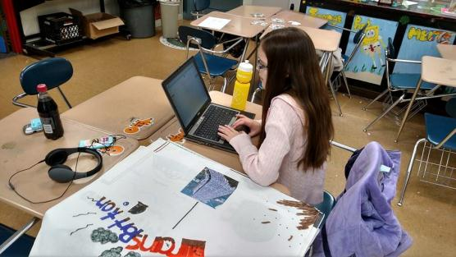
Future City – How from Teacher
Syringa Middle School
Calendar out deadlines as a whole class
Begin research (fieldtrips, webinars, etc.) as a class with oral presentation team serving as a clearinghouse for all ideas
As each team finishes their components, the become available to help as consultants to other teams

Slide 18
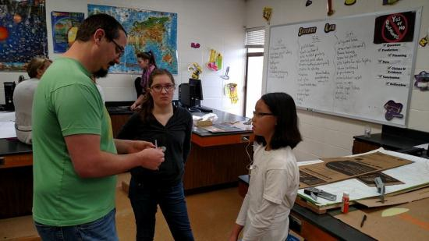
Future City – How from Teacher
Syringa Middle School
Work days during class time on Fridays (October-January) with mentors coming in as often as they can
Teams spend time during PAWS, after school and over breaks working as well
Final “dress rehearsal” party at Ferro’s house before January competition

Slide 19

Future City – How from Mentor
Lake Hazel Middle School
Who can be a mentor?
Engineers are preferred, but can also be another technical professional such as architect or planner
The intent of a mentor is to provide advice, guidance, and technical assistance to the students

Slide 20
Future City – How from Mentor
Lake Hazel Middle School
Time commitment and involvement varies,
the Future City “recommendation” is 12-14 hours.
Level of involvement of the mentor is flexible and is up to the educator and mentor.

Slide 21
Future City – How from Mentor
Lake Hazel Middle School
Future City as a Club
Met once a week after school for 1 ½ hours from mid September through January
Met several Saturdays and a couple of Friday evenings at student or mentor’s homes
Two teams worked collaboratively with two teachers and two mentors
At least one mentor attended all meetings, usually both mentors attended

Slide 22
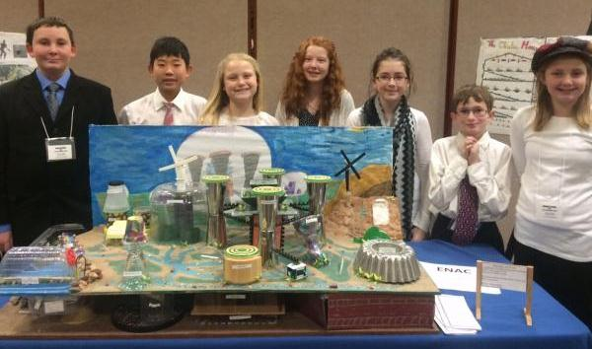
Future City – How from Students

Slide 23
Future City – How from Students
Presentation by
Lake Hazel Future City Team
Idaho 2014-2015 winners
ENAC (Evolutionary Neolithic Agriculture Community)
6th grade 7th grade mixed team
Students: Maddison Grunig (6th), Elliot Hardy (6th), Andrew Keller (7th), Yohan Lim (6th), Kylie Larandeau (6th), Nicholle Taylor (6th) & Amanda Walker (6th)
Educators: Sarah Baker & Ann Biason
Mentors: Karissa Hardy & Jim Baker

Slide 24
Future City – How from Students
Recap: what these students accomplished
Sim City Computer Model
Research Essay (1000 word max.)
City Narrative (500 word max.)
3D Scaled Model
Oral Presentation (7 minutes max.)

Slide 25
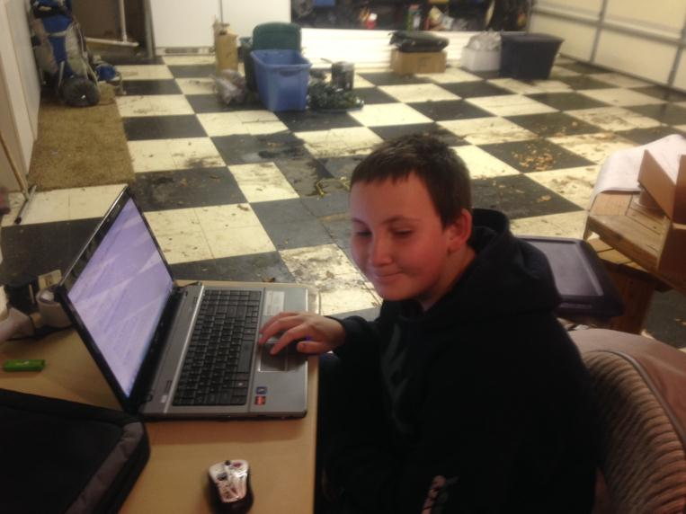
Future City – How from Students
1. Sim City Computer Model

Slide 26
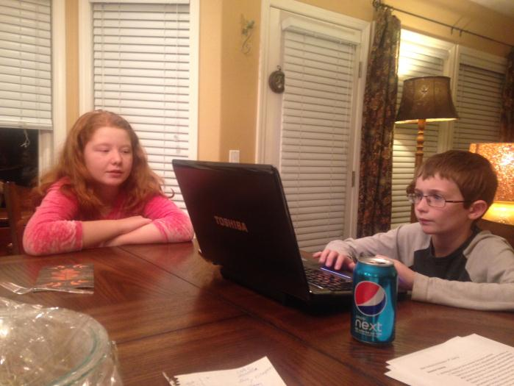
Future City – How from Students
2. Research Essay

Slide 27
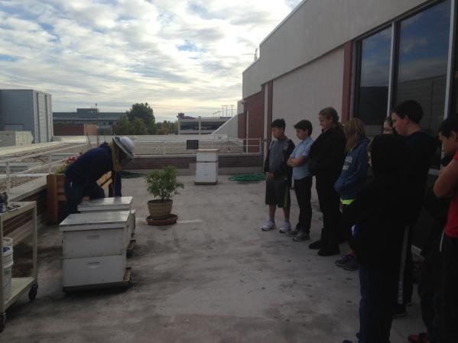
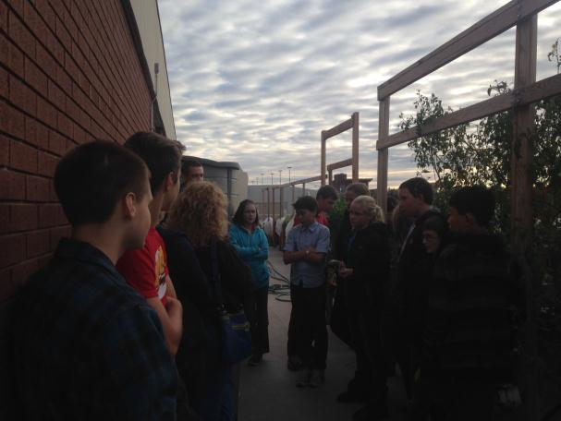
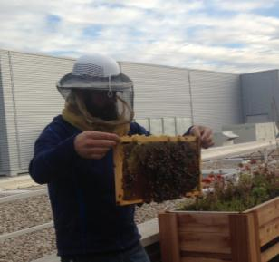
Future City – How from Students
Research: Field Trip to Boise State
Roof Top Garden and Bees

Slide 28
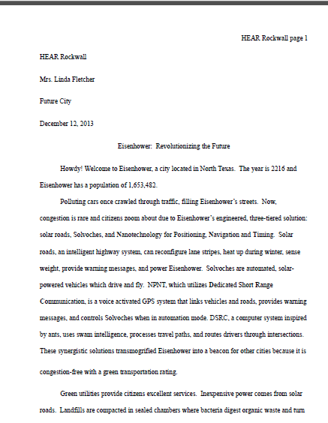
Future City – How from Students
3. City Narrative – Cool Features of City
Review past winners on-line
http://futurecity.org/gallery

Slide 29
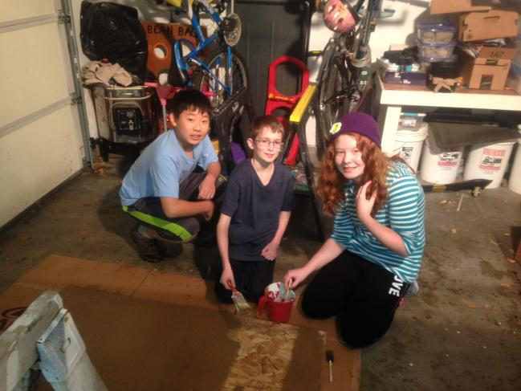
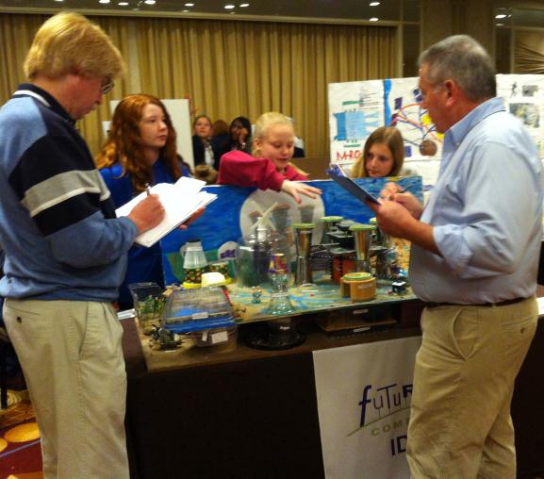
Future City – How from Students
4. 3D Model

Slide 30
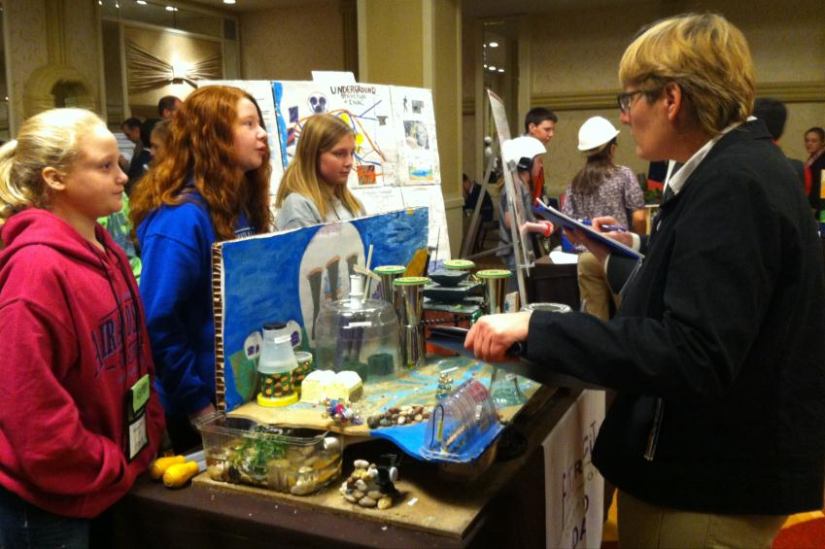
Future City – How from Students
5. Oral Presentation

Slide 31
Future City – How from Students
Oral Presentation clip (max. 7 minutes)

Slide 32
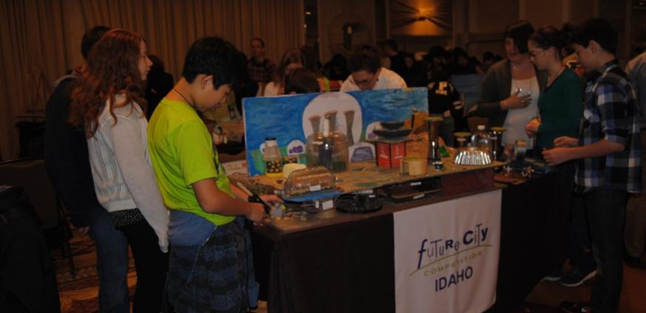
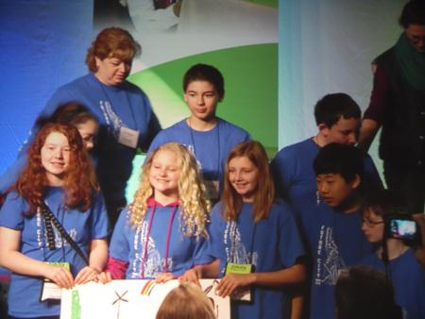
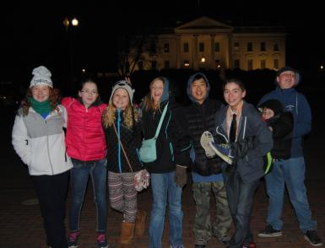
Future City – How from Students
National competition in Washington D.C.

Slide 33
Future City – How from Students
Student Discussion
What did you learn?
What was your favorite part?
What did you learn about city planning?
Talk about some futuristic aspects of your city

Slide 34
Future City – How from Students
Questions?

