Slide 1
Degree Programs in Idaho that Prepare Students for High Demand STEM Careers
June 9, 2015
Larry Stauffer
Dean, College of Engineering, UI
Amy Moll
Dean, College of Engineering, BSU

Slide 2
Overview
Current characterization of STEM
Career demand in STEM
AP Introduction to Engineering
STEM education opportunities in Idaho
Supporting diversity in STEM fields
Notes:
In this presentation we provide an overview of STEM careers that are in high demand and the post-secondary degree programs that are available in Idaho to prepare students for them. Current STEM initiatives lump all science, technology, engineering, and math majors together. This single characterization is fine in most K-12 situations as students just need to build an interest in technical programs. But the reality is that not all STEM fields are alike. Some STEM majors prepare students for careers that are in high demand and some in fields with many more applicants than positions. Some STEM careers require four or more years of college and some less. We will provide an overview of the various degree programs that are available in Idaho to prepare students for STEM careers that are in high demand and where students can go to earn them. We will also discuss how students can best prepare themselves for these majors while in high school. This preparation includes a new AP Introduction to Engineering course being developed by the College Board and slated to be introduced in 2018. This information should be of particular interest to K-12 teachers as they help students prepare to go on. We will also discuss why improving diversity in these fields is especially important and how K-12 teachers can support diversity.

Slide 3
Warnings
There are always exceptions.
Don’t take it personally.
Notes:
As best we try, none of the data and charts presented will be exactly right. Studies have inherent assumptions and we don’t truly know cause and effect. There will always be an exception and someone will have a story that goes against the data. We acknowledge that. We can only report what generally is known. Also, don’t take this information too personally. By saying something ranks higher or lower than something else may offend those in the lower categories. We are not attempting to dismiss anyone; just tell it like we see it. There will always be a different opinion.

Slide 4
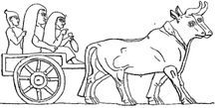
The Future of Work
Forces of the past: interchangeable parts, electrification, agricultural technology
Forces of the future: artificial intelligence, sensors, robotics
Notes:
Society has seen major changes in the nature of work and this change will keep coming. If you go back a century or more, the concept of interchangeable parts enabled workers of less skill to become more productive. Electricity became available everywhere that provided the power for a wide variety of devices. Technology was applied to agriculture such that we have gone from a society where half of all workers were involve in our food and fiber to less than 2% today. The near future is no different. Advances in technologies such as artificial intelligence in conjunction with inexpensive, numerous sensors will bring decision making to many applications and the robots will make them mobile. Many types of work from driving cars, buses, and airplanes to cleaning the house, making dinner, and doing the dishes will be done by technology; not people. Someday, intelligent robots will be a part of teaching your kids. The educational needs of tomorrow will not be the ones of yesterday. But no one knows what they will be.

Slide 5
What is STEM?
STEM movement “started” around 2000
STEM is a WORKFORCE and COMPETITIVENESS initiative
STEM is about keeping wages down and immigration
STEM is losing focus
Notes:
The current use of the acroynm STEM started with the NSF around the turn of the century and has increased in visibility ever since.
STEM is a workforce and competitive initiative. We don’t want to lose our competitive edge. We can’t have an economy where everyone just sells insurance and lattes to each other. We need to create new technologies and produce products and we need the people to do it. The reason the STEM initiative exists is we have more jobs in certain areas than we have trained people to fill them. STEM is also about keeping wages down. If we don’t address the shortage, wages will have to climb even further to attract people to the field. Or we will have to “import” more technical workers (H1-B visa caps) or send more technical jobs overseas where the relative percentage of critical STEM fields are greater and relative wages are lower.
One thing that worries me is that STEM is losing its focus. It has taken on a perception of importance, that somehow STEM fields are more important to society than non-STEM fields. To this I say Hogwash.

Slide 6
STEM or STEAM
“It’s an effort to broaden the dialogue that has developed around STEM, or science, technology, engineering and math. Instead of STEM, there is an effort to make sure that art is not left out of the conversation.” Pittsburg Bizjournal
Schools should promote the value of every discipline.

Slide 7
The STEM Pipeline
Retention
Underrepresentation
Notes:
We could improve retention and the STEM issue goes away. There used to be a saying, look to your left and look to your right. In four years only one of you will be here. Sad, but true. The situation hasn’t changed. There is also a problem with underrepresentation of women and minorities. Only 18% of engineering students are women. A smaller % are Hispanic or black. We are losing a huge group of potential students. Improving either of these issues could make the entire STEM pipeline issue a non issue.

Slide 8
It’s Not About Job Growth
Top Job Openings through 2022 Bureau of Labor Statics
1 | food preparation
2 | cashiers
3 | wait person
4 | nurses
5 | customer service rep
6 | laborer
7 | office clerk
8 | janitors
9 | personal care aide
10 | administrative assistants

Slide 9
It’s About Supply and Demand
Notes:
National Association for Colleges and Employers (NACE), which surveyed nearly 10,000 college seniors who were set to earn bachelor’s degrees in the spring of last year. NACE ran the survey from mid-February through the end of March. It pulled together a tally for students graduating in 17 different majors, who were looking for full-time work. This is not an exact indicator but probably not far off. Notice that some STEM fields are not in the high offers. For example, Environment Science is a STEM field but we have way too many graduates for the number of jobs available. All STEM fields are not the same.

Slide 10
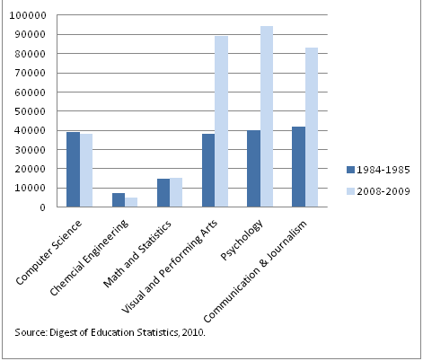
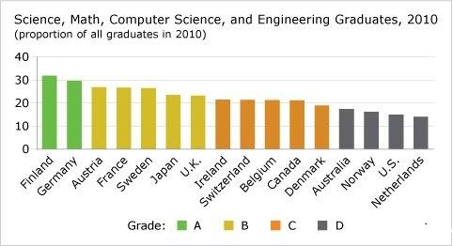
Over the last 30 years we have developed an imbalance
Number of Graduates
Conference Board of Canada
Notes:
Here is the real issue. Over the last 30 years we have developed an imbalance in the fields of the graduates to where the job are. Yes, there has been a growth in the number of jobs in fields such as psychology and communications. But not at the rate of growth in these majors. Meanwhile, there has also been a increase in the jobs for engineers and computer scientists but US schools are not producing more.

Slide 11
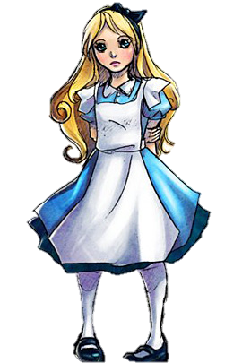
Not All STEM Fields are the Same
The Cheshire Cat and Alice
Notes:
In Lewis Carroll's classic, Alice in Wonderland, Alice asks the Cheshire Cat which way to go. The cat replies, "That depends a good deal on where you want to get to." Alice says, "I don't much care where." The cat then comments, "Then it doesn't matter which way you walk." When Alice adds that she doesn't care "so long as I get somewhere," the cat says, "Oh, you're sure to do that, if only you walk long enough!"
It is not good enough to just major in STEM. You need to “look under the hood”. Some STEM fields are in high demand (chemical engineering) and some are not (environmental engineering).

Slide 12
Salaries, Payscale.com
Highest 15 Majors
Rank | Major | Salary
1 | Petroleum Engineering | $102,300
2 | Chemical Engineering | $ 69,600
3 | Computer Engineering (CE) | $ 67,300
4 | Nuclear Engineering | $ 67,000
5 | Computer Science (CS) & Engineering | $ 66,700
6 | Electrical & Computer Engineering (ECE) | $ 66,500
7 | Electrical Engineering (EE) | $ 65,900
8 | Aerospace Engineering | $ 64,700
9 | Electronics & Comm Engineering | $ 64,100
10 | Materials Science & Engineering | $ 64,000
11 | Computer Science (CS) & Mathematics | $ 63,200
12 | Mechanical Engineering (ME) | $ 62,100
13 | Industrial Engineering (IE) | $ 61,900
14 | Software Engineering | $ 61,700
15 | Computer Science (CS) | $ 61,600
Lowest 15 Majors
Rank | Major | Salary
136 | Sociology | $ 38,600
137 | Environmental Studies | $ 38,500
138 | English Language & Literature | $ 38,500
139 | Hospitality Management | $ 38,500
140 | Health Sciences | $ 38,300
141 | Criminology | $ 37,900
142 | Film, Video & Media Studies | $ 37,500
143 | Sports Medicine | $ 37,300
144 | Psychology | $ 37,300
145 | Graphic Design, Illustration | $ 37,300
146 | Interior Design | $ 37,100
147 | Creative Writing | $ 37,100
148 | Music Performance | $ 36,800
149 | Broadcast Journalism | $ 36,100
150 | Religious Studies | $ 35,700
Notes:
Payscale.com is the authority in salaries. The top 15 majors with the highest starting salaries are all STEM fields. In fact, they are all engineering and CS fields. Why are the salaries so high? Largely it is because of supply and demand. What are the lowest starting salaries? They aren’t STEM fields.

Slide 13
Not All STEM Fields are the Same
Other STEM Majors
Rank | Major | Salary
19 | Electrical Engineering Technology (EET) | $ 58,900
20 | Physics | $ 57,200
24 | Mechanical Engineering Technology (MET) | $ 56,600
27 | Civil Engineering (CE) | $ 55,100
30 | Applied Mathematics | $ 54,300
41 | Environmental Engineering | $ 51,400
60 | Geology | $ 46,200
72 | Chemistry | $ 44,200
93 | Environmental Science | $ 42,000
94 | Microbiology | $ 41,900
99 | Geography | $ 41,500
107 | Agriculture | $ 40,900
111 | Biology | $ 40,700
112 | Forestry | $ 40,700
140 | Health Sciences | $ 38,300
Notes:
Here are some STEM majors that might surprise you! In the top 25 we begin to see some of the engineering technology majors earning more. But a lot of non-STEM fields command good starting wages. But look at many of the sciences. Geology, Chemistry, Environmental Science are getting into the lower half of the pay scale. Biology is in the bottom third. Why? The supply is greater than the demand.

Slide 14
Summary Comment
STEM education is vital in junior high to get them thinking of technical careers
In high school, students need to be encouraged to pursue majors in selected fields of engineering, technology, and computer science

Slide 15
STEM TIMELINE
High School
Technology AS, 2 yrs
Science, 2 yrs
Engineering, 2 yrs
Science, Engineering, Mathematics, 4 yrs
Science, Calculus, Pre-Engineering, 2 yrs
Mathematics, 2 yrs
Technology BS, 4 yrs

Slide 16
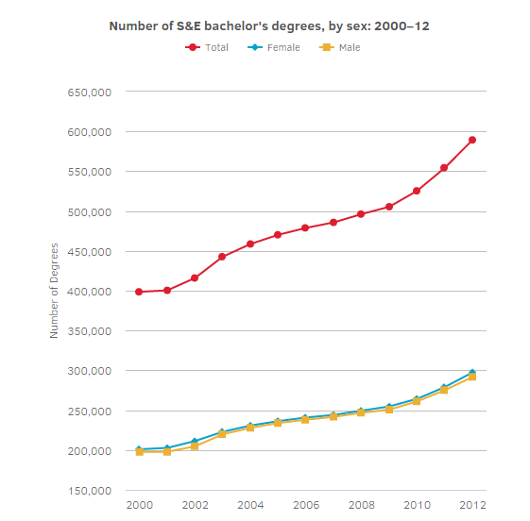
National Science Foundation STEM Education Data
https://www.nsf.gov/nsb/sei/edTool/explore.html

Slide 17
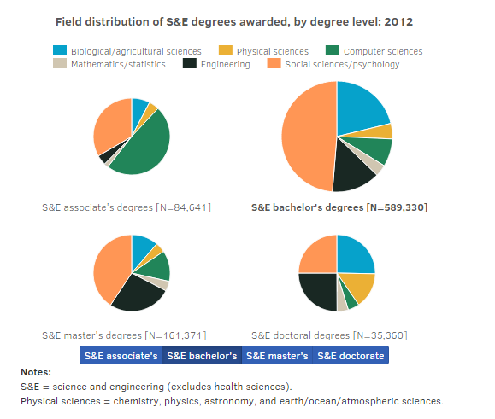
National Science Foundation STEM Education Data
https://www.nsf.gov/nsb/sei/edTool/explore.html

Slide 18
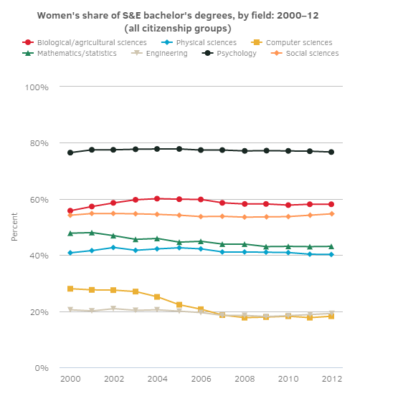
National Science Foundation STEM Education Data
https://www.nsf.gov/nsb/sei/edTool/explore.html

Slide 19
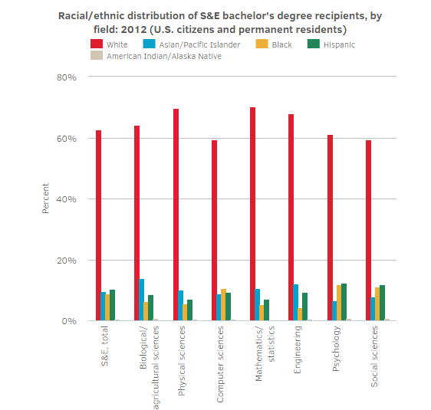
National Science Foundation STEM Education Data
https://www.nsf.gov/nsb/sei/edTool/explore.html

Slide 20
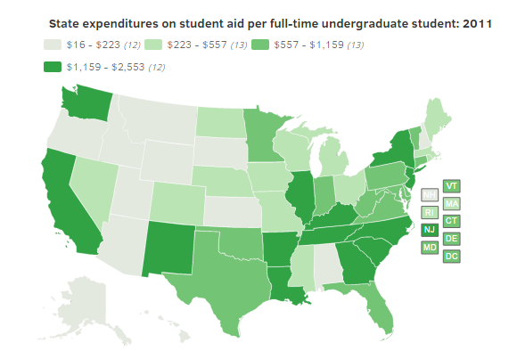
National Science Foundation STEM Education Data
https://www.nsf.gov/nsb/sei/edTool/explore.html

Slide 21
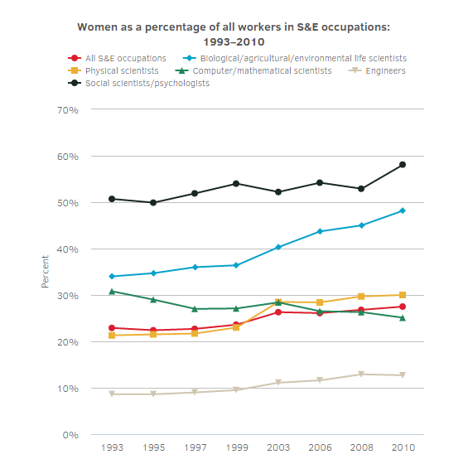
National Science Foundation STEM Education Data
https://www.nsf.gov/nsb/sei/edTool/explore.html

Slide 22
Where to get an engineering or computer science degree in Idaho?

Slide 23
B.S. Degrees in Engineering and CS
 | UI | BSU | ISU | BYU-I | NNU | CofI
Computer Science | X | X | X | X | X | X
Computer Engineering | X |  |  | X
Electrical Engineering | X | X | X | X | *
Mechanical Engineering | X | X | X | X | *
Civil Engineering | X | X | X | X
Nuclear Engineering |  |  | X
Chemical Engineering | X
Materials Science & Engineering | X | X
Biological Engineering | X
*Note: NNU offers a BS in Engineering with specialization in EE, ME or Engineering Physics

Slide 24
Technology Programs
 | NIC | LCSC | CWI | CSI | ISU | EITC
Engineering Technology Education | X |  |  | X
Information Systems Technology | X |  |  |  | X
Skilled and Technical Sciences | X |  | X | X | X | X
Pre-Engineering Education | X | X |  | X
 | X |  | X | X | X

Slide 25
B.S. Science and Math Programs
 | UI | BSU | ISU | BYU-I | NNU | CofI
Biology | X | X | X | X | X
Chemistry | X | X | X | X | X
Physics | X | X | X | X | X | *
Geological Science | X | X | X | X
Mathematics | X | X | X | X | X | X
Geography | X

Slide 26
What should a H.S. student do if they want to major in engineering?
Well rounded education
Math
Science
Computer programming
English

Slide 27
How do we get more students interested in engineering?
http://www.idahostem.org/
Camps at universities
STEM Exploration Day
Discovery Center of Idaho
Discover Technology Bus
FIRST Robotics
Boys and girls club
Boy Scouts and Girl Scouts activities
Idaho Science and Aerospace Scholars
Let us know how we can help!

Slide 28
Myths about majoring in engineering
You have to be in calculus in HS
You have to love math
You have to be a nerd
Engineers are anti-social

Slide 29
AP Introduction to Engineering
Engage students in collaborative engineering processes to create solutions to meet the needs of society. The processes are:
Frame problems and opportunities
Define design requirements and specifications for solutions
Address constraints and assumptions
Evaluate solution alternatives
Engage in iteration to refine and improve attempted solutions
Explore a variety of engineering disciplines (e.g., biological, chemical, civil, electrical, mechanical, etc.) as they engage in multidisciplinary projects
Notes:
The College Board is developing an advanced placement course in engineering. The engineering deans are a part of the conversation. The course is proposed to focus on two main paradigms—engineering processes and engineering disciplines.

Slide 30
AP Course Content
20 page curriculum framework
Big Idea 1: Engineering and Society
Big Idea 2: Engineering Processes
Big Idea 3: Essential Engineering Content, Skills and Tools
AP exam mostly Big Ideas 3
AP course roll out in 2018
Notes:
There is an extensive curriculum framework organized around 3 Big Ideas. These ideas are around engineering and society, engineering processes, and the essential content, skills, and tools of engineering. For example, basic statistics, data analysis, bias, experimental design, significant figures, linear and non-linear modeling, prototyping, conservation of energy, etc.

Slide 31
Put the E back in stEm
Thanks for your attention
Let us know how we can help.

Slide 32
QUESTIONS?

