Slide 1
Effort Reporting
Kelly McDowell-Morgan and Wendy Kerr
Office of Sponsored Programs

Slide 2
Quick quiz
1) A PAR is?
A. An accurate estimation of the effort someone devotes to their various activities based on payroll
B. A report only required by the University of Idaho for internal checks
C. An exact account of the time devoted to a sponsored project
D. A real pain
2) Inaccurate effort reporting affects
A. The potential research opportunities for the PI
B. The future funding for the University
C. None of the above
D. A and B
3) Individuals who are paid on a sponsored project are obligated to complete an effort report.
A. True
B. False
C. It depends
4) The current Effort Report can only be certified by
A. The employee
B. The DGA
C. OSP
D. The employee or someone with comprehensive knowledge of their work
E. All of the above
5) Per current UI policy, PARs are certified
A. Weekly
B. Monthly
C. Semester-ly
D. Yearly
6) In what scenario would one need to enter text into the “Notes” section of the PAR?
A. If there are no problems with the PAR
B. If a payroll cost transfer needs to be done
C. If the effort reflected in the PAR does not account for actual effort
D. To say hello to Wendy

Slide 3
Topics to be covered
What is Effort Reporting?
Why is it necessary?
Who has to do it?
How is it done?
When is it done?

Slide 4
What is Effort Reporting?
Or,
Wait, am I in the right class?

Slide 5
What is Effort Reporting?
The University is required by federal regulations and accounting standards to ensure that the apportionment of compensation for faculty and professional and other staff accurately reflects the work performed by these individuals in connection with sponsored projects
          University of Idaho APM Chapter 45 Section A

Slide 6
What is Effort Reporting?
An official certification confirming that the effort put forth on a project is accurately reflected by supporting documents
  Payroll record

Slide 7
What is Effort Reporting?
The University of Idaho has selected an after-the-fact payroll distribution certification method
This is accomplished through the certification of PARs – Personnel Activity Reports

Slide 8
Why is it necessary?
Or,
So, why do I have to do this?

Slide 9
Why is it necessary?
Provides an internal check and balance
Office of Management and Budget (OMB) Circular A-21requires that we keep accurate record of effort distribution
Failure to do so jeopardizes future research opportunities for the PI
Also jeopardizes future funding for the University

Slide 10
Why is it necessary?
Harvard University
  $3,300,000 settlement
  Researcher spent fewer hours than promised on a research study
Johns Hopkins
  $2,600,000 Department Of Justice Settlement
  Faculty time and effort devoted to NIH grants was overstated.
  Knowingly overstated time worked
University of Alabama at Birmingham
  Fined $3,400,000
  Two separate lawsuits under false claims act
  In grant applications overstated percentage of work effort the researchers were able to devote to the grant.

Slide 11
Why is it necessary?
Northwestern University
  $5,500,000 DOJ Settlement-False Claims Act
  Researchers spent less time on NIH-sponsored projects than they reported.
  Misrepresentation of time spent
  Failed to comply with effort reporting standards
Florida International University
  $11,500,000 Settlement
  Cost Transfers incomplete documentation, grants used as a clearing account, cost transfers after grant had closed.
  Audit indicated that the faculty members’ time promised had not been properly documented and did not equate to actual effort.
Information compiled from: http://www.costaccounting.org
  Updated May 26, 2008
Notes:
Joke here

Slide 12
Who has to do it?
Or,
Wait, you want me to do what?

Slide 13
Who has to do it?
A University employee is required to complete a PAR when:
  Salaries/wages are partially or totally provided by:
    A sponsored program
    Federal funds
    Cost share

Slide 14
Who has to do it?
What if I cannot complete my PAR?
  In the event that an employee is unable to certify their effort, a responsible individual with means of verification can complete the effort report.
Cost share
  Mandatory committed
  Voluntary committed
  Voluntary uncommitted
    Not tracked or recorded

Slide 15
How is it done?
Or,
So, how do I do this?

Slide 16
How is it done?
OSP
  OSP generates the report from employee’s payroll records
  OSP does not create, calculate, or alter the numbers in any way
  The interactive form is then sent to the DGA for initial review

Slide 17
How is it done?
DGA’s
  Verify the information
  Add cost share data
  Initial check for errors
    Initiate payroll cost transfer if necessary
  Notify OSP of any terminated employees

Slide 18
How is it done?
PI
  Will receive three notices when PARs are due
    Must be completed within 30 working days
Notes:
Wendy breaks in and shows screen shots of the PAR and walks through accurate completion

Slide 19
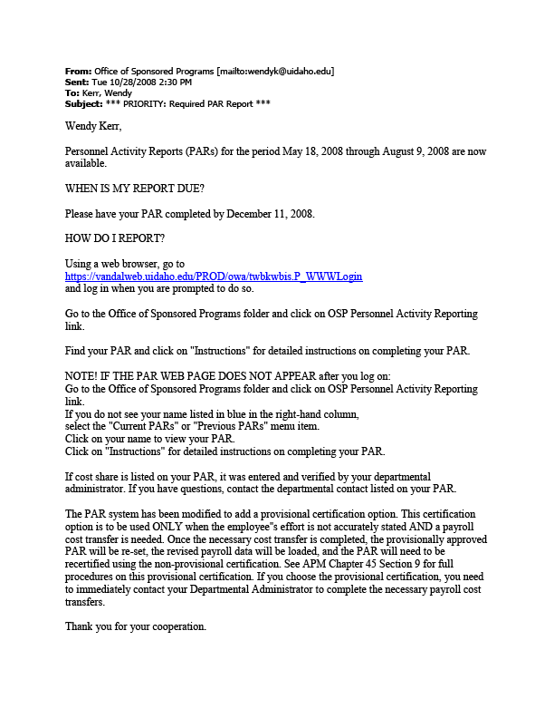
How is it done?

Slide 20
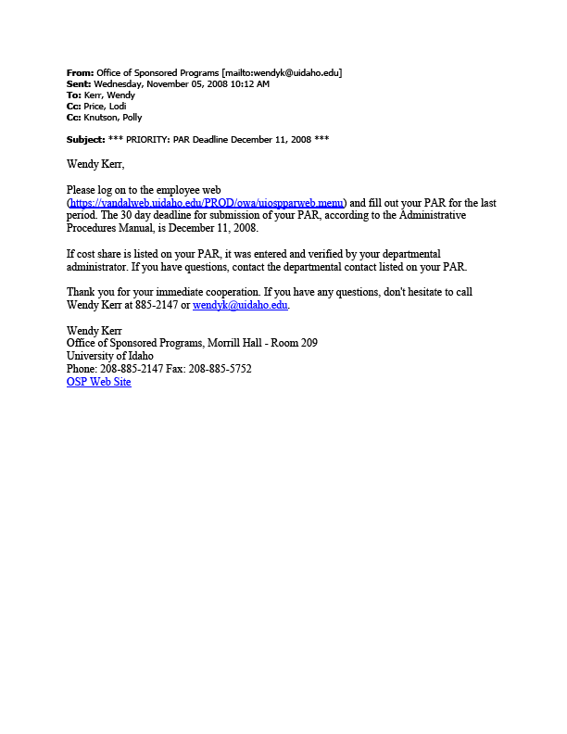
How is it done?

Slide 21
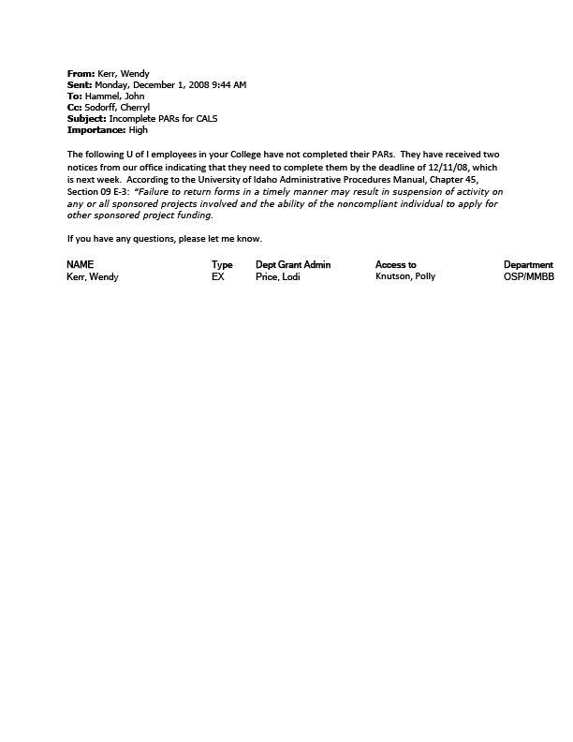
How is it done?

Slide 22
How is it done?
PI
  Log in to VandalWeb to access the PAR
  Talk with DGA first if there are problems
    Cost share, effort etc.
  Notes section
    Use for unusual circumstances (i.e. Academic Year employees paid over 12 months - “I work in the academic year on budget XYZ, but am paid over 12 months. No work was performed on budget XYZ during this time, I just received spread pay during this time period”)

Slide 23
How is it done?
“. . .the University requires that faculty and professional staff certify actual effort expended in terms of percentages of effort . . . Calculating effort using a percentage basis fosters faculty and staff compliance with effort reporting requirements by encouraging an individual to estimate his or her effort on a given activity as a percentage of his or her total University activities rather than as a fraction of a fixed time-period (such as the forty hour week). This process acknowledges that some fluctuation in effort levels is inherent in the conduct of academic activities.”
      University of Idaho APM 45.09 D-2

Slide 24
How is it done?
“ . . . It is recognized that, in an academic setting, teaching, research, service, and administration are often inextricably intermingled. A precise assessment of factors that contribute to costs is not always feasible, nor is it expected. Reliance, therefore, is placed on estimates in which a degree of tolerance is appropriate.”
          OMB Circular A-21 J10b(1)(c).

Slide 25
How is it done?
  Two types of certification
    Regular
      Everything looks the way it should (+/- 5%)
    Provisional
      The PAR is incorrect by a larger deviation than 5%
      Indicate on the PAR that there will be changes
      Initiate payroll cost transfer
      Once the transfer is completed, the correct allocations will flood into the PAR
      Recertify, this time as a regular certification

Slide 26
How is it done?
Back to OSP
  OSP reviews for accuracy
  Notifies DGA and PI if changes are needed
    Cost share over/under what was proposed or mandated
    Notes are confusing or in conflict with the data on the PAR

Slide 27
When is it done?
Or,
You want this, when?

Slide 28
When is it done?
Effort reports are currently completed at the close of every academic term
  Fall
  Spring
  Summer
Effective 1/1/09 Classified Employees will be required to certify effort monthly to be in compliance with OMB A-21, Section J10c(2)(e).
All other employees will continue to certify every academic term

Slide 29
Putting it all together
Or,
Are we going to have to know this for the test?

Slide 30
Putting it all together
Effort reporting is designed to be a best estimate of the effort you devoted to projects, teaching and other activities
The current system allows for +/- 5% deviation from actual effort.
Do not certify your PAR if you do not understand or agree with the data – use the provisional certification
This is not a time or labor intensive process, but it does require accuracy and prompt attention.

Slide 31
Another quick quiz
1) If you are paid in whole or in part from federal funds, a grant or sponsored project, or have part or all of your salary as cost-share
A. The University requires that you certify a PAR
B. You are responsible for tracking and recording your hours
C. The Federal Government mandates that your effort is tracked
D. All of the above
E. A and C only
2) Effort reports are based on
A. Actual UI payroll data
B. Numbers generated by OSP
C. Cost share only
D. All of the above
3) If I am not paid on a grant but part of my time is contributed as cost-share, I have to complete an effort report.
A. True
B. False
C. It depends
4) The PAR allows for what percent deviation from actual effort before an adjustment needs to be made?
A. 5%
B. 10%
C. 15%
D. 25%
5) As of right now, how often are PARs certified?
A. Every year
B. Every semester
C. Every quarter
D. Every month
6) PARs can be certified by
A. The employee
B. The employee or their DGA
C. The employee or someone with direct knowledge of the project (i.e. supervisor)
D. OSP
E. All of the above

Slide 32
What if I have questions?
For assistance with Effort Reporting, contact the OSP Cost Accounting Unit:
  Office of Sponsored Programs
    Wendy Kerr
    (208) 885-2147
    wendyk@uidaho.edu

