Slide 1

Module 4
Funding Opportunities

Slide 2
Objectives
In this module you will learn how to:
  Understand what an “opportunity” is
  Determine if an opportunity has already been downloaded into Cayuse424
  Download opportunities from Grants.gov into Cayuse424
  Manage opportunities

Slide 3
The Opportunity
An opportunity is a grant application package that is downloaded, completed and routed for review prior to submitting to Grants.gov
New proposals can be built once the Opportunity (i.e. FOA) has been downloaded into Cayuse424
Before you start to build your proposal you need to determine if the opportunity you are applying for has already been downloaded
You do this by reviewing the Opportunity List

Slide 4
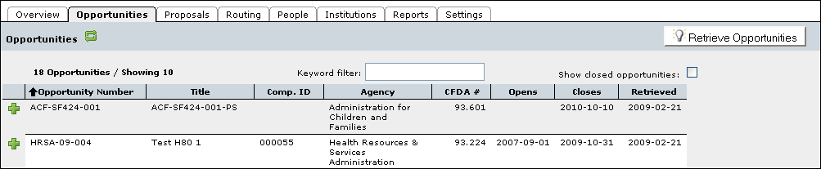
Reviewing the Opportunity List
Click the Opportunities Tab
Cayuse424 displays a list of opportunities already downloaded

Slide 5
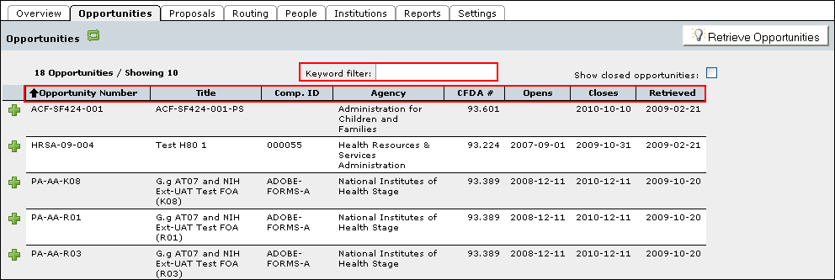
The Opportunity List
Filter the list using the Keyword Filter
Sort the list by clicking any of the column headings

Slide 6
Managing Opportunities
If you locate the opportunity you are applying for in Cayuse424, you do not need to download that opportunity again
If your opportunity has not been previously downloaded, if must be before you can proceed

Slide 7
Finding Opportunities
To retrieve an opportunity from Grants.gov you must know the Opportunity Number or CFDA#
You can obtain the Funding Opportunity number by going to www.grants.gov and using the Find Grant Opportunities link

Slide 8
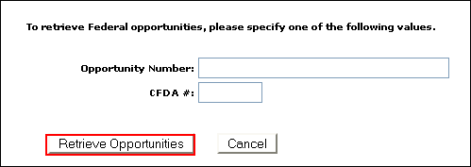
How to Download an Opportunity
1. Click the Opportunities tab
2. Click the Retrieve Opportunities button
3. Enter the Opportunity Number or CFDA # into the respective fields
4. Click Retrieve Opportunities

Slide 9
Using Opportunities
Simply select the opportunity using the green plus symbol.
Refer to the Proposal Creation training module for more details

Slide 10
Conclusion
In this module you learned how to use Cayuse424 to:
  Understand what an “opportunity” is
  Determine if an opportunity has already been downloaded into Cayuse424
  Download opportunities from Grants.gov into Cayuse424
  Manage opportunities

