Slide 1

Budget and Finance Update – Fall 2017
Please ask questions as we go – don’t feel obligated to wait until the end of the presentation!

Slide 2


Slide 3

The General Education Fund
What is it?
Who owns it?
Who finances/supports it?
Who manages it?
What is it used for?
How can it be spent?
How much is it?
One-to-many relationship (a shared fund)

Slide 4

The General Education Fund
Student Tuition
State Appropriations
Gen Ed Revenue Budgets
(Central Oversight)

Slide 5

The General Education Fund
Gen Ed Expense Budgets
(Unit Oversight)
Tuition or Appropriations???

Slide 6
FY18 General Education Revenue Budget (Projection Made in April)
Source | Total
State General Fund - Base | $ 90,696,100
State General Fund - One Time | 735,000
Land Grant Endowment | 10,099,200
Tuition & Fees | 74,369,700
Total General Education | $ 175,900,000

Slide 7
FY18 General Education Expense Budget (Authority to Spend as of July 1)
By Natural Classification
Cost Category | Total
Salaries & Benefits | $ 136,146,102
Operating | 32,215,939
One-Time | 735,000
Capital Outlay | 6,802,959
 | $ 175,900,000

Slide 8
FY18 General Education Expense Budget (Authority to Spend as of July 1)
By Functional Classification
Program | Total
Institutional Support | $ 32,345,602
Instruction | 72,034,153
Academic Support | 12,061,513
One-Time | 735,000
Research | 9,216,196
Library | 10,208,012
Auxiliary Enterprises (Athletics) | 4,352,000
Public Service | 181,626
Student Services | 10,530,140
Physical Plant | 24,235,758
Total General Education | $ 175,900,000

Slide 9
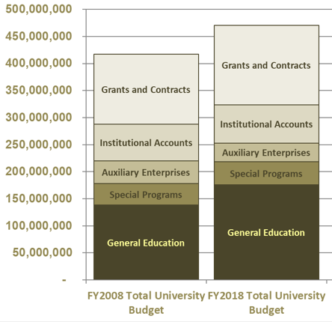
general education trends – which revenue source is growing in importance in financing university activities?

Slide 10
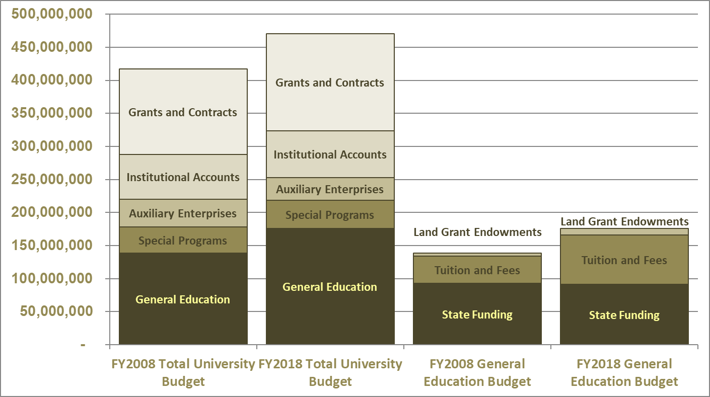
general education trends – which revenue source is growing in importance in financing university activities?

Slide 11
The General Education Fund
Budget vs revenue vs cash
What’s the difference?
What really matters?
Budget = spending authority on a shared fund like Gen Ed
What happens to unspent Gen Ed budget balances?
What is carryforward authority?

Slide 12
The General Education Fund
Revenue budget and variability
How do we set the state appropriations budget?
How do we set the student tuition budget?
State appropriations – annual budget variance is essentially zero
Student tuition – annual budget variance is…well…greater than zero

Slide 13
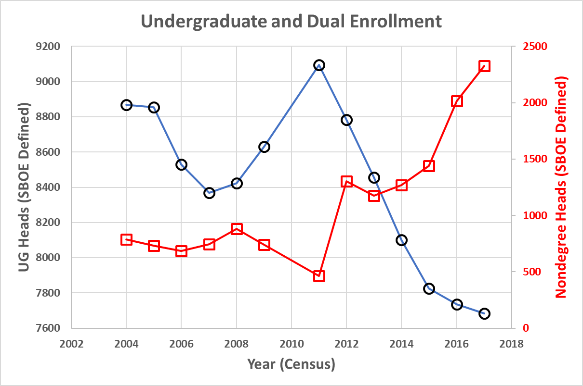
Enrollment – The October Surprise – What does this have to do with the Gen Ed fund???

Slide 14
Tuition Collections – The October Surprise – $2.1M Shortfall for FY18

Slide 15
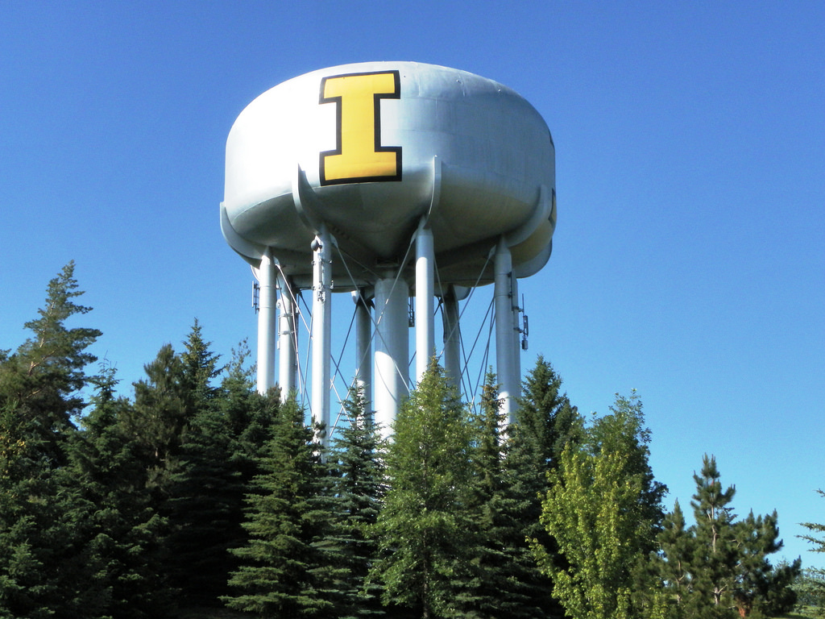
The General Education Fund
What should happen when tuition collections fall short of the budgeted amount?
What actually happens when tuition collections fall short of the budgeted amount?
Whose problem is a tuition collection shortfall?
Who should cover a tuition collection shortfall?
Who has been covering tuition collection shortfalls for the last decade?
Enter the Central Reserve (a Gen Ed fund belonging to “the Center”)
What happens when you combine unit carryforward authority with central tuition collection shortfalls?
What is the cumulative impact of this policy over the last decade?
$12.4M cumulative shortfall means an effective transfer of $12.4M from the center to the units.

Slide 16
The General Education Fund
GEN ED BUDGET - SIMPLIFIED EXAMPLE
Revenue | Budget |  | Actual |  | Variance
State Appropriations | 500 |  | 500 |  | 0
Student Tuition | 500 |  | 300 |  | -200
 | 1000 |  | 800 |  | -200
Expenses
Dept Biology | 300 |  | 280 |  | 20
Payroll Office | 150 |  | 120 |  | 30
Provost | 150 |  | 130 |  | 20
Dept Business | 250 |  | 240 |  | 10
Human Resources | 150 |  | 140 |  | 10
 | 1000 |  | 910 |  | 90
Surplus/Deficit | 0 |  | -110 |  | ???
What happens to this?
Who owns these balances?

Slide 17
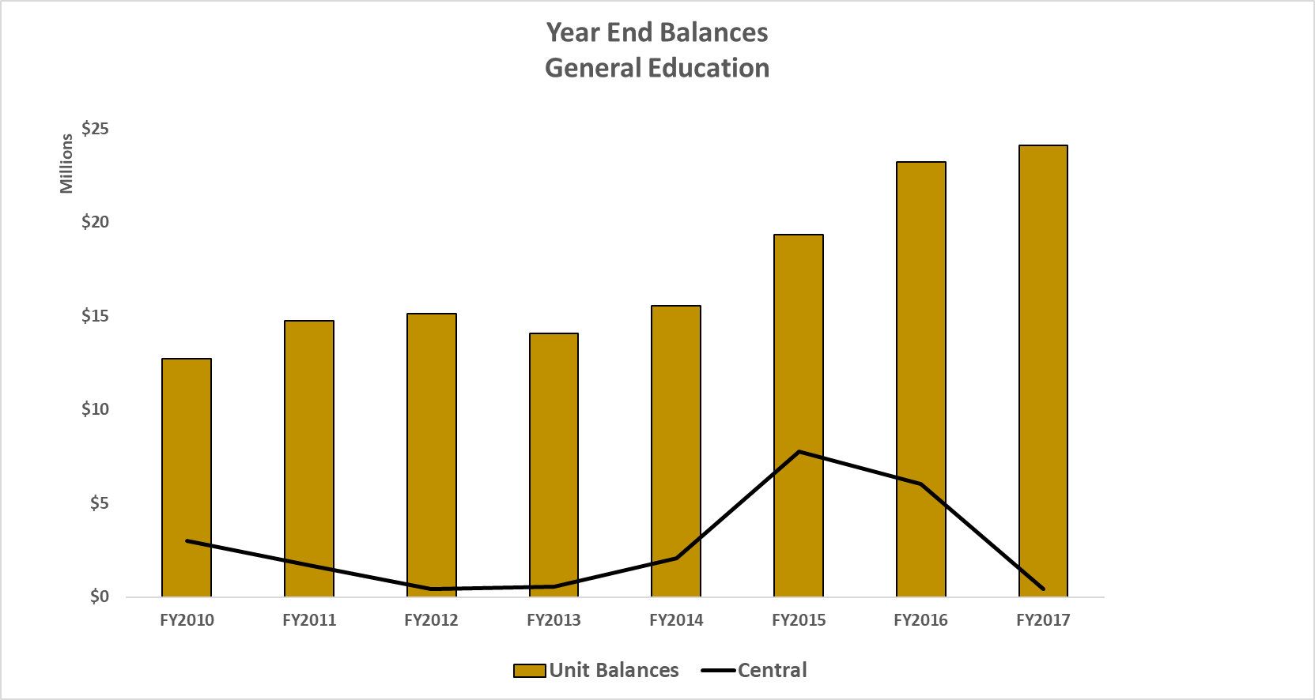
Central Reserves vs Unit Reserves – What it Actually Looks Like Today

Slide 18
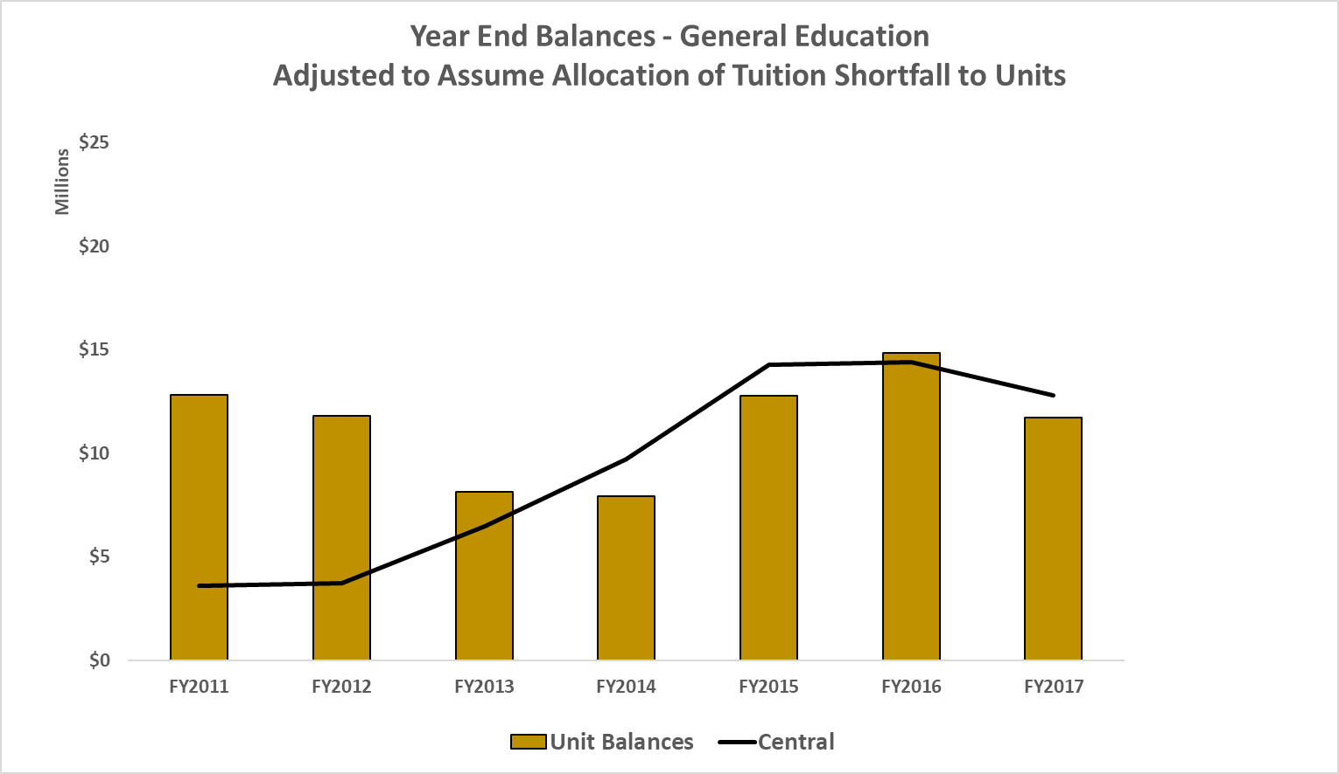
Central Reserves vs Unit Reserves – What it Would Have Looked Like If…

Slide 19
Central Reserves vs Unit Reserves – Which approach is best for U of I?
Perhaps somewhere in the middle of these two extremes?

Slide 20
General Education Year-End Balances: 7-Year Trend (FY2010 – FY2017)
On average, all Units across campus experienced an 89% increase in Gen Ed year-end balances, while…
Central University reserves decreased by 85%
At the end of FY2017, Central reserves were equal to only 0.2% of the total FY18 Gen Ed revenues
Overall Gen Ed balances = 14% of FY18 Gen Ed revenues

Slide 21
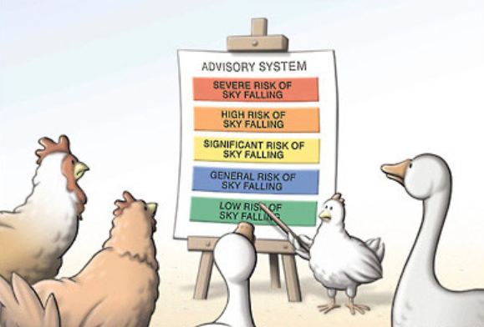

Slide 22
The General Education Fund
Provost and SEM have offered to cover the $2.1M shortfall from their carryforward balances. But this is a one-time fix, and we can’t keep doing this in the future.
This solves the problem for one year only (FY18), and keeps us from having to cut budgets in a time when we are trying to invest in people and programs in order to grow enrollment.
At the same time, it creates a challenge and an opportunity. Absent significant growth and/or right-sizing budget cuts, we’ll face a similar tuition collection shortfall at this same time next year.
What can we do to redesign our accounting systems and budget policies to encourage us to shift our thinking from a group of confederated units to a single university?
Without a change, we’ll continually run from fiscal crisis to fiscal crisis.
Current policies and practices create the need for things like gainsharing, and impose opportunity costs on the institution.

Slide 23
The General Education Fund
If we each continue to stare at our own small piles of cash, the University will never have the resources it needs to effect change.
The current financial structure sets us up for conflict, implies disparity, encourages silo mentality, does not support university-wide thinking.
With the Chart of Accounts project going live for FY19, we have an opportunity to redesign business practices and budget policies to support a university-wide mindset.
We need an increase in financial transparency, and we want to involve you in the conversation about achieving long-term viability. Let’s work together to develop a path forward. Otherwise, we’ll simply continue to run from fiscal crisis to fiscal crisis.

Slide 24
The General Education Fund – sli.do
Who should we involve in the conversation? Who should be represented on a committee?
What current financial policies, practices, and processes should be considered?
How long should a committee need to complete this work? When should a change be implemented?
Have we missed anything? What else should we consider?
SLI.DO Event #J331

