Slide 1
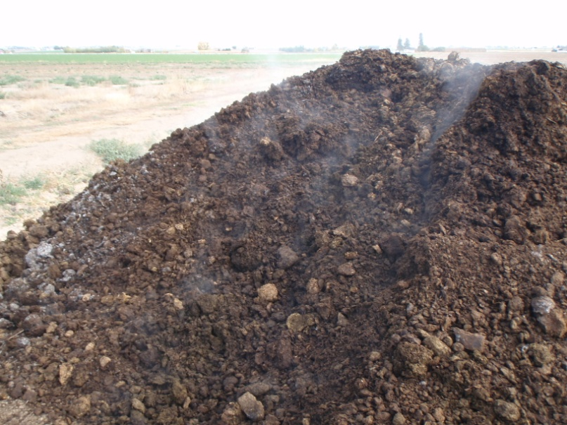
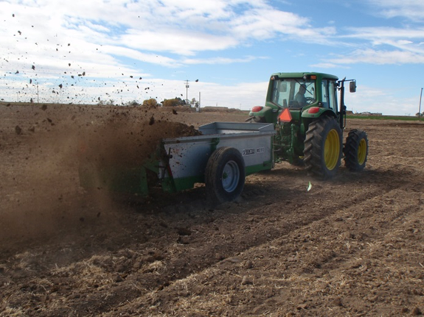

Manure and Environmental Impacts
Amber Moore et al.
Extension Soil Fertility Specialist
University of Idaho
Twin Falls, Idaho

Slide 2
Today’s Discussion
Environmental Impacts and Manure
  Nitrate leaching
  N mineralization
  Nitrous oxide emissions
  Soil Phosphorus accumulations
  Phosphate leaching
  Crop nutrient removal potential

Slide 3
Nitrate leaching and manure

Slide 4
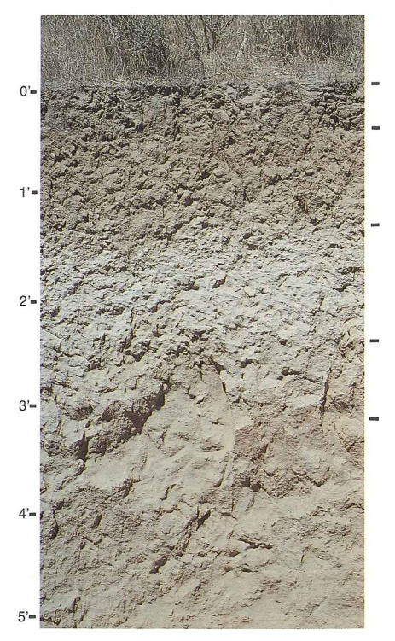
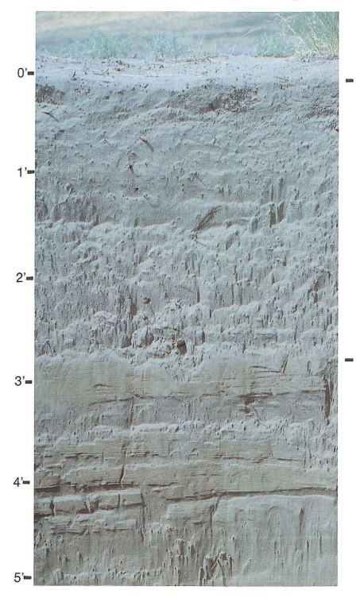
Soil Type
Portneuf Silt Loam
Quincy Sand

Slide 5
Soil type
Sandy soils
  Very susceptible to nitrate leaching
  Prefer spring over fall manure applications for sands
  Fall applications of compost to sands are fine
  Liquid manures and N fertilizers are especially susceptible to nitrate leaching on sandy soils
    Apply when plants need N
    Apply smaller amounts more often
    Monitor soil test N level in-season, if possible

Slide 6
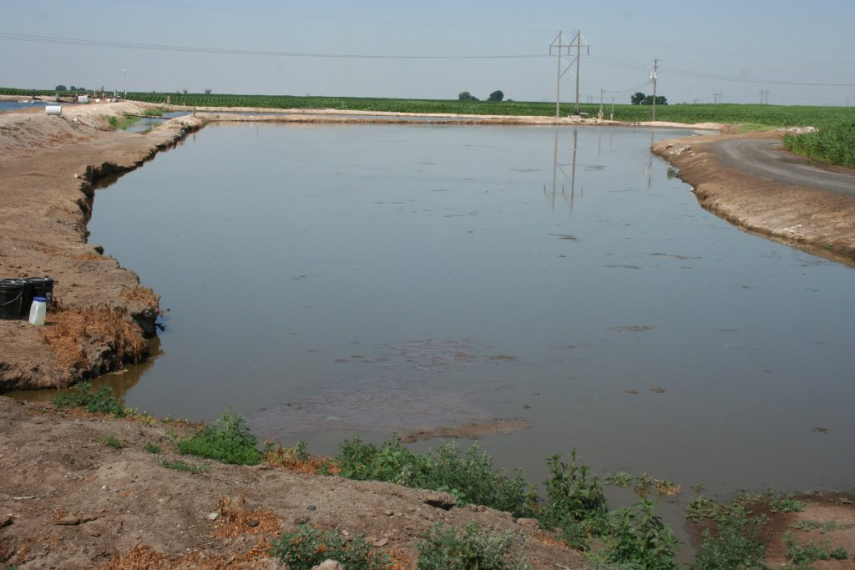
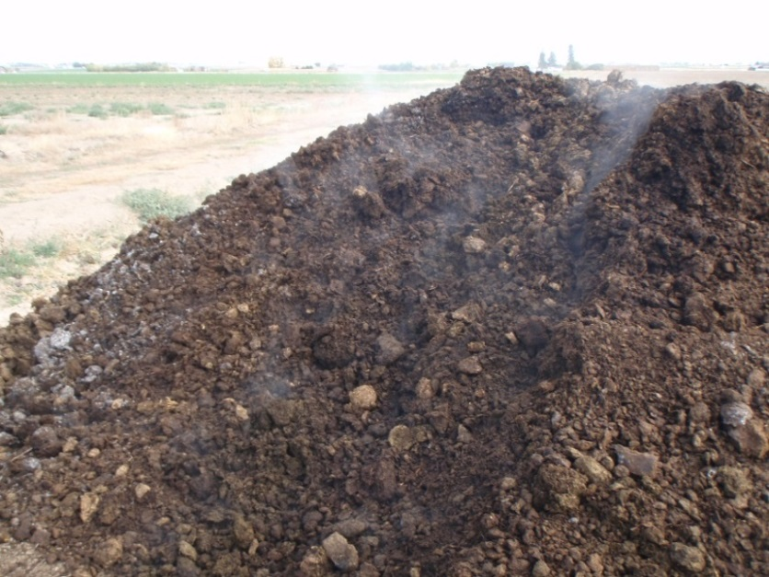
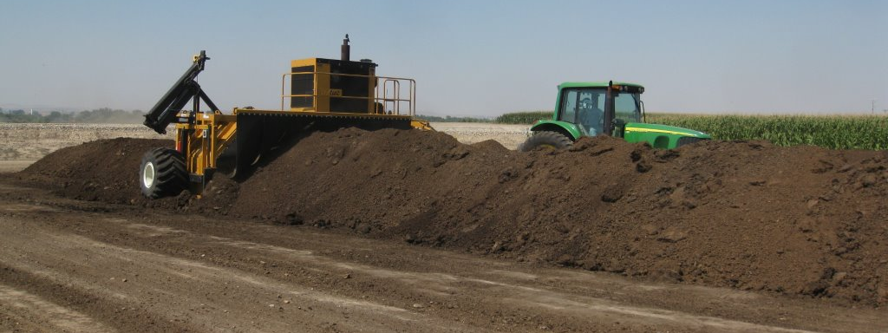
Dairy Manure Type

Slide 7
Dairy Manure Type
General rules of thumb
  More liquid usually means more ammonium and readily mineralizeable N
  More turning usually means more stable organic N, less ammonium and readily mineralizeable N
How to account for various forms?
  Manure testing
  Analyze for moisture, Total N, ammonium, and nitrate
  Takes out the guessing

Slide 8
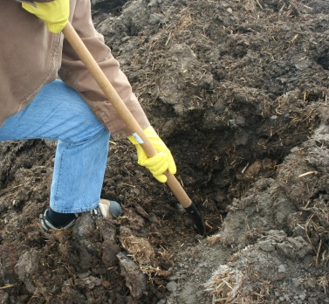
Manure testing
Find a location in the pile that has a representative mix of manure and plant residues.
Take samples from a depth of 12 inches.
Samples should be moist and have a mixture of manure and residues. Place the manure subsample in bucket.
Collect subsamples from a minimum of 8 locations throughout the pile, and place in the same bucket.

Slide 9
Certified manure and compost testing labs in the PNW
2014 MAP Certified Testing Labs | 2014 CAP Certified Testing Labs
SoilTest Farm Consultants Inc. 2925 Driggs Dr. Moses Lake, WA 98837 509 765-16222 www.soiltestlab.com | SoilTest Farm Consultants Inc. 2925 Driggs Dr. Moses Lake, WA 98837 509 765-16222 www.soiltestlab.com
Best Test Analytical Services LLC 3394 Bell Rd. NE Moses Lake, WA 98837 509 766-7701 www.besttestlabs.com
Stukenholtz Laboratory Inc. 2924 Addison Ave. E. Twin Falls, ID 83301 208 734-3050 www.stukenholtz.com
Custom Dairy Services Inc. 8895 Guide Meridian Rd. Lynden, WA 98264 360 354-4344

Slide 10
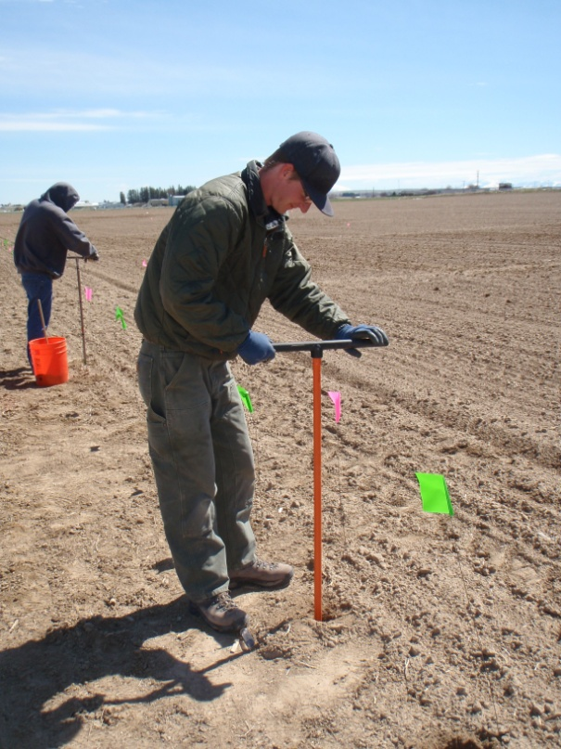
Soil testing
If preplant soil test N is above what is recommended by UI for your crop, stop applying N as fertilizer or manure
PSNT (In-season) soil sampling
  ~Mid-June
  Nitrate and ammonium-N
  Better reflection of mineralizeable N pool than preplant soil test

Slide 11
Crop rotation
Shorter season crops, less susceptible
  Ex. – Wheat
  Require moderate irrigation from May to early July
  Efficient user of water
Longer season crops, more susceptible
  Ex. – Potatoes, corn
  Require intensive irrigation from May to August
  Inefficient user of water

Slide 12
Post-Harvest Soil Nitrate Testing
(Leytem & Dungan, ARS)
Soil Depth (ft.)
Soil Nitrate (mg/kg)

Slide 13
Crop residues
Crops returning high amounts of N back to soil through residues
  Potatoes
  Sugar beets
  Other crops that leave green residues on the soil after harvest
Crops returning low amounts of N back to soil through residues (assuming full residue removal)
  All silage crops
  Alfalfa hay
  Small grains

Slide 14
N mineralization

Slide 15
Percent of Plant Available Nitrogen following a one-time compost or manure fall application
Year following a 1-time application | Composted dairy manure (12 or 28 dry ton/acre) | Stockpiled dairy manure (10 or 20 dry ton/acre)
First year | -4.2% | 17.4%
Second year | 4.3% | 17.0%
Third year | 4.8% | 11.4%
Lentz, R.D. and Lehrsch, G.A. and Brown, Bradford and Johnson-Maynard, J. and Leytem, A.B. (2011) Dairy Manure Nitrogen Availability in Eroded and Noneroded Soil for Sugarbeet Followed by Small Grains. Agronomy Journal. 103(3):628-642.

Slide 16
Nitrogen mineralization after 1 and 2 years of dairy compost fall applications. (unpublished data: Falen, Hunter, Kinder, and Moore)
Days of Incubation
(Day 0 = mid-May, Day 120 = mid-September)

Slide 17
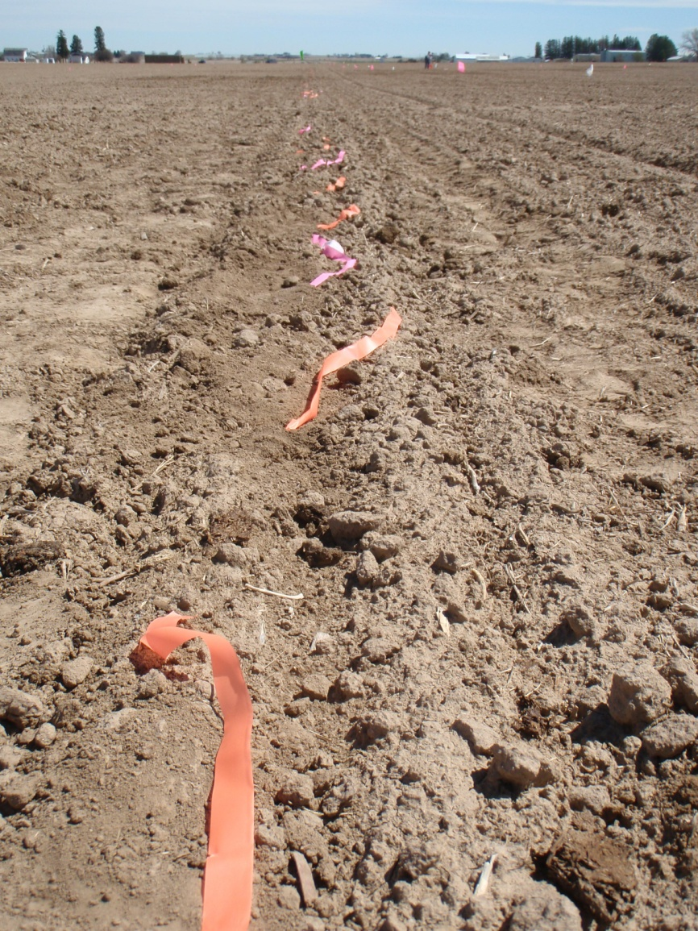
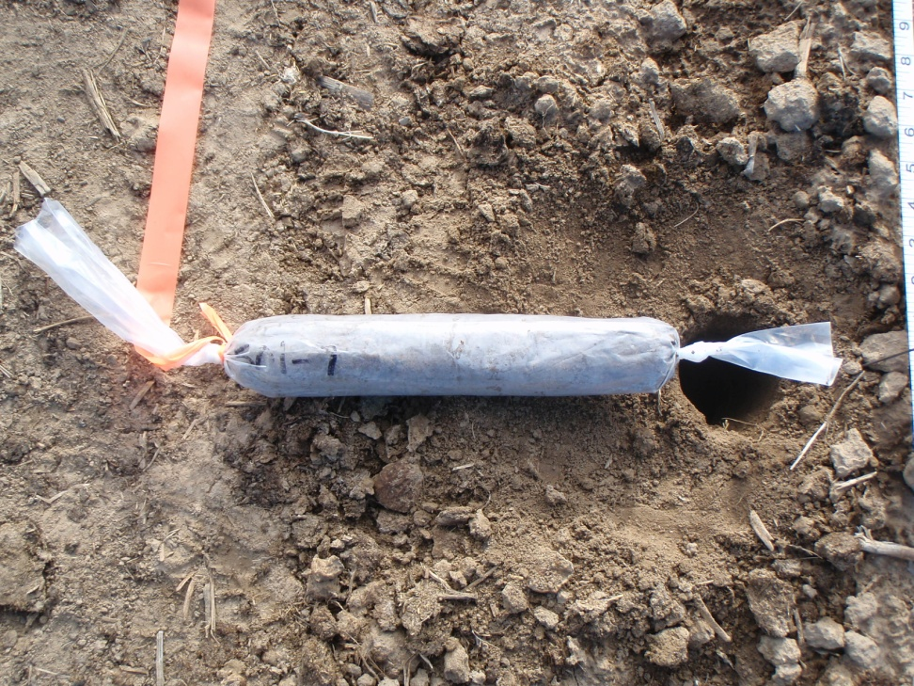
Nitrogen mineralization from Kimberly buried bag study

Slide 18
Nitrogen mineralization

Slide 19
Nitrogen mineralization

Slide 21
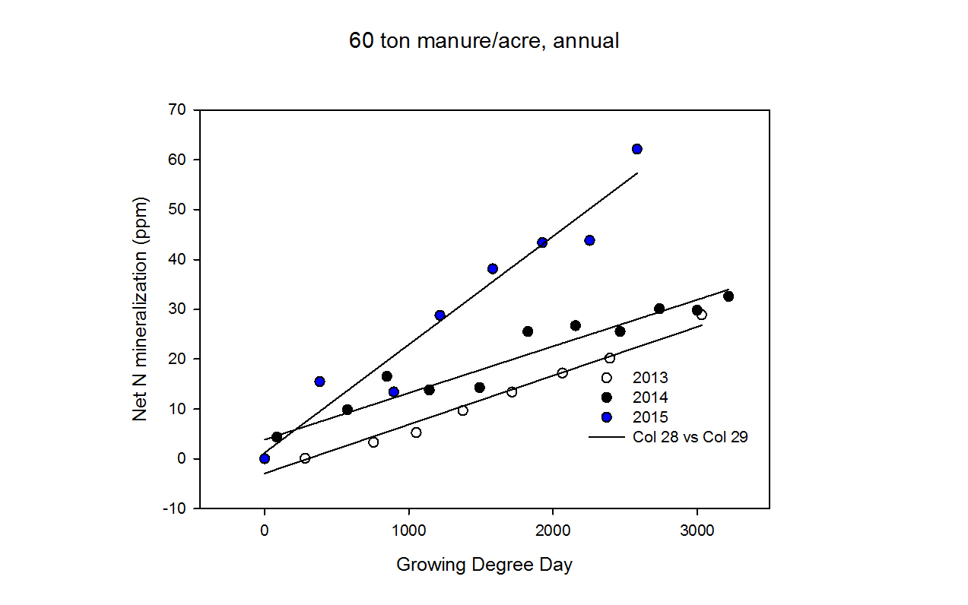

Slide 22
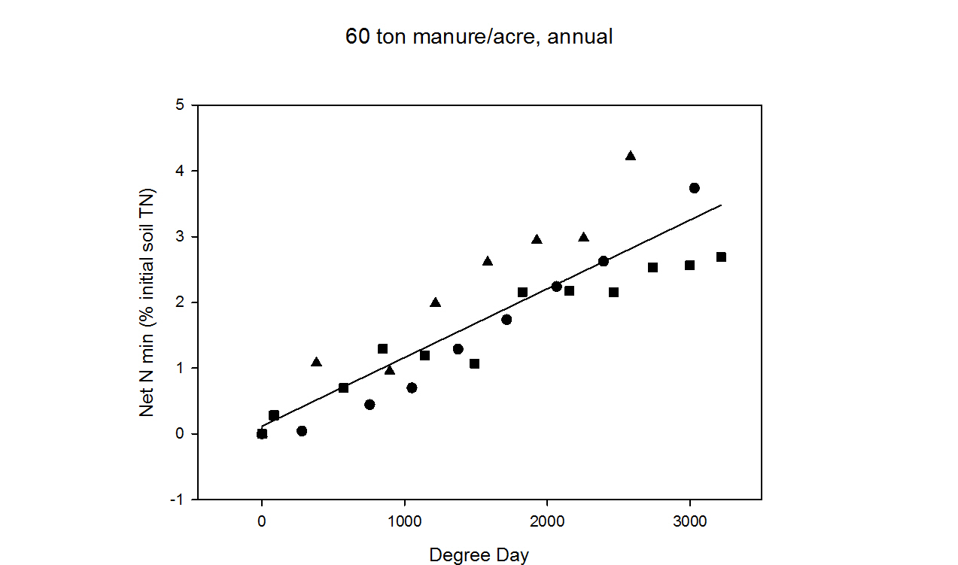

Slide 23
Soil P accumulations

Slide 24
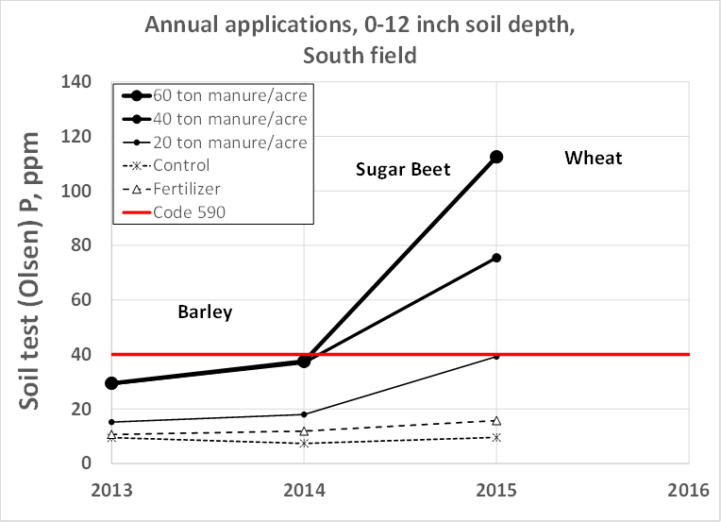
Soil P accumulations

Slide 25
Post-Harvest Soil Phosphate Testing
(Leytem & Dungan, ARS)
Soil Depth (ft)
Soil Olsen P (mg/kg)

Slide 26
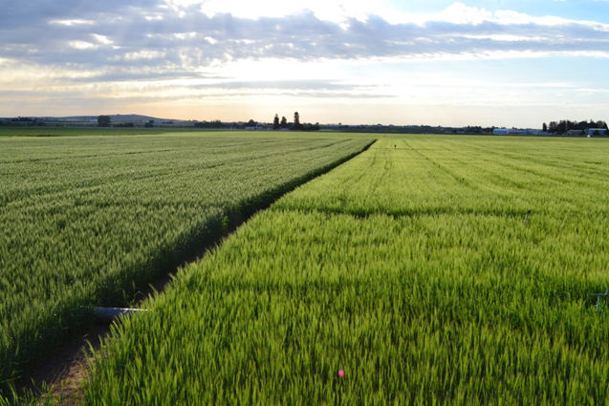
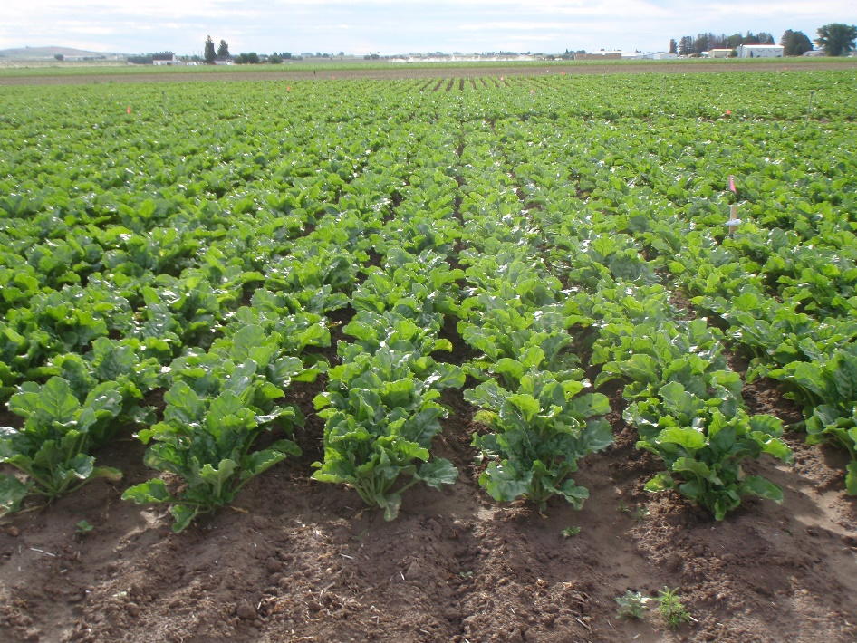
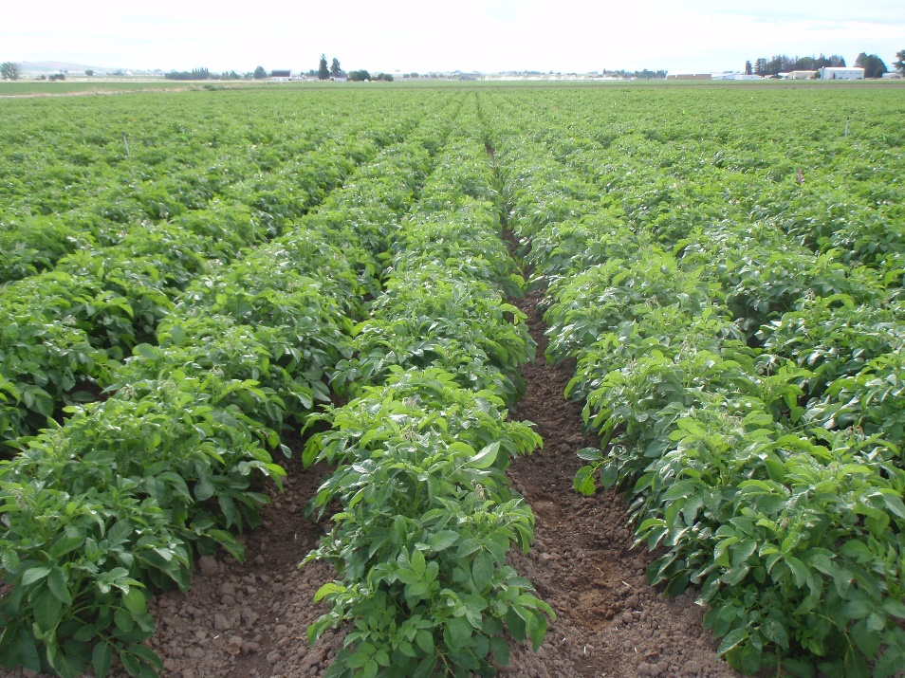
Plant N removal

Slide 27
Plant uptake of N http://www.ipni.net/article/IPNI-3296
Irrigated Crop | Average yield (Idaho, 2012) | Total N uptake (lb/acre) | N removal (lb/acre) | N remaining
Alfalfa | 4.6 ton/acre | 248 | 235 | 14
Barley | 108.8 bu/acre | 141 | 141* | 0
Corn Silage | 27.2 ton/acre | 264 | 264 | 0
Potato (2013) | 402 cwt/acre | 197 | 121 | 76
Sugar Beet | 35.1 ton/acre | 337 | 130 | 207
Wheat (2013) | 104.0 bu/acre | 208 | 208* | 0
*Assuming removal of all straw residue at harvest

Slide 28
Annual Applications
Biennial Applications

Slide 29
Annual Applications
Biennial Applications

Slide 30
Annual Applications
Biennial Applications

Slide 31
Annual Applications
Biennial Applications

Slide 32
Annual Applications
Biennial Applications

Slide 33
Annual Applications
Biennial Applications

Slide 34
Plant P removal

Slide 35
Annual Applications
Biennial Applications

Slide 36
Annual Applications
Biennial Applications

Slide 37
Annual Applications
Biennial Applications

Slide 38
Annual Applications
Biennial Applications

Slide 39
Bottom Line
Nitrate leaching and soil P accumulations can be prevented with the help of
  Soil testing
  Manure testing
  Following UI fertilizer recommendations
  Understanding the factors that contribute to nitrate and P movement on your fields

Slide 40
Thank you.

Slide 41
Bottom Line
Soil testing can provide insight on nitrate leaching susceptibility of a field
Some factors that can contribute to nitrate leaching
  Sandy soil texture
  Liquid manure or fertilizer N applications when the plant doesn’t need it
  Applying N (fertilizer or manure form) to soils with high/excessive soil test N levels

Slide 42
Bottom Line
Nitrogen uptake estimates in regional crops can improve N removal and prevent overloading of N
Finding methods for removing potato, sugar beet, and other crop residues will help to prevent nitrate leaching issues

Slide 43
Bottom Line
Wheat, barley, potatoes, and sugarbeets remove more P from manured soils, compared to corn and other P removing crops
With that said, they only removed a small amount of P added as manure
Applying P-rich manure to soils with high P is not sustainable, as crops can not remove enough P to keep P from accumulating in the soil

Slide 44
Bottom Line
Nitrogen mineralization potential was directly related to total N content in the soil
Testing soils for total N may give us an idea of N mineralization potential of Idaho soils
Growing degree day models provide further information on timing of N release over the growing season

Slide 45
Nitrous Oxide Emissions

Slide 46
Daily fluxes of Nitrous Oxide - N from Wheat and Potato

