Slide 1
Cost of Potato Production in Idaho Project
Objective 1. Collect data annually from input suppliers, and as necessary equipment dealers and potato growers.
Objective 2. Revise & update existing potato costs & returns estimates to reflect current input costs and production practices.
Objective 3. To develop cost of production estimates for new varieties or new or proposed production systems as needed or as requested.

Slide 2
Cost of Potato Production in Idaho Project
Objective 4. To calculate changes in production cost per acre and per hundredweight from the previous year and 5-year trend.
Objective 5. To develop an annual report on changes in cost of production and make this available to the Idaho potato industry & present the information at the Idaho Potato Conference & elsewhere as requested.
Objective 6. To maintain an advisory committee that represents different segments of the Idaho potato industry, to meet annually to obtain input and to review & discuss the cost of production estimates.

Slide 3
2016
Idaho Potato Production Costs Review
Idaho Potato Conference
January 21, 2016
Paul Patterson
Ben Eborn
Extension Agricultural Economist
beborn@uidaho.edu
Idaho AgBiz
www.uidaho.edu/cals/idaho-agbiz

Slide 4
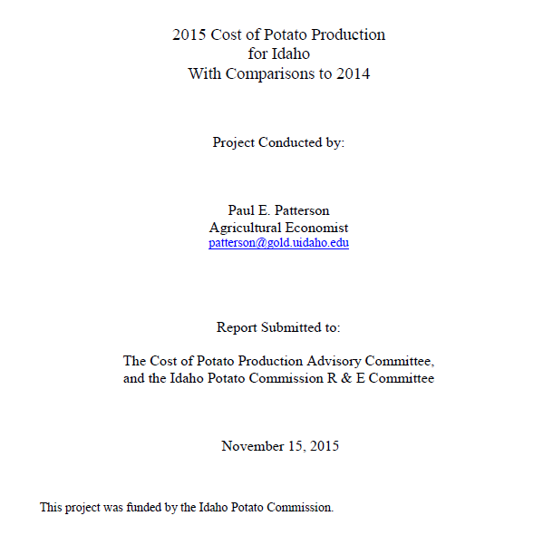
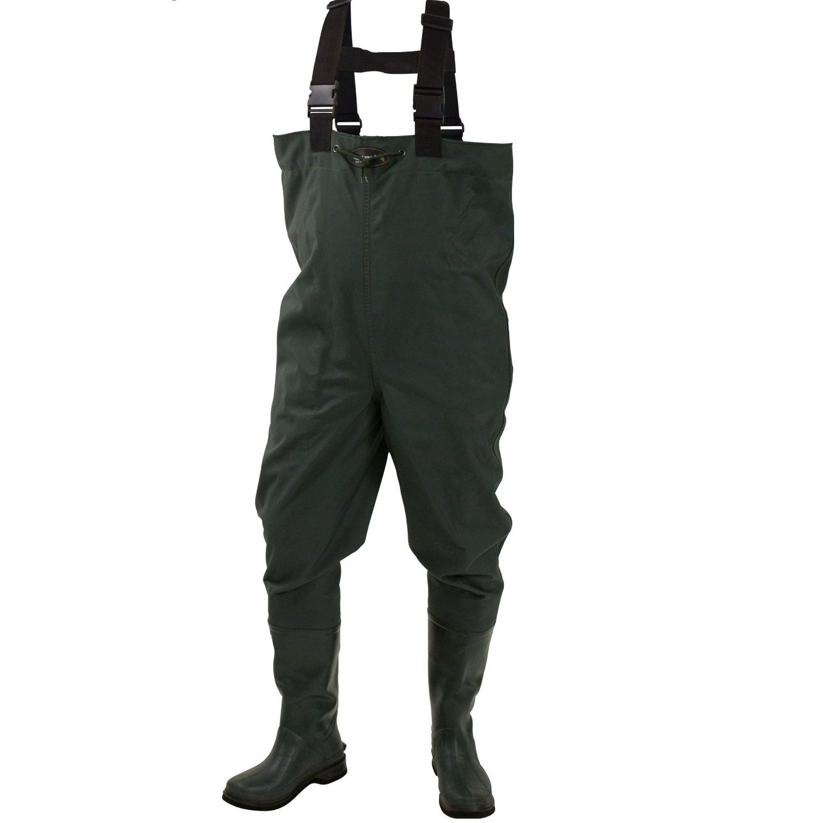
Paul’s boots

Slide 5
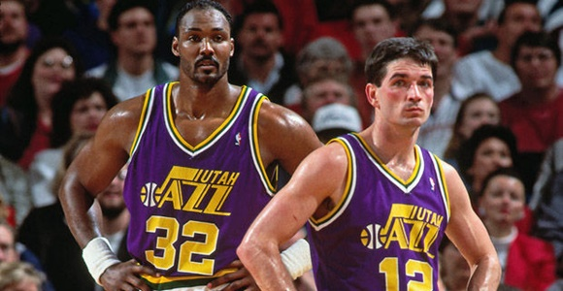
Record for most career assists = Paul Patterson
The Mailman = me

Slide 6
Cost of Production Estimates
Typical or representative costs of production estimates, not average
Model farm for each region or sub region
Based on grower surveys, sequence of operations
Economic costs, not accounting (cash) costs
Opportunity cost for all resources
Machinery: 75% of replacement cost new
Management depreciation, not tax depreciation

Slide 7
Procedures and Assumptions
Management: ~5% of total expenses (gross receipts)
Overhead: ~2.5% of cash operating expenses
Land: crop specific 1-year cash rental value
Surface water, avg. price by region
Pressurization only, per acre-inch water applied, using Idaho Power Ag. Irrigation Service rate

Slide 8
Annual Crop Input Cost Summary
Annual survey: February through October
Ag Lenders
Seed dealers (seed potato growers)
Chemical Fertilizer Dealers
Custom Applicators *
Fuel Suppliers: February, April, June, August
Irrigation Districts / Canal Companies
Idaho Power Irrigation Service Rate (Schedule 24)

Slide 9
Budget Changes: 2015
Specific changes by region - 2015: see pages 10-11
No change in herbicides, either product or # of applications for any region
Southwestern Idaho:
Foliar Fungicides
Increased applications from 6 to 8
Increased products applied from 7 to 10
Foliar Insecticides
Increased applications from 5 to 7
Increased products from 5 to 7

Slide 10
Budget Changes: 2015
Southcentral Idaho:
Foliar Fungicides
Increased applications from 5 to 7
Increased products applied from 7 to 8
Foliar Insecticides
Increased applications from 4 to 7 (correction to p. 10 & 3x in Appendix B for Agri-Mek)
Increased products from 4 to 7 (correction to p. 10 & 3x in Appendix B for Agri-Mek)

Slide 11
Budget Changes: 2015
Eastern Idaho - South:
Foliar Fungicides
Increased applications from 5 to 6
Increased products applied from 7 to 8
Foliar Insecticides
Increased applications from 3 to 4
Increased products from 3 to 4

Slide 12
How much did it cost to grow, harvest and sort potatoes in 2015?

Slide 13
2015 Russet Burbank: Cost of Production
Fumigated | Total Cost/ac | Yield | Cost per Cwt
SWI – Operating | $2,511 | 515 | $4.88
SCI – Operating | $2,228 | 470 | $4.74
EI-S – Operating | $1,993 | 425 | $4.34
SWI – Ownership | $1,223 |  | $2.37
SCI – Ownership | $1,073 |  | $2.28
EI-S – Ownership | $938 |  | $2.39
SWI – Total Costs | $3,734 |  | $7.25
SCI – Total Costs | $3,301 |  | $7.02
EI-S – Total Costs | $2,931 |  | $6.73
Cost to grow, harvest & sort. Table 11-A & 11-B and 12-A & 12-B.

Slide 14
2015 Russet Burbank: Cost of Production
Non-Fumigated | Total Cost/ac | Yield | Cost per Cwt
SCI – Operating | $1,868 | 425 | $4.40
EI-S – Operating | $1,669 | 385 | $4.34
EI-N – Operating | $1,554 | 360 | $4.32
SCI – Ownership | $1,061 |  | $2.50
EI-S – Ownership | $930 |  | $2.42
EI-N – Ownership | $818 |  | $2.27
SCI – Total Costs | $2,929 |  | $6.90
EI-S – Total Costs | $2,599 |  | $6.76
EI-N – Total Costs | $2,372 |  | $6.59
Cost to grow, harvest & sort. Table 11-A & 11-B and 12-A- and 12-B.

Slide 15
How much did costs change in 2015?
It Depends:
Region
Acre vs. Cwt
Which inputs

Slide 16
Potato Cost Changes: 2014 to 2015
Per Acre Changes
Per Cwt Changes
Total cost/acre: $ change
+$41 to +$101
Total Cost/ Cwt $ change
-$0.13 to +$0.26
Total cost/acre: % Change
+1.6% to +3.6%
Total cost/Cwt: % Change
-1.9% to +3.7%
Yield changes:
SWI -10 cwt -1.9% *Adjusted RB Yield (Avg. -4%)
SCI +5 cwt +1.1 to +1.2%
SEI-S +5 cwt +1.2 to +1.3%
SEI-N +5 cwt +1.3%

Slide 17
Idaho Fumigated RB Production Costs per Acre
Cost Categories | SWI | SCI | SEI-S
2014 Operating Costs | $2,457 | $2,182 | $1,956
2015 Operating Costs | $2,511 | $2,228 | $1,993
$ Change | +$54 | +$46 | +$37
% Change | +2.9% | +2.1% | +1.9%
2014 Ownership Costs | $1,214 | $1,035 | $911
2015 Ownership Costs | $1,223 | $1,073 | $938
$ Change | +$9 | +$38 | +$27
% Change | +0.7% | +3.7% | +3.0%
2014 Total Costs | $3,671 | $3,217 | $2,867
2015 Total Costs | $3,734 | $3,301 | $2,931
$ Change | +$63 | +$84 | +$64
% Change | +1.7% | +2.6% | +2.2%
Cost to grow, harvest & sort. Table 11-A

Slide 18
ID Non-Fumigated RB Production Costs per Acre
Cost Categories | SCI | SEI-S | SEI-N
2014 Operating Costs | $1,803 | $1,656 | $1,508
2015 Operating Costs | $1,868 | $1,669 | $1,554
$ Change | +$65 | +$13 | +$46
% Change | +3.6% | +0.8% | +3.1%
2014 Ownership Costs | $1,025 | $902 | $795
2015 Ownership Costs | $1,061 | $930 | $818
$ Change | +$36 | +28$ | +$23
% Change | +3.5% | +3.1% | +2.9%
2014 Total Costs | $2,828 | $2,558 | $2,303
2015 Total Costs | $2,929 | $2,599 | $2,372
$ Change | +$101 | +$41 | +$69
% Change | +3.6% | +1.6% | +3.0%
Cost to grow, harvest & sort. Table 11-B

Slide 19
Idaho Fumigated RB Production Costs per Cwt
Cost Categories | SWI | SCI | SEI-S
2014 Operating Costs | $4.68 | $4.69 | $4.48
2015 Operating Costs | $4.88 | $4.74 | $4.34
$ Change | +$0.20 | +$0.05 | -$0.14
% Change | +4.3% | +1.1% | -3.1%
2014 Ownership Costs | $2.31 | $2.23 | $2.38
2015 Ownership Costs | $2.37 | $2.28 | $2.39
$ Change | +$0.06 | +$0.05 | +$0.01
% Change | +2.6% | +2.2% | +0.4%
2014 Total Costs | $6.99 | $6.92 | $6.86
2015 Total Costs | $7.25 | $7.02 | $6.73
$ Change | +$0.26 | +$0.10 | -$0.13
% Change | +3.7% | +1.4% | -1.9%
Cost to grow, harvest & sort. Table 12-A.

Slide 20
ID Non-Fumigated RB Production Costs per Cwt
Cost Categories | SCI | SEI-S | SEI-N
2014 Operating Costs | $4.29 | $4.36 | $4.25
2015 Operating Costs | $4.40 | $4.34 | $4.32
$ Change | +$0.11 | -$0.02 | +$0.07
% Change | +2.6% | -0.5% | +1.6%
2014 Ownership Costs | $2.44 | $2.37 | $2.24
2015 Ownership Costs | $2.50 | $2.42 | $2.27
$ Change | +$0.06 | +$0.05 | +$0.03
% Change | +2.5% | +2.1% | +1.3%
2014 Total Costs | $6.73 | $6.73 | $6.49
2015 Total Costs | $6.90 | $6.76 | $6.59
$ Change | +$0.17 | +$0.03 | +$0.10
% Change | +2.5% | +0.4% | +1.5%
Cost to grow, harvest & sort. Table 12-B.

Slide 21
Which input cost categories changed in 2015 and by how much?

Slide 22
Cost change summary for 2015
Operating Expense Category | $ Change/acre | % Change/acre
Seed | +$0 to +$1/ac | -0.4 to +0%
Fertilizer | +$4 to +$27/ac | +0.8 to +6.0%
Pesticides & Chemicals | +$15 to +$48/ac | +4.9 to +23%
Custom & Consultant | +$6 to +$38/ac | +5.0to +31%
Irrigation | Flat
Machinery (FOLR) | -$30 to -$35 | -18 to -20%
Labor | +$3 to +$5/ac | +2.1 to 3.3%
Other | -$2 to +$2/ac | -1.1 to +1.2%
Operating interest | Flat
Table 10.

Slide 23
Cost change summary for 2015
Ownership Expense Category | $ Change/acre | % Change/acre
Field Equipment | +$2 to +$5/ac | +1.2 to 2.8% %
Overhead | +$1 to +$2/ac | +1.2 to +3.3%
Land | +$0 to + $25/ac | +0 to +4.2%
Handling/Sorting Equip. | +$1 to +$3/ac | +4%
Storage System |  | +2.5%
Table 10.

Slide 24
Field-run vs. Paid Yield
What percentage of the potatoes that you deliver do you get paid for?
Does it vary by market?

Slide 25
2015 Production Costs, Storage Ownership & Repair Costs, & Monthly Storage Operating Costs (Tables A-2, B-2 andC-2)
 | SWI Field-Run | SWI Paid-Yield | SCI Field-Run | SCI Paid-Yield | EI-S Field-Run | EI-S Paid-Yield
Base COP: | $7.25 | $7.63 | $7.02 | $7.39 | $6.90 | $7.26
+ Storage Owner. | $7.61 | $8.01 | $7.36 | $7.75 | $7.25 | $7.63
+ Storage Repairs | $7.65 | $8.05 | $7.40 | $7.79 | $7.29 | $7.68
Oct | $7.87 | $8.28 | $7.61 | $8.01 | $7.350 | $7.89
Nov* | $8.04 | $8.46 | $7.78 | $8.19 | $7.67 | $8.07
Dec | $8.13 | $8.56 | $7.86 | $8.28 | $7.75 | $8.16
Jan | $8.22 | $8.65 | $7.95 | $8.36 | $7.83 | $8.25
Feb | $8.30 | $8.74 | $8.03 | $8.45 | $7.92 | $8.33
Mar | $8.39 | $8.84 | $8.11 | $8.54 | $8.00 | $8.42
Apr* | $8.58 | $9.04 | $8.30 | $8.74 | $8.18 | $8.61
May | $8.69 | $9.15 | $8.40 | $8.85 | $8.29 | $8.72
Jun | $8.82 | $9.28 | $8.52 | $8.97 | $8.41 | $8.85
Paid-Yield = 95% of Field-Run Yield Fumigated
*Sprout inhibitor applied
Storage Operating Costs: labor, power, chemicals, interest, shrink and insurance
SWI = Southwestern Idaho, SCI = Southcentral Idaho, EI = Eastern Idaho

Slide 26
2015 Production Costs, Storage Ownership & Repair Costs, & Monthly Storage Operating Costs (Tables D-2, E-2 andF-2)
 | SCI Field-Run | SCI Paid-Yield | EI-S Field-Run | EI-S Paid-Yield | EI-N Field-Run | EI-N Paid-Yield
Base COP: | $6.89 | $7.26 | $6.75 | $7.11 | $6.59 | $6.93
+ Storage Owner. | $7.25 | $7.63 | $7.11 | $7.48 | $6.95 | $7.31
+ Storage Repairs | $7.29 | $7.68 | $7.15 | $7.53 | $6.99 | $7.35
Oct | $7.59 | $7.89 | $7.35 | $7.74 | $7.19 | $7.57
Nov* | $7.67 | $8.07 | $7.52 | $7.92 | $7.36 | $7.75
Dec | $7.75 | $8.16 | $7.61 | $8.01 | $7.44 | $7.83
Jan | $7.84 | $8.25 | $7.69 | $8.09 | $7.53 | $7.92
Feb | $7.92 | $8.34 | $7.77 | $8.18 | $7.61 | $8.01
Mar | $8.01 | $8.43 | $7.86 | $8.27 | $7.69 | $8.10
Apr* | $8.19 | $8.62 | $8.04 | $8.46 | $7.88 | $8.29
May | $8.29 | $8.73 | $8.14 | $8.57 | $7.98 | $8.40
Jun | $8.42 | $8.86 | $8.26 | $8.70 | $8.10 | $8.52
Paid-Yield = 95% of Field-Run Yield Non-Fumigated
*Sprout inhibitor applied
Storage Operating Costs: labor, power, chemicals, interest, shrink and insurance
SWI = Southwestern Idaho, SCI = Southcentral Idaho, EI = Eastern Idaho

Slide 27
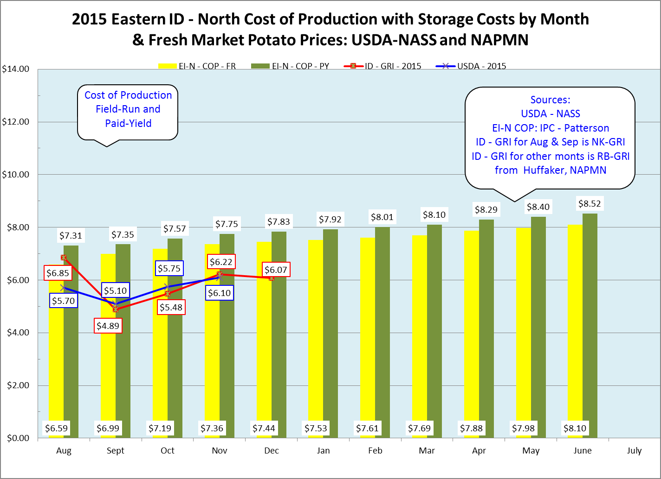

Slide 28
How have costs changed over time? 2003 to 2015

Slide 29
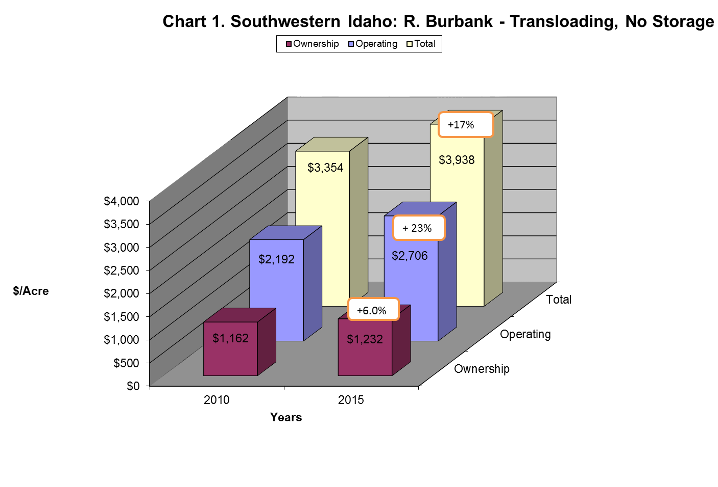

Slide 32
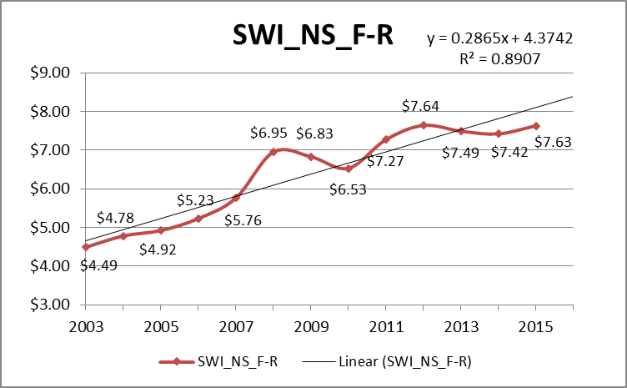

Slide 33
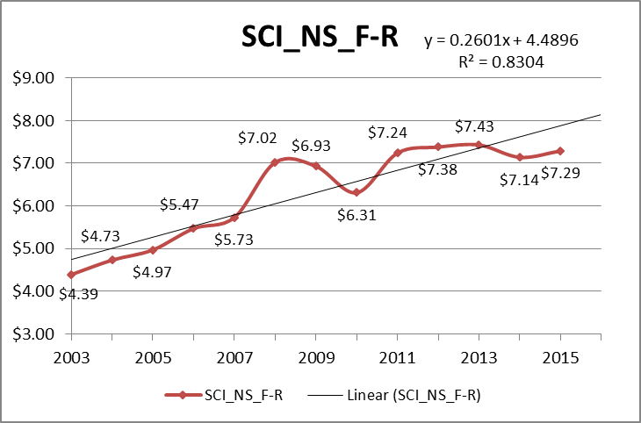

Slide 34
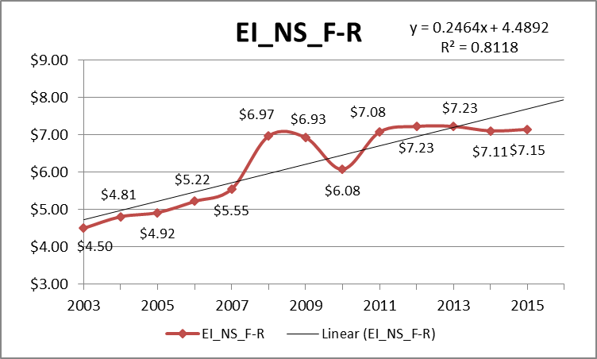

Slide 35
Questions?

