Slide 1
Common livestock breeds and characteristics

Slide 2
breeds
Each breed for each species has characteristics and attributes that make it popular in general and for specific purposes such as reproductive qualities versus meat qualities versus other production qualities.

Slide 3
Breeds
Example: some cattle breeds are large framed and have high milk production, making them desirable for reproduction of large healthy calves while other cattle breeds are popular for producing meat that is tender or some sheep breeds exist due to the value of their wool
There are also breeds that are meant for more than one purpose.
Example: Maine-Anjou cattle have good milking capabilities but can also perform well in feed yards

Slide 4
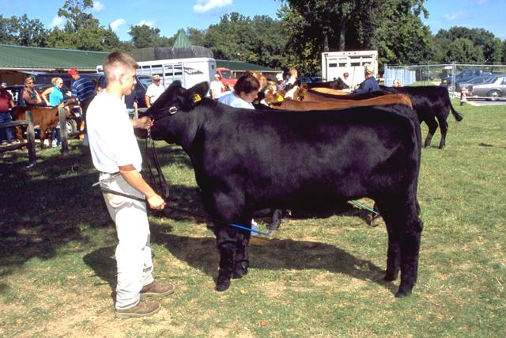
Beef cattle breeds
Angus (including Red)
Smooth black or red coat
Known for carcass quality as well as milking, mothering and reproductive abilities
“What is the benefit of having one hair color over the other?”
Notes:
Answer: Black coat is popular with consumers for marketing of product, but red coat handles hot sunny days better

Slide 5
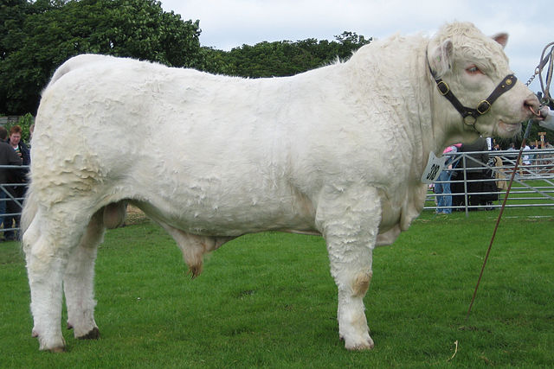
Beef cattle breed
Charolais
Large framed and white
Known for fast growth and lean meat
“What’s the benefit of that large frame?”
Notes:
Answer: Allows for larger calves and better calving ease

Slide 6
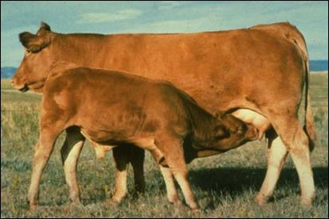
Beef cattle breeds
Gelbvieh
Cream or reddish-yellow in color
Known for being a general-purpose breed with good milking abailities

Slide 7
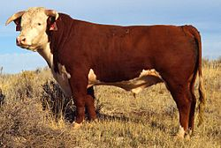
Beef cattle breeds
Hereford (including Polled i.e. no horns)
Large framed and red body with white face
Known for foraging ability, vigor, hardiness, and quiet disposition
“Why would the industry prefer polled cattle over horned?”
Notes:
Answer: When cattle are horned there is higher incidence of carcass bruising to other animals

Slide 8
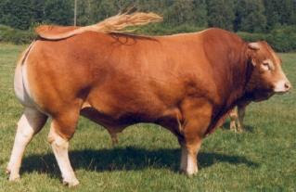
Beef cattle breeds
Limousin
Red body
When slaughtered at a young age yield high percentage of lean meat with a minimum amount of fat

Slide 9
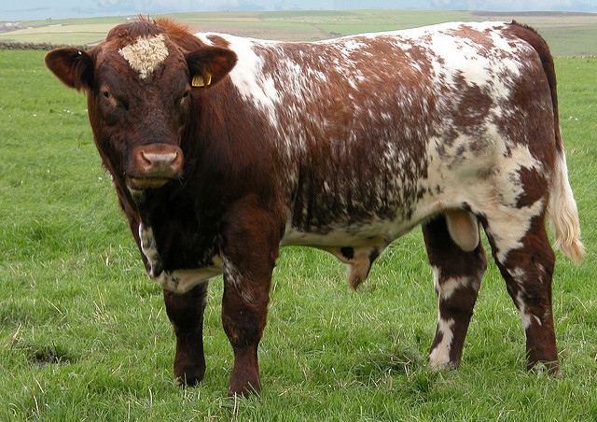
Beef cattle breeds
Shorthorn
Red or black body with white speckling
Good disposition, mothering and milking abilities
Females ideal for a reproduction herd purpose

Slide 10
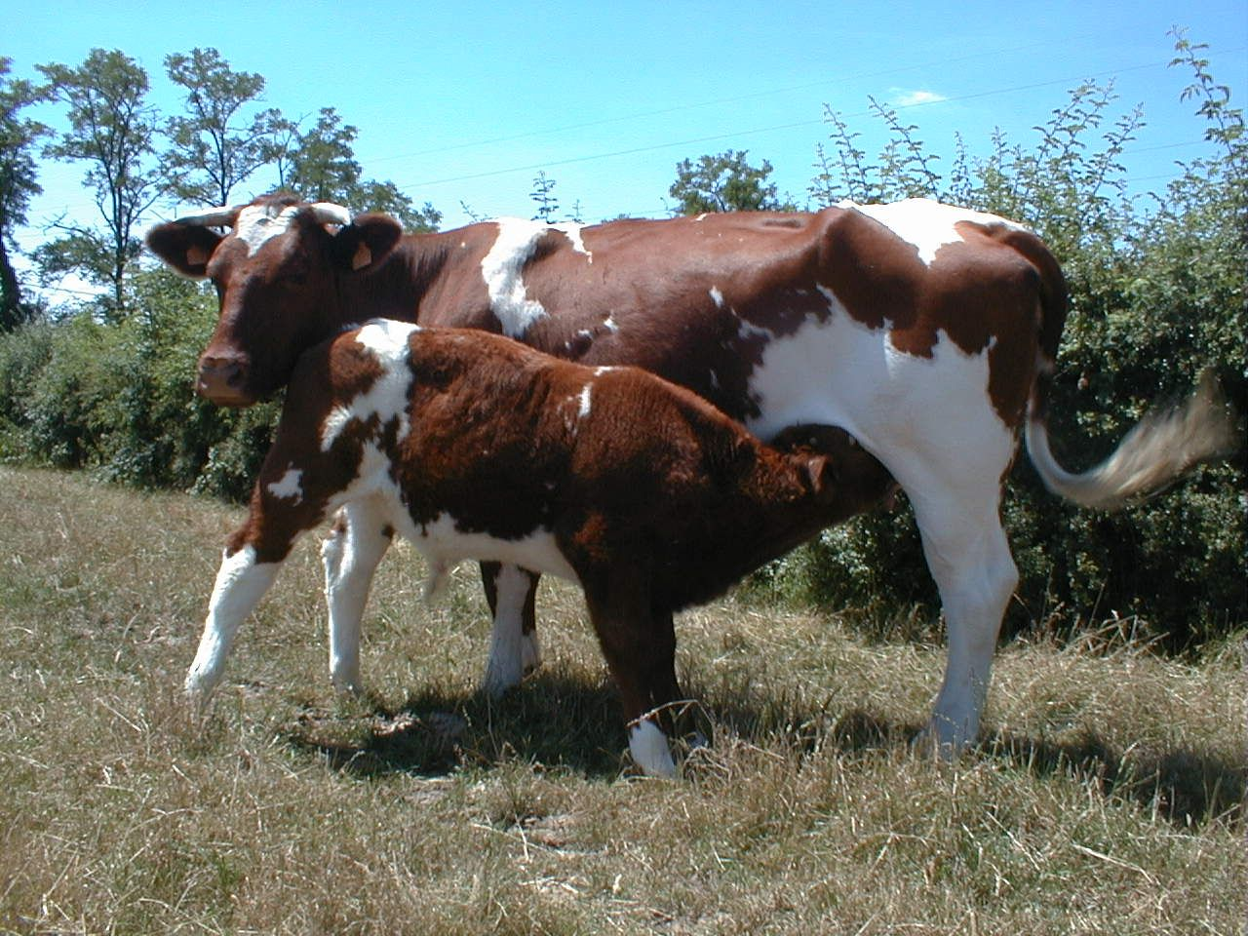
Beef cattle breeds
Maine-Anjou
Red and white body
Dual-purpose breed
Cows used for milk production
Bull calves fed for market

Slide 11
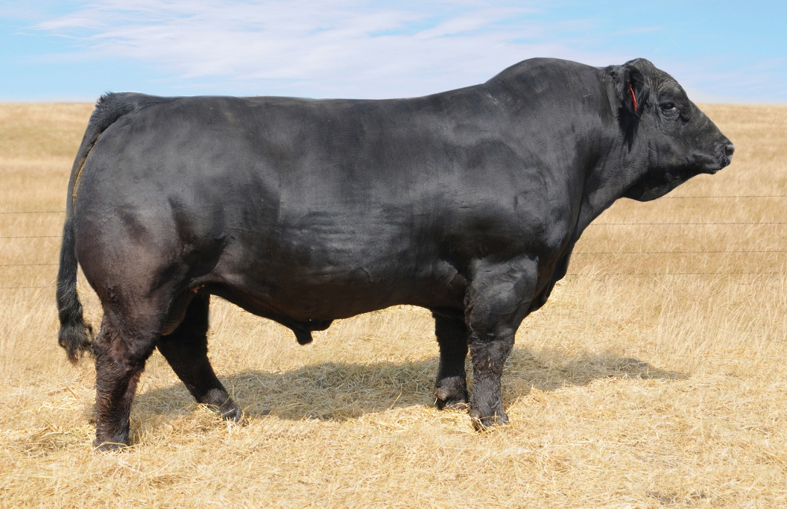
Beef cattle breeds
Simmental
Long bodied with black coat
Fast growth
Milking abilities
Meat quality

Slide 12
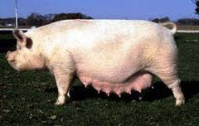
Swine breeds
American Yorkshire
Referred to as the mother breed due to its ability to produce large litters
Big framed
Susceptible to sunburn
“Why is litter size important?”
Notes:
Answer: The more offspring produced by one individual sow the more animals a producer has to sell

Slide 13
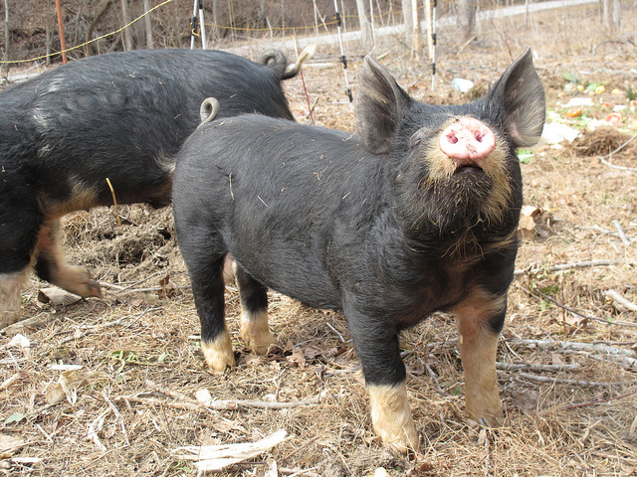
Swine breeds
Berkshire
Black body with white points and short erect ears
Typically make for good sires (male)
Does well in enclosed buildings

Slide 14
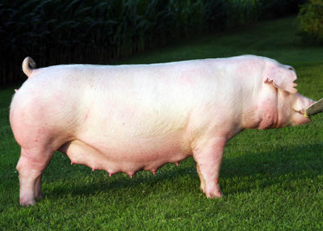
Swine breeds
Chester White
Large body, susceptible to sunburn
Good mother
Large litters

Slide 15
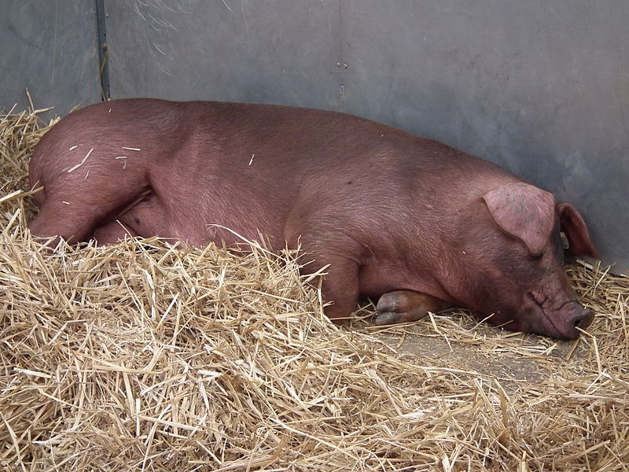
Swine Breeds
Duroc
Red body
Grows quickly and efficiently needing less feed per pound of muscled gained compared to any other breed.
“What is feed to gain ratio?”
Notes:
Answer: The pounds of feed required to put on one pound of gain, typically about 3 for the swine

Slide 16
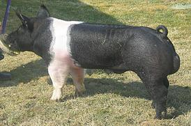
Swine breeds
Hampshire
Black body with white belt
Known for being heavy muscled and lean

Slide 17
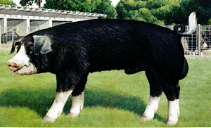
Swine breeds
Poland China
Black with white points with droopy ears
Known for being lean and heavy muscled

Slide 18
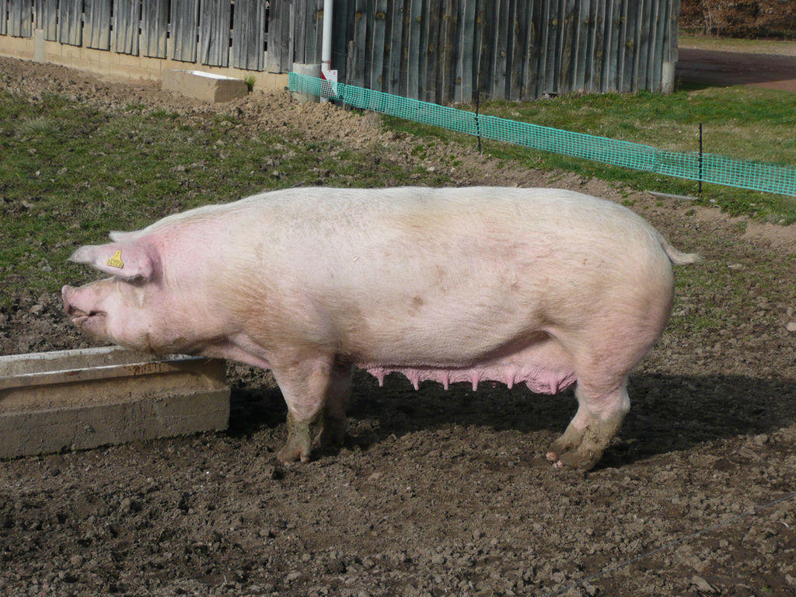
Swine breeds
Landrace
Long white body with large floppy ears
Known for being a good mother

Slide 19
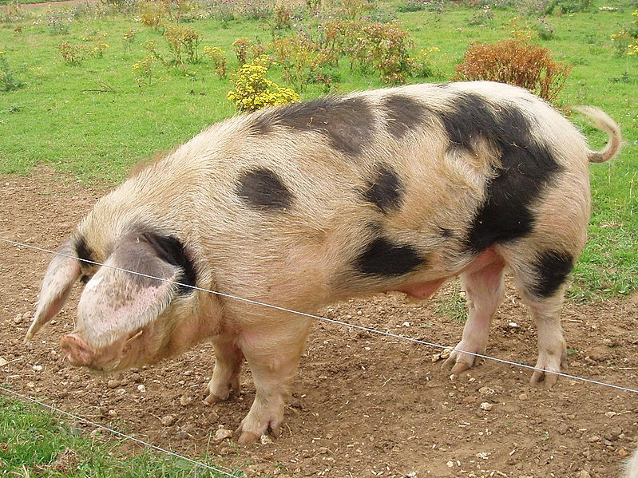
Swine breeds
Spot
Spotted
Gains weight well but also known for being an aggressive breeder producing piglets with high growth rates that are feed efficient
Gentle and durable

Slide 20
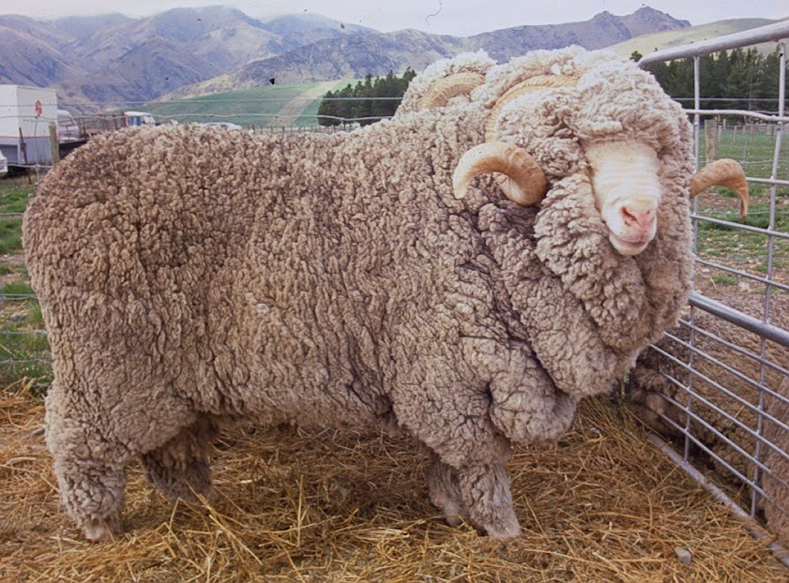
Sheep breeds
Merino (Ewe breed, fine wool
Basis of all wool breeds
High flocking instinct

Slide 21
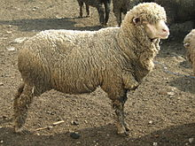
Sheep breeds
Rambouillet (Ewe breed, fine wool)
Large with white face and wool on head and legs
Long-lived and rugged
Capability to breed out of season

Slide 22
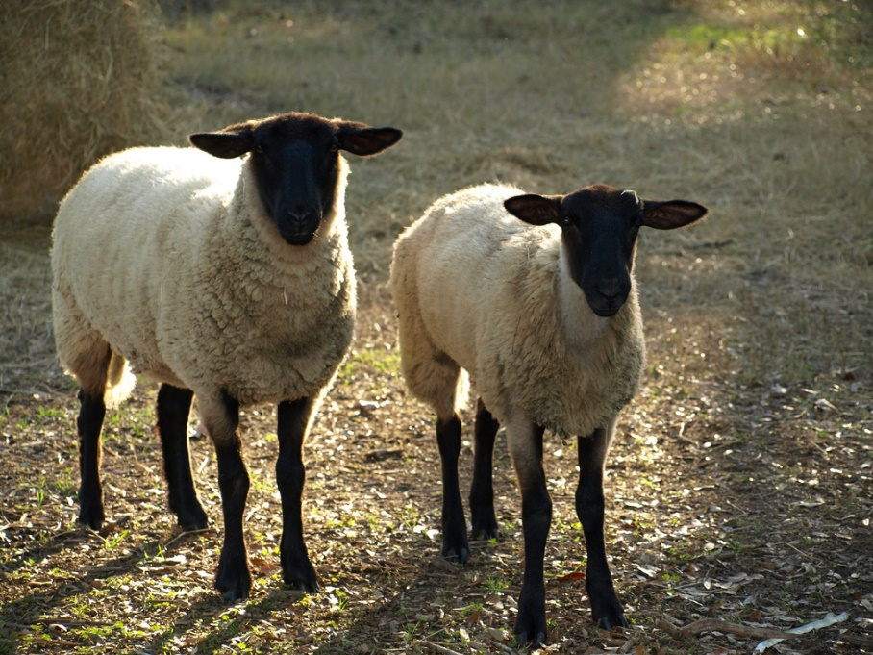
Sheep breeds
Suffolk (Ram breed, medium wool)
Black head and legs
Known for its meatiness and high carcass quality
Ability to grow rapidly and produce high cutability carcasses

Slide 23
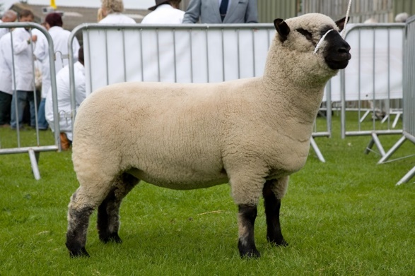
Sheep breeds
Hampshire (Ram breed, medium wool)
Black face with wool cap
Moderately prolific
Very good milking ability, growth and carcass cutability

Slide 24
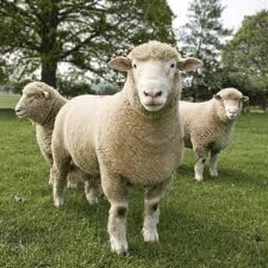
Sheep breed
Dorset (Dual breed, medium wool)
Able to breed out of season
Heavy milkers
Produce more than one lamb crop per year
Lambs are hardy and yield heavy muscled carcasses

Slide 25
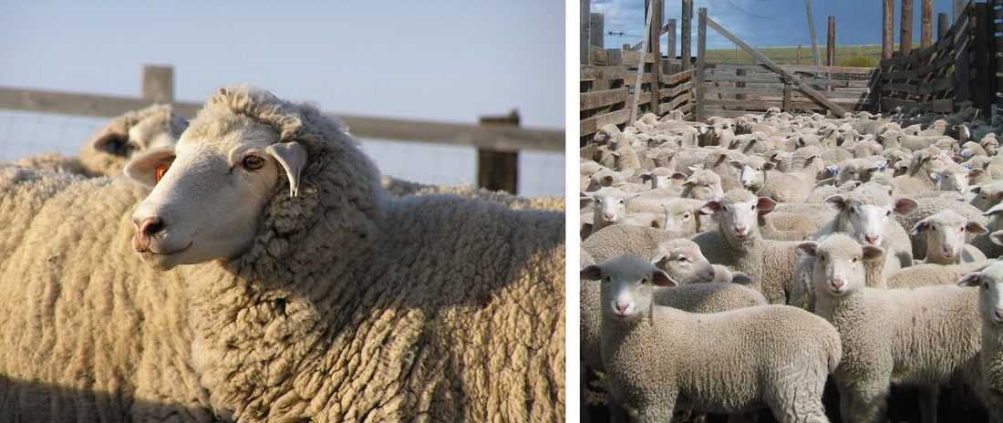
Sheep breeds
Columbia (Dual breed, medium wool)
Large body with white face and wool on legs
Known for size and wool-producing ability and productivity on range

Slide 26
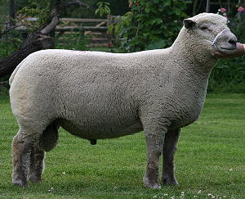
Sheep breeds
Southdown (Ram breed, medium wool)
Small to medium frame with grayish face and wool on legs
Produces a meaty carcass

