Slide 1
Heat and Drought Stress in Potatoes
Xi Liang
Aberdeen Research & Extension Center, Aberdeen, ID 83210
Notes:
The Role of Conservation Agriculture in Sustainable Agriculture
http://www.directseed.org/research-resources/
http://www.nrcs.usda.gov/wps/portal/nrcs/detail/wa/newsroom/factsheets/?cid=nrcs144p2_036621

Slide 2
Water transportation in plants
Cooling the crop canopy
http://images.slideplayer.com/1/245357/slides/slide_5.jpg
Notes:
When temperatures are too high, water uptake cannot match transpiration. Stomata tend to close, and transpiration decreases, and canopy temperatures increase.
The water potential gradient or demand for water of dry air outside the leaf pulls water from the soil through the plant and into the outside air through the stomata. It is this movement of water through the plant to the outside air that keeps leaves cool.
As soil dries and less moisture is available to the plant, water potential within the plant is reduced (held with greater tension) and the stomata in the leaves close. This process reduces the amount of water that moves through the plant and thus results in less cooling of the leaves. Put another way, water deficit stress elevates leaf temperatures because less water being pumped through the plant into the surrounding air results is less plant cooling.
Photosynthesis, transpiration, and leaf growth are major plant processes that are related to water potential or status of water in the plant. Thus, crop growth and productivity are greatly dependent on a plant’s ability to extract water from soil. Leaf temperature can be used as a gauge of how these plant processes may be affected as soil water becomes insufficient to supply the water demanded by dry air. Since transpiration functions mainly to cool leaves, canopy temperature relative to that of the surrounding air is an indication of the level of moisture deficit stress a plant is encountering. This relationship between canopy temperature, air temperature, and transpiration involves atmospheric conditions, available soil water, and plant parameters such as canopy size and structure, and leaf adjustments (wilted or turgid).
- See more at: http://mssoy.org/blog/can-canopy-temperature-be-used-for-irrigation-scheduling/#sthash.4sbrZp7O.dpuf

Slide 3
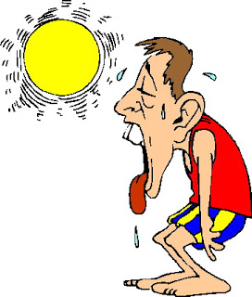
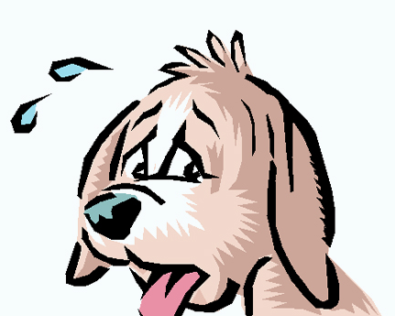
How does heat and drought stress feel?
https://www.petsworld.in/blog/understanding-sweating-in-dogs.html
http://persistentrunner.blogspot.com/2013/08/worst-run-ever-so-far.html
Notes:
Sweat gland

Slide 4
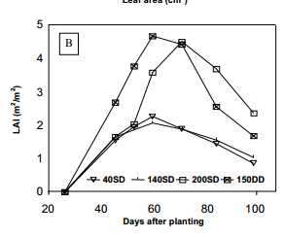
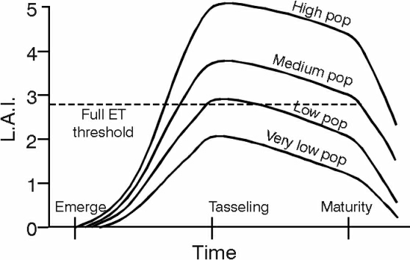
Potato Canopy Development
Potato
Cereal
LAI = leaf area / ground area
Potato and cereal can reach similar LAI.
http://croptechnology.unl.edu/pages/informationmodule.php?idinformationmodule=1130447123&topicorder=6&maxto=73&minto=1
http://www.scielo.br/pdf/pab/v35n5/4715.pdf

Slide 5
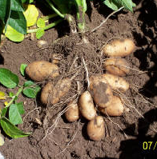
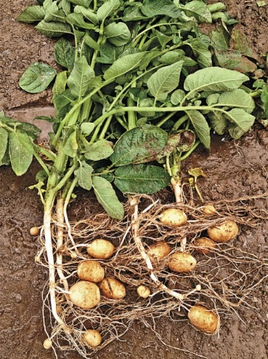
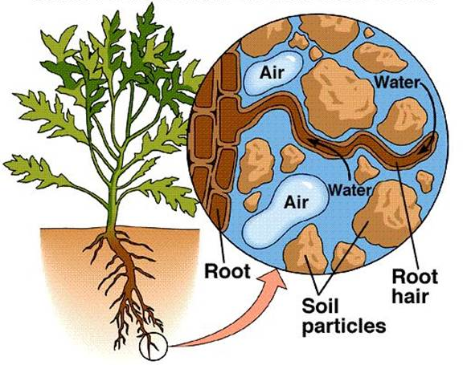
Potato Root Growth
Fine roots
Rooting depth
http://preuniversity.grkraj.org/html/4_PLANT_AND_WATER_RELATIONSHIP.htm
http://nuearthllc.com/id1.html
http://www.potatogrower.com/Article.aspx?year=2013&month=08&article=2805
Differing wheat root systems produced by alternative cultivation methods, and the estimated effects of varying root system characters on water capture. See King et al., pp 383–390.
Notes:
Potato plants are relatively susceptible to drought and heat stress due to their limited ability of roots to transport water efficiently to stems and leaves.
Compared to wheat and grasses, root biomass
The differences roots make potato more susceptible to heat and drought stress.

Slide 6
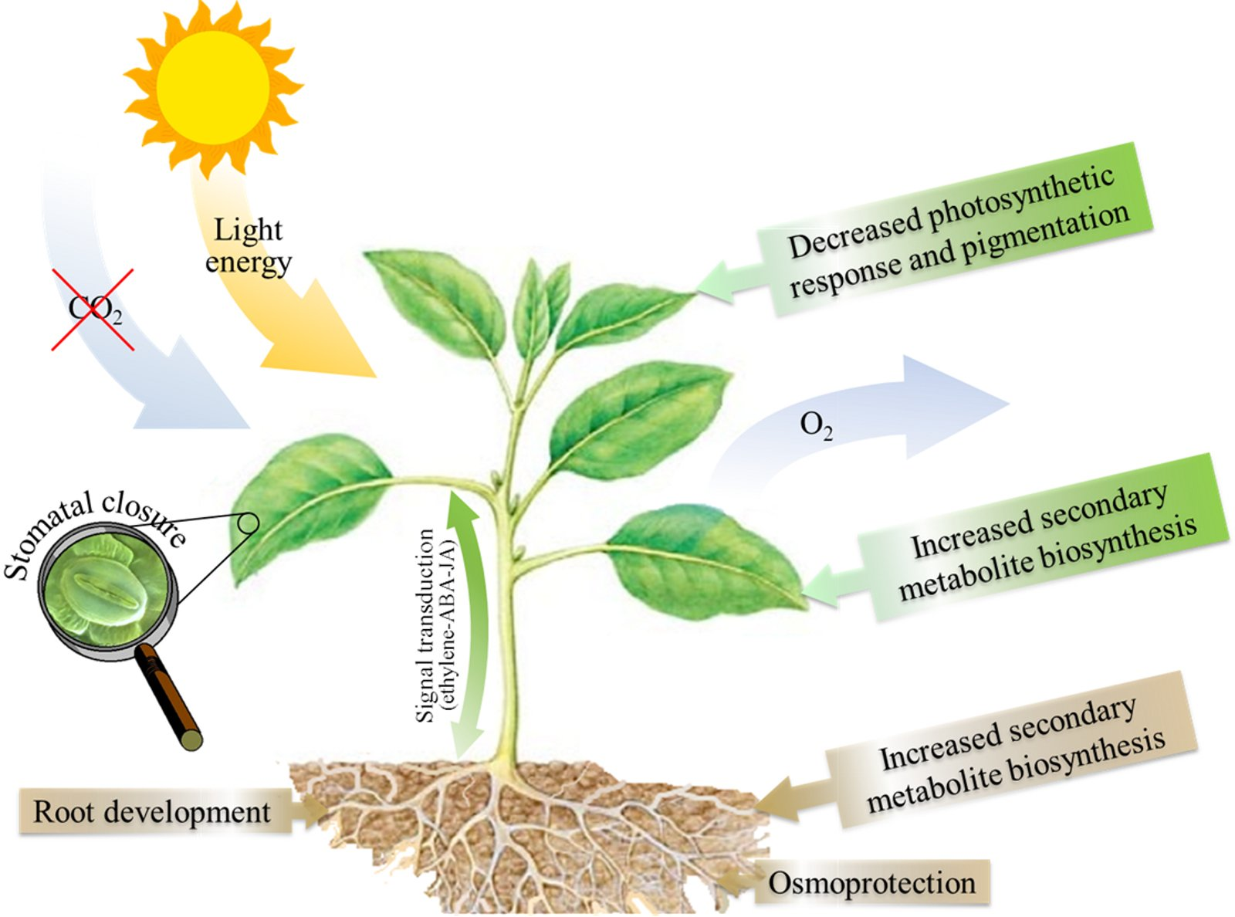
Heat and Drought Stress Physiology
http://www.intechopen.com/books/responses-of-organisms-to-water-stress/water-stress-and-agriculture
Notes:
Potato has less root but more leaves.

Slide 7
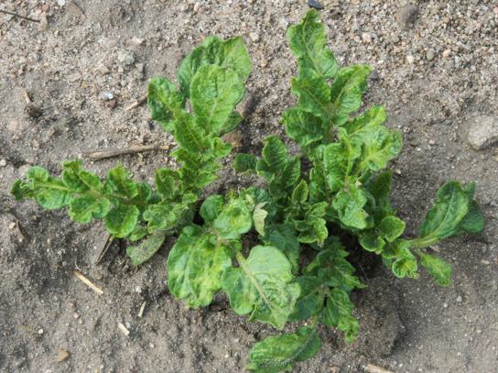
Heat and Drought Stress in Potatoes
Hasten leaf senescence, and thus crop senescence
Reduce leaf size and total leaf area.
https://www.ag.ndsu.edu/cpr/images/06-12-14/plant-science-robinson-heat-crinkle-on-russets.png

Slide 8
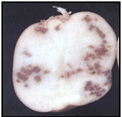
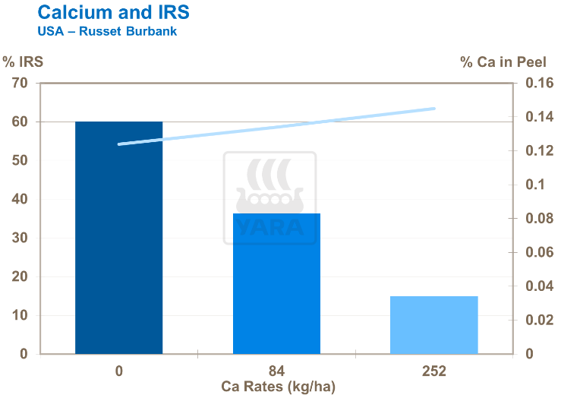
Heat and Drought Stress in Potatoes
Irrigation scheduling
Fertilization management
https://www.agric.wa.gov.au/sites/gateway/files/%28AK-a%29%20-%20Potato-HollowHeart4.jpg
http://yara.co.uk/crop-nutrition/crops/potato/quality/reducing-potato-internal-spotting/
http://www.inspection.gc.ca/plants/potatoes/guidance-documents/pi-009/eng/1383933490053/1383934020925?chap=9
Notes:
Blackheart, hollow heart, heat sprouting,
Non-uniform growth as a result of irregular irrigation can increase the risk of hollow heart developing, so it follows that a well-scheduled irrigation programme will help reduce its incidence. Too little irrigation early in the growing season may reduce tuber number per plant, leading to excessively large tubers with hollow heart. Low potassium levels have also been linked to hollow heart.
The name Internal Rust Spot (IRS) (internal brown spot) describes the disorder well. Brown or rust coloured spots or blotches appear at random in the tuber flesh. IRS appears to be a stress-related disorder associated with restricted Ca uptake into the tubers, despite most arable soils having ample available Ca in them.

Slide 9
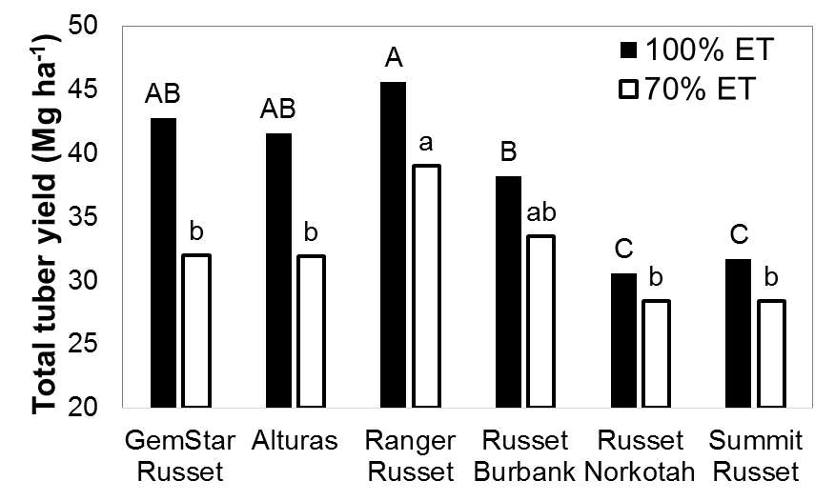
Cultivar Selection
Notes:
Jeff stark’s paper

Slide 10
Summary
Water transportation in plants
Physiology and symptoms of heat and drought stress in potatoes
Management practices:
Irrigation management
Fertilization: calcium
Cultivar selection
Notes:
http://www.intechopen.com/books/responses-of-organisms-to-water-stress/comparison-between-the-water-and-salt-stress-effects-on-plant-growth-and-development

