Slide 1
Be the first to know:
Use the PNW Pest Alert Network Presented by Jerry Neufeld and Ariel Agenbroad

Slide 2
Cooperators
University of Idaho Extension
Oregon State University Extension
Snake River Sugarbeet Research and Seed Alliance
Idaho Alfalfa and Clover Seed Growers Commission
Idaho Potato Commission
Notes:
Over and under irrigation
disease problems; reduced yield
Irrigation induced erosion
TMDL process
Deep percolation of nutrients
contaminates the aquifer
Nutrient losses from runoff
removal of P with sediment causes problems in surface water
Nutrient Mgmt plans

Slide 3
What is it?
A free service of University of Idaho and Oregon State Extension
A “real-time” pest alert notification system

Slide 4
PNW Pest Pest Alert Network www.pnwpestalert.net
IPM tool designed to increase communication about pest outbreaks and increase management options when pest outbreaks occur in southern Idaho/Eastern Oregon crops.

Slide 5
Who is it for?
Farmers
Crop Advisors
Landscapers & Groundskeepers
Green Industry Professionals
Homeowners

Slide 6
How does it work?
Alerts, updates and announcements are posted as pests emerge or reach thresholds
Alerts are delivered via web, email or text message

Slide 7
What do I do with the info?
You choose which alerts to receive and how
Most pest alerts contain photos, links to info or management advice

Slide 8
Homepage
Notes:
This is a screen shot of the home page.

Slide 9
Forecasting alerts
Notes:
This is a screen shot of the home page.

Slide 10
Confirmed pest outbreak
Notes:
This is a screen shot of the home page.

Slide 11
Announcements
Notes:
This is a screen shot of the home page.

Slide 12
Alerts
In 2015 alerts were posted regarding…
potato psyllid-potato
cereal leaf beetle-grain
corn earworm-sweet corn seed
lygus bug-alfalfa seed
black bean aphid-sugarbeets
iris yellow virus-onions
powdery mildew-sugarbeets
sugarbeet root maggot-sugarbeets

Slide 13
Number of subscribers

Slide 14
Subscriber location

Slide 15
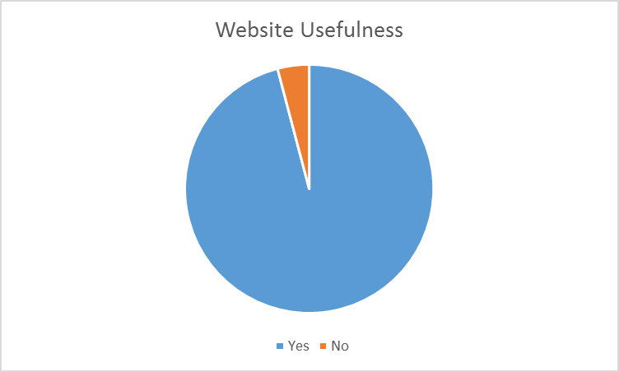
Website usefulness

Slide 16
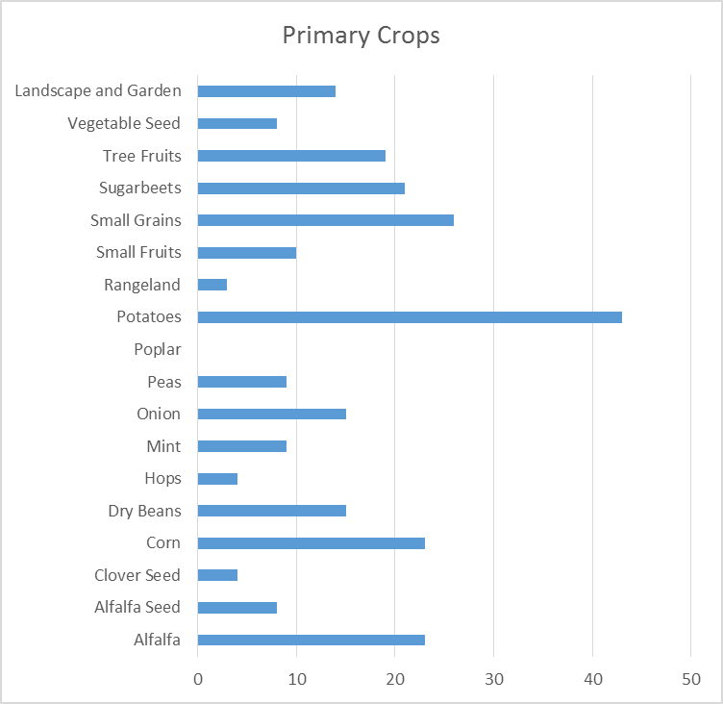
Primary crops

Slide 17
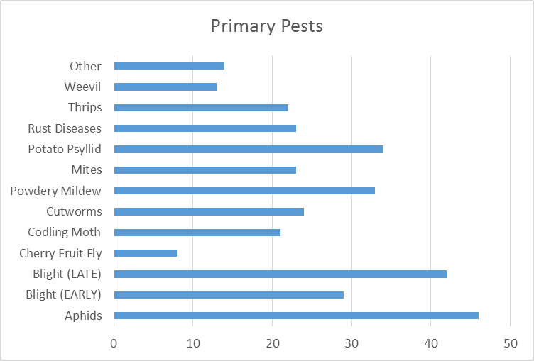
Primary pests

Slide 18
2015 Evaluation
Which statements below best reflect your views? Because of information received through PNWPestAlert.net…
A) I increased my field scouting to document the pest level in my fields. 56%
B) I was able to use additional IPM strategies to control pests because of information I received from TV/PNWPestAlert. 41%
C) I was able to reduce the number of sprays applied to my crops. 18%
D.) A spray I applied was more effective due to the timeliness of the application. 49%

Slide 19
2015 Evaluation
As a result of the IPM practices being used that were mentioned in the previous slide, PNWPestAlert.net users are reporting that they used 6 percent less pesticides on their crops from between 2004 to 2015.

Slide 20
Comments from 2015 evaluation
Knowing when mites and thrips are showing up helps me time my application recommendations to my clients
Allowed for timely applications that were more effective than just spraying on a schedule which was never based on actual emergence
Was able to time the applications better so that we could reduce the overall amount of chemical that was applied
Phyllid/zebra chip program prevented numerous insecticide applications
Notes:
Some comments from the 2013 evaluation.

Slide 21
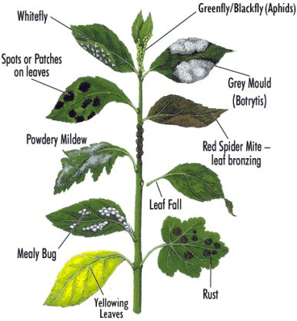
New category for 2016
Landscape & Garden Pest category added for homeowners and those serving the gardening public

Slide 22
New upgrades for 2016
New mobile-friendly interface
Greater search capacity
“Report a Pest” function
Marketing materials for you to share with your customers

Slide 23
See for yourself!
http://pnwpestalert.net/

Slide 24
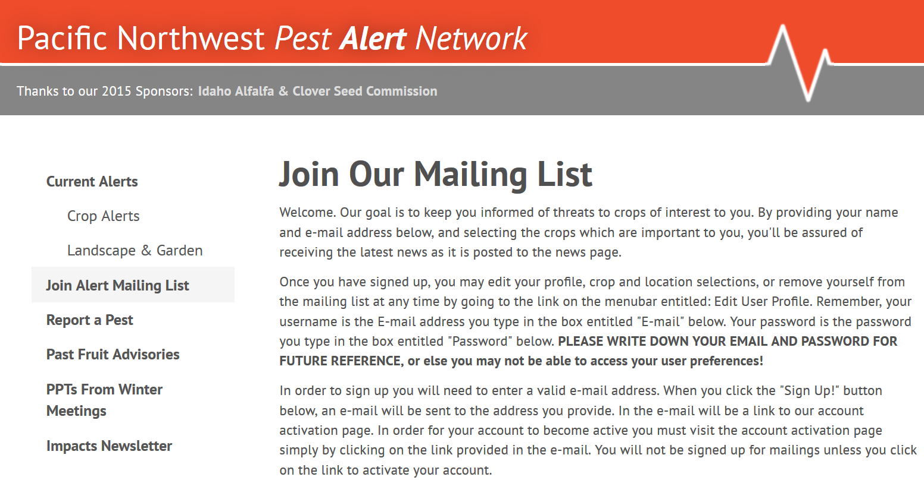
For the most benefit,

Slide 25
Questions

