Slide 1
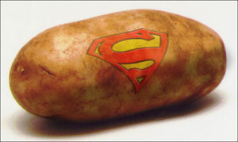
Nutrition: Are Potatoes a Super Food?
Dr. Martha Raidl
Rhea Lanting

Slide 2
Overview
History
Consumption
Nutrient profile
Health benefits
MyPlate
Summary and Conclusions

Slide 3
History – Past –Positive image
First cultivated: 8,000 to 5,000 BC in Peru
In Ireland in 1589
Worth their weight in gold
Grown in space
Notes:
The Inca Indians in Peru were the first to cultivate potatoes around 8,000 BC to 5,000 B.C.
Sir Walter Raleigh introduced potatoes to Ireland in 1589 on the 40,000 acres of land near Cork. It took nearly four decades for the potato to spread to the rest of Europe.
Arrived in the Colonies in 1621
•During the Alaskan Klondike gold rush, (1897-1898) potatoes were practically worth their weight in gold. Potatoes were valued for their vitamin C. And gold, at that time, was more plentiful than nutritious foods!
•In October 1995, the potato became the first vegetable to be grown in space. NASA and the University of Wisconsin, Madison, created the technology with the goal of feeding astronauts on long space voyages, and eventually, feeding future space colonies.

Slide 4
When were potatoes first grown in Idaho?
1621
1719
1836
1853
Notes:
Potatoes arrived in the Colonies in 1621 when the Governor of Bermuda, Nathaniel Butler, sent two large cedar chests containing potatoes and other vegetables to Governor Francis Wyatt of Virginia at Jamestown.
The first permanent potato patches in North America were established in 1719, most likely near Londonderry (Derry), NH, by Scotch-Irish immigrants. From there, the crop spread across the country.
Idaho, the present-day largest producer of potatoes, actually did not begin growing potatoes until 1836, when missionaries moved west in an effort to teach the native tribes to grow crops instead of relying upon hunting and gathering methods.
In 1853 railroad magnate Commodore Cornelius Vanderbilt complained that his potatoes were cut too thick and sent them back to the kitchen at a fashionable resort in Saratoga Springs, NY. To spite his haughty guest, Chef George Crum sliced some potatoes paper thin, fried them in hot oil, salted and served them. To everyone’s surprise, Vanderbilt loved his “Saratoga Crunch Chips,” and potato chips have been popular ever since.
Arrived in the Colonies in 1621
1st potato crop in 1719, in NH
Grown in Idaho, in 1836
French fries: 1867 by Thomas Jefferson
185Worth its weight in gold

Slide 5
History Present – Negative image
Couch potato
Comments people made about potatoes:
“Too high in calories”
“They’re fattening”
“Too many carbs”
Notes:
The current image of potatoes is unfortunately somewhat negative.
We even refer to some who is inactive as a couch potato.
These are some comments and misconceptions that people have made about potatoes:
They are too high in calories
They’re fattening
They have too many carbs
Let’s look at each of those comments and compare them to the facts.

Slide 6
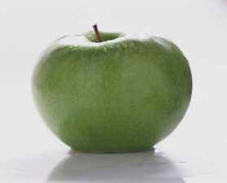
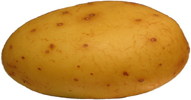
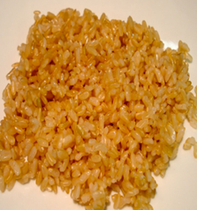
Potato Calorie Comparison
Examples of foods in the five food groups
Notes:
Calorie content of foods
Medium sized potato = 110 calories
Medium sized apple = 95 calories
1 cup of nonfat milk = 110 calories
3 ounces boneless chicken breast, cooked, skin removed = 128 calories
½ cup cooked brown rice = 110 calories

Slide 7
Q2. Which of the following food items contains the most calories?
Medium sized potato
Medium sized apple
1 cup of nonfat milk
½ cup cooked brown rice
3 oz chicken breast

Slide 8
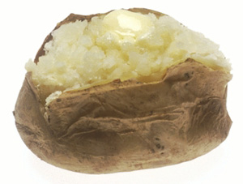
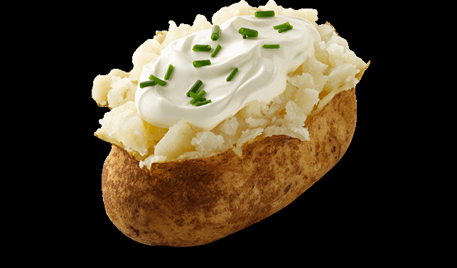
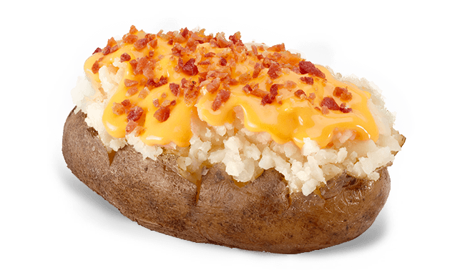
Potato toppings – increase calorie content
270 calories 440 calories
320 calories 540 calories
Notes:
The potato, by itself, isn’t high in calories.
However, the toppings that you add can significantly increase the calorie content.
If you order a baked potato from Wendy’s, it is about 270 calories (That is about a 10 ounce potato). The 110 calorie potato I mentioned in the previous slide is about 5 ounces.
If you add sour cream and chives, the calorie content increases to 320 calories.
If you order the cheese and broccoli topping, that increases the calories to 440
If you order the cheese and bacon topping, that doubles the original calorie content to 540 calories.

Slide 9
Q3: What percentage of calories that people consume come from potatoes?
< 5 %
10%
20%
30%
40%

Slide 10
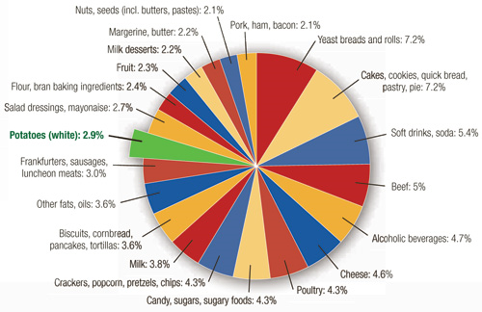
Potatoes = 3% of calories
Notes:
Potatoes make up just 3% of our daily calorie intake, based on data analyzed from the National Health and Nutrition Examination Survey (NHANES).
Calorie intake from white potatoes is surprisingly modest for adults and school-aged children, according to a new study released today at the Experimental Biology 2012 Annual Meeting.
"School-aged children consumed, on average, only three percent or less of calories per day from all types of white potatoes, including baked, boiled, mashed, French fried and other mealtime preparation methods. And children consumed, on average, less than one percent of their daily caloric intake from white potatoes at school," said Dr. Storey.
"By the same token, adults also consume few calories from white potatoes and as people get older, they consume fewer total calories, as well as fewer calories from white potatoes. For example, adult males 19-30 years consume about 92 calories a day from white potatoes or about 3.3 percent of total calories; males 71+ consume 63 calories a day from white potatoes or about 3.3 percent of total calories consumed, on average. Similarly adult women 19+ years consumed, on average, 52 calories from white potatoes a day, which is a little less than three percent of their total calories.

Slide 11
Are potatoes too high in carbohydrates?
2000 - 2200 calories = Daily calorie recommendation
50% calories from carbohydrate =1000 carb calories
1000 calories/4 calories/g carbohydrate =
250 grams of carbohydrate/day
1 medium sized potato = 26 grams of carbohydrate = ~10% of daily carbohydrate recommended intake

Slide 12
Low carb lunacy
Weight loss: water, muscle mass, fat
High in fat and cholesterol
Low in fruits, vegetables, whole grains, dairy
Side effects: headaches, dizziness, fatigue, and constipation
Notes:
Carbohydrate (stored in your muscles and liver as glycogen) is accompanied by a good bit of water. For every gram of glycogen stored, you store anywhere from 3-4 grams of water with it.
A well-nourished adult can store approximately 500 grams or 2000 kcal of carbohydrates. Of this, approximately 400 grams are stored as muscle glycogen, 90-110 grams as liver glycogen, and 25 grams circulate in the blood as glucose.
If you restrict carbohydrate, then your body starts using your glycogen stores and releases a significant amount of water, Then this is followed by breaking down muscle tissue and then fat stores.
A low carb diet is high in fat, saturated fat, and cholesterol which is linked to development of heart disease.
On a low carb diet, you will need to restrict your intake of fruits, vegetables, whole grains, and dairy foods, because they contain carbohydrate. Every time you eliminate a food group from your diet, you are also eliminating essential nutrients that your body needs. You cannot get all the nutrients by taking a vitamin or mineral supplement.
Some of the side effects of a low carb diet include: headaches and dizziness and fatigue (because your glucose levels could be low), constipation because are eliminating foods high in fiber (fruits, vegetables, beans, whole grains).

Slide 13
Q4. Which of the following was the most frequently consumed vegetable in 2011?
Onions
Tomatoes
Potatoes
Corn
Lettuce

Slide 14
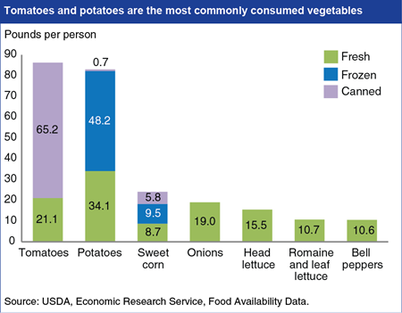
Q4. Answer - Tomatoes
Notes:
USDA: Tomatoes, potatoes, most commonly consumed vegetables
According to ERS's food availability data, 383.2 pounds of vegetables per person were available for Americans to eat in 2011, down from a peak of 424.7 pounds per person in 1996.
The decline was largest for potatoes (34.5 pounds) due to decreased production, followed by carrots (7 pounds), head lettuce (6.1 pounds), and tomatoes (4.2 pounds).
Despite declines in potato and tomato consumption, these two vegetables still dominate U.S. vegetable consumption.
In 2011, 86.3 pounds per person of tomatoes and 83 pounds of potatoes (not including dehydrated and chips) were available for Americans to eat.
French fries and pizza from fast-food restaurants and grocery stores contribute to the high consumption of these two vegetables.
The third highest vegetable, sweet corn, came in at 24.1 pounds per person in 2011.
This chart is found in ERS's new data product, Ag and Food Statistics: Charting the Essentials, released on September 16, 2013.
Source: agrimarketing.com Publication date: 11/11/2013

Slide 15
Nutrient Profile
Potato
Nutrients
Macro-nutrients
Carbo-hydrate
Protein
Micro-nutrients
Vitamins
Phyto-chemicals
Fat
Minerals

Slide 16
Q5. Potatoes are high in:
Fat
Simple carbs
Protein
None of the above

Slide 17
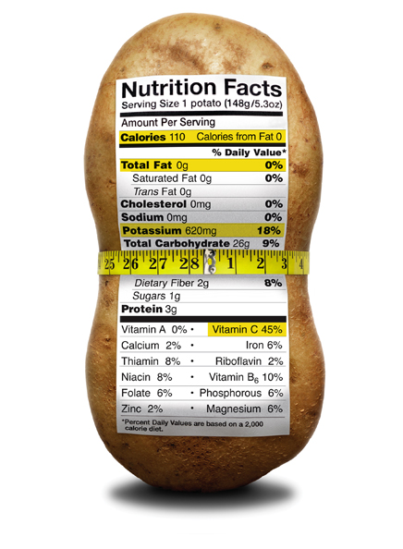
Potatoes – Nutrient Profile
Notes:
The Percent (%) Daily Value is a useful tool to check whether a food is high or low in a certain nutrient such as fat or fiber. A product is:
•A good source of a particular nutrient if one serving provides 10 to 19% of the Daily Value
•High in a given nutrient if it contains 20% or more of the Daily Value
•Low in that nutrient if the Daily Value is 5% or less

Slide 18
Macronutrients
Protein
Relatively low
High quality
Fat
Fat-free, heart healthy
0 grams total, trans and saturated fat
0 mg cholesterol
Notes:
Protein – Protein content is relatively low, need 50 grams of protein/day
High quality: is easily digested and has a high content of four essential amino acids, lysine, methionine, threonine, and tryptophan. content
Fat content of potatoes
0 grams total fat and 0 grams saturated fat
For example in the U.S. a product labeled as "low fat" must not contain more than 3 grams of fat per serving; and to be labeled "fat free" it must contain less than 0.5 grams of fat per serving.

Slide 19
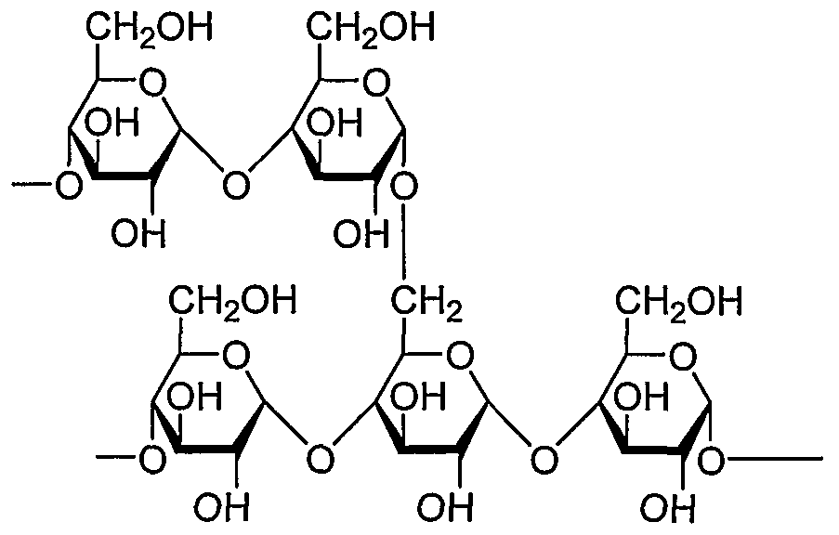
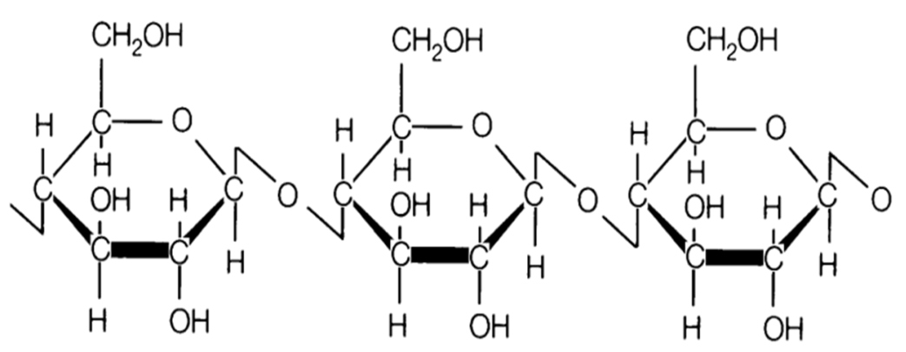
Macronutrients
Carbohydrate: 26 grams
Mainly complex
Amylose and amylopectin
Fiber (cellulose): 2 gm
74% = Insoluble: stay regular
26% = Soluble, lowers cholesterol
Notes:
Potato tubers, and here I refer to Solanum tuberosum, store their starch as amylose and amylopectin. Amylose is an unbranched polymer of repeating D-glucose subunits linked by alpha 1,4 bonding. Amylopectin is formed by non-random alpha-1,6 branching from the amylose base polymers. An amylopectin molecule may contain as many as 2 million glucose units.
Approximately 74 percent of the fiber in a whole baked potato is insoluble, according to the USDA. Insoluble fiber binds to water and sweeps material through the digestive tract more efficiently. It also supports bowel regularity by generating larger, softer stools that are easier to pass. Whole baked potatoes are still a significant source of soluble fiber, which accounts for about 26 percent of their total fiber content. Soluble fiber dissolves in water to form a gel-like substance capable of binding to fatty acids. By attaching to cholesterol and promoting its excretion, soluble fiber is useful for achieving and maintaining healthy cholesterol levels.
Like most vegetables, potatoes contain both types of fiber, soluble and insoluble. Insoluble fiber prevents constipation by adding bulk to stool. Soluble fiber helps lower cholesterol and becomes gel-like in your stomach, which fills you up and helps you feel full longer.

Slide 20
Micronutrients and Phytochemicals
Vitamins
Vitamin C
Minerals
Potassium
Phytochemicals
Phenolics
Vitamin B6
Folate
Sodium
Magnesium
Anthocyanins
Carotenoids
Kukoamines
Quercetin

Slide 21
Q6. Potatoes have low levels of:
Potassium
Vitamin C
Sodium
Magnesium
Phytochemicals

Slide 22
Micronutrients- keeps body healthy
Immune system
Vitamin C = 45% DV
Vitamin B6 = 10% DV
Heart healthy
Potassium = 18% DV
Sodium = 0%
Metabolic reactions
Magnesium = 10% DV
RBC and NTD
Folate = 6% DV
Notes:
The micronutrients and other compounds that are found in potatoes help keep your body functioning and healthy. Some of this occurs at the cellular level.
Immune system: One small potato meets 45% of your vitamin C requirements. Vitamin C has numerous functions in your body, among them helping your immune system function properly (fight illness), and plays a role in wound healing and preventing your gums from bleeding. One of the first signs of vitamin C deficiency is bleeding gums.
Potatoes are heart healthy; I mentioned earlier that they contain zero fat and cholesterol. They also contain zero milligrams of sodium. Excess sodium is linked to high blood pressure, holds water, makes your heart work harder. High potassium levels decrease blood pressure by helping your heart to contact (beat). It also plays a role in keeping your bones strong and dense. We should consume 4,700 mg of potassium per day; only 2-3% of the population meet the recommendation.
> 300 metabolic reactions: Magnesium plays a role in protein synthesis, energy production, nerve transmission, muscular contraction, blood pressure.
Vitamin B6- protein synthesis.
Folate: Folic acid supplements are suggested for use in women of childbearing age in order to prevent neural tube defects; plays a role in synthesis of red blood cells.
Antioxidants: compounds in potatoes that help prevent against heart disease and cancer.

Slide 23
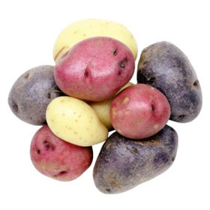
Phytochemicals/Phytonutrients
Help prevent heart disease and cancer
Phenolics (all)
Anthocyanins (red, purple)
Carotenoids (yellow)
Kukoamines
Quercetin
Ezekiel et al., Beneficial phytochemicals in potato- a review, Food Research International, 50, 2013,487-496
Notes:
Phyto means plant, so these chemicals are found in plants.
There are over 25,000 phytonutrients that have been identified in plants. Researchers have found over 60 different phytochemicals in potatoes. They act by neutralizing cancer-causing agents and cell-damaging molecules called “free radicals. Generally speaking, though, consumers associate phytochemicals with brightly colored fruits and vegetables or leafy green ones, like broccoli and Brussels sprouts—but not potatoes.
This is a partial list of some of the phytochemicals. They are important because they play a role in preventing heart disease and cancer.
Phenolics: are found in high concentrations in potatoes, in the peel and the flesh, with more in the peel. Potatoes have a better phenolic content than spinach, brussels sprouts or broccoli. In fact they are the most important source of phenols, after apples and oranges.
Flavanoids: the content depends on the color of the potato, with more being present in red skinned and purple potatoes. An example of a flavanoid in red and purple potatoes is anthocyanin. Researchers found that subjects who ate purple potatoes for one month lowered their systolic blood pressure by 3.5% and systolic by 4.3%.
Carotenoids: are highest in yellow potatoes.
Quercetin and kukoamines: These last compounds are of interest for their potential to lower blood pressure, and have only been found in one other plant, Lycium chinese.

Slide 24
Q7. What is the cost of eating 5 servings of fruits/vegetables a day?
$1.50
$2.50
$3.50
$4.50
$5.50

Slide 25
Is it too expensive to eat fresh produce?
It costs ~ $2.50* for five 1-cup servings of fruits and vegetables
Fruits: $0.56/ cup
Bananas, apples, pears, pineapple, peaches
Vegetables: $0.42/cup
Potatoes, lettuce, eggplant, greens, carrots
*based on 2009-2010 prices

Slide 26
Potatoes are extremely economical
Based on 2008 prices,
Fresh potatoes:
1 lb = $0.48
Per 1 cup serving = $0.19
Frozen potatoes
1 lb= $0.93
Per serving = $0.41
http://www.ers.usda.gov/data-products/fruit-and-vegetable-prices.aspx#26396
Notes:
How much do fruits and vegetables cost? ERS estimated average prices for 153 commonly consumed fresh and processed fruits and vegetables. Reported estimates include each product's average retail price per pound and per edible cup equivalent (the unit of measurement for Federal fruit and vegetable consumption recommendations). For many fruits and vegetables, a 1-cup equivalent equals the weight of enough edible food to fill a measuring cup. ERS calculated average prices at retail stores using 2008 Nielsen Homescan data. Retail quantities were further adjusted for the removal of inedible parts and cooking loss.

Slide 27
Dietary Guidelines for vegetables
Vegetables are organized into 5 subgroups:
dark green
starchy
red and orange
beans and peas
other

Slide 28
Are potatoes a nutritional and economic value?
Study conducted by Dr. Adam Drewnowski
Analyzed nutritional value of 98 vegetables
Six nutrients analyzed: Dietary fiber, potassium, magnesium, and Vitamins A,C, and K
Determined % Daily Value of the six nutrients for 1 serving (1 edible cup)of vegetable in four subgroups
Used 2008 fruit and vegetable prices to determine price per edible cup
Drewnowski and Rehm, May 2013, www.plosone.org
Notes:
Study conducted by Dr. Adam Drewnowski and a graduate student, Colin Rehm to determine cost of 1 cup of 98 fresh, frozen, and canned vegetables. This study was conducted to help schools determine which vegetables they should include as part of their school lunch program which requires them to offer 5 cups of vegetables (1 cup per day) to students. They wanted to determine the nutrients per calorie and nutrients per penny.
The six nutrients they analyzed were dietary fiber, potassium, magnesium, and vitamins A, C, and K. These were chosen because the DGA identifies vegetables as being excellent sources of these nutrients and many youth do not meet the daily recommendations for these nutrients.
For each vegetable, they determined the % DV (The Percent Daily Value on the Nutrition Facts label is a guide to the nutrients in one serving of food. For example, if the label lists 15 percent for calcium, it means that one serving provides 15 percent of the calcium you need each day.)

Slide 29
Q8. Which vegetable is the most economical for meeting potassium and fiber recommendations?
Iceberg lettuce
Potatoes
Carrots
Beans

Slide 30
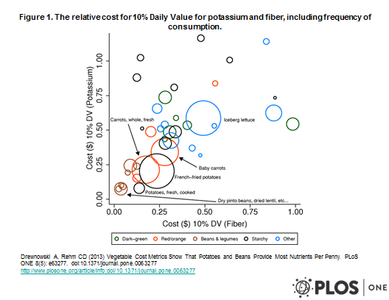
Cost for Potassium and Fiber
Notes:
Vegetables are important sources of dietary fiber, vitamins and minerals in the diets of children. The United States Department of Agriculture (USDA) National School Lunch Program has new requirements for weekly servings of vegetable subgroups as well as beans and peas. This study estimated the cost impact of meeting the USDA requirements using 2008 national prices for 98 vegetables, fresh, frozen, and canned. Food costs were calculated per 100 grams, per 100 calories, and per edible cup. Rank 6 score, a nutrient density measure was based on six nutrients: dietary fiber; potassium; magnesium; and vitamins A, C, and K. Individual nutrient costs were measured as the monetary cost of 10% daily value of each nutrient per cup equivalent. ANOVAs with post hoc tests showed that beans and starchy vegetables, including white potatoes, were cheaper per 100 calories than were dark-green and deep-yellow vegetables. Fresh, frozen, and canned vegetables had similar nutrient profiles and provided comparable nutritional value. However, less than half (n = 46) of the 98 vegetables listed by the USDA were were consumed >5 times by children and adolescents in the 2003-4 National Health and Nutrition Examination Survey database. For the more frequently consumed vegetables, potatoes and beans were the lowest-cost sources of potassium and fiber. These new metrics of affordable nutrition can help food service and health professionals identify those vegetable subgroups in the school lunch that provide the best nutritional value per penny.

Slide 31
Nutrient cost comparison
10% DV | Beans/ Peas | Potatoes | Dark Green | Red/ Orange | Other
Potassium | $0. 10 | $0.14 | $0.54 | $0.34 | $0.81
Fiber | $0.05 | $0.19 | $0.32 | $0.20 | $0.49
Magnesium | $0.10 | $0.29 | $0.60 | $0.97 | $1.12
Vitamin C | $0.58 | $0.10 | $0.12 | $0.26 | $0.34
Vitamin A | - | - | $0.30 | $0.05 | $2.49
Vitamin K | $3.70 | $6.64 | $0.17 | $1.89 | $2.93
Notes:
This is a nutrient cost comparison of how much it would cost to get 10% of your Daily Value of potassium, fiber, magnesium, and Vitamins A, C, and K from four different vegetable groups-beans/peas, potatoes, dark green, and red/orange, and other vegetables.
Let’s look at the first four nutrients, It cost 5-58 cents to get 10% of your DV of potassium, fiber, magnesium and vitamin C from beans
and $0.10 to $0.29 from potatoes
and $0.12 to $0.60 from dark green vegetables (broccoli and spinach)
and $0.05 to $0.97 from red/orange vegetables
Beans and potatoes don’t contain vitamin A and are very low in Vitamins A and K.
This table also demonstrates why it is important to eat a variety of vegetables to get all the nutrients you need.

Slide 32
Additional study results
Only beans, white potatoes and carrots combined nutrient density, affordability and consumer acceptance.
White potatoes had lower energy density (calories) and were most frequently consumed than beans .
Notes:
Out of 98 vegetables, only 46 were consumed more than 5 times, led by potatoes, carrots, tomatoes, onion, and iceberg lettuce.
White potatoes (including fried), sweet potatoes, beans, carrots, and some dark green vegetables were the most affordable and nutrient-dense.
Consumption of sweet potatoes and some dark green leafy and non leafy vegetables was low.
Only beans, white potatoes and carrots combined nutrient density, affordability and consumer acceptance. White potatoes rivaled beans in nutrient density and had lower energy density and much higher frequency of use.

Slide 33
Summary and Conclusions
Potatoes are a nutrient-dense and economical vegetable
Potatoes are an important staple of the diet.

Slide 34
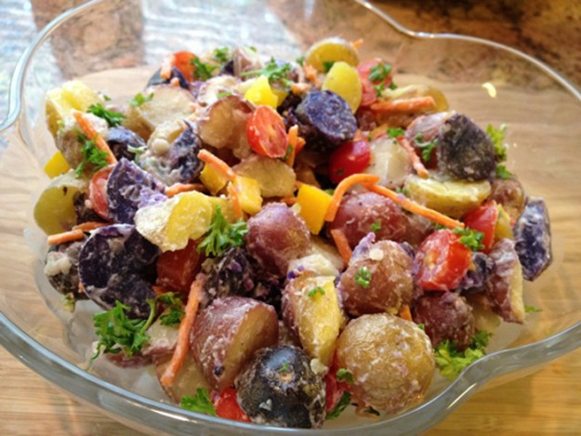
Next Nutrition Presentation:
1 potato, 2 potato, red, white, and blue potato
Notes:
No matter how you slice them, potatoes are more than patriotic. Potatoes provide comfort all year-round. High in potassium, fiber, vitamin C, and a host of powerful antioxidants, this affordable vegetable is easy to prepare, shop for, and store. Depending on how you prepare them and what they’re served with, potatoes also have a great calorie-to-comfort ratio. Weighing in at only 67 calories for about a ½ cup serving of boiled potato, this nutrient-rich vegetable can please your palate and pant size at the same time.
On this 4th of July, a barbeque may be on the menu, and it wouldn’t be the same without burgers and dogs. For my family, firing up the grill means they’ll be making some space on their plates for my homemade potato salad. The welcoming blend of colors, textures, and flavors would please any crowd. For your 4th of July festivities, why not try cooking up red, white, and blue(ish) potatoes (I know they are really purple, but you can use your imagination!)? For my recipe, Patriotic Potato Salad, please visit my website. For hundreds of other potato recipe ideas, visit the U.S. Potato Board’s Potatoes: Goodness Unearthed website. Also check out APRE’s scientific brief, The White Potato: An Affordable, Nutrient-Dense Vegetable, for more information about the potassium- and dietary fiber-rich potato.

