Slide 1
Globodera ellingtonae: a new Potato cyst nematode Species
Inga A. Zasada AND Wendy Phillips
USDA-ARS horticultural Crops Research Laboratory, Corvallis, OR
Russell E. Ingham
Oregon State University, Corvallis, OR

Slide 2
Outline
Globodera in the United States
  Discovery of Globodera ellingtonae in the United States
  What we know about G. ellingtonae
  Conclusions

Slide 3
Globodera in the United States
PCN are considered quarantine pests for the U.S. as they can cause severe economic damage to host crops if uncontrolled
1932 – G. rostochiensis found in New York; confined to this area as a result of regulatory and management practices
2006 - a sample comprised of tare dirt from a grading station in Blackfoot, ID was determined to contain G. pallida
2008 – three nematode samples distinct from known PCN species were found in Oregon and Idaho
2013 - 19 G. pallida-infested field have been identified in Idaho

Slide 4
Globodera spp.
Elevated to a subgenus in 1959 (Skarbilovich) and genus in 1975 (Behrens)
Recognized species:
  G. achilleae 1973 (yarrow)
  G. artemisiae 1972 (artemisia)
  G. chaubattia 1984 (apple)
  G. ellingtonae 2012
  G. hypolysi 1983
  G. leptonepia 1953 (solanaceous plants)
  G. mexicana 1967 (tomato, black nightshade)
  G. millefolii 1965
  G. mirabilis 1971
  G. pallida 1973 (potato, tomato, solanaceous weed)
  G. psudorostochiensis 1963
  G. rostochiensis 1923 (potato, tomato, solanaceous weed)
  G. tabacum complex1954 -1972 (solanaceous plants)
  G. zelandica 1984 (tree fuschia)

Slide 5
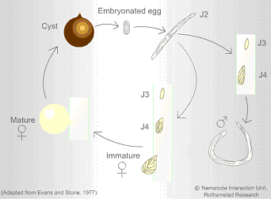
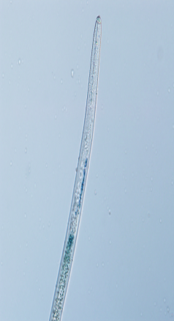
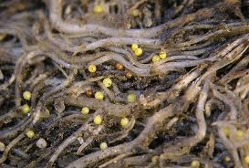
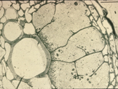
Globodera spp. lifecycle
Contains
400-500
eggs
Diapause
Hatching factor
Narrow host range
J1
Males are need for reproduction in most species
Syncytium formed
“transfer cell”
Some images from mactode.com
“Ultimate in evolutionary specialization”

Slide 6
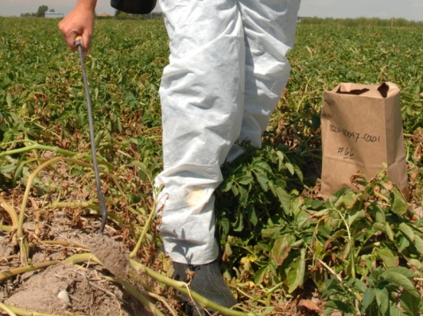
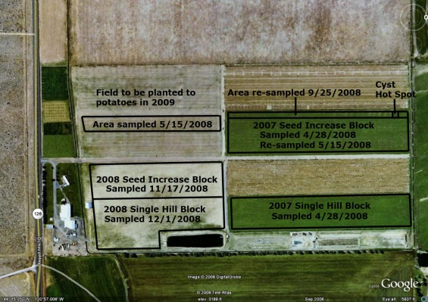
Globodera ellingtonae discovery
2008 – three nematode samples distinct from known PCN species were found in Oregon and Idaho
  Oregon Department of Agriculture processed samples from Powell Butte, OR, 6 cysts were found
  In Idaho cysts were found in 2 fields (Caribou and Teton Counties, Idaho) for a total of 4 cysts
  All cysts sent to USDA-ARS Nematology Laboratory for identification
  2010 – USDA-ARS and Oregon State University demonstrate that potato and tomato are hosts for this Globodera (Skantar et al., 2011)
    OSU voluntarily closes Powell Butte research facility
Map of OSU
Powell Butte Farm

Slide 7
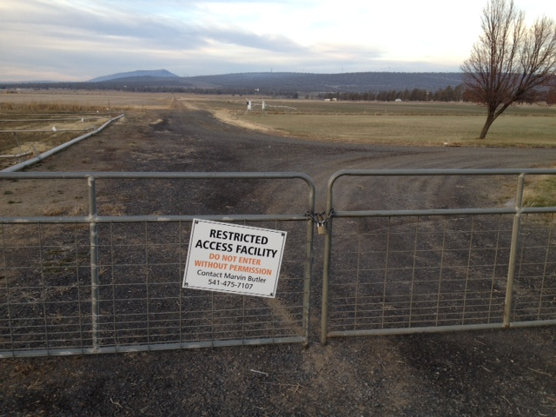

Slide 8
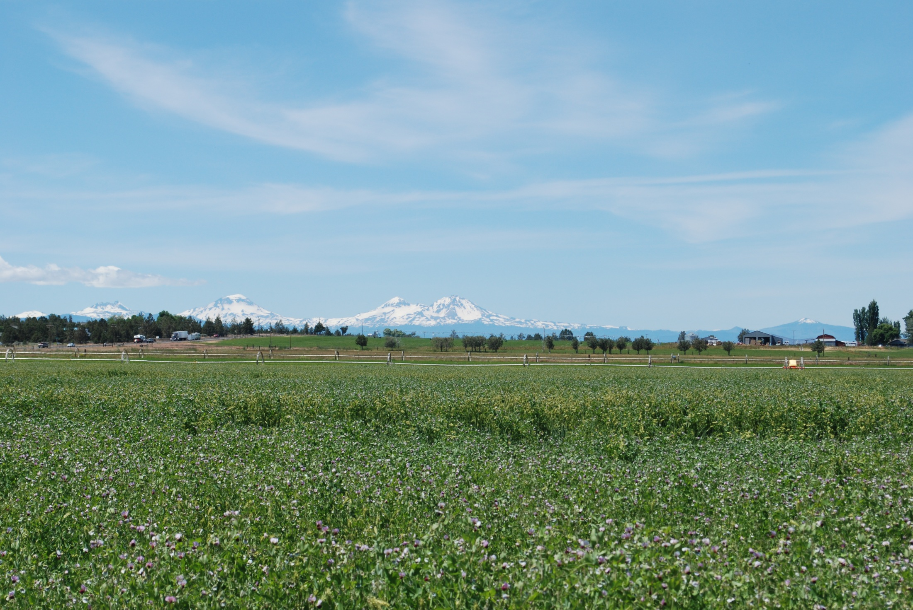

Slide 9
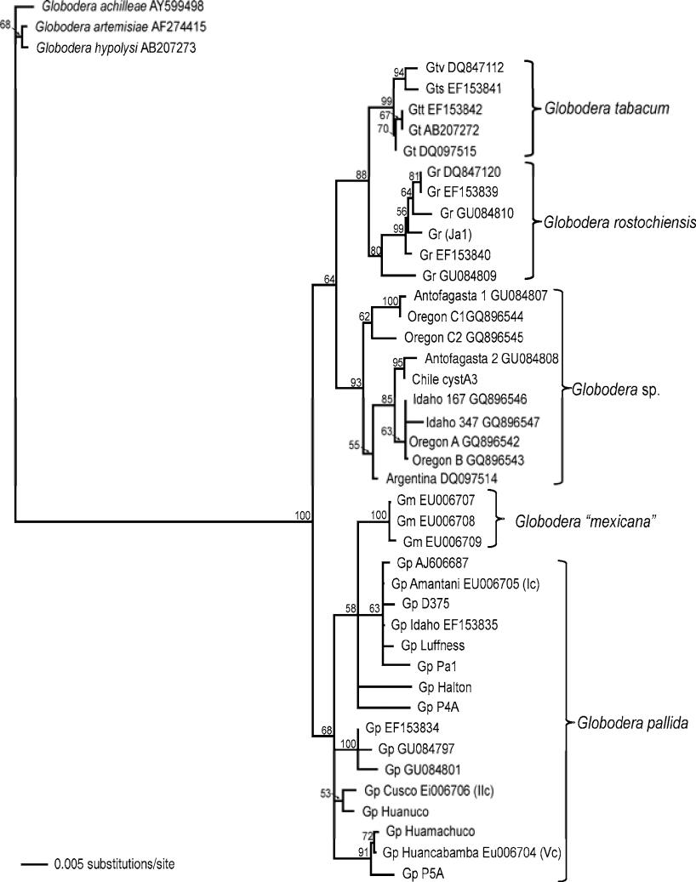
Globodera ellingtonae discovery
2012 – described as a new species by Handoo et al.
  Morphologically G. ellingtonae differs from other Globodera by its distinctive J2 tail and by one or more differences in stylet length, cuticular ridges, spicules, etc…
  Based upon ITS sequence data G. ellingtonae is distinct from G. pallida, G. rostochiensis, G. tabacum, and G. mexicana
  Multiplex RT-PCR used for detection of G. rostochiensis, G. pallida, and G. tabucum resulted in no false positive detections involving G. ellingtonae
G. ellingtonae
Handoo et al. (2012)

Slide 10
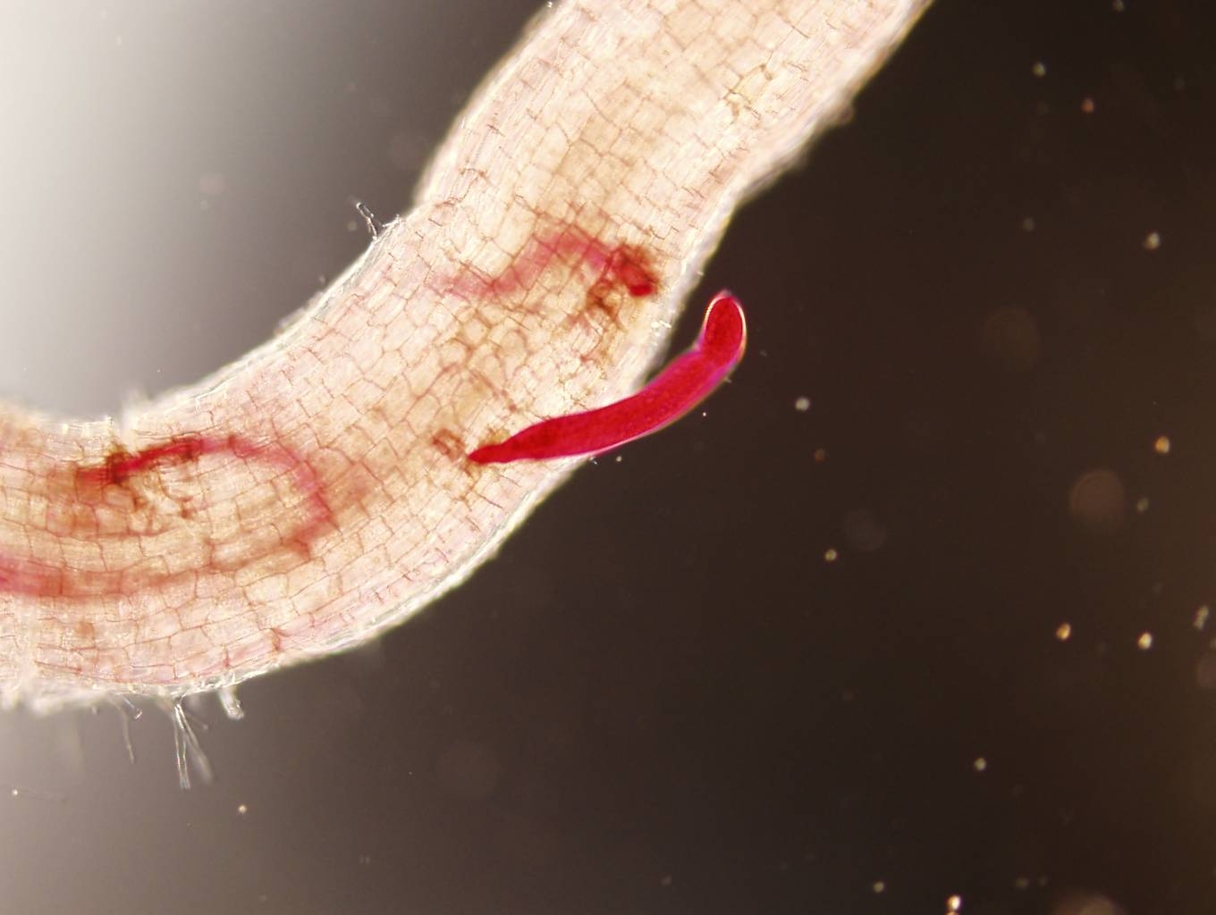
Globodera ellingtonae discovery

Slide 11
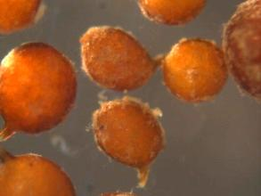
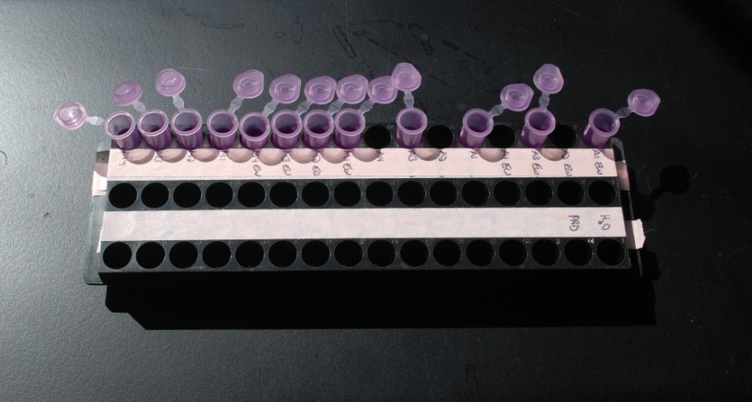
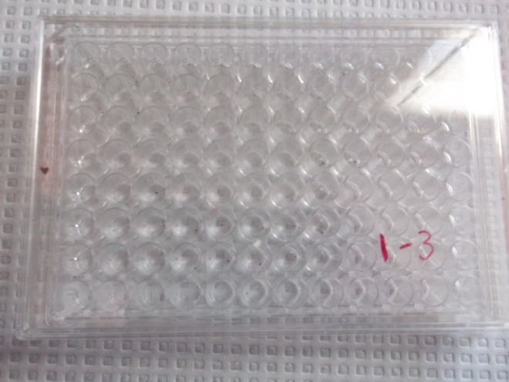
What we know - hatching
Roy Navarre (USDA-ARS) – Zasada et al. (2013)

Slide 12
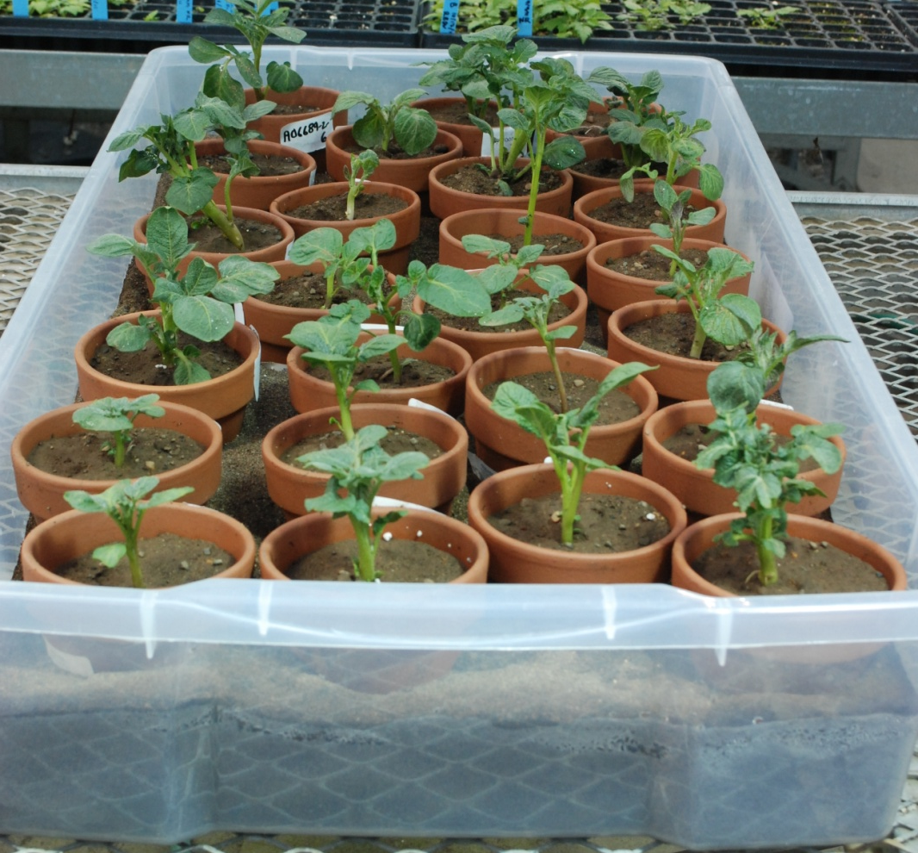
What we know – potato hosts
P < 0.05
All Ro1
resistant

Slide 13
What we know – host range

Slide 14
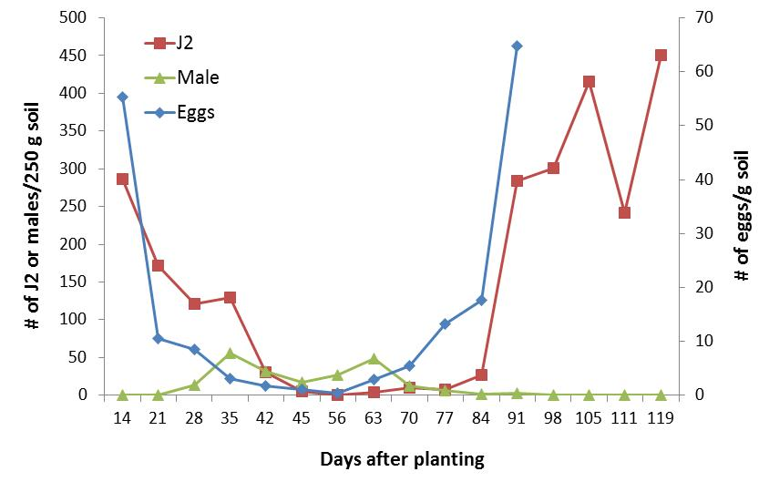
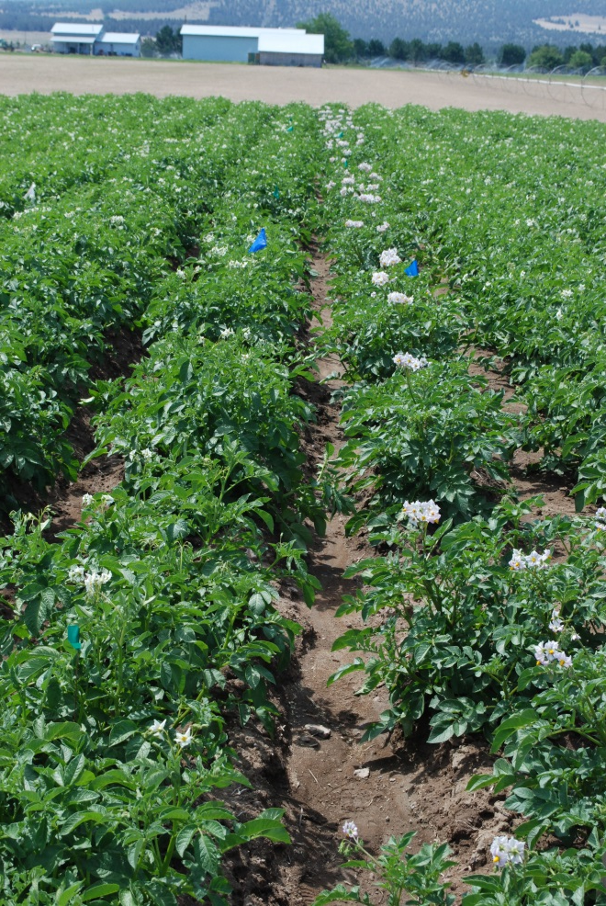
What we know - biology
Population dynamics of G. ellingtonae life stages in soil on potato

Slide 15
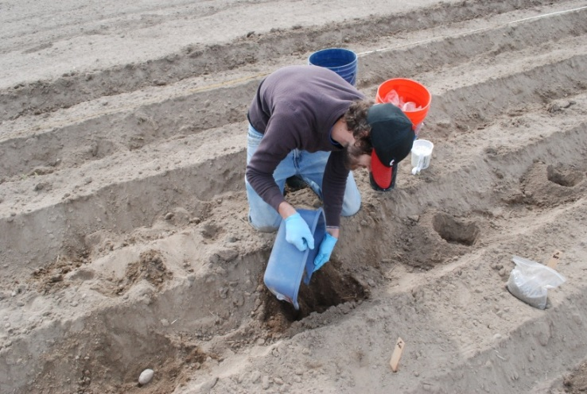
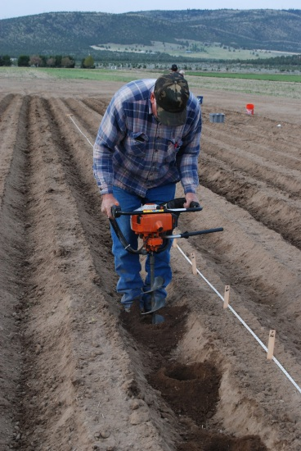
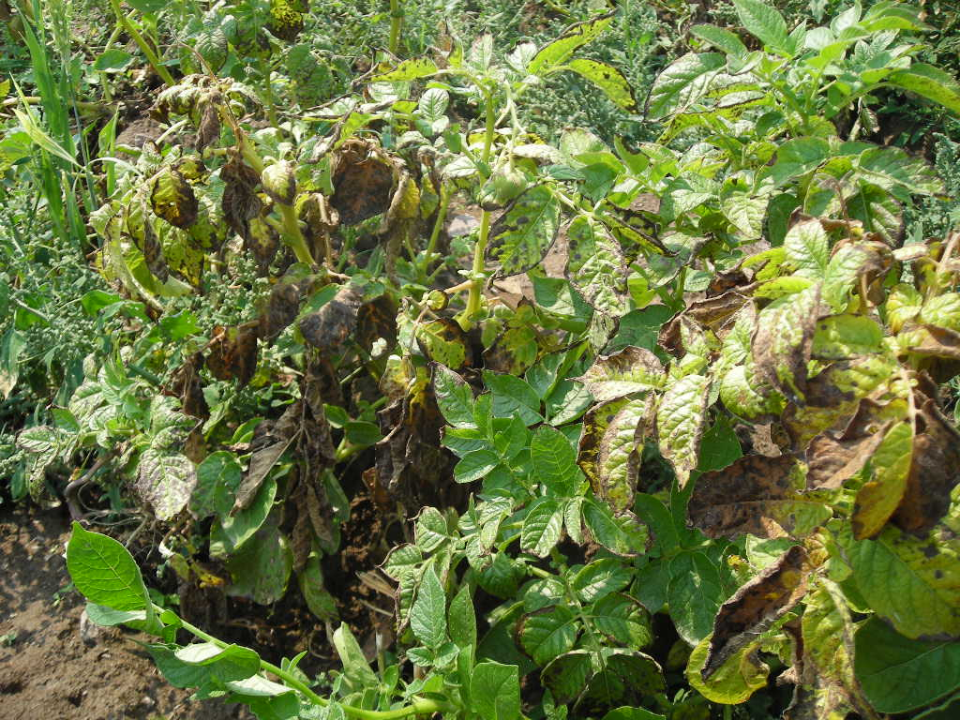
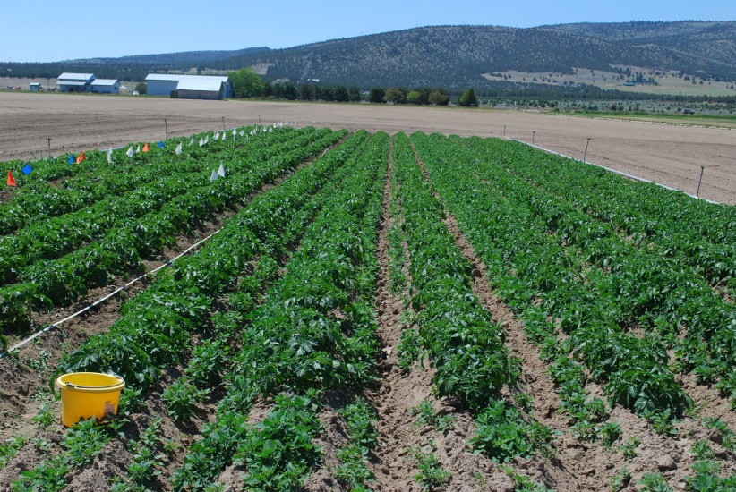
What we know - pathogenicity
2012 - Inoculated potato ‘Russet Burbank’ with 0, 5, 10, 20, 40 eggs/g soil
2013 – Inoculated potato “Russet Burbank’ and ‘Desiree’ with 0, 5, 10, 20, 40, 80 eggs/g soil

Slide 16
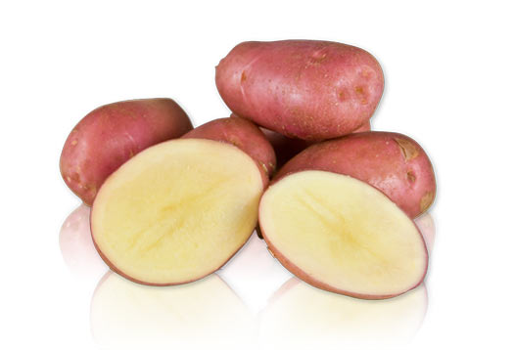
Desiree Results

Slide 17
Pathogenicity – Desiree 2013

Slide 18
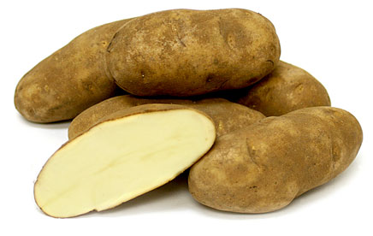
Russet Burbank Results

Slide 19
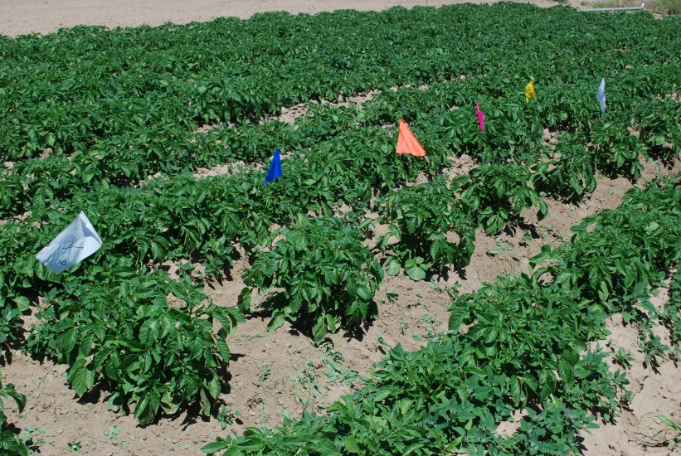
Pathogenicity – Burbank 2012

Slide 20
Pathogenicity – Burbank 2013

Slide 21
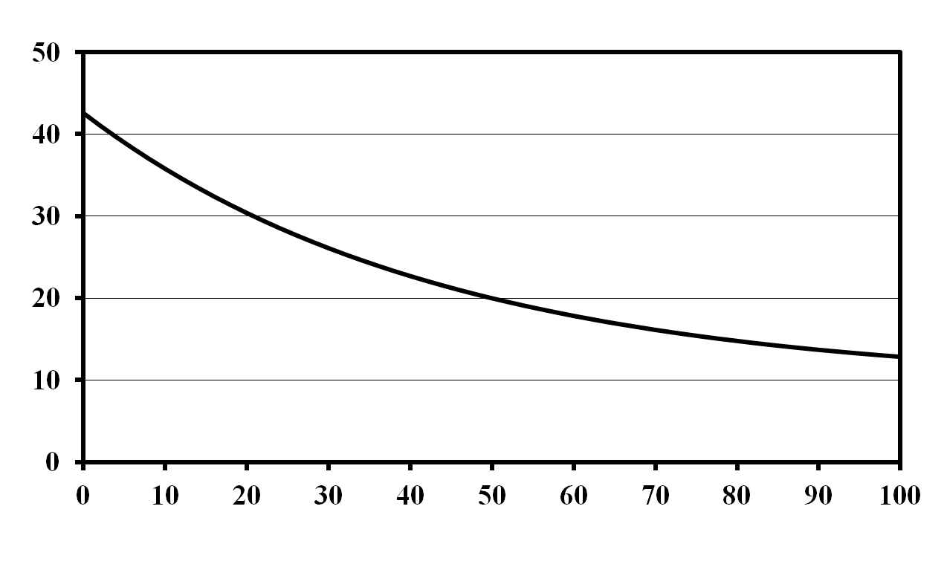
Effect of G. pallida on yield of a moderately intolerant potato cultivar
Yield (mt/ha)
Initial Population Density (eggs/g soil)
Trudgill and Phillips

Slide 22
Conclusions
Biological data supports the morphological and molecular conclusion that G. ellingtonae is a distinct species from G. pallida and G. rostochiensis
G. ellingtonae appears to be more closely related to G. rostochiensis
It is still not clear to what extent G. ellingtonae is a pathogen of potato – this nematode is not regulated!!
Future research will include: expanded host range, continued molecular characterization, and identification of ways to manage this new nematode species

Slide 23
Acknowledgements
USDA-ARS
Roy Navarre
Chuck Brown
Xiaohong Wang
Rich Novy
Jonathan Whitworth
Oregon State University
Nadine Wade
Solomon Yilma
Dee Denver
University of Idaho
Louise-Marie
Dandurand
Joe Kuhl
Zasada USDA-ARS Lab
Amy Peetz
Duncan Kroese
Mariella Ballato
Amanda Howland
Funding
Oregon Potato Commission
USDA-APHIS
USDA-ARS

