Slide 1
Guía de Campo para la Identificación de Plagas del Cultivo de la Papa
Lisa Downey Blecker
Wayne Jones
Ronda Hirnyck
Juan Alvarez
Reed Findlay

Slide 2
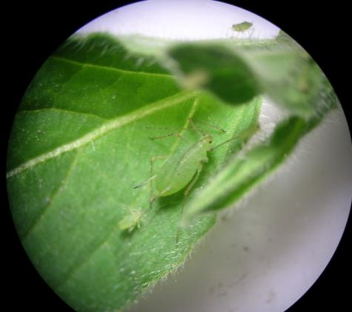
Introducción
Manual presenta un plan de monitoreo para el cultivo de la papa
Enfoque en plagas que causan daño económico y plagas nuevas
No incluye información especifica sobre como manejar las plagas
Notes:
Applicable for Potatoes in Idaho, Oregon and Washington.
Focus is on economically damaging pests, but also new pests that have the potential to become economically damaging.
The Manual does not include specific pest management recommendations, specific scouting requirements or economic thresholds for each pest.
It is intended to be used in conjunction with the Potato Production Systems book, as well as other resources listed in the book.

Slide 3
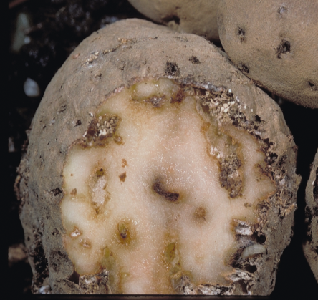
Introducción
El público al que se dirige son los trabajadores del campo
Es una ayuda para identificar plagas que ocurren durante cada etapa de desarrollo del cultivo
Informa cómo hacer el monitoreo
Notes:
Proper pest identification and scouting are indispensible to an IPM program.

Slide 4
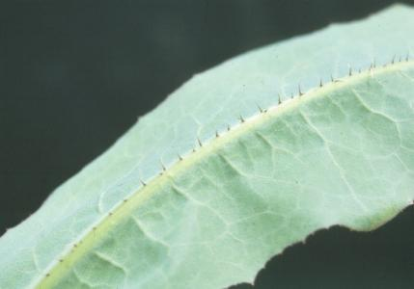
El Manejo Integrado de Plagas
Sistema completa para controlar plagas
Utiliza una combinación de opciones en lugar de enfocarse en una sola estrategia
El propósito es maximizar el beneficio económico de la producción y a la vez minimizar riesgos a los seres humanos y al medio ambiente
Depende de programas de monitoreo, identificación y pronostico
Notes:
IPM utilizes a combination of options instead of relying on one method for managing pests. These options may include, but are not limited to:
Scouting
Pest forecasting models
Cultural controls (e.g., crop rotation)
Biological controls
Pesticides

Slide 5
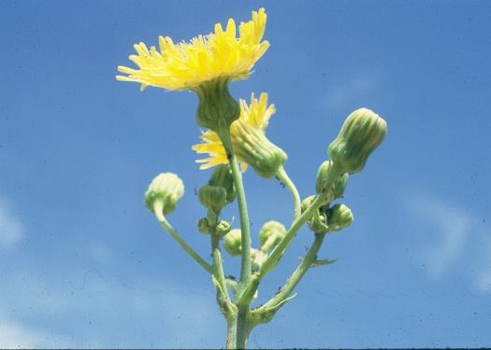
Los Principios Básicos del Manejo Integrado de Plagas
No hay una solución para todo
Prevenir es mejor que curar
La presencia de algunos insectos no necesariamente implica problemas
Los enemigos naturales son importantes
El monitoreo es la clave
Notes:
No silver bullet: over-reliance on one method will cause long-term problems with pesticide resistance, pest resurgence and pest replacement.
Prevention is easier than treatment: if we know which pests are likely to be present (by keeping a field history), then it is easier to prevent infestations by researching the biology of the pests and the environmental conditions that encourage pest infestation.
Some pests are OK: depending on the pest, potatoes can tolerate a certain level of infestation without significant yield loss. To know this, you must know the biology of the pests. Pesticides should only be used when field scouting shows that a pest infestation exceeds the economic threshold.
Natural enemies are important: excessive pesticide use and use of broad-spectrum insecticides will kill natural enemies, creating more work for the pest manager.
Scouting is key: regularly scouting fields to determine pest type, number and location of pests within the field will help the pest manager schedule control actions when they are needed.

Slide 6
El Monitoreo
Se debe efectuar el monitoreo en todo el campo
Ingrese el campo por un borde y camine en una configuración especifica hasta llegar al otro extremo

Slide 7
El Monitoreo
Inspeccione un mínimo de 20 plantas por cada 10 – 20 acres
Inspeccione las hojas, los tallos las raíces y las papas
Notes:
Tools that can be helpful in identifying pests include a shovel, a magnifying glass and a knife.
Be sure to inspect plants that look different from the surrounding plants, as well as areas where there are no plants (skips). Dig up the skips.
It is important to keep a record of pest activity. Important details include: date, location (specific field name or number) and pest. You can do this in the manual (mention and show notes pages).

Slide 8
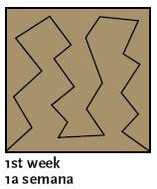
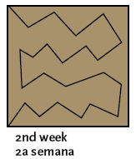
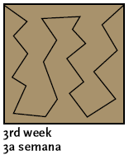
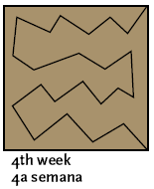
El Monitoreo
En monitoreos secuenciales, hay que ingresar al bloque por diferentes extremos.

Slide 9
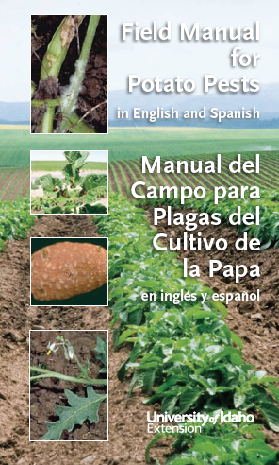
Como Usar Este Manual
Está organizado por clase de plaga
Enfermedades
Nematodos
Insectos
Malezas.
Dentro de cada clase, se ordena cada plaga de acuerdo a la Etapa de Desarrollo del Cultivo.

Slide 10
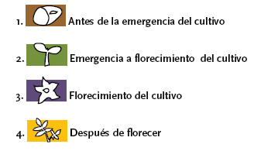
Como Usar Este Manual
En cada pagina, hay cuadros de colores diferentes
Cada cuadra tiene un numero y una figura que corresponde a una Etapa Desarrollo del Cultivo

Slide 11
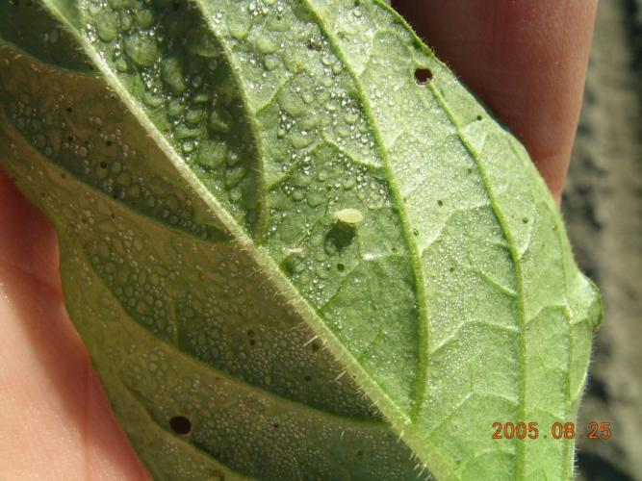
Como Usar Este Manual
Por cada plaga, se clasifica el Tipo de Plaga
Plaga de mayor importancia
Plaga común
Plaga ocasional
Plaga nueva/potencial
Notes:
Major pest: a pest that consistently causes economic damage and is the driving force behind management decisions.
Common pest: a pest that commonly occurs throughout most potato growing areas in the northwest, but does not reach economically damaging levels every year.
Occasional pest: a pest that does not commonly occur, but often causes economic damage when it does occur.
New/potential pest: a pest that has not yet become established, or that has surfaced as a concern in the last 5 years, and has the potential to become a major pest.

Slide 12
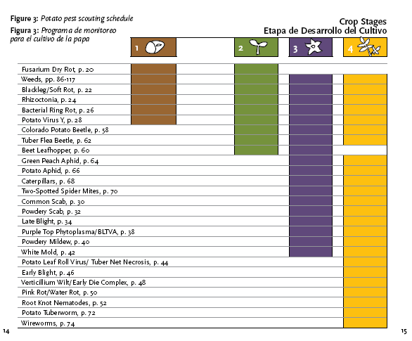
Notes:
Potato pest scouting schedule for all the pests in the Manual.

Slide 13
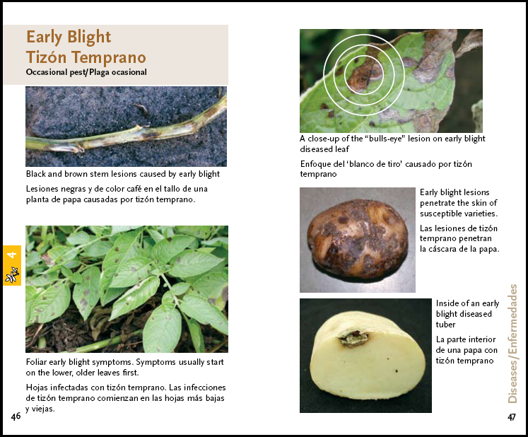

Slide 15
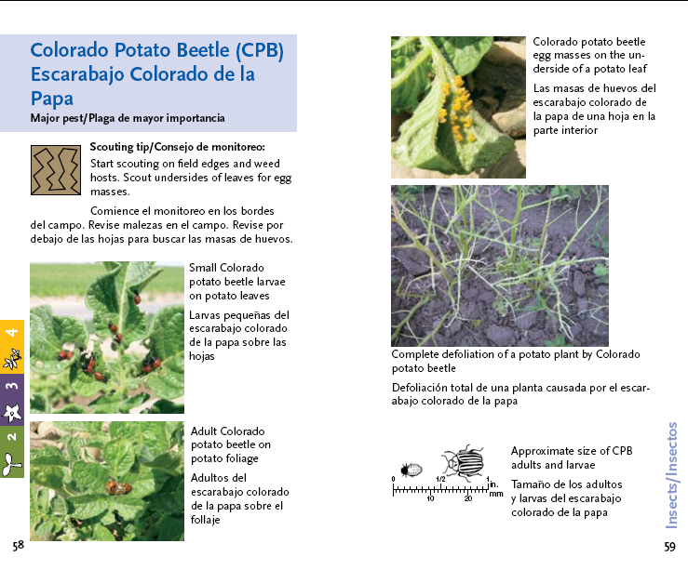

Slide 16
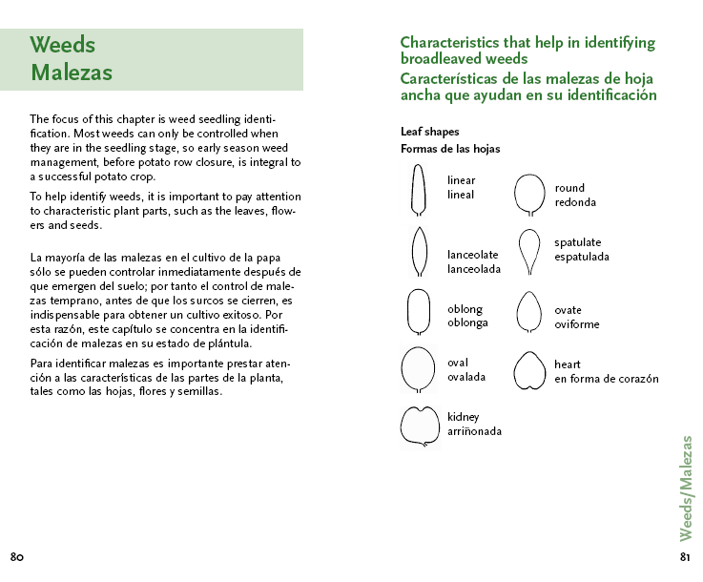

Slide 17
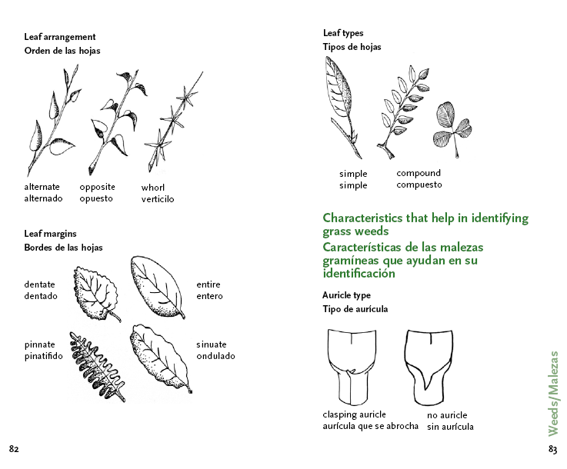

Slide 18
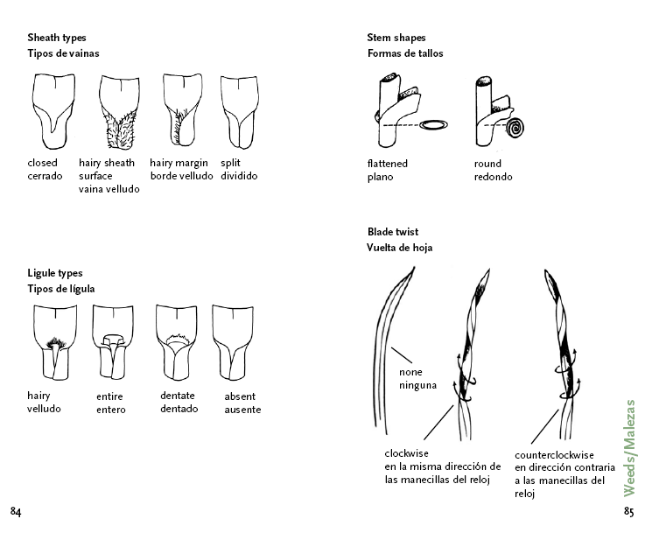

Slide 19
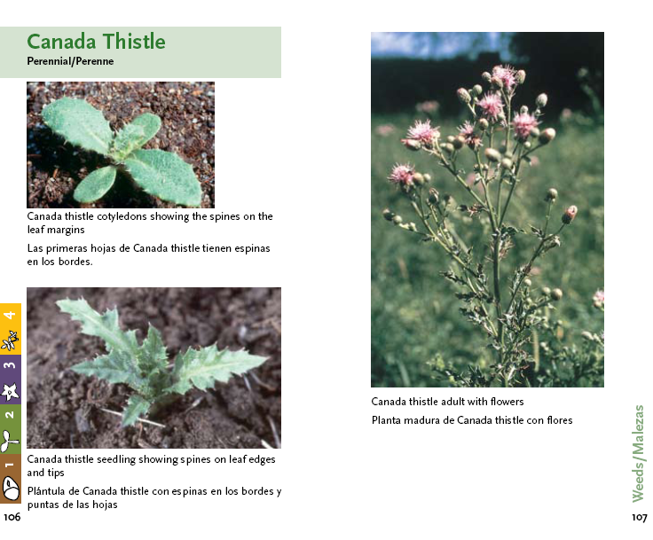

Slide 21
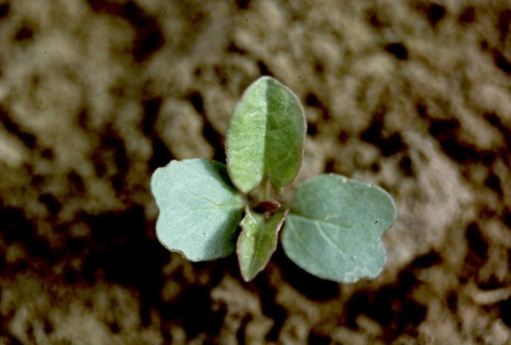
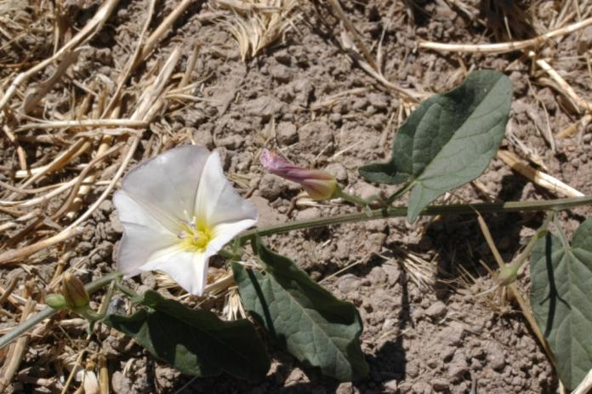
Practica: Utilizando una Guía identifique esta plaga.
Notes:
Field bindweed.

Slide 22
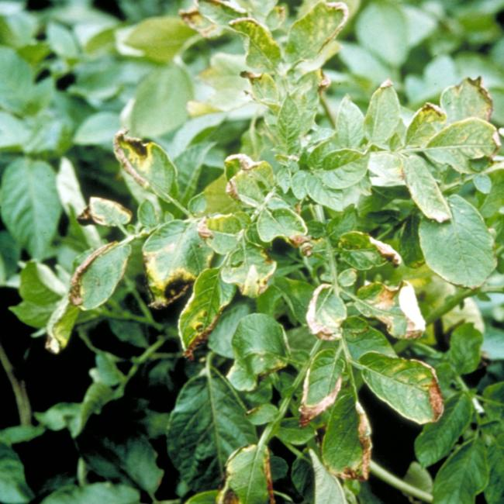
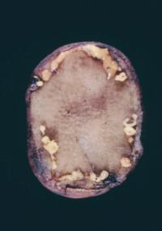
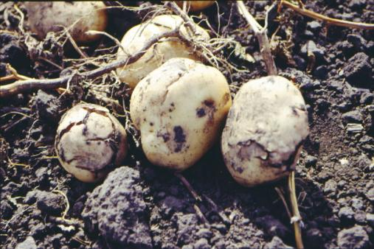
Practica: Utilizando una Guía identifique esta plaga
Notes:
Bacterial Ring Rot.

Slide 23
Preguntas?

