Slide 1
Collaborative initiatives to address STEM careers in manufacturing in North Central Idaho
Mrs. Christine Frei, CEDA
Dr. Raymond Dixon, University of Idaho

Slide 2
National Context
With the exception of some PhD-level researchers in academia, the demand for workers in STEM occupations is increasing at every education level.
The STEM supply problem goes beyond the need for more professional scientists, engineers, and mathematicians.
More qualified technicians and skilled STEM workers in Advanced Manufacturing, Utilities and Transportation, Mining, and other technology-driven industries.

Slide 3
National Context
STEM occupations will grow far more quickly than the economy as a whole (17% versus 10%),
By 2018, roughly 35 percent of the STEM workforce will be comprised of those with sub-baccalaureate training, including:
  Associate’s degrees
  Certificates
  Industry-based certifications.
Many students drop out of the STEM pipeline between high school and college.

Slide 4
Addressing STEM competencies
Higher premium placed on the mastery of 21st Century skills; the separation of vocational/occupational and academic becomes untenable
Cannot limit our vision that college is the sole desired outcome for secondary school students
Just under 52 percent of Idaho’s high school graduates have enrolled in two- or four-year college.
Researchers need to be engaged in helping employers and community understand the skills sets required for workforce (Marshall and Plotkin, 2010)

Slide 5
North Central Idaho Southeast Washington Context
Industrial Cluster defined
A geographically bounded group of similar or related firms— connected by common markets, technologies or knowledge—suppliers, skilled workers and supporting institutions.

Slide 6
Metal Supercluster
The Metal Supercluster is made up of metal fabrication manufacturers including
  ammunition and firearms makers
  jet boat and trailer builders
  equipment
  machine shops and a foundry
The cluster has similar workforce needs and cross over in their supply chains.

Slide 7
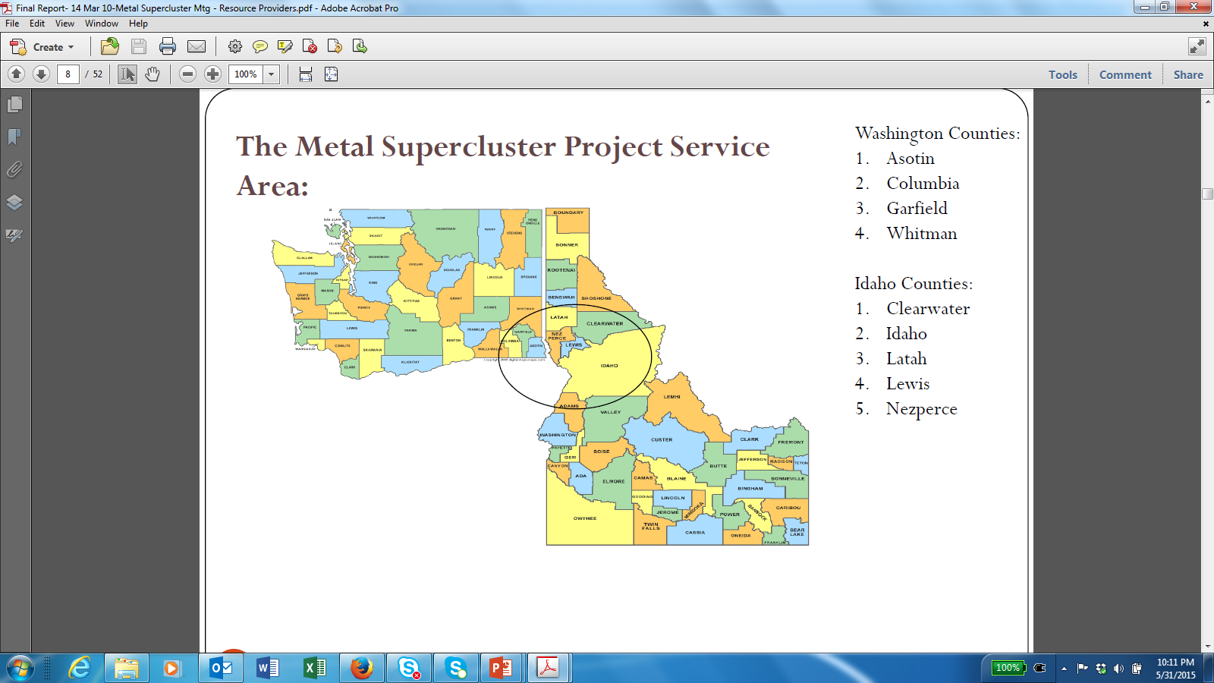

Slide 8
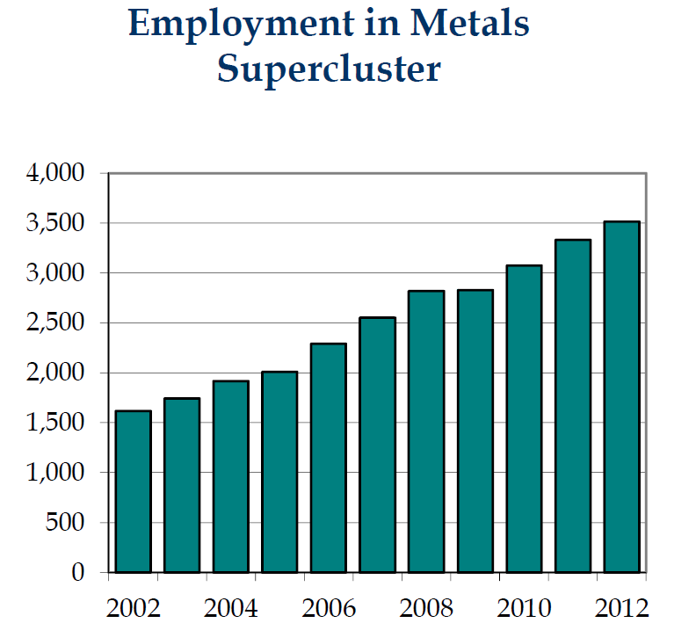
Metal Supercluster
National Location Quotient: 1.63. Proportional the region has 63% more jobs in manufacturing than in the nation

Slide 9
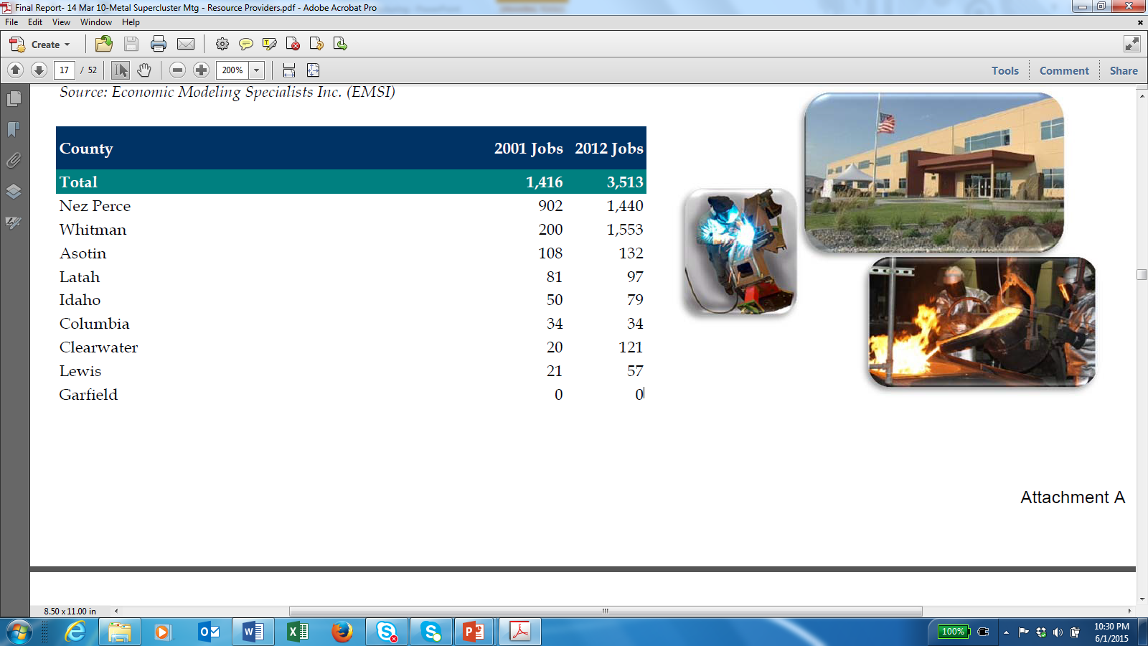
Metal Supercluster
Between December 2011 and December 2012, north-central Idaho and southeast Washington added 700 jobs in the Metal cluster.
In the first four months of 2013, manufacturers in the cluster added another 190 jobs.

Slide 10
UI
Rural Business Opportunity Grants Program
Strategy for Cluster Development
CEDA
Metal Cluster
DOL
NAICS
WDC
LCSC, Walla Walla CS
CEDA
K-12
Manufacturers
Community Groups

Slide 11
Goals of Strategy
Identify the regional resources for expansion.
Determine how to create and sustain a regional resource “delivery system”.
Identifying the five most critical occupations, devise strategy to develop training programs.

Slide 12
What is DACUM?
A process that uses expert workers in industry to identify occupational and job competencies. The profile generated is generally used to inform the development of training (curriculum) to meet industry needs.

Slide 13
DACUM
Used for:
Job analysis
Occupation analysis
Functional analysis

Slide 14
Critical Occupations
DACUM process was used to identify top five Jobs
8 Operations/HR managers participated
      Nightforce Optics
      Hillco Technologies Inc.
      Schweitzer Engineering Laboratories (SEL)
      Howell Munition and Technologies
      Seekins Precisions, LLC
      Gem Chain Bar
      ATK

Slide 15
Five Critical Jobs
Machinist
Fabricator
Electronic Technician
Machine Technician
Quality Assurance Supervisor

Slide 16
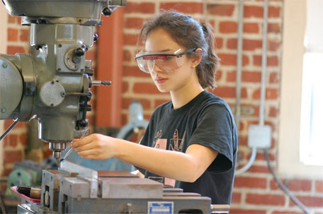
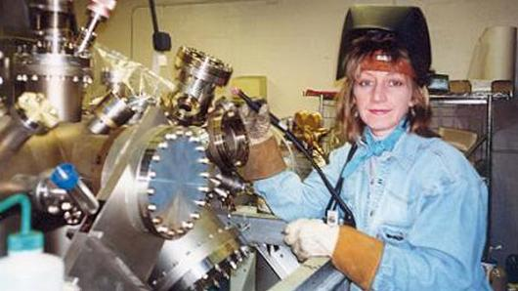
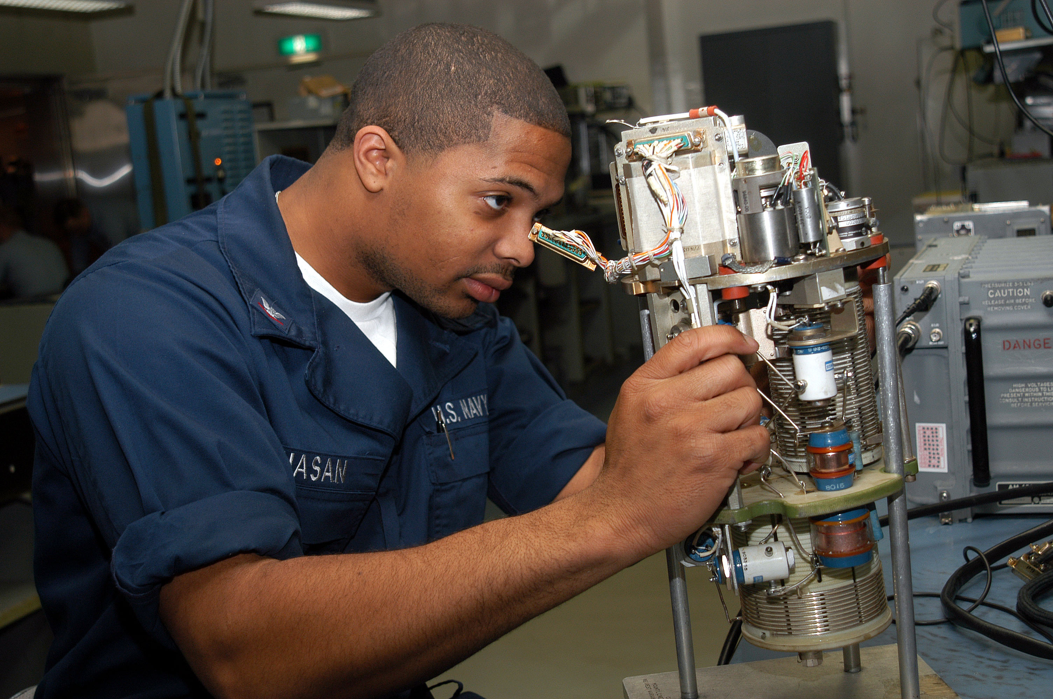
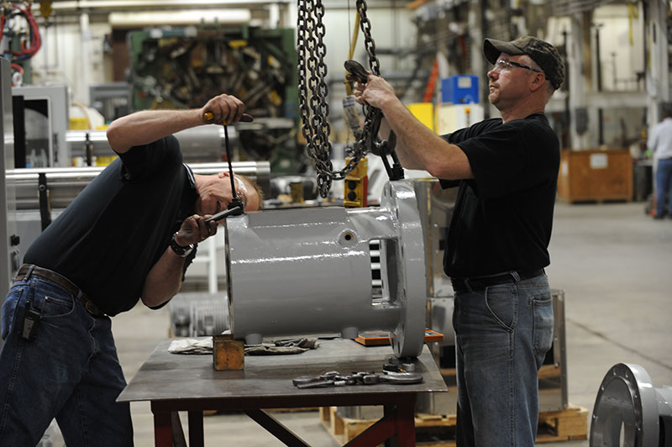
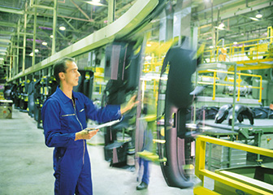
Five Critical Jobs
5. Quality assurance
supervisor
1. Machinist
3. Electronic Technician
2. Fabricator
4. Machine Technician
ALL STEM OCCUPATIONS

Slide 17
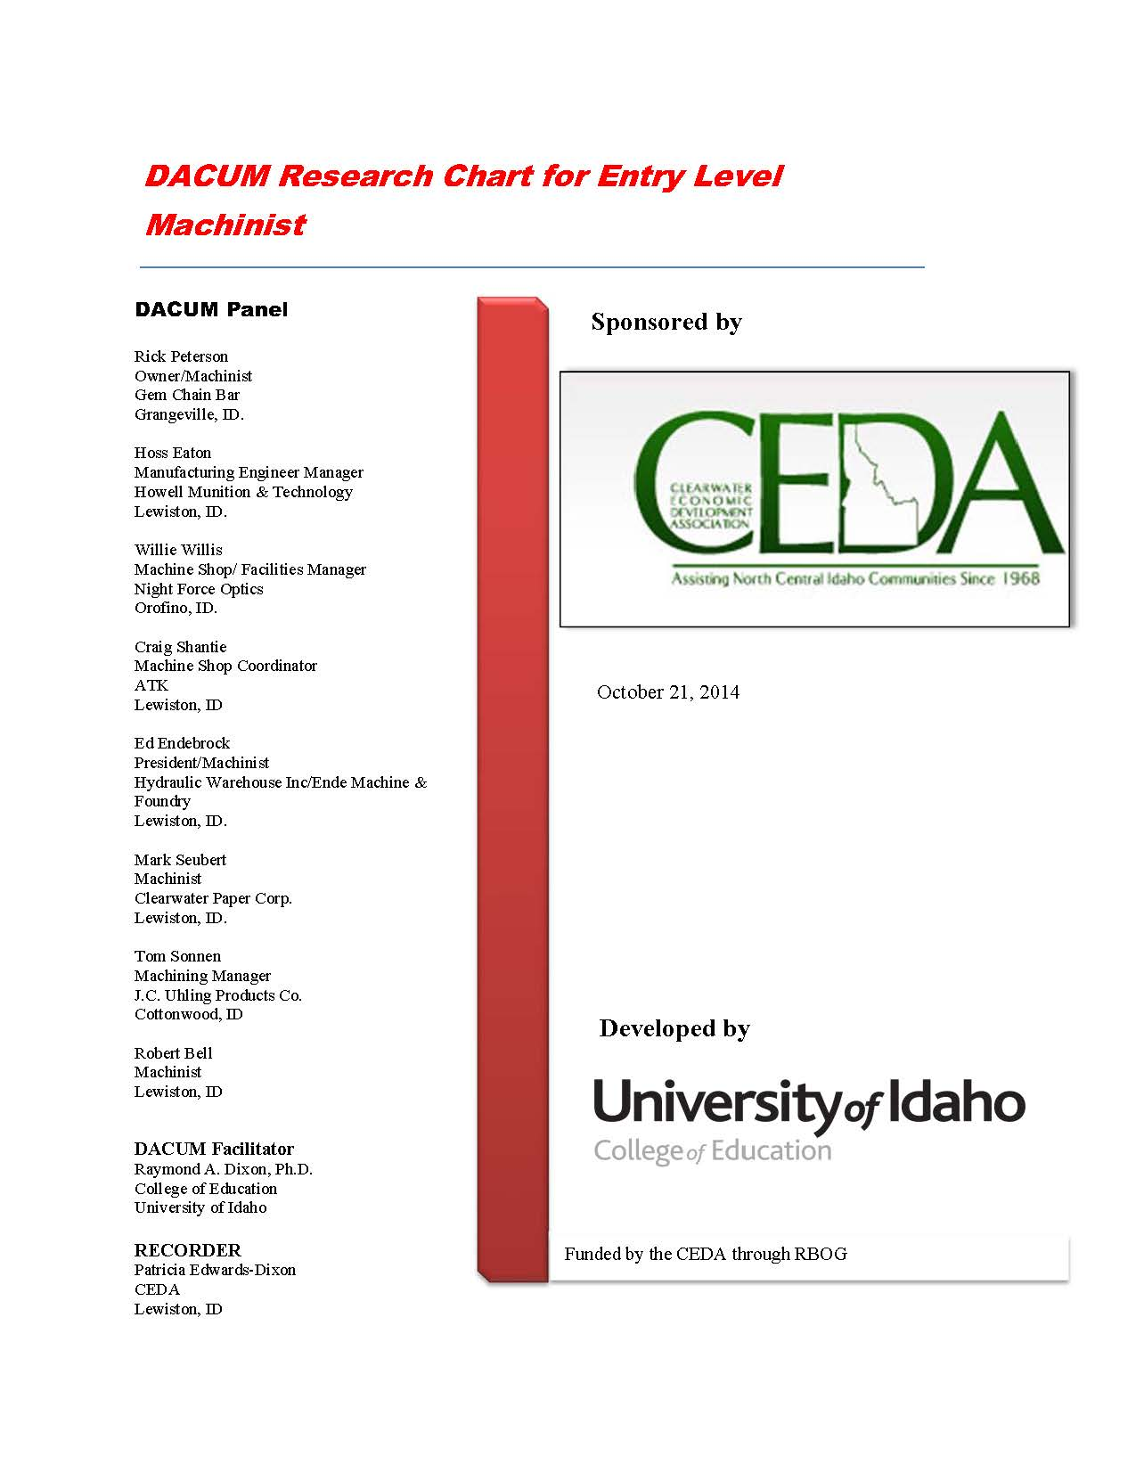
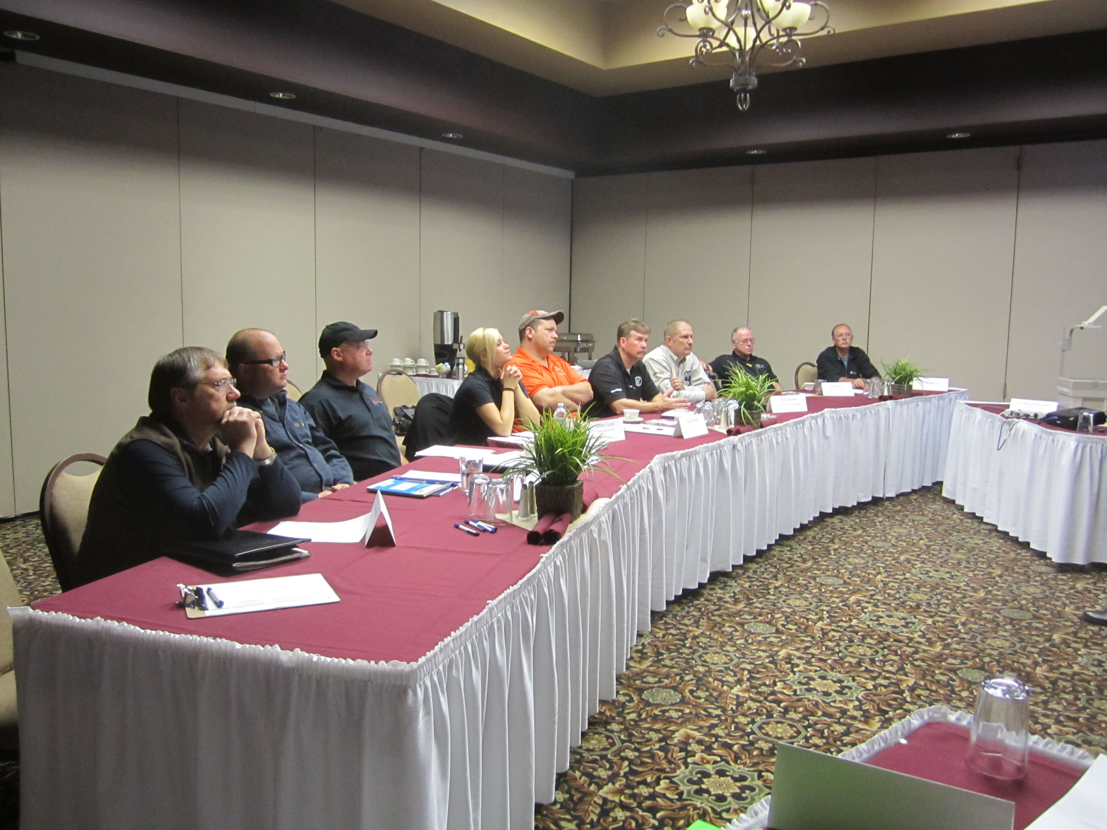
MODIFIED DACUM
Identifying the Duties, Tasks, Skills &
General Competencies top three job areas
See Handout
Notes:
RAY

Slide 18
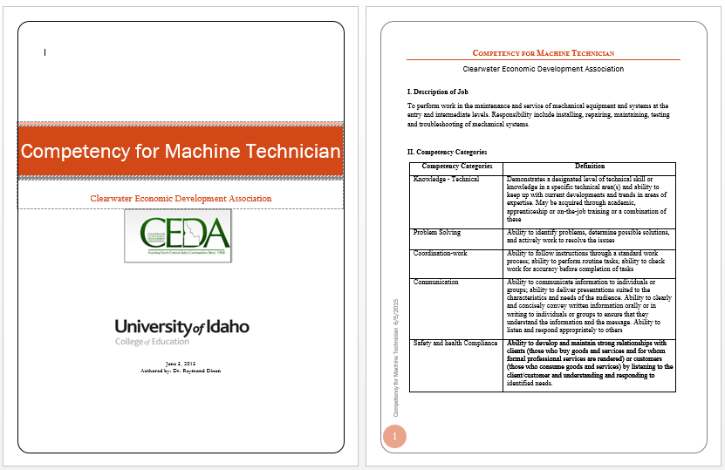
INTROSPECTIVE APPROACH technical knowledge, problem solving, coordination, communication, safety competencies
See Handout
Notes:
RAY

Slide 19
Moving Forward- Issues
Bodies
Changing Attitudes
Fewer youths
About 4 out of 10 not going to college
Hugh increase in employment
More workers close to retirement
Tour of manufacturing facilities
Career awareness and guidance
Dream –IT Do –IT initiative

Slide 20
Moving Forward- Issues
Skills
Skills
Higher Skill level required
Need to acquire while still in school
PTE in school need to align with manufacturers need
Schools may not be equipped to deliver
Technology education teachers do not have the skills to prepare students at the proficiency required
Stronger collaboration will be needed between schools and technical colleges
Innovative approach need to be found to deliver practical training in occupational areas

Slide 21
Moving Forward- Issues
Skills
Manufacturers’ endorsed certificates acquired during high school
Stackable credentials that pathway into associate degree programs
Orientation to life long learning

Slide 22
Questions

