Slide 1
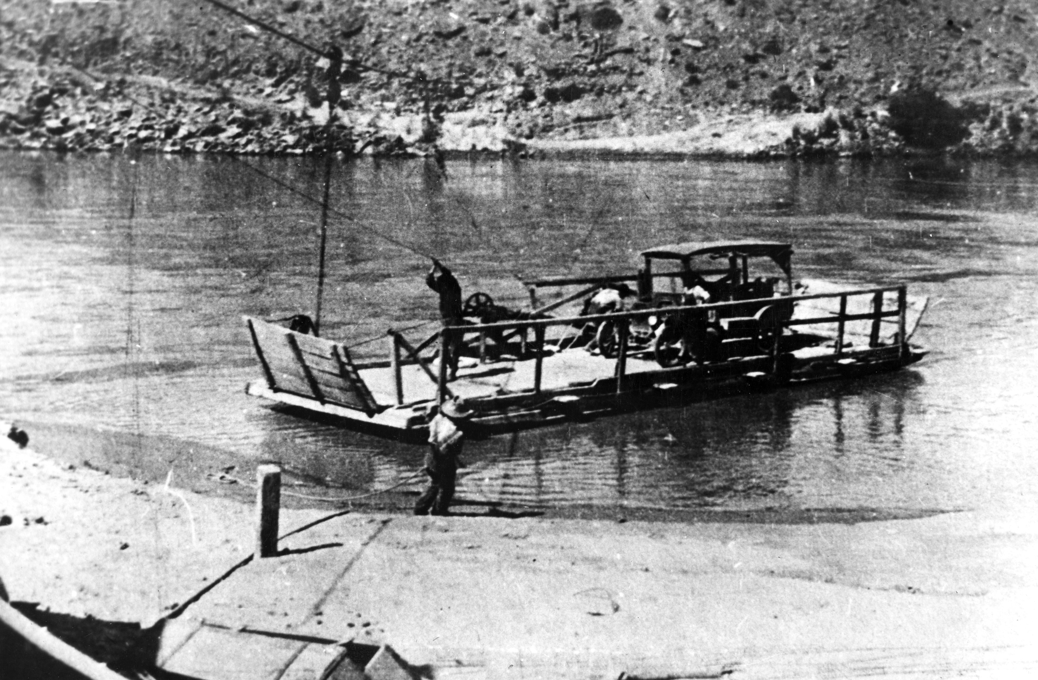
The Changing Colorado
Source: University of Utah Marriott Library
Lee Ferry (1922)
Jason Anthony Robison
Carl M. Williams Professor of Law & Social Responsibility
Adjunct Professor, Haub School of Environment & Nat. Resources
University of Wyoming
Idaho Law Review 2024 Water Law Symposium
Legal Mechanisms for Ensuring the Resilience of Interstate Water Resources
Boise, Idaho
March 22, 2024

Slide 2
Overview
Climate Change Along “America’s Nile”
Adaptation Amidst Megadrought/Aridification
Towards Post-2026 Operations

Slide 3
Climate Change Along America’s Nile

Slide 4
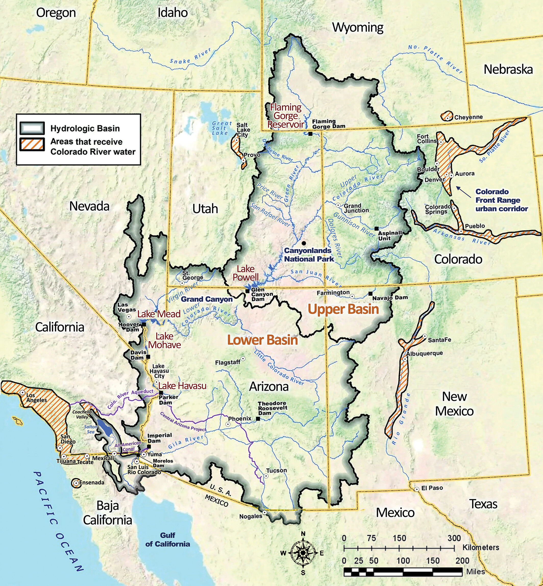
Source: Schmidt et al.

Slide 5
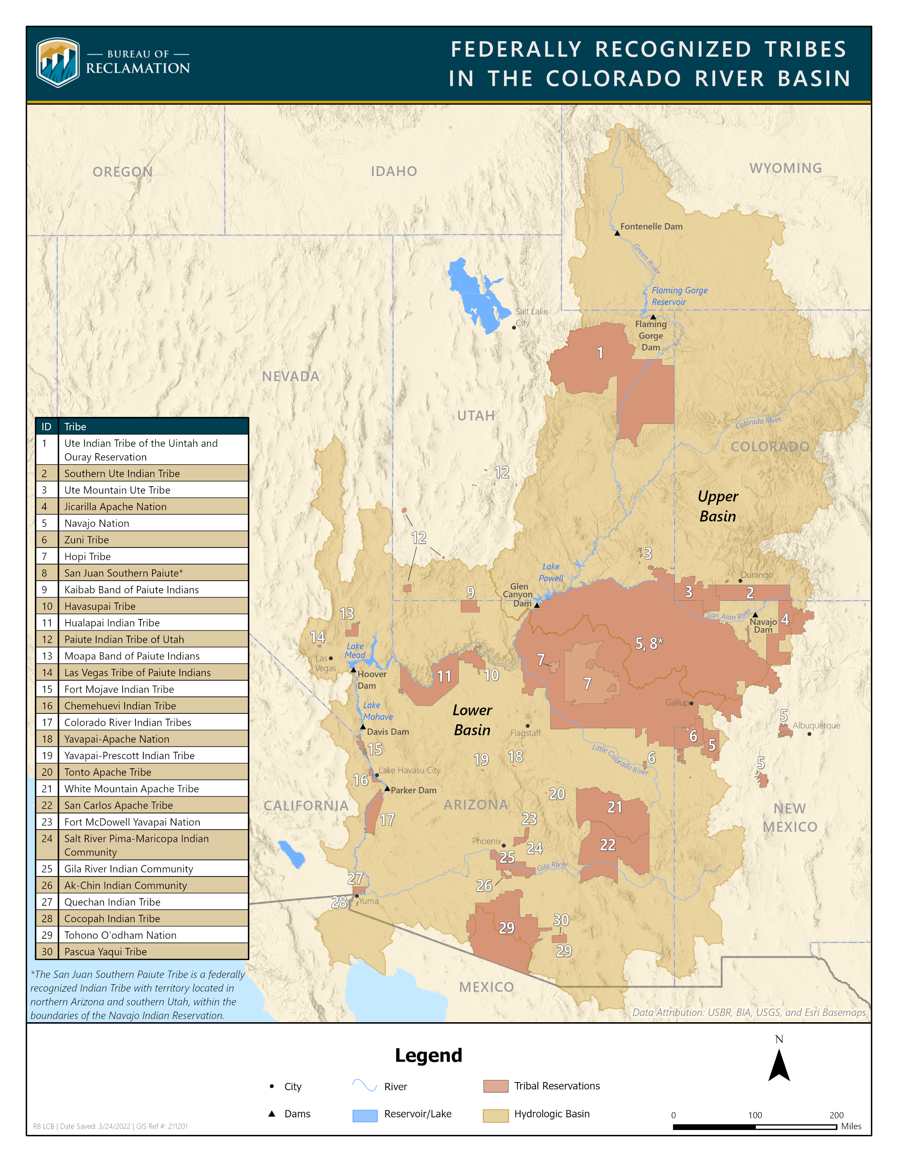

Slide 6
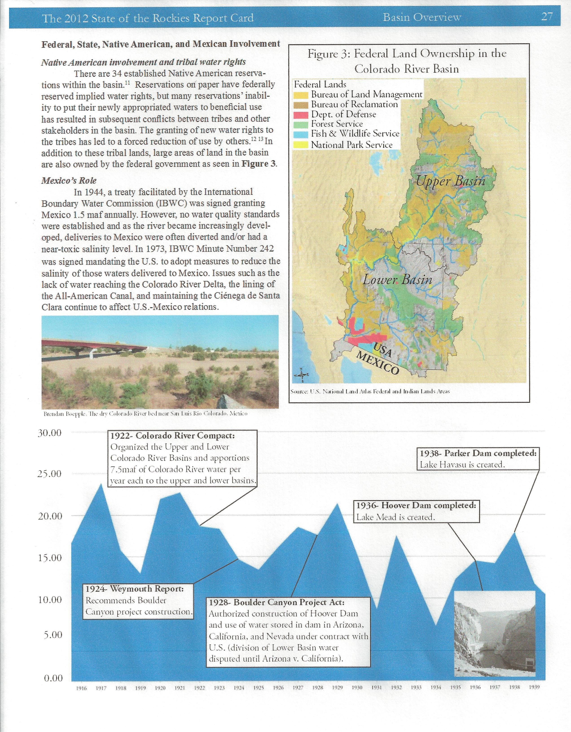
Source: U.S. National Atlas

Slide 7
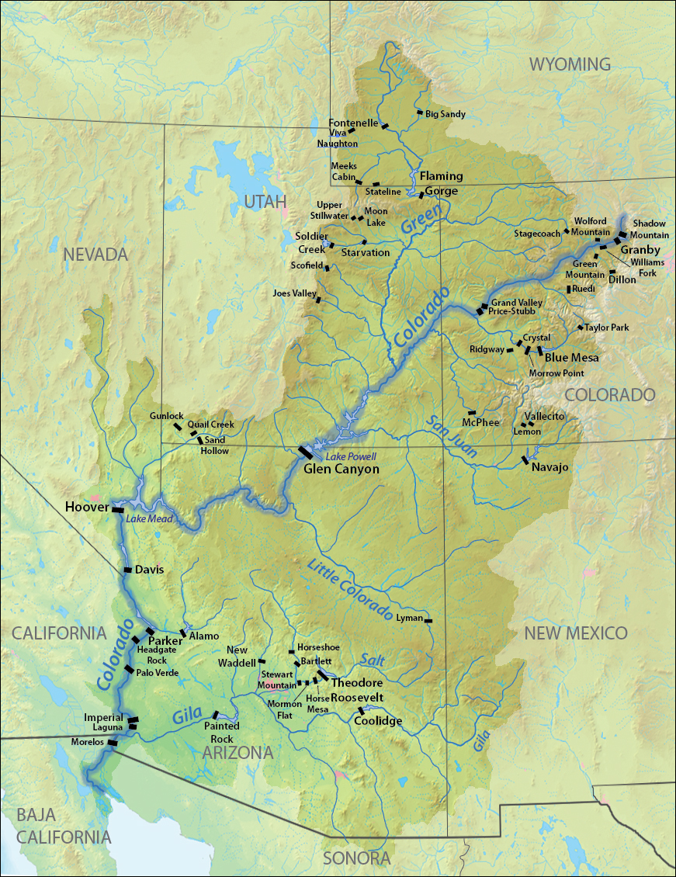
Source: Wikipedia

Slide 8
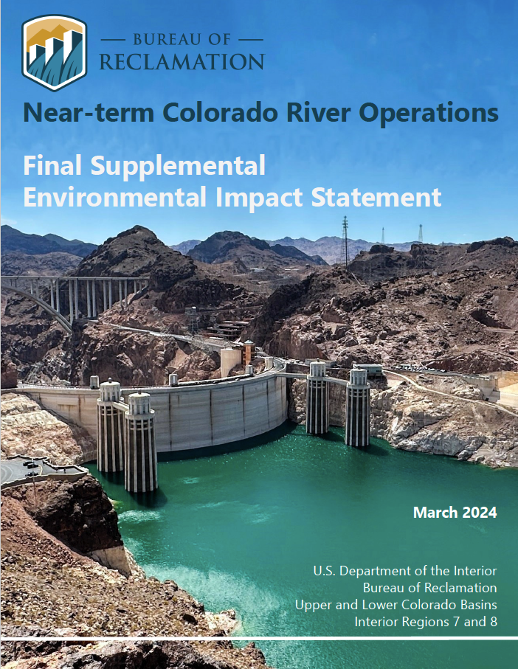
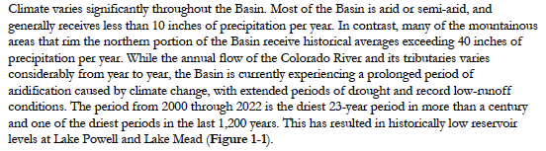

Slide 9
Source: Jack Schmidt (USU) (Bureau of Reclamation Data)

Slide 10
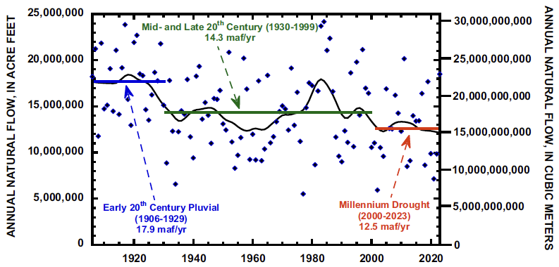
Source: Jack Schmidt (USU) et al.

Slide 11
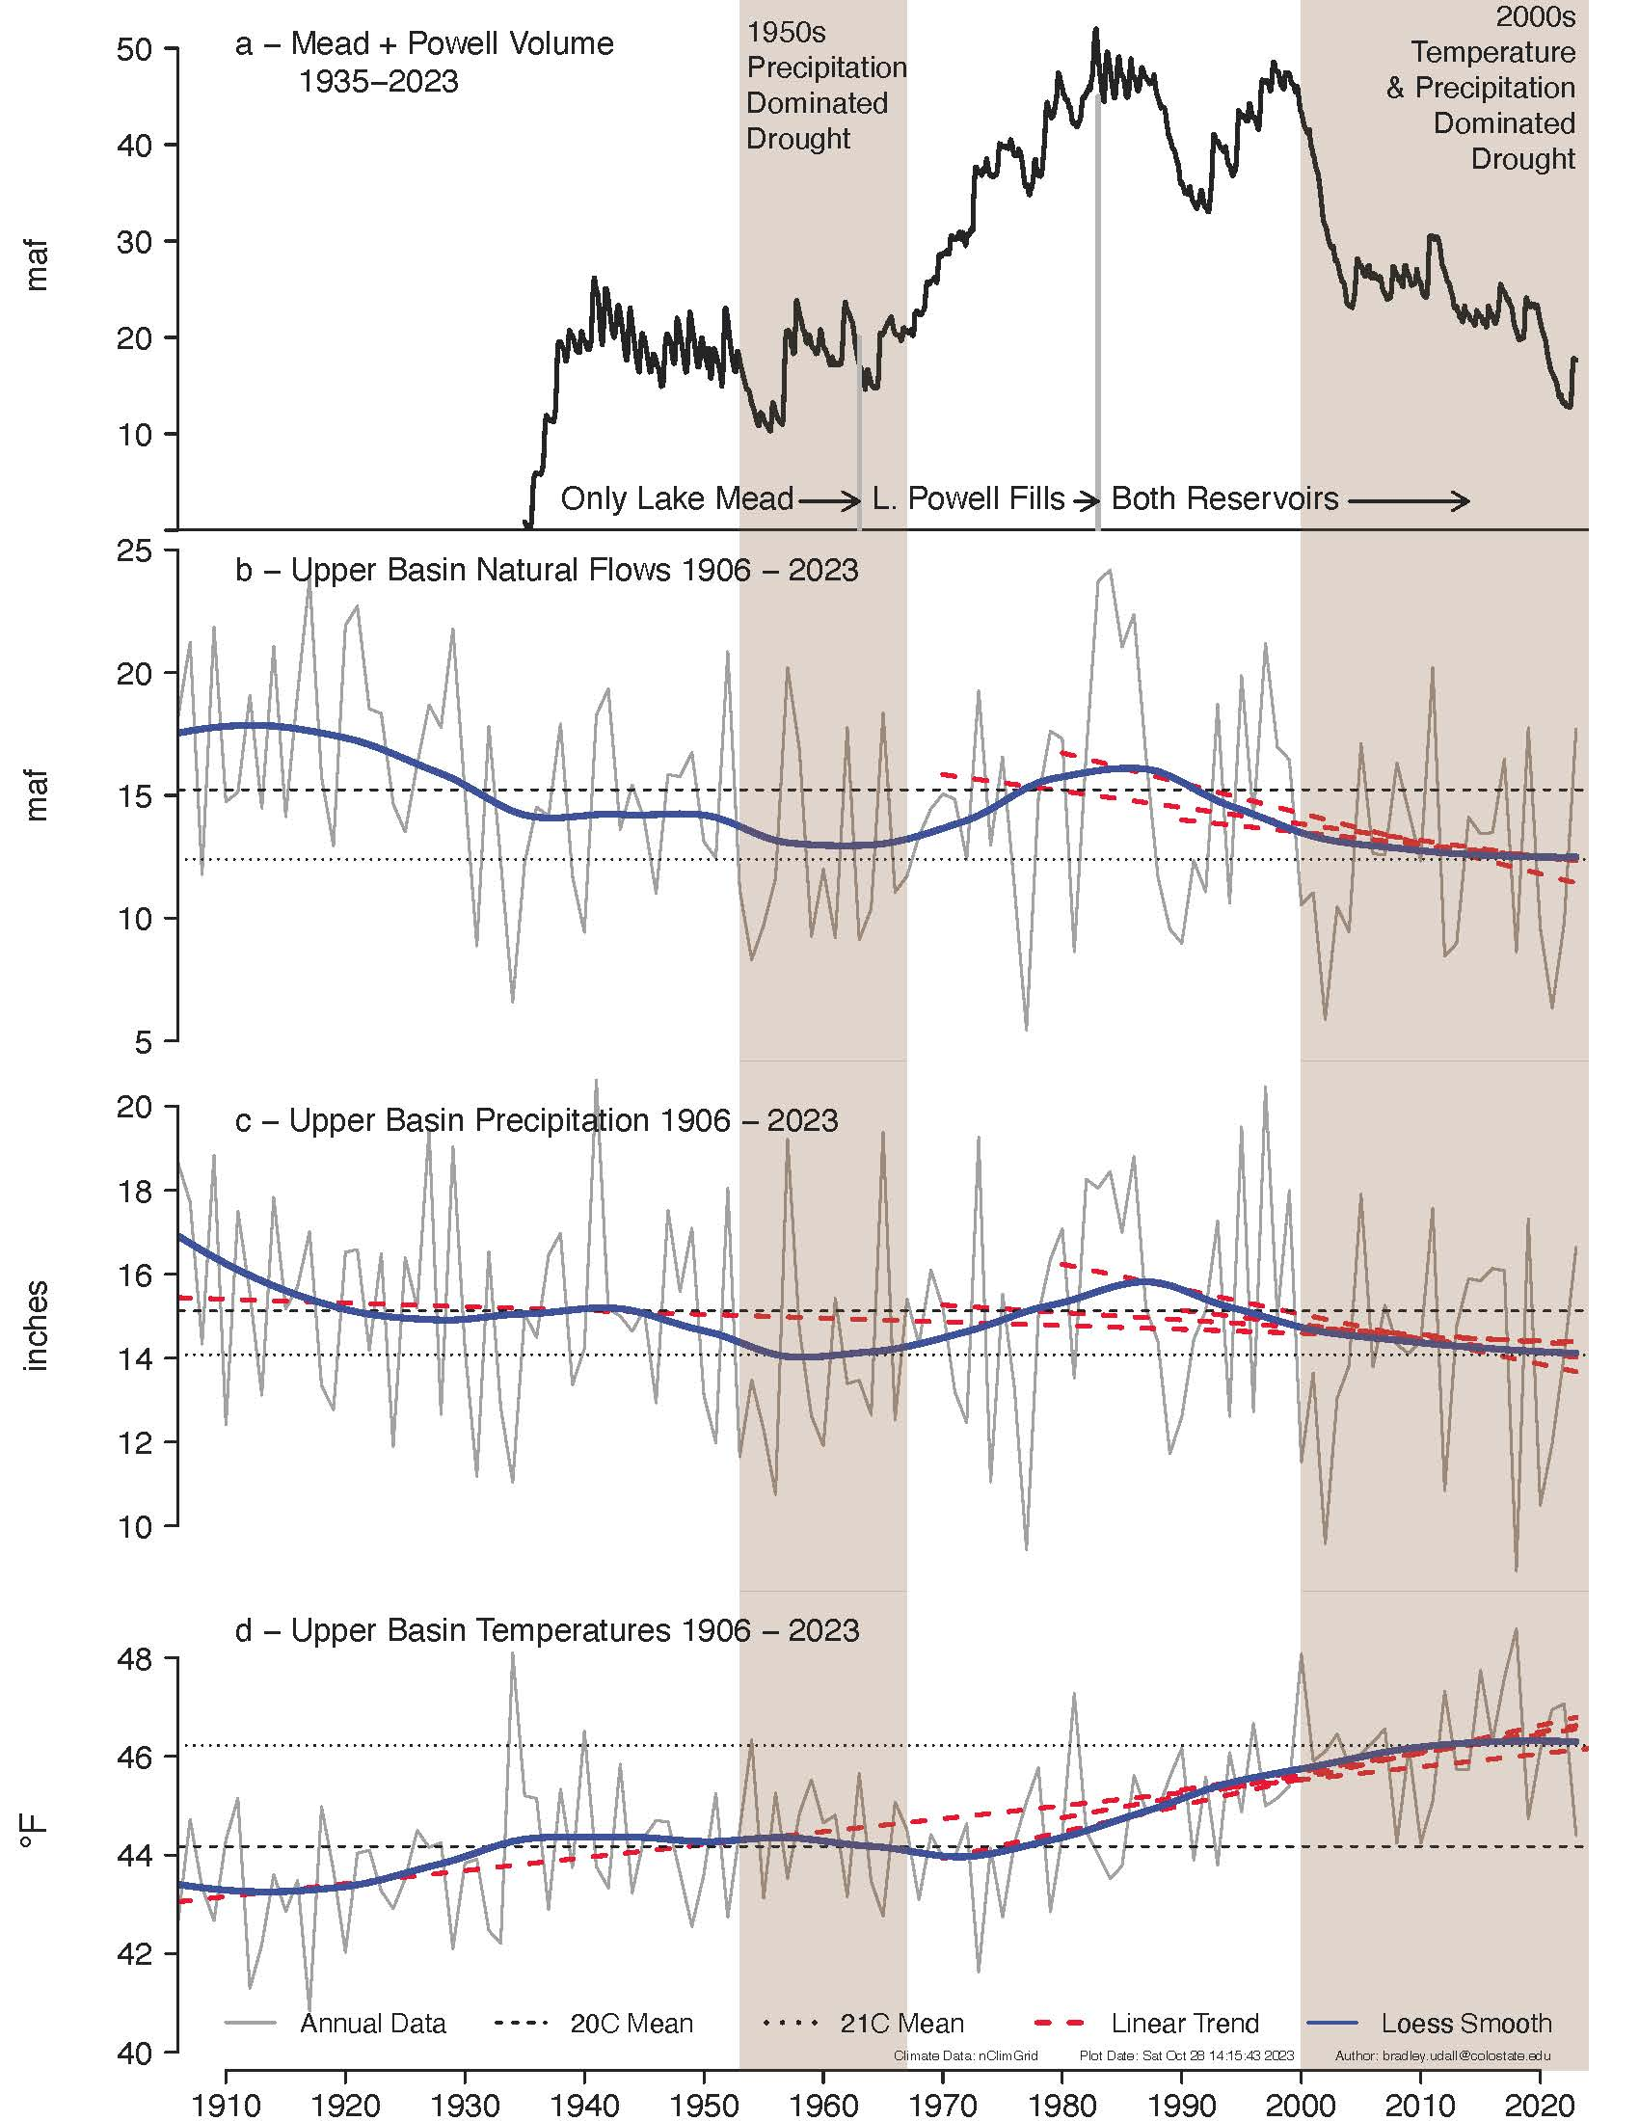
Source: Brad Udall (CSU)

Slide 12
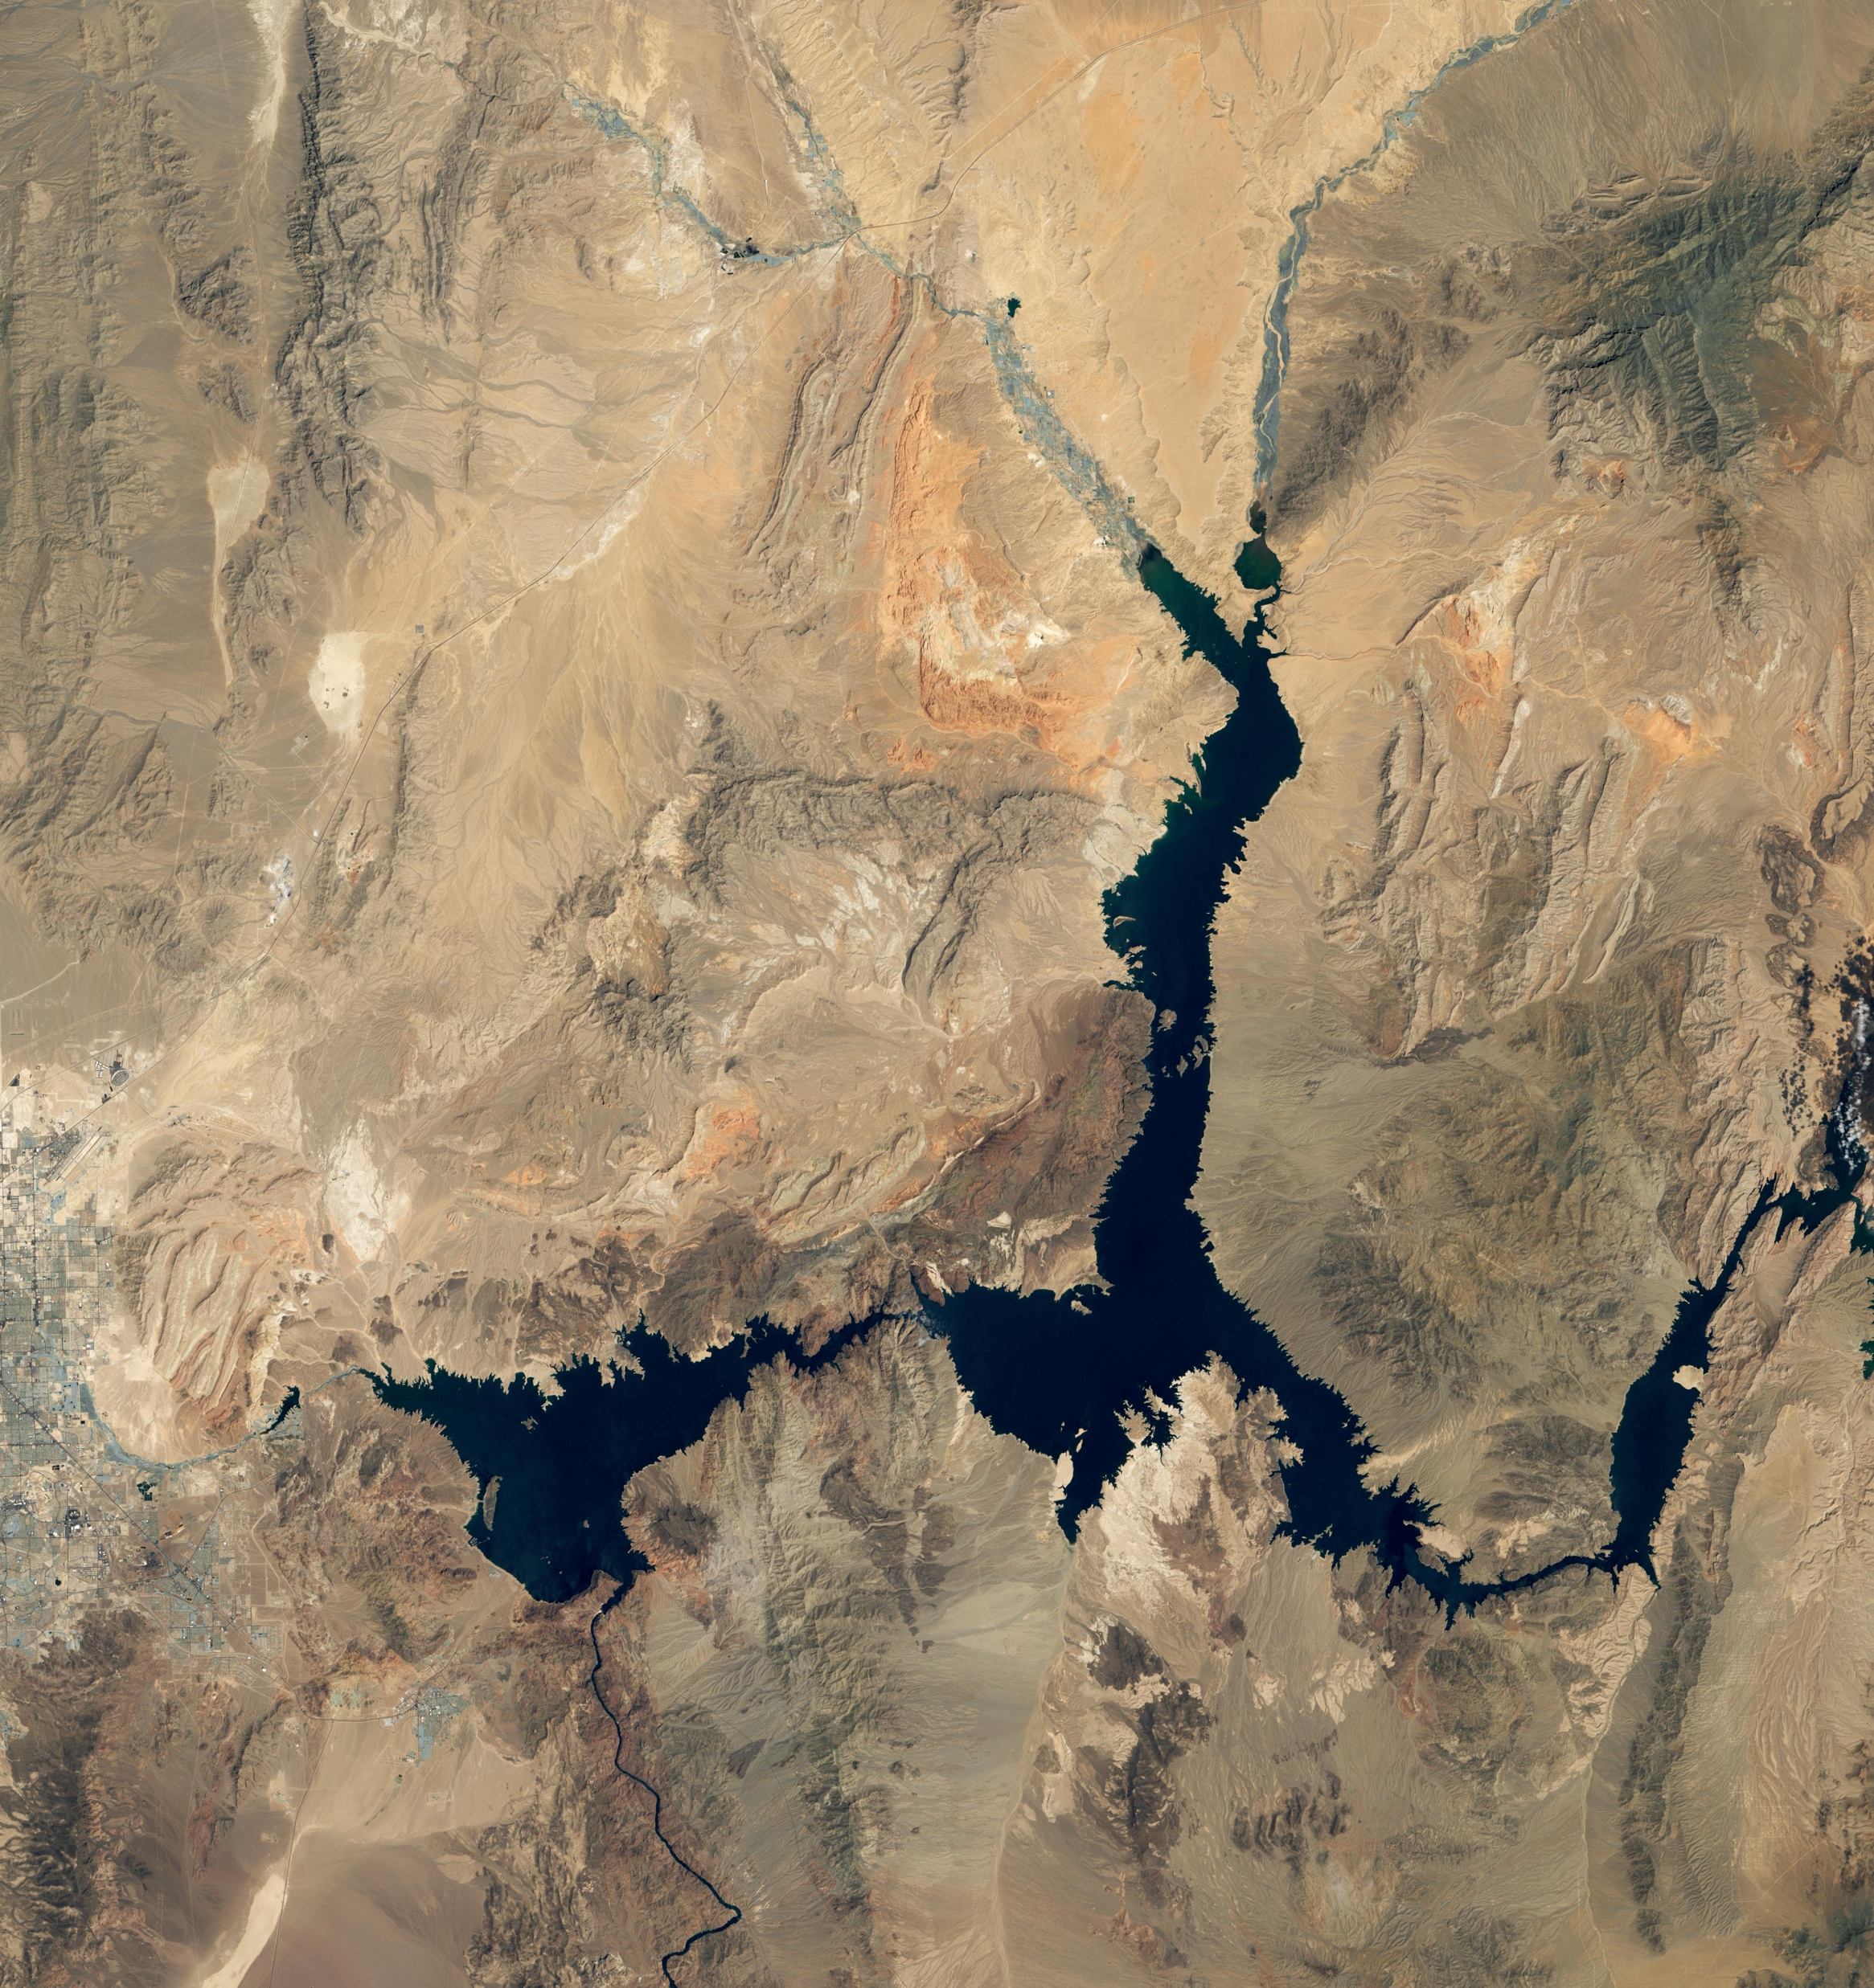
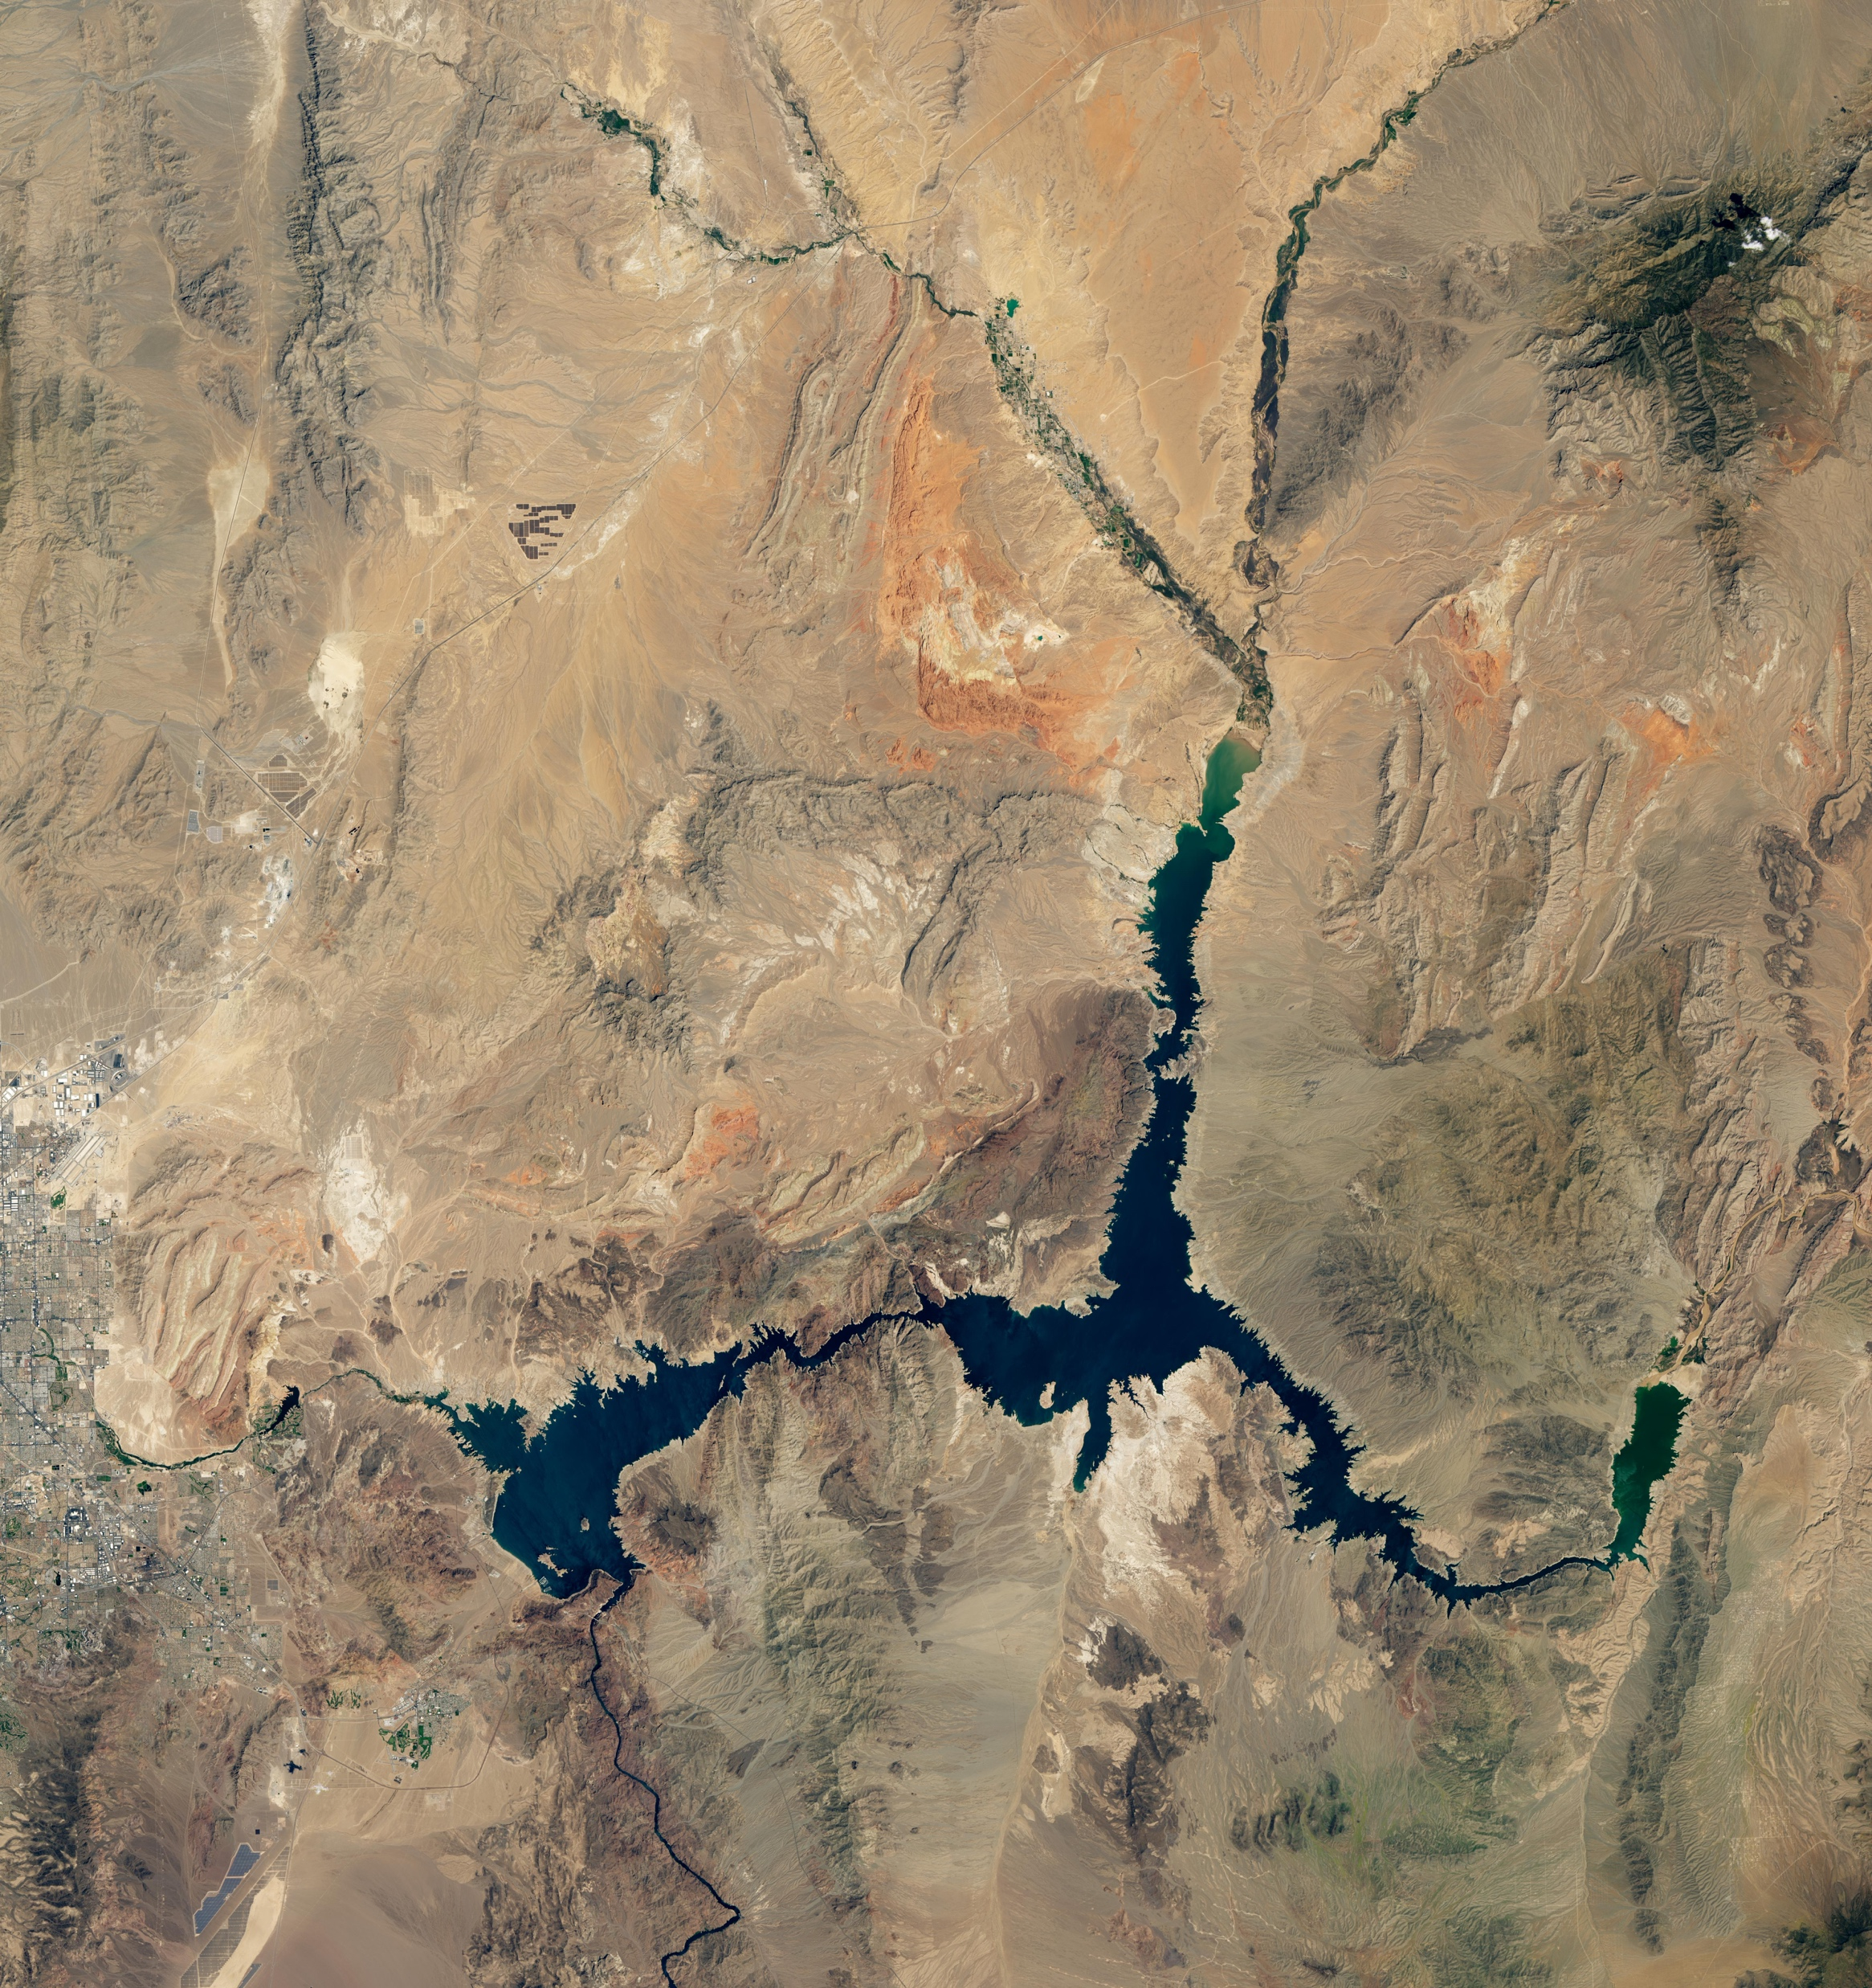
Lake Mead (2000)
Lake Mead (2021)
Source: NASA Earth Observatory

Slide 13
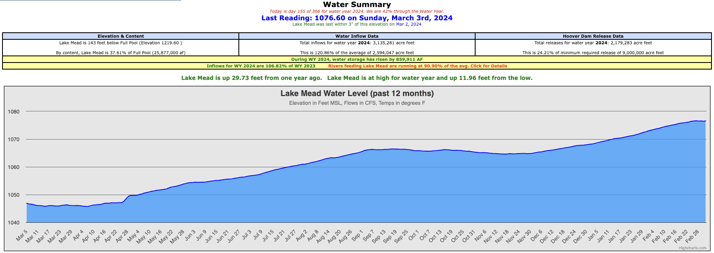
Source: Lake Mead Database (https://lakemead.water-data.com/)

Slide 14
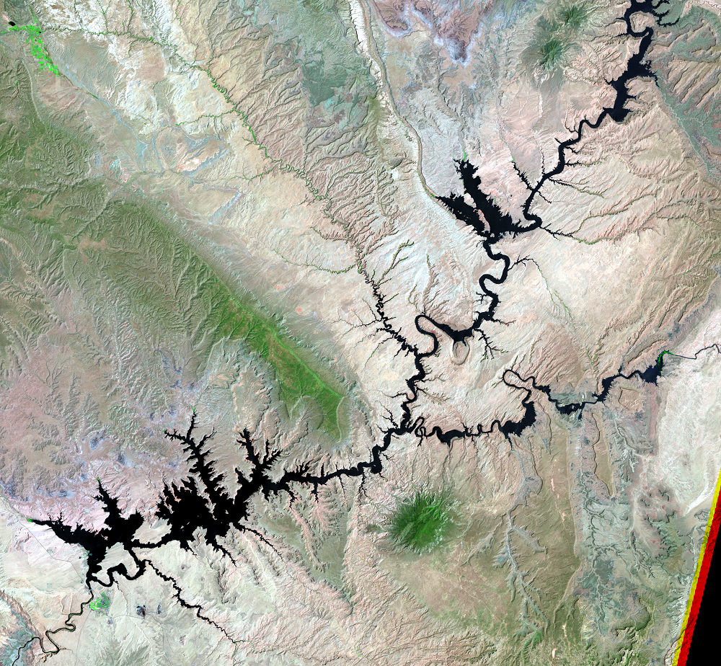
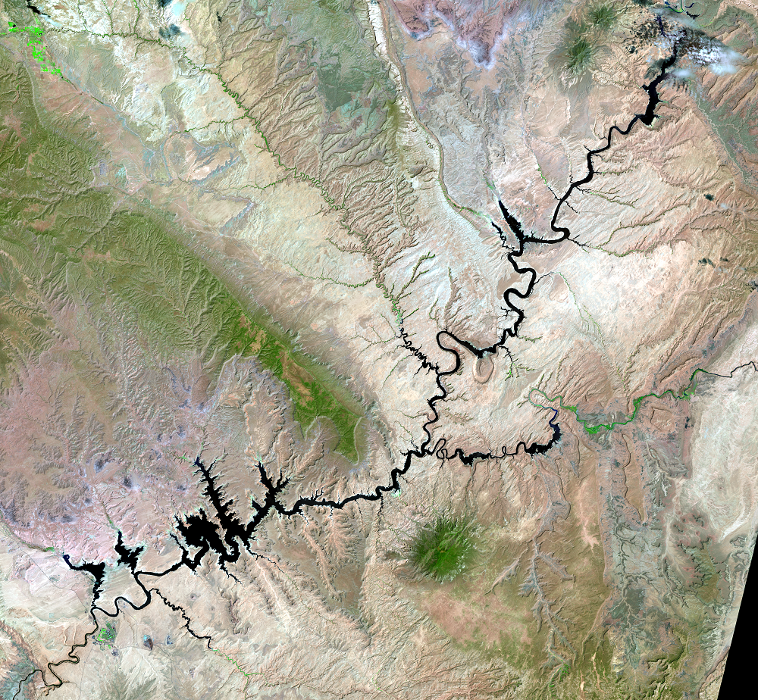
Lake Powell (1998)
Lake Powell (2021)
Source: U.S. Geological Survey

Slide 15
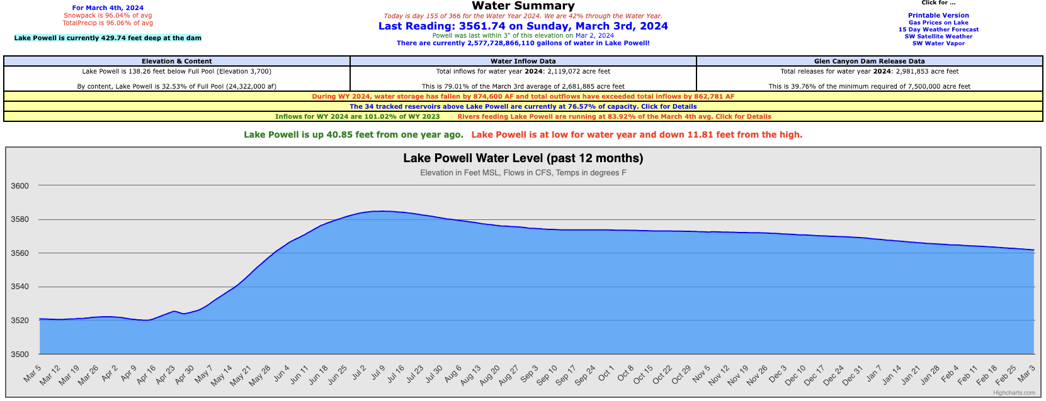
Source: Lake Powell Database (https://lakepowell.water-data.com/)

Slide 16
Adaptation Amidst Megadrought/Aridification

Slide 17
Law of the River
Select Chronology
Colorado River Compact (1922)
Boulder Canyon Project Act (1928)
U.S.-Mexico Treaty (1944)
Upper Colorado River Basin Compact (1948)
Colorado River Storage Project Act (1956)
Arizona v. California, 373 U.S. 546 (1963)
Colorado River Basin Project Act (1968)
Long-Range Operating Criteria (1970)
Lower Basin Water Bank Regulations (1999)
Colorado River Interim Guidelines for Lower Basin Shortages and Coordinated Operations (2007)
Minute 319 (2012)
Minute 323 (2017)
Drought Contingency Plans (2019)
500+ Plan (2021)
Final SEIS for Near-Term Colorado River Operations (2024)
Source: Schmidt et al.

Slide 18

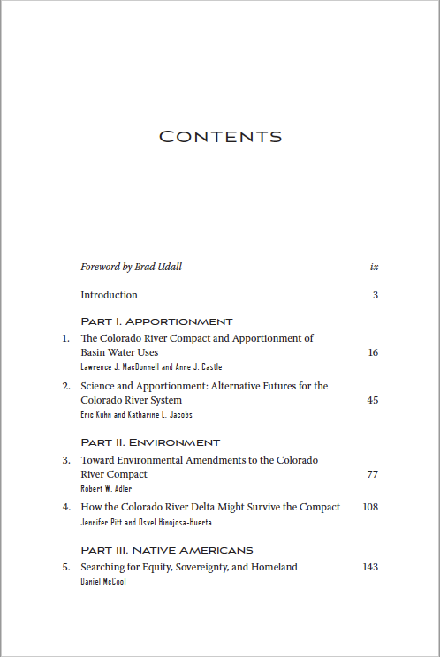
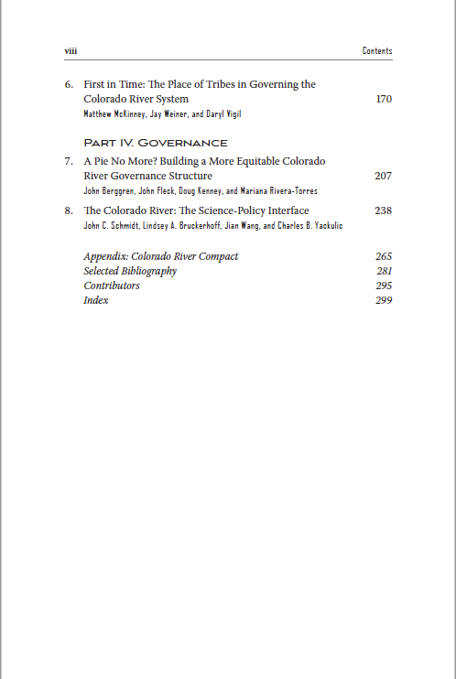

Slide 19
Law of the River
Allocation Framework
U.S.-Mexico Treaty (1944):
International Apportionment.
Colorado River Compact (1922):
Domestic (U.S.) Basinwide Apportionment.
Upper Colorado River Basin Compact (1948): Domestic (U.S.) Upper Basin Apportionment.
Arizona v. California Decree (1964):
Domestic (U.S.) Lower Colorado River Apportionment.
Source: Schmidt et al.

Slide 20
Law of the River
Implementing Infrastructure
Boulder Canyon Project Act (1928):
Hoover Dam & Lake Mead.
Colorado River Storage Project Act (1956):
Glen Canyon Dam & Lake Powell +
3 Additional CRSP Units.
Colorado River Basin Project Act (1968):
§ 602(a) Long-Range Operating Criteria Mandate +
§ 301(b) Central Arizona Project Subordination.
Long-Range Operating Criteria (1970):
Upper Basin Reservoirs + Lake Mead Operations.
Source: Schmidt et al.

Slide 21
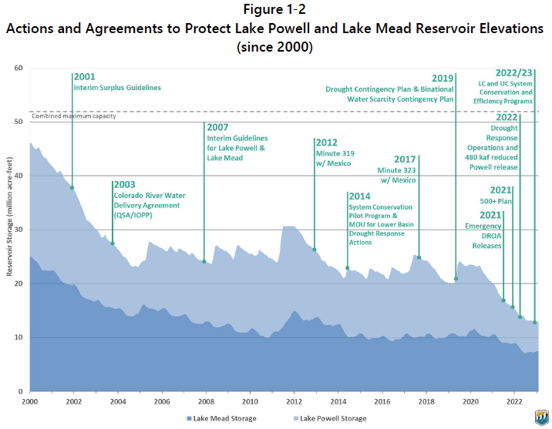
Source: Final SEIS

Slide 22
Law of the River
Rationing & Risk Allocation
International Apportionment:
  Lake Mead Operating Regime.
  Minute 319 (2012) & Minute 323 (2017).
Domestic (U.S.) Basinwide Apportionment:
  Lake Powell & Lake Mead Coordinated Operating Regime.
  2007 Interim Guidelines.
Domestic (U.S.) Lower Colorado River Apportionment:
  Lake Mead Operating Regime.
  2007 Interim Guidelines.
  2019 Lower Basin Drought Contingency Plan.
Source: Schmidt et al.

Slide 23
Law of the River
Constraint Avoidance & Mitigation
International Apportionment:
  Banking of Deferred Treaty Deliveries in Lake Mead.
  Minute 318 (2010) (Earthquake Water).
  Minute 319 (2012) (ICMA)
  Minute 323 (2017) (Mexico’s Water Reserve).
Domestic (U.S.) Lower Colorado River Apportionment:
  Intentionally Created Surplus Program under 2007 Interim Guidelines & 2019 Lower Basin Drought Contingency Plan.
  Pilot System Conservation Program & Lower Colorado River Basin System Conservation and Efficiency Program.
Domestic (U.S.) Upper Basin Apportionment:
  Demand Management Program Feasibility Investigations under 2019 Upper Basin Drought Contingency Plan.
  System Conservation Pilot Program.
Source: Schmidt et al.

Slide 24
Law of the River
Interpretive Conflict Management
International Apportionment:
  “Escape Clause” of Art. 10 of U.S.-Mexico Treaty.
  Lake Mead Operating Regime under Minute 319 (2012) & Minute 323 (2017).
Domestic (U.S.) Basinwide Apportionment:
  Flow Obligations of Art. III(c)-(d) of Colorado River Compact.
  Lake Powell & Lake Mead Coordinated Operating Regime under 2007 Interim Guidelines.
  Basin States Agreement.
Source: Schmidt et al.

Slide 25
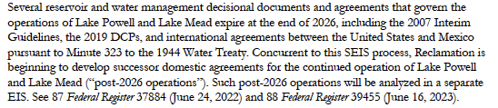

Slide 26
Towards Post-2026 Operations

Slide 27
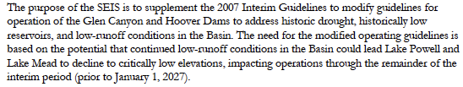

Slide 28
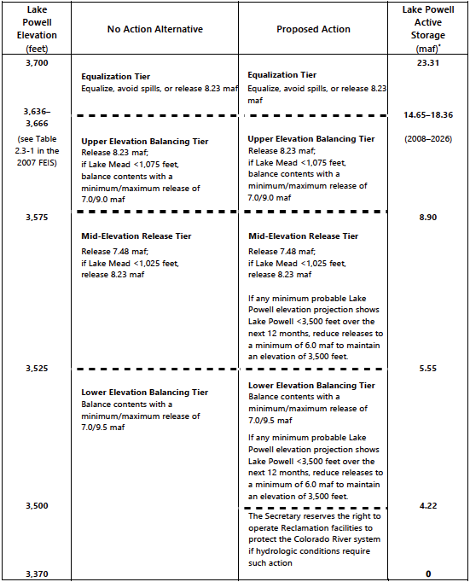

Slide 29
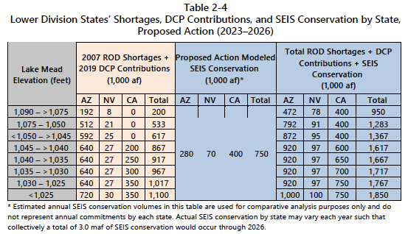

Slide 30
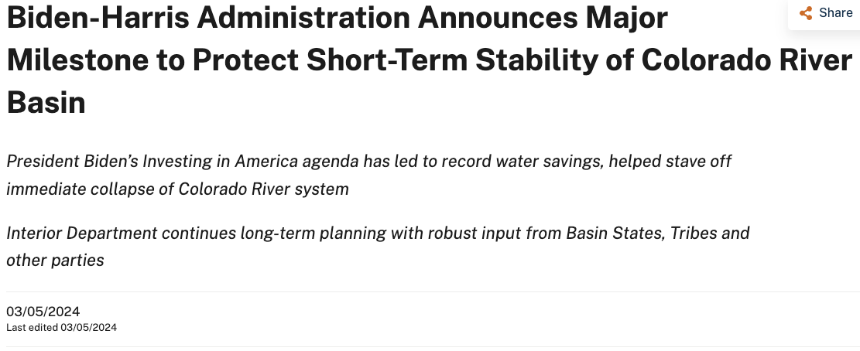
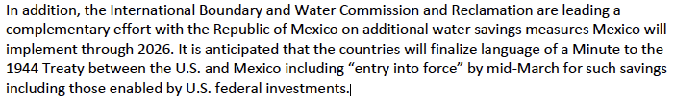

Slide 31
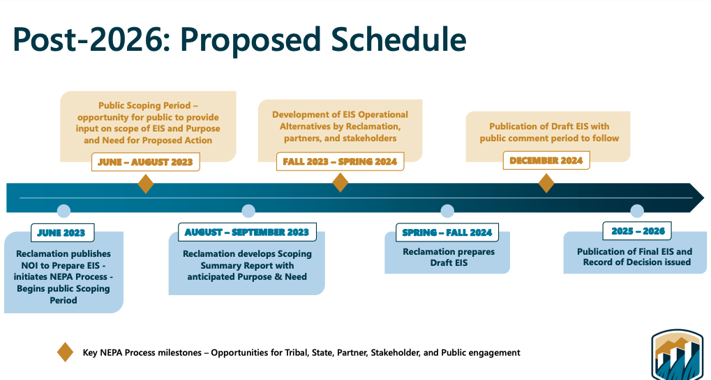

Slide 32
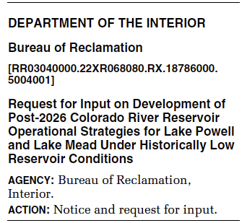
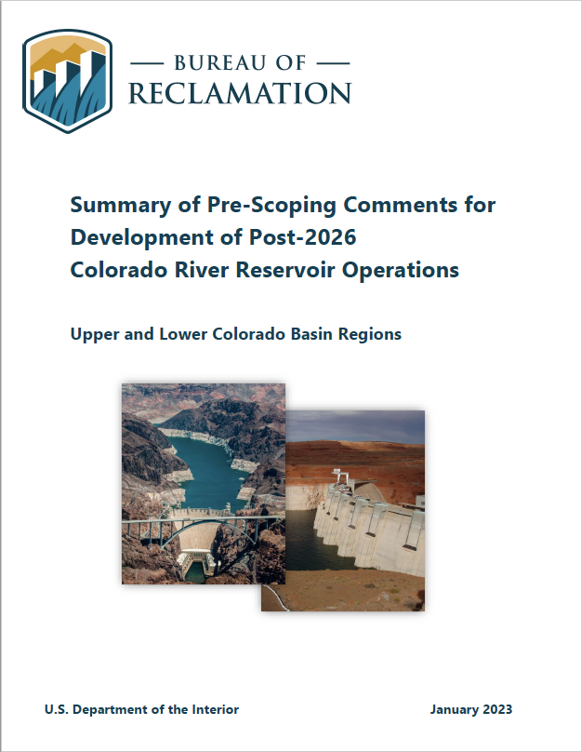
Federal Register, Vol. 87, No. 121 (June 24, 2022)
https://www.usbr.gov/ColoradoRiverBasin/post2026/documents/Post-2026_Pre-Scoping%20Comment%20Summary%20Final_Updated1.30.2023_508.pdf

Slide 33
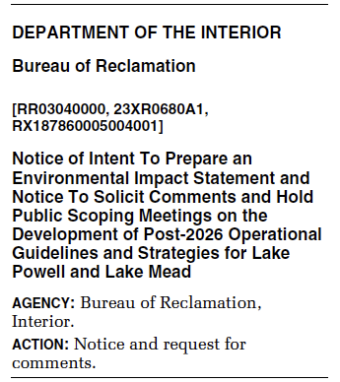
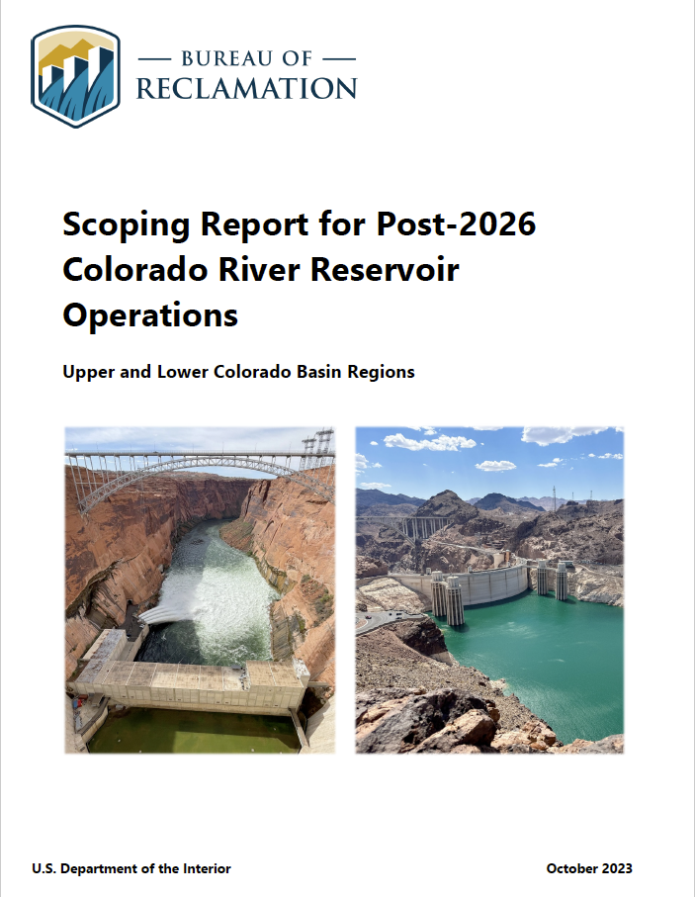
Federal Register, Vol. 88, No. 116 (June 16, 2023)
https://www.usbr.gov/ColoradoRiverBasin/documents/post2026/scoping/Post2026Operations_ScopingReport_October2023_508.pdf

Slide 34
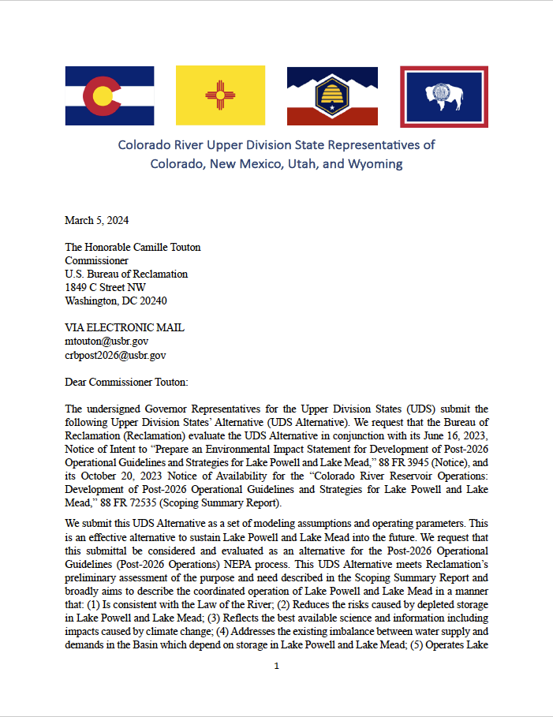
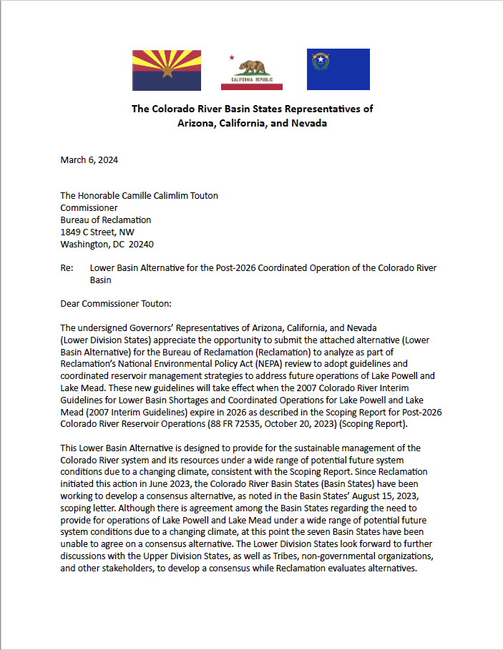
Lower Basin Alternative: https://www.azwater.gov/sites/default/files/2024-03/Lower%20Basin%20Alternative%20Letter%205.6.24.pdf
Upper Division States’ Alternative: http://www.ucrcommission.com/wp-content/uploads/2024/03/UDS-Alternative-Submittal-March-5-2024.pdf

Slide 35

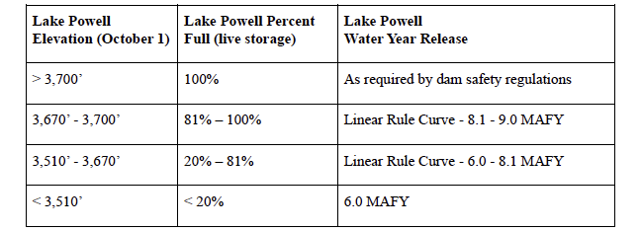
Upper Division States’ Alternative: http://www.ucrcommission.com/wp-content/uploads/2024/03/UDS-Alternative-Submittal-March-5-2024.pdf

Slide 36
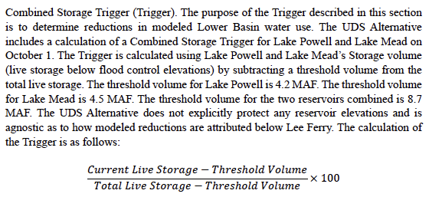
Upper Division States’ Alternative: http://www.ucrcommission.com/wp-content/uploads/2024/03/UDS-Alternative-Submittal-March-5-2024.pdf

Slide 37
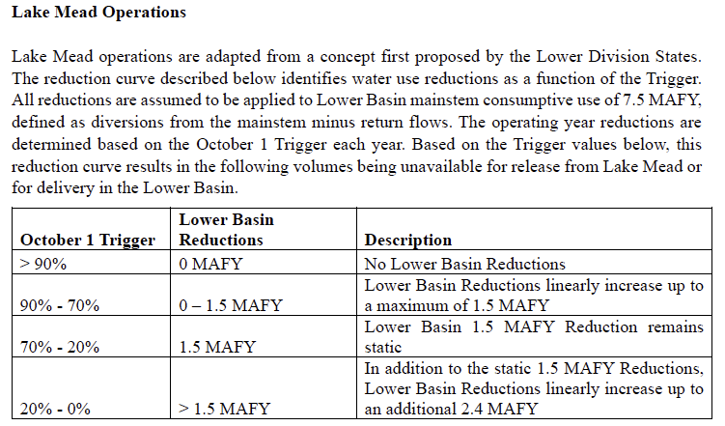
Upper Division States’ Alternative: http://www.ucrcommission.com/wp-content/uploads/2024/03/UDS-Alternative-Submittal-March-5-2024.pdf

Slide 38
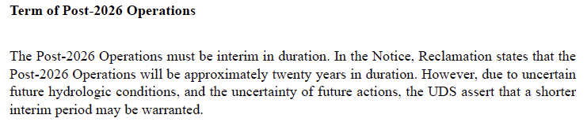
Upper Division States’ Alternative: http://www.ucrcommission.com/wp-content/uploads/2024/03/UDS-Alternative-Submittal-March-5-2024.pdf

Slide 39
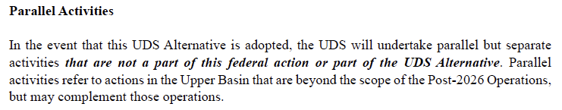
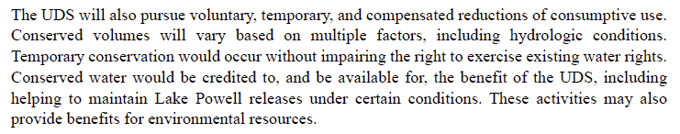
Upper Division States’ Alternative: http://www.ucrcommission.com/wp-content/uploads/2024/03/UDS-Alternative-Submittal-March-5-2024.pdf

Slide 40
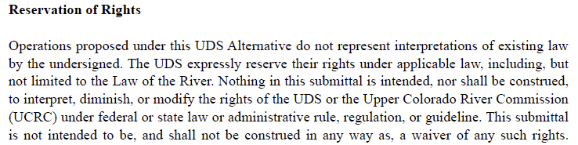
Upper Division States’ Alternative: http://www.ucrcommission.com/wp-content/uploads/2024/03/UDS-Alternative-Submittal-March-5-2024.pdf

Slide 41
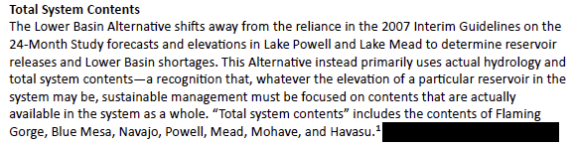
Lower Basin Alternative: https://www.azwater.gov/sites/default/files/2024-03/Lower%20Basin%20Alternative%20Letter%205.6.24.pdf

Slide 42
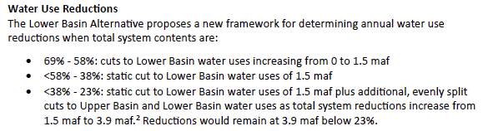
Lower Basin Alternative: https://www.azwater.gov/sites/default/files/2024-03/Lower%20Basin%20Alternative%20Letter%205.6.24.pdf

Slide 43
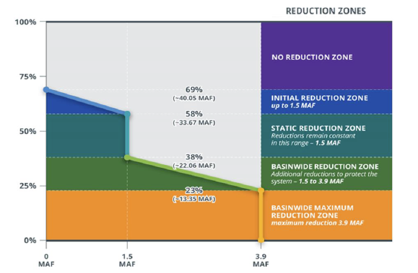
Lower Basin Alternative: https://www.azwater.gov/sites/default/files/2024-03/Lower%20Basin%20Alternative%20Letter%205.6.24.pdf

Slide 44
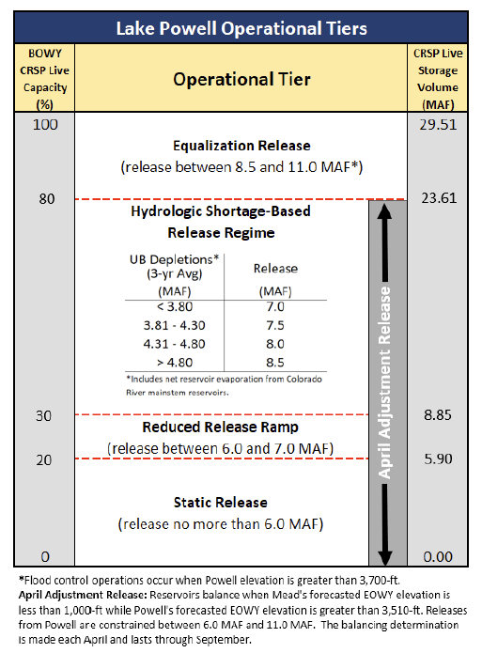

Slide 45
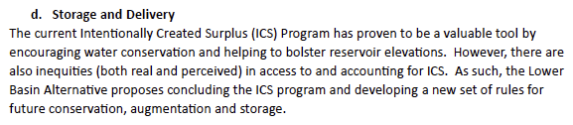
Lower Basin Alternative: https://www.azwater.gov/sites/default/files/2024-03/Lower%20Basin%20Alternative%20Letter%205.6.24.pdf

Slide 46
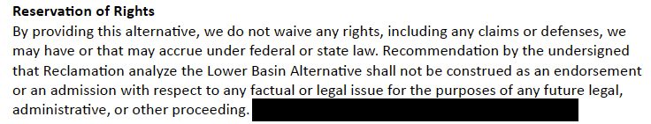
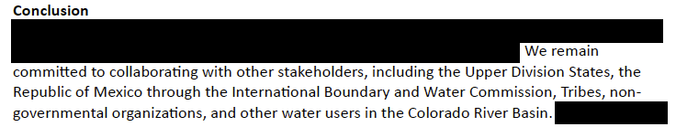
Lower Basin Alternative: https://www.azwater.gov/sites/default/files/2024-03/Lower%20Basin%20Alternative%20Letter%205.6.24.pdf

Slide 48

Thank You!

