Slide 1
VERSO Vandal Expertise, Research, and Scholarship Online
verso.uidaho.edu

Slide 2
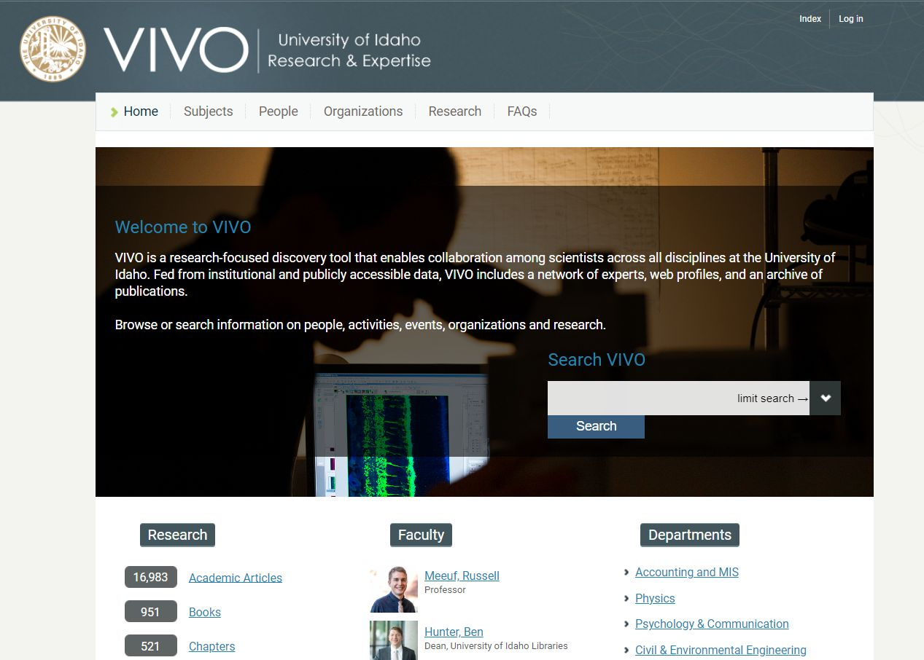
Research Information Management Systems (RIMs)
Research information management(RIM) systems support the transparent
aggregation, curation, and utilization of data about institutional research activities.
(Bryant et al, 2021)
https://www.oclc.org/research/publications/2021/oclcresearch-rim-united-states.html

Slide 3
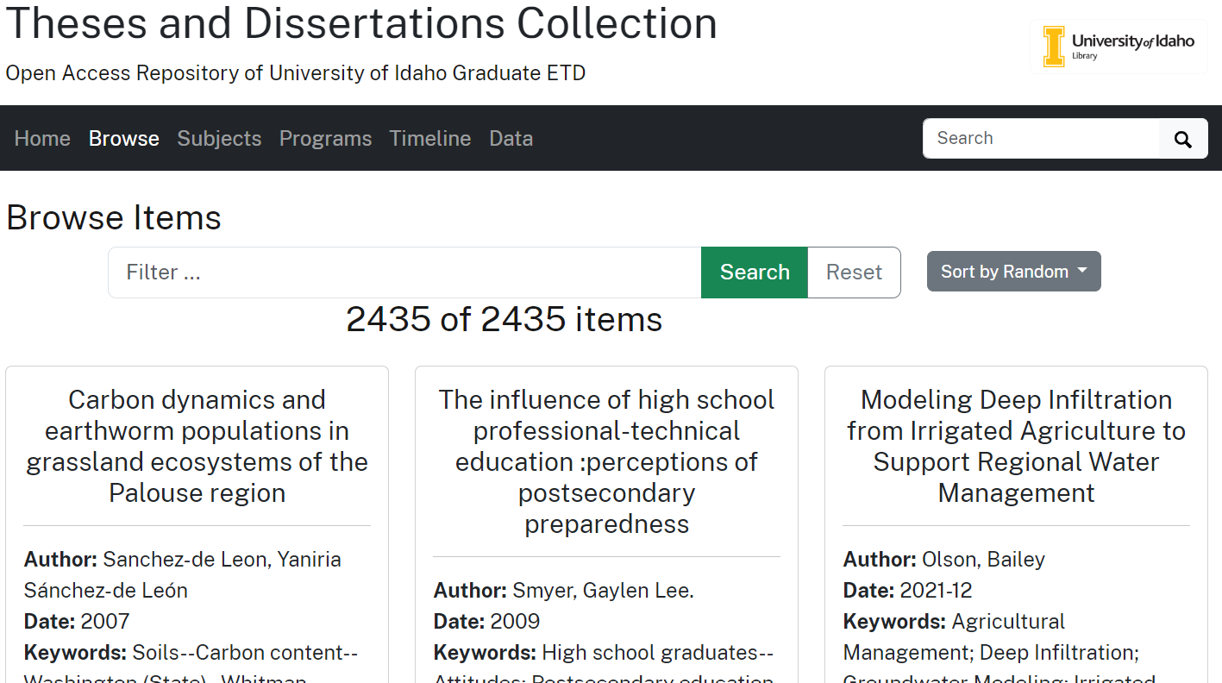
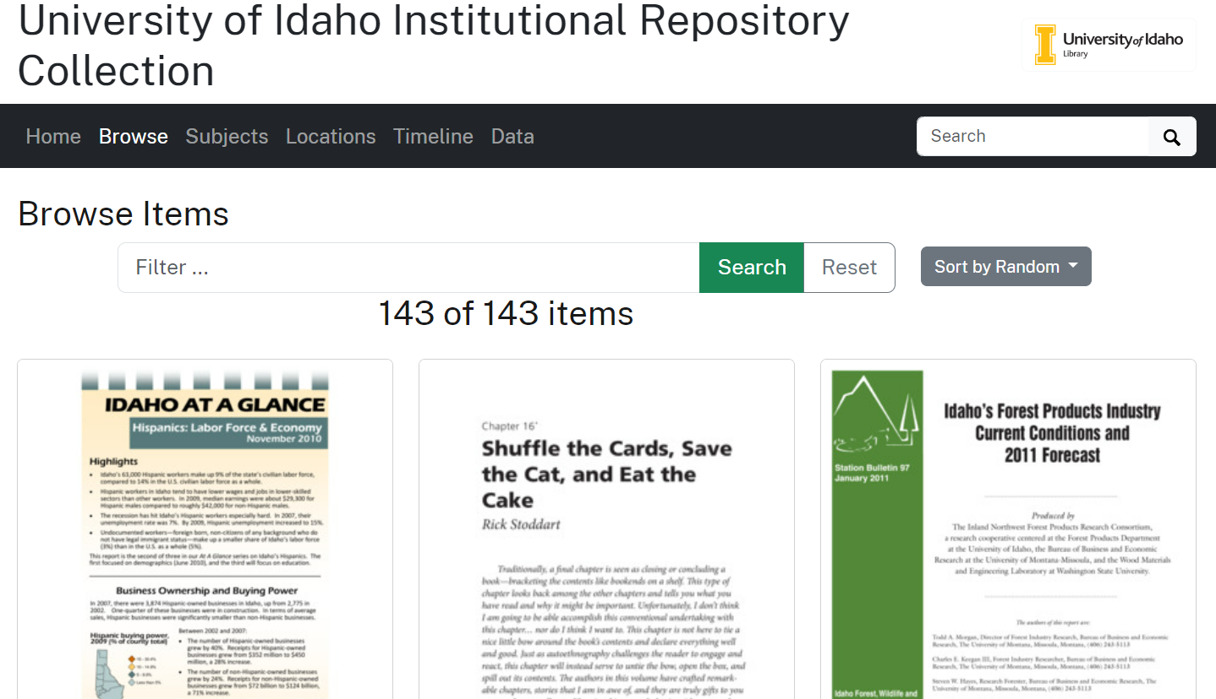
Institutional Repositories (IRs)
…digital collections capturing and preserving the intellectual output of
a single or multi-university community.
(Crow, 2002)
https://sparcopen.org/wp-content/uploads/2016/01/instrepo.pdf

Slide 4
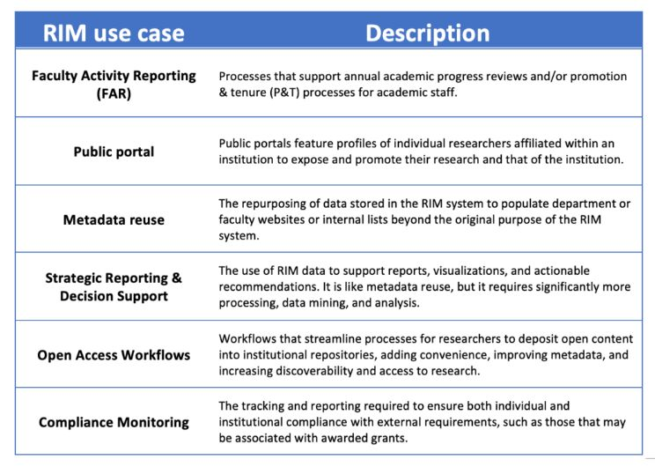
https://hangingtogether.org/what-is-rim/

Slide 5
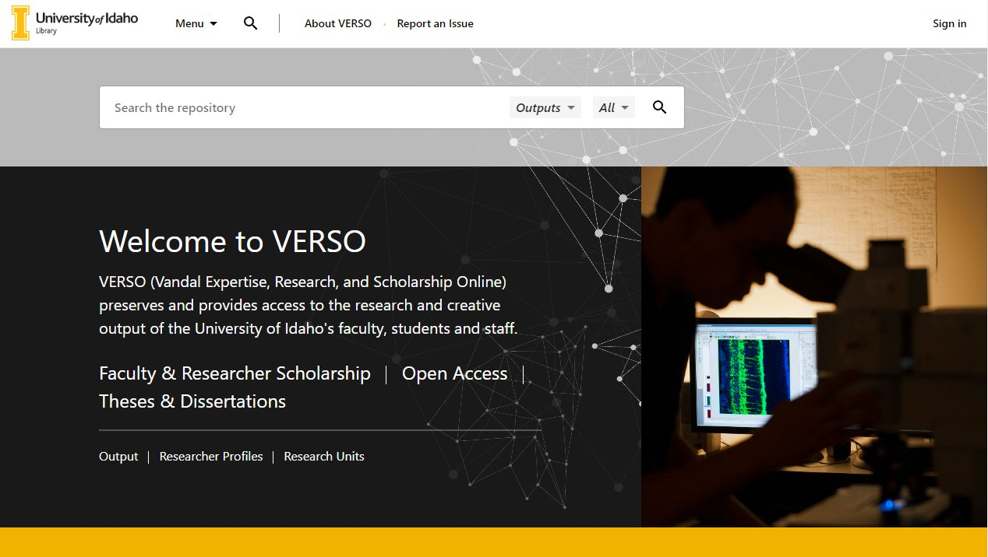
VERSO: verso.uidaho.edu

Slide 6
VERSO: verso.uidaho.edu

Slide 7
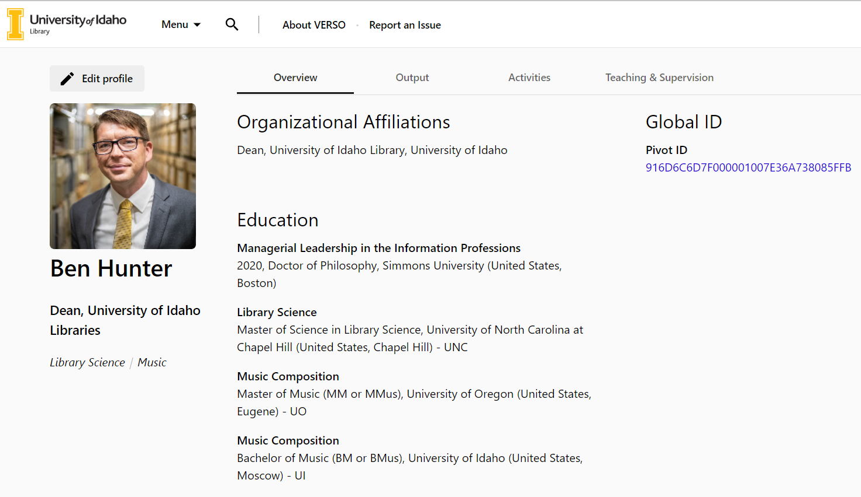
Faculty pages

Slide 8
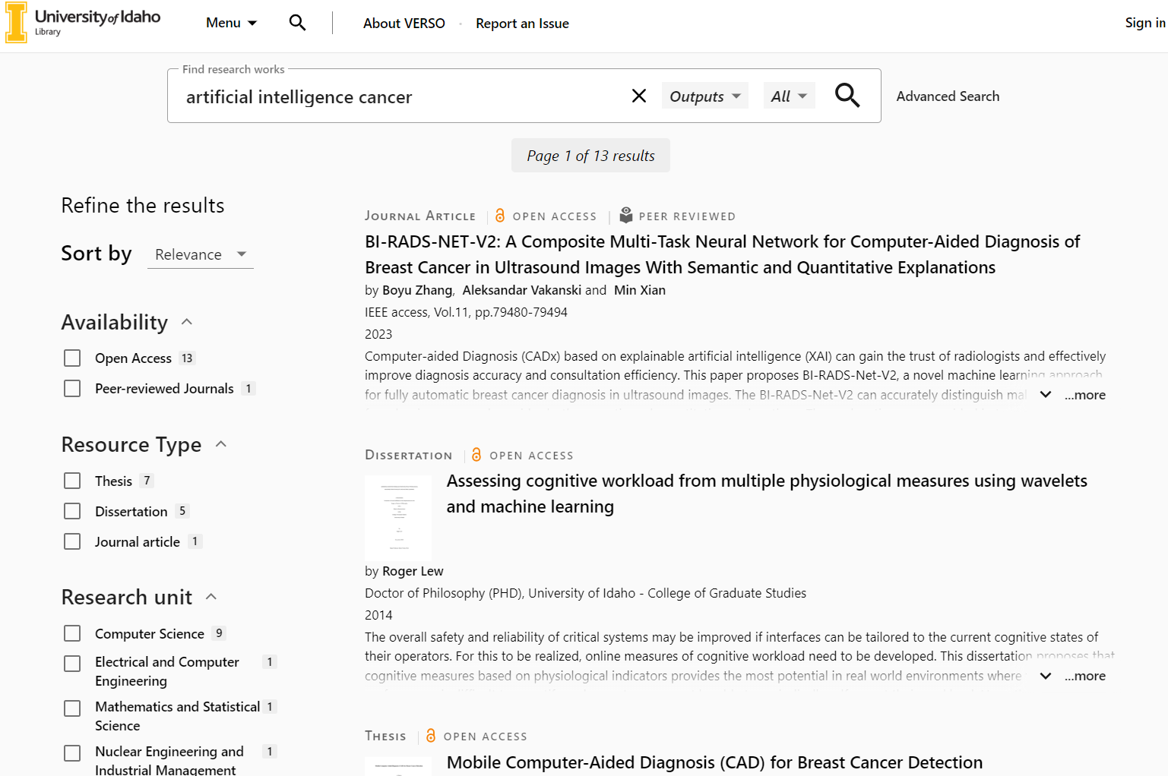
VERSO: verso.uidaho.edu

Slide 9
VERSO: verso.uidaho.edu
Built on Ex Libris’ Esploro platform
Integrated RIMS and IR
Automatic daily harvesting of data
SSO for personal profile maintenance
Detailed reporting functions for description and strategic decision making
Easy listing of researchers and research by unit
Increase discoverability and access to university research and publications
Custom list generation
ORCID integration

Slide 10
Release Timeline
Fall 2023
Migrate data from VIVO
Establish single-sign-on and other system features
Spring 2024
Begin initial data harvests
Create policies and protocols
Gather feedback from various faculty and units
Soft rollout to faculty in March/April 2024
Retire VIVO and redirect to VERSO
Summer 2024
Data cleaning and further harvests
Establish IR deposit protocols and workflows
Further testing and feedback from campus
Fall 2024
Full campus/public rollout
VERSO becomes discoverable via Google, Google Scholar, and other indexes

Slide 11
Future Plans
Analytics/Reporting improvements
Specialized use cases, commonly requested reports
API Use
Fairly robust and allows for both read/write capabilities
Center/Institute Support
Open to discussions on how to make this maximally useful
Ongoing software update/improvements
Ex Libris continues to roll out improvements, so expect new functionality over time
CV Generation

Slide 12
Questions?

