Slide 1
Nursery/Landscape Plant Identification
F-L
133-160

Slide 2
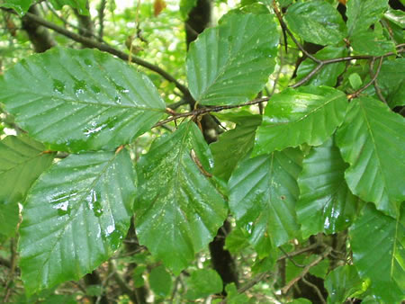
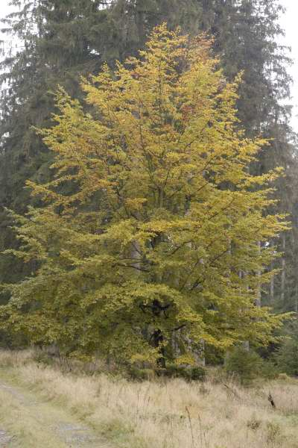
133 Fagus sylvatica cv. European Birch
plant-identification.co.uk
commanster.eu
Notes:
http://www.plant-identification.co.uk/images/fagaceae/fagus-sylvatica-5.jpg
http://www.commanster.eu/commanster/Plants/Trees/Trees/Fagus.sylvatica2.jpg

Slide 3
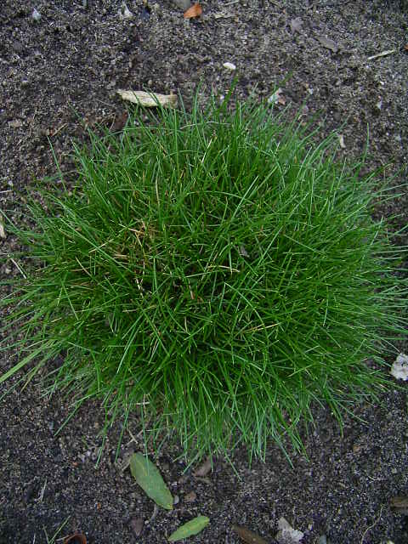
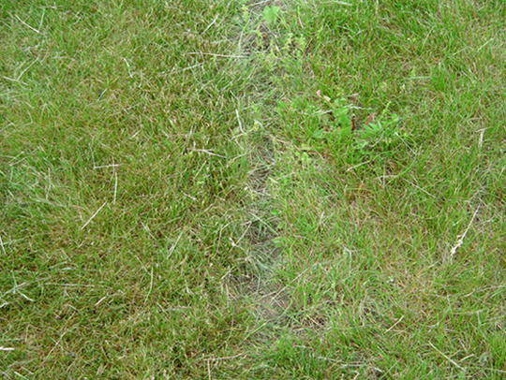
134 Festuca spp. & cv. Fescue
hort.cornell.edu
image.gardening.eu
Notes:
http://www.hort.cornell.edu/department/faculty/weston/fescue/comparison.jpg
http://image.gardening.eu/immagini/festuca_scoparia_pic_carlit.jpg

Slide 4
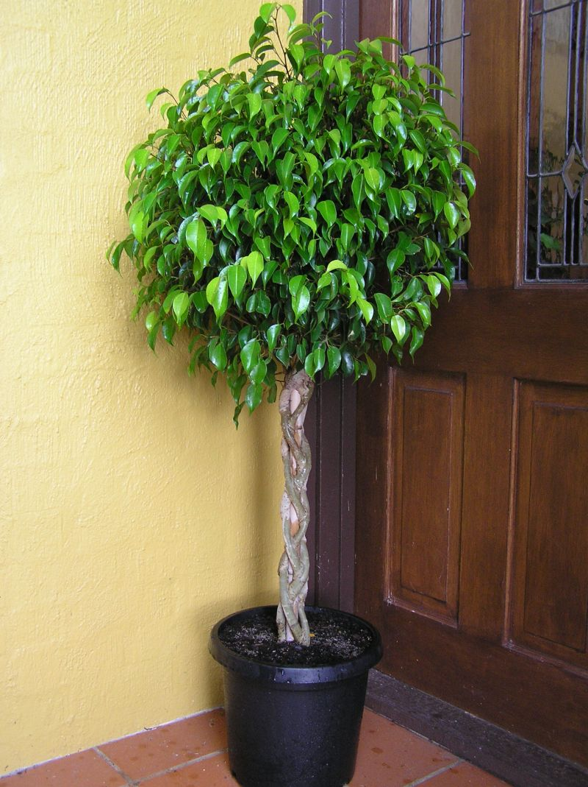
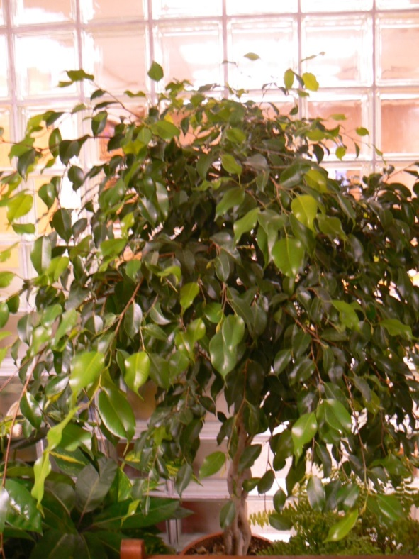
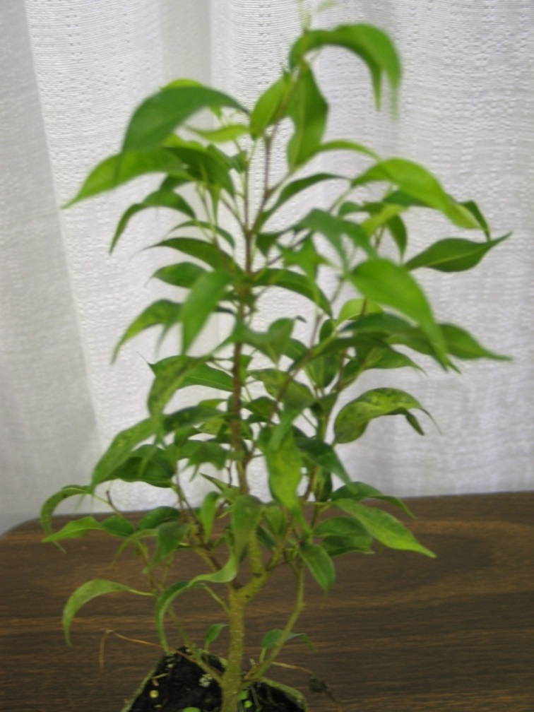
135 Ficus benjamina ‘Exotica’ Benjamin Fig
Gardenmart.com
Notes:
Gardenmart.com

Slide 5
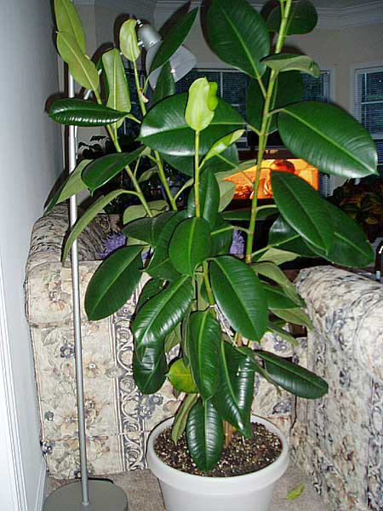
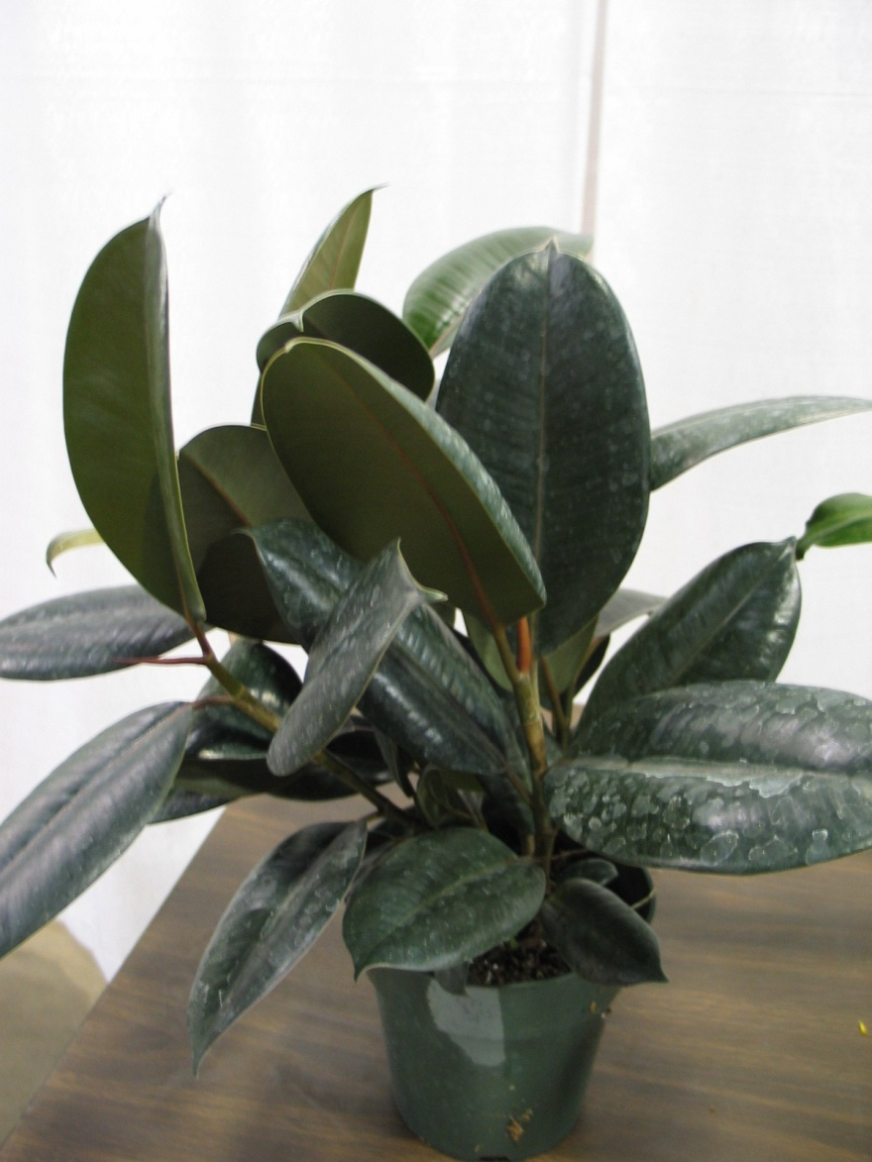
136 Ficus elastica ‘Decora’ ‘Decora’ Rubber Plant
Toptropicals.com
Notes:
Toptropicals.com

Slide 6
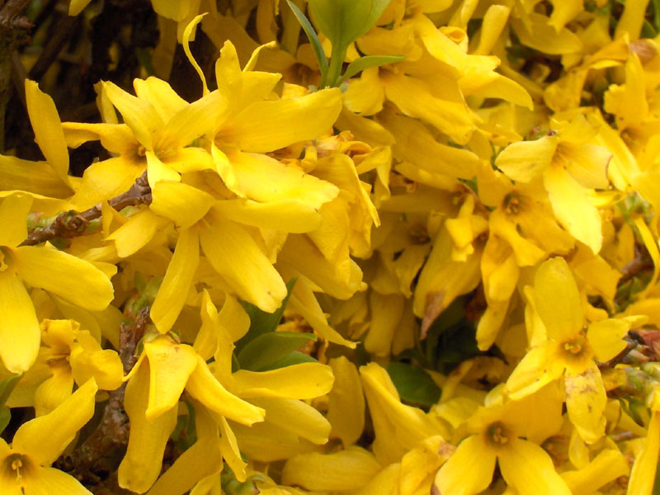
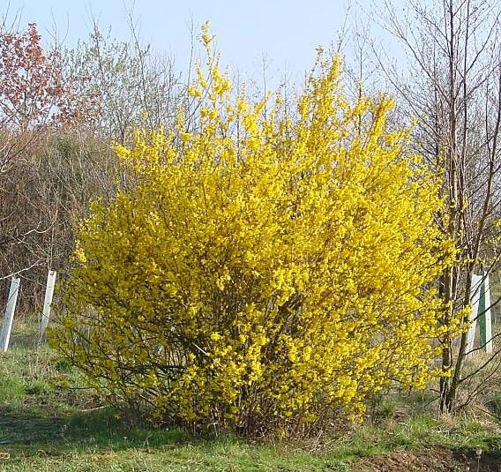
137 Forsythia x intermeda cv. Border Forsythia
soonerplantfarm.com
lh6.ggpht.com
Notes:
http://www.soonerplantfarm.com/_ccLib/image/plants/deta5-644.jpgPermission is granted to copy, distribute and/or modify this document under the terms of the GNU Free Documentation License, Version 1.2 or any later version published by the Free Software Foundation; with no Invariant Sections, no Front-Cover Texts, and no Back-Cover Texts. A copy of the license is included in the section entitled "GNU Free Documentation License".
http://lh6.ggpht.com/_rWksMjEBTQk/Sa1NXbfTpxI/AAAAAAAAKZk/Ya55nX1vyp0/s800/leo-mic-Forsythia-x-intermedia-1229.jpg

Slide 7
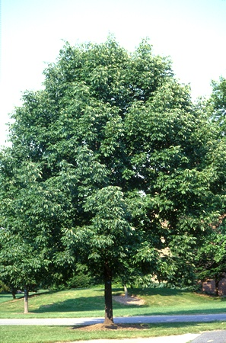
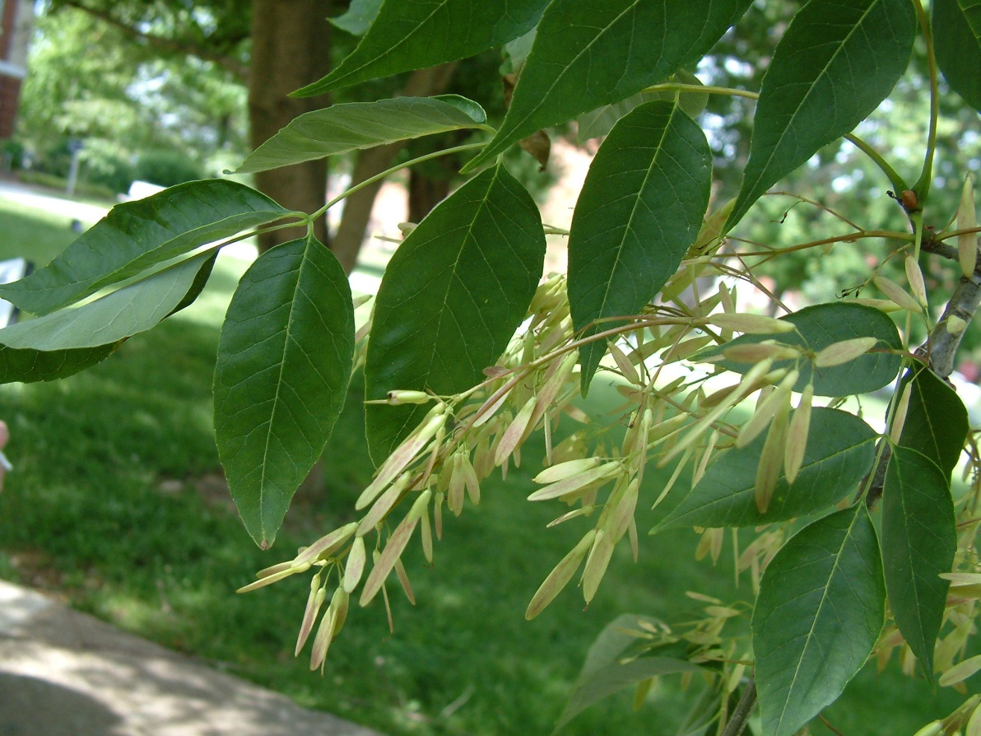
138 Fraxinus americana cv. White Ash
faculty.etsu.edu
jvh-nurseries.com
Notes:
http://faculty.etsu.edu/MCDOWELT/Pictures%20Use/Fraxinus%20americana.JPG
http://www.jvh-nurseries.com/language/multilingual/plants/list/fraxinus%20americana.jpg

Slide 8
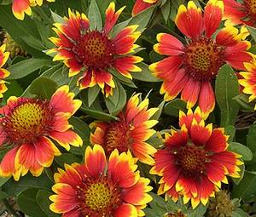
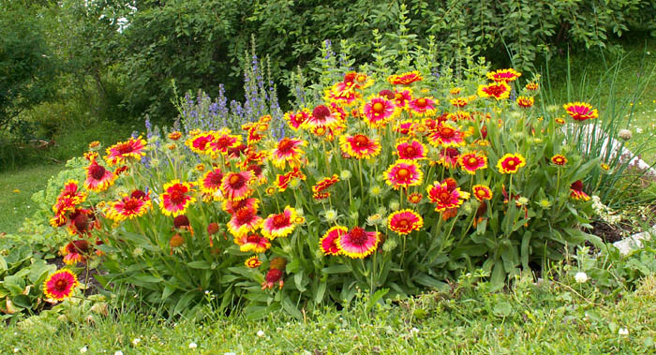
139 Gailardia aristata cv. Common blanketflower
images.marketplaceadvisor.channeladvisor.com
plantcare.com
Notes:
http://images.marketplaceadvisor.channeladvisor.com/hi/74/73694/blanket_flower_gaillardia_aristata_seeds.jpg
http://www.plantcare.com/oldSite/httpdocs/images/namedImages/Blanketflower.jpg

Slide 9
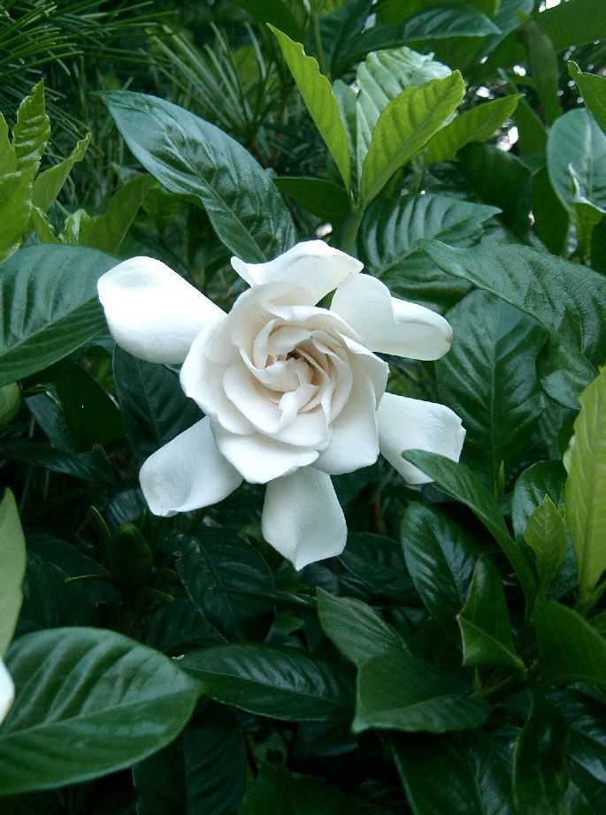
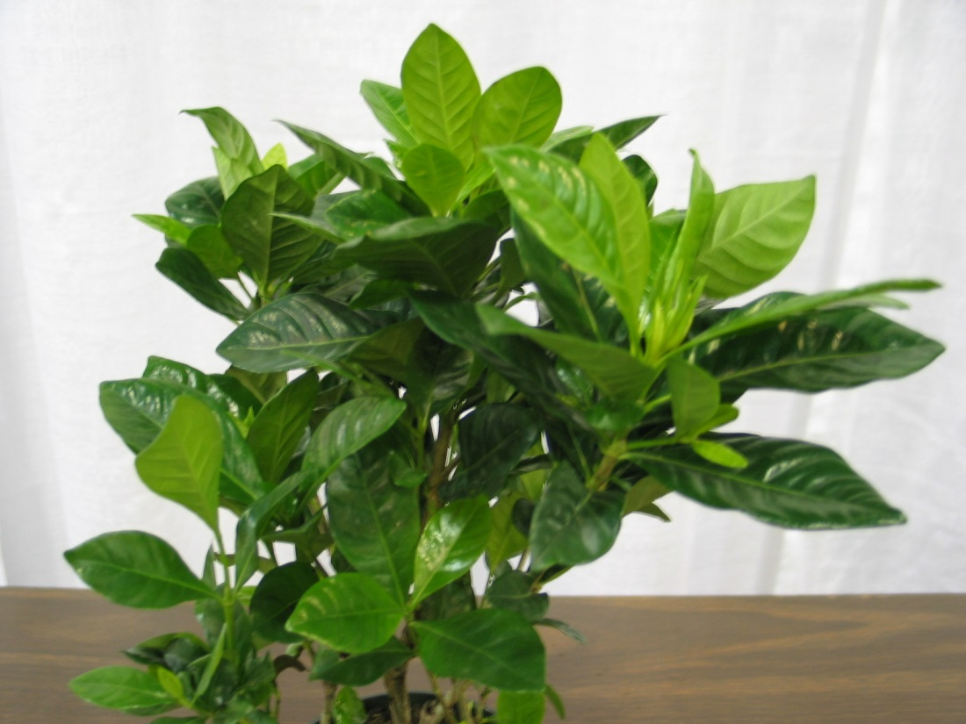
140 Gardenia jasminoides ‘Fortuniana’ Gardenia
wikimedia.org
Notes:
Upload.wikimedia.org

Slide 10
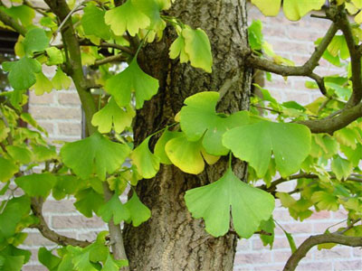
141 Ginkgo biloba Ginkgo, Maidenhair Tree
brianandsherry.com
Notes:
http://www.brianandsherry.com/photos/non-ebay/Ginkgo-biloba-tree.jpg

Slide 11
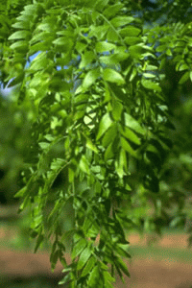
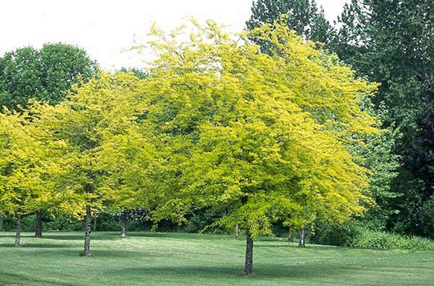
142 Gleditsia triacantos inermis cv. Thornless Honeylocust
gerdes-wholesale-nursery.com
shadetreesandevergreens.com
Notes:
http://www.gerdes-wholesale-nursery.com/trees/gleditsia-triacanthos-inermis-skyline.html
http://www.shadetreesandevergreens.com/assets/images/products/sunbursthoneylocust.jpg

Slide 12
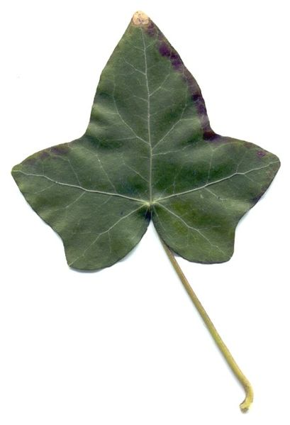
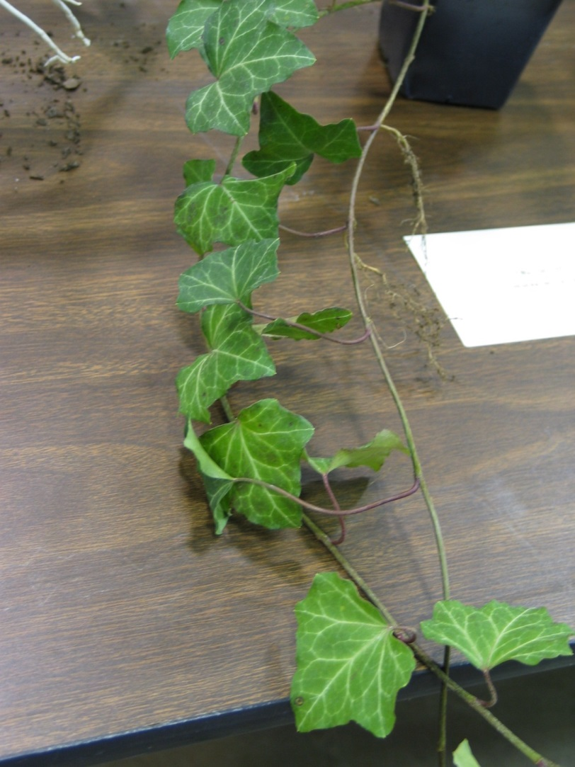
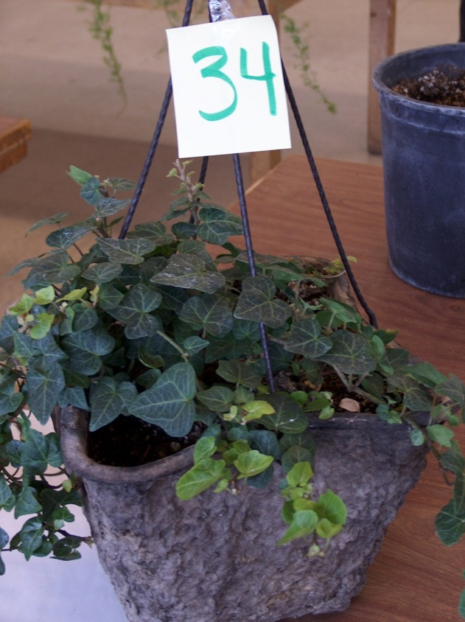
143 Hedra helix cv. English Ivy
Assets.babycenter.com
Notes:
Assets.babycenter.com

Slide 13
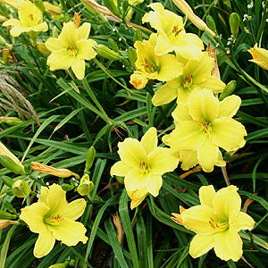
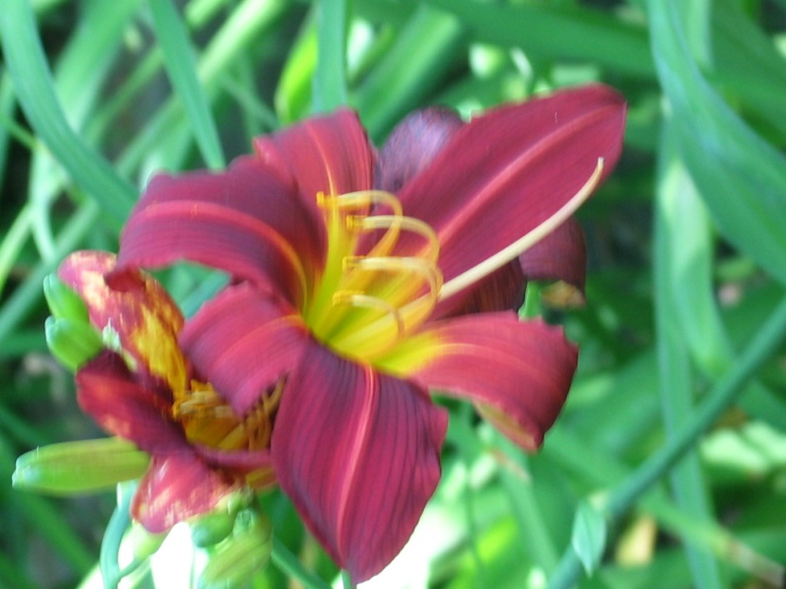
144 Hemerocallis spp. & cv. Daylily
Findmeplants.co.uk
Notes:
Findmeplants.co.uk

Slide 14
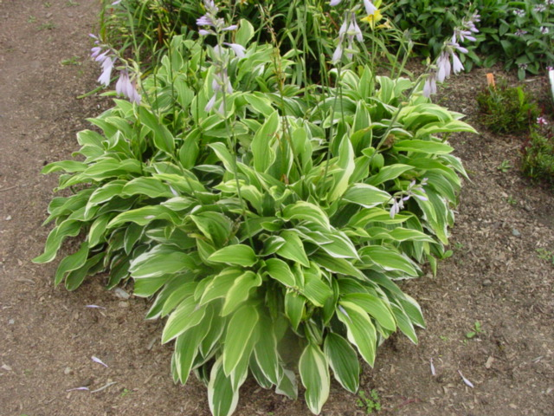
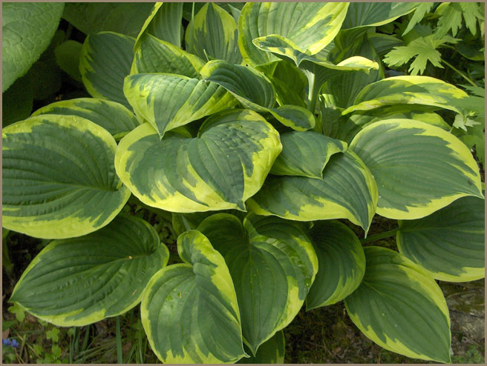
145 Hosta x hybrida cv. Plaintain lily
florifacts.umn.edu
quaint.kapsi.fi
Notes:
http://www.florifacts.umn.edu/2006%20Herbaceous%20Perennials/Hosta%20Sundance%20083.jpg
http://quaint.kapsi.fi/puutarha/kasvilistat/kuvakasvilista/Hosta/hosta_aureomarginata.jpg

Slide 15
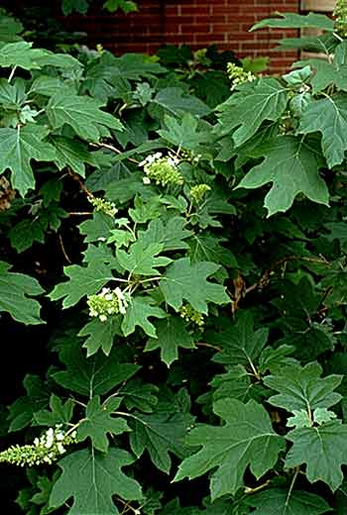
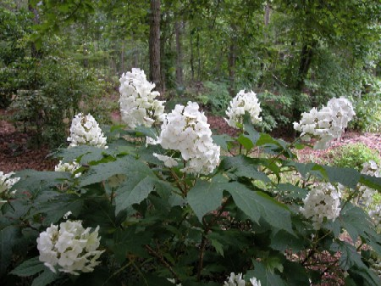
146 Hydrangea quercifolia Oakleaf Hydrangea
greengrasslandscape.com
thymeafterthyme.com
Notes:
http://thymeafterthyme.com/images/Hydrangea_quercifolia.jpg
http://www.greengrasslandscape.com/photogallery/Hydrangea%20quercifolia.jpg

Slide 16
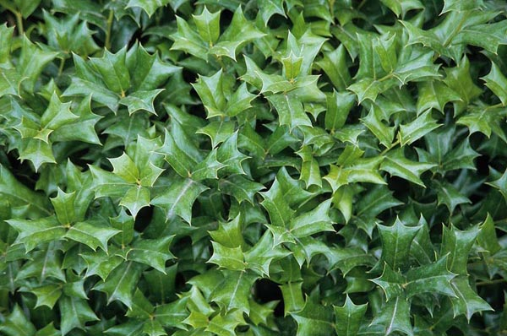
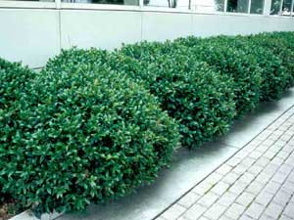
147 Ilex cornuta cv. Chinese Holly
gardensandplants.com
aragriculture.org
Notes:
http://www.gardensandplants.com/images/plants/Ilex%20cornuta%20Dazzler.jpg
http://www.aragriculture.org/Images/plant_db/shrubs/ilex_cornuta_carissa_fm.jpg

Slide 17
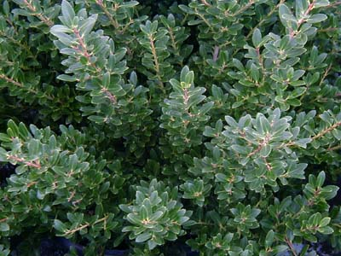
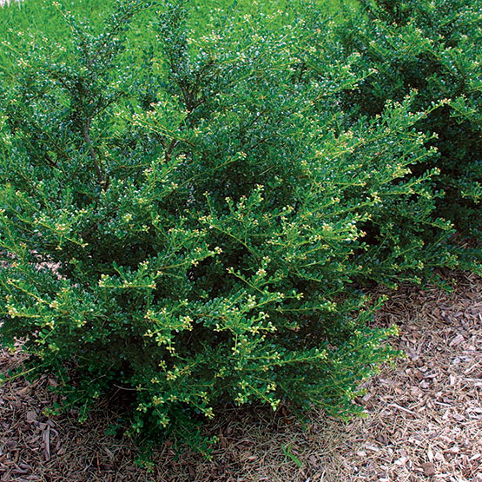
148 Ilex crenata cv. Japanese Holly
finegardening.com
seedlingsrus.com
Notes:
http://www.seedlingsrus.com/IlexCrenataHoogendorn.jpg
http://www.finegardening.com/CMS/uploadedimages/Images/Gardening/Plants/Ilex_Crenata_MG_lg.jpg

Slide 18
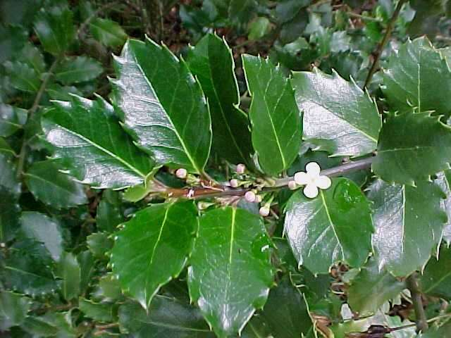
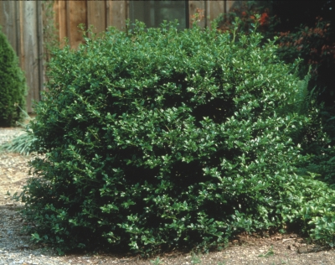
149 Ilex x meserveae cv. Meserve Holly
mobot.org
connon.ca
Notes:
http://www.connon.ca/gallery/BROADLEAFS%20EVERGREENS/2405.jpg
http://www.google.com/imgres?imgurl=http://www.mobot.org/gardeninghelp/images/low/D460-0901020.jpg&imgrefurl=http://www.mobot.org/gardeninghelp/plantfinder/Plant.asp%3Fcode%3DD460&usg=__QADgbB6hccxlayiFl1GtRYEoqvY=&h=480&w=640&sz=47&hl=en&start=5&sig2=SpJ-bc0D8N18uhWK2Thpxg&itbs=1&tbnid=QvVz44NVDPi_uM:&tbnh=103&tbnw=137&prev=/images%3Fq%3DIlex%2Bx%2Bmeserveae%26hl%3Den%26sa%3DG%26tbs%3Disch:1&ei=SRTOS93bOaeutAP4gKlQ

Slide 19
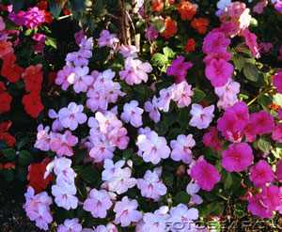
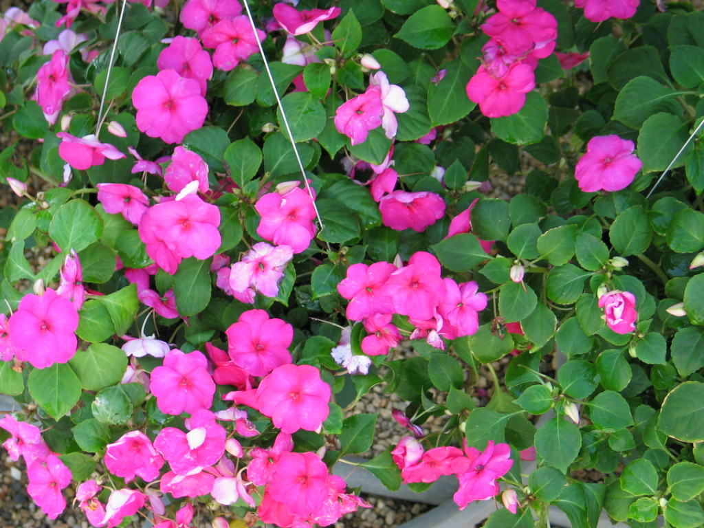
150 Impatiens hybrid cv. Impatiens
Fotosearch.com
Notes:
Fotosearch.com

Slide 20
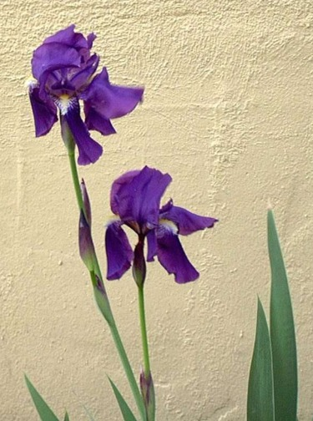
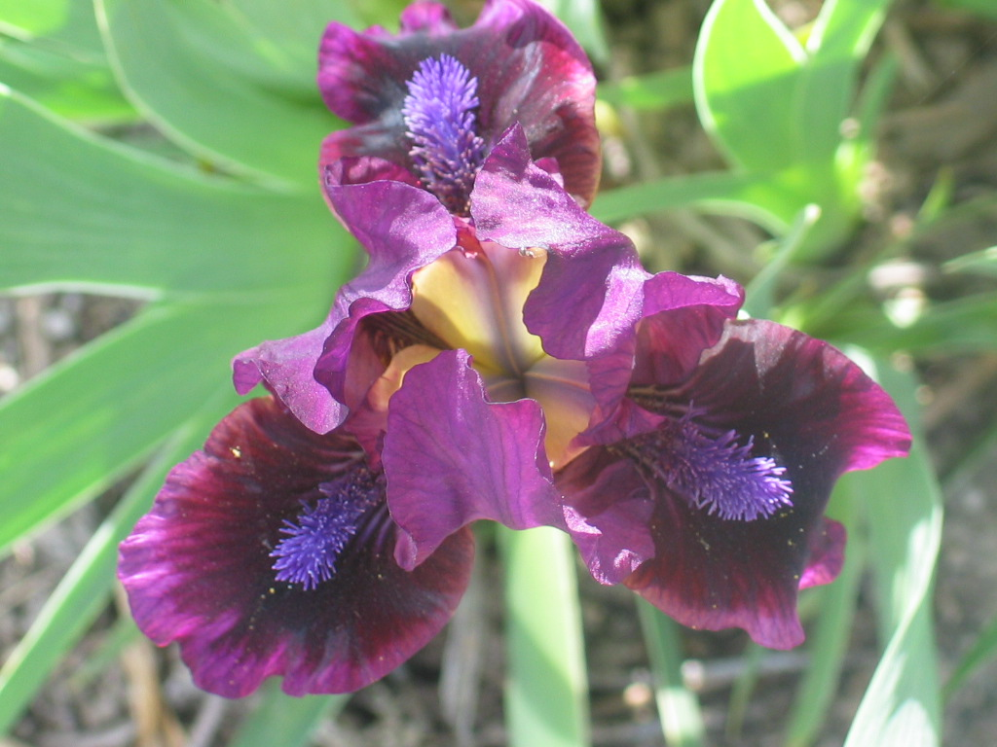
151 Iris x germanica florentina cv. Bearded Iris
Home.comcast.net
Notes:
Home.comcast.net

Slide 21
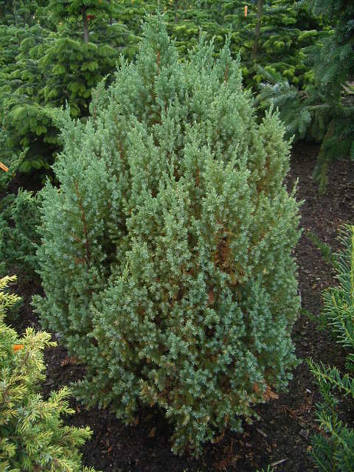
152 Juniperus chinensis cv. Chinese Juniper
image.gardening.eu
Notes:
http://image.gardening.eu/immagini/juniperus_chinensis_stricta.jpg

Slide 22
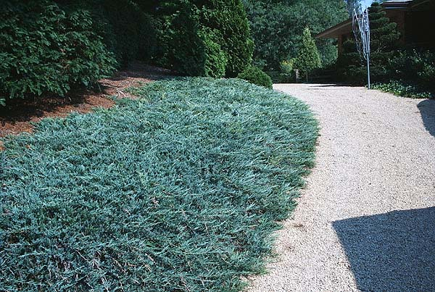
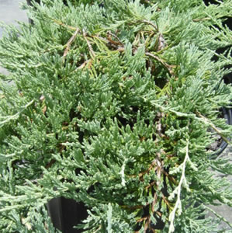
153 Juniperus horizontalis cv. Creeping juniper
magnoliagardensnursery.com
zelenhoz.com
Notes:
http://www.zelenhoz.com/n/1/JUNIPERUS%20HORIZONTALIS%20BLUE%20CHIP%20PA.jpg
http://www.magnoliagardensnursery.com/productdescrip/pictures300/Juniperus_Bar300.jpg

Slide 23
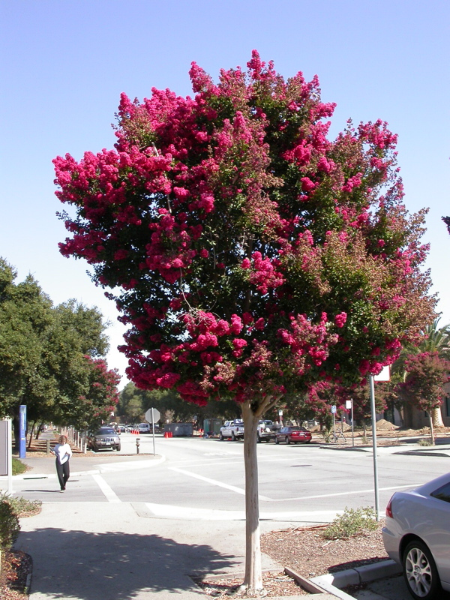
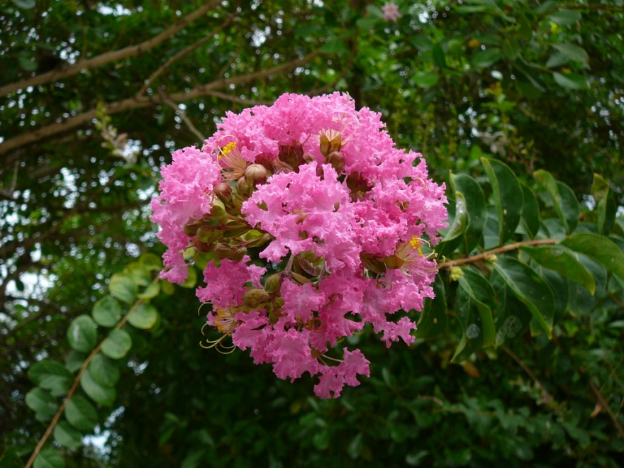
154 Lagerstroemia indica cv. Crape Myrtle
jabalamelnursery.com
wikimedia.org
Notes:
http://jabalamelnursery.com/mediafiles/Pictures/Plants/LAGERSTROEMIA%20INDICA.jpg
http://upload.wikimedia.org/wikipedia/commons/3/31/Lagerstroemia_indica_0001.jpg

Slide 24
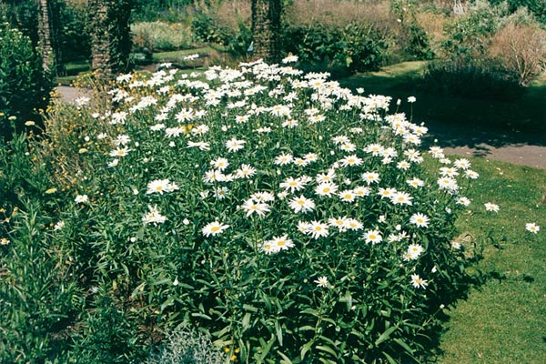
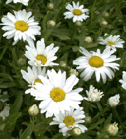
155 Leucanthemum x superbum cv. Shasta daisy
gardensandplants.com
shootgardening.co.uk
Notes:
http://www.gardensandplants.com/images/plants/Leucanthemum%20x%20superbum.jpg
http://www.shootgardening.co.uk/uploaded/images/plant_leucanthemum_x_superbum___silver_princess____1_21.jpg

Slide 25
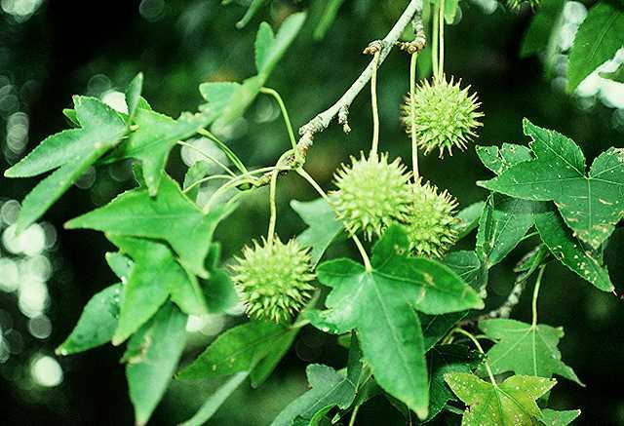
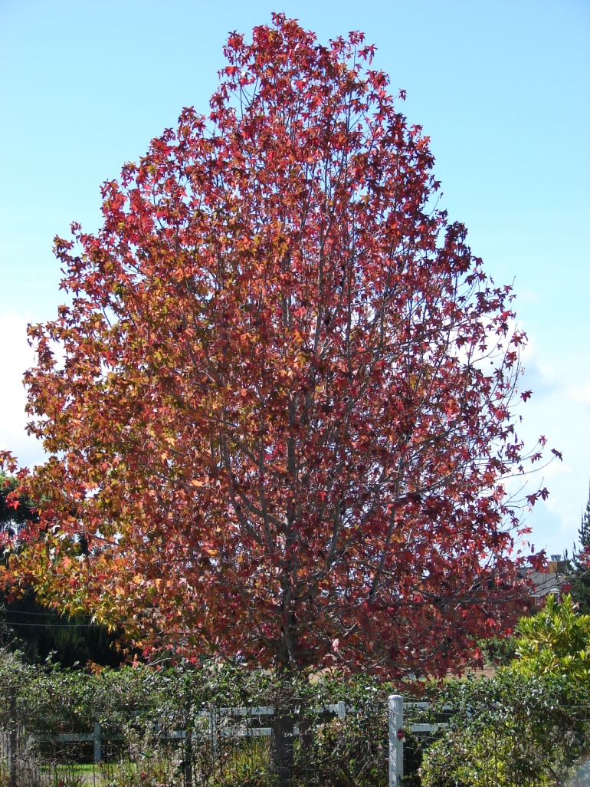
156 Liquidambar styraciflua Sweet Gum
biology.missouristate.edu
hear.org
Notes:
http://biology.missouristate.edu/Herbarium/TreesonCampus/images/Sweetgum.jpg
http://www.hear.org/starr/images/full/starr-061204-1831.jpg

Slide 26
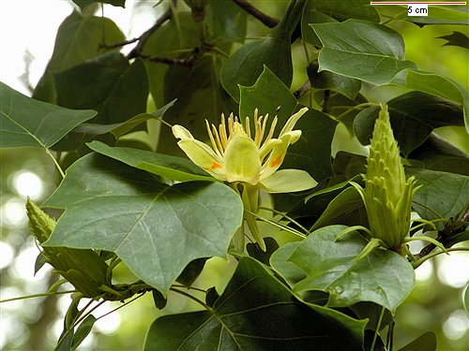
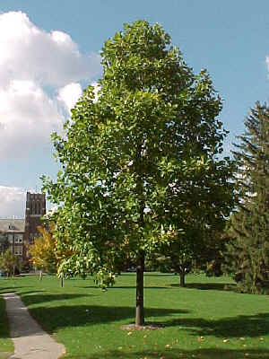
157 Liriodendron tulipifera Tuliptree
floralimages.co.uk
mivak.nl
Notes:
http://www.floralimages.co.uk/images/liriodendron_tulipifera_1027.jpg
http://www.mivak.nl/Noorkerhof/images/Liriodendron%20tulipifera.jpg

Slide 27
158 Liriope spp. cv. Lily-turf
marecromwell.files.wordpress.com
gruporiobravo.com
Notes:
http://marecromwell.files.wordpress.com/2009/03/liriope.jpg
http://www.gruporiobravo.com/images/photos/Public/Groundcovers/Liriope%20-%20Silver%20Dragon%202.jpg

Slide 28
159 Lobularia maritima Sweet Alyssum

Slide 29
160 Lonicera japonica ‘Halliana’ Hall’s Japanese Honeysuckle
desert-tropicals.com
lejardin.ro
Notes:
http://www.lejardin.ro/images/LONICERA_JAPONICA_HALLIANA.jpg
http://www.desert-tropicals.com/Plants/Caprifoliaceae/Lonicera_japonica.jpg

