Slide 1
Nursery/Landscape Plant Identification
A-E
101-132

Slide 2
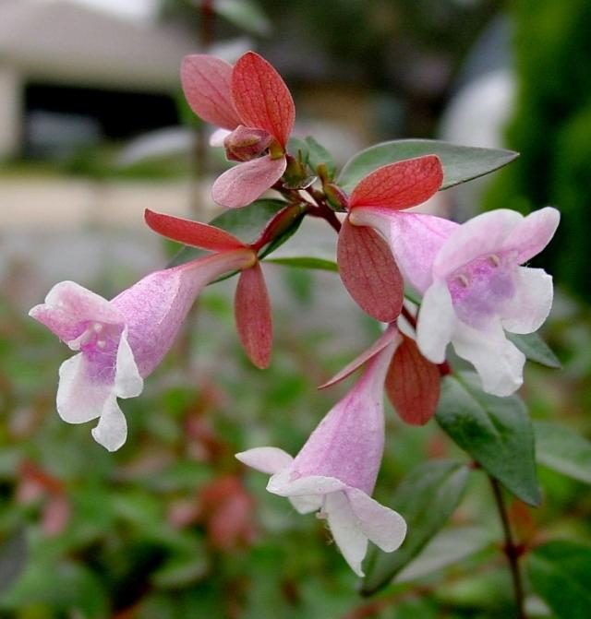
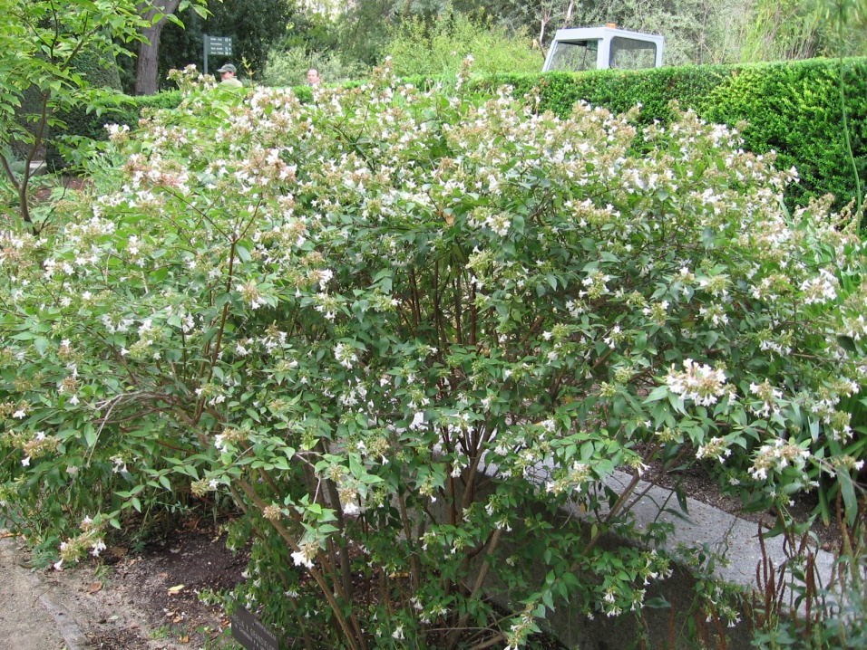
101 Abelia x grandiflora Glossy Abelia
Davesgarden.com
wikimedia.org
Notes:
http://pics.davesgarden.com/pics/2003/12/15/htop/b7e65f.jpg
http://upload.wikimedia.org/wikipedia/commons/0/06/Abelia_x_grandiflora_03.jpg

Slide 3
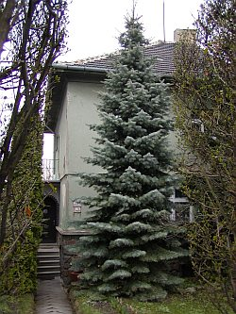
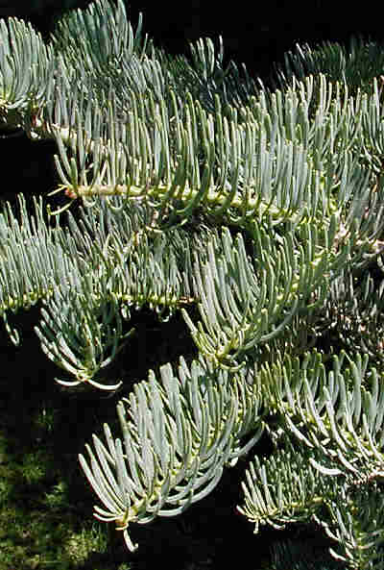
102 Abies concolor White Fir
about-garden.com
jungleseeds.com
Notes:
http://www.about-garden.com/images_data/2902-abies-concolor-1.jpg
http://www.jungleseeds.com/images/AbiesConcolor.jpg

Slide 4
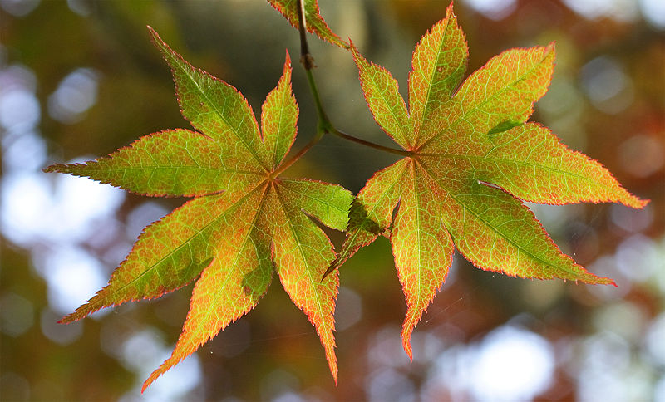
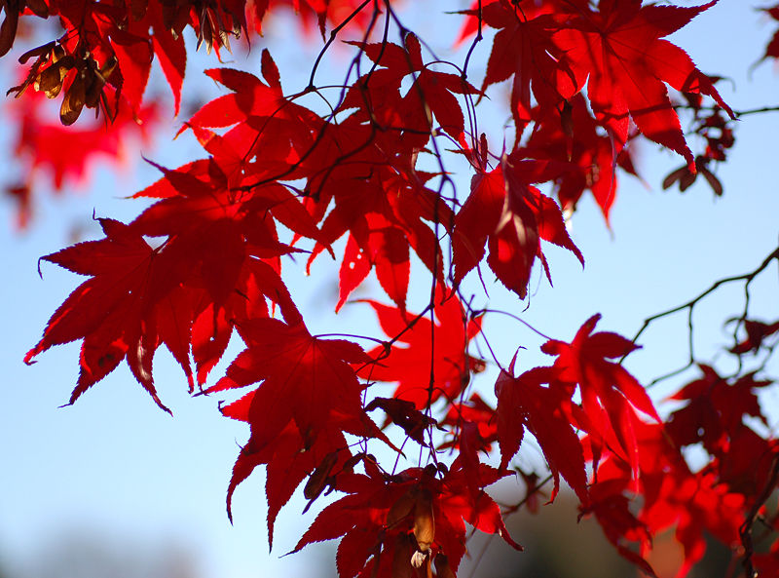
103 Acer palmatum cv. Japanese Maple
Wikipedia.com
Notes:
Wikipedia.com

Slide 5
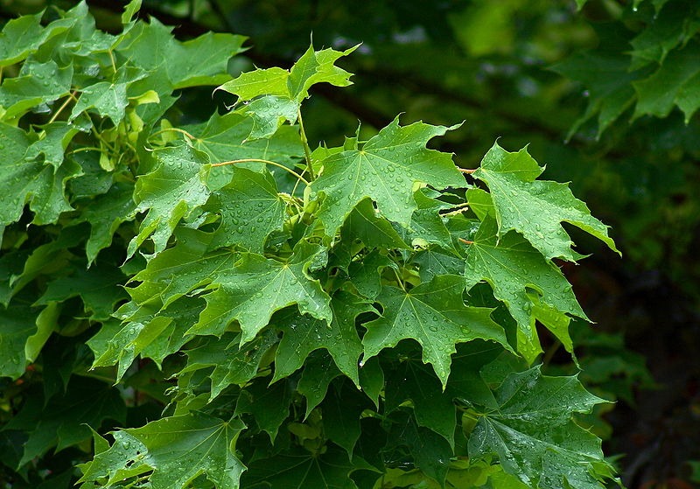
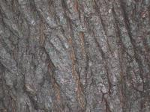
104 Acer platanoides cv. Norway Maple
Wikipedia.com
Notes:
Wikipedia.com

Slide 6
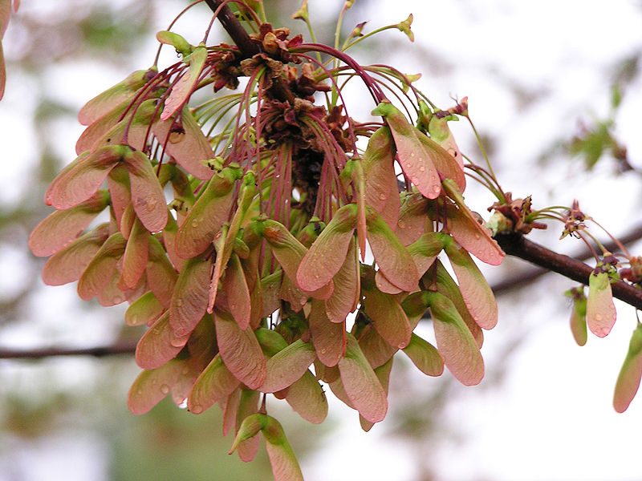
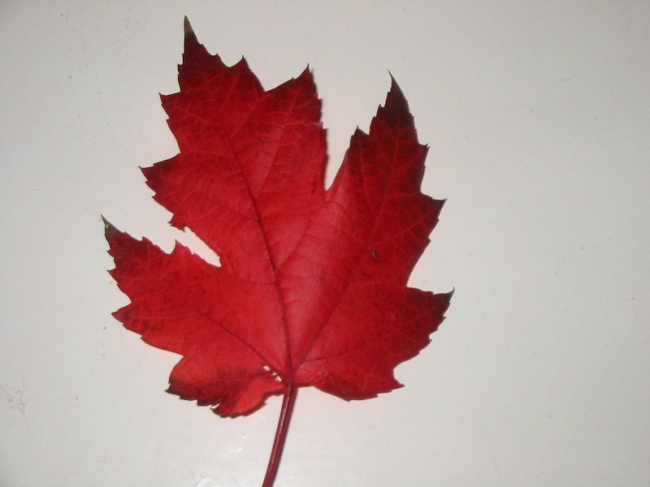
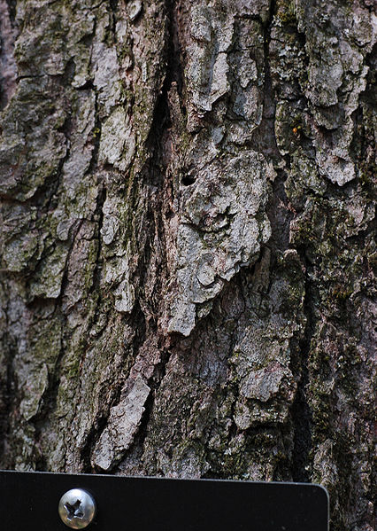
105 Acer rubrum cv. Red Maple
Wikipedia.com
Notes:
Wikipedia.com

Slide 7
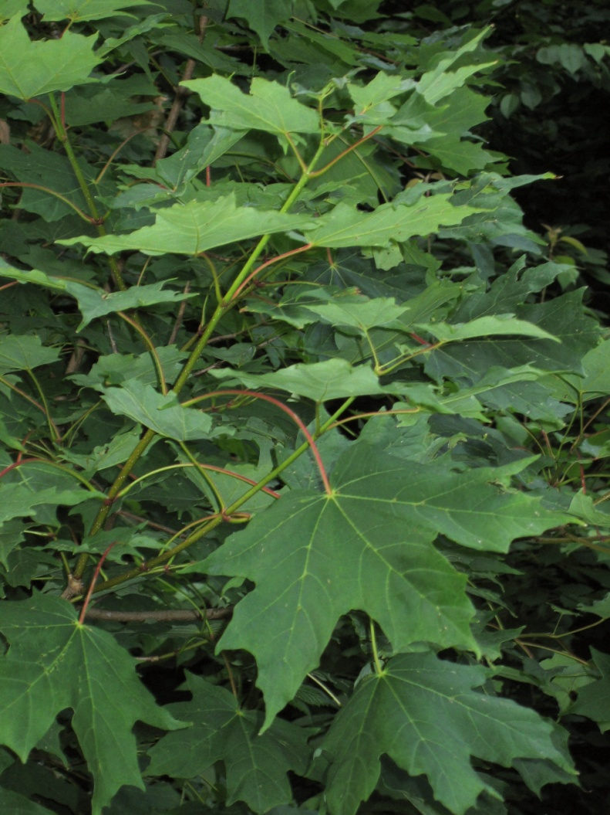
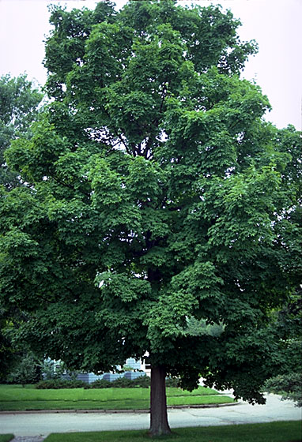
106 Acer saccharum cv. Sugar Maple
wikimedia.org
cirrusimage.com
Notes:
http://upload.wikimedia.org/wikipedia/commons/2/22/Acer_saccharum_foliage.jpg
http://www.google.com/imgres?imgurl=http://www.cirrusimage.com/Trees/maple/acer_saccharum_1.jpg&imgrefurl=http://www.cirrusimage.com/tree_maple_sugar.htm&h=1024&w=768&sz=557&tbnid=bBI7R0tn-H3lTM:&tbnh=150&tbnw=113&prev=/images%3Fq%3DAcer%2Bsaccharum&hl=en&usg=__jBRqLiQwxBW2ZiAXBHDqqhz_yj0=&ei=9gbOS4eGNJLqsQPo1YyvDg&sa=X&oi=image_result&resnum=8&ct=image&ved=0CCEQ9QEwBw

Slide 8
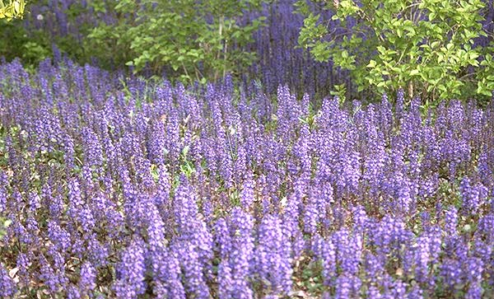
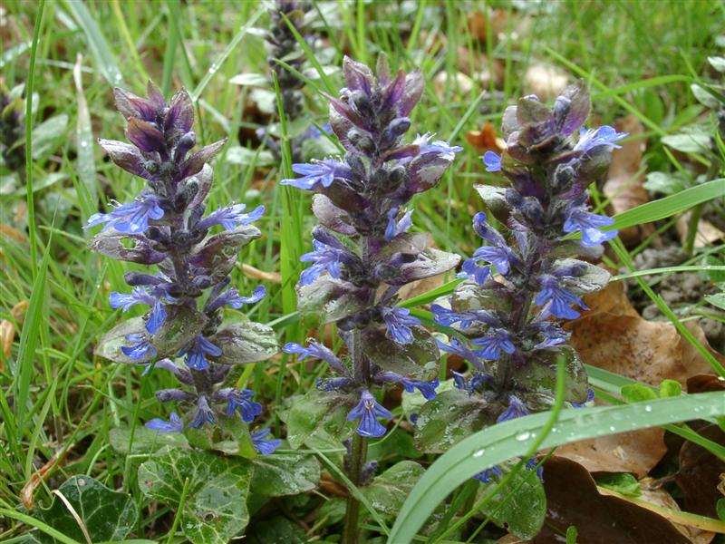
107 Ajuga reptans cv. Carpet Bugle
ajuga.org/
floracyberia.net
Notes:
http://www.ajuga.org/images/Ajuga%20reptans%201.jpg
http://www.floracyberia.net/spermatophyta/angiospermae/dicotyledoneae/lamiaceae/ajuga_reptans.jpg

Slide 9
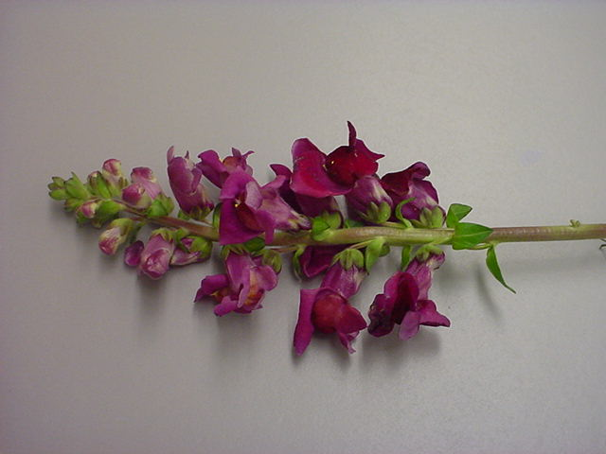
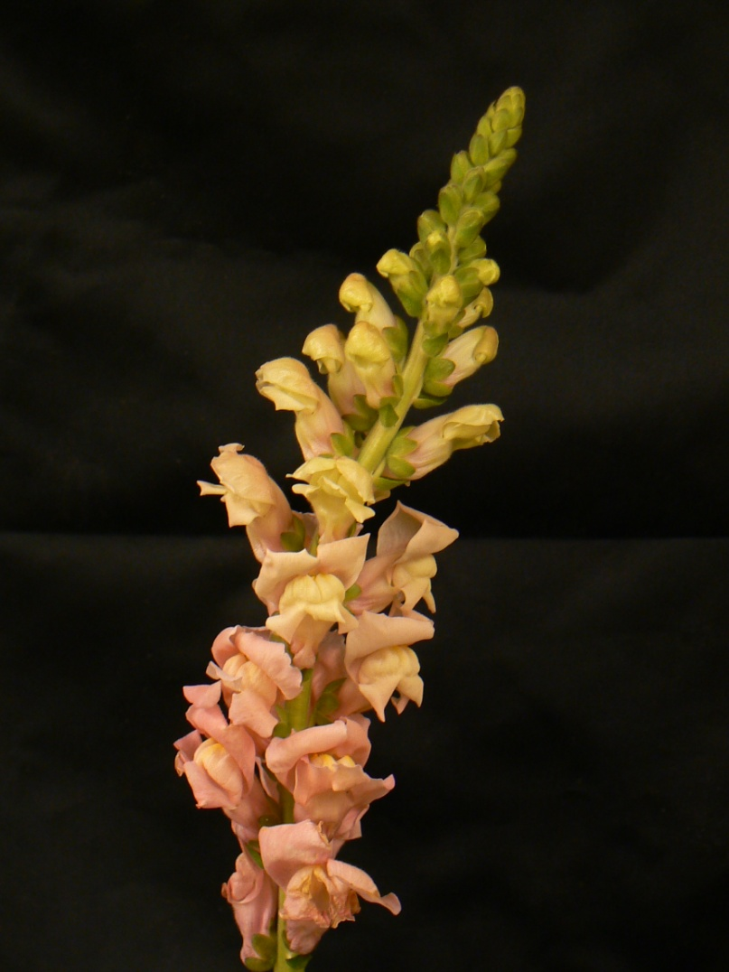
108 Antirrhinum majus cv. Snapdragon

Slide 10
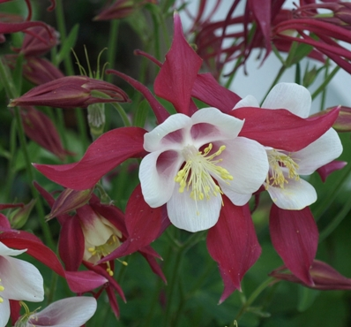
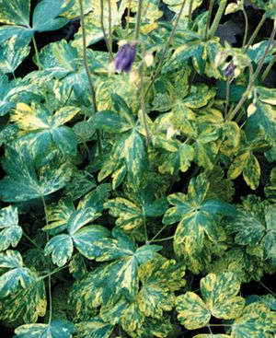
109 Aquilegia x hybrida cv. Columbine
robsplants.com
vanbloem.com
Notes:
http://www.robsplants.com/images/portrait/AquilegiaCrimsonStar080601a.jpg
http://www.vanbloem.com/_ccLib/image/plants/DETA-499.jpg

Slide 11
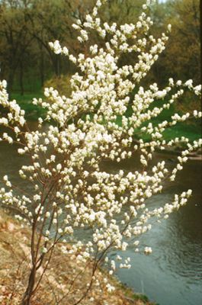
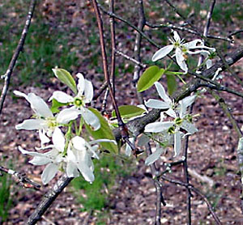
110 Amelanchier arborea Downy Serviceberry
critsite.com
bernheim.org
Notes:
http://www.critsite.com/_ccLib/image/plants/DETA-100087.jpg
http://www.bernheim.org/images/urbanTree/Amelanchier_arborea_flowers.jpg

Slide 12
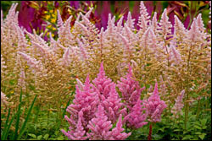
111 Astilbe hybrid cv. Astilbe
Americanmeadows.com
Notes:
Americanmeadows.com

Slide 13
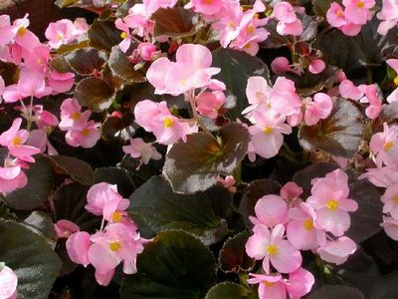
112 Begonia x semperflorens-cultorum Wax Begonia
Bpl.blogger.com
Notes:
Bpl.blogger.com

Slide 14
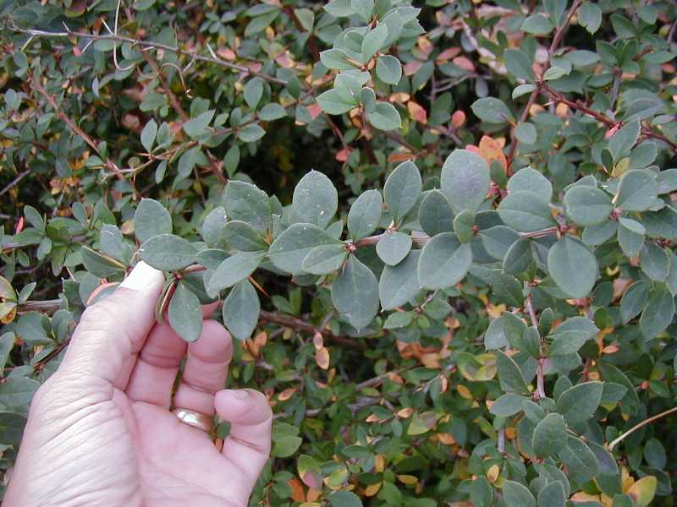
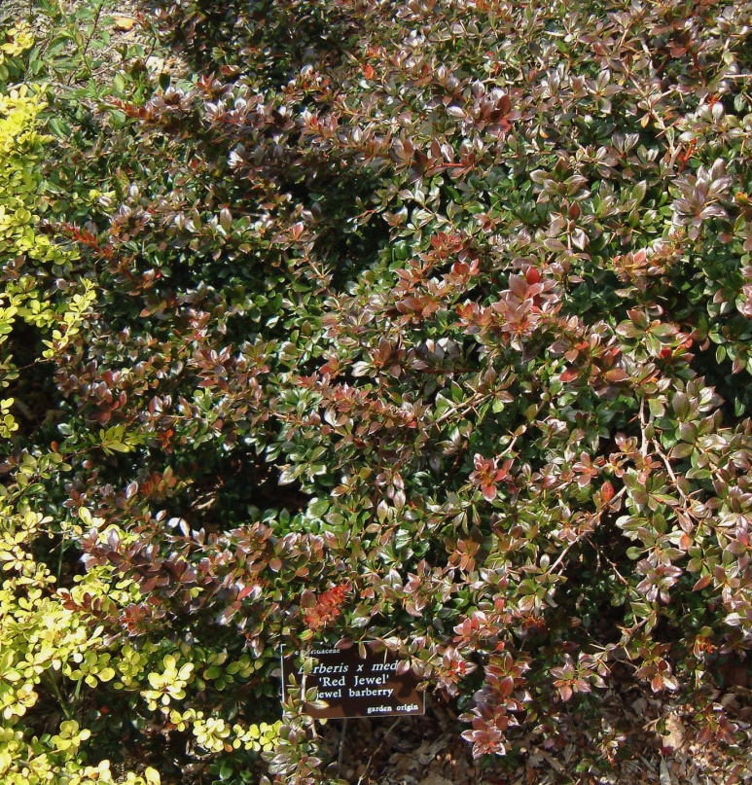
113 Berberis x mentorensis Mentor Barberry
members.tripod.com
mobot.org
Notes:
http://www.mobot.org/gardeninghelp/images/low/C295-0628050cs.jpg
http://members.tripod.com/hatch_l/berbredjewel.jpg

Slide 15
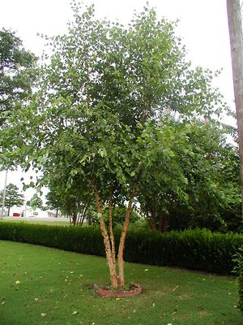
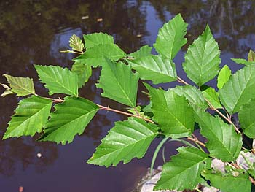
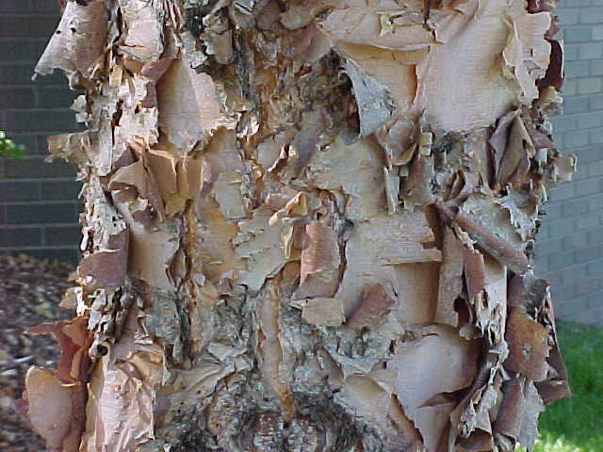
114 Betula nigra River birch
talltreesgroup.com
duke.edu
soonerplantfarm.com
Notes:
http://www.talltreesgroup.com/Betula%20nigra.jpg
http://www.duke.edu/~cwcook/trees/beni3452.jpg
http://www.soonerplantfarm.com/_ccLib/image/plants/DETA-10.jpg

Slide 16
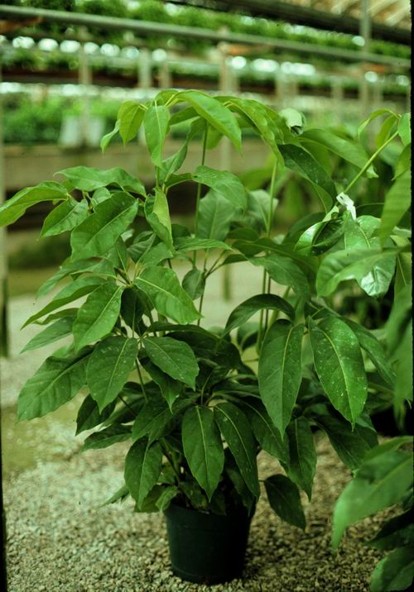
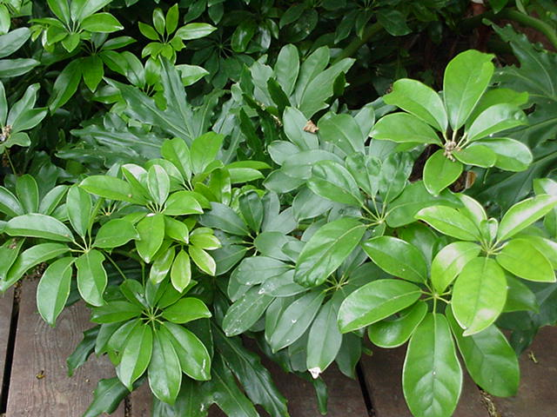
115 Brassaia actinophylla Schefflera, Octopus tree
aggie-horticulture.tamu.edu
hort.cornell.edu
Notes:
http://www.hort.cornell.edu/4hplants/flowers/Images/Schefflera%201.jpg
http://aggie-horticulture.tamu.edu/ornamentals/coastalplants/plants/schefflera.jpg

Slide 17
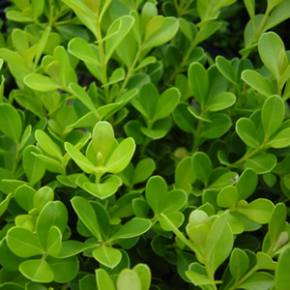
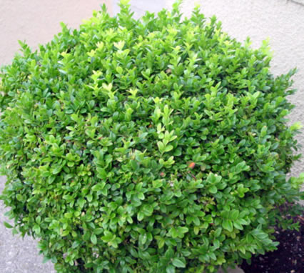
116 Buxus microphylla cv. Littleleaf Boxwood
magnoliagardensnursery.com
hortiplex.gardenweb.com
Notes:
http://hortiplex.gardenweb.com/plants/jour/p/10/gw1006410/3356711002541905.jpeg
http://www.google.com/imgres?imgurl=http://www.magnoliagardensnursery.com/productdescrip/pictures300/Buxus_Jap300.jpg&imgrefurl=http://www.magnoliagardensnursery.com/productdescrip/Buxus_Japanese.html&usg=__xxid4svaagJuA_v6e0jBRs36e4k=&h=300&w=300&sz=53&hl=en&start=2&sig2=MdTIEuE_sDs4En9I_ZnBCg&itbs=1&tbnid=OB86S-jRD6jkLM:&tbnh=116&tbnw=116&prev=/images%3Fq%3DBuxus%2Bmicrophylla%26hl%3Den%26sa%3DG%26tbs%3Disch:1&ei=TAvOS6PGO6PutQO8kpyvDg

Slide 18
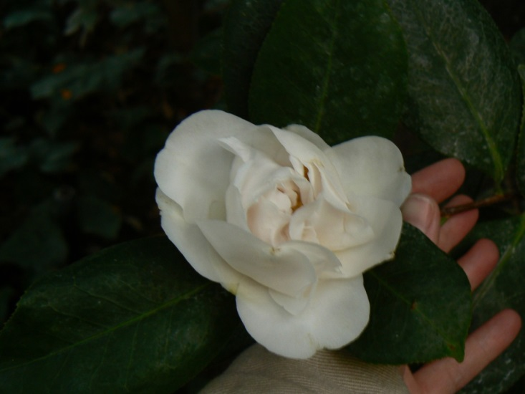
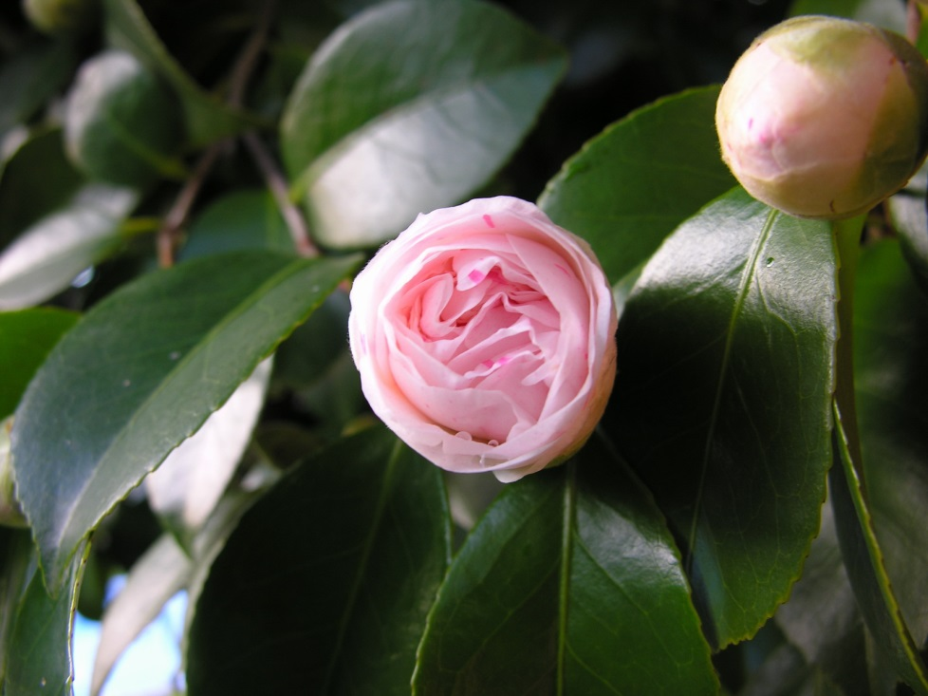
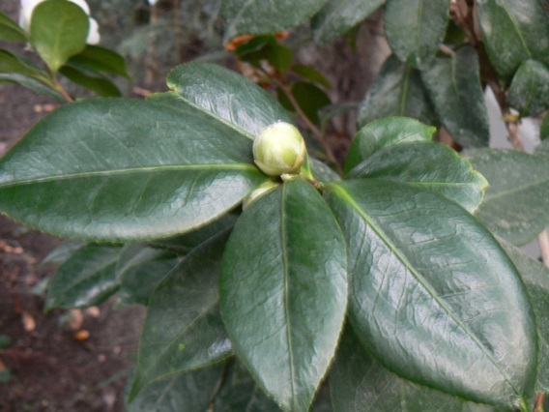
117 Camellia japonica cv. Common Camellia
wikimedia.org
Notes:
Uploads.wikimedia.org

Slide 19
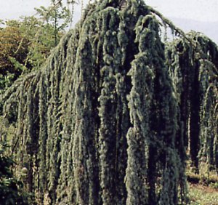
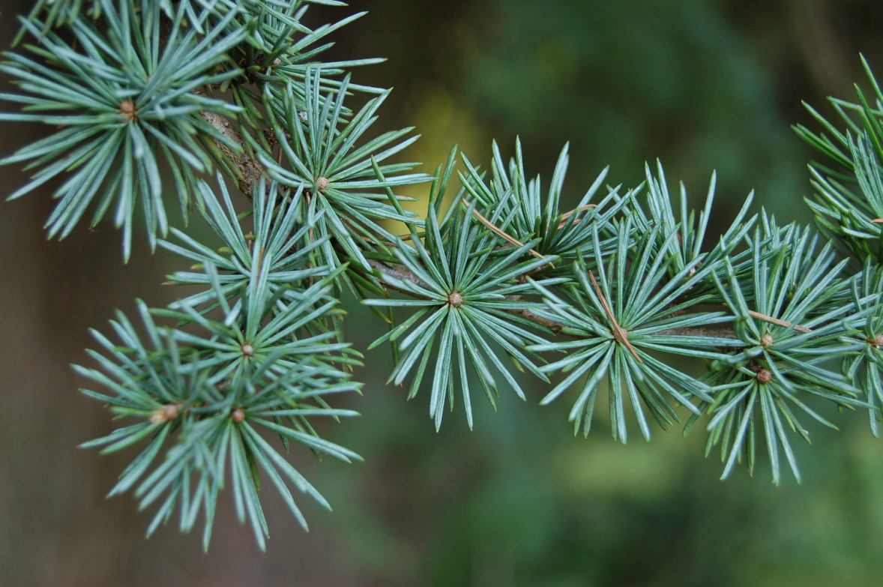
118 Cedrus atlantica ‘Glauca’ Blue Atlantis Cedar
image.gardening.eu
wikimedia.org
Notes:
http://upload.wikimedia.org/wikipedia/commons/9/90/Atlas_Cedar_Cedrus_atlantica_%27Glauca%27_Needles_3008px.JPG
http://image.gardening.eu/piante/Immdata/cedrus_atlantica_glauca_pendula.jpg

Slide 20
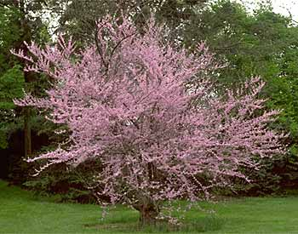
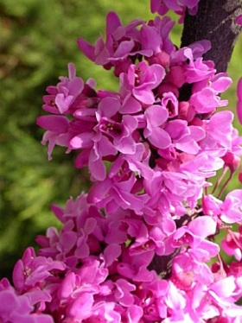
119 Cercis canadensis Redbud
about-garden.com
greengrasslandscape.com
Notes:
http://www.greengrasslandscape.com/photogallery/Cercis%20canadensis.jpg
http://www.about-garden.com/images_data/3529-cercis-canadensis-forest-pansy-judas-tree.jpg

Slide 21
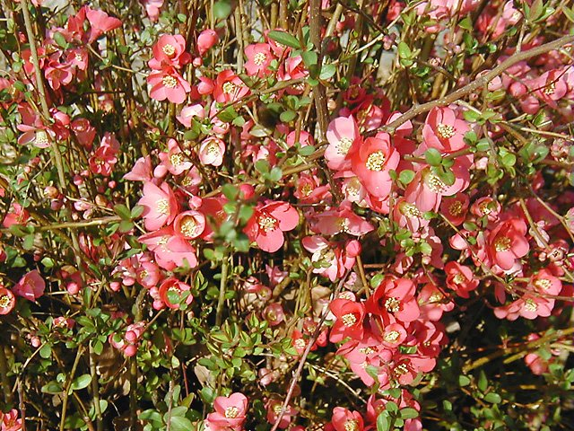
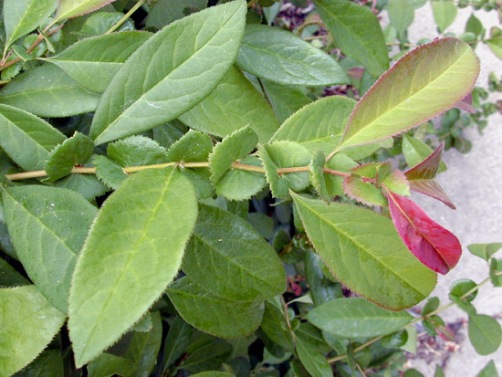
120 Chaenomeles speciosa cv. Japanese (Flowering) Quince
greengrasslandscape.com
oncampus.richmond.edu
Notes:
http://www.greengrasslandscape.com/photogallery/Chaenomeles%20speciosa%20%27Cameo%27.jpg
http://oncampus.richmond.edu/academics/biology/trees/images/Chaenomeles_speciosa_main.jpg

Slide 22
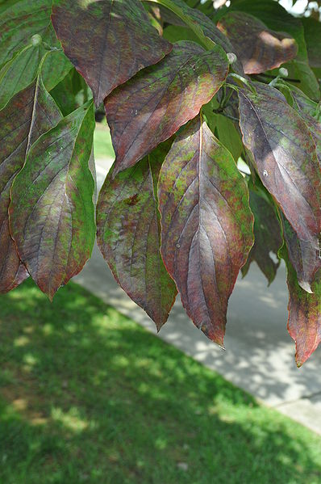
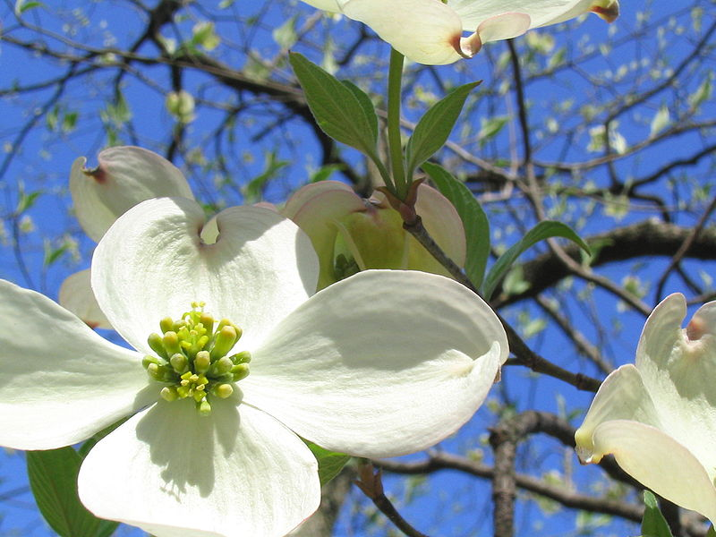
121 Cornus florida cv. Flowering Dogwood
wikimedia.org
Notes:
(A flowering dogwood blooming in April in Missouri.)
({{Information |Description={{en|1=Leaves of the Cornus florida (flowering dogwood) in the fall.}} |Source=Own work by uploader |Author=EnLorax |Date=2008-09-28 |Permission= |other_versions= }} <!--{{ImageUpload|full}}--> [[Category:Cornu)

Slide 23
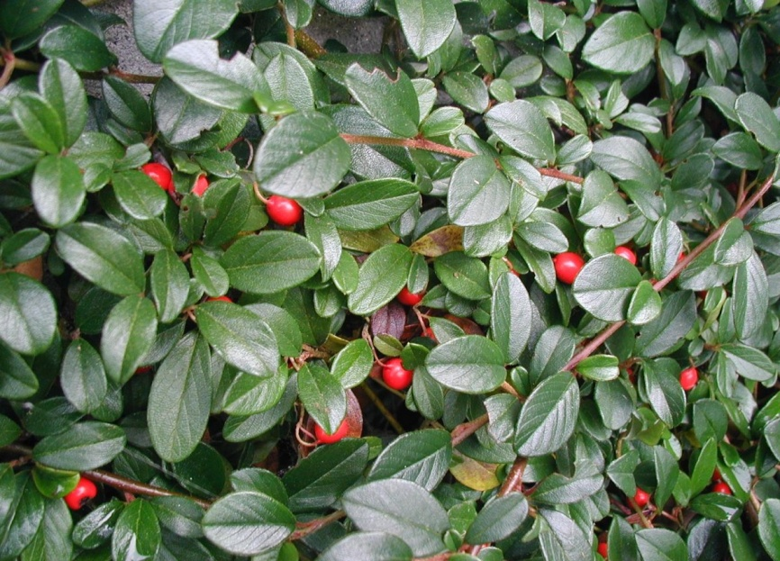
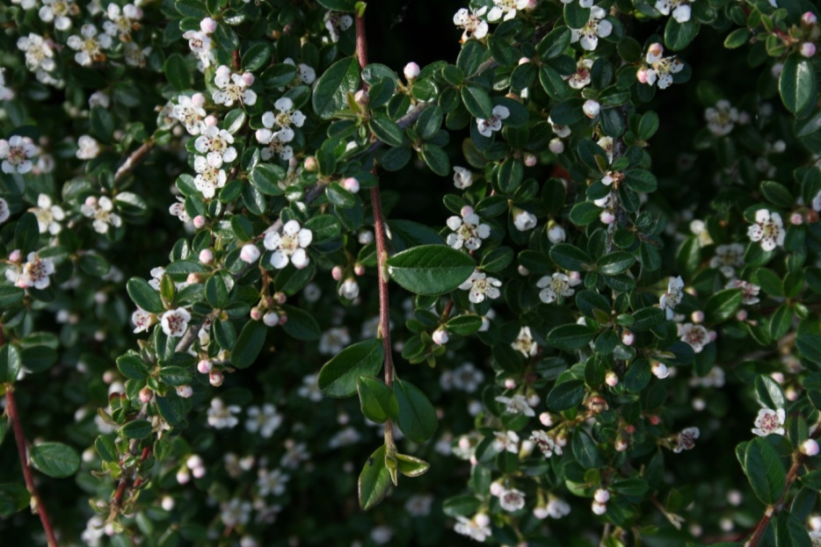
122 Cotoneaster dammeri Bearberry Cotoneaster
wikimedia.org
Notes:
http://upload.wikimedia.org/wikipedia/commons/0/0d/Cotoneaster-dammeri-berries.JPG
http://upload.wikimedia.org/wikipedia/commons/7/75/Cotoneaster-dammeri-flowering.JPG

Slide 24
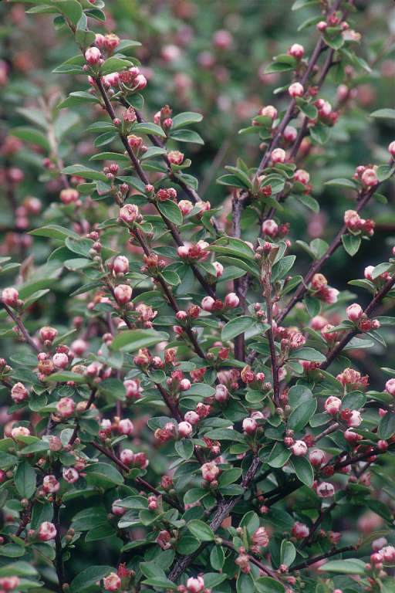
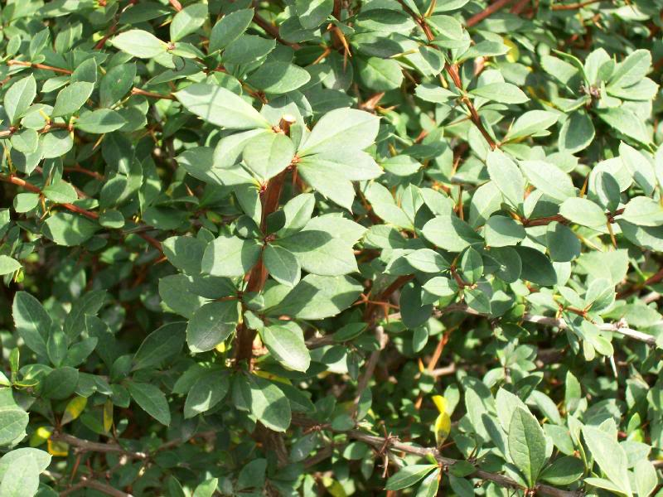
123 Cotoneaster divaricatus Spreading Cotoneaster
image51.webshots.com
dkimages.com
Notes:
http://image51.webshots.com/51/6/70/45/456567045BGgcDM_ph.jpg
http://www.dkimages.com/discover/previews/925/715058.JPG

Slide 25
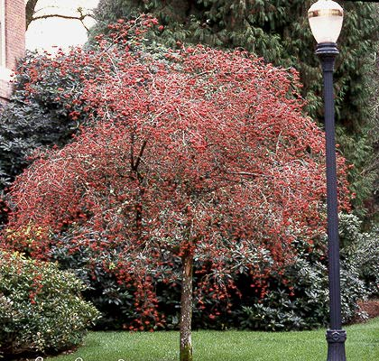
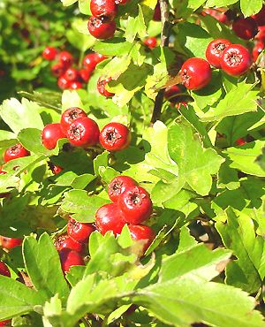
124 Crataegus phaenopyrum Washington Hawthorn
soonerplantfarm.com
oregonstate.edu
Notes:
http://oregonstate.edu/dept/ldplants/images/crph12.jpg
http://www.soonerplantfarm.com/_ccLib/image/plants/DETA-44.jpg

Slide 26
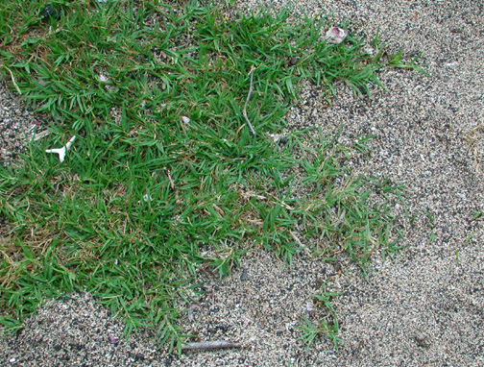
125 Cynodon dactylon cv. Bermudagrass
US NPS photo
Notes:
Cynodon dactylon - US NPS photo )

Slide 27
126 Dieffenbachia maculata cv. Spotted Dumbcane
Flowerservant.com
Notes:
Flowerservant.com

Slide 28
127 Dracaena deremensis ‘Warneckii’ Striped Dracaena
greengrowerindia.com
wikimedia.org
Notes:
http://www.greengrowerindia.com/files/products/images/162.jpg
http://upload.wikimedia.org/wikipedia/commons/2/21/Dracaena.deremensis.Warneckii.jpg

Slide 29
128 Dracaena fragrans ‘Massangeana’ Corn Plant Dracaena
Mgonline.com
Notes:
Mgonline.com

Slide 30
129 Echinacea purpurea Purple coneflower
darrell.barrell
wikimedia.org
Notes:
({{Information |Description = A stand of ''Echinacea purpurea'' |Source = I created this work entirely by myself. |Date = 6 August 2009 |Author = Ed! (Photography) |other_versions )
(== Beschreibung == {{Information |Description=Asteraceae |Source=Eigenes Werk (own work) |Date=2008-9-9 |Author=Hedwig Storch |Permission= |other_versions= }} <!--{{ImageUpload|basic}}--> == Licensing: == )
(author: darrell.barrell description: closeup of echinacea purpura flower)

Slide 31
130 Epipremnum aureum cv. Golden Pothos, Devil’s Ivy
Img.hgtv.com
Notes:
Photo courtesy of Allison Touchstone
Img.hgtv.com

Slide 32
131 Euonymus alatus Winged Euonymus
inmygarden.org
wikipedia.org
Notes:
(== Summary == {{Information| |Description = Euonymous Alatus in autumn colour |Source = self-made / en.wikipedia.org |Date = created 3. Oct. 2002 |Author = Chris Barton/Gif absarnt |Permission = )
( winged euonymus Category:Euonymus alatus Image © [http://www.inmygarden.org/ Sue Sweeney]{{GFDL}}See this page for further copyright information.)

Slide 33
132 Euonymus fortunei cv. Wintercreeper
pendernursery.com
Wikipedia.org
Notes:
http://www.pendernursery.com/Images/Euonymus-fortunei-%27Emerald-.jpg
Wikipedia--Permission is granted to copy, distribute and/or modify this document under the terms of the GNU Free Documentation License, Version 1.2 or any later version published by the Free Software Foundation; with no Invariant Sections, no Front-Cover Texts, and no Back-Cover Texts. A copy of the license is included in the section entitled "GNU Free Documentation License".

