Slide 1
Color

Slide 2
Color-
The visual response of the eye to reflected rays of light
Element of design
Chromatic colors-
Colors derived from the visible spectrum
All colors other than black, white or gray
Achromatic colors-
White, black, & any values of gray
Do not appear on the color wheel
Neutral colors-
Achromatic color to which a small amount of hue has been added
Notes:
The American Institute of Floral Designers. The AIFD Guide to Floral Design. Terms, Techniques, and Traditions. The Intelvid Group 2005.

Slide 3
Hue-
The descriptive name of color
(i.E. Red, yellow, & green)
Pure color w/o black, white, or gray added
Defines a specific spot on the color wheel
12 hues on the color wheel
Notes:
The American Institute of Floral Designers. The AIFD Guide to Floral Design. Terms, Techniques, and Traditions. The Intelvid Group 2005.

Slide 4
Color wheel
Twelve hour color system which was developed by Louis Prang, an American Printer in 1876.
Notes:
The American Institute of Floral Designers. The AIFD Guide to Floral Design. Terms, Techniques, and Traditions. The Intelvid Group 2005.

Slide 5
Primary Colors-
Red, yellow, & blue
Spaced equidistantly apart on the color wheel
Cannot be created by mixing any other colors

Slide 6
Secondary colors-
Orange, green, & violet
Created by mixing two primary colors
Placed in between primary colors

Slide 7
Tertiary colors-
Red-orange, red-violet, blue-violet, blue-green, yellow-green, & yellow-orange
Between primary and secondary colors
Mixing primary & secondary colors
Primary color is always listed first with a hyphen in the center of the word

Slide 8
Value-
The lightness or darkness of a hue
Achieved by the addition of black, white, or gray
Shade
A hue which has been darkened by the addition of black
Deeper in appearance
I.E. Navy is a shade of blue, burgundy is a shade of red
Tint
A hue which has been lightened by the addition of white
Pastel in appearance
I.E. Baby blue is a tint of blue, pink is a tint of red
Tone
A hue which has been muted by the addition of gray
Dusty in appearance
I.E. Country blue is a tone of blue, mauve is a tone of red
Notes:
The American Institute of Floral Designers. The AIFD Guide to Floral Design. Terms, Techniques, and Traditions. The Intelvid Group 2005.

Slide 9
TINT Hue + White
TONE Hue + Gray
HUE
SHADE Hue + Black

Slide 10
Advancing (warm) colors-
Aggressive or warm
Visually move forward toward the viewer
Red, orange, yellow
Association with warm and hot things
Active, cheery, evoking warm and happy feelings
Dominate, look larger
Informal and blend
Irritating if too much
Notes:
The American Institute of Floral Designers. The AIFD Guide to Floral Design. Terms, Techniques, and Traditions. The Intelvid Group 2005.

Slide 11
Receding (cool) colors-
Passive or cool
Visually pull back or recede from the viewer
Look smaller
Blue, green, violet
Association with cool things
Restful, peaceful, soothing, quiet, melancholy, “less friendly”
May appear formal and lack unity
Cannot be seen from a distance
Notes:
The American Institute of Floral Designers. The AIFD Guide to Floral Design. Terms, Techniques, and Traditions. The Intelvid Group 2005.

Slide 12
Color harmonies—
Groupings of specific hues and/or different values of a hue
A pleasing or useful combination
Changing value does not change harmony
ie. Pink and mint green may be used and it is still complementary color harmony
Achromatic colors can be included in any color harmony
Notes:
The American Institute of Floral Designers. The AIFD Guide to Floral Design. Terms, Techniques, and Traditions. The Intelvid Group 2005.

Slide 13
Color Harmonies--
Achromatic color harmony-
A grouping of colors without hue; white, black, and any values of gray.
Monochromatic color harmony-
A grouping of different values of one hue
May include achromatic colors
An example would be red and tints, tones, shades of red—i.e. pink, mauve, red, & burgundy
Polychromatic color harmony-
A multicolored grouping of many hues which may otherwise be unrelated
Notes:
The American Institute of Floral Designers. The AIFD Guide to Floral Design. Terms, Techniques, and Traditions. The Intelvid Group 2005.

Slide 14
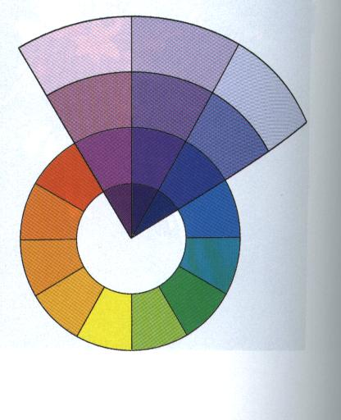
Analogous color harmony-
A color harmony featuring adjacent hues on the color wheel
No more than one primary color
Colors form an angle of up to 90 degrees on the color wheel
One color usually dominates
One of the most harmonious and pleasing of all
I.E. Green, blue-green, and yellow-green, with green dominating
Notes:
The American Institute of Floral Designers. The AIFD Guide to Floral Design. Terms, Techniques, and Traditions. The Intelvid Group 2005.
Hunter, Norah T., The Art of Floral Design Second Edition Delmar 2000.

Slide 15
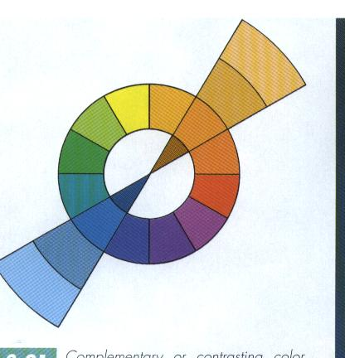
Complementary color harmony-
A pair of hues directly opposite each other on the color wheel
I.E. Red & green, violet & yellow, or blue & orange
Many schools select their colors from a complementary color harmony
Notes:
The American Institute of Floral Designers. The AIFD Guide to Floral Design. Terms, Techniques, and Traditions. The Intelvid Group 2005.
Hunter, Norah T., The Art of Floral Design Second Edition Delmar 2000.

Slide 16
Split complementary color harmony-
A trio of hues, consisting of a hue and the two hues on either side of its direct complement
I.E. Violet, yellow-orange, & yellow-green
Many restaurants use a split-complementary color scheme
Notes:
The American Institute of Floral Designers. The AIFD Guide to Floral Design. Terms, Techniques, and Traditions. The Intelvid Group 2005.

Slide 17
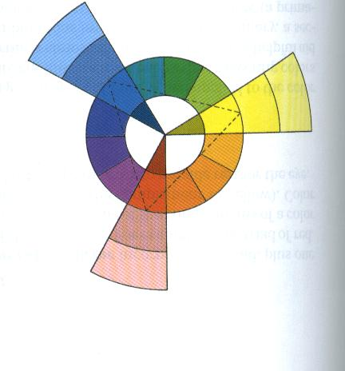
Triadic color harmony-
A grouping of three hues which are equidistant on the color wheel
I.E. Primary colors--red, blue & yellow
Tints of primaries-pink, baby blue, & soft yellow
Changing the value does not change the color harmony
Notes:
The American Institute of Floral Designers. The AIFD Guide to Floral Design. Terms, Techniques, and Traditions. The Intelvid Group 2005.
Hunter, Norah T., The Art of Floral Design Second Edition Delmar 2000.

Slide 18
Tetradic color harmony-
A grouping of four hues which are equidistant on the color wheel
Notes:
The American Institute of Floral Designers. The AIFD Guide to Floral Design. Terms, Techniques, and Traditions. The Intelvid Group 2005.

Slide 19
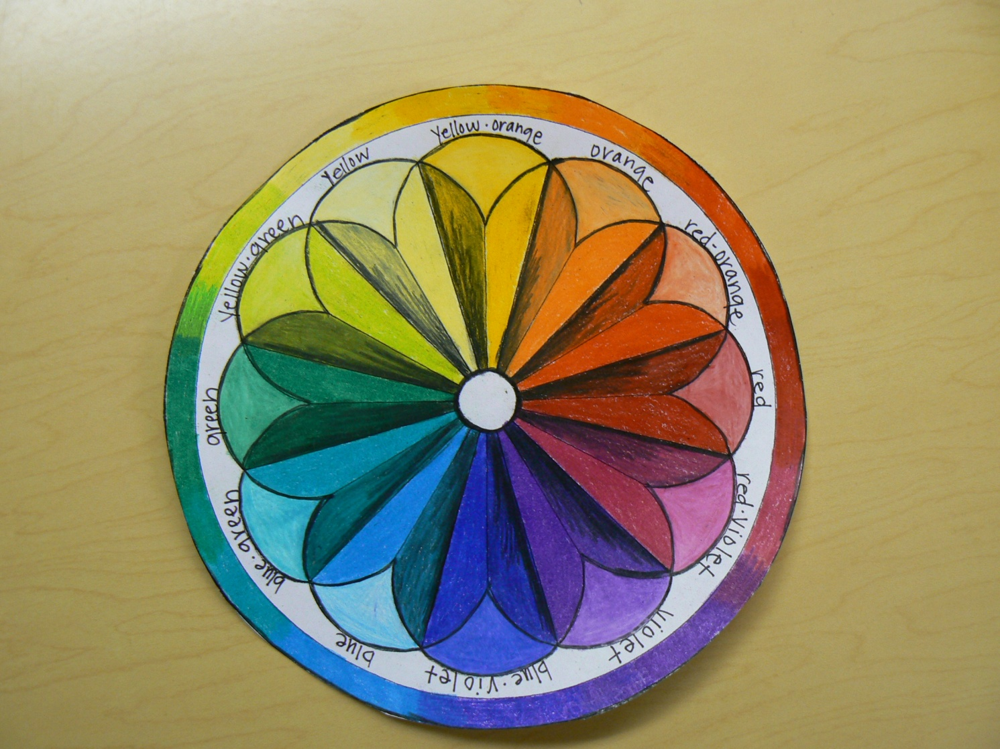
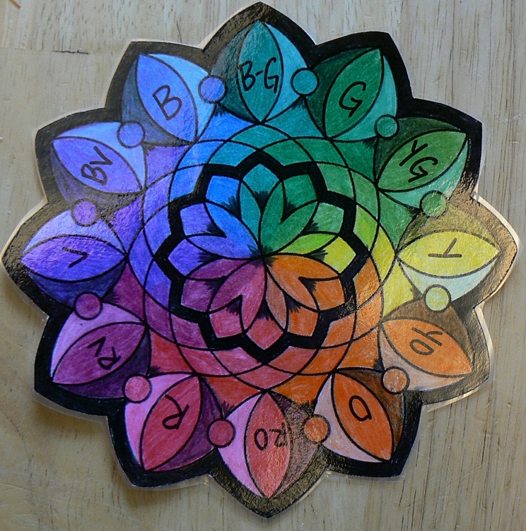
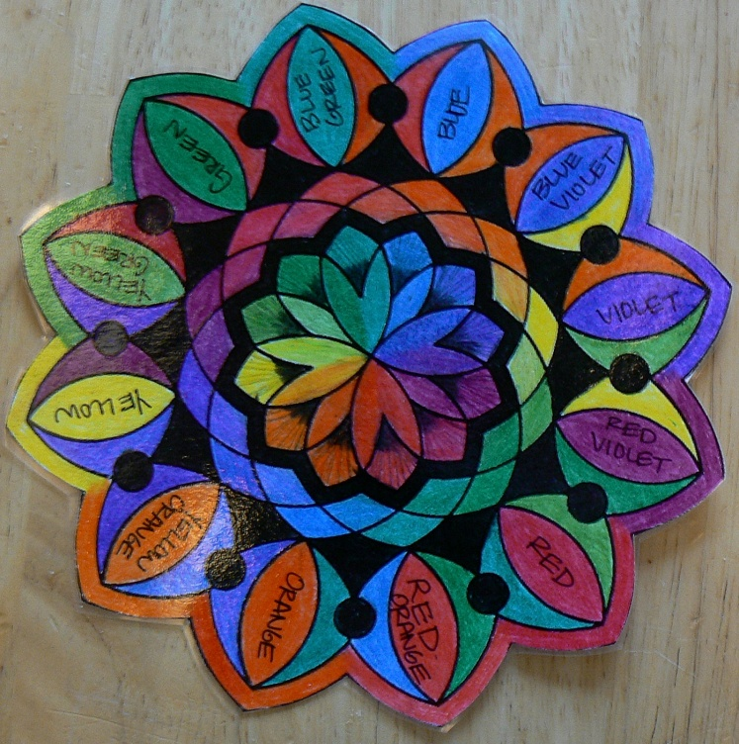
Examples of Color Activity--Mandala

