Slide 1
Floriculture Plant Identification Quiz
A-C
101-134

Slide 2
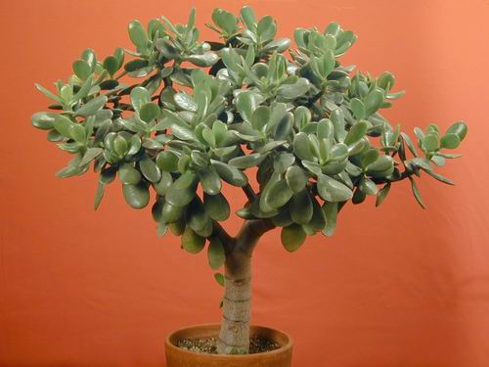
1
Notes:
132 Crassula argentea Jade Plant
Freeinfosociety.com

Slide 3
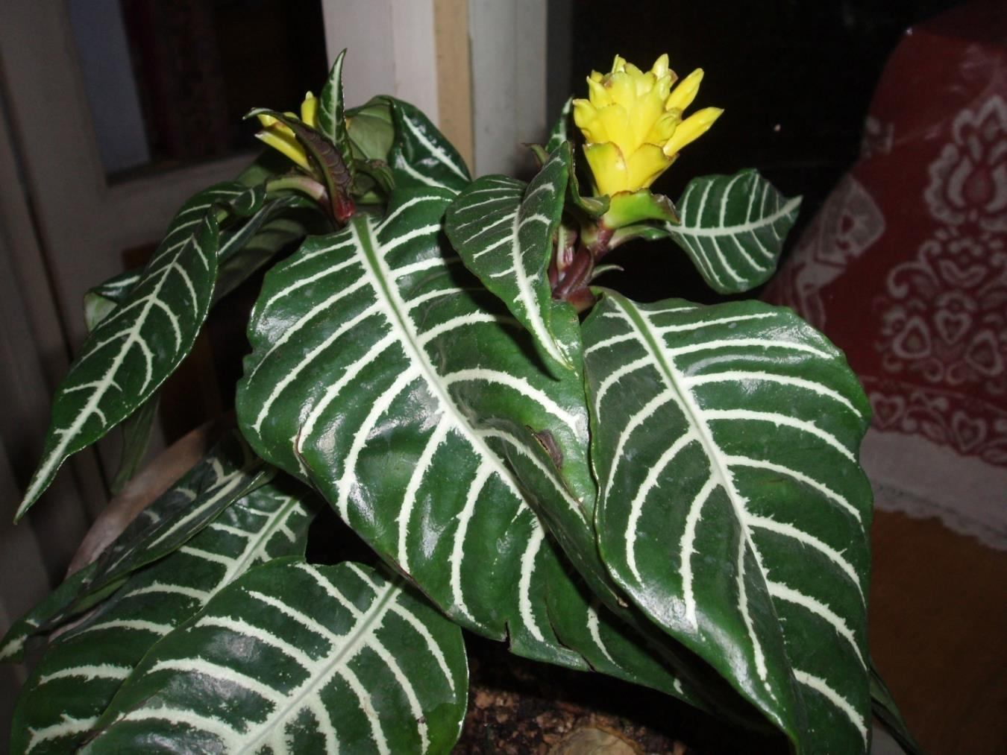
2
Notes:
107 Aphelandra squarrosa cv. Aphelandra, Zebra Plant
Uploadwikimedia.org

Slide 4
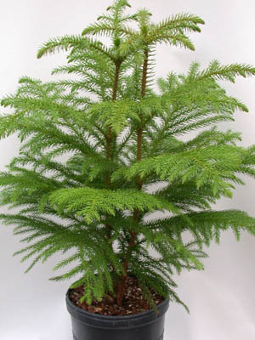
3
Notes:
108 Araucaria heterophylla Norfolk Island Pine
Freeinformationsociety.com

Slide 5
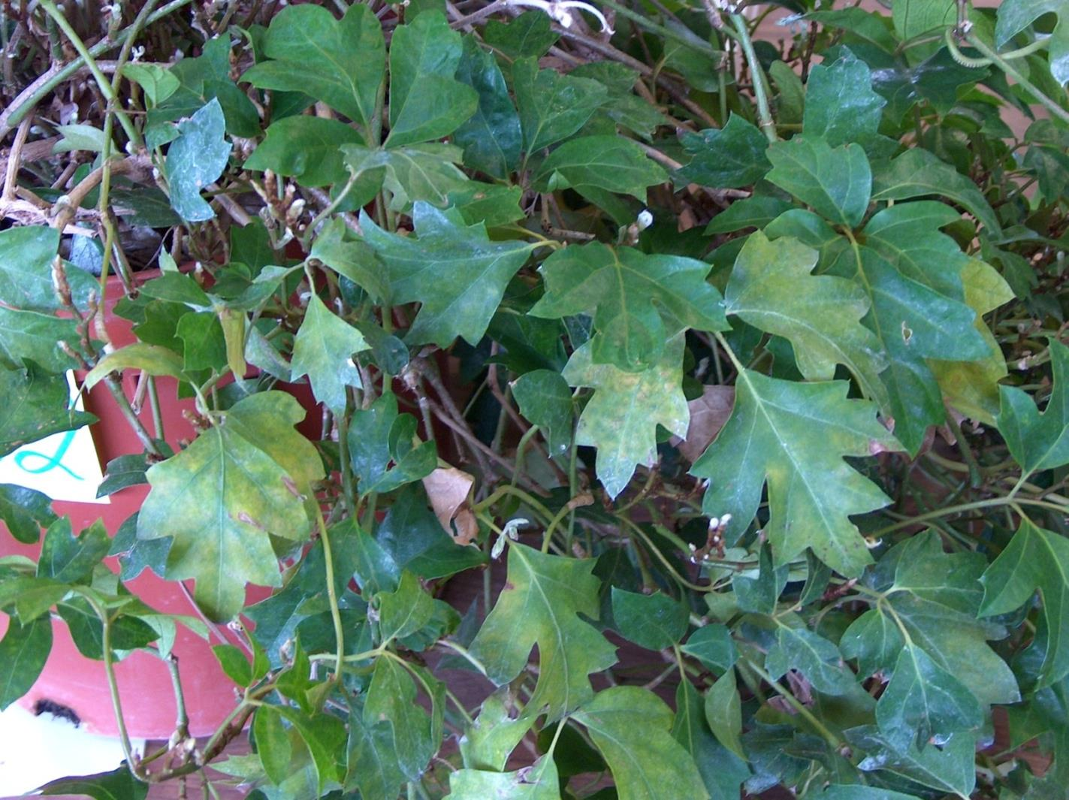
4
Notes:
128 Cissus rhombifolia ‘Mandaiana’ Grape Ivy
Photo courtesy of Allison Touchstone

Slide 6
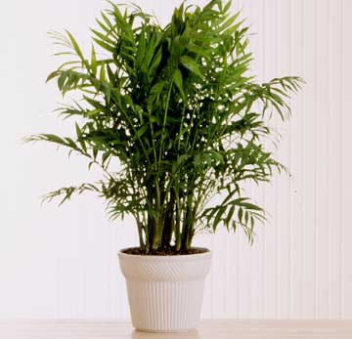
5
Notes:
122 Chamaedorea elegans Parlor Palm
Bha.com

Slide 7
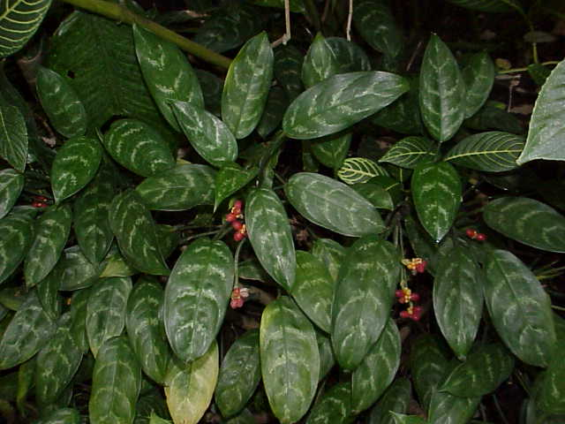
6
Notes:
103 Aglaonema commutatum cv. Aglaonema
Uploadwikipedia.org
Toptropicals.com

Slide 8
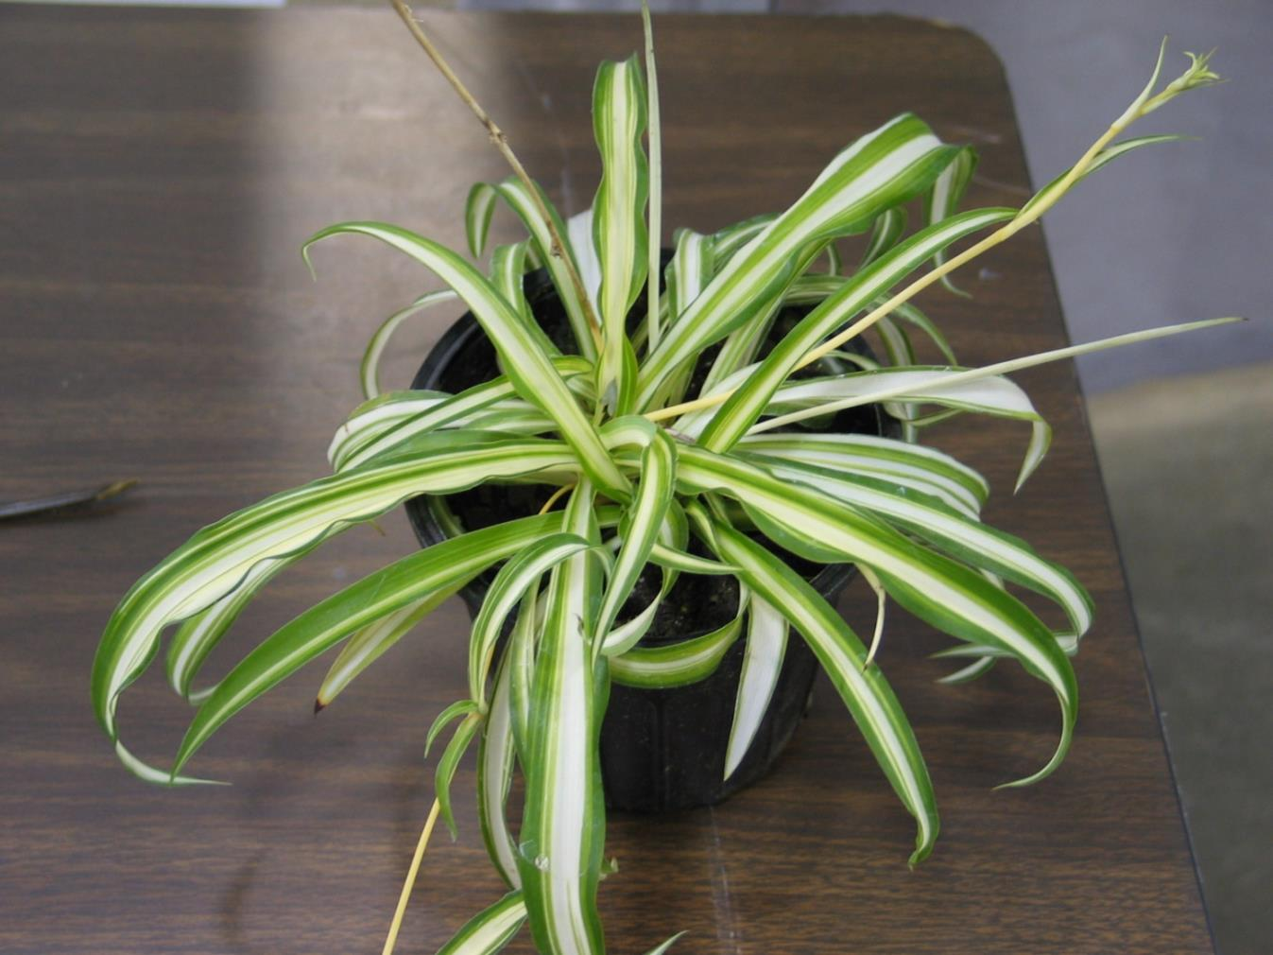
7
Notes:
124 Cholorophytum comosum cv. Spider Plant
Photo courtesy of Allison Touchstone

Slide 9
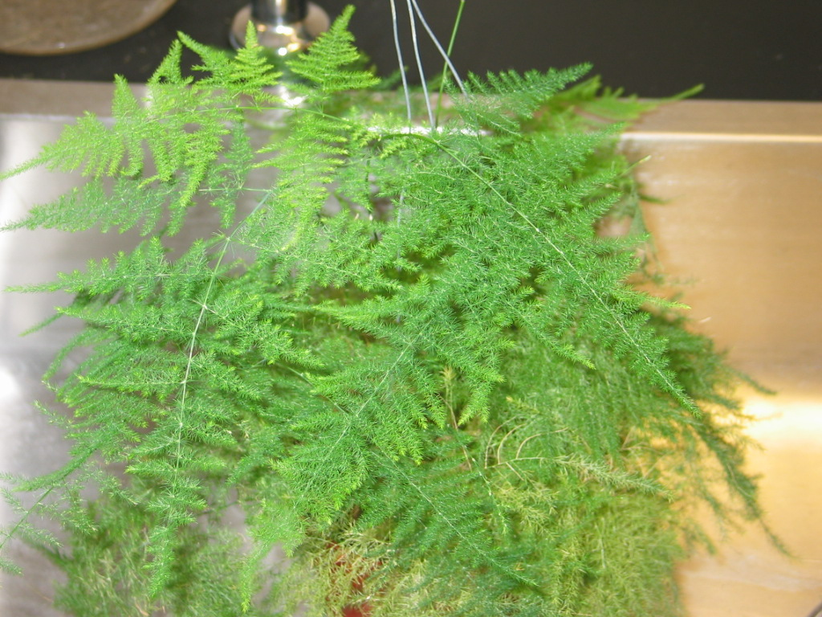
8
Notes:
110 Asparagus setaceus Asparagus “Fern”
Photo courtesy of Allison Touchstone

Slide 10
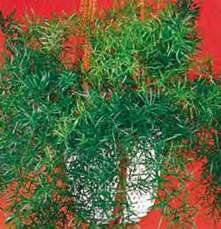
9
Notes:
109 Asparagus densiflorus ‘Sprengeri’ Sprengeri “Fern”
Seedman.com

Slide 11
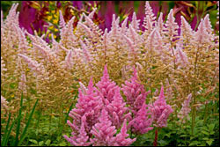
10
Notes:
111 Astilbe hybrid cv. Astilbe
Americanmeadows.com

Slide 12
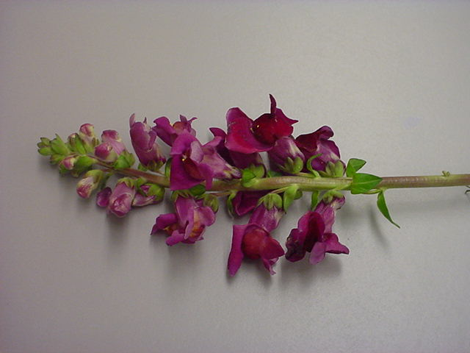
11
Notes:
105 Antirrhinum majus cv. Snapdragon
Photo courtesy of Brenda Patten

Slide 13
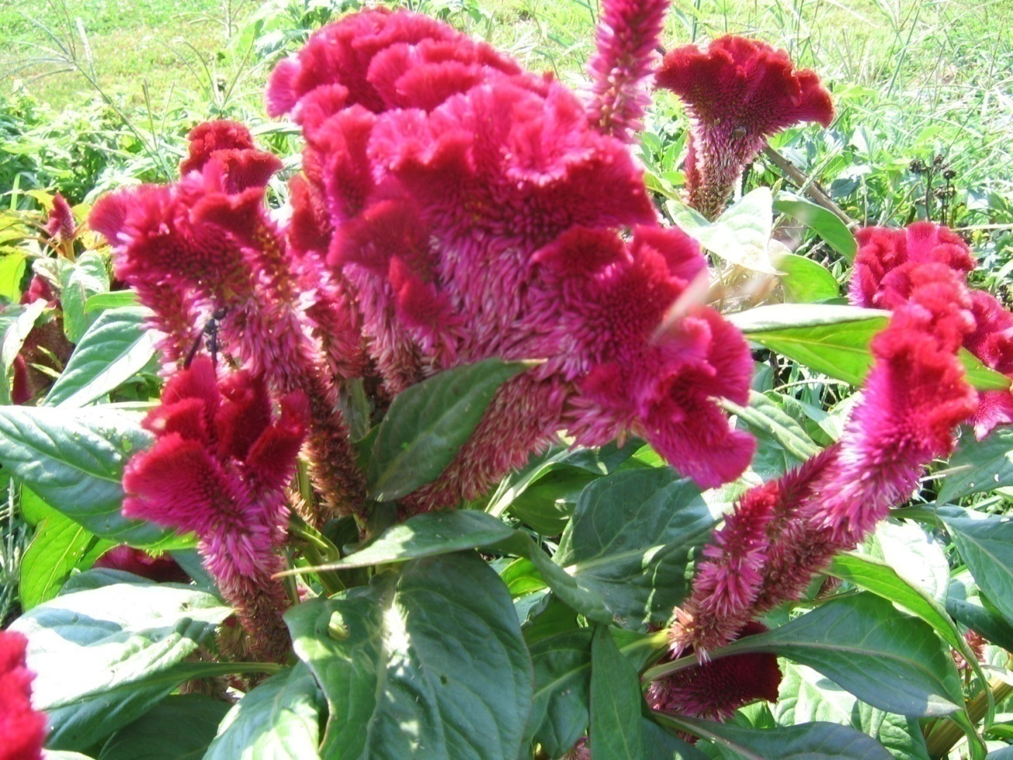
12
Notes:
121 Celosia argentea Cockscomb
Horseandbuggyproduce.com
Flickr.com

Slide 14
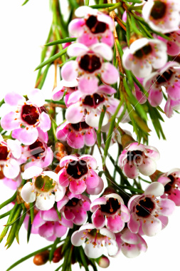
13
Notes:
123 Chamelaucium uncinatum Wax flower
Toptropicals.com
Istockphoto.com

Slide 15
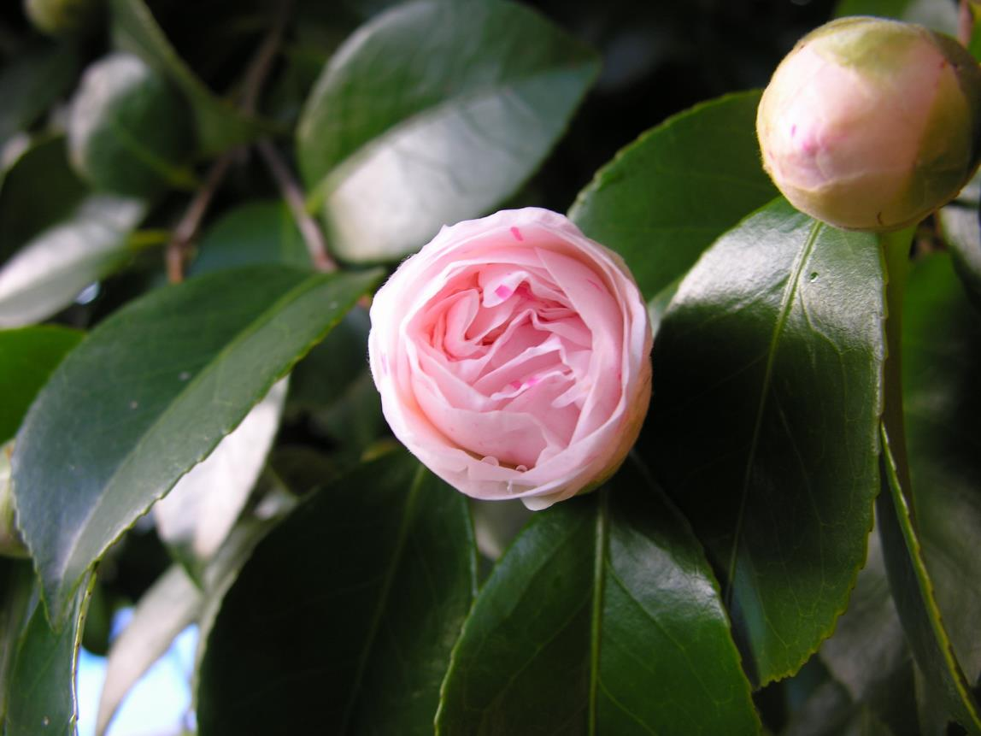
14
Notes:
117 Camellia japonica cv. Common Camellia
Uploads.wikimedia.org

Slide 16
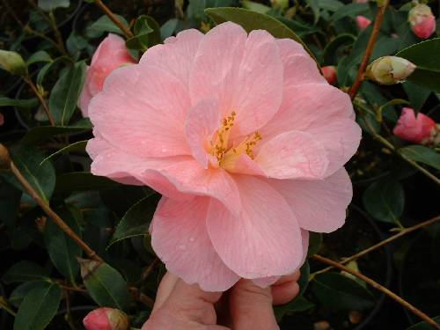
15
Notes:
112 Begonia x tuberhybrida cv. Tuberous Begonia
Extension.unh.edu

Slide 17
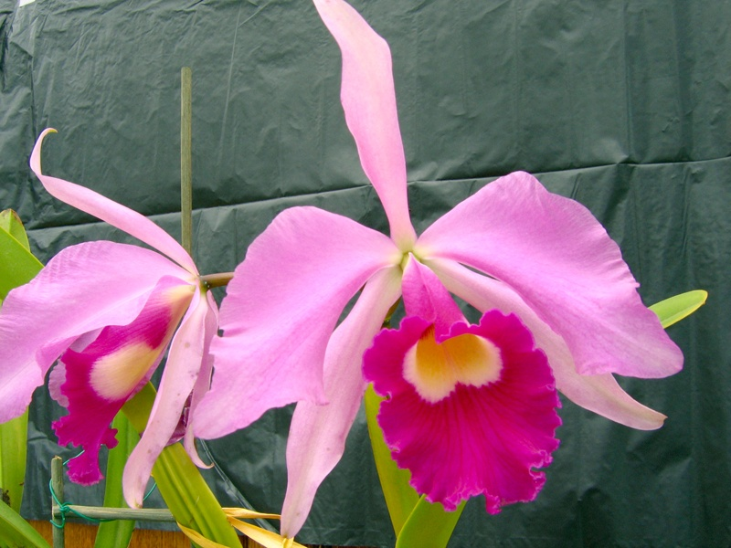
16
Notes:
120 Cattleya cv. Cattleya Orchid Hybrid
Portchids.com
Imagesschack.us

Slide 18
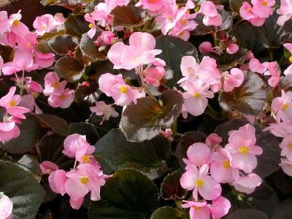
17
Notes:
113 Begonia x semperflorens-cultorum Wax Begonia
Bpl.blogger.com

Slide 19
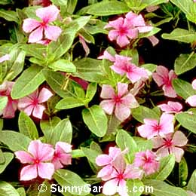
18
Notes:
119 Catharanthus roseus Madagascar Periwinkle
Sunnygardens.com

Slide 20
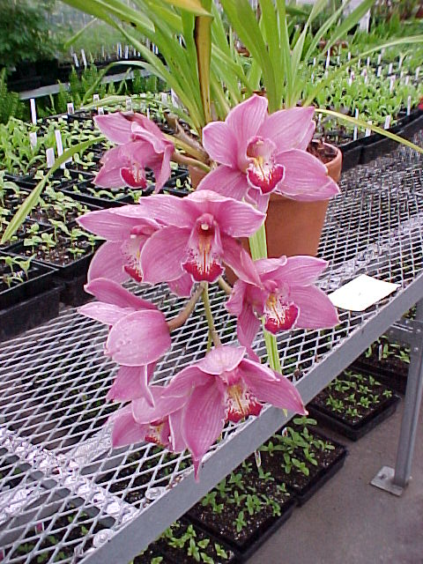
19
Notes:
134 Cymbidium cv. Cymbidium Orchid
Photo courtesy of Allison Touchstone

Slide 21
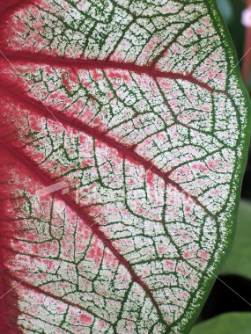
20
Notes:
114 Caladium x hortulanum cv. Fancy-Leaved Caladium
Istockphoto.com

Slide 22
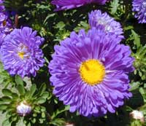
21
Notes:
116 Callistephus chinensis cv. China Aster
Gardenmusic.com

Slide 23
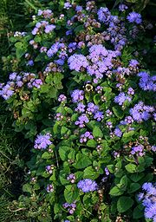
22
Notes:
102 Ageratum mexicanum cv. Ageratum
Uploadwikipedia.org

Slide 24
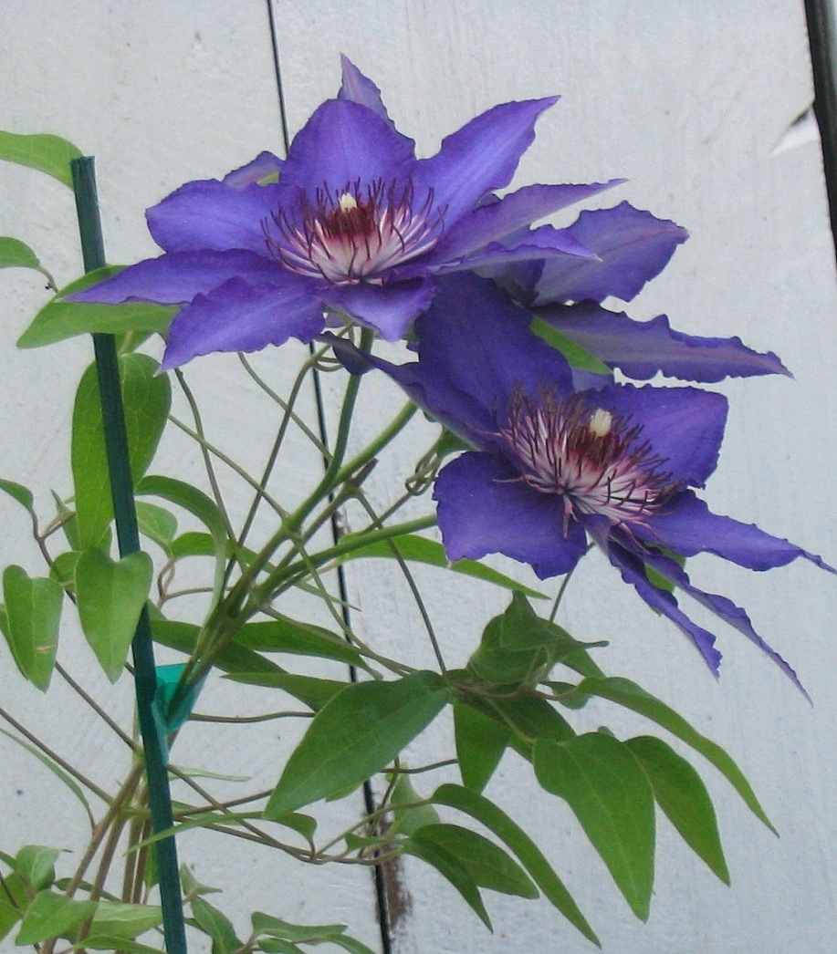
23
Notes:
129 Clematis Jackmanii Group cv. Clematis
Wikimedia.org

Slide 25
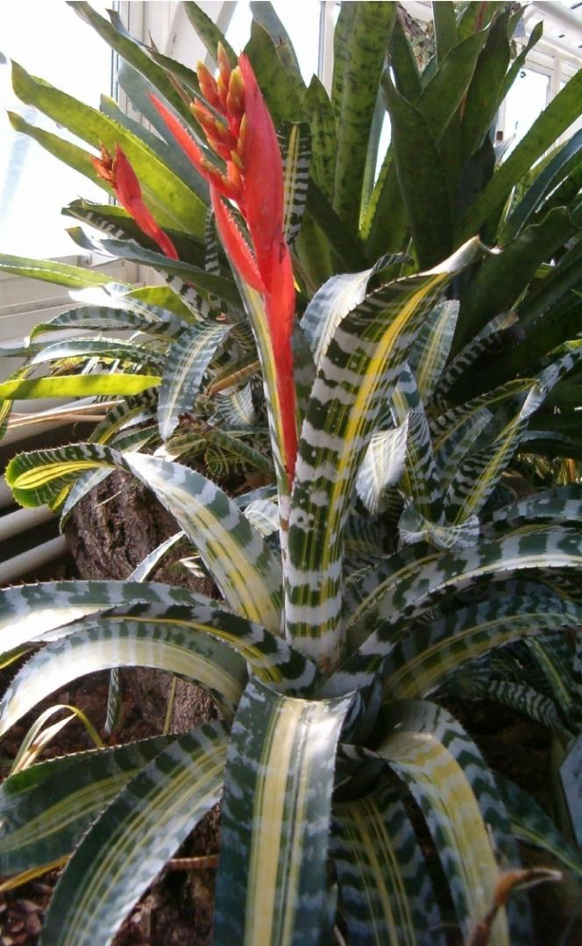
24
Notes:
101 Aechmea chantinnii cv. Bromeliad
Uploadwikipedia.org

Slide 26
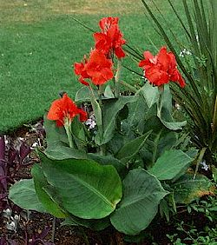
25
Notes:
118 Canna x generalis cv. Common Garden Canna
Gardenguides.com

Slide 27
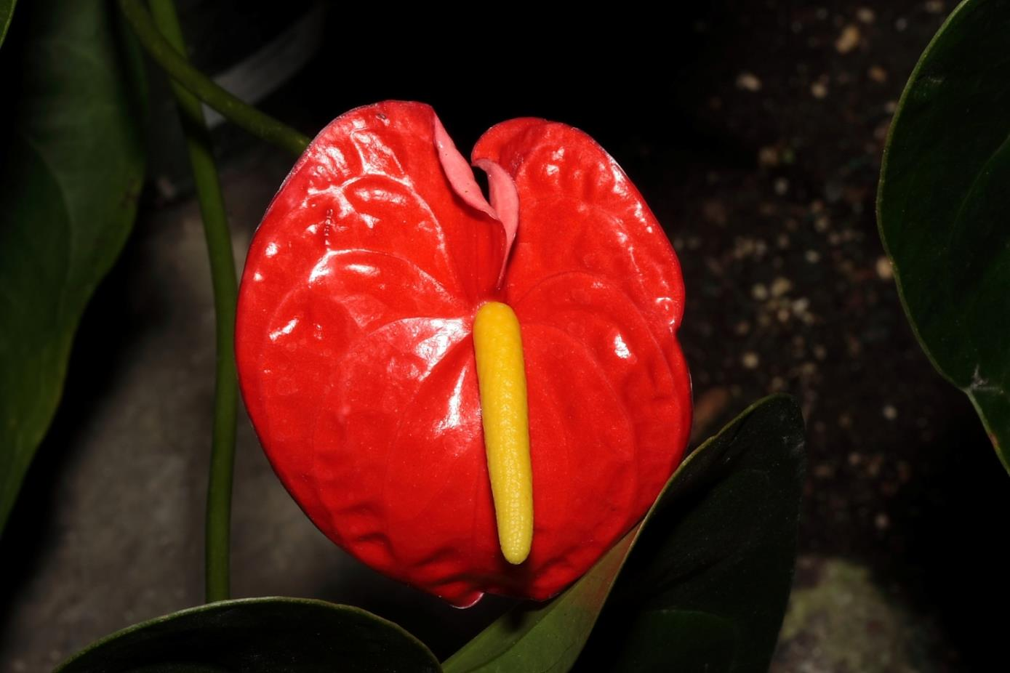
26
Notes:
106 Anthurium x andraeanum cv. Anthurium, Flamingo Lily
Uploadwikimedia.org

Slide 28
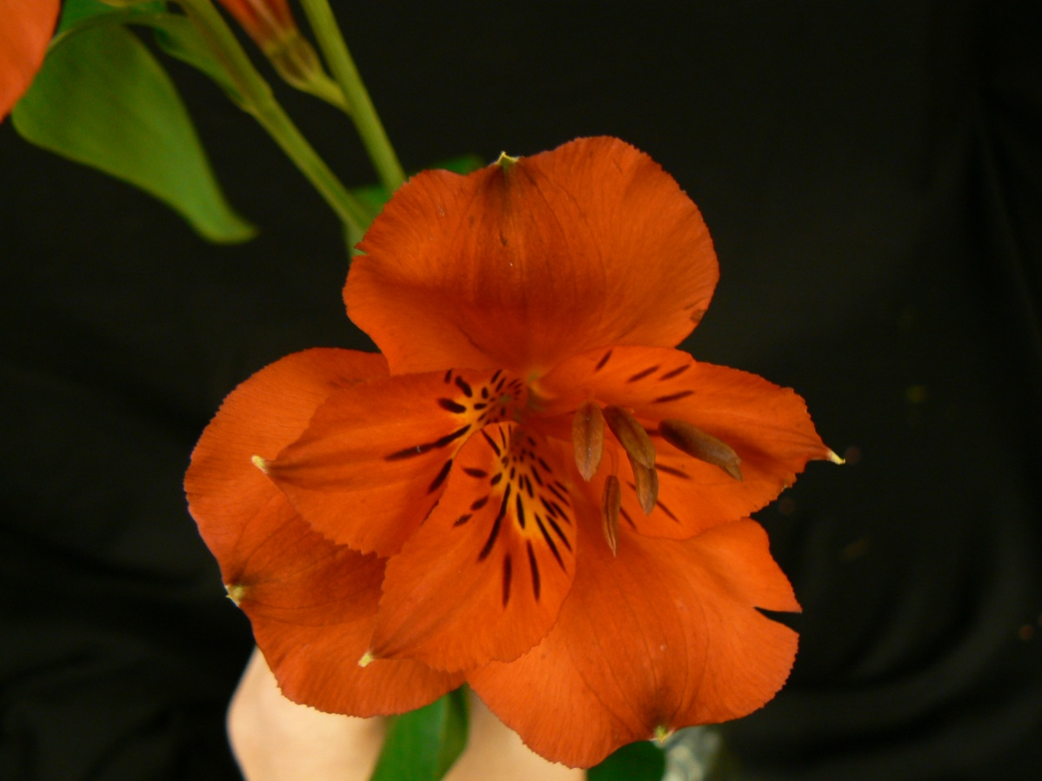
27
Notes:
104 Alstromeria aurantiaca Peruvian Lily
Photo courtesy of Brenda Patten

Slide 29
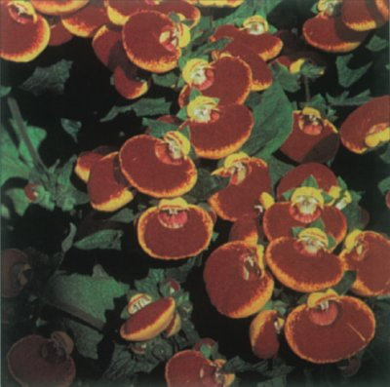
28
Notes:
115 Calceolaria crenatiflora cv. Pocketbook Plant
Howstuffworks.com

Slide 30
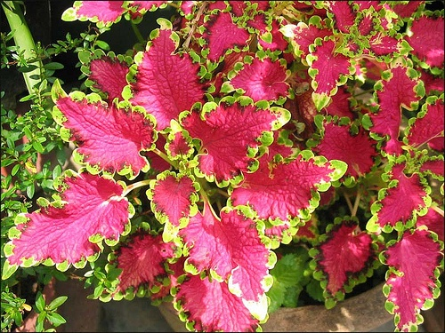
29
Notes:
131 Coleus x hybridus Coleus

Slide 31
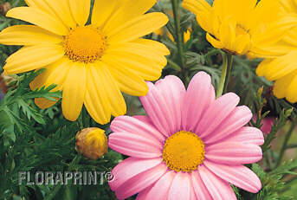
30
Notes:
125 Chrysanthemum x frutescens Marguerite Daisy

Slide 32
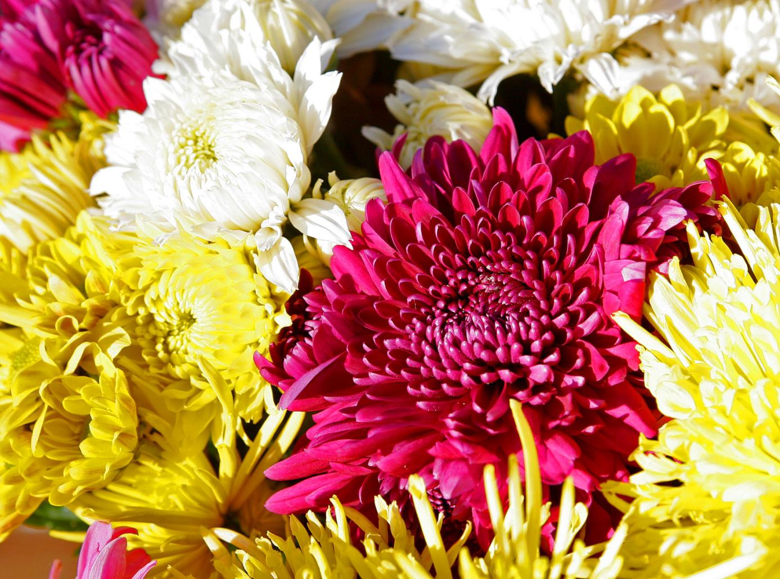
31
Notes:
126 Chrysanthemum x morifolium cv. Florist’s Chrysanthemum
Wikimedia.org

Slide 33
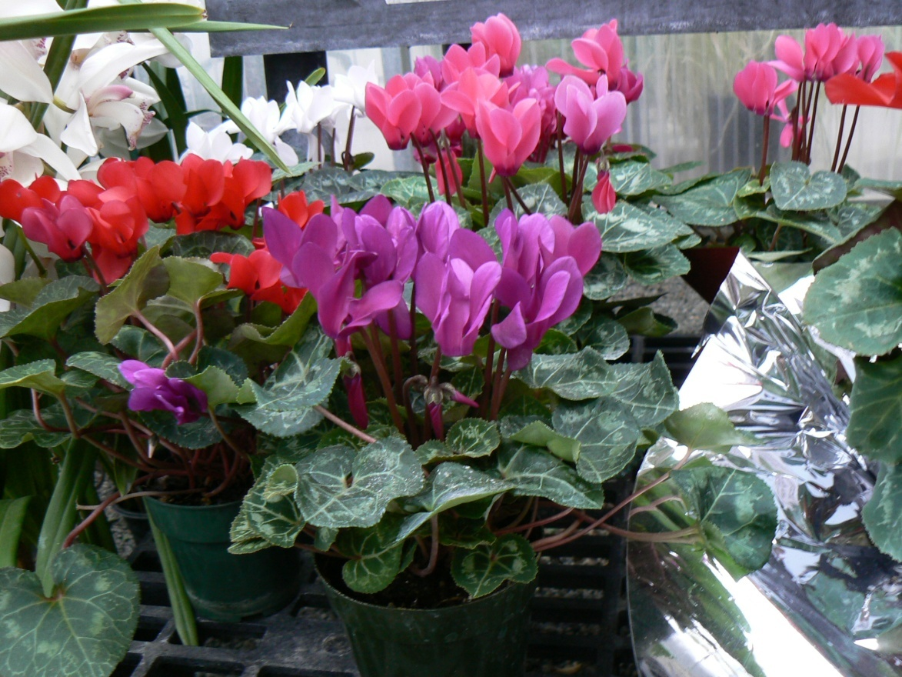
32
Notes:
133 Cyclamen x persicum cv. Florist’s Cyclamen
Photo courtesy of Brenda Patten

Slide 34
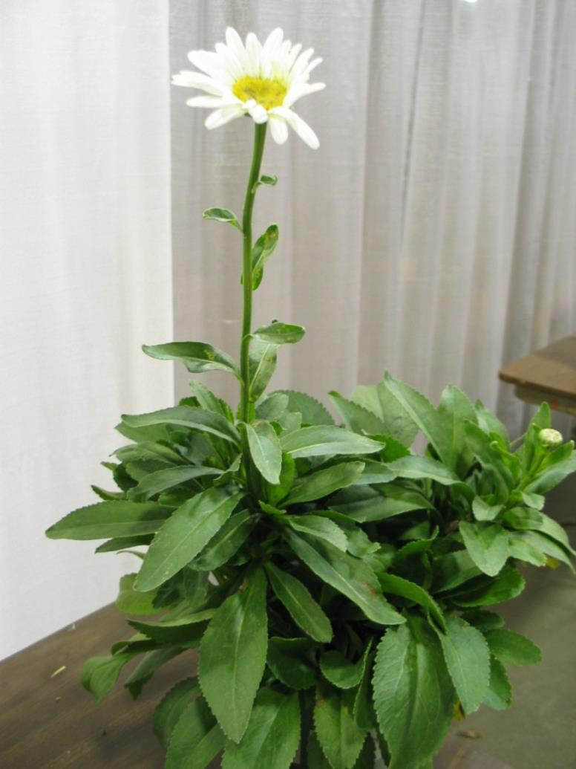
33
Notes:
127
Chrysanthemum x superbum cv. Shasta Daisy

Slide 35
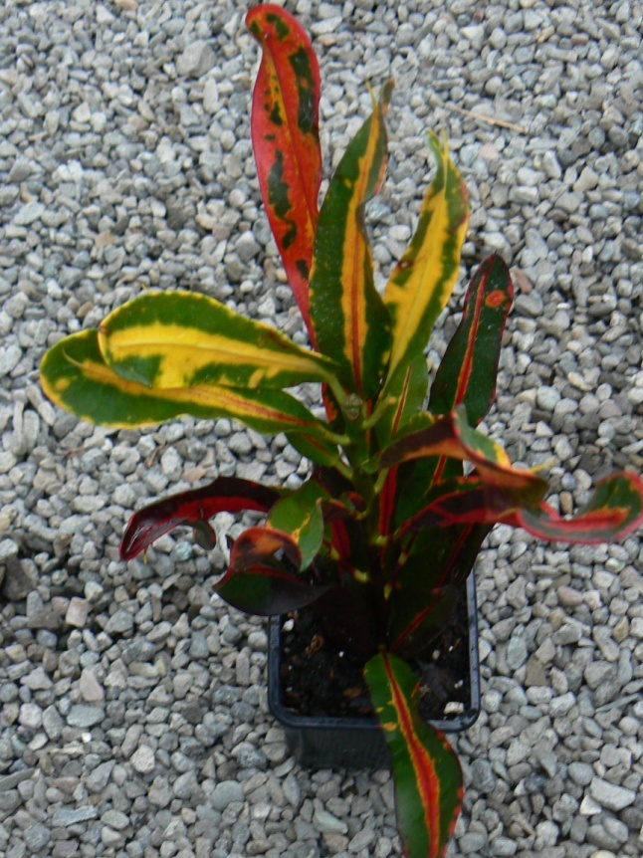
34
Notes:
130 Codiaeum variegatum pictum cv. Croton
Photo courtesy of Brenda Patten

Slide 36
Floriculture Plant Identification Quiz
D-F
135-151

Slide 37
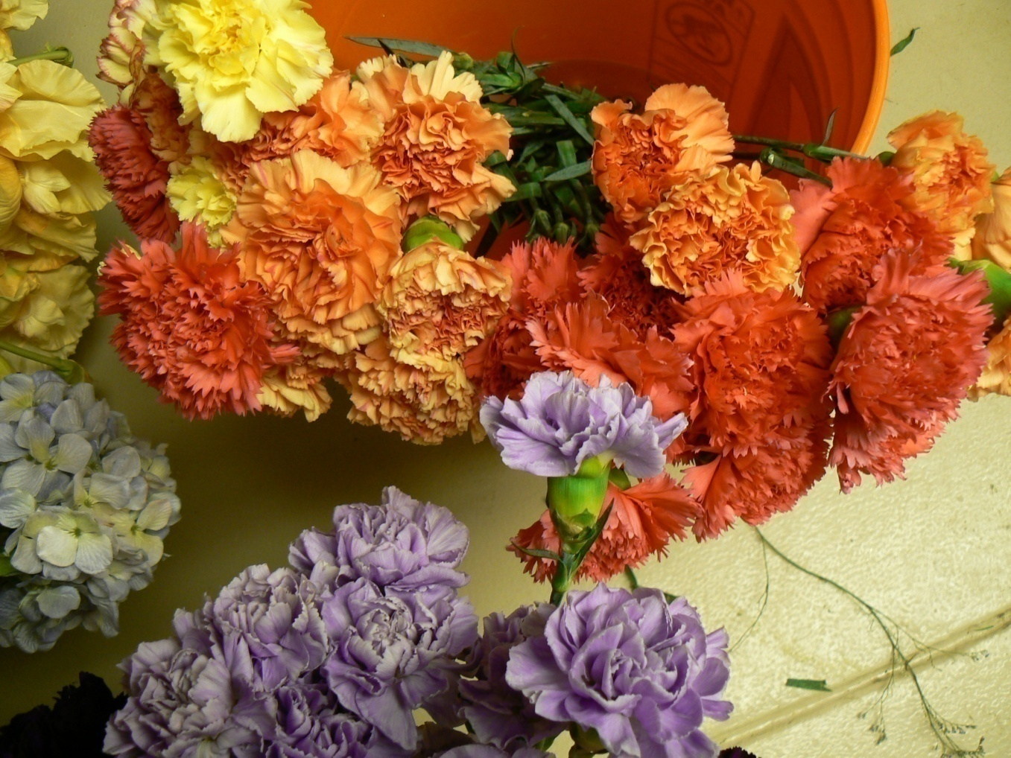
1
Notes:
135 Dianthus caryophyllus cv. Carnation
Photo courtesy of Brenda Patten

Slide 38
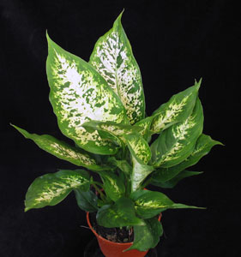
2
Notes:
136 Dieffenbachia maculata cv. Spotted Dumbcane
Flowerservant.com

Slide 39
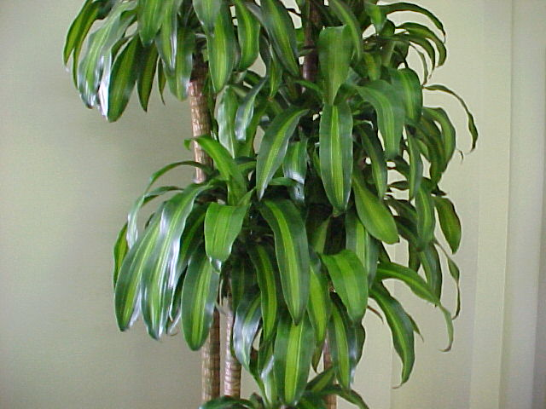
3
Notes:
137 Dracaena fragrans ‘Massangeana’ Corn Plant Dracaena
Mgonline.com

Slide 40
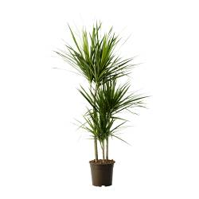
4
Notes:
138 Dracaena cincta Red Edge Dracaena
Ikea.com

Slide 41
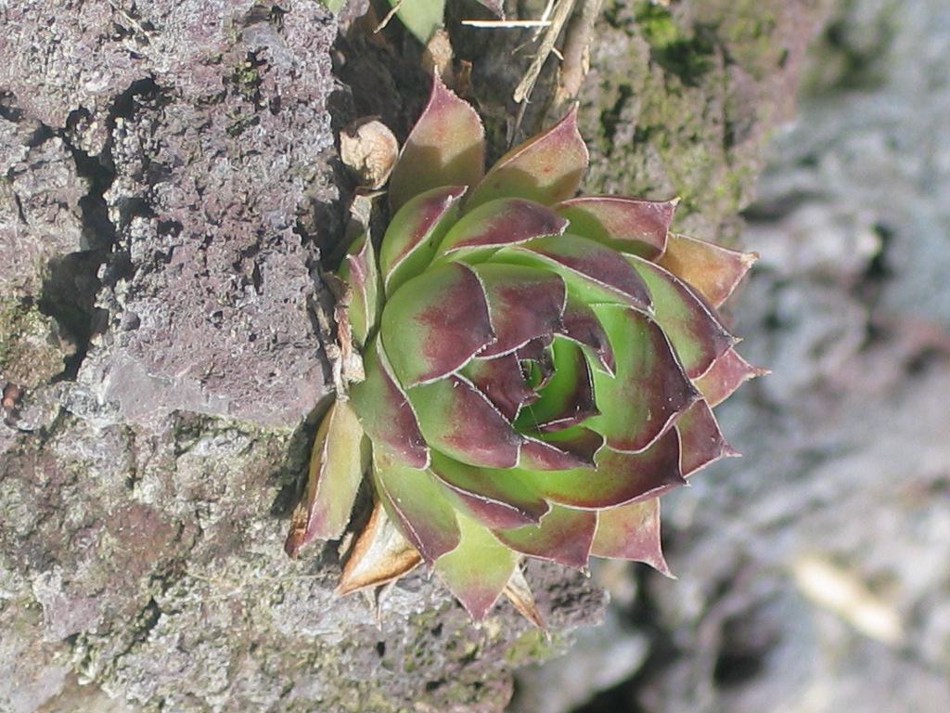
5
Notes:
139 Echeveria cv. Hens and Chickens
Photo courtesy of Allison Touchstone

Slide 42
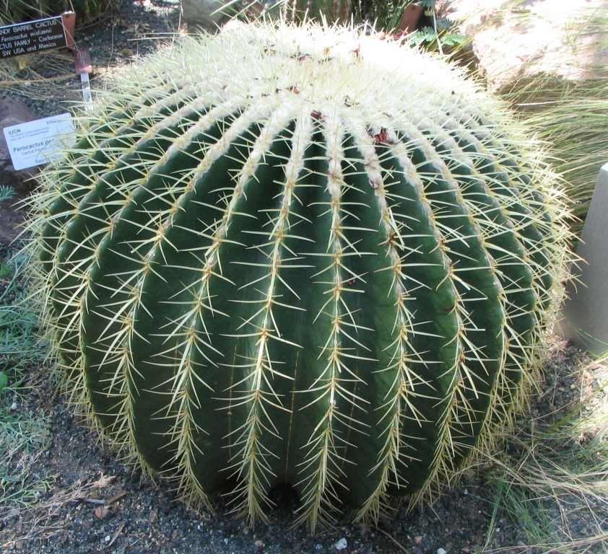
6
Notes:
140 Echinocactus cv. Barrel Cactus
Wikimedia.org

Slide 43
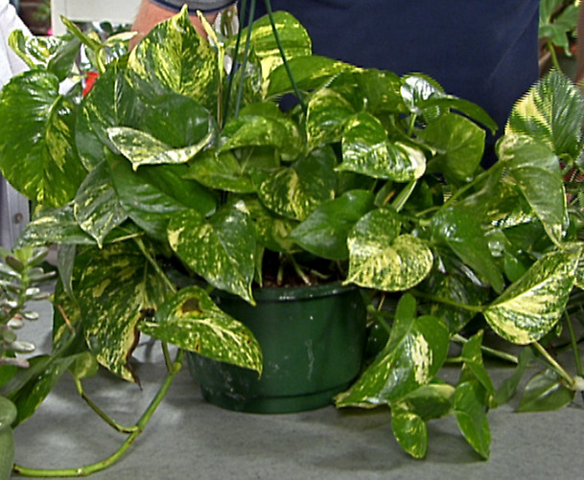
7
Notes:
141 Epipremnum aureum cv. Golden Pothos, Devil’s Ivy
Img.hgtv.com

Slide 44
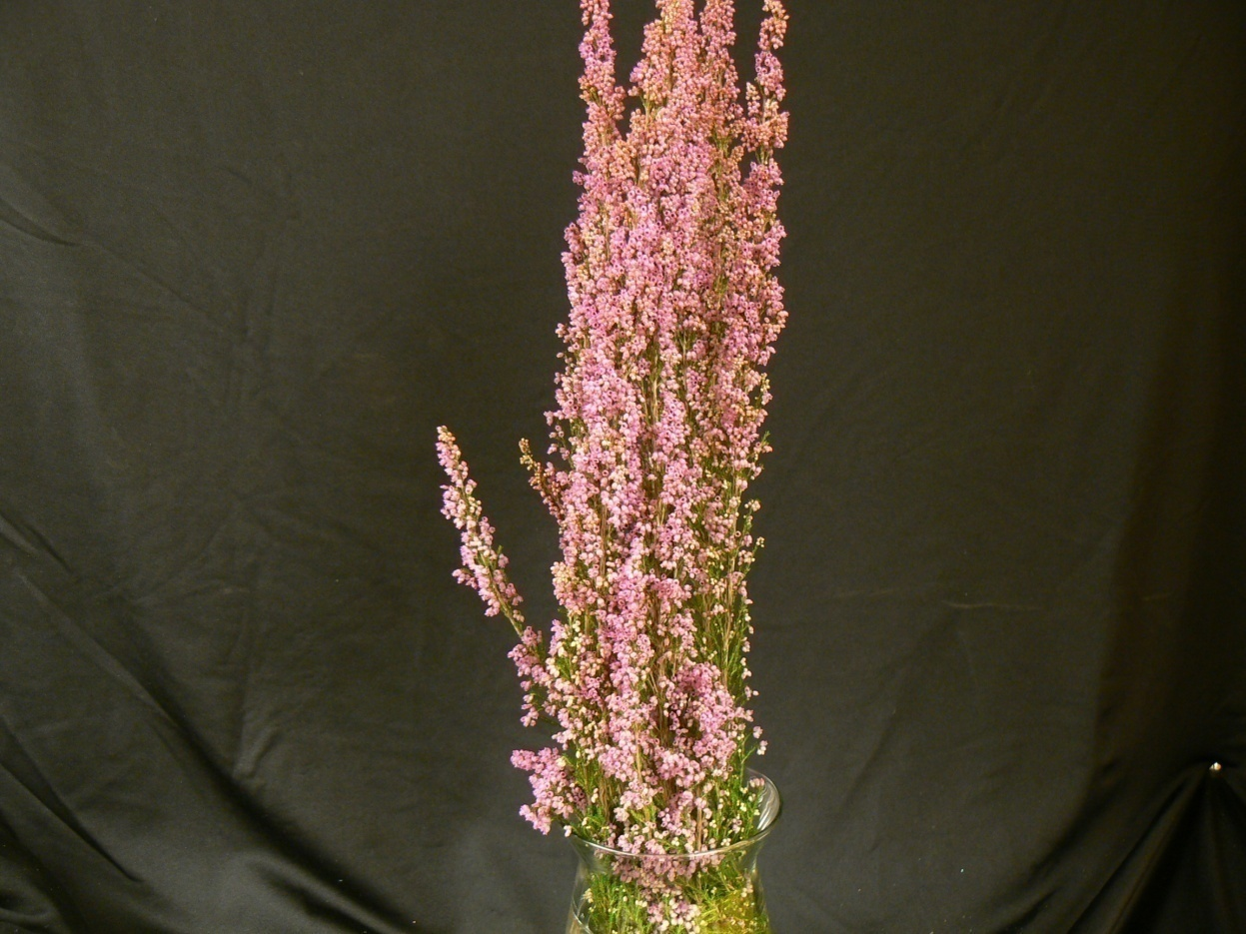
8
Notes:
142 Erica carnea cv. Spring Heather
Photo courtesy of Brenda Patten

Slide 45
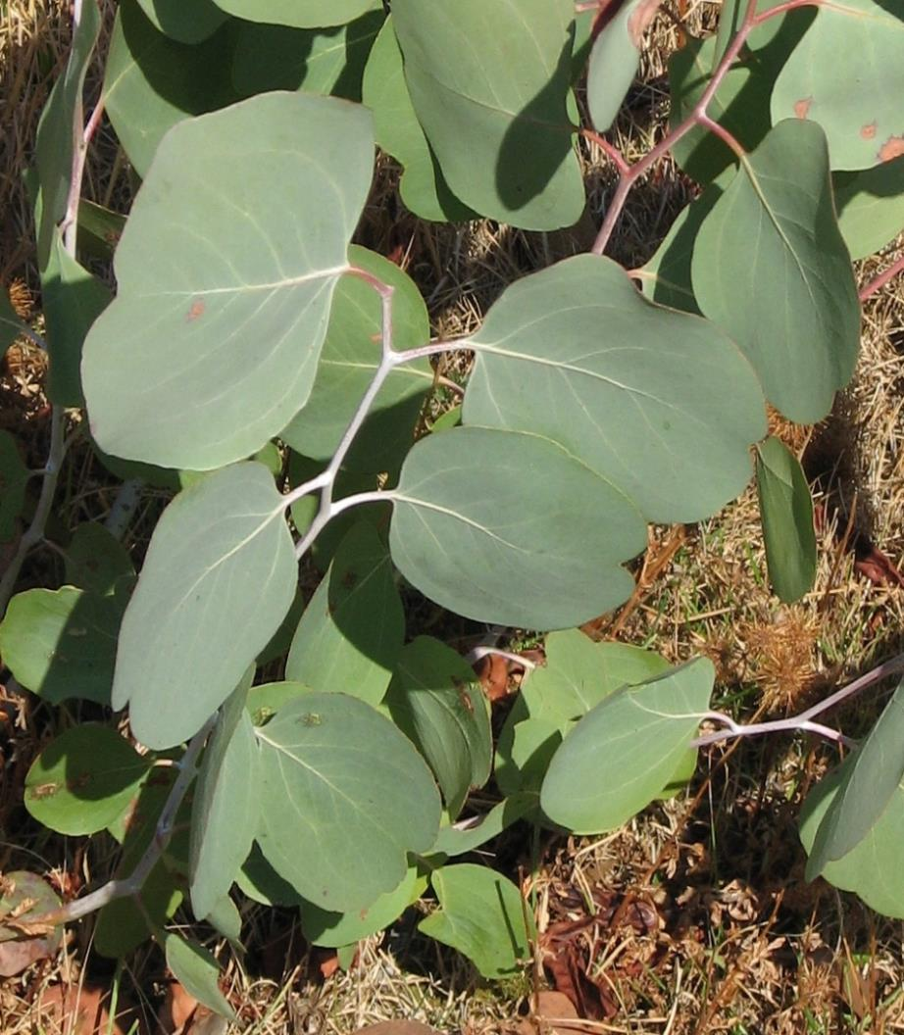
9
Notes:
143 Eucalyptus polyanthemos Silver Dollar Gum
Upload.wikimedia.org

Slide 46
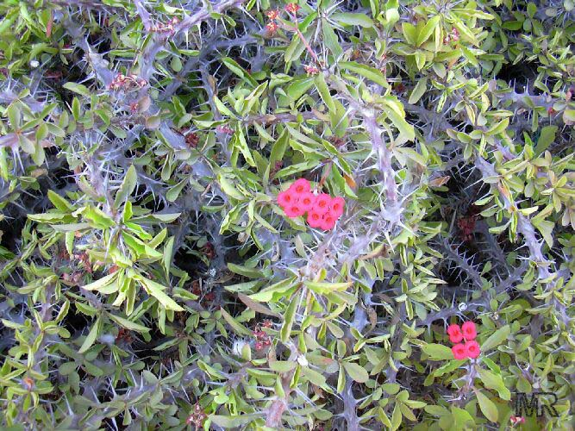
10
Notes:
144 Euphorbia milii splendens Crown-of-Thorns
Toptropicals.com

Slide 47
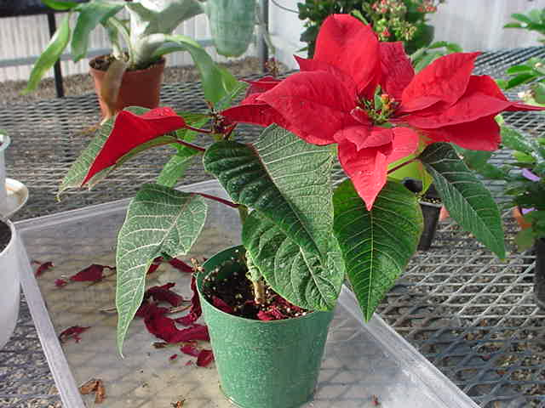
11
Notes:
145 Euphorbia pulcherrima cv. Poinsettia
Photo courtesy of Brenda Patten

Slide 48
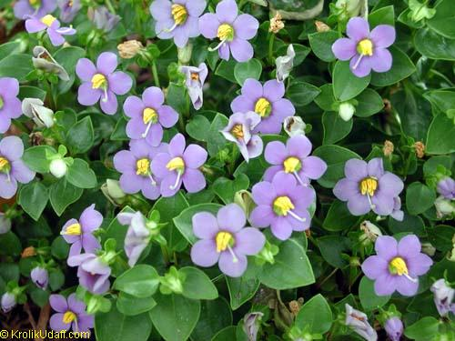
12
Notes:
146 Exacum affine German (Persian) Violet
Toptropicals.com

Slide 49
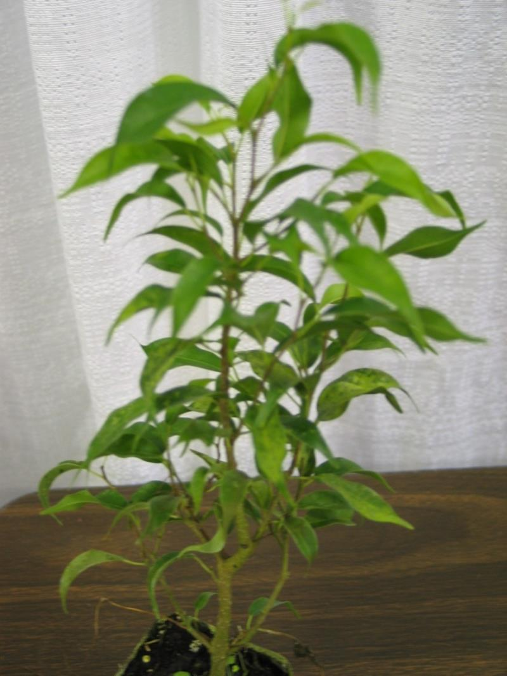
13
Notes:
147 Ficus benjamina ‘Exotica’ Benjamin Fig
Photo courtesy of Allison Touchstone

Slide 50
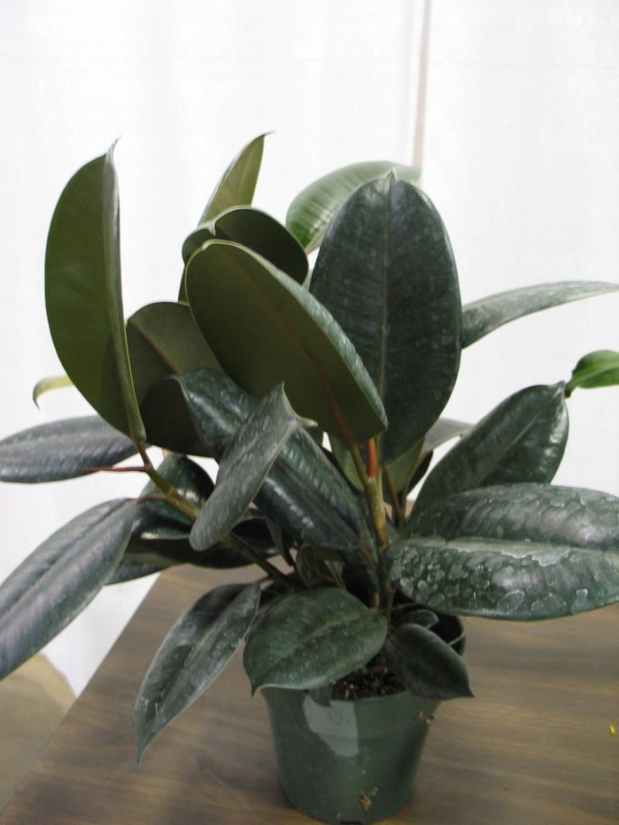
14
Notes:
148 Ficus elastica ‘Decora’ ‘Decora’ Rubber Plant
Photo courtesy of Allison Touchstone

Slide 51
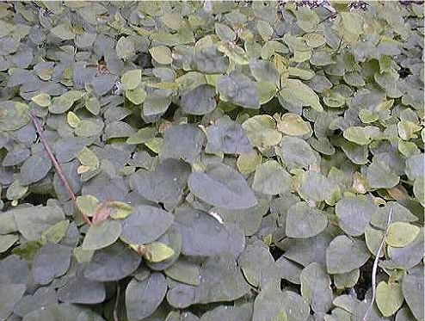
15
Notes:
149 Ficus pumia Creeping Rubber Plant
Turfarm.com

Slide 52
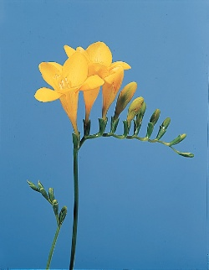
16
Notes:
150 Freesia x hybrida Freesia
Dubaiflowers.net

Slide 53
17
Notes:
151 Frittonia verschaffeltii Oklahoma State University

Slide 54
Floriculture Plant Identification Quiz
G-L
152-174

Slide 55
1
Notes:
157 Hedra helix cv. English Ivy
Photo courtesy of Allison Touchstone

Slide 56
2
Notes:
161 Hosta undulata Plantain Lily
Photo courtesy of Allison Touchstone

Slide 57
3
Notes:
158 Heptapleurum arboricola Dwarf Schefflera, Dwarf Octopus Plant
Cloveflorist.com

Slide 58
4
Notes:
162 Hoya carnosa Wax Plant
Upload.wikimedia.org

Slide 59
5
Notes:
155 Gynura aurantiaca ‘Sarmentosa’ “Purple Passion”, Velvet Plant
Upload.wikimedia.org

Slide 60
6
Notes:
153 Gladiolus x hortulanus cv. Garden Gladiolus
Photo courtesy of Brenda Patten

Slide 61
7
Notes:
156 Gypsophila elegans cv. Baby’s Breath
Blossomswap.com

Slide 62
8
Notes:
152 Gardenia jasminoides ‘Fortuniana’ Gardenia
Upload.wikimedia.org

Slide 63
9
Notes:
171 Lilium longiflorum cv. Trumpet (Easter) Lily
Content.answers.com

Slide 64
10
Notes:
174 Lobularia maritima Sweet Alyssum
Upload.wikimedia.org

Slide 65
11
Notes:
159 Hemerocallis cv. Daylily
Findmeplants.co.uk

Slide 66
12
Notes:
154 Gerbera jamesonii Transvaal Daisy

Slide 67
13
Notes:
165 Impatiens hybrid cv. Impatiens
Fotosearch.com

Slide 68
14
Notes:
172 Lilium x hybridum cv. Hybrid (Garden) Lily
Worldofgardens.ca

Slide 69
15
Notes:
167 Iris x xiphium cv. Dutch Iris
Easytogrowbulbs.com

Slide 70
16
Notes:
163 Hyacinthus orientalis cv. Hyacinth
Istockphoto.com

Slide 71
17
Notes:
170 Liatris spicata Liatris
Upload.wikimedia.org

Slide 72
18
Notes:
166 Iris x germanica florentina cv. Flag (Bearded) Iris
Home.comcast.net

Slide 73
19
Notes:
173 Limonium sinuatum Statice
Upload.wikimedia.org

Slide 74
20
Notes:
160 Hippeastrum hybrid cv. Amaryllis
Photo courtesy of Allison Touchstone

Slide 75
21
Notes:
168 Justicia brandegeana Shrimp Plant
Toptropicals.com

Slide 76
22
Notes:
164 Hydrangea macrophylla cv. French (Florist’s) Hydrangea
Photo courtesy of Brenda Patten

Slide 77
23
Notes:
169 Kalanchoe x blossfeldiana cv. Kalanchoe
Upload.wikimedia.org

Slide 78
Floriculture Plant Identification Quiz
M-R
175-203

Slide 79
1
Notes:
191 Phalaenopsis cv. Phalaenopsis (Butterfly) Orchid
Orchidconsultant.com

Slide 80
2
Notes:
176 Matthiola incana cv. Flowering Stock
Photo courtesy of Brenda Patten

Slide 81
3
Notes:
201 Rhododenron cv. Azalea
Photo courtesy of Brenda Patten

Slide 82
4
Notes:
198 Polianthes tuberosa Tuberose
Kvbwholesale.com

Slide 83
5
Notes:
202 Rosa hybrid, Class Hybrid Tea cv. Hybrid Tea Rose
Photo courtesy of Brenda Patten

Slide 84
6
Notes:
178 Narcissus pseudonarcissus cv. Daffodil
Upload.wikimedia.org

Slide 85
7
Notes:
183 Paphiopedilum x hybrid cv. Ladyslipper Orchid
I3.photobucket.com

Slide 86
8
Notes:
181 Opuntia tribe cv. Cactus
Upload.wikimedia.org

Slide 87
9
Notes:
184 Pelargonium x domesticum cv. Regal (Martha Washington) Geranium
Peoriagardens.com

Slide 88
10
Notes:
200 Primula malacoides cv. Fairy Primrose
Photo courtesy of Brenda Patten

Slide 89
11
Notes:
190 Petunia x hybrida cv. Common Garden Petunia
Photo courtesy of Allison Touchstone

Slide 90
12
Notes:
182 Paeonia cv. Peony
Binnyplants.co.uk

Slide 91
13
Notes:
185 Pelargonium x hortorum cv. (Zonal) Geranium
Upload.wikimedia.com

Slide 92
14
Notes:
188 Peperomia caperata Emerald Ripple Peperomia
Photo courtesy of Brenda Patten

Slide 93
15
Notes:
177 Monstera deliciosa Cutleaf “Philodendron”
Photo courtesy of Allison Touchstone

Slide 94
16
Notes:
193 Pilea cadierei Aluminum Plant
Upload.wikimedia.org

Slide 95
17
Notes:
187 Peperomia argyreia Watermelon Peperomia
Toptropicals.com

Slide 96
18
Notes:
203 Rumohra adiantiformis Leatherleaf Fern
Photo courtesy of Allison Touchstone

Slide 97
19
Notes:
175 Marnata leuconeura var. kerchoviana Prayer Plant
Photo courtesy of Brenda Patten

Slide 98
20
Notes:
195 Pilea microphylla Artillery Plant Upload.wikimedia.org

Slide 99
21
Notes:
186 Pelargonium peltatum cv. Ivy Geranium
Photo courtesy of Allison Touchstone

Slide 100
22
Notes:
197 Plectranthus mummularis Swedish Ivy
Photo courtesy of Allison Touchstone

Slide 101
23
Notes:
196 Pilea nummularifolia Creeping Charley
Upload.wikimedia.org

Slide 102
24
Notes:
189 Peperomia obtusifolia ‘Variegata’ Variegated Peperomia
Waterroots.com

Slide 103
25
Notes:
180 Nephrolepis exalta cv. Boston Fern
Photo courtesy of Allison Touchstone

Slide 104
26
Notes:
192 Philodendron scandens oxycardium Heartleaf Philodendron
Photo courtesy of Allison Touchstone

Slide 105
27
Notes:
194 Pilea involucrata Friendship Plant
Toptropicals.com

Slide 106
28
Notes:
179 Neoregelia carolinae ‘Tricolor’ Bromeliad
Waterroots.com

Slide 107
29
Notes:
199 Primula x polyanthus cv. Polyanthus (Primrose)
Photo courtesy of Allison Touchstone

Slide 108
Floriculture Plant Identification Quiz
S-Z
204-224

Slide 109
1
Notes:
208
Schlumbergera
Christmas Cactus
Photo courtesy of Allison Touchstone

Slide 110
2
Notes:
220 Tulipa cv. Tulip
Photo courtesy of Allison Touchstone

Slide 111
3
Notes:
211 Senecio x hybridus cv. Florist’s Cineraria Howstuffworks.com

Slide 112
4
Notes:
212 Sinningia speciosa fiana Group cv. Gloxinia
Thefloweringgarden.com

Slide 113
5
Notes:
222 Viola x wittrockiana cv. (Garden) Pansy
Photo courtesy of Allison Touchstone

Slide 114
6
Notes:
218 Tagetes species cv. Marigold
Photo courtesy of Allison Touchstone

Slide 115
7
Notes:
214 Spathiphyllum clevelandii White Athurium, Peace Lily
Photo courtesy of Allison Touchstone

Slide 116
8
Notes:
223 Zebrina pendula cv. Wandering Jew

Slide 117
9
Notes:
215 Stephanotis floribunda Stephanotis
Burncoose.co.uk

Slide 118
10
Notes:
205 Salvia splendens cv. Salvia
Landscaping.about.com

Slide 119
11
Notes:
209 Schlumbergera truncata cv. Thanksgiving Cactus, Crab Cactus
Photo courtesy of Brenda Patten

Slide 120
12
Notes:
213 Solanum pseudocapsicum cv. Jerusalem Cherry
Worldofstock.com

Slide 121
13
Notes:
216 Strelitzia reginae Bird-of-Paradise
Flickr.com

Slide 122
14
Notes:
221 Vaccinium ovatum Florist’s “Huckleberry”

Slide 123
15
Notes:
207 Saxifraga stolonifera Strawberry Plant
Davesgarden.com

Slide 124
16
Notes:
224 Zinnia elegans Zinnia
Flickr.com

Slide 125
17
Notes:
217 Syngonium podophyllum Nephthytis

Slide 126
18
Notes:
204 Saintpaulia ionantha cv. African Violet
shootgardening.co.uk

Slide 127
19
Notes:
219 Tolmiea menziesii Pickaback Plant
Flickr.com

Slide 128
20
Notes:
210 Senecio cineraria ‘Diamond’ Diamond Dusty Miller
Home.howstuffworks.com

Slide 129
21
Notes:
206 Sansevieria trifasciata cv. Snake Plant
Evergrowing.com

