Slide 1
Floral Design History
Notes:
Floral Design History:
Berrall, Julia S. A History of Flower Arrangement. Viking Press, Inc. 1968.
Hunter, Norah T., The Art of Floral Design Second Edition Delmar 2000. Chapter 1

Slide 2
Historical periods:

Slide 3
Egyptian 2800-28 BC:
Repetition and alteration
Lotus flower—Egyptian goddess Isis
traced back as far as 2500 b.c.
Separate primary colors
Egyptian flower vases made to hold up flowers with weaker stems like lotus
Festivals and feasts
Faience—type of finely ground silicate
Mostly used wide-mouth bowls
During time of pharaohs lotus, papyrus and palm tree most commonly portrayed members of the plant kingdom
Notes:
Floral Design History:
Berrall, Julia S. A History of Flower Arrangement. Viking Press, Inc. 1968.
Hunter, Norah T., The Art of Floral Design Second Edition Delmar 2000. Chapter 1

Slide 4
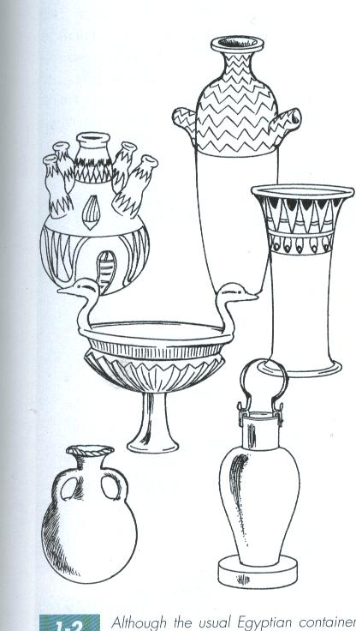
Mostly used wide-mouth bowls
Weak flower stems supported by smaller tubes in vase like lotus blossom
Notes:
Hunter, Norah T., The Art of Floral Design Second Edition Delmar 2000. Chapter 1

Slide 5
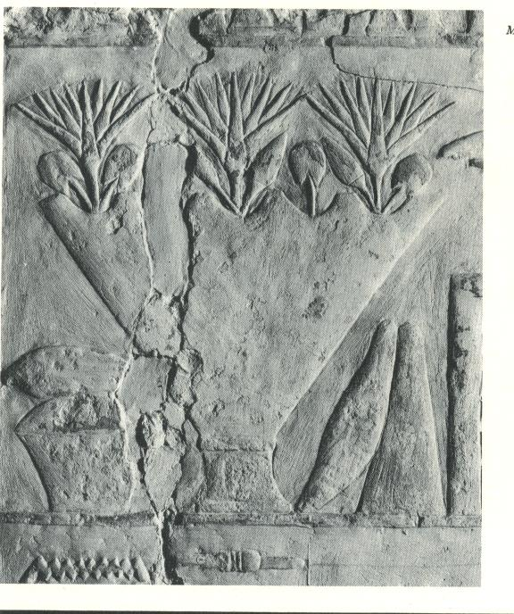
Stone relief from the old Kingdom tomb of Perneb
showing a bowl filled with lotus blossoms and buds.
Notes:
Berrall, Julia S. A History of Flower Arrangement. Viking Press, Inc. 1968.

Slide 6
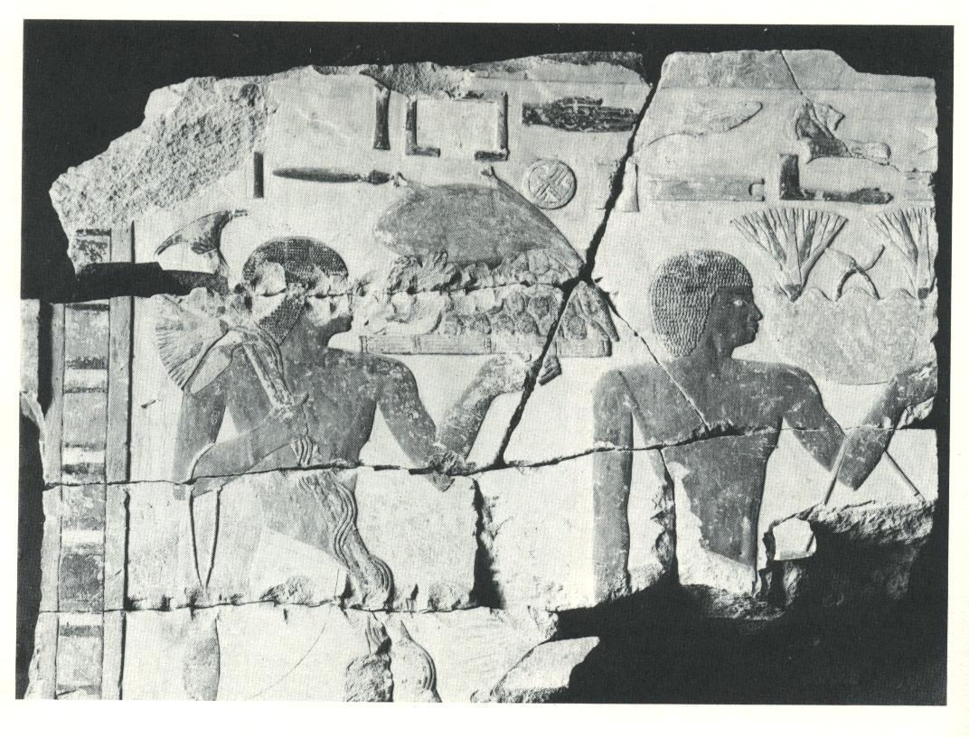
Elaborately designed metal vases, one of which holds lotus blossoms-
originals probably had inset fragments of colorful stones
Used for ceremonial tribute
Notes:
Berrall, Julia S. A History of Flower Arrangement. Viking Press, Inc. 1968.

Slide 7
Greek (Classical) 600-146 BC:
Garlands-exchanged by lovers, worn at weddings and hung on door to denote the birth of a son
Wreaths-a symbol of allegiance and dedication
rewarded to athletes, poets, civic leaders and victorious soldiers and sailors
Cornucopia --symbol of abundance
Scattered petals
Mythology
Chaplet-head piece
Professional flower makers and sellers
Notes:
Floral Design History:
Berrall, Julia S. A History of Flower Arrangement. Viking Press, Inc. 1968.
Hunter, Norah T., The Art of Floral Design Second Edition Delmar 2000. Chapter 1

Slide 8
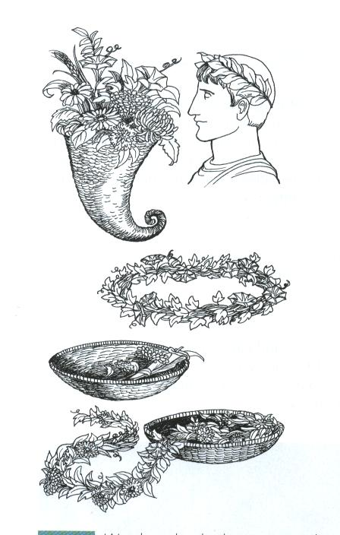
Wreaths and garlands worn for personal adornment or decoration
Notes:
Hunter, Norah T., The Art of Floral Design Second Edition Delmar 2000. Chapter 1

Slide 9
Roman 28 BC-AD 325:
Continued the use of garlands and wreaths (fuller, wider)
Day to day life and celebrations
Rose petals piled on floor
Nero and Cleopatra used them extravagantly
during festivities lavish and fantastic strewn on banquet tables and couches, streets and lakes
Grew roses among hot water pipes to supply all demand
Sachet
Fragrance
Notes:
Floral Design History:
Berrall, Julia S. A History of Flower Arrangement. Viking Press, Inc. 1968.
Hunter, Norah T., The Art of Floral Design Second Edition Delmar 2000. Chapter 1

Slide 10
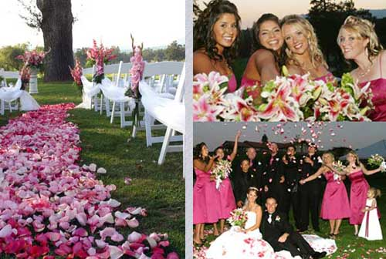
Notes:
Yosemiteweddings.com

Slide 11
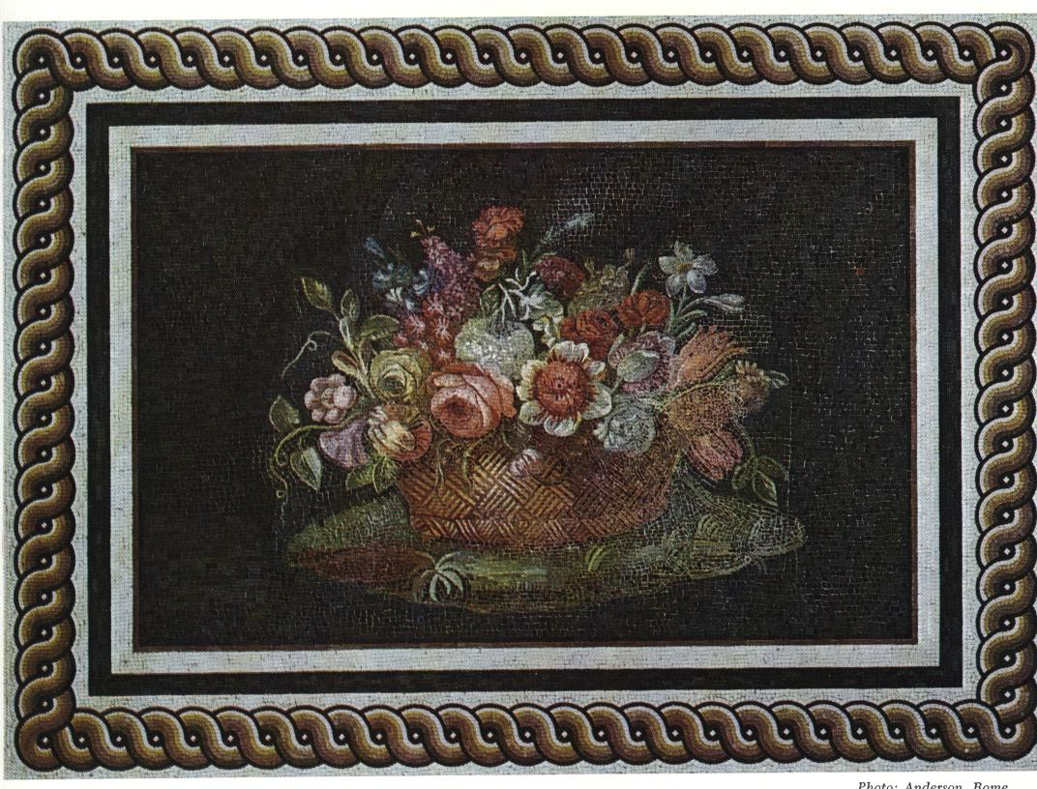
Roman mosaic
Beginning of 2nd century a.d.
Basket of mixed flowers—first representation of a truly naturalistic flower bouquet
Basket motif recurs throughout history of art
Notes:
Berrall, Julia S. A History of Flower Arrangement. Viking Press, Inc. 1968.

Slide 12
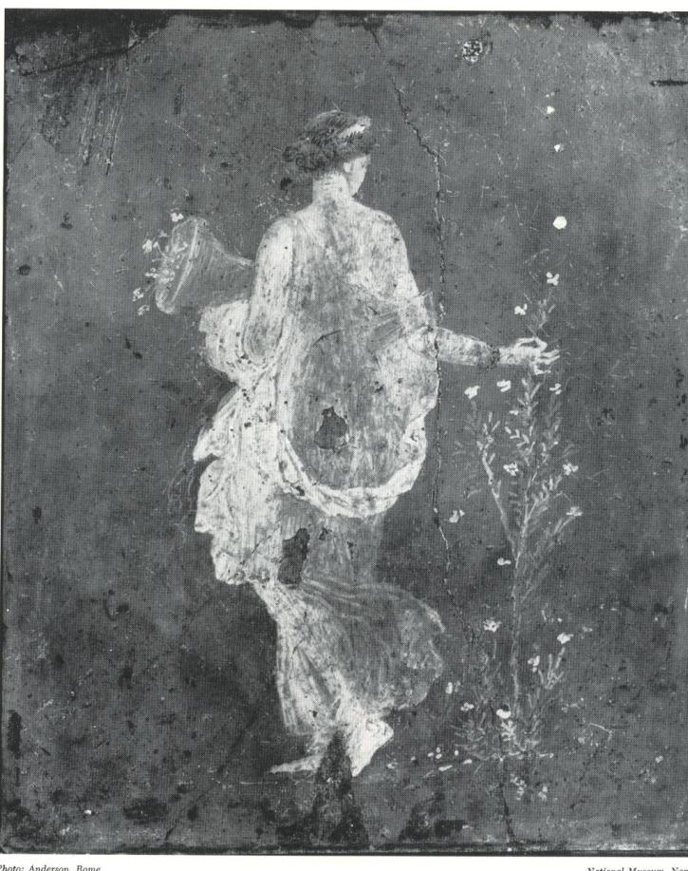
“Maiden gathering flowers”
wall paining found in a town destroyed by Vesuvius in a.d. 79
Notes:
Berrall, Julia S. A History of Flower Arrangement. Viking Press, Inc. 1968.

Slide 13
Byzantine 320-600 AD:
Garlands of fruit
Symmetrical conical designs with concentric rings of fruit, stones, jewels, metals.
Tree compositions
Notes:
Floral Design History:
Berrall, Julia S. A History of Flower Arrangement. Viking Press, Inc. 1968.
Hunter, Norah T., The Art of Floral Design Second Edition Delmar 2000. Chapter 1

Slide 14
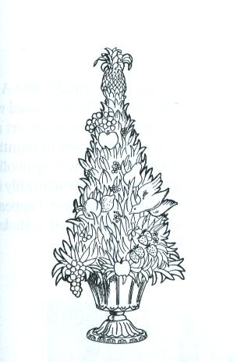
Symmetrical and conical
Notes:
Hunter, Norah T., The Art of Floral Design Second Edition Delmar 2000. Chapter 1

Slide 15
Middle Ages 476-1400 AD:
Warring feudal lords state of unrest
Monks
grew herbs
were well acquainted with many of the beautiful everyday flowers
illuminated in manuscripts
Everyday life—wild and cultivated used in food, drink, medicine
Fragrant flowers strewn on ground and freshen air
Art belonged to the church—stained glass windows, mosaics, tapestries, sculpture, paintings and illuminated religious books
Notes:
Floral Design History:
Berrall, Julia S. A History of Flower Arrangement. Viking Press, Inc. 1968.
Hunter, Norah T., The Art of Floral Design Second Edition Delmar 2000. Chapter 1

Slide 16
Renaissance 1400-1600 AD:
Resurgence and flourishing of the arts
Religious symbolism
7 flowers representing the 7 stations of the cross
Seven fully-opened columbine flowers represent the seven gifts of the holy spirit—wisdom, understanding, counsel, strength, knowledge, true godliness and holy fear
purity represented by certain flowers—usually the white lily (Virgin Mary) because it appeared in so many Annunciation paintings, it soon became known as the Madonna Lily
Annunciation where angel appears to Mary
rose represented sacred or profane love
Notes:
Floral Design History:
Berrall, Julia S. A History of Flower Arrangement. Viking Press, Inc. 1968.
Hunter, Norah T., The Art of Floral Design Second Edition Delmar 2000. Chapter 1

Slide 17
Renaissance 1400-1600 AD:
Old garden book for growing, freshening and arranging flowers—Flora overo Cultura di Fiori
Bouquets usually pyramidal and full
Containers made for arranging flowers
removable lid so flower arrangement can be lifted and flowers recut every 3rd day
tearred affect so short stemmed flowers could be placed on top
Notes:
Floral Design History:
Berrall, Julia S. A History of Flower Arrangement. Viking Press, Inc. 1968.
Hunter, Norah T., The Art of Floral Design Second Edition Delmar 2000. Chapter 1

Slide 18
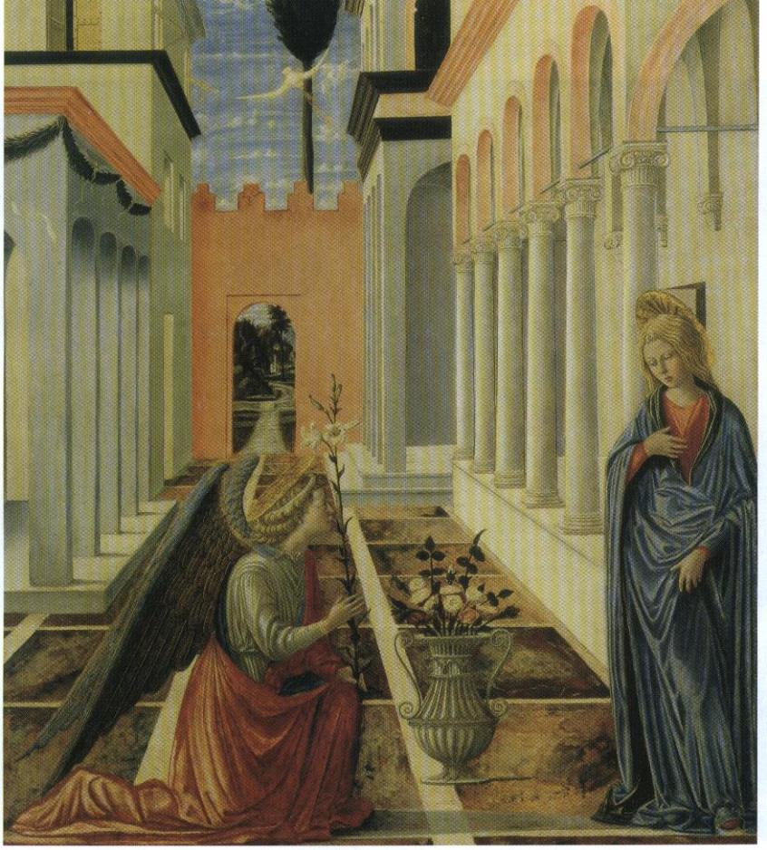
Pink and white roses in classic renaissance vase.
White lily depicting the Annunciation, symbolized chastity and fertility
Notes:
Berrall, Julia S. A History of Flower Arrangement. Viking Press, Inc. 1968.

Slide 19
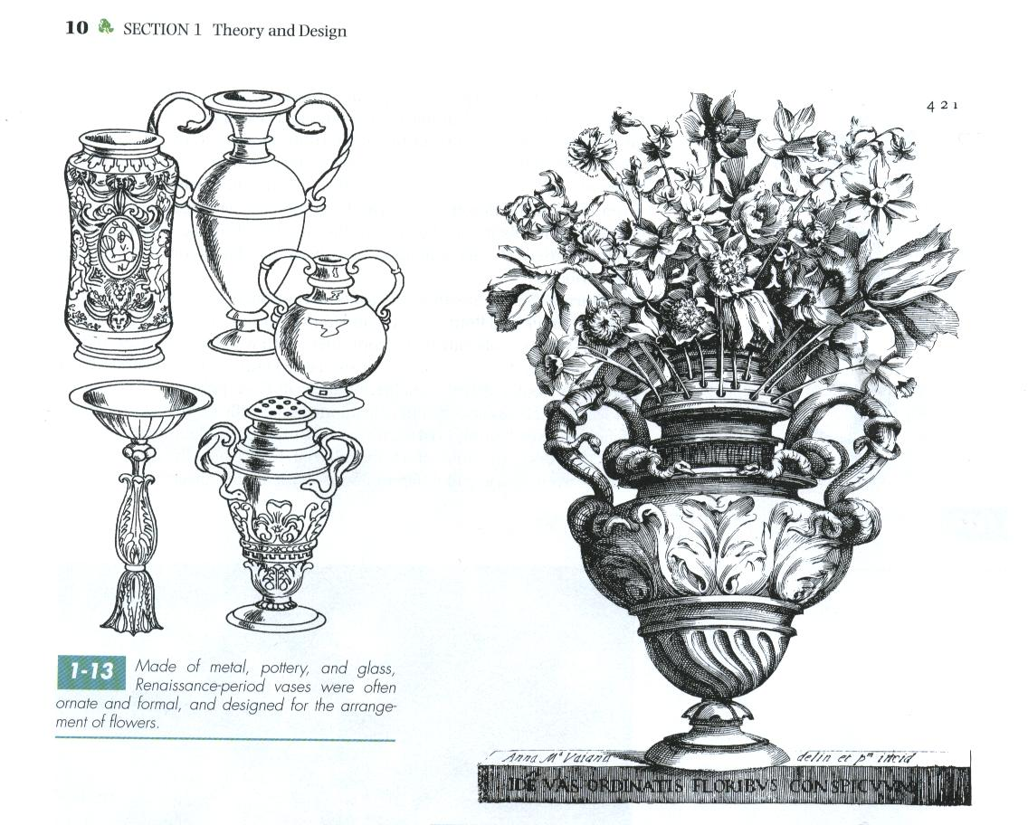
Vases ornate and formal—designed for the arrangement of flowers
Removable lids with holes in them
Notes:
Hunter, Norah T., The Art of Floral Design Second Edition Delmar 2000. Chapter 1

Slide 20
Baroque 1600-1775 AD:
Influence of artists
The “S” curve or Hogarth curve
Lavish designs--bright colors
Large, overly proportioned designs in big, heavy containers
Not for church or nobility any longer—middle class could have flowers—due to trading and redistribution of wealth with new world
Notes:
Floral Design History:
Berrall, Julia S. A History of Flower Arrangement. Viking Press, Inc. 1968.
Hunter, Norah T., The Art of Floral Design Second Edition Delmar 2000. Chapter 1

Slide 21
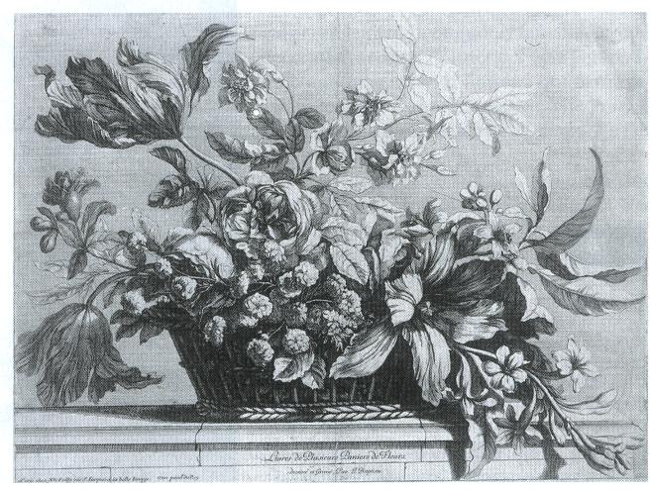
Baroque—asymmetrical, massed, and overflowing sweeping lines—
dramatic contrasts of large and small, dark and light
Notes:
Berrall, Julia S. A History of Flower Arrangement. Viking Press, Inc. 1968.

Slide 22
Dutch-Flemish 1550-1760 AD:
Holland and Belgium
Tulip imported from Turkey
New flowers-- particularly “out of season” greenhouse grown flowers
Paintings included composite groups of flowers—painted during different seasons
Terra-cotta
Age of great scientific, botanical and horticultural discoveries
Delftware-copied Chinese porcelain vases in blue and white but less expensive—named after Netherland city where it was invented
Notes:
Floral Design History:
Berrall, Julia S. A History of Flower Arrangement. Viking Press, Inc. 1968.
Hunter, Norah T., The Art of Floral Design Second Edition Delmar 2000. Chapter 1

Slide 23
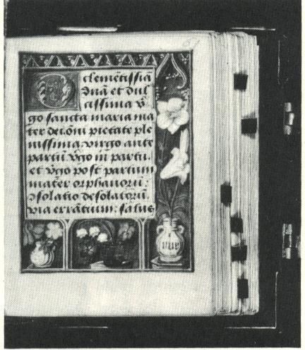
Illuminated “book of hours”
Flemish Symbolism in the selection of flowers, the little jug, the glass tumbler, and the two handled bottle in which the flowers are placed suggest the casual and natural gesture of bringing cut flowers indoors
Notes:
Berrall, Julia S. A History of Flower Arrangement. Viking Press, Inc. 1968.

Slide 24
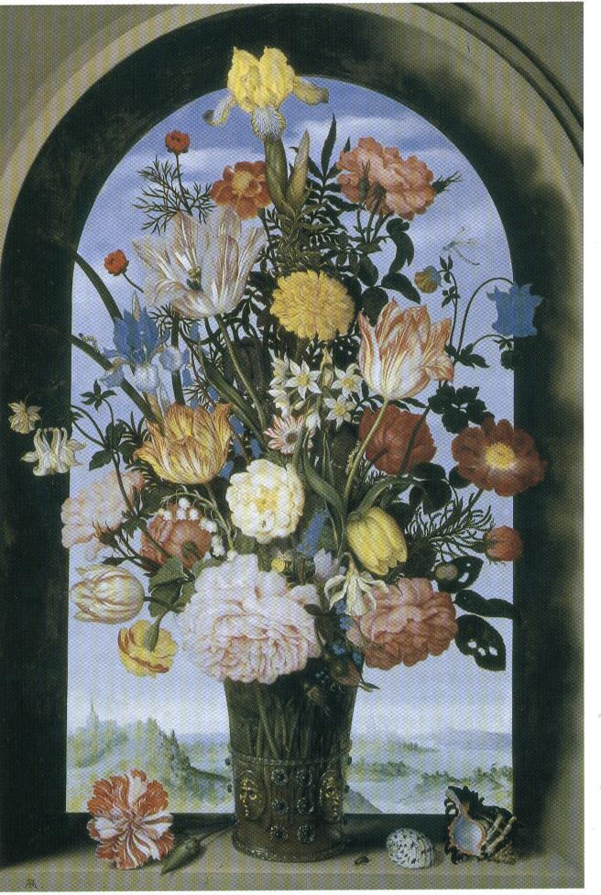
Little or no overlapping flowers—each flower clearly evident
Scattering of shells, insects, etc. characteristic of Dutch-Flemish
Notes:
Berrall, Julia S. A History of Flower Arrangement. Viking Press, Inc. 1968.

Slide 25
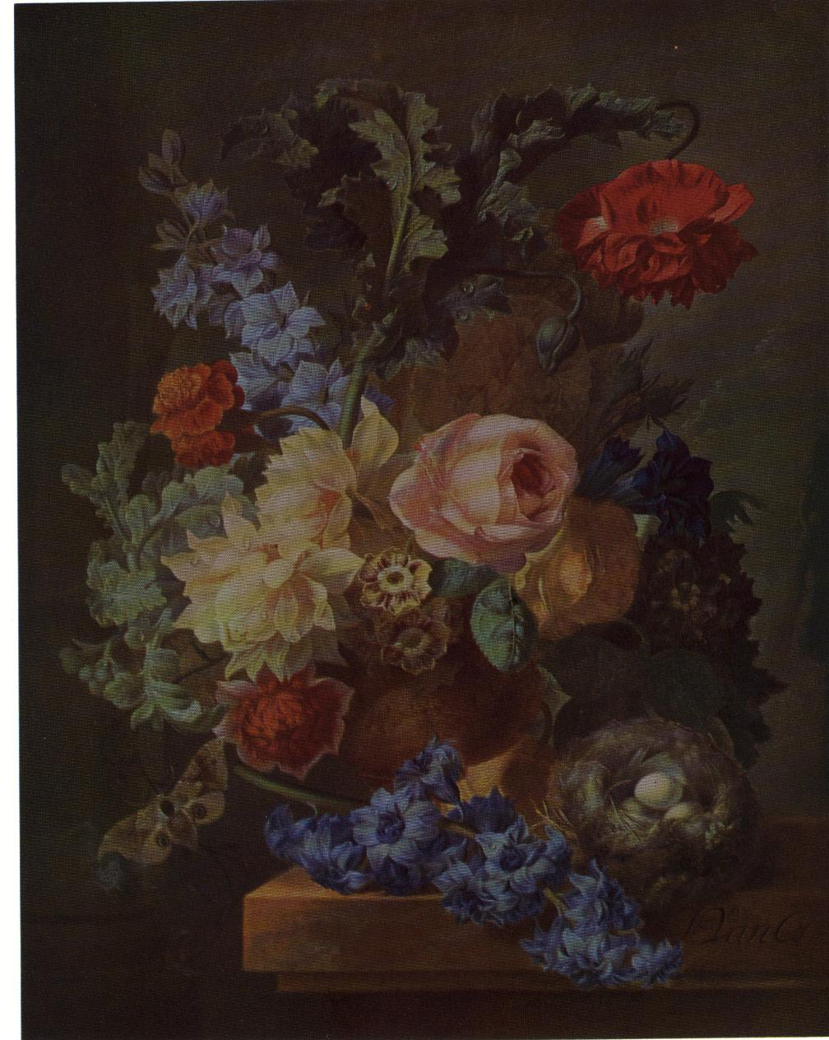
“still life”
Complementary colors blue and orange
delphinium
Notes:
Berrall, Julia S. A History of Flower Arrangement. Viking Press, Inc. 1968.

Slide 26
FRENCH PERIODS:

Slide 27
French Baroque 1600’s:
Louis XIV--effeminate extravagance
Art evolved around the aristocracy
Topiary balls or trees
Chateau of Versailles
large rooms decorated with elaborate wood and stone carvings
marble fireplaces and floors
decorative flower arrangements large in scale
Enormous conservatory
stored 3000 orange trees during the winter using hothouses to supply indoor plants for massive decoration
Notes:
Floral Design History:
Berrall, Julia S. A History of Flower Arrangement. Viking Press, Inc. 1968.
Hunter, Norah T., The Art of Floral Design Second Edition Delmar 2000. Chapter 1

Slide 28
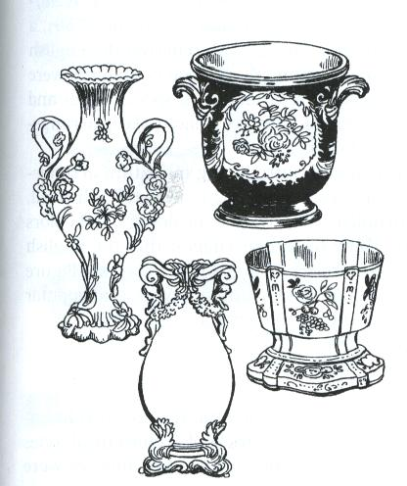
Elegant and highly ornate
Many made of porcelain
Notes:
Hunter, Norah T., The Art of Floral Design Second Edition Delmar 2000. Chapter 1

Slide 29
French Rococo 1700’s:
Louis XIV mistress-Antoinette Poisson, the Marquis do Pompadour had great influence.
Asymmetrical, curvilinear, formal crescent (C curve)
“Rock and shell” curving lines
Predominant subtle colors: apricot, peach, cream, rose, gray, sage green, yellow, beige, turquoise, and powder blue
Delicate accessories
Notes:
Floral Design History:
Berrall, Julia S. A History of Flower Arrangement. Viking Press, Inc. 1968.
Hunter, Norah T., The Art of Floral Design Second Edition Delmar 2000. Chapter 1

Slide 30
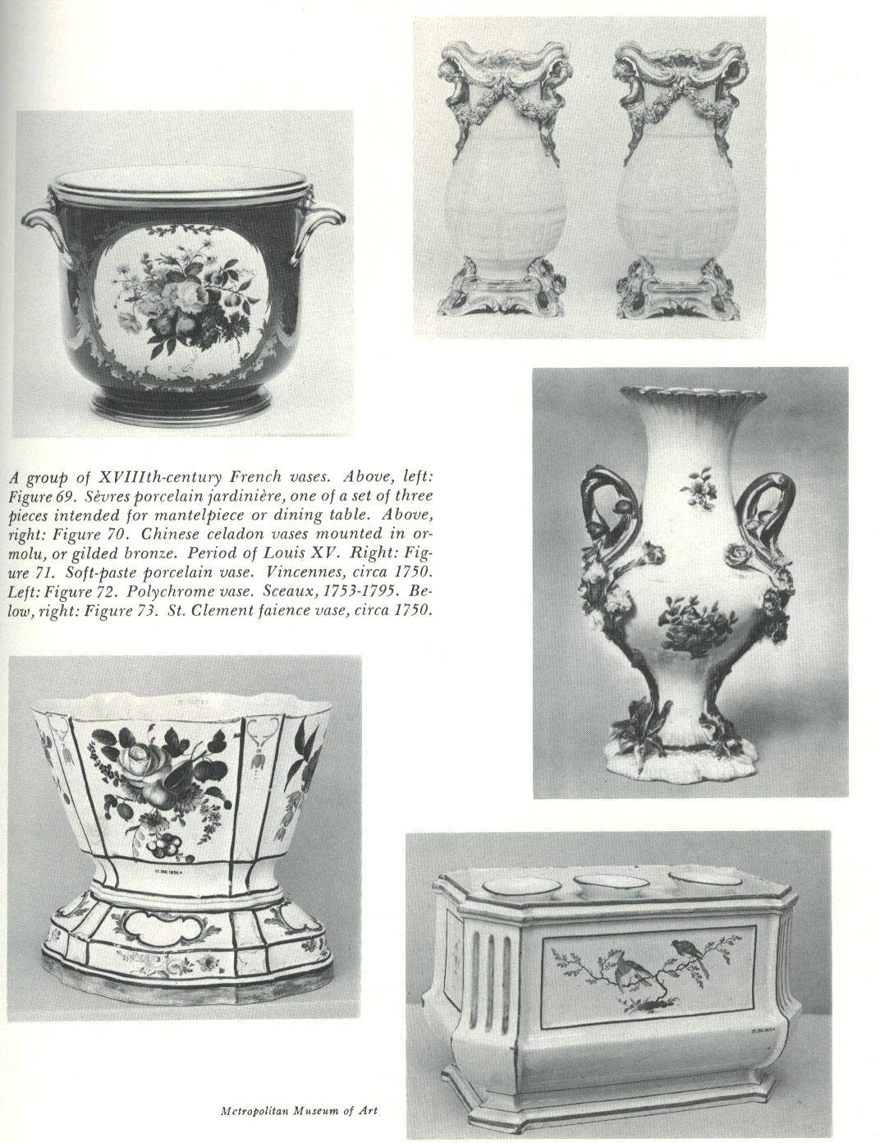
Porcelain vases
Notes:
Hunter, Norah T., The Art of Floral Design Second Edition Delmar 2000. Chapter 1

Slide 31
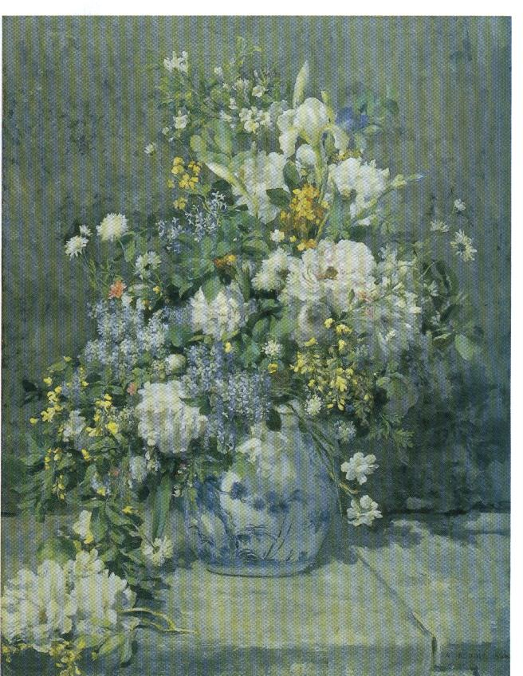
Beauty and overabundance
Notes:
Berrall, Julia S. A History of Flower Arrangement. Viking Press, Inc. 1968.

Slide 32
Louis XVI late 1700’s:
Strong feminine influence of Marie Antoinette—delicate, cool colors, highlighted with gold, more simple containers than previous
Notes:
Floral Design History:
Berrall, Julia S. A History of Flower Arrangement. Viking Press, Inc. 1968.
Hunter, Norah T., The Art of Floral Design Second Edition Delmar 2000. Chapter 1

Slide 33
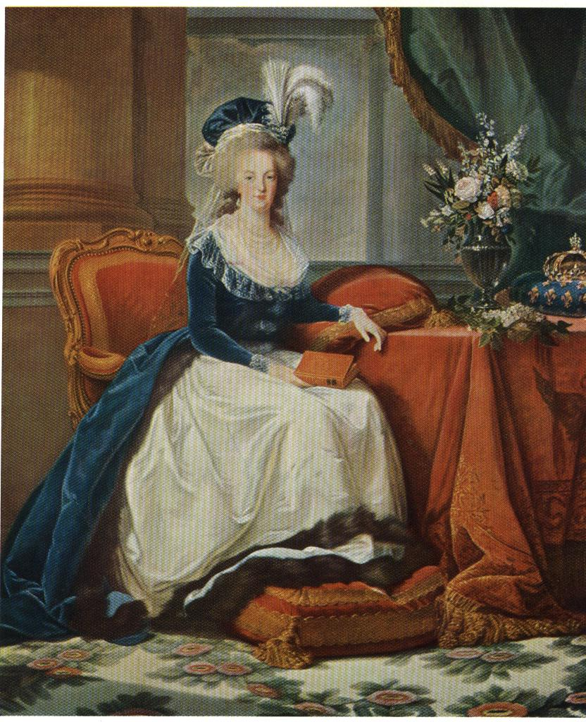
1785
Crystal vase mounted in gold
lilac
Notes:
Berrall, Julia S. A History of Flower Arrangement. Viking Press, Inc. 1968.

Slide 34
Empire 1804-1814:
Strong use of neoclassical design ideas
Napoleon Bonaparte
Masculine designs, dramatic, militaristic, dictator-oriented symbols predominate
Heavy massive designs and containers with large boldly colored flowers
Notes:
Floral Design History:
Berrall, Julia S. A History of Flower Arrangement. Viking Press, Inc. 1968.
Hunter, Norah T., The Art of Floral Design Second Edition Delmar 2000. Chapter 1

Slide 35
ENGLISH PERIODS:

Slide 36
English-Georgian Period 1714-1760:
Named after English Kings George I,II, III
Full, strongly stylized symmetrical bouquets, oval to triangular shapes
Formal and symmetrical—tightly arranged
“tuzzy-muzzy” or nosegay
“tuzzy” refers to old English word for knot of flowers
Nosegay to carry the sweet scents—relief from unsanitary surroundings
Fragrance to rid air of contagious and infectious diseases
Decolletage—flowers around neckline of a dress
Bough pot—flower filled container set in the fireplace in non heated seasons
Wedgwood--English potter Josiah Wedgwood—fine ceramic ware used during this season—special holes to hold flowers in stiff and formal shape
Notes:
Floral Design History:
Berrall, Julia S. A History of Flower Arrangement. Viking Press, Inc. 1968.
Hunter, Norah T., The Art of Floral Design Second Edition Delmar 2000. Chapter 1

Slide 37
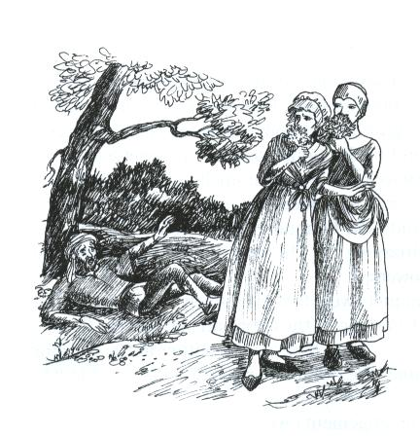
Nosegay believed that carrying a small perfumed bouquet would
rid the air of infectious diseases
Notes:
Hunter, Norah T., The Art of Floral Design Second Edition Delmar 2000. Chapter 1

Slide 38
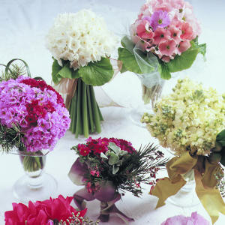
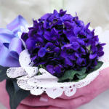
Notes:
Sunset.com

Slide 39
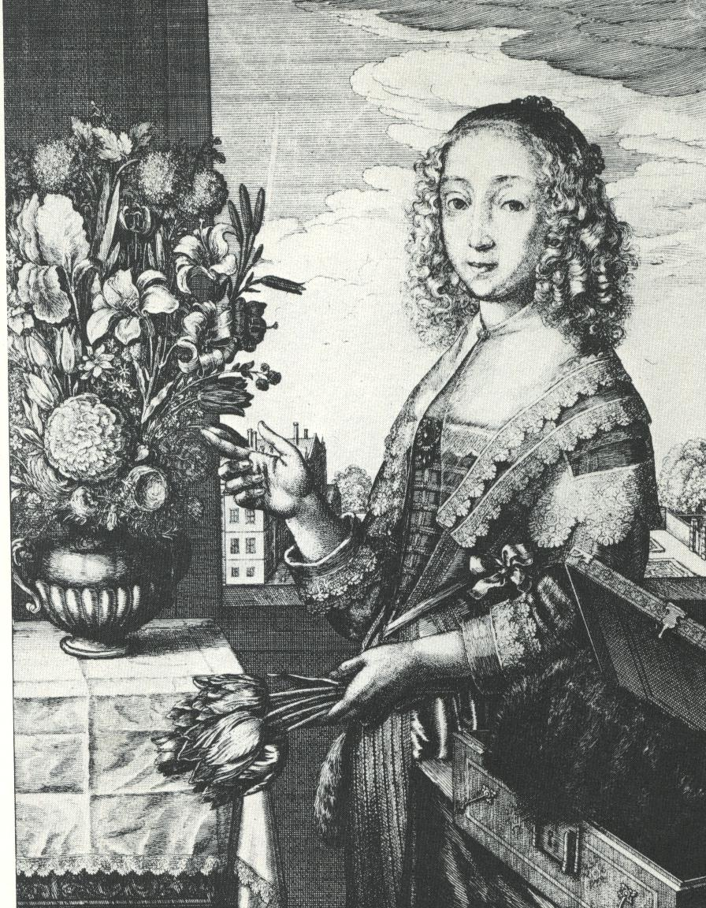
English woman
Large in proportion to the container, massed, and oval
Two handled metal container
Notes:
Berrall, Julia S. A History of Flower Arrangement. Viking Press, Inc. 1968.

Slide 40
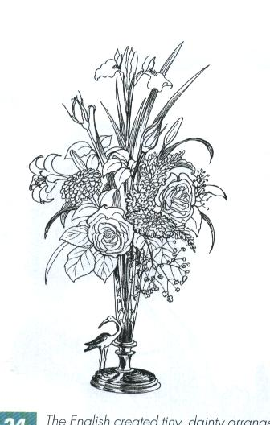
Dainty arrangements that led to today’s bud vase
Notes:
Hunter, Norah T., The Art of Floral Design Second Edition Delmar 2000. Chapter 1

Slide 41
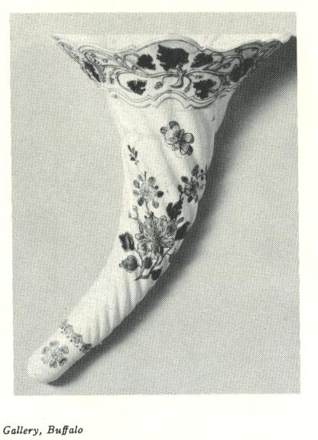
Wall vase
Notes:
Hunter, Norah T., The Art of Floral Design Second Edition Delmar 2000. Chapter 1

Slide 42
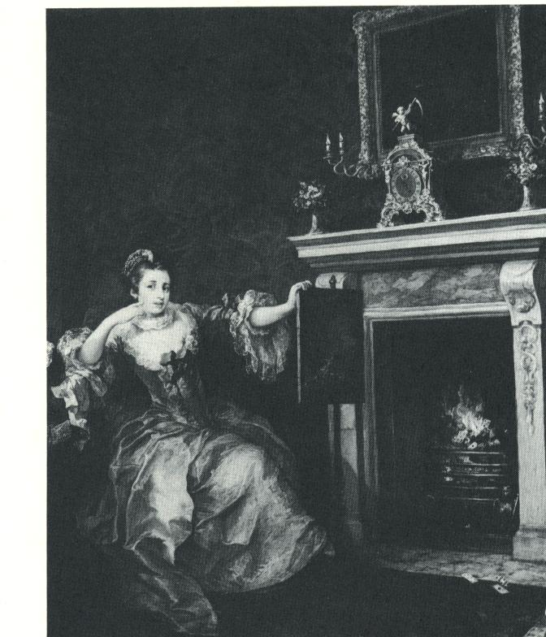
“the lady’s last stake”
Paired bouquets on the mantle piece
Notes:
Berrall, Julia S. A History of Flower Arrangement. Viking Press, Inc. 1968.

Slide 43
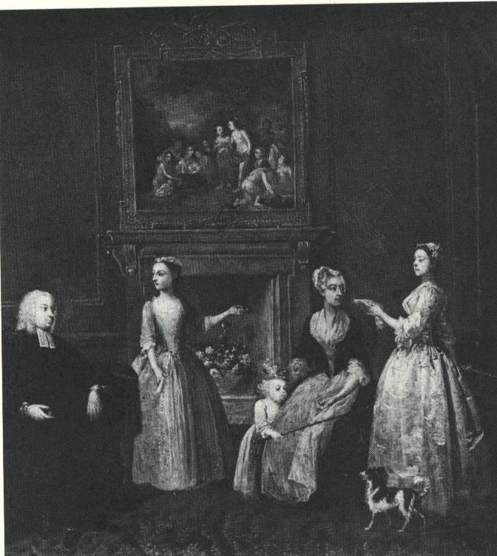
“the vicar of the parish at the house of the infant squire”
Bough pot
Notes:
Berrall, Julia S. A History of Flower Arrangement. Viking Press, Inc. 1968.

Slide 44
Victorian Period 1820-1901:
“Of all modes of enlivening the aspect of an apartment, there is perhaps none more pleasing than the sight of plants and flowers suitably arranged and distributed. They are ornaments of Nature’s own producing, which inspire an interest apart from their beauty, by the care and attention required for their culture. They employ the hand, delight the eye, and inform and edify the mind, and, unlike many artificial objects, the enjoyment and instruction they afford are within the reach of all, the poor may partake as well as the rich.” --Article written in Jan 1855
Notes:
Floral Design History:
Berrall, Julia S. A History of Flower Arrangement. Viking Press, Inc. 1968.

Slide 45
Victorian Period 1820-1901:
Named after Queen Victoria who reined in England from 1837 to 1901
Floral design recognized as an art
Establishing rules of design led to the development of today’s floral industry
Girls taught to arrange flowers and make tussie-mussies as well as grow, preserve, press, draw and paint flowers
Make artificial flowers using shells, wax, feathers, hair, textiles, and beads
Bouquets poorly designed. “Airless,”overstuffed and flat, symmetrical, with no particular focal point.
Short-stemmed flowers
Notes:
Floral Design History:
Berrall, Julia S. A History of Flower Arrangement. Viking Press, Inc. 1968.
Hunter, Norah T., The Art of Floral Design Second Edition Delmar 2000. Chapter 1

Slide 46
Victorian Period 1820-1901:
Nosegays more popular—conveyed sentiments
silent messages depending on what went into them
Posey holders—small container to hold nosegay
made of metals, steel, and alloy, ivory, glass, painted porcelain, amber, tortoiseshell, and mother of pearl, inlaid with jewels, pearls, and small mirrors
Included two small chains—one with ring for finger, other pin attached to secure flowers
Notes:
Floral Design History:
Berrall, Julia S. A History of Flower Arrangement. Viking Press, Inc. 1968.
Hunter, Norah T., The Art of Floral Design Second Edition Delmar 2000. Chapter 1

Slide 47
Victorian Period 1820-1901:
Bosom bottles—small container to hold flowers used as an accent for clothing
worn at decolletage
Complementary color schemes—blue next to orange and so on
Sand used to place flowers into
Notes:
Floral Design History:
Berrall, Julia S. A History of Flower Arrangement. Viking Press, Inc. 1968.
Hunter, Norah T., The Art of Floral Design Second Edition Delmar 2000. Chapter 1

Slide 48
bosom bottles also made to go in hair or waist
Notes:
Hunter, Norah T., The Art of Floral Design Second Edition Delmar 2000. Chapter 1

Slide 49
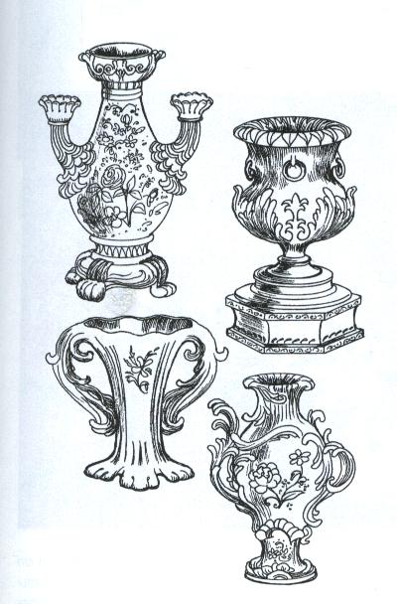
Elaborate hand-painted porcelain, metal and ceramic containers
typify the entire Victorian period
Notes:
Hunter, Norah T., The Art of Floral Design Second Edition Delmar 2000. Chapter 1

Slide 50
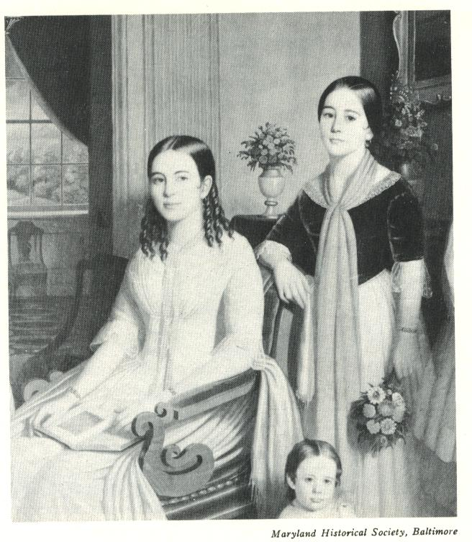
“Children of Israel and Sarah Ann Griffith”
Compactness of the bouquets and nosegay-outlines softened by delicate green foliage
Notes:
Berrall, Julia S. A History of Flower Arrangement. Viking Press, Inc. 1968.

Slide 51
EARLY AMERICAN PERIODS:
(Closely correlated with the simultaneous periods in Europe)

Slide 52
Early American Period 1620-1720:
Simplified versions of the European designs
Colonists were avid gardeners
Common people who lived a “puritan” existence
Common household containers
Bouquets made of wildflowers, often including dried materials.
Notes:
Floral Design History:
Berrall, Julia S. A History of Flower Arrangement. Viking Press, Inc. 1968.
Hunter, Norah T., The Art of Floral Design Second Edition Delmar 2000. Chapter 1

Slide 53
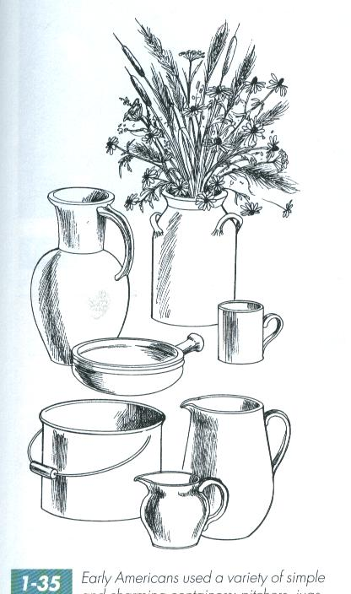
Simple and charming containers, pitchers, jugs, cups
and kettles made from pottery, copper, and pewter
Notes:
Hunter, Norah T., The Art of Floral Design Second Edition Delmar 2000. Chapter 1

Slide 54
Colonial Williamsburg Period 1714-1780:
Life more sophisticated
Trade provided a richer choice of containers and materials
Designs copied from floral prints and tapestries
Designs were fan-shaped or mounded
Fruit and flowers placed for centerpiece
Notes:
Floral Design History:
Berrall, Julia S. A History of Flower Arrangement. Viking Press, Inc. 1968.
Hunter, Norah T., The Art of Floral Design Second Edition Delmar 2000. Chapter 1

Slide 55
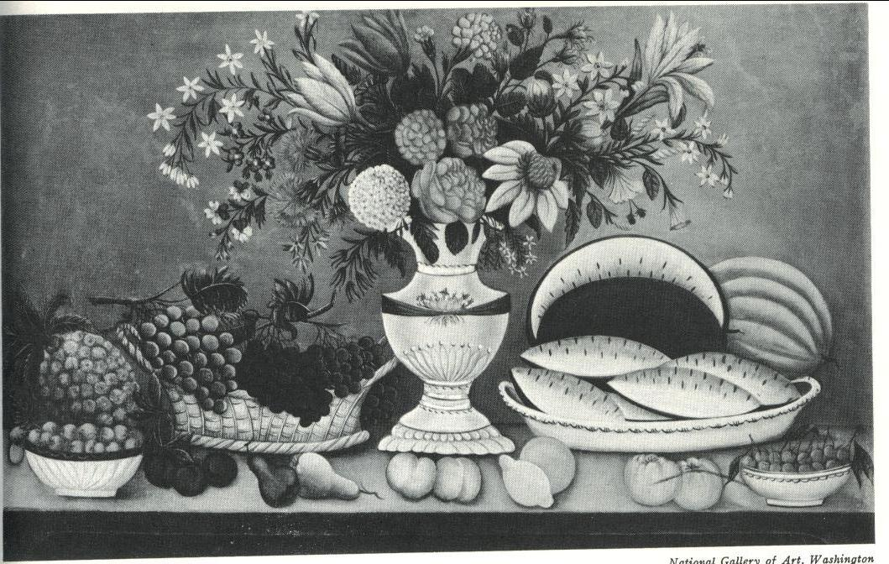
“fruit and flowers”
American artist 1835
Notes:
Berrall, Julia S. A History of Flower Arrangement. Viking Press, Inc. 1968.

Slide 56
American Federal Period 1780-1820:
The neoclassical, Empire
New freedom and independence
Designs were influenced by the delicate French, the masculine French, and an emphasis on the individual merits of each flower.
Notes:
Floral Design History:
Berrall, Julia S. A History of Flower Arrangement. Viking Press, Inc. 1968.
Hunter, Norah T., The Art of Floral Design Second Edition Delmar 2000. Chapter 1

Slide 57
American Victorian 1845-1900:
Romantic era
Copied European Victorian
Epergne
Notes:
Floral Design History:
Berrall, Julia S. A History of Flower Arrangement. Viking Press, Inc. 1968.
Hunter, Norah T., The Art of Floral Design Second Edition Delmar 2000. Chapter 1

Slide 58
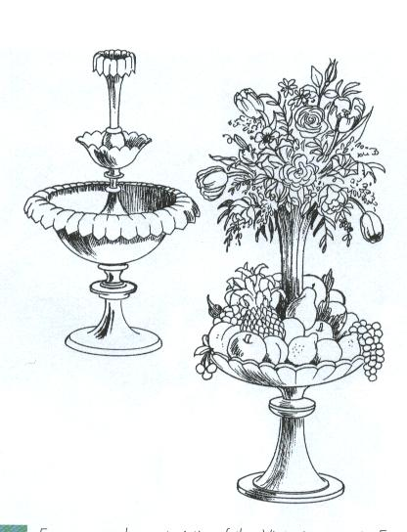
Epernge
Fruit and flowers used for centerpieces in
Victorian Europe and America
Notes:
Hunter, Norah T., The Art of Floral Design Second Edition Delmar 2000. Chapter 1

Slide 59
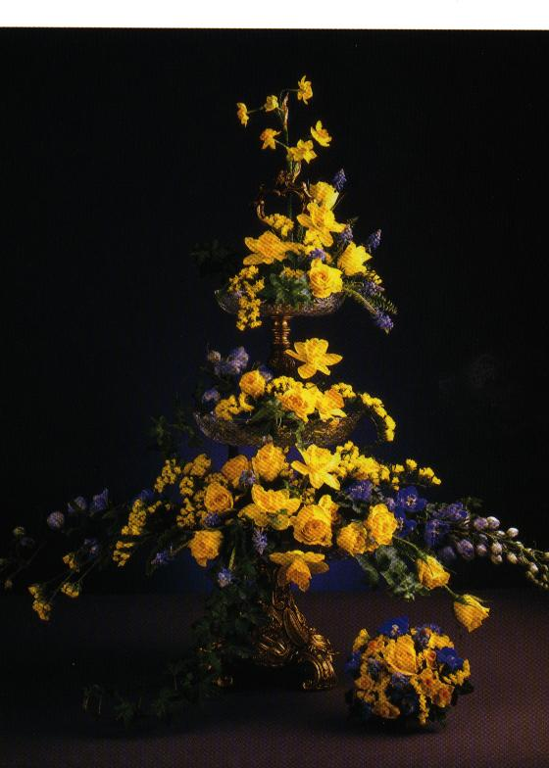
Notes:
Hunter, Norah T., The Art of Floral Design Second Edition Delmar 2000. Chapter 1

Slide 60
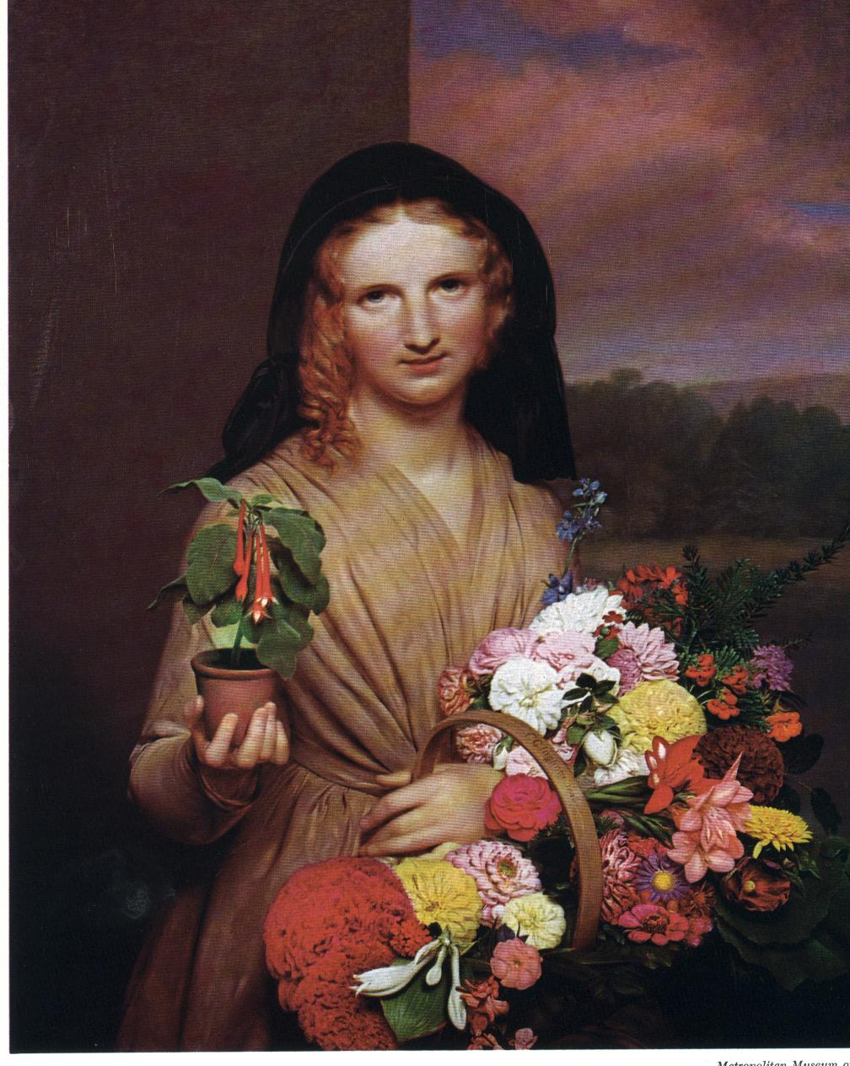
“The flower girl”
Notes:
Berrall, Julia S. A History of Flower Arrangement. Viking Press, Inc. 1968.

Slide 61
ORIENTAL INFLUENCE:
place emphasis on individual form, texture, and color of plant material
Great attention to negative space and line
Notes:
Floral Design History:
Berrall, Julia S. A History of Flower Arrangement. Viking Press, Inc. 1968.
Hunter, Norah T., The Art of Floral Design Second Edition Delmar 2000. Chapter 1

Slide 62
Chinese Style:
China known as “The Flowery Kingdom.”
Unstructured and naturalistic, but require careful thought and planning.
1.art of contemplation—Confucius
Confucius—real enjoyment consists in simplicity
there is a distraction that comes from viewing too much beauty
serenity to be gained from savoring one thing at a time
shadow of a tree on a pond—structure, seasons, strength
a few flowers in a vase can conjure up the whole life-history of a plant, as well as display the beauty of perfect blooms
Notes:
Floral Design History:
Berrall, Julia S. A History of Flower Arrangement. Viking Press, Inc. 1968.
Hunter, Norah T., The Art of Floral Design Second Edition Delmar 2000. Chapter 1

Slide 63
Chinese Style:
2.preservation of life-Buddhism
prohibits taking of life—cut flowers sparingly
Not conquering nature, following it.
Gardens have strategic flowering plants instead of masses—areas for contemplation
3.floral symbolism-folklore
all flowers are feminine because of fragile beauty and are given women’s names
tree peony most revered of all flowers
liked to depict the seasons
Notes:
Floral Design History:
Berrall, Julia S. A History of Flower Arrangement. Viking Press, Inc. 1968.
Hunter, Norah T., The Art of Floral Design Second Edition Delmar 2000. Chapter 1

Slide 64
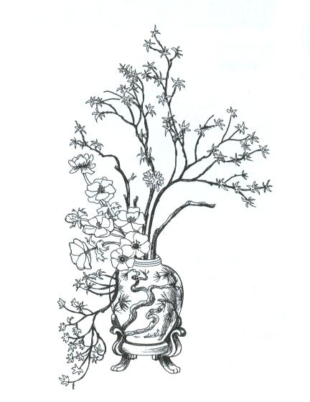
Appears unstructured and naturalistic but requires careful thought and planning
Notes:
Hunter, Norah T., The Art of Floral Design Second Edition Delmar 2000. Chapter 1

Slide 65
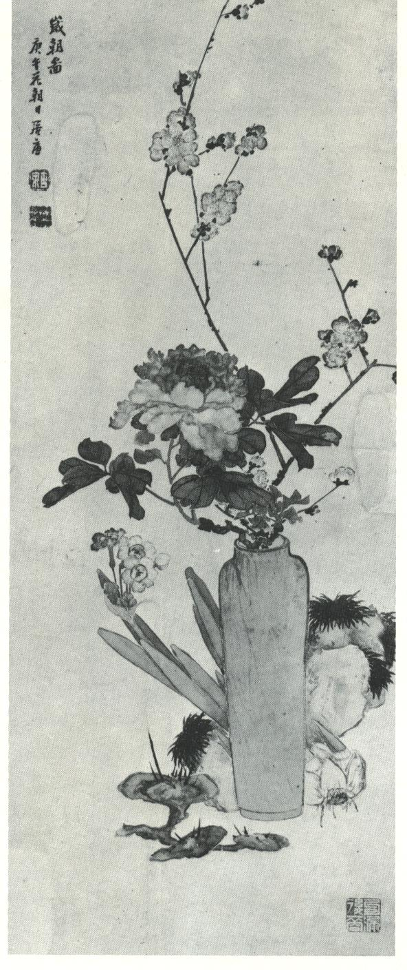
Tree peony—most revered of all flowers
coupled with early flowering plum
Paper-white narcissus symbolic of the new year and
fungus, symbolic of longevity
Notes:
Berrall, Julia S. A History of Flower Arrangement. Viking Press, Inc. 1968.
Komoda, Shusui & Horst Pointer Idebana Spirt & Technique. Kyodo Printing 1983

Slide 66
Japanese Style a.k.a. Ikebana
Highly formalized and follows strict rules of construction--Ikenobo
Adapted from ancient Chinese art and steeped in tradition and symbolism.
Materials placed in a manner reflecting how they are found in nature.
Arrangements emphasize simplicity and line
Notes:
Floral Design History:
Berrall, Julia S. A History of Flower Arrangement. Viking Press, Inc. 1968.
Hunter, Norah T., The Art of Floral Design Second Edition Delmar 2000. Chapter 1
Komoda, Shusui & Horst Pointer Idebana Spirt & Technique. Kyodo Printing 1983

Slide 67
Japanese Style a.k.a. Ikebana
Ono-no-Imoko—founded Ikenobo—flower arranging school
Items found in nature would complement the flowers, rocks, pine, bamboo, cypress, cedar water
Exclusively by men at first—priest then nobility and warrior class to find tranquility of mind and relief from life’s tension in the handling and observation of flowers
In the doing not it the decorating
Contests and books of instruction
Flowers never used out of season—water, branches
Elements of a design face each other
Notes:
Floral Design History:
Berrall, Julia S. A History of Flower Arrangement. Viking Press, Inc. 1968.
Hunter, Norah T., The Art of Floral Design Second Edition Delmar 2000. Chapter 1
Komoda, Shusui & Horst Pointer Idebana Spirt & Technique. Kyodo Printing 1983

Slide 68
Japanese Style a.k.a. Ikebana
Heaven, man, earth (shin, soe, tai)
Shin one and one half times the height of the container
Soe two thirds the length of Shin
Tai is two thirds the length of soe line
Notes:
Floral Design History:
Berrall, Julia S. A History of Flower Arrangement. Viking Press, Inc. 1968.
Hunter, Norah T., The Art of Floral Design Second Edition Delmar 2000. Chapter 1
Komoda, Shusui & Horst Pointer Idebana Spirt & Technique. Kyodo Printing 1983

Slide 69
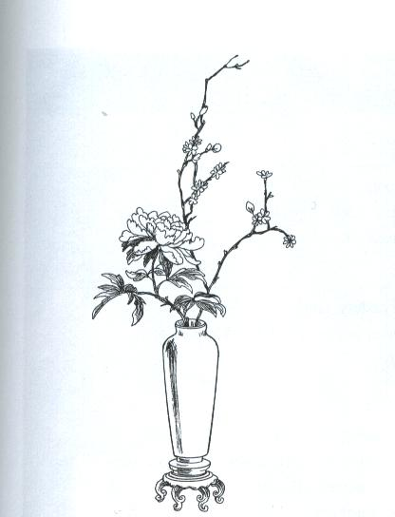
Emphasize simplicity and line
Notes:
Hunter, Norah T., The Art of Floral Design Second Edition Delmar 2000. Chapter 1

Slide 70
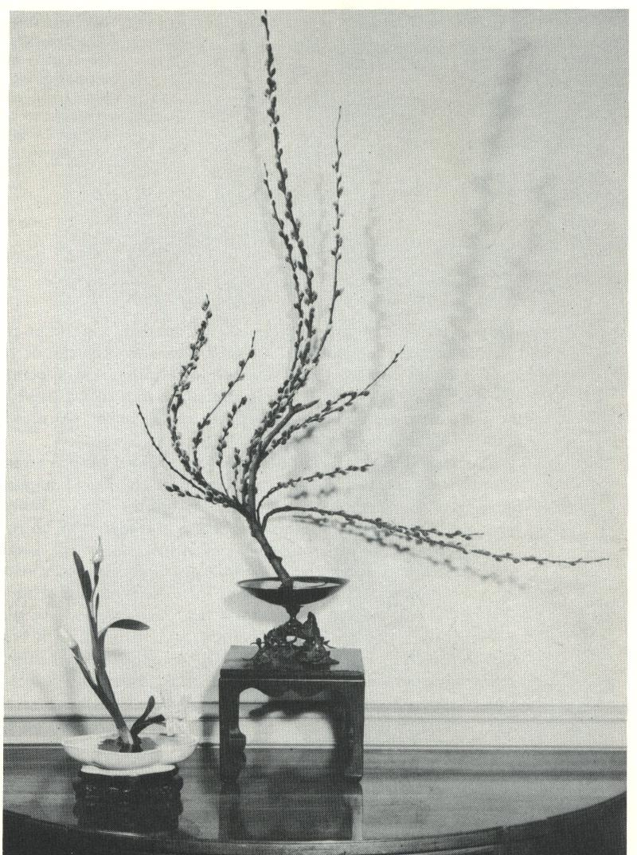
Informal So style of Ikenobo arrangement
Notes:
Berrall, Julia S. A History of Flower Arrangement. Viking Press, Inc. 1968.

Slide 71
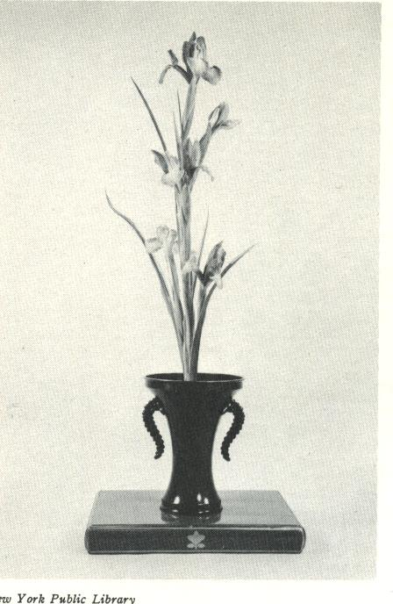
Shoka arrangement
Heaven man earth
Notes:
Berrall, Julia S. A History of Flower Arrangement. Viking Press, Inc. 1968.

Slide 72
MODERN FLORAL ARRANGING:

Slide 73
Art Nouveau 1890-1910:
Curvilinear lines
Patterned after nature
Shape of plants or flowers as well as the human form
Asymmetrical flower arrangement
Notes:
Floral Design History:
Berrall, Julia S. A History of Flower Arrangement. Viking Press, Inc. 1968.
Hunter, Norah T., The Art of Floral Design Second Edition Delmar 2000. Chapter 1

Slide 74
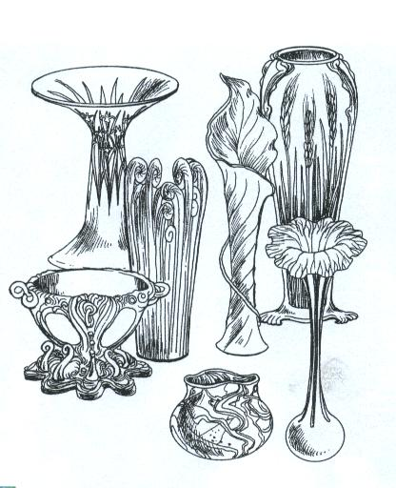
Curving lines of nature, organic motifs
Animals, foliage, vines, flowers
Notes:
Hunter, Norah T., The Art of Floral Design Second Edition Delmar 2000. Chapter 1

Slide 75
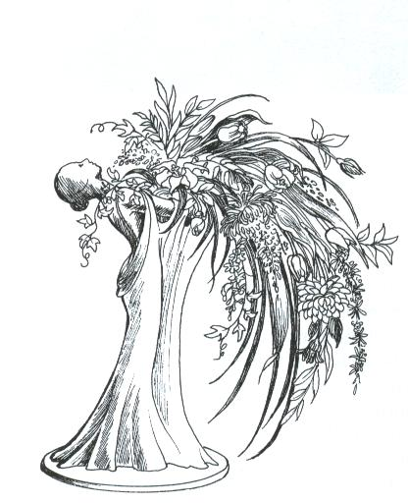
Asymmetrical cascading waterfall style
Notes:
Hunter, Norah T., The Art of Floral Design Second Edition Delmar 2000. Chapter 1

Slide 76
Art Deco 1925-1930
Derived from 1925 Paris world’s Fair exhibition.
Characterized as strong, streamlined, geometric lines, forms and patterns, including zigzags, pyramids, and sunburst motifs
Known as le style 25
Notes:
Floral Design History:
Berrall, Julia S. A History of Flower Arrangement. Viking Press, Inc. 1968.
Hunter, Norah T., The Art of Floral Design Second Edition Delmar 2000. Chapter 1

Slide 77
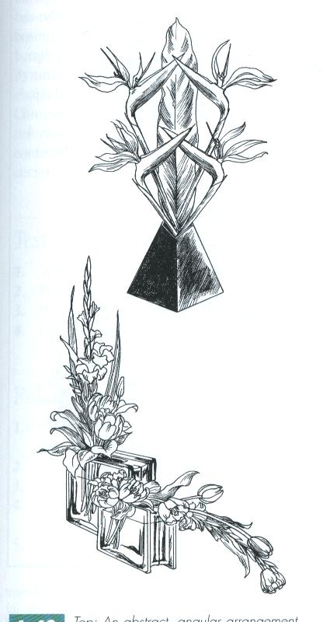
Abstract, angular and unusual
Glass bricks popular in 1940’s
Notes:
Hunter, Norah T., The Art of Floral Design Second Edition Delmar 2000. Chapter 1

Slide 78
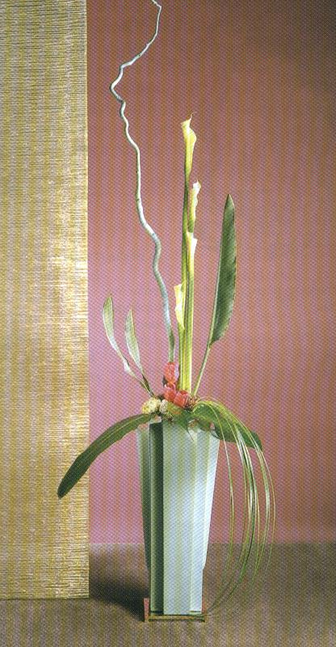
Strong, streamline, geometric lines, forms and patterns
Notes:
Hunter, Norah T., The Art of Floral Design Second Edition Delmar 2000. Chapter 1

Slide 79
Free-Form Expression 1950’s:
A modern, natural appearance.
Expressive with both a feeling of movement and of freedom
Use of driftwood and other figurines in designs
Notes:
Floral Design History:
Berrall, Julia S. A History of Flower Arrangement. Viking Press, Inc. 1968.
Hunter, Norah T., The Art of Floral Design Second Edition Delmar 2000. Chapter 1

Slide 80
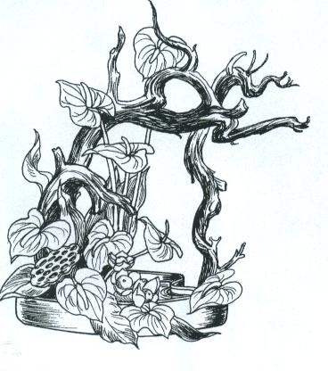
Freedom of expression
Bold foliage, oriental influence of line and use of driftwood
Notes:
Hunter, Norah T., The Art of Floral Design Second Edition Delmar 2000. Chapter 1

Slide 81
Geometric Mass Design 1960-1970’s:
Tight geometric bouquets.
Include mass and line.
Notes:
Floral Design History:
Berrall, Julia S. A History of Flower Arrangement. Viking Press, Inc. 1968.
Hunter, Norah T., The Art of Floral Design Second Edition Delmar 2000. Chapter 1

Slide 82
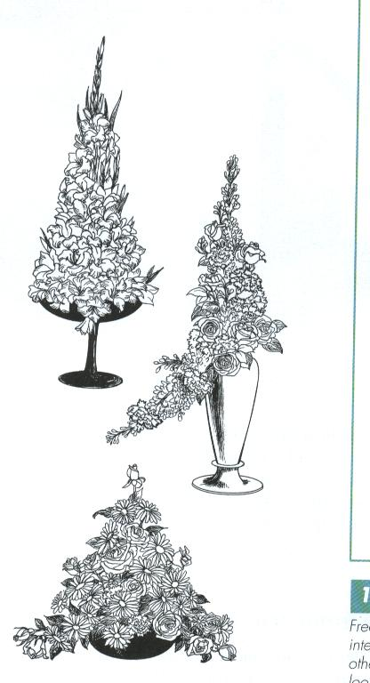
Tight geometric designs symmetrical and asymmetrical
Notes:
Hunter, Norah T., The Art of Floral Design Second Edition Delmar 2000. Chapter 1

Slide 83
Contemporary
Contemporary refers to the time of the present or of recent times
Called modern because they generally are different than whatever style was previously popular
Notes:
Floral Design History:
Berrall, Julia S. A History of Flower Arrangement. Viking Press, Inc. 1968.
Hunter, Norah T., The Art of Floral Design Second Edition Delmar 2000. Chapter 1

Slide 84
Cultures that have had the greatest influence in today’s design:
Oriental European
Line Mass
Line-Mass
“American,” or “Western Style”
Notes:
Floral Design History:
Berrall, Julia S. A History of Flower Arrangement. Viking Press, Inc. 1968.

Slide 85
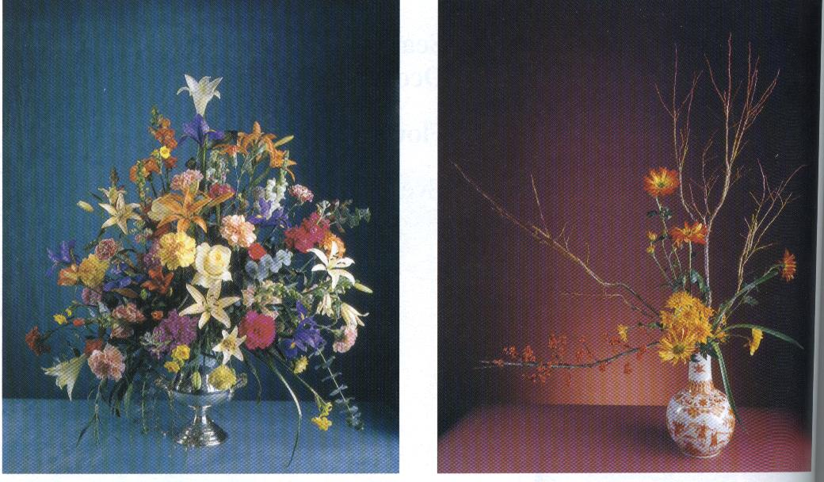
European Oriental
Notes:
Hunter, Norah T., The Art of Floral Design Second Edition Delmar 2000. Chapter 1

Slide 86
Examples of Student activities

Slide 87
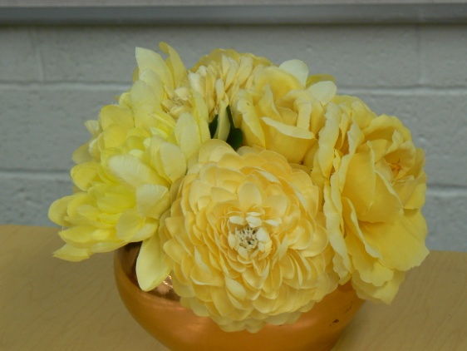
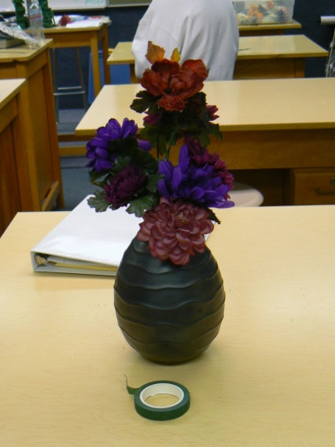
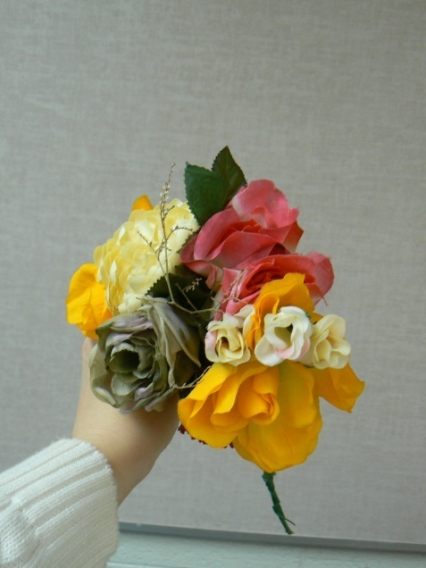
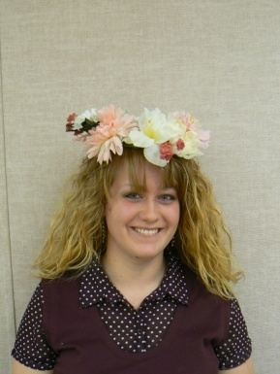
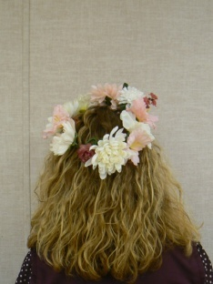
Period floral design

Slide 88
Chaplet

