Slide 1
Flower & Foliage Morphology

Slide 2
Parts of the Flower

Slide 3
Flower Nomenclature (name of parts)
Flower parts
Sepals
Calyx
Tepals
Perianth
Petals
Corolla
Stamen
Pistil
Receptacle

Slide 4
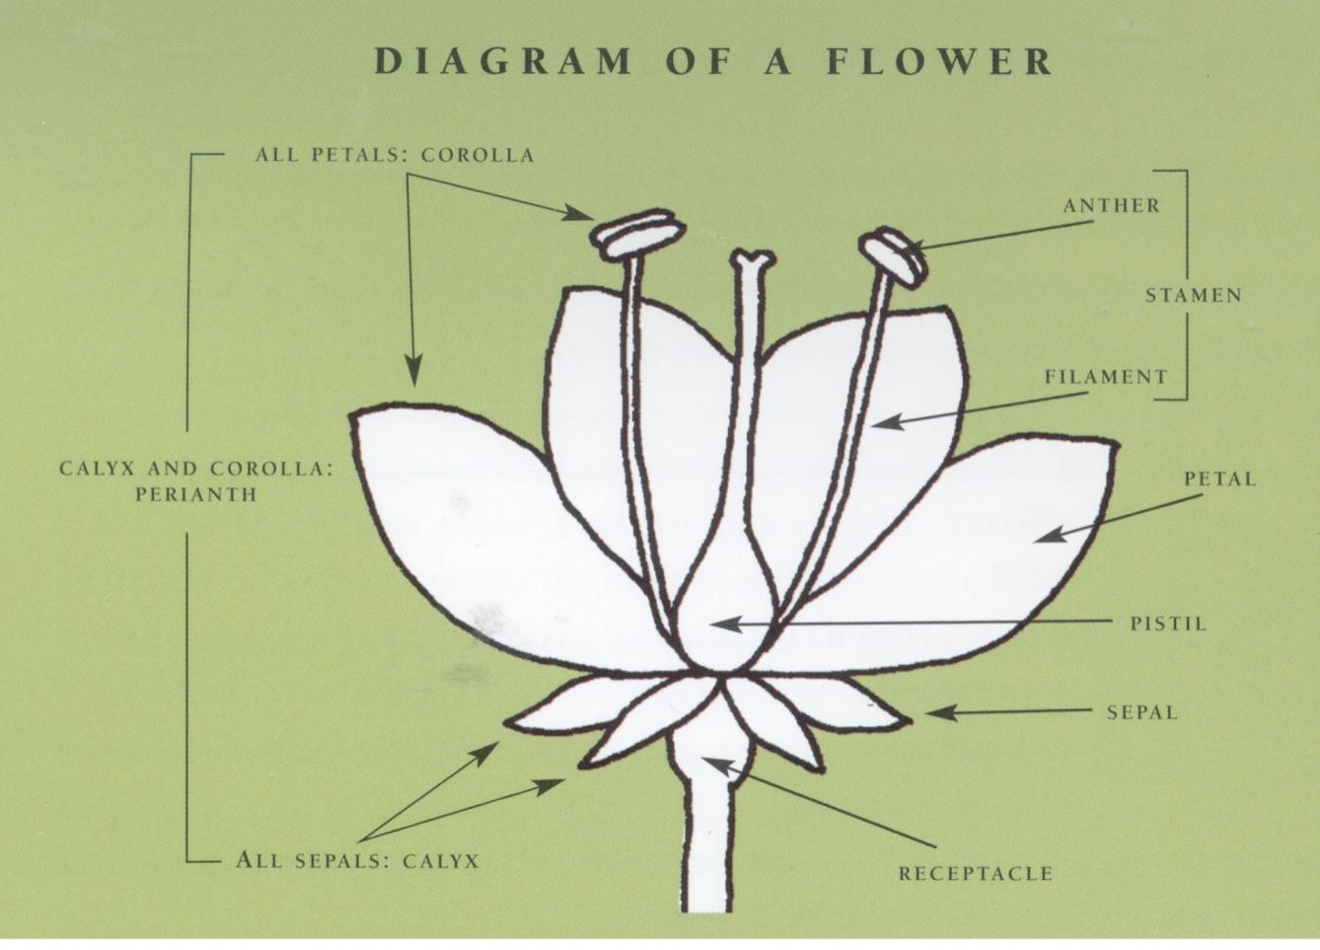
Notes:
Hunter, Norah T., The Art of Floral Design Second Edition Delmar 2000.
The American Institute of Floral Designers, The AIFD Guide to Floral Design: Terms, Techniques, and Traditions. Intelvid Group 2005

Slide 5
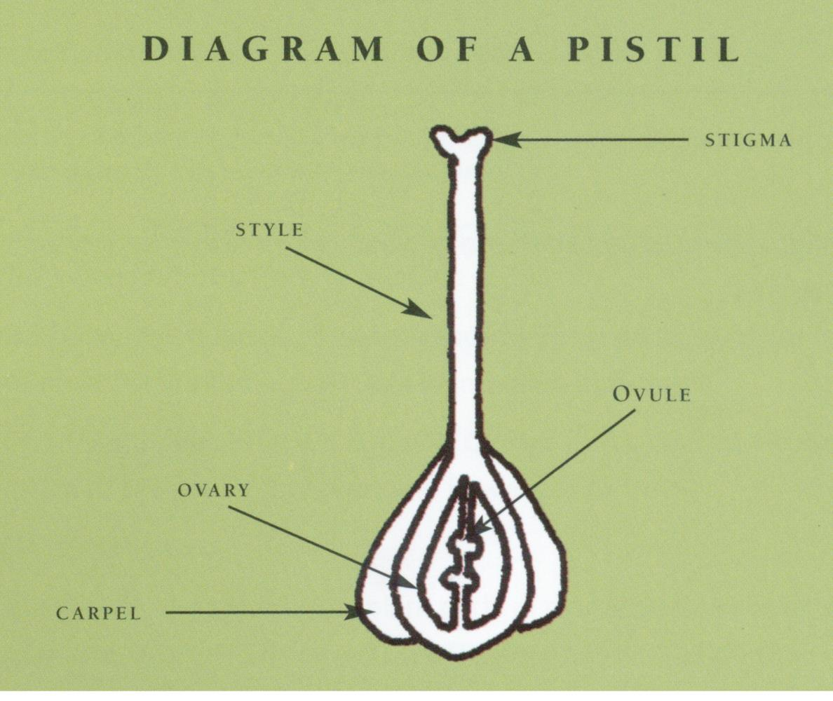
Notes:
The American Institute of Floral Designers, The AIFD Guide to Floral Design: Terms, Techniques, and Traditions. Intelvid Group 2005

Slide 6
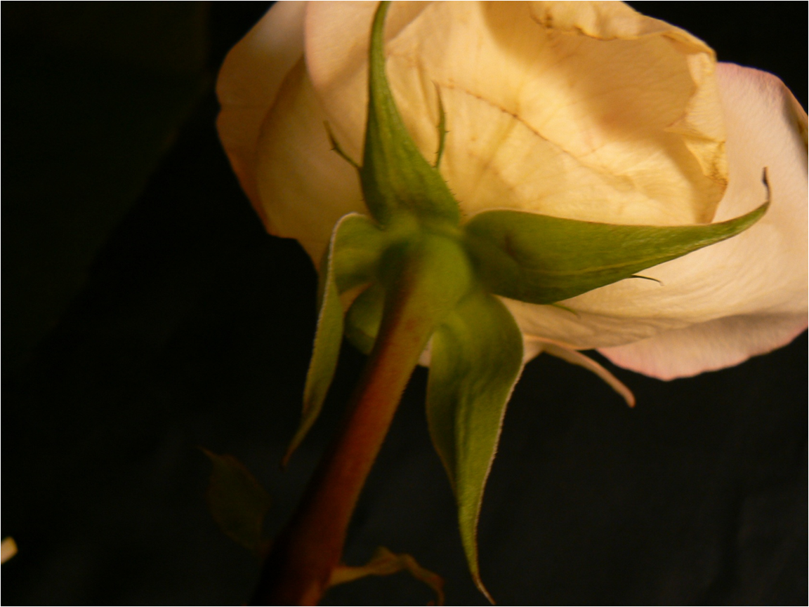
Sepals-outermost flower structure that encloses the other flower parts in the bud
Sepals
Notes:
Hunter, Norah T., The Art of Floral Design Second Edition Delmar 2000.

Slide 7
Calyx-collective term for all sepals in a flower
Calyx
Notes:
Hunter, Norah T., The Art of Floral Design Second Edition Delmar 2000.

Slide 8
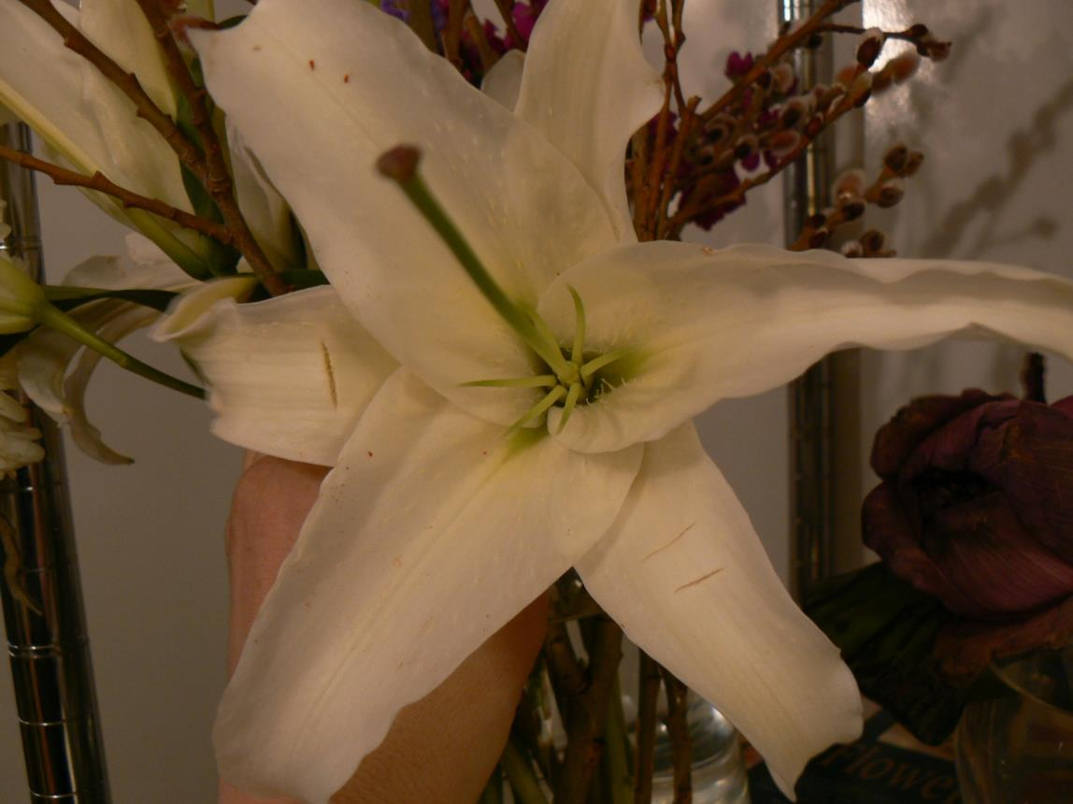
Tepals-both sepals and petals are identical
Petals
Sepals
Petals + Sepals = Tepals
Only when sepals and petals look alike. Inner whorl is petals, outer whorl is sepals.
Notes:
Hunter, Norah T., The Art of Floral Design Second Edition Delmar 2000.

Slide 9
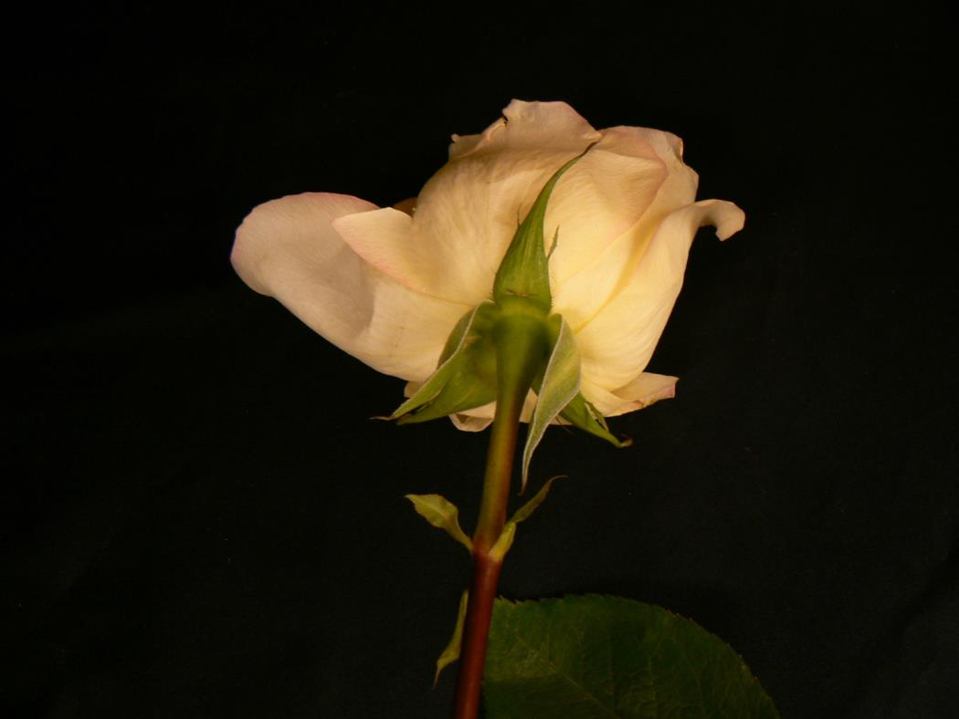
Perianth-petals and sepals combined (may or may not be identical)
Petals
Perianth
Sepals
Notes:
Hunter, Norah T., The Art of Floral Design Second Edition Delmar 2000.

Slide 10
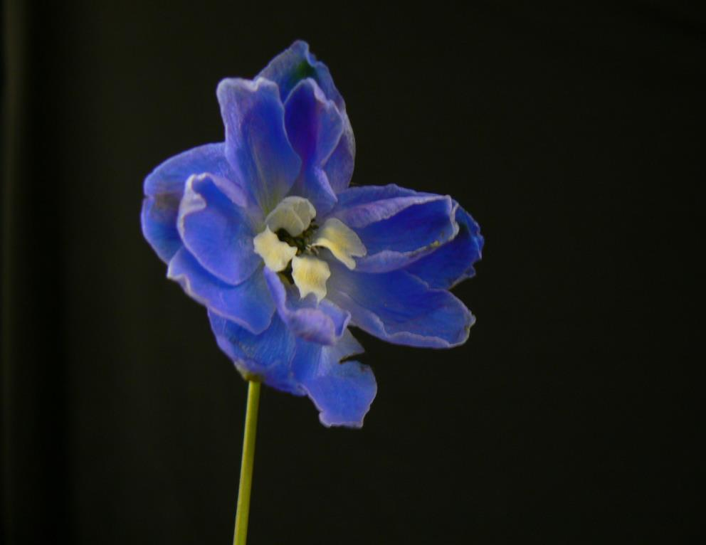
Petals-flower’s showpiece positioned between the sepals and inner flower parts
Petal
Notes:
Hunter, Norah T., The Art of Floral Design Second Edition Delmar 2000.

Slide 11
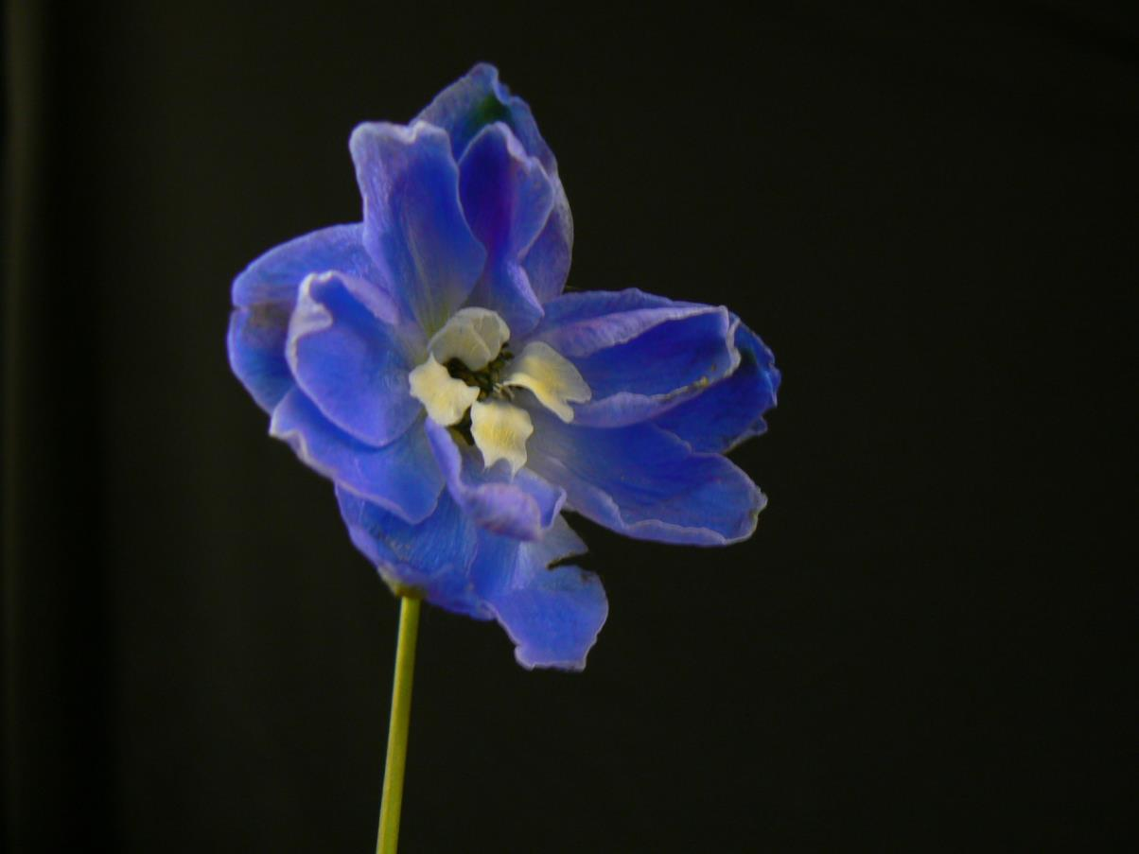
Corolla-collective term of all petals in a flower
All Petals
Corolla
Notes:
Hunter, Norah T., The Art of Floral Design Second Edition Delmar 2000.

Slide 12
Flower Nomenclature
Stamens-male reproductive parts of the flower
Androecium-collective term of all male parts
“meaning house of man”
Anther-pollen-bearing portion of the stamen
Filament-stalk of the stamen bearing the anther
Notes:
Hunter, Norah T., The Art of Floral Design Second Edition Delmar 2000.

Slide 13
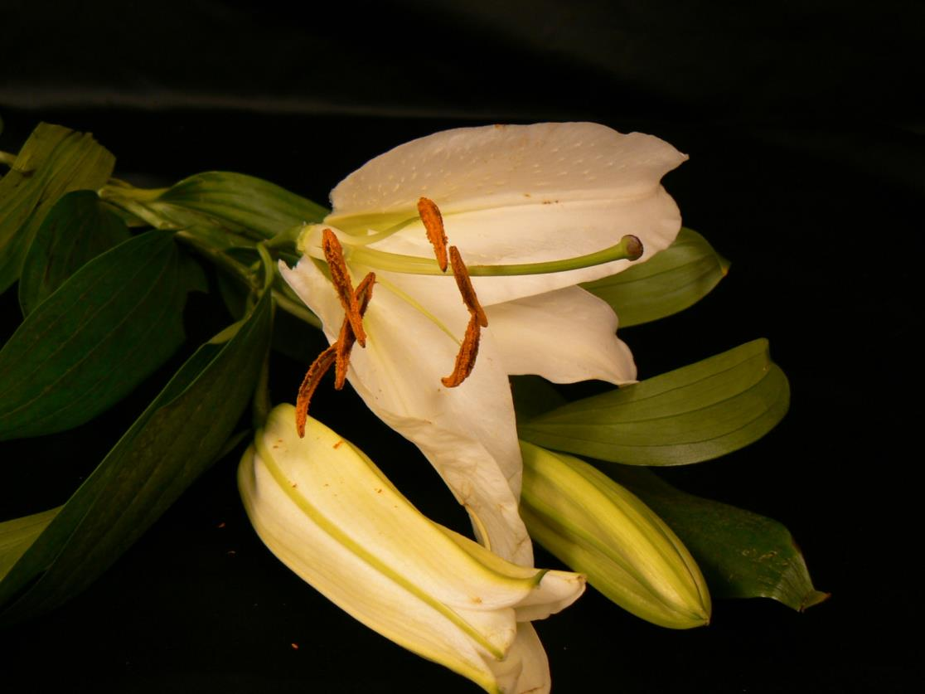
Stamen=Anther + Filament
Filament
Stamen
Anther

Slide 14
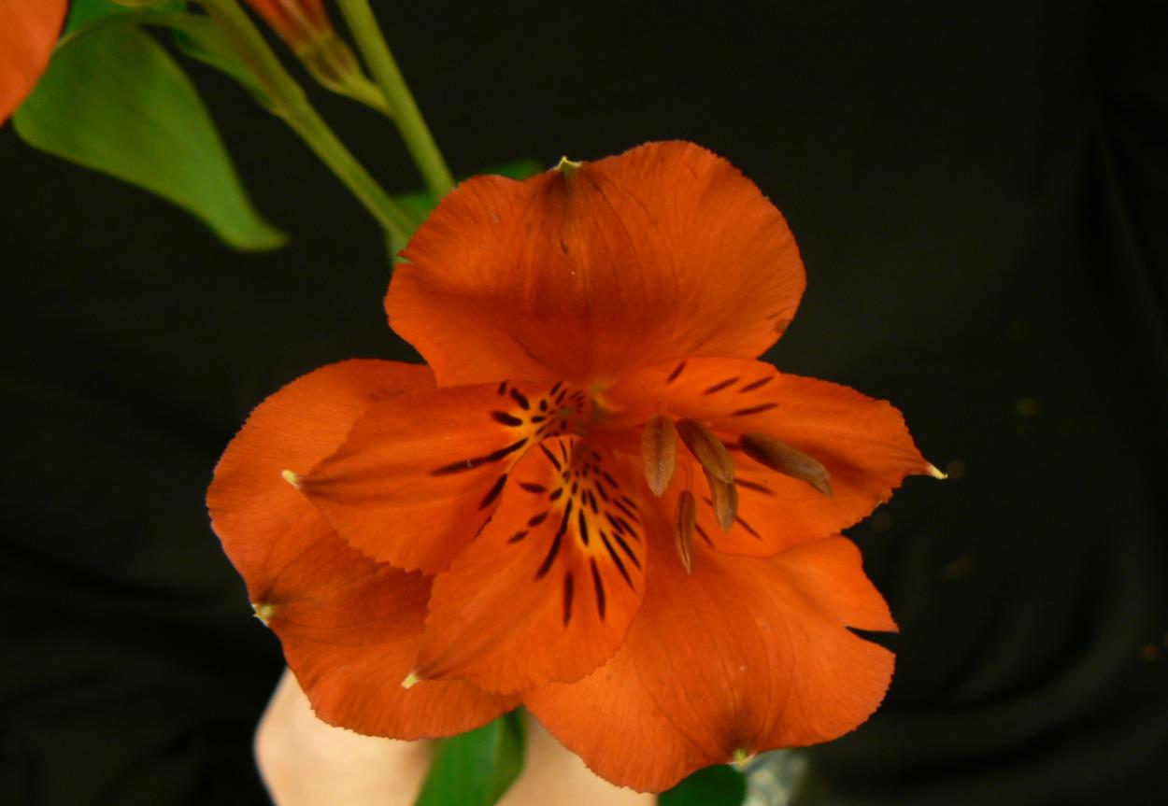
Stamen=Anther + Filament
Anther
Stamen
Filament

Slide 15
Flower Nomenclature
Pistils-female reproductive parts of the flower
Gynoecium-collective term of all female parts
“meaning house of woman”
Stigma-pollen receptive part of the top of the pistil
Style-the slender column of tissue that arises from the top of the ovary
Ovary-enlarged basal portion of a pistil. It becomes the fruit
Ovules-the structure that becomes a seed after fertilization
Receptacle-stem tip bearing all flower parts
Notes:
Hunter, Norah T., The Art of Floral Design Second Edition Delmar 2000.

Slide 16
Pistil=Stigma + Style + Ovary
Ovary
Stigma
Style
Pistil

Slide 17
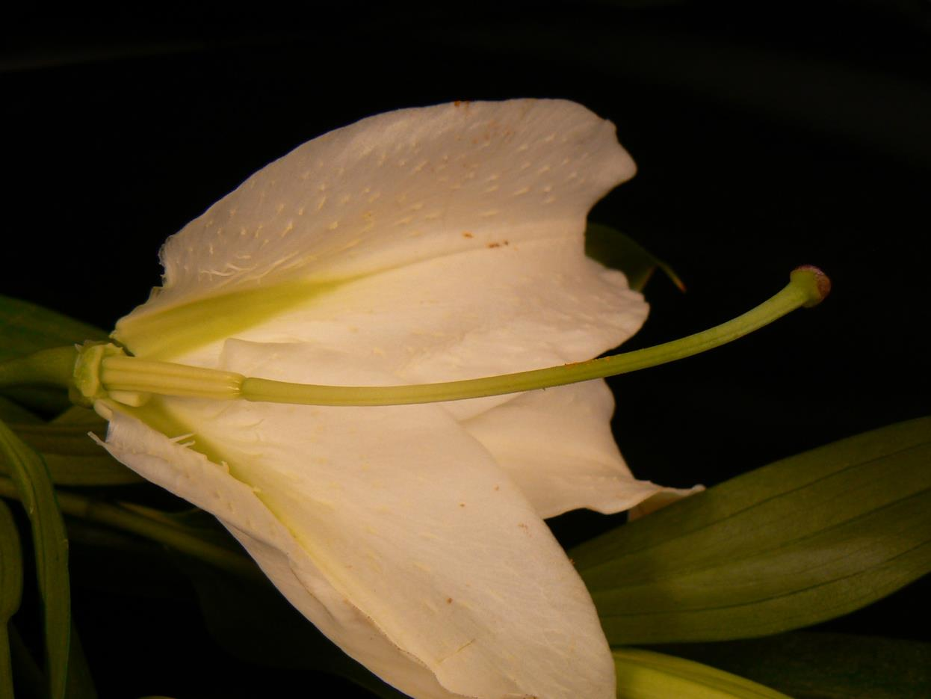
Pistil-female flower parts
Ovary-develops into fruit
Ovule-develops into seed
(inside ovary)
Style-long tube
Stigma-sticky
Notes:
Hunter, Norah T., The Art of Floral Design Second Edition Delmar 2000.

Slide 18
Stamen and Pistil
Filament
Ovary
Stamen
Stigma
Anther
Style
Pistil

Slide 19
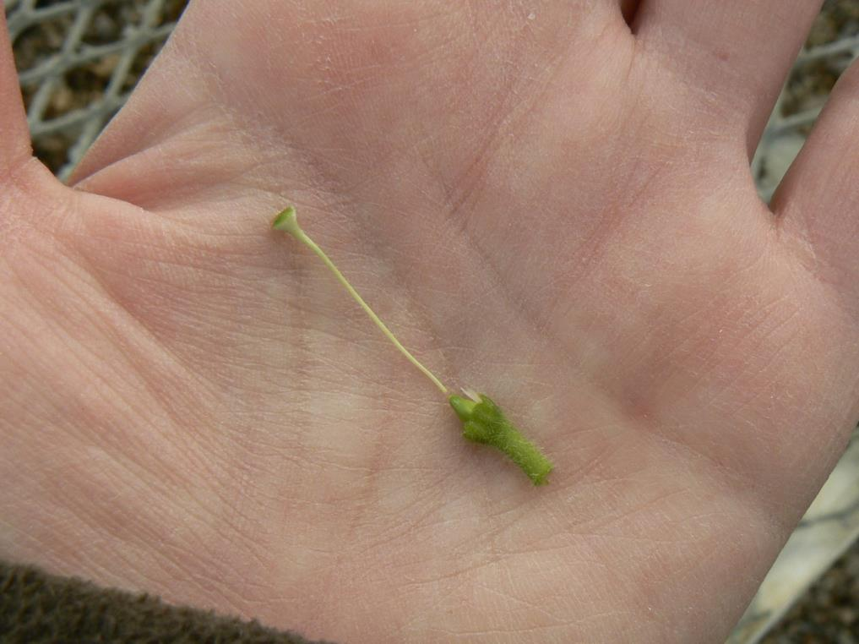
Identify the Flower Parts

Slide 20
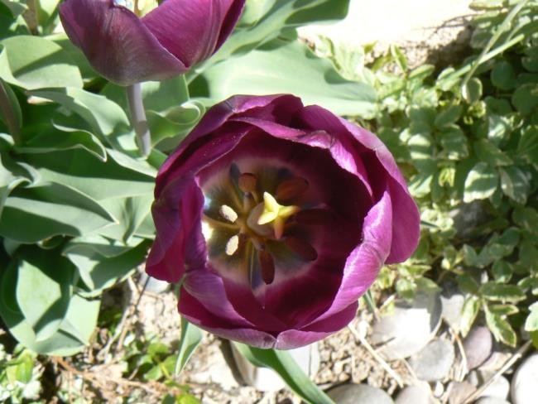
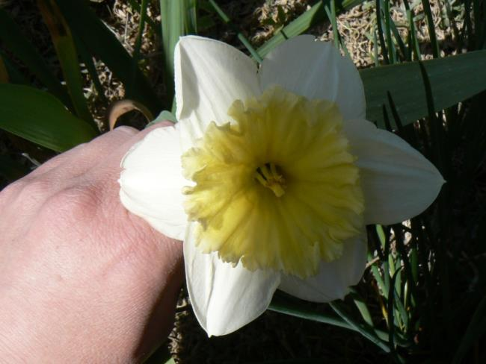
Identify the Flower Parts

Slide 21
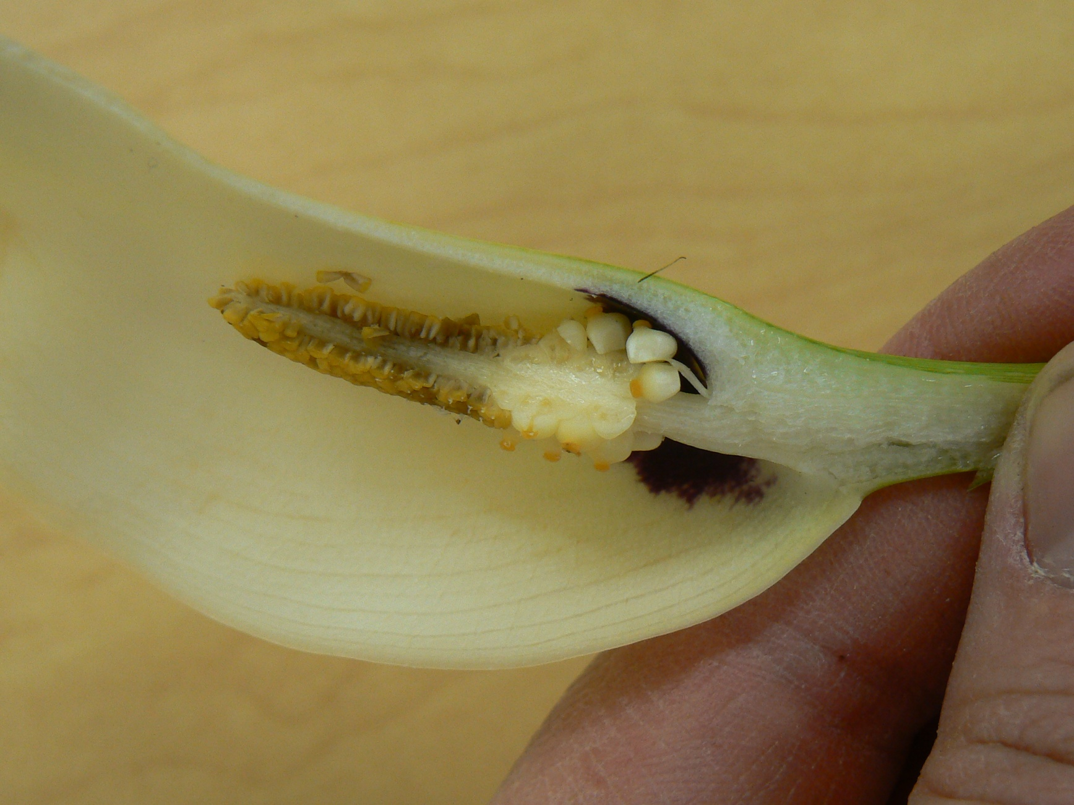
Identify the Flower Parts

Slide 22
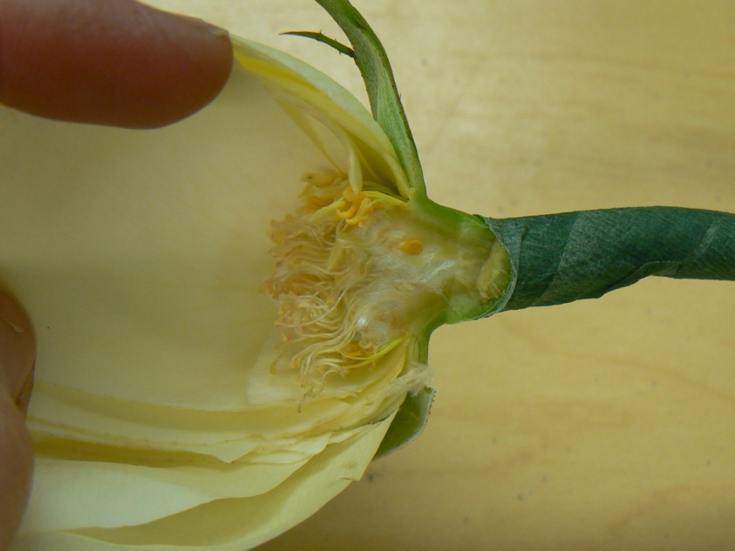
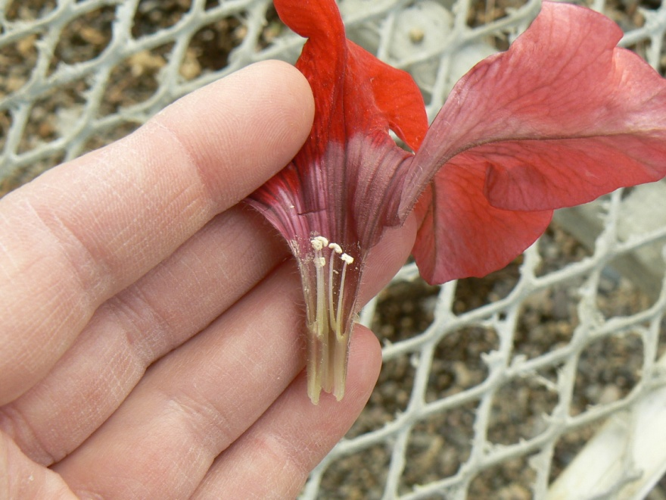
Identify the Flower Parts

Slide 23
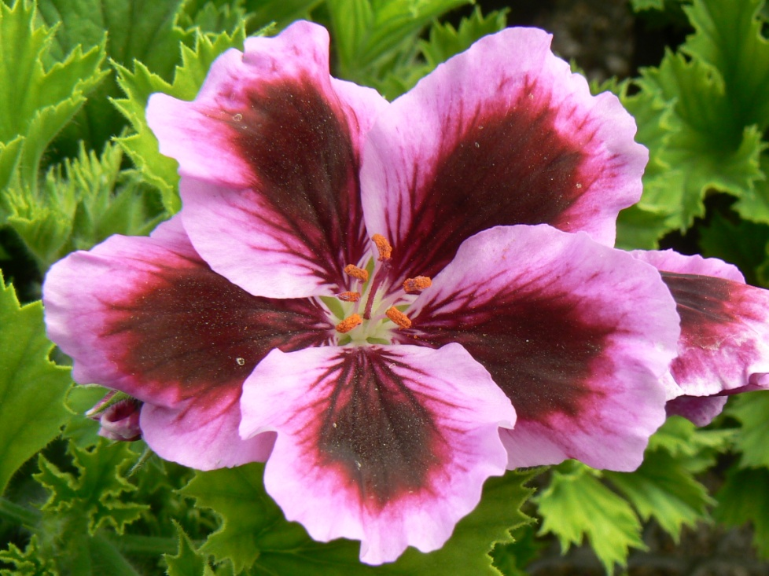
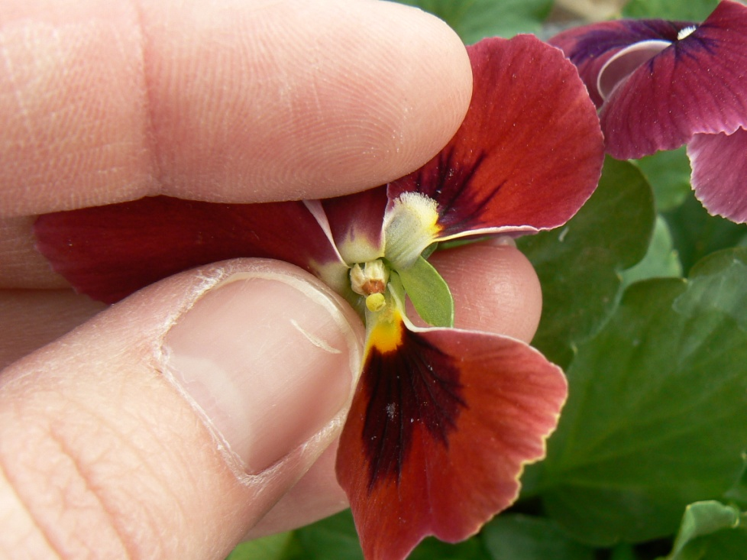
Identify the Flower Parts

Slide 24
Flower Nomenclature
Solitary flowers-form singly on upright stalks
Perianth structural types
(collective term for the calyx and corolla)
Inflorescence-a flower made of several florets
Florets-one of the small flowers that make up the entire Solitary flowers
Peduncle-main supporting stalk of inflorescence
Pedicels-stalks supporting single flowers
Bracts-modified or reduced leaves from the axils
Axils-upper angle between a leaf where the flowers originate
Notes:
Hunter, Norah T., The Art of Floral Design Second Edition Delmar 2000.

Slide 25
Flower Nomenclature
Inflorescence patterns
Spike
Raceme
Panicle
Corymb
Cyme
Umbel
Spadix
spathe
Catkin
Head
ray florets
disc florets
Notes:
Hunter, Norah T., The Art of Floral Design Second Edition Delmar 2000.

Slide 26
Spike—unbranched inflorescence form consisting of a main stalk with stemless florets attached along its length liatris, gladiola
Notes:
Hunter, Norah T., The Art of Floral Design Second Edition Delmar 2000.

Slide 27
Raceme—an unbranched inflorescence form consisting of a main stalk with florets attached along its length by short pedicels
Notes:
Hunter, Norah T., The Art of Floral Design Second Edition Delmar 2000.

Slide 28
Panicle—a loosely branched, pyramidal inflorescence form
Notes:
Hunter, Norah T., The Art of Floral Design Second Edition Delmar 2000.

Slide 29
Corymb—a flat-topped, open flower cluster, blooming from the outside edges in
Notes:
Hunter, Norah T., The Art of Floral Design Second Edition Delmar 2000.

Slide 30
Cyme—a broad, usually flat-topped inflorescence with center flowers opening first
Notes:
Hunter, Norah T., The Art of Floral Design Second Edition Delmar 2000.

Slide 31
Umbel—an inflorescence in the shape of an inverted umbrella having pedicels radiating from one point
Notes:
Hunter, Norah T., The Art of Floral Design Second Edition Delmar 2000.

Slide 32
Spadix—a fleshy spike which carries numerous minute flowers embedded on its surface, usually surrounded by a colorful bract called a spathe
Spadix
Spathe
Notes:
Hunter, Norah T., The Art of Floral Design Second Edition Delmar 2000.

Slide 33
Catkin—an elongated inflorescence of unisexual flowers on a woody plant pussy willow, oak, walnut, birch
Notes:
Hunter, Norah T., The Art of Floral Design Second Edition Delmar 2000.

Slide 34
Head--a dense inflorescence of small, often stalkless flowers.
Ray florets—linear, petal-like floret attached at the perimeter
Disk florets—tubular flowers found in the center of a composite or daisy-like flower
Disk Florets
Ray Florets
Notes:
Hunter, Norah T., The Art of Floral Design Second Edition Delmar 2000.

Slide 35
Leaf Nomenclature

Slide 36
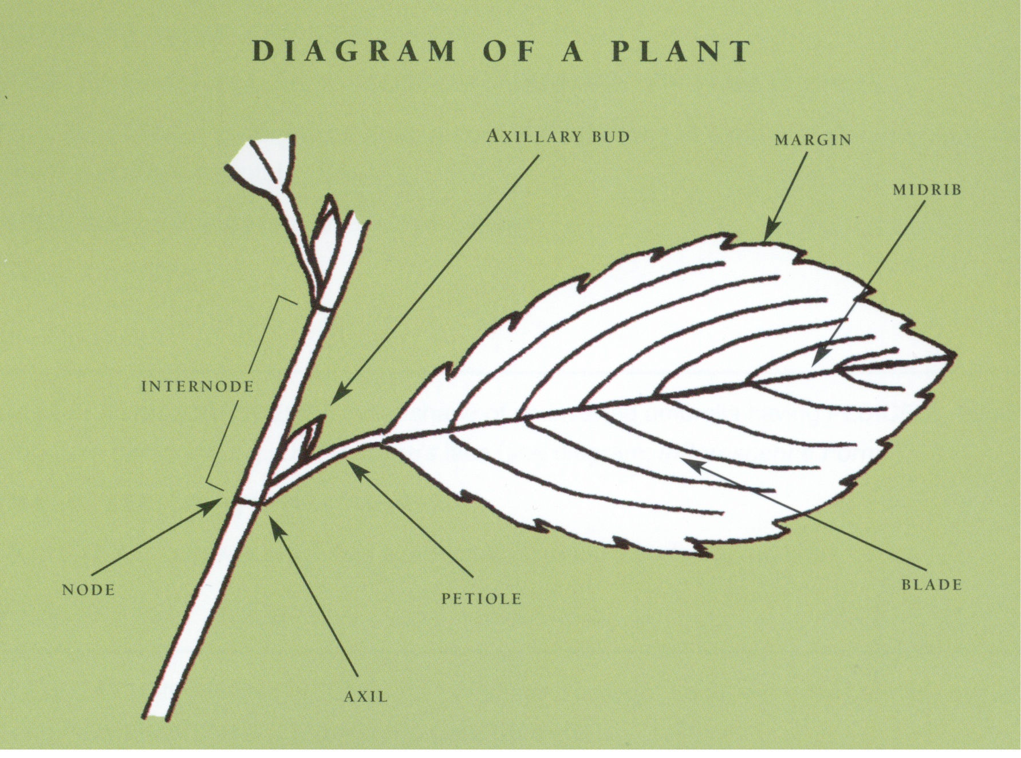
Leaf parts
Notes:
The American Institute of Floral Designers, The AIFD Guide to Floral Design: Terms, Techniques, and Traditions. Intelvid Group 2005

Slide 37
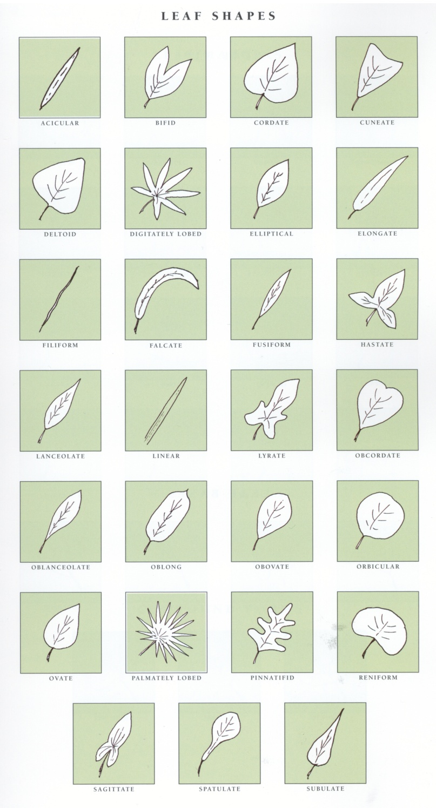
Leaf Shapes
Notes:
The American Institute of Floral Designers, The AIFD Guide to Floral Design: Terms, Techniques, and Traditions. Intelvid Group 2005

Slide 38
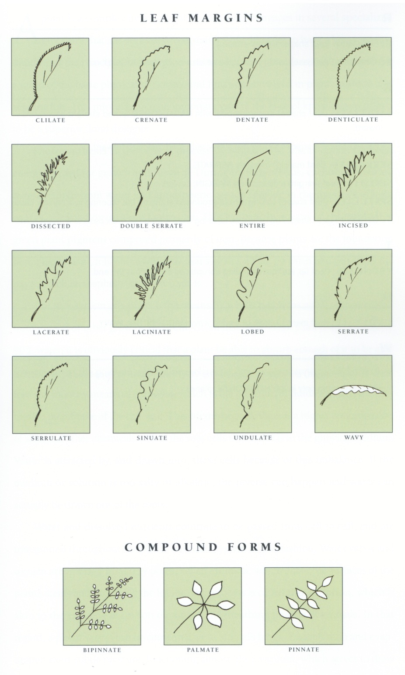
Leaf Margins
Notes:
The American Institute of Floral Designers, The AIFD Guide to Floral Design: Terms, Techniques, and Traditions. Intelvid Group 2005

Slide 39
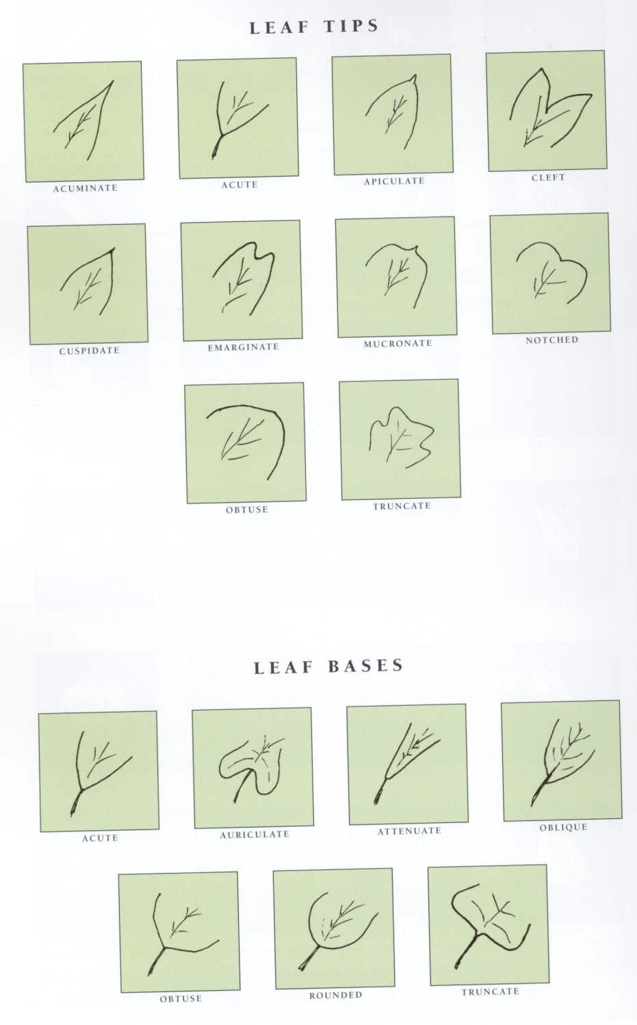
Leaf Tips & Bases
Notes:
The American Institute of Floral Designers, The AIFD Guide to Floral Design: Terms, Techniques, and Traditions. Intelvid Group 2005

Slide 40
Flower Parts Quiz
1.
4.
2.
5.
3.
6.
7.

Slide 41
Examples of Student Activities

Slide 42
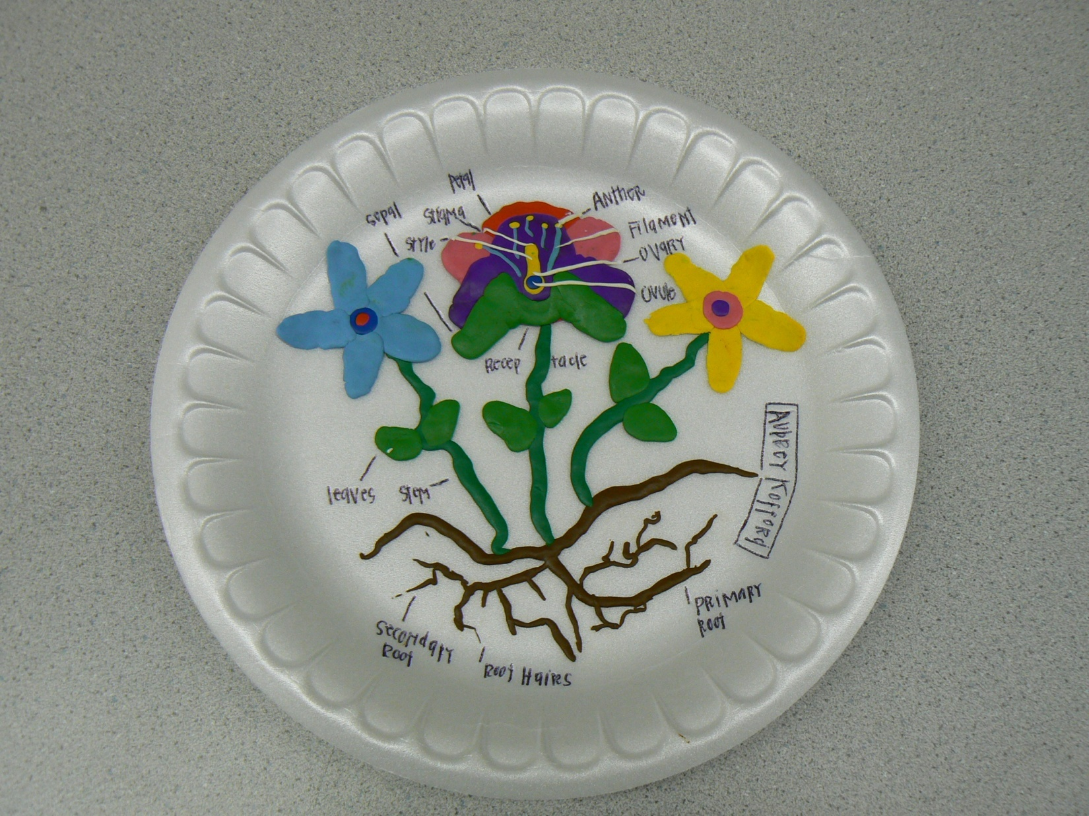
Clay Flower

Slide 43
