Slide 1
VIP Vandal Ideas Project 2016: Go On!

Slide 2
Welcome
Introductions: Hosts, College of Education (Dean Carr-Chellman) CALS (Dr. Barbara Petty)
Why VIP mixers & Why the Go On focus
Enjoy!

Slide 3
What is the VIP Project?
Internal grants project
Opportunity for broad statewide impact
In its 2nd year
Information on past funding available at: https://www.uidaho.edu/research/faculty/find-funding/internal-funding/vandal-ideas-project

Slide 4
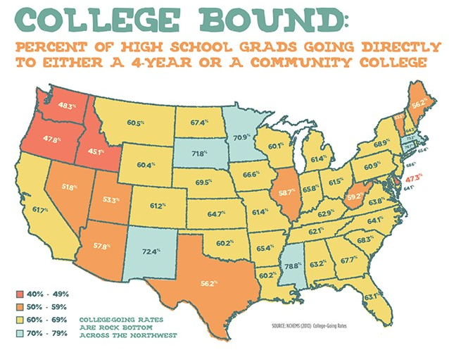
Why the Go ON Rate?

Slide 5
Why the go on rate?
Rates fluctuate, but continue to trend down.
2011-2015 rate dropped in 66% of ID high schools.
Only 28% of schools improved their go-on rates during that same time frame.
In 2015 only 17% of high schools had a go on rate of 60% of higher.

Slide 6
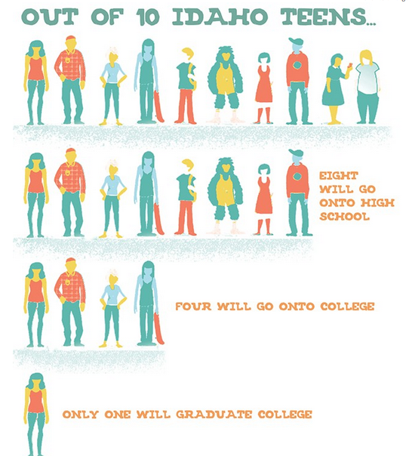
Go on rates in Idaho

Slide 7
Go On Rates Further Explored
Eastern ID rates are alarmingly low
Significant male/female gap

Slide 8
Why might this be happening?
Varied reasons, for example:
Family (pregnancy, homelessness, refusal to sign paperwork)
Finances (lack of support, plentiful low wage jobs)
Isolated geography
Scholastic alienation
Culture (Independence of Idahoans, Universities viewed as bastions of liberalism, counter to family values)
Weak public schools

Slide 9
What is The State Doing?
What is ID doing about this?
Albertson’s foundation
Free SATs
Increased scholarship $$
Dual credit monies
College Application Day
Increased budgets for high school college & career advisors & teacher salaries

Slide 10
What UI Is doing
Waived application fee
Increases in scholarship dollars (more than double what other public institutions in ID are offering)
Engage extension offices
Direct admissions process originated here

Slide 11
Why is UI Focusing on this?
Sacred Trust of the Land Grant University
Premier Research institution in the state…lots of smart people should be able to formulate & test smart solutions
Among the more pressing issues in workforce preparation
Our efforts are not to see only UI enrollment increases, rather to increase the Go On rate across the state

Slide 12
What Can we do?
VIP Internal grants ideas:
Mixers in which ideas are shared and refined
Colleges take responsibility for mixers, CALS & COE
Internal seed grants which may lead to longer-term & sustainable solutions
Intend to fund several projects under the $75K level.
More modest projects have a higher likelihood of being funded
One year pilot projects

Slide 13
What will we do tonight?
12 brief elevator pitches
Brief description of Open Space process
Followed by open conversations about the pitches or other ideas

Slide 14
Elevator Pitches
Scott Clyde: TRIO (4)
Kathy Canfield-Davis
David Schloss
Dean Kahler
Julie Fodor: CDHD
Jim Connors & Karen Launchbaugh
Shirley Luckart
Judith McShane
Jae Rue

Slide 15
Open Space
Open opportunity to meet with colleagues
Law of Two Feet: If at any time you find yourself in any situation where you are neither learning nor contributing, use your two feet, go someplace else.

Slide 16
Open Space Thoughts
Whoever comes is the right people.
Whenever it starts is the right time.
Wherever it is, is the right place.
Whatever happens is the only thing that could have.
When it’s over, it’s over.

